Slide 1

Rayzit Widget
Patroklos Patroklou
George Antoniou
Constantinos Kyprianou

Slide 2
What is a web Widget?
A component that you provide to other people to display data coming from your site on their own pages.
“Chunk of a webpage”
Mixture of HTML,CSS and Client Side Scripting Language
Goal: Hide any possible complexity and make it easy for people to include the widget on their pages

Slide 3
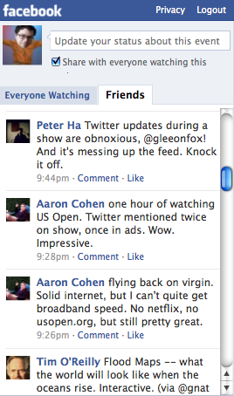
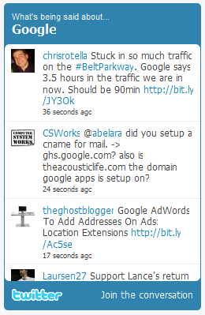
Example Widgets

Slide 4
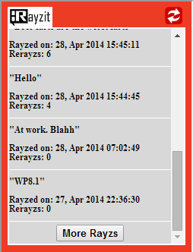
Rayzit Widget

Slide 5
Building a Widget
Decide what information you should provide
How you should provide your information
Design a user friendly component
Flexible design
Keep it simple

Slide 6
Technical Scope

Slide 7
Minimum Requirements
A text Editor
A Web browser (even Internet Explorer)
Google skills ☺
“If it isn’t on Google it doesn’t exists”

Slide 8

HTML
HTML stands for Hyper Text Markup Language
HTML is a markup language (set of markup tags)
The tags describe document content
HTML documents contain HTML tags and plain text
HTML documents are also called web pages

Slide 9
Markup Code Example
<html>
<head>
<title>Hello World Website</title>
</head>
<body>
Hello EPL371 People!!
</body>
</html>

Slide 10

Cascading Style Sheets(CSS)
Style sheet language(expresses the presentation of structured documents)
Describes the look and formatting of a document written in a markup language (color, height , width etc.)
Reduce complexity and repetition in the structure content

Slide 11
CSS code Example
<html>
<head>
<title>Hello World Website</title>
<style type="text/css">
.boxed {
width: 800px;
height: 100px;
border: 10px solid green;
font-size:500%;
color:blue;
margin-left:390px;
margin-top:300px; }
</style>
</head>
<body>
<div class="boxed">
Hello EPL371 People!!
</div>
</body>
</html>

Slide 12
Client Side Scripting Language
Generate scripts that are executed by a web browser
Enables web pages to be scripted
Security restrictions(avoid them with ActiveX)

Slide 13

JavaScript
Most Popular Scripting Language
Only similarity with Java is syntax
Interpreted language until 2012
Just-in-time compilation is now performed by recent (post-2012) browsers.
Supported by every major web browser (Chrome , Firefox, Internet Explorer, Netscape, Safari, Opera etc.)

Slide 14
More JavaScript…
Variables declared with var in front of name :
var name = “John";
var money;
money = 2000.50;
typeof ‘var_name’ returns the type of the variable
Syntax of loops , operands, if statements are the same as in Java

Slide 15
More JavaScript Again…
Functions:
function concatenate(first, last) {
var full;
full = first + last;
return full; }
Notes:
No return type function

Slide 16
Putting it all together
Use HTML to define the content and the general structure of the widget
Use Css to define the format and the appearance of the widget
Use JavaScript to add behavior to the Widget and convert it from static into one that users can interact with

Slide 17
OUR WORK

Slide 18
Rayzit Widget
Gets and displays information from http://dev.rayzit.com/
(3 different API calls)
User enters UserId and the API Call(Live Feed, Latest and Popular Rayzs)
For each rayz the widget displays Text, Time and Rerayzs Count

Slide 19
Additional Options
Fixed number of information is shown
User can get more information by clicking “More Rayzs”
User can refresh the information that the widget displays

Slide 20
Options
Refresh
Link to Rayzit website
Load More Rayzs

Slide 21
How to use it
You can simply include it to your website by using for example an iframe:
User can set Width and Height of the Widget
Example import of Rayzit Widget:
src="RayzitWidget.html?userID=1&width=250&height=330&request=Live"

Slide 22
How to embed it using an iframe
<html>
<body>
<iframe id="RayzitF"
src="RayzitWidget.html?userID=1&width=250&height=330&request=Live”
style="background-color:#ED3C24;"
width="250"; height="330"
allowtransparency="true“>
</iframe>
</body>
</html>

Slide 23
Questions???

