Slide 1
Rayzit
EPL 371
Aζίζ Φίλιππος
Παπαϊωάννου Βαρνάβας
Πασχαλίδης Δημήτρης
Χαραλάμπους Θεόδωρος

Slide 2
Technologies

Slide 3


HTML5
HTML5 is the latest version of Hypertext Markup Language
Designed to deliver almost everything you'd want to do online without requiring additional software such as browser plugins. (e.g. flash)
HTML5 isn't proprietary
Very flexible and powerful and with its features makes its ancestors obsolete
Notes:
3

Slide 4

JavaScript
Implementation of ECMAScript standard.
JavaScript is a dynamic programming language.
Client-side scripts to interact with the user.
Asynchronous communication with server.
Create dynamically changing environments.
Notes:
4

Slide 5


BootStrap
Bootstrap is a free collection of tools for creating websites and web applications. It contains HTML and CSS-based design templates for typography, forms, buttons, navigation and other interface components, as well as optional JavaScript extensions.
It features:
Consistent design
Easy to use
Cross-Browser compatibility
Open source
Notes:
5

Slide 6
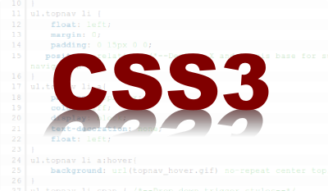

Unlike CSS 2, which is a large single specification defining various features, CSS 3 is divided into several separate documents called "modules". Each module adds new capabilities or extends features defined in CSS 2, preserving backward compatibility.
Some of its modules:
The Box Model
Lists Module
Hyperlink Presentation
Speech Module
Backgrounds and Borders
Text Effects
Multi-Column Layout

Slide 7

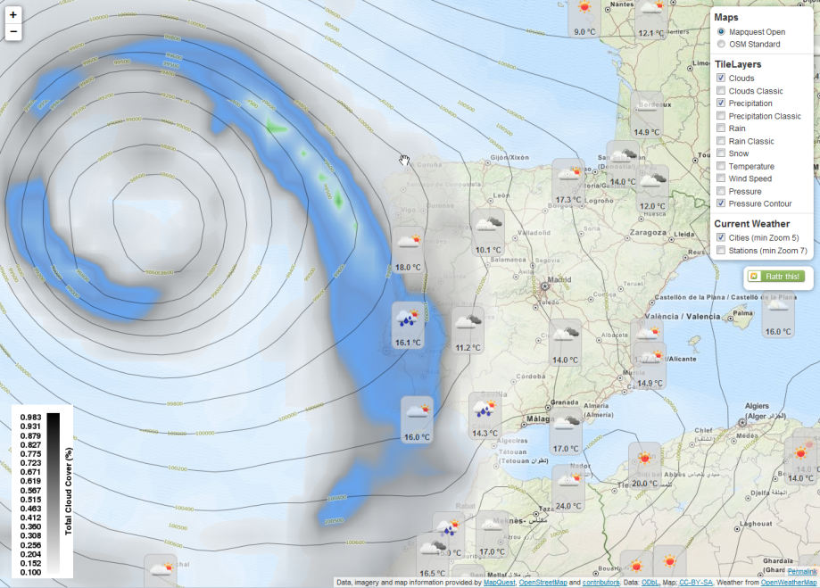
Leaflet is a modern open-source JavaScript library for mobile-friendly interactive maps.
It features:
Designed with simplicity, performance and usability in mind.
Works efficiently across all major desktop and mobile platforms
Huge number of plugins that can be extended with
Easy to use and well documented API
Readable code
Active community

Slide 8
About Rayzit

Slide 9

Rayzit - Introduction
Rayzit is an award-winning application. It’s the implementation of an innovative architecture for anonymous dynamic social networks, the first that is utilizing the proximity and the dynamic social environment of a kNN network. To achieve that, it utilizes a combination of state-of-the-art computational techniques and crowdsourcing concepts to provide a new compelling social interaction experience.

Slide 10
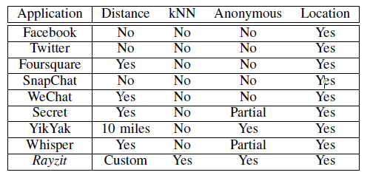
Taxonomy of anonymity

Slide 11
KNN Social Graph
Creates dynamic social graph every few seconds
Connects user with k closest peers
Real world examples:
2012 floods in China
2013 Egypt protest
2014 Syria protest

Slide 12
Crowdsourcing
It uses crowdsourcing to detect and remove any abusive rayz.
It considers the gravity of the number between the starred and rerayz and the number of reports
It executes dynamicaly

Slide 13
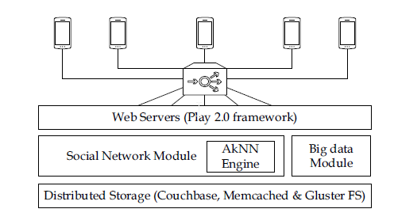
Architecture
Social networks generate petabytes of data so Big data transfers are necessary
Rayzit uses NoSQL to hold the rayz information in JSON format, and destributes them through the play 2.0 web server framework (REST)

Slide 14
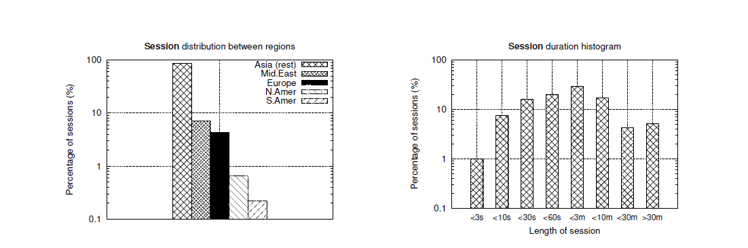
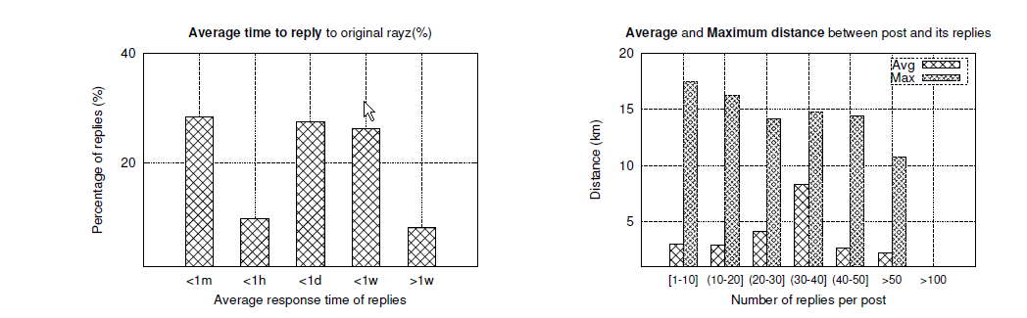
Analytics

Slide 15


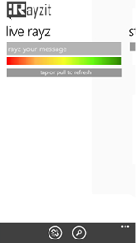
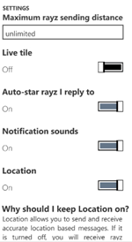
Rayzit - Features
Send Rayz messages to the crowd around you
Re-Rayz a message you receive to spread the word about important things. (similar to twitter’s retweet)
Star a message to follow a conversation wherever you go.
Anonymity. Rayzit was build with privacy in mind so in order to use it there is no sign up and no user information collection.
Fast and stable by using state of the art computaion algorithms
In-site crowdsourcing mechanism to remove abusive messages
Notes:
15

Slide 16
Implementation

Slide 17
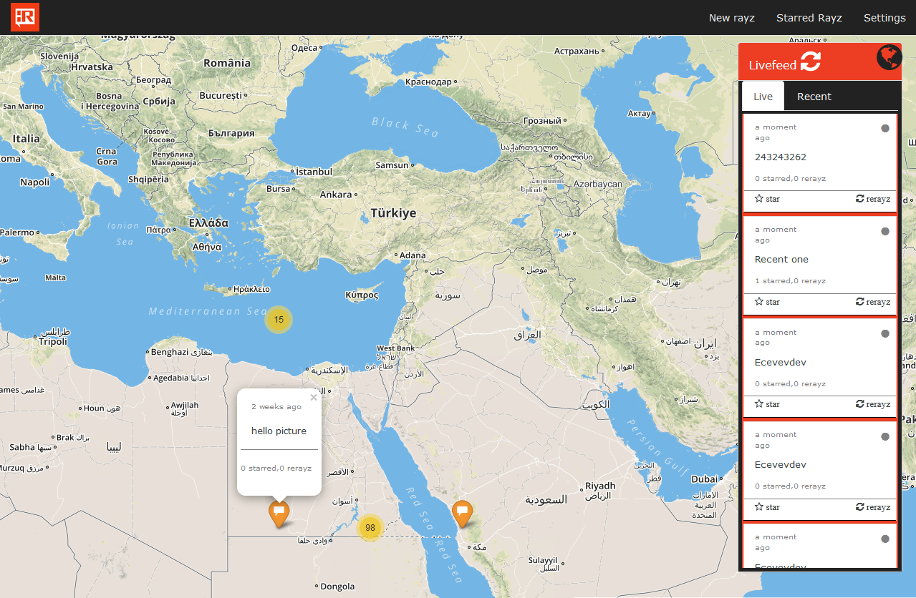
Rayzit Website
This is the leaflet's map where rayz are placed based on their partial location for anonymity issues.
Notes:
17

Slide 18
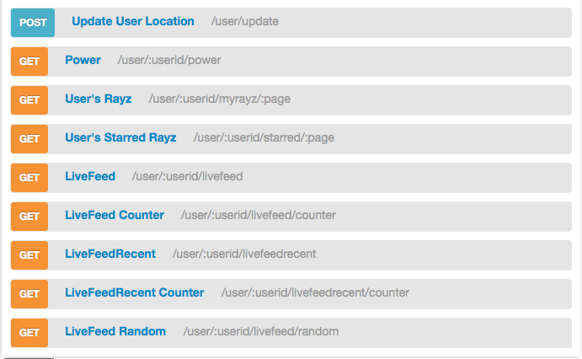
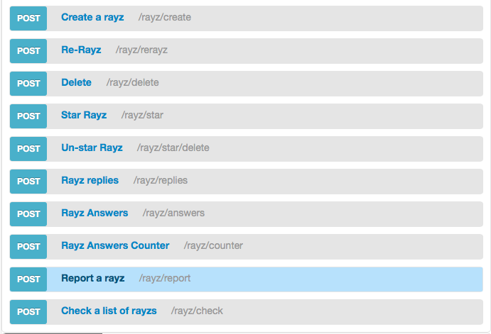
Rayzit API Website

Slide 19
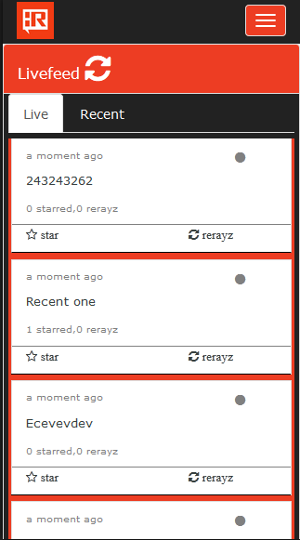
Livefeed panel
Livefeed panel shows the rayz near you based on time or the location.
It is the main screen on the mobile web view.
By pressing a rayz you can see the replies and also you can write your own reply.
Notes:
19

Slide 20
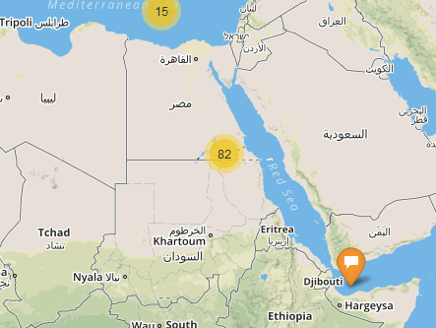
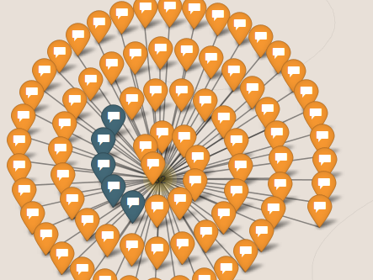
Rayz clusters
Overlapping rayz are presented in a cluster form.
That acts as a spatio-temporal map of the rayz.
By pressing the cluster, the rayz expand to be clickable or touchable.
Notes:
20

Slide 21
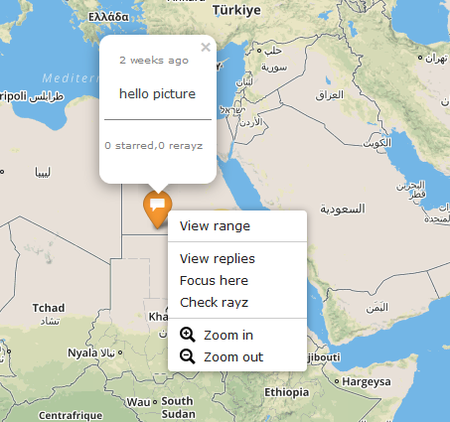
Context menu on map or rayz markers
By left clicking the marker you can see the rayz and its data.
By right clicking the marker you can see the context menu with several options.
View range: see the radius in kilometers.
View replies: see the replies on that rayz.
Check rayz: view the livefeed on the clicked area.
On mobile the right click corresponds to long press on the screen.
Notes:
21

Slide 22
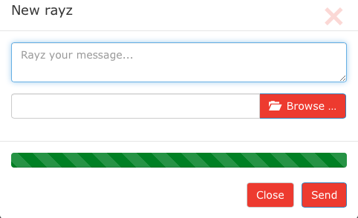
New Rayz
The bar corresponds to the application power bar that prevents users from spamming!

Slide 23
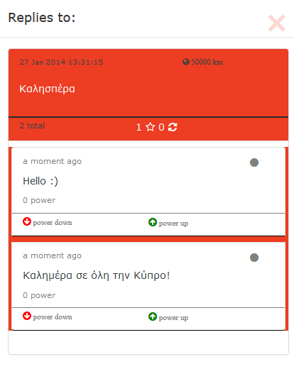

Show replies for a rayz
When a rayz is clicked a modal with the replies to that rayz is toggled.
Here the user can:
Power up or power down a reply.
Reply to the selected rayz depending on his current power.
Notes:
23

Slide 24
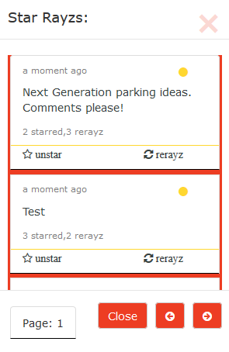
Starred Rayz
Star Rayz modal shows the user's starred rayz.
Here the user can:
Unstar a stared rayz.
Rerayz a starred rayz.
Notes:
24

Slide 25
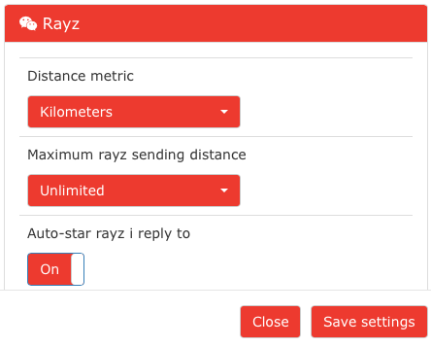
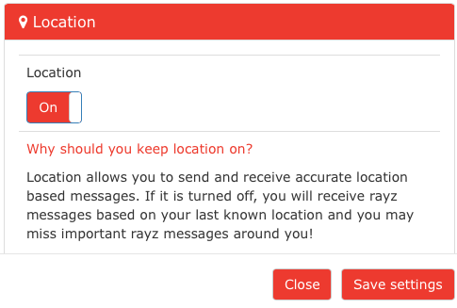

Rayzit Settings
Users settings saved in JSON format for better use. They are stored localy on user’s device by making use of HTML5 local storage functionality.

Slide 26


