Slide 1

NAGIOS
EPL421: Systems Programming
.
By: Constantinos Anastasiou (canast07-AT-cs.ucy.ac.cy)
Stefanos Pantziaros (spantz01-AT-cs.ucy.ac.cy)
Antonis Vasiliou (avasil06-AT-cs.ucy.ac.cy)

Slide 2
Nagios (1)
Monitoring system
Monitors systems, networks and infrastructure
Nagios Core – Open Source Software
Nagios Plugins – separate Nagios project.
Nagios XI – Extended Interface (Enterprise), maintained by Nagios Enterprises and Ethan Galstad(Standard Edition starts at $1,995)
https://www.cs.ucy.ac.cy/courses/EPL421

Slide 3

Nagios (2)
1996 – Ethan Galstad creates MS-DOS application to ping Novell Netware servers and pages.
1998 – build new improved application to run under Linux.
1999 – release as open source under the name “NetSaint”
2002 – Change to Nagios (Nagios Ain’t Gonna Insist On Sainthood)
2008 – Nagios Enterprises, LLC is founded by Ethan Galstad
2008 – Nagios is downloaded directly from SourceForge.net over 500,000 times.
2009 – Nagios is renamed Nagios Core
2010-2018 – Many versions were released (Nagios XI in 2015)
2019 – Nagios 4.4.5, Nagios Plugins 3.2.1, Nagios XI 5.6.8
Alternative systems:
PANDORAFMS
Icinga
LibreNms
Zenoss
Can monitor:
Website Monitoring (Application, Transactions, Hijack Detection, Content Monitoring, etc)
OS Monitoring (Windows, Linux, Servers, RHEL, Centos, AIX, etc.)
Database Monitoring (MS SQL, Postgres, Oracle,DB2, MSSQL)
Protocol Monitoring (HTTP, FTP, DNS, SNMTP, SMTP, LDAP, etc.)
Managed Service Providers (Passive checks, scalability, Distributed Monitoring)
Environmental Monitoring
Power Monitoring (UPS)
Storage Monitoring (File systems, files, directories, RAID Array & RAID Controller Monitoring, etc.)
Email Monitoring (Delivery monitoring, Postfix, Sendmail, IMAP, POP, etc.)

Slide 4
Nagios (3)
PROS
CONS
Open source software
Easy to add custom scripts
Can monitor many different systems
Notification and Alert settings for early preventing of situations
All features are not provided in the free version
A lot of configuration files – Hard to configure
Can’t manage networks, only monitor them

Slide 5
Nagios (4)
Available connections:
NRPE - Nagios Remote Plugin Executor
using scripts that are hosted on the remote systems, TCP port 5666
NRDP - Nagios Remote Data Processor
agent with a flexible data transport mechanism and processor.
NSClient++ - NRPE for Windows Machines
monitors Windows machines, TCP port 12489
NCPA - Nagios Cross Platform Agent
scale-able API that allows flexibility and simplicity in monitoring hosts
installs on Windows, Linux, and Mac OS X
https://www.cs.ucy.ac.cy/courses/EPL421

Slide 6
Prequisites
System requirements
1 GHz Processor
1 GB RAM
8 GB HD
Recommended system specs
2+ GHz Processor
2 GB RAM
40 GB HD
RAID 5 Drive Configuration
$sudo apt-get install -y autoconf gcc libc6 make wget unzip apache2 php libapache2-mod-php7.2 libgd-dev

Slide 7
Installing (1)
Easy installation guides are available at assets.nagios.com for many OS.
Download Nagios Core tar, compile and install the contents,
Download Nagios Plugins, to use commands and install them,
Download any of the files needed for the connection with the hosts (ex. NRPE).
After installation configuration files, that need to be edited in order to work.

Slide 8
Installing (2)
/usr/local/nagios/etc/objects$ cat contacts.cfg
define contact {
contact_name # Short name of user
usegeneric-contact # Inherit default values from generic-contact template
alias # Full name of user
email #user email address
}
…
define contactgroup {
contactgroup_name admins
alias Nagios Administrators
members nagiosadmin, nagiosadmin2, nagiosadmin3
}
/usr/local/nagios/etc/objects$ cat commands.cfg
define command {
command_name check-host-alive
command_line $USER1$/check_ping -H $HOSTADDRESS$ -w 3000.0,80% -c 5000.0,100% -p 5
}
…
define command{
command_name check_ddos
command_line $USER1$/check_ddos.pl -w $ARG1$ -c $ARG2$
}
/usr/local/nagios/etc/objects$ cat hostgroups.cfg
define hostgroup {
hostgroup_name Linux_servers
alias Linux Servers
}
/usr/local/nagios/etc/objects$ cat timeperiods.cfg
define timeperiod {
name 24x7_sans_holidays
timeperiod_name 24x7_sans_holidays
alias 24x7 Sans Holidays
use us-holidays Get holiday exceptions from other timeperiod
sunday 00:00-24:00
Monday 00:00-24:00
tuesday 00:00-24:00
wednesday 00:00-24:00
Thursday 00:00-24:00
Friday 00:00-24:00
Saturday 00:00-24:00
}
/usr/local/nagios/etc/objects/servers$ cat 10.16.30.36.cfg
define host {
use linux-server
host_name #name of host
alias #alias name
address 10.16.30.36
max_check_attempts 5
check_period 24x7
notification_interval 30
notification_period 24x7
contact_groups admins
hostgroups linux-servers
}
…
define service {
host_name ubuntu
service_description DDoS
check_command check_ddos!50!70
max_check_attempts 5
check_period 24x7
notifications_enabled 1
check_interval 0.30
notification_interval 30
notification_period 24x7
contact_groups admins
}

Slide 9
Installing (3)
sudo /usr/local/nagios/bin/nagios -v /usr/local/nagios/etc/nagios.cfg #Run pre-flight check on configuration data
sudo systemctl restart nagios.service
sudo systemctl start nagios.service
sudo systemctl stop nagios.service
sudo systemctl status nagios.service

Slide 10
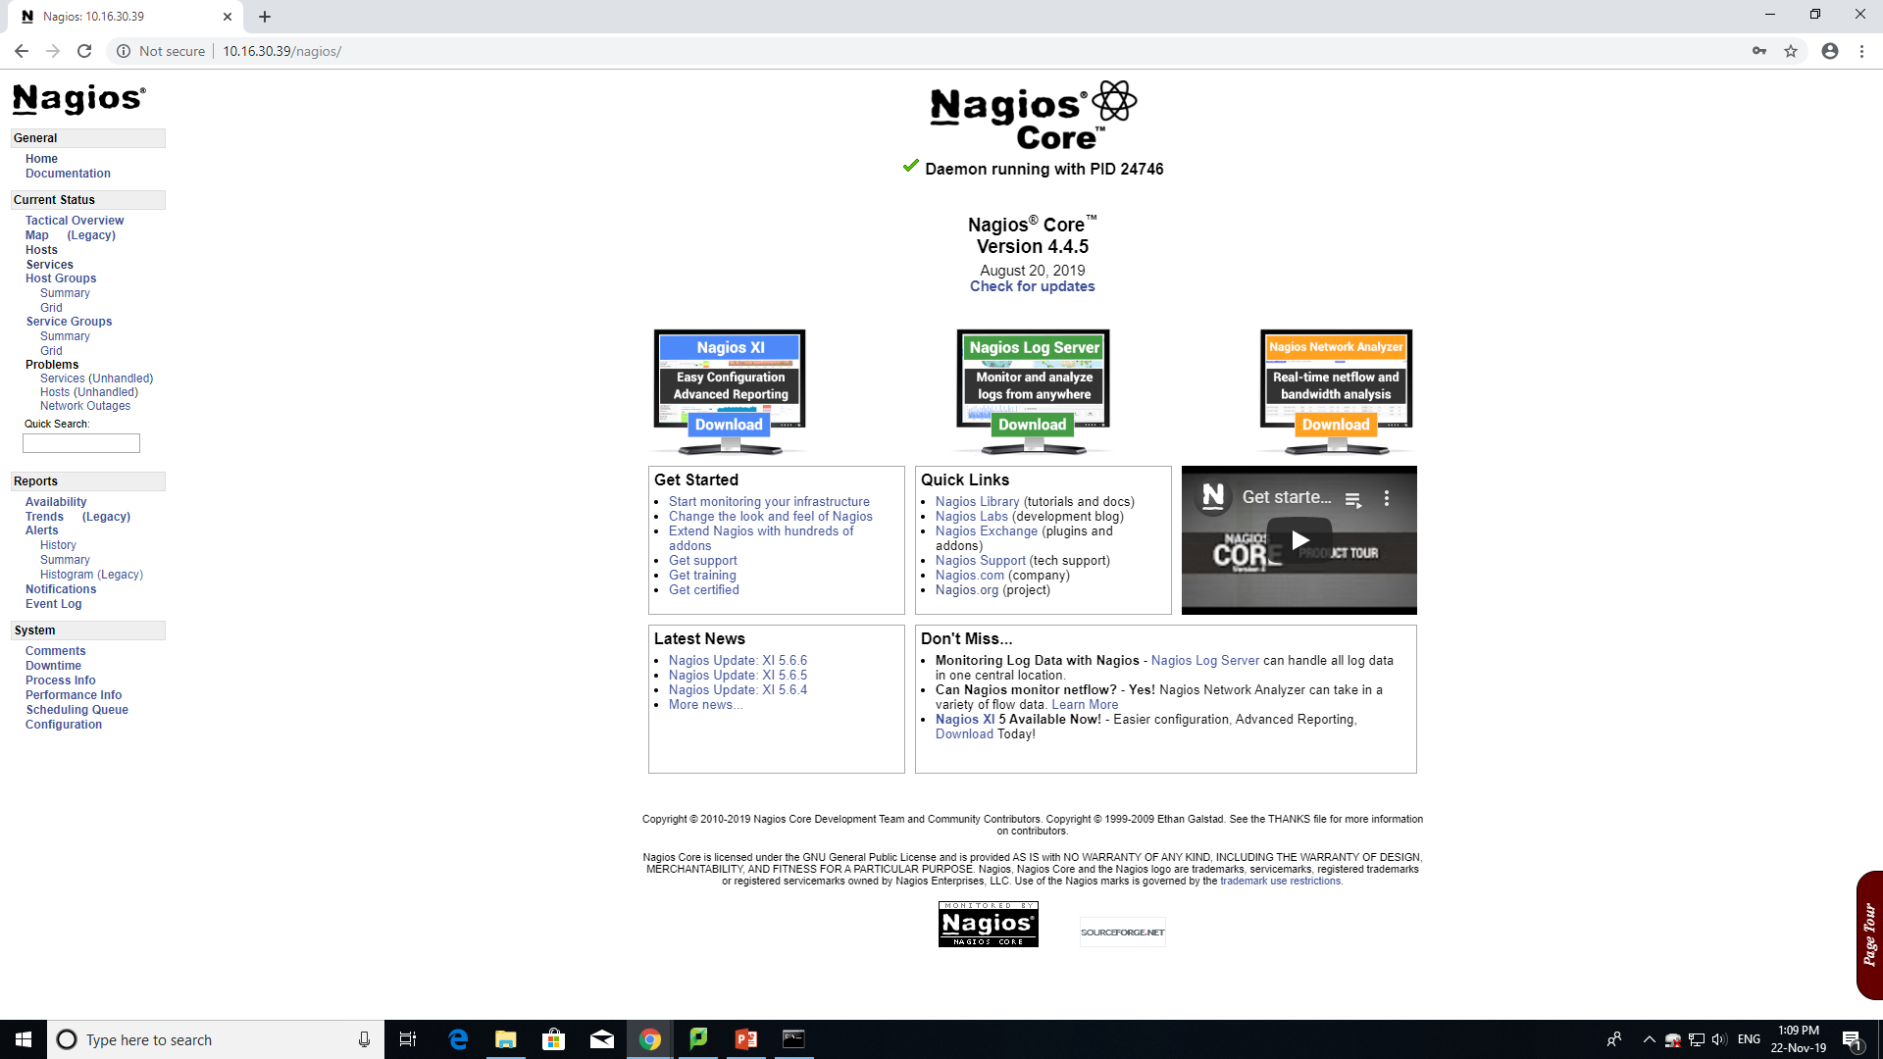

Slide 11
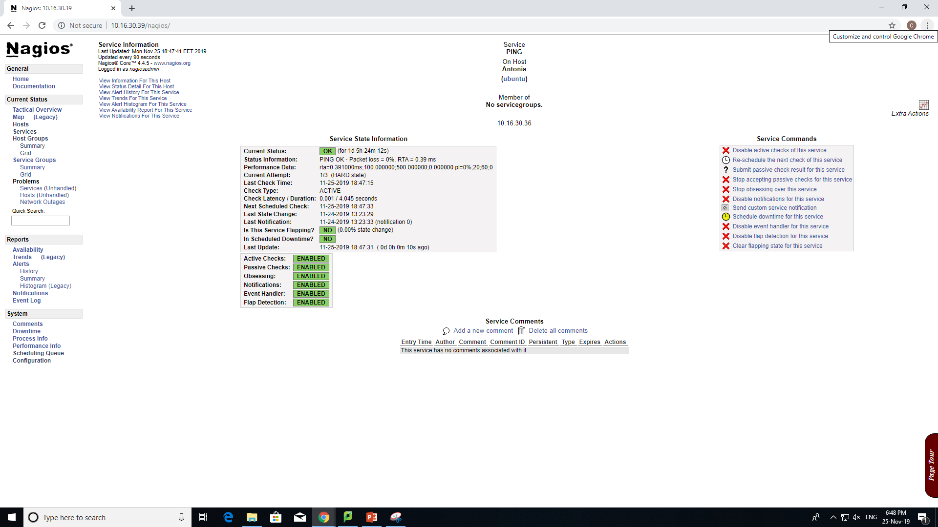

Slide 12
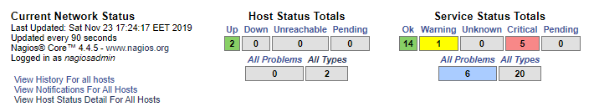
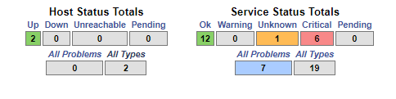
Notes:
Βλέπουμε την κατάσταση των hosts που παρακολουθούμε και την κατάσταση των services των hosts που παρακολουθούμε

Slide 13
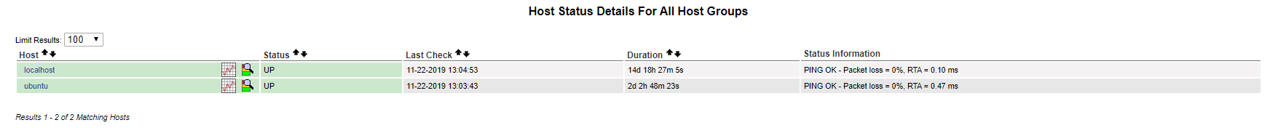
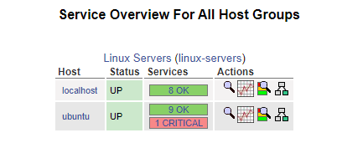
Hosts
Hosts groups

Slide 14
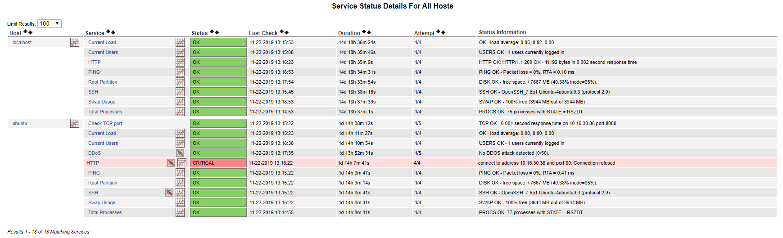
Services

Slide 15
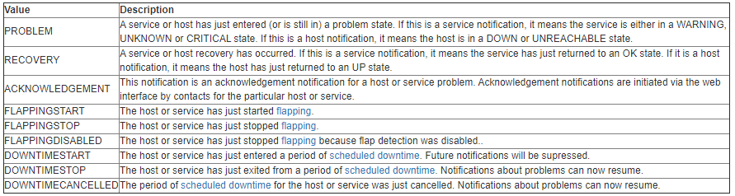
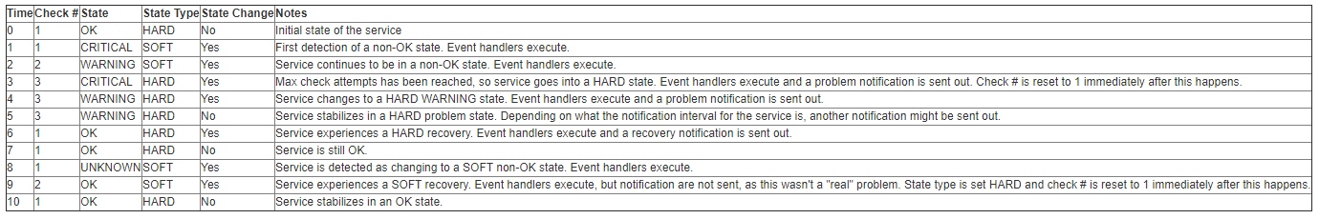
Warnings
***** Nagios ***** Notification Type: PROBLEM Service: Current Load Host: ubuntu Address: 10.16.30.36 State: WARNING Date/Time: Sun Nov 24 13:30:26 EET 2019 Additional Info: WARNING - load average: 0.97, 4.12, 2.29

Slide 16
Recovery
***** Nagios ***** Notification Type: RECOVERY Service: Current Load Host: ubuntu Address: 10.16.30.36 State: OK Date/Time: Sun Nov 24 13:33:16 EET 2019 Additional Info: OK – load average: 0.001, 0.33, 2.97
As soon as the default values are restored, Nagios will inform the contact group.

Slide 17
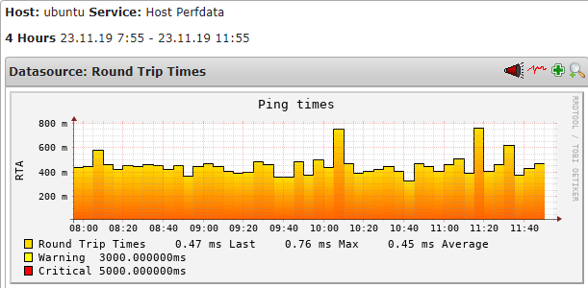
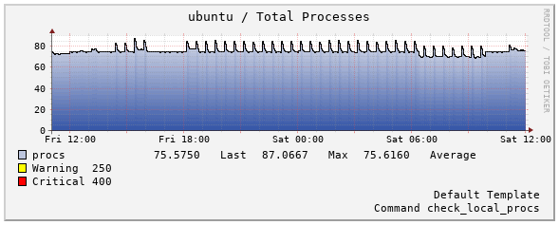
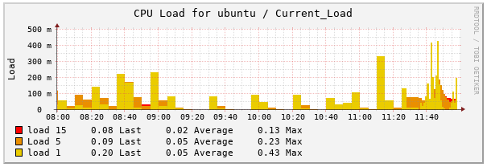
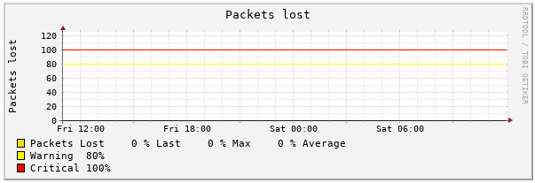
pnp4nagios
Add-on to Nagios which analyzes performance data provided by plugins and stores them automatically into RRD-databases

Slide 18
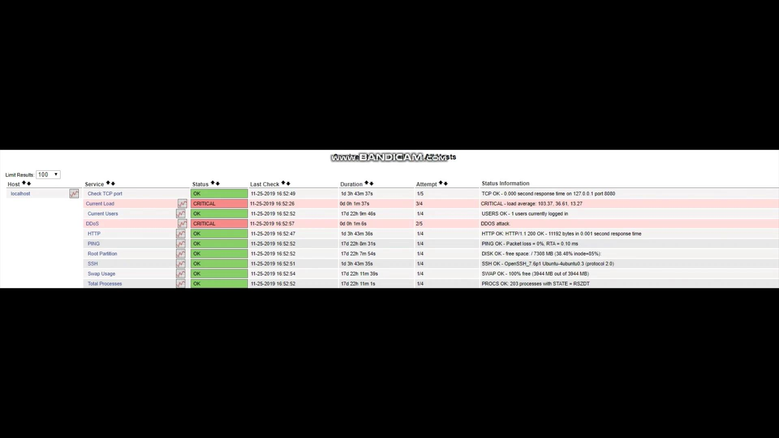
DDoS Attack
ab -c 1000 -k -n 1000000 http://10.16.30.39:80/
ab: Apache Benchmarking. A tool for benchmarking your Apache Hypertext Transfer Protocol (HTTP) server.
-k: Keep Alive
-c: Number of Concurrent requests
-n: Total number of requests to be made

Slide 19
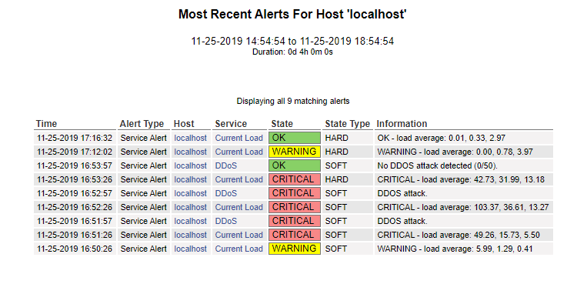
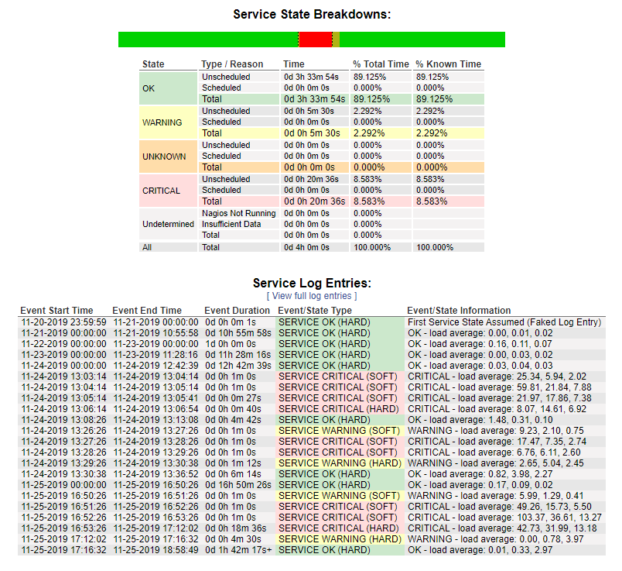
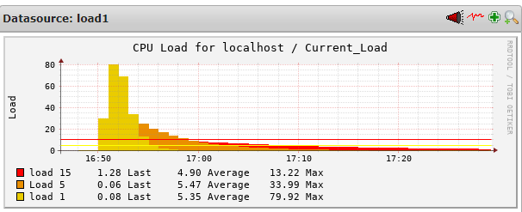
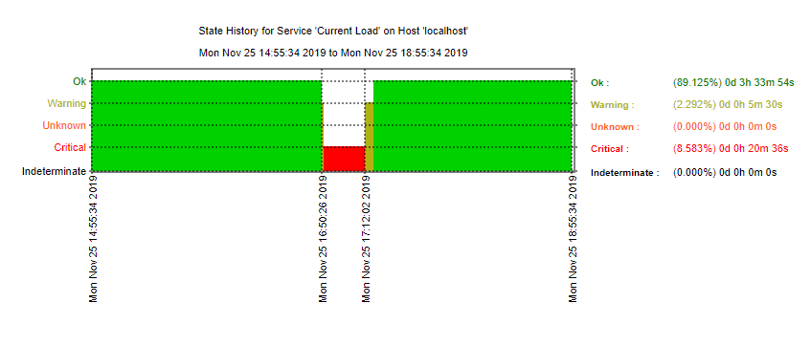

Slide 20
Summary (1)
Once installed, we only need to create/edit configuration files.
To add a host we have to create a .cfg file with the name of the host to be monitored and define the services that will be monitored.
For each service we have to use commands from the plugins we installed, or we can create our commands.
After each modification we have to restart Nagios service to apply all modifications.

Slide 21
Summary (2)
In case of an attack/error/failure Nagios monitors and informs the contacts defined in order to take measures.

Slide 22
Conclusions
Nagios is a very useful tool for system administrators. It can show prevent major problems by monitoring servers and detecting problems. When a problem is found Nagios sends notifications to the administrators therefore, administrators can act as soon as possible.
Nagios can make a system’s administrators life easier by automating some routine functions that a system admin has to do. Also it provides a GUI that is easy to understand without needing specialized skills.
Unfortunately many functions that Nagios provides aren’t free. To get the full potential of it you would have to pay at least $1995.
To set up Nagios you will have to be knowledgeable about systems programming.

Slide 23
Sources
Nagios System and Network Monitoring, Wolfgang Barth, ISBN: 978-1-59327-070-4
https://assets.nagios.com/
https://www.dnsstuff.com/open-source-network-monitoring-tools
https://sites.google.com/site/itcs465nagios/protocols-supported
https://draculaservers.com/tutorials/install-nagios-ubuntu/
http://jo-roy.com/doku.php?id=nagios

Slide 24
THANK YOU!

