Slide 1

AUTOMATION
EPL421: Systems Programming
.
By: Σταύρος Γεωργίου
Παναγιώτης Γρούτας
Κυριακή Κέκκου

Slide 2
Contents
Introduction
Build Automation
Continuous Integration
Toolchain
Jenkins
Gradle
Git (GitHub)
Toolchain Setup and examples

Slide 3
Introduction
Automation in software build with Continuous Integration (CI)
Toolchain is the key for build Automation
In our project, we used Jenkins, Gradle and GitHub

Slide 4
Software Build
The process in which the source code is compiled to create the executable program and other build artifacts.

Slide 5
Build Automation
Is the repeatable process that executes a build of a project and other related processes without needing a direct human intervention.

Slide 6
Build Automation
At first was accomplish through makefiles
Today there are two categories:
Build-automation utility
Build-automation servers

Slide 7
Build-automation utility
Software programs that are used for automated building
Producing build artifacts thought processes like compile and linking
Make, Ant, Maven, Gradle etc.

Slide 8
Build-automation servers
Web based tools
They execute build automation utilities after a trigger or at a schedule time.
There is a classification of the servers in categories based on the level of automation; we will focus on Continuous Integration Servers.
Some examples : Jenkins, Bamboo, TeamCity etc.

Slide 9
Continuous Integration
“Continuous Integration is a software development practice where members of a team integrate their work frequently, usually each person integrates at least daily - leading to multiple integrations per day. Each integration is verified by an automated build (including test) to detect integration errors as quickly as possible” – Martin Fowler

Slide 10
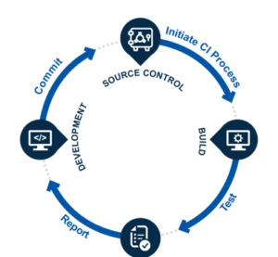
Notes:
Epeksigisi eikonas
Na tonisti oti ine se share repositories

Slide 11
Benefits of CI
Make the development process easier
There is no need for a whole step for integration in the development cycle
Functional System in any moment
Easier detection of bugs
Any change from every developer in the code is being recorded
Notes:
τα θετικά της συνεχής ενσωμάτωσης είναι:
- το γεγονός πως δεν χρειάζεται ένα ολόκληρο στάδιο στον κύκλο ανάπτυξης για ενσωμάτωση τμημάτων κώδικα καθώς αυτό γίνεται αυτόματα
- γίνεται αναγνώριση των bug άμεσα
- έχουμε ένα αναπτυγμένο σύστημα ανα πάσα στιγμή
- και έχουμε διαθέσιμο ένα αρχείο στο οποίο καταγράφετε η ανάπτυξη του έργου

Slide 12
Toolchain
Set of distinct programming tools that are chained together to execute complex tasks.
An example of a toolchain is the conversion of a source code to an executable program with the use of a compiler , linker, assembler and debugger .

Slide 13
About Hudson
Since 2005
CI tool written in Java that runs in a servlet container.
By Sun Microsystems
Under MIT license – free software
Primary Developer was Kohsuke Kawaguchi
When Oracle bought Sun, Kawaguchi and other developers continue the project under the name Jenkins in 2011

Slide 14

Jenkins
Open source CI server
Orchestrates a chain of actions in automated fashion
Runs in servlet container
Today it supports 1400 plugins
These plugins are classified in 5 categories that consist code or build management, the user interface, platforms and administration.

Slide 15
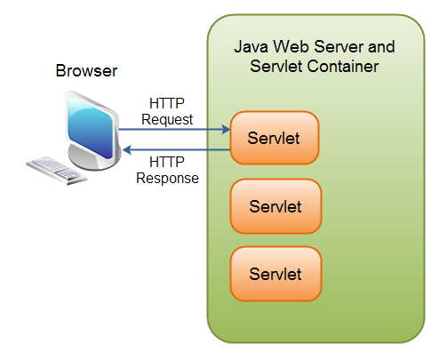
But what is Servlet Container?
Servlet : is a Java program that works on the server-side and gives extensive capabilities to the server by handling, processing and sending back a response to the web server. Servlet doesn’t have direct communication with the client the following chained process is followed: Client <-> Web Server <-> Servlet Container <-> Servlet.
Servlet container: is an system that provides run time environment for Java Servlet components. Is on the top of the webserver.

Slide 16
Getting Started with Jenkins
After setting up a project in Jenkins we have the following options:
- To connect Jenkins with a version control system
- To automate triggering build or to schedule tasks by using periodical building
- To associate Jenkins with other projects
- To send the results of the tests to the developers
- To archive the different artifacts that are produce after the building

Slide 17
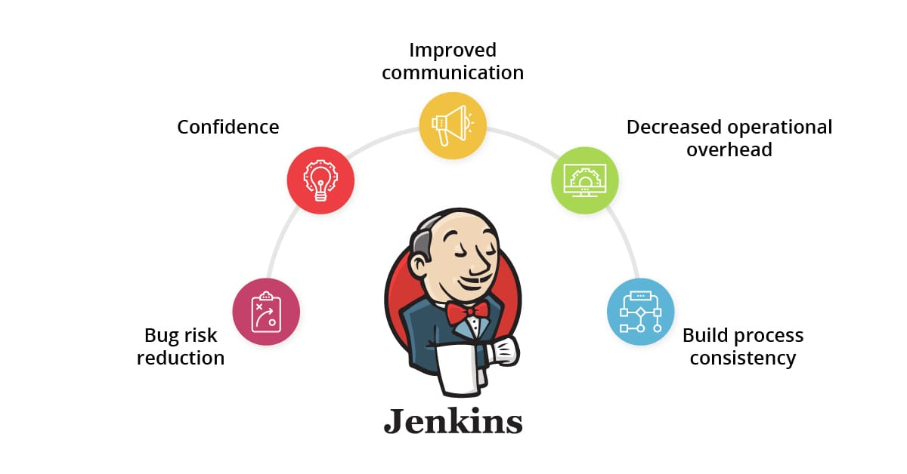
Benefits of Jenkins
Accelerating software development process
Supports the complete development lifecycle of software from building, testing, documenting the software, deploying and other stages of a software development lifecycle

Slide 18

Gradle
Open Source
Build Automation Tool
Generates a build.gradle file written in Groovy (Groovy is JVM language that looks like Java but with simpler syntax )
Creates a set of tasks for every project that need to be done in order to build our project

Slide 19

Git
Open Source Version Control System
Command Line Tool
Helps the management of project files
Keeps track of the entire history and allows to go back in a previous version of the file

Slide 20

GitHub
Web based hosting service for Git.
Social Networking site for developers

Slide 21
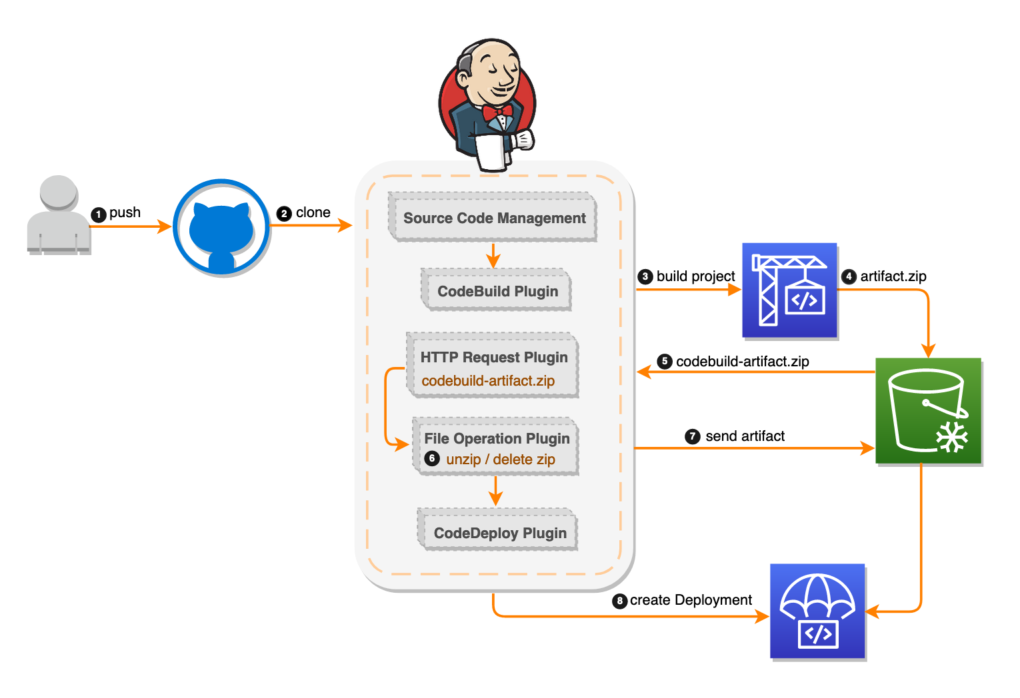

Slide 22
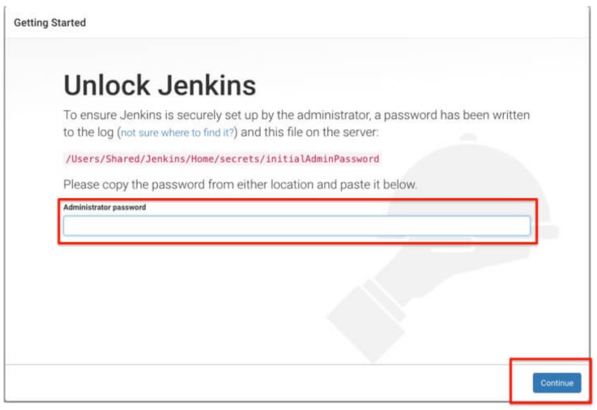
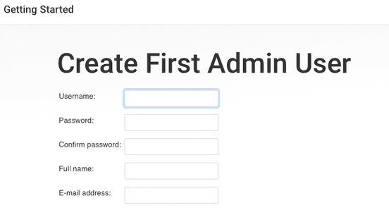
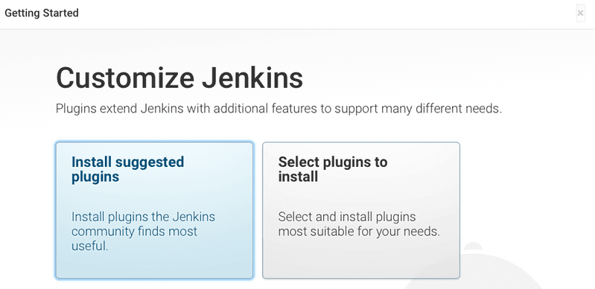
Start Jenkins

Slide 23
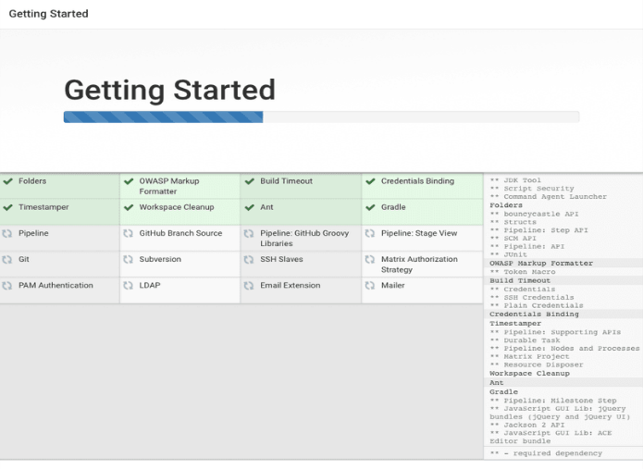
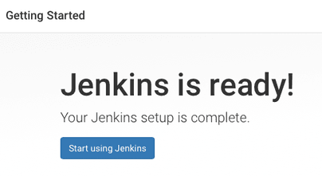
Start Jenkins

Slide 24
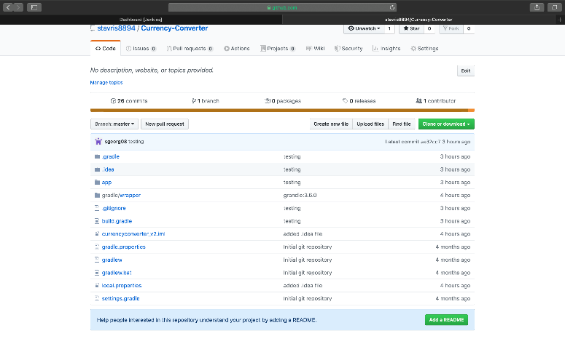
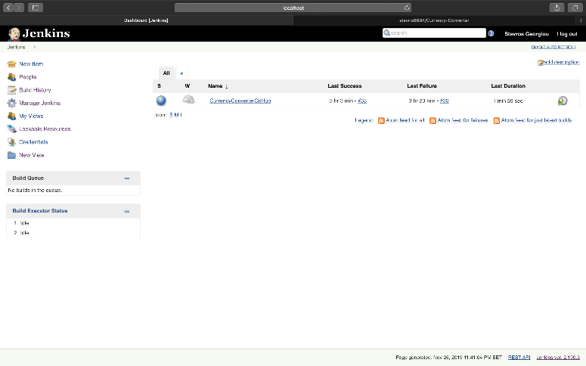
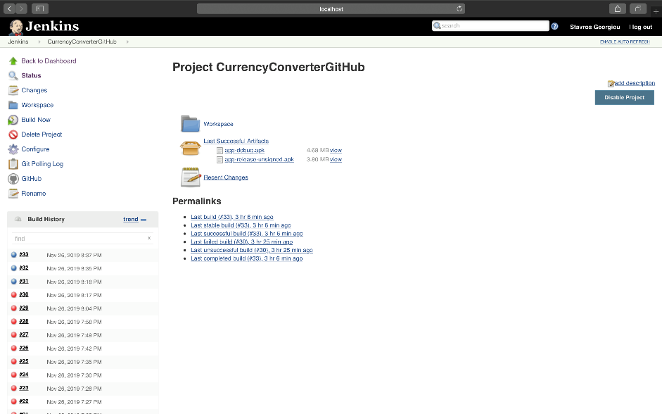
Build Project

Slide 25
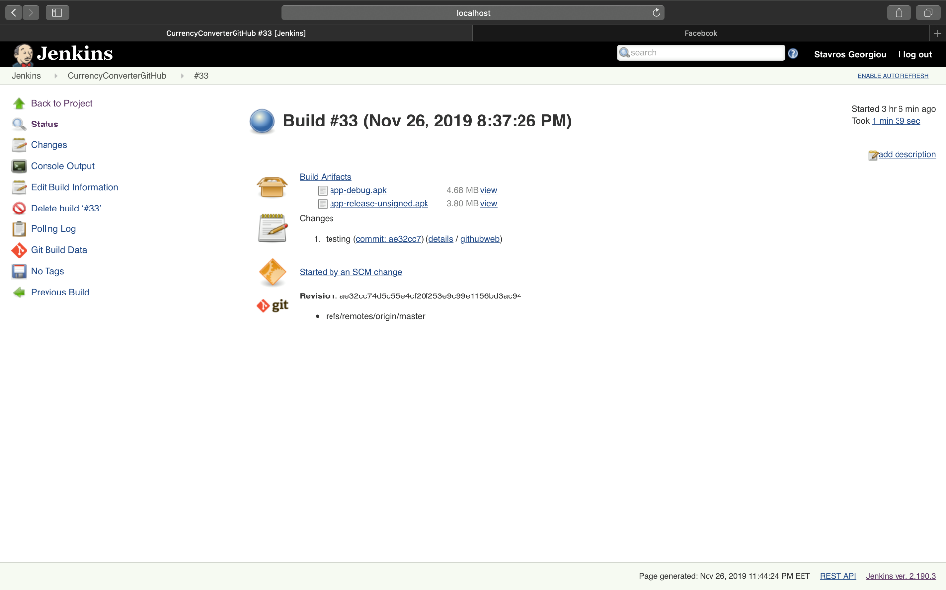
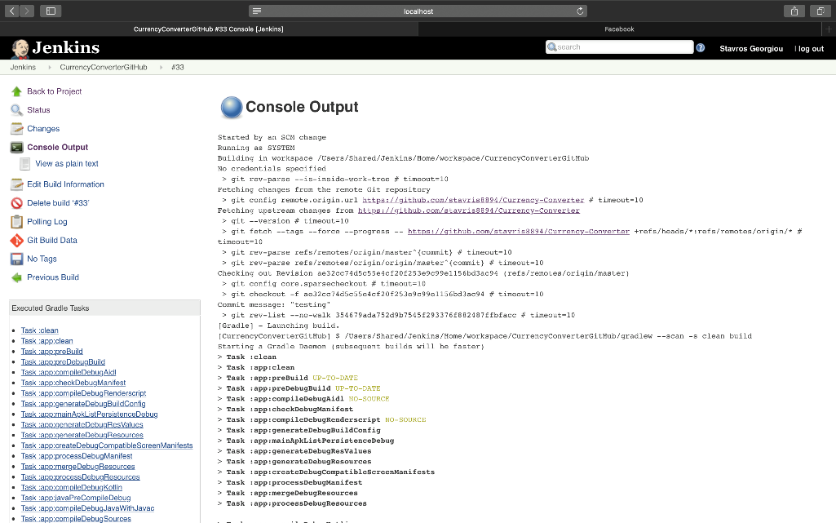
Build Project

Slide 26
Citation
https://www.geeksforgeeks.org/introduction-java-servlets/
http://inheritingjava.blogspot.com/2011/02/chapter-2-web-servers-and-servlet.html
https://scmquest.com/software-build-knowledge/
https://www.worksoft.com/corporate-blog/is-continuous-integration-and-continuous-testing-a-one-size-fits-all-no-and-heres-why/
https://elinux.org/Toolchains
https://jenkins.io/blog/2011/01/11/hudsons-future/
https://www.guru99.com/jenkin-continuous-integration.html
https://www.infoworld.com/article/3239666/what-is-jenkins-the-ci-server-explained.html
https://www.cs.colorado.edu/~kena/classes/5828/s12/presentation-materials/bowesjesse.pdf
http://tutorials.jenkov.com/java-servlets/overview.html
https://itsvit.com/blog/must-have-devops-tools-make-things-right-get-go/
https://medium.com/@andrewMacmurray/a-beginners-guide-to-gradle-26212ddcafa8
https://docs.gradle.org/current/userguide/what_is_gradle.html
https://codeburst.io/git-and-github-in-a-nutshell-b0a3cc06458f

