Slide 1

Apache Kafka
EPL421: Systems Programming
.
By: Solomonidis Nikolas (nsolom03@cs.ucy.ac.cy)
Christou Neophytos (nchris23@cs.ucy.ac.cy)
Pantazi Christoforos (cpanta02@cs.ucy.ac.cy)

Slide 2
What is Apache Kafka
Kafka is a high performance, real-time messaging system.
It is an open source tool and is part of Apache projects.
It has a distinctive design but also provides all of the functionality of a distributed and partitioned messaging system.
It can be part of any large scale data system.
Kafka is highly available, can manage any node failures and supports automatic recovery for the data.
Kafka is written in Scala and Java.

Slide 3
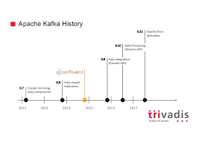
Kafka History
Apache Kafka was developed by Linkedin and is open source since 2011.
A stable Apache Kafka version 0.8.2 was released in Feb, 2015
Latest stable Apache Kafka version 2.31 was released in Oct 24, 2019.

Slide 4
What Apache Kafka does
It passes messages using a publish-subscribe model, through some applications that are named producers.
Consumers are the applications that can read those messages.
Also consumers can decide which messages they want to read. This removes the complexity to manage the way we store these messages to any part of the system.
Kafka servers can store, receive and send messages on different nodes - VMs which are called brokers.

Slide 5
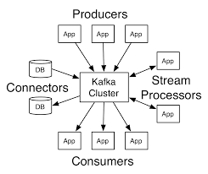
Apache Kafka Architecture Design

Slide 6
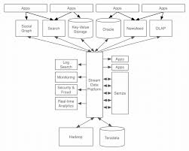
Funnel Architecture
The designs shown before looks like a funnel where all incoming data is first placed in Kafka and all outgoing data is read from Kafka.
Kafka centralizes communication through Brokers,Topics,partitions between producers of data and consumers of that data.
Producers are able to write records into Kafka and consumers can read these records (one or more consumers).

Slide 7
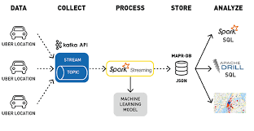
Combining Kafka with other services

Slide 8

Kafka in systems of big companies
Many big companies use Kafka, such as LinkedIn, Microsoft, Netflix, Uber, some of the biggest banks, insurance companies telecom companies and many more.
Notes:
A;ll the companies had in common

Slide 9
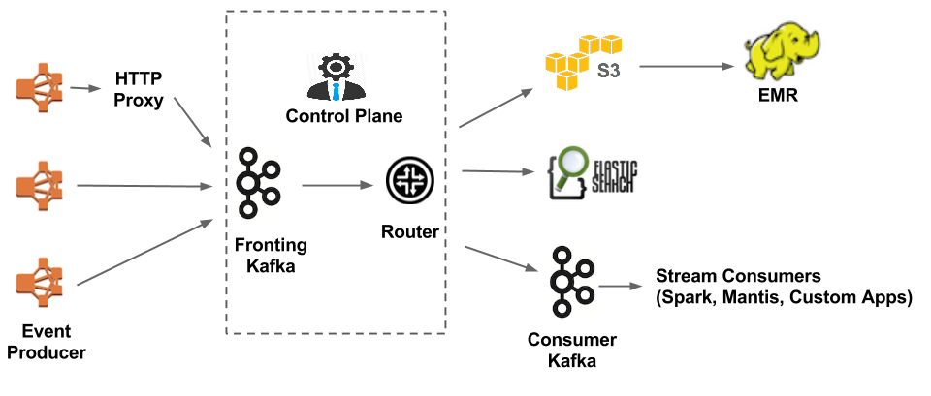
Kafka in Netflix Keystone Pipeline (streaming pipeline)

Slide 10
Kafka in Netflix Keystone Pipeline (streaming pipeline)
Uses two sets of Kafka clusters: Fronting Kafka and Consumer Kafka.
Producers: every running instance of Netflix
Fronting Kafka clusters: their role is to get the messages from the producers
Those clusters send the data to Samza, a stream processing software
Samza routes a subset of the received topics to the Consumer Kafka clusters
Current numbers:
36 Kafka clusters
4,000+ brokers for both Fronting Kafka and Consumer Kafka
Around 700 billion messages ingested each day.
Notes:
Samza: stream processing software by apache

Slide 11
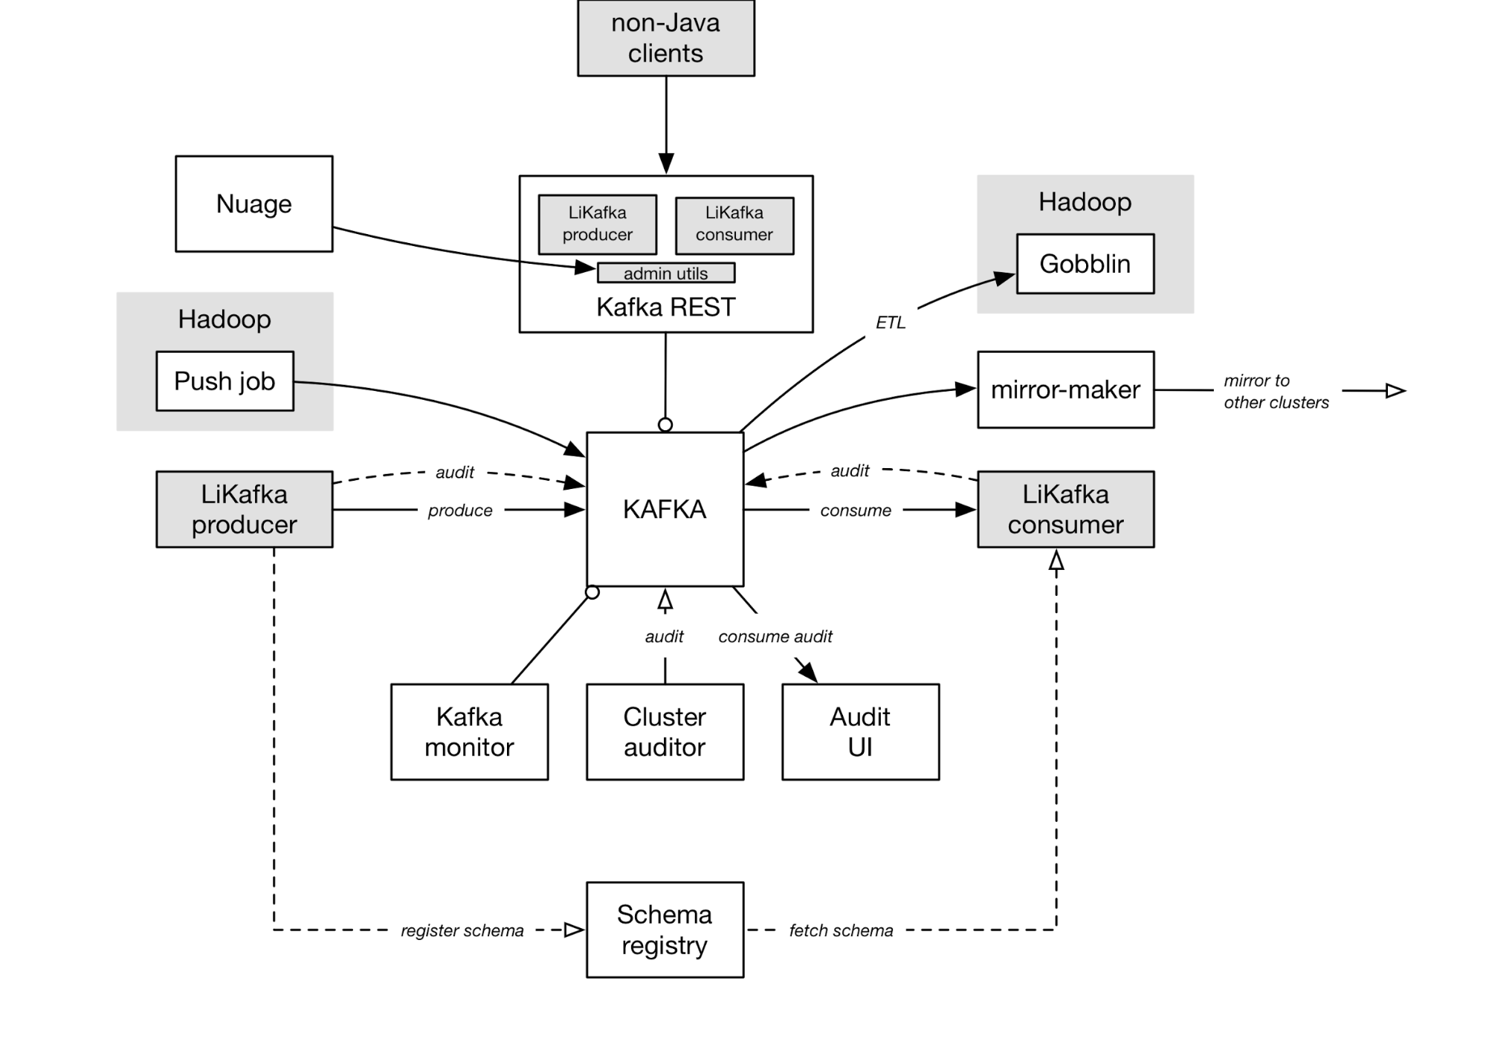
Kafka in LinkedIn

Slide 12
Kafka in LinkedIn
Currently use:
Nearly 1400 brokers
1.4 trillion messages per day
Receive over two petabytes of data every week
Other parts:
Kafka mirror-maker: consumes from a source cluster and produces into a target cluster to create copies of clusters
LiKafka Client Libraries: wrappers around open source producer and consumer to add extra features
Kafka monitor: runs validation tests for Kafka(end-to-end latency, data loss etc.)

Slide 13
Why is Kafka so fast
Kafka depends on the OS kernel to move data quickly through the system.
It also relies on the method of Zero Copy.
Kafka has the ability to divide data records into multiple chunks.
Batching gives the opportunity to reduce I/O latency and allows more efficient data compression.
A Topic where messages are stored can be divided into thousands of partitions to thousands of servers providing horizontal Scale.
Therefore it can handle massive load of data.

Slide 14
Persistence in Kafka
Kafka allows the persistence of messages through the Linux File System.
It ensures that messages are not lost.
It also relies on the file system page cache for fast reads and writes.
Messages are grouped for more efficient writes.
During transmission messages can be compressed to reduce network bandwidth.
Messages have a standard binary format for all messages. This can minimize data modification.

Slide 15
Kafka’s Capabilities
It can sent and receive billions of messages in real-time through a day.
It can be used from distributed systems as an external commit log.
It can handle and maintain events through time sequence.
It can be used to collect log files from multiple systems and store them in a central location (e.g. HDFS).
It can be used to process a continuous stream of information in real-time. Then it can pass them to any stream processing system (e.g. Spark).

Slide 16
Kafka Use Cases
Kafka is mainly used for real-time stream processing
Website activity tracking
Metrics collection and monitoring
Log aggregation
Real-time analytics
Messaging service
Error recovery and guaranteed distributed commit log for in-memory computing (microservices).

Slide 17
Records placed in Kafka
Each record consists of a key, a value, and a timestamp.
The key of each record is assigned by Kafka when producers publish a record.
Each record can be published only in one partition of a topic.
Keys are used to have more control.
Typically, record’s content have the format of JSON.
These records cannot be deleted or modified once they are sent to Kafka.
Record represents information, for example lines in a log file or an error message from a system.

Slide 18
Topics
A Topic is a category of messages in Kafka:
The producers write the messages into topics.
The consumers read the messages from topics.
A topic has one or more partitions upon creation.
Each partition is like a queue that contains messages.
Each message is associated by its offset in the partition.
Messages are enqueue on one end of the partition and consumed on the same one.

Slide 19
Partitions
Topics are separate into partitions, which are the unit of parallelism in Kafka.
A topic can have one or more partitions.
Each partition should fit in a single Kafka server.
The number of partitions determine the parallelism of the topic

Slide 20
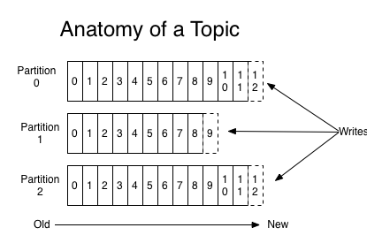
Topic X

Slide 21
Replication / Partition Distribution
Partitions can be distributed across the Kafka cluster.
Each Kafka broker may manage one or more partitions.
A partition can be replicated across all Kafka brokers for fault-tolerance.
In one broker, that partition is marked as a leader and the other partitions in other brokers are marked as followers.
The leader has the responsibility to read/write from the partition and the followers update their data from the leader.
If a leader fails, one of the followers automatically become the leader.

Slide 22
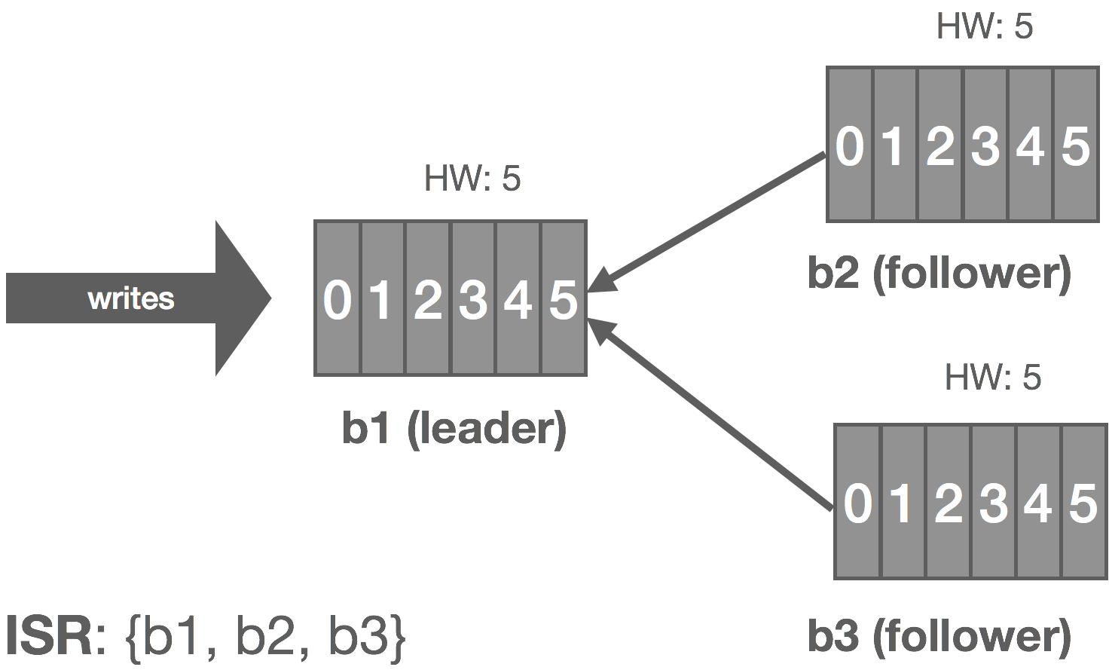
Replication

Slide 23
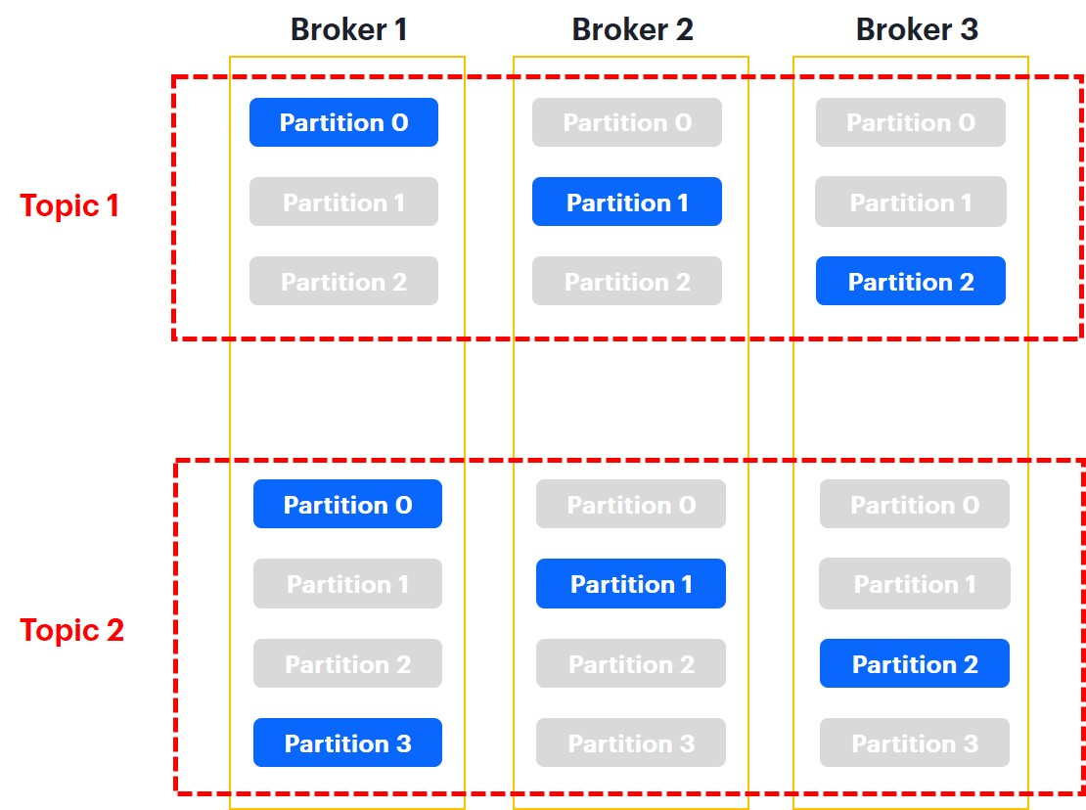
Replica Cont

Slide 24
Producers
The processes that publish the records into a topic in Kafka.
They can decide in which topic to give the message and in which partition specifically of the topic.
These records are appended at the end of the partition.
As a result a consumer will receive the records in the same order as they are produced in the partition.

Slide 25
Consumers
Consumers belong to a consumer group.
A consumer group has one or more consumers and work together to consume a topic.
When a new record is placed to a topic, it will be read by just one consumer from any consumer group.
Consumers can subscribe to one or more topics to read from its records.
Zookeeper or Kafka itself are storing the offset of the last consumed record for each partition in order to allow consumer to stop and restart without losing its place.

Slide 26
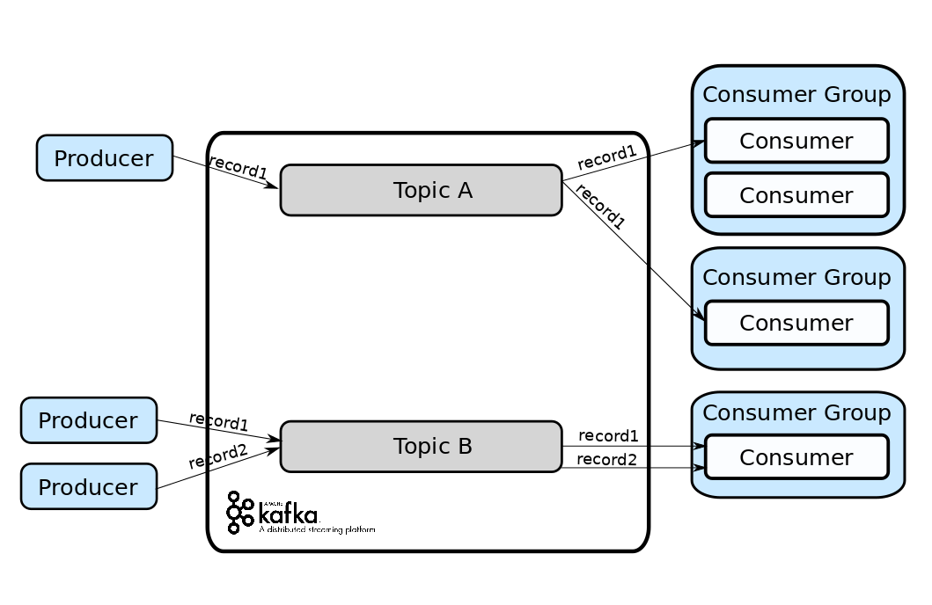
Producers, Consumers

Slide 27
Zookeeper
It is a service for providing configuration and synchronization for distributed systems
Very stable service, used in many distributed frameworks
Zookeeper is used in Kafka to:
Elect a broker as a leader for a partition after a previous leader fails
Manage the topology of the cluster and send information about changes in the topology. For example, it informs all nodes when a new broker joins the cluster, when a broker dies or leaves the cluster, when a new topic is added or removed etc.
Provide synchronization and an overview of the current state of the cluster and its configuration
Notes:
Top-level software by Apache, used by other distributed software such as hadoop
Very stable and widely used software by apache
Provides distributed configuration
Provides self-election and consensus
More detail for the role of zookeeper at each part of kafka next

Slide 28
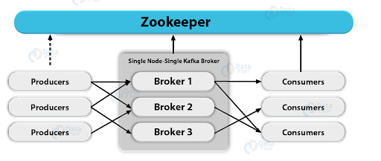
Zookeeper

Slide 29
Roles of Zookeeper
In Kafka Brokers:
State: Zookeeper checks the status of each broker by sending messages to check if the broker is alive
Replicas: It keeps information about the location of each partition replica for a topic and has the responsibility of choosing a new leader in case of a failure of a previous leader
Nodes and Topics: Zookeeper has information about which Kafka broker holds which topic
In Kafka Consumers:
Offsets: Zookeeper holds information the offset of each consumer
Notes:
Consumer offset: which message a consumer is going to read next

Slide 30
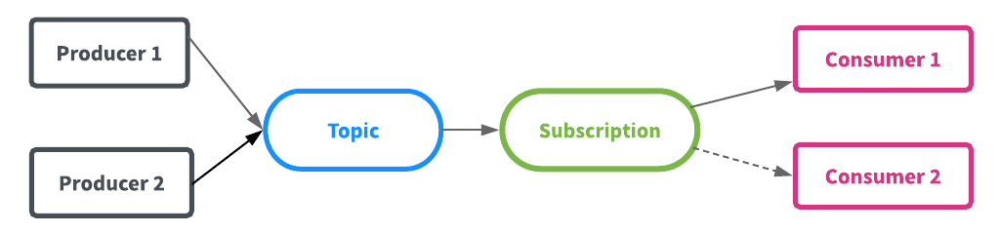
Kafka messaging models
Queueing (messaging) : producers write messages to a topic, each message is consumed by only one consumer
Publish - subscribe: producers write messages to a topic, all subscribed consumers receive all the messages
Notes:
Kafka generalizes these two models and can be used for both of these models. How? Next slide
No need to choose only one model

Slide 31
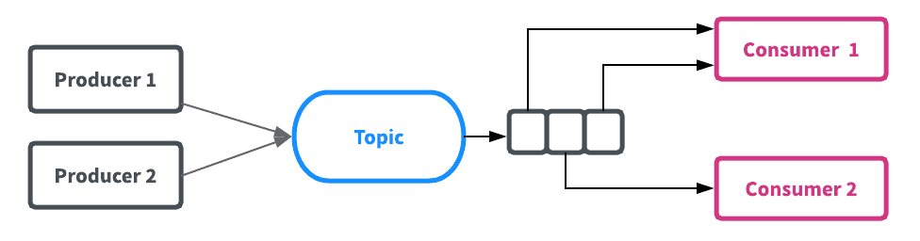
Kafka as a Queueing System
Why use Kafka and not another messaging system?
Kafka uses more reliable clustering and data replication mechanisms than most conventional messaging systems

Slide 32
Kafka as a Storage system
Messages are stored in the brokers until they are acknowledged
Due to the replication that Kafka provides, it is ensured that a message will not get deleted even if a server fails
Parallelization techniques of Kafka allow for good scaling. Good performance is guaranteed even for large volumes of data
For these reasons, one could say that Kafka is a special purpose distributed filesystem

Slide 33
Kafka for Stream Processing
Simple stream processing can be done using the producer and consumer APIs.
If we want to do more complex processing, we can use the Streams API to give the data to a specialized stream processing application
It allows to build programs that do computations using streams and do more complex operations such as joining streams together
Example: an application which sells clothes could take as input streams containing information about sales and output a stream containing information about changes in prices, computed off of the input
Notes:
For example, a retail application might take in input streams of sales and shipments, and output a stream of reorders and price adjustments computed off this data.

Slide 34
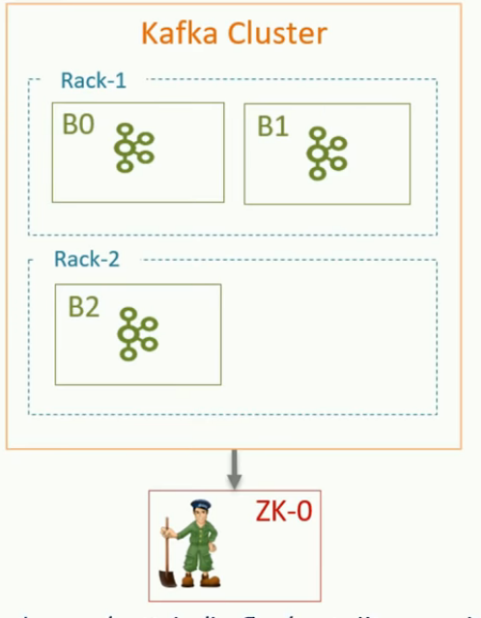
Apache Kafka Setup

Slide 35
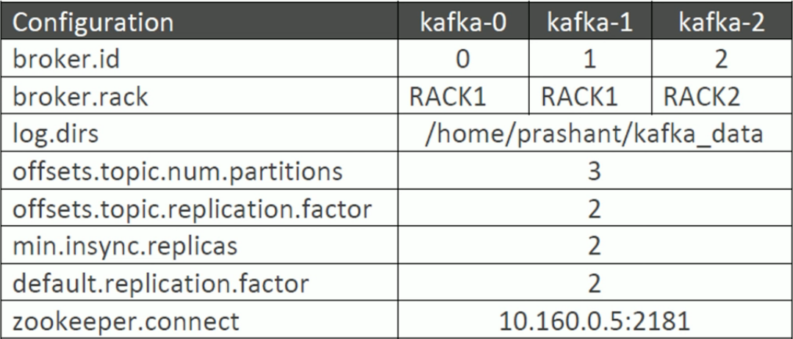
Apache Kafka Setup(2)

Slide 36
Testing Kafka Installation
Zookeeper Server start: sudo $HOME/kafka_2.12-2.3.1/bin/zookeeper-server-start.sh $HOME/kafka_2.12-2.3.1/config/zookeeper.properties
Kafka Server start: sudo $HOME/kafka_2.12-2.3.1/bin/kafka-server-start.sh $HOME/kafka_2.12-2.3.1/config/server.properties
Create Topic: kafka-topics.sh --create --zookeeper 10.160.0.5:2181 --replication-factor 3 --partitions 3 --topic test

Slide 37
Testing Kafka Installation (2)
List Kafka servers: kafka_2.12-2.0.0/bin/zookeeper-shell.sh 10.160.0.5:2181 ls /brokers/ids
List Topics: kafka-topics.sh --list --zookeeper 10.160.0.5:2181
Producer start: kafka-console-producer.sh --broker-list 10.160.0.2:9092 --topic test
Consumer start: kafka-console-consumer.sh --bootstrap-server 10.160.0.2:9092 --topic test --from-beginning

Slide 38
References
https://www.youtube.com/watch?v=PzPXRmVHMxI
https://www.youtube.com/watch?v=U4y2R3v9tlY&t=47s
http://cloudurable.com/blog/kafka-architecture/index.html
https://dzone.com/articles/an-introduction-to-apache-kafka
https://medium.com/@maheshdeshmukh22/producer-consumer-example-in-kafka-multi-node-multi-brokers-cluster-6044e1d8c96a
https://www.learningjournal.guru/article/kafka/installing-multi-node-kafka-cluster/ (Setup)
https://kafka.apache.org/
Images from:
https://sookocheff.com/post/kafka/kafka-in-a-nutshell/
https://medium.com/hacking-talent/kafka-all-you-need-to-know-8c7251b49ad0
https://data-flair.training/blogs/zookeeper-in-kafka/
https://techbeacon.com/app-dev-testing/what-apache-kafka-why-it-so-popular-should-you-use-it
https://engineering.linkedin.com/blog/2016/04/kafka-ecosystem-at-linkedin

