Slide 1

Time Series Databases
EPL421: Systems Programming
.
By: Kyriakou Stefanos (skyria12 AT cs.ucy.ac.cy) Leontiou Panayiotis (pleont02 AT cs.ucy.ac.cy) Tymvios Stelios (stymvi01 AT cs.ucy.ac.cy)
https://www.cs.ucy.ac.cy/courses/EPL421

Slide 2
Main presentation topics
Relational vs Tagset data model
What is a time series database and some of the current available options
InfluxDB compared to other time series databases
Setup of Couchbase, anyplace and influxDB
Api Usage
Security issues
InfluxDB Tutorial
https://www.cs.ucy.ac.cy/courses/EPL421

Slide 3
Relational data model
The database management system is responsible for describing the data structures, for storing data and retrieval procedures are responsible for answering queries
Most relational databases use the SQL data definition and query language
Each time-series measurement is recorded in its own row, with a time field followed by any number of other fields
Fields support various and more complex data types
Create indexes on any field or on multiple fields
Any of these fields can be used as a foreign key to secondary tables
https://www.cs.ucy.ac.cy/courses/EPL421

Slide 4
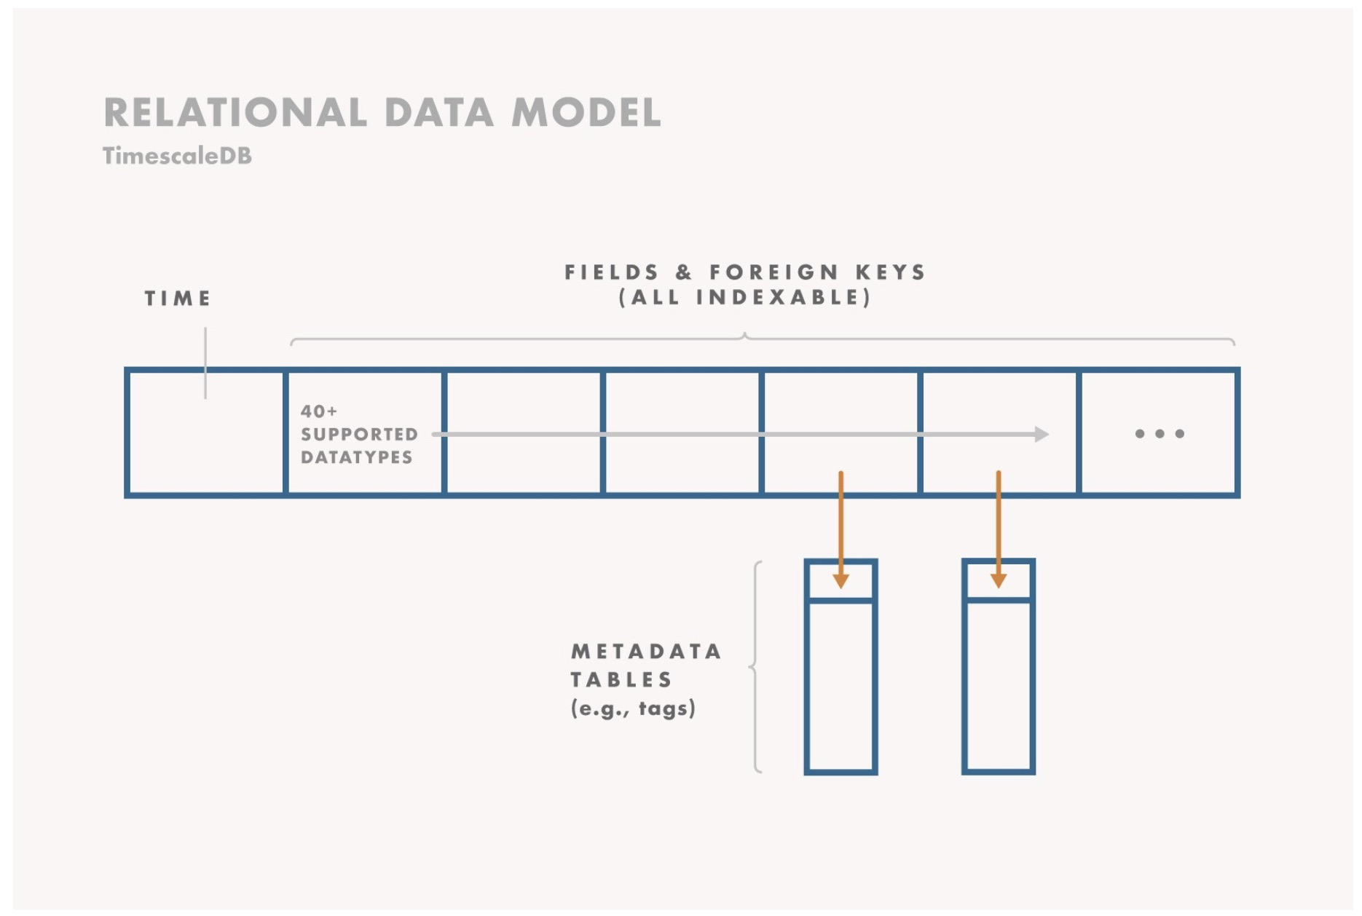
https://www.cs.ucy.ac.cy/courses/EPL421

Slide 5
Advantages of Relation data model
A narrow or wide table, based on how much data and metadata we want to record per reading
Many indexes to speed up queries or few indexes to reduce disk usage
Denormalized metadata within the measurement row, or normalized metadata that lives in a separate table
A rigid schema that validates input types or a schemaless JSON blob to increase iteration speed
Check constraints that validate inputs, for instance checking for uniqueness or non-null values
https://www.cs.ucy.ac.cy/courses/EPL421

Slide 6
Disadvantages of Relation data model
Need to select a schema and explicitly decide whether or not to use indexes
https://www.cs.ucy.ac.cy/courses/EPL421

Slide 7
Tagset data model
Each measurement has a timestamp, an associated set of tags (tagset) and a set of fields (fieldset)
The fieldset represents the actual measurement data values.
The tagset represents the metadata to describe the measurements
Field data types are limited to floats, ints, strings, and booleans, and cannot be changed without rewriting the data
Tagset values are always represented as strings and cannot be updated
Tagset values are indexed while fieldset values are not
https://www.cs.ucy.ac.cy/courses/EPL421

Slide 8
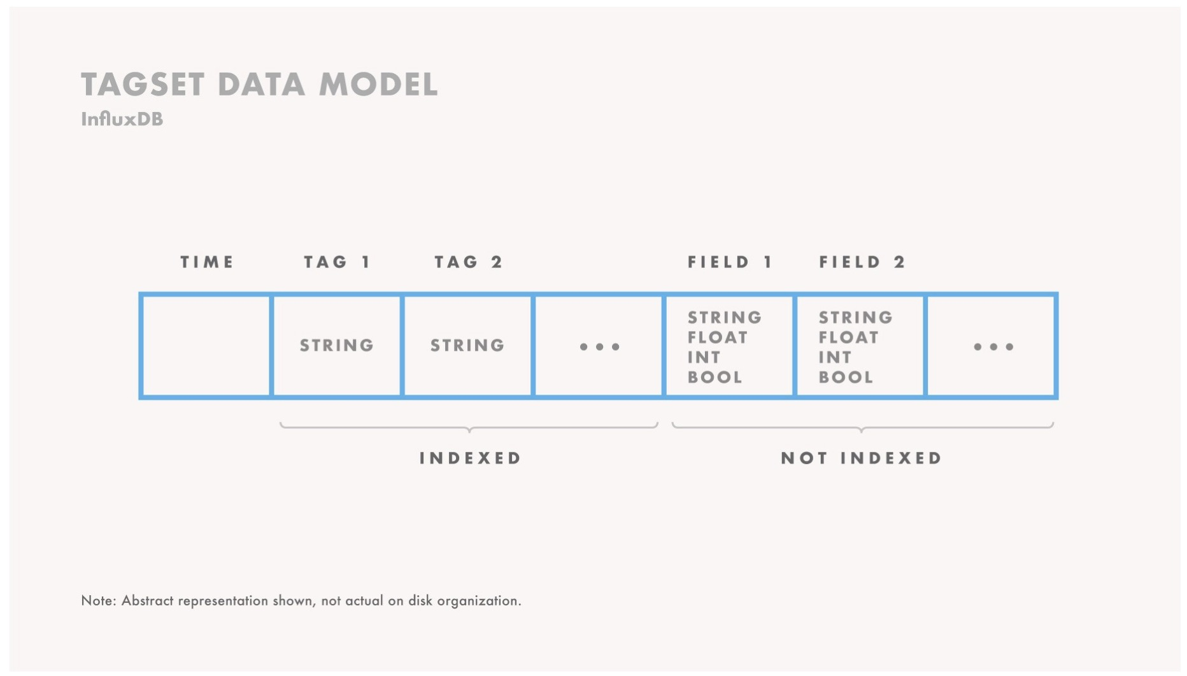
https://www.cs.ucy.ac.cy/courses/EPL421

Slide 9
Advantages of tagset data model
Very easy to get started
No need to create schemas or indexes
https://www.cs.ucy.ac.cy/courses/EPL421

Slide 10
Disadvantages of Tagset data model
Rigid and limited, with no option to create any additional indexes
The underlying schema is auto-generated based on the input data, which may differ from the desired schema
https://www.cs.ucy.ac.cy/courses/EPL421

Slide 11
What is a Time series database (TSDB)?
A software system that is optimized for storing and serving time series through associated pairs of time and values.
https://www.cs.ucy.ac.cy/courses/EPL421

Slide 12
Why time series DBs are exploding in popularity?
Enterprises want to be able to query, analyze and create reports based on streaming data in real-time, instead of batch mode.
Over past years, time series databases have exploded in popularity, according to database engines data
https://www.cs.ucy.ac.cy/courses/EPL421

Slide 13
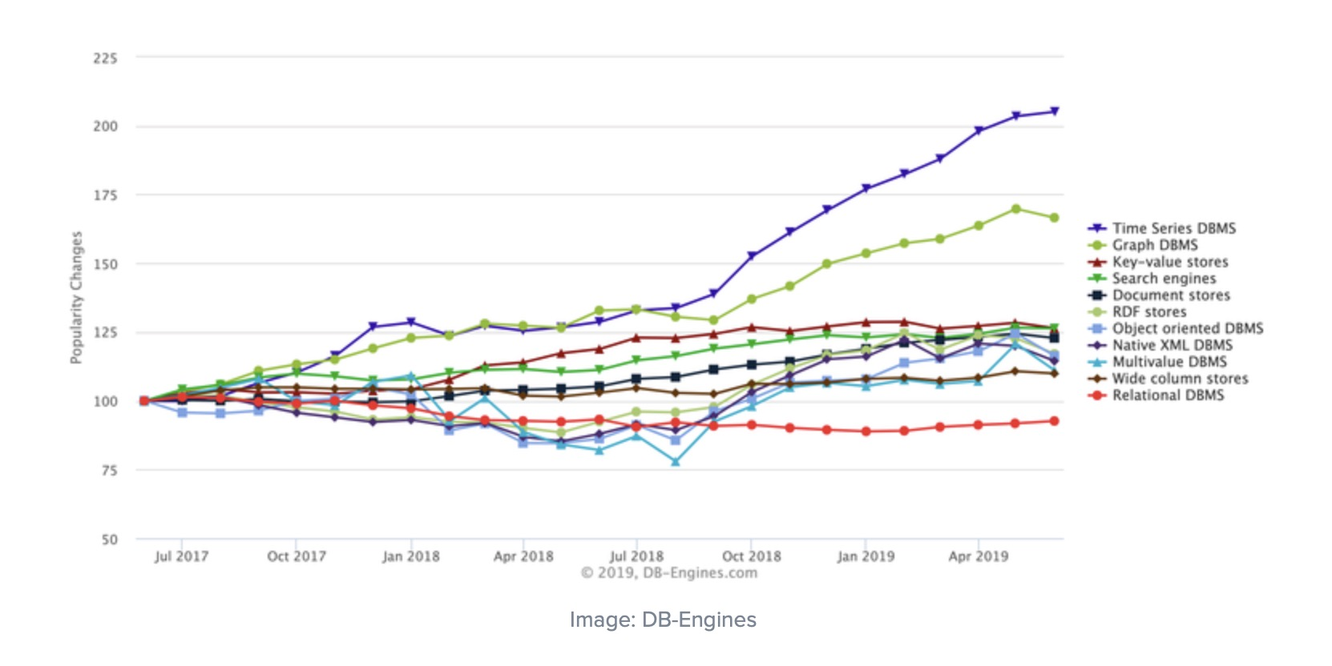
No database type has grown faster in popularity than time series DBs
https://www.cs.ucy.ac.cy/courses/EPL421

Slide 14
According to Timescale CEO Ajay Kulkarni …
Time-series datasets track changes to the overall system as INSERTS, not UPDATES.
What makes time-series data so powerful is the fact that they record each and every change to the system as a new different row.
Time-series databases introduce the ability to analyze how something changed in the past. In addition they can be monitored to see how something is changing in the present, or even to make predicting about how it may change in the future
https://www.cs.ucy.ac.cy/courses/EPL421

Slide 15
Choosing a time series DB
Check what they offer and if those fit your needs
Should be OpenSource
No data size limitations
Free to use DB
Fast and efficient
https://www.cs.ucy.ac.cy/courses/EPL421

Slide 16
Some of the available options
InfluxDB
Graphite
TimescaleDB
OpenTSDB
VictoriaMetrics
https://www.cs.ucy.ac.cy/courses/EPL421

Slide 17
InfluxDB
Date of birth: 2013
Ranked in the first place in the last 3 years (2017-2019)
Completely open-source time series database
Working on all current operating systems
Supports a very large set of programming languages
Optimized for heavy writing load
Works amazingly well with concurrency
Schema-Free database
https://www.cs.ucy.ac.cy/courses/EPL421

Slide 18
Why choose InfluxDB?
Super easy to install, configure and launch
As a NoSQL-like database, you don’t have to setup your database
InfluxData provides a visualization tool
Uses Flux, a new processing language, which is becoming a new tech trend, or an SQL-like language (it can also be used with HTTP requests)
Gives more power to the user but at the same time reduces the power of the database
Stores data in LSM trees, which are better suited for storing time series data comparing to general-purpose storage provided by Postgresql
Drawbacks: 1. No same-time insert 2. Poor performance for deletion with predicates
https://www.cs.ucy.ac.cy/courses/EPL421

Slide 19
Graphite
Very widely used time series database system
Powerful monitoring tool that stores numeric time series data
Can display the stored data on demand via its Graphite-web interface at a fair speed
Most of the time used as a system, network and application performance metric store
Big companies such as Booking.com, Reddit and GitHub use it on a daily basis to be able to easily detect outage on their architecture
https://www.cs.ucy.ac.cy/courses/EPL421

Slide 20
Why choose Graphite?
Built to deal with numeric data
Graphite Web is an interface for developers to monitor their application
Connects with a lot of tools natively
Makes it easy for developers to connect with their existing infrastructure
https://www.cs.ucy.ac.cy/courses/EPL421

Slide 21
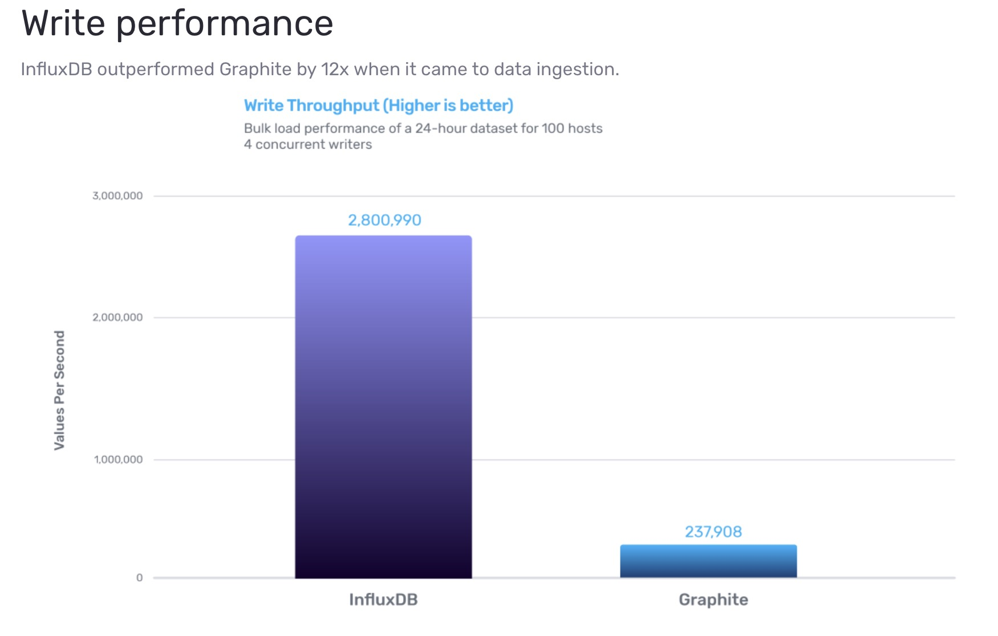
https://www.cs.ucy.ac.cy/courses/EPL421

Slide 22
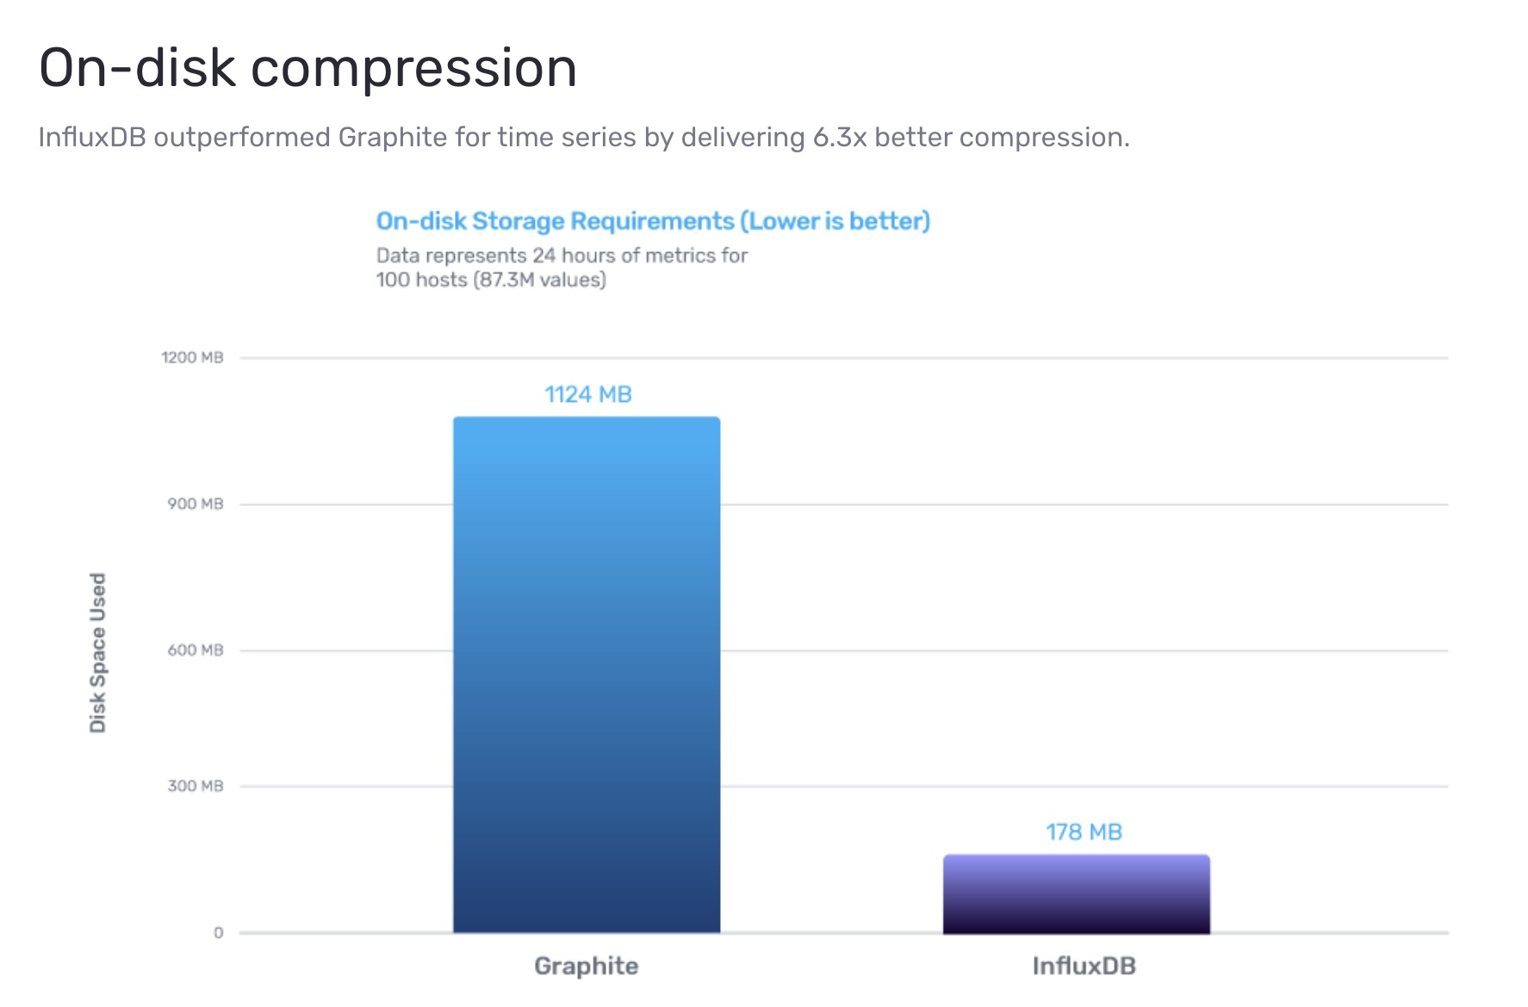
https://www.cs.ucy.ac.cy/courses/EPL421

Slide 23
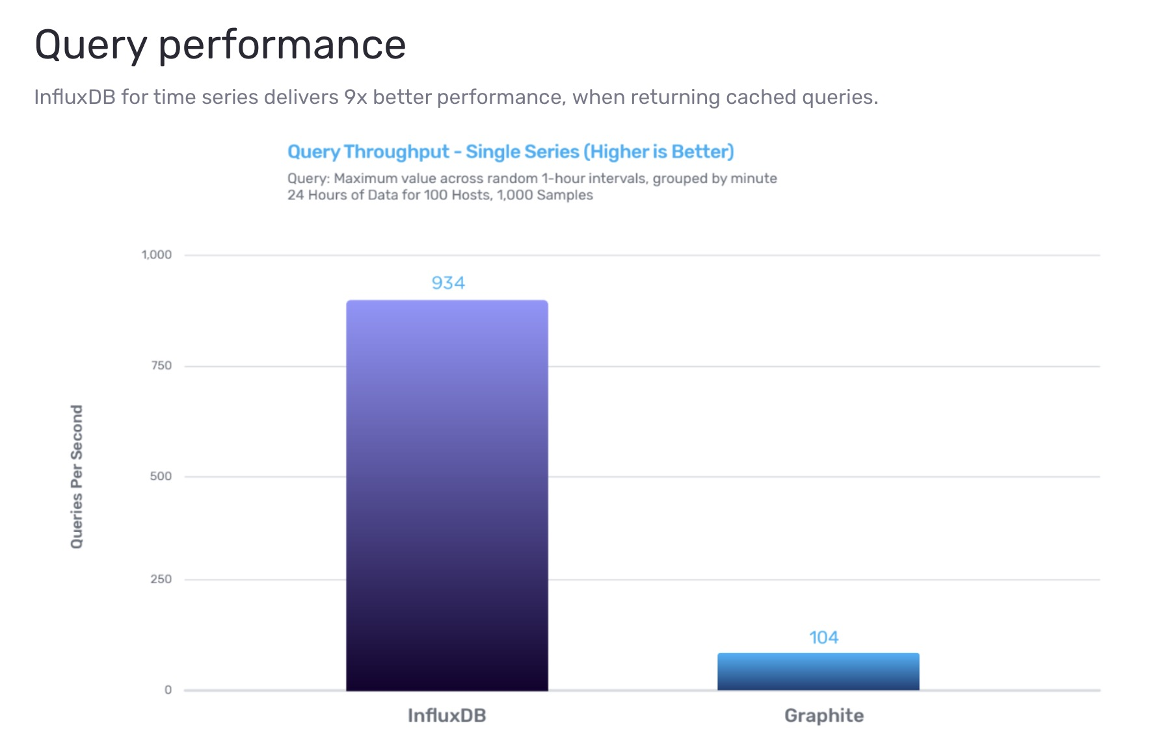
https://www.cs.ucy.ac.cy/courses/EPL421

Slide 24
TimescaleDB
Open-sourced
Based on SQL premises
Very large set of supported programming languages
Directly tied with PostgresSQL
Offers a unique set of time series related operations (like fast ingest)
https://www.cs.ucy.ac.cy/courses/EPL421

Slide 25
Why choose TimescaleDB?
Supports the SQL language natively
No need to learn a new language
Big companies rely on SQL-constraint systems in order to ensure system reliability and accessibility
Drawbacks: 1. Quickly reaches disk bandwidth limit, which can be lifted by using more expensive disks with higher read / write bandwidth such as high-end SSDs 2. Requires much more storage space comparing to VictoriaMetrics and InfluxDB for storing the same amount of data points
https://www.cs.ucy.ac.cy/courses/EPL421

Slide 26
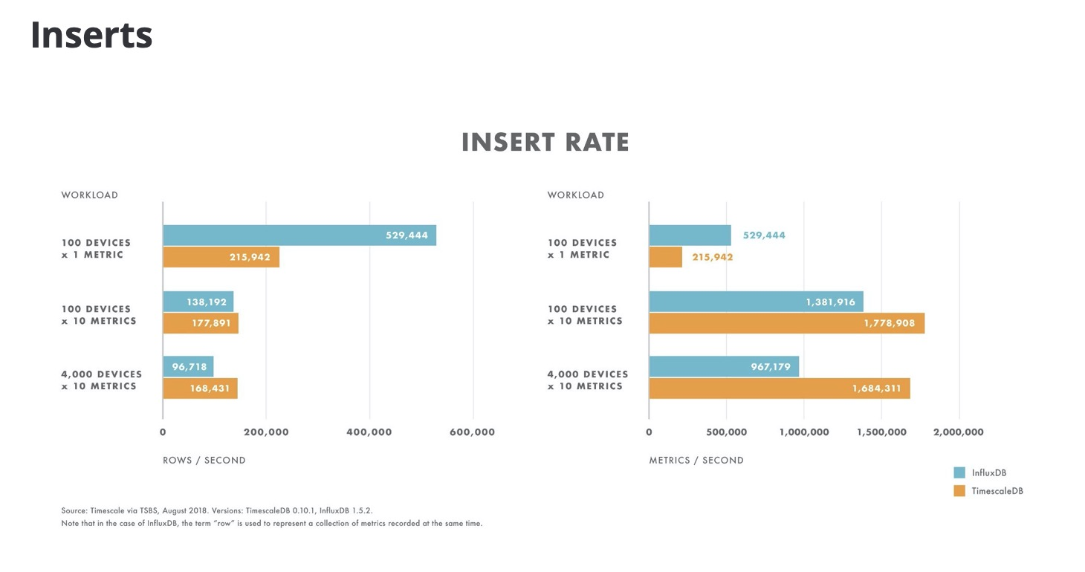
https://www.cs.ucy.ac.cy/courses/EPL646
https://www.cs.ucy.ac.cy/courses/EPL421

Slide 27
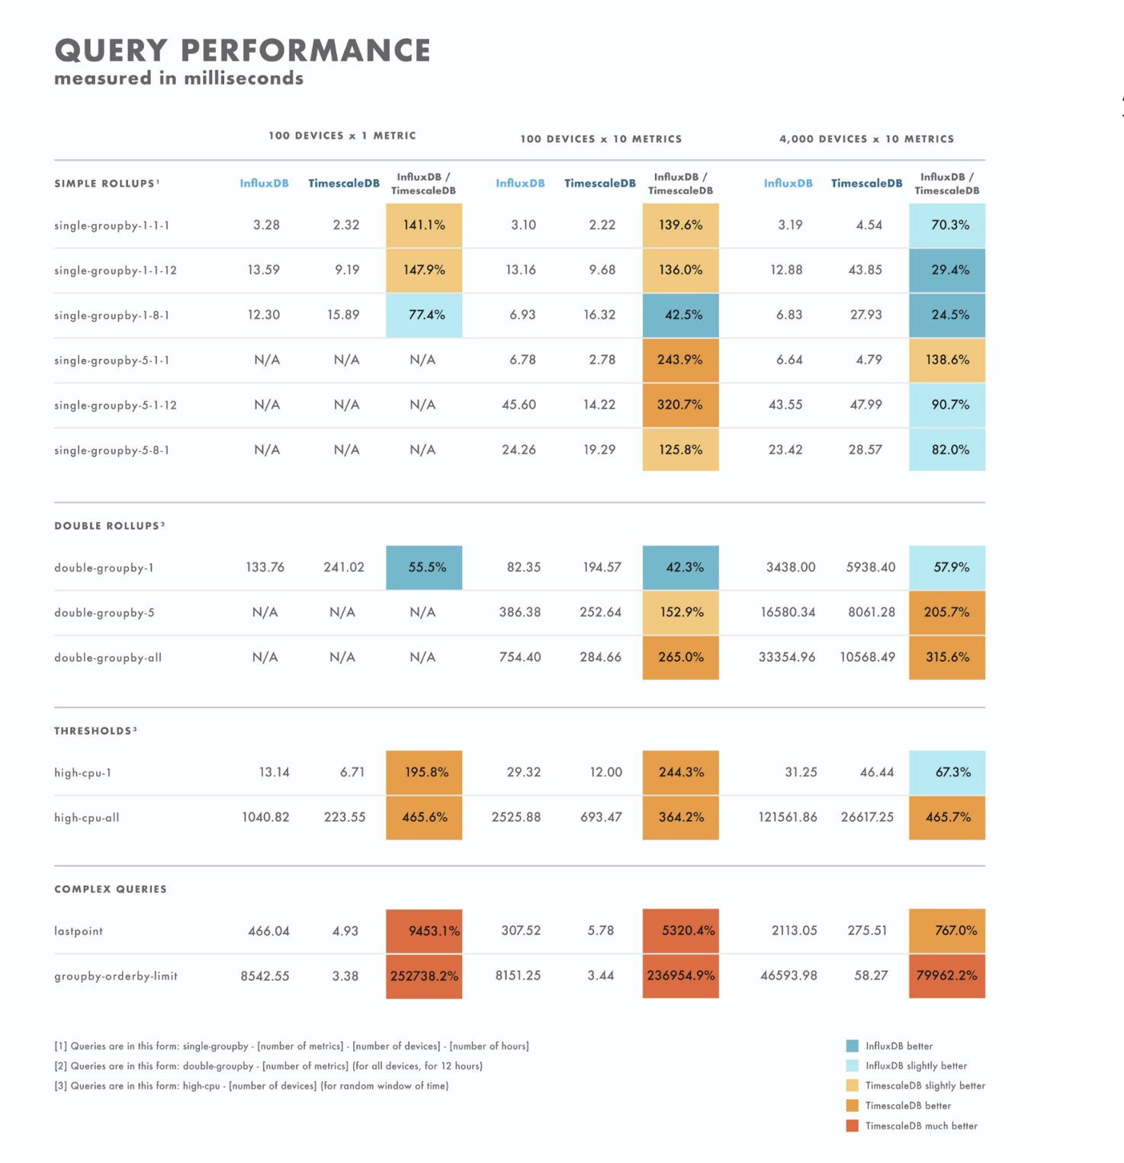
https://www.cs.ucy.ac.cy/courses/EPL421

Slide 28
OpenTSDB
Able to store hundreds of billions of data rows over distributed instances of TSD servers
Schema free database built on Apache HBase
HBase is a non-relational management system written to handle big tables storage in an elegant and efficient way
https://www.cs.ucy.ac.cy/courses/EPL421

Slide 29
Why choose OpenTSDB?
Can handle several millions writes per second
Better performance than InfluxDB, when dealing with more than one million writes per second.
OpenTSDB integrates with Cassandra, BigTable, CollectD, StatsD, Chef and even Puppet for deployment management
https://www.cs.ucy.ac.cy/courses/EPL421

Slide 30
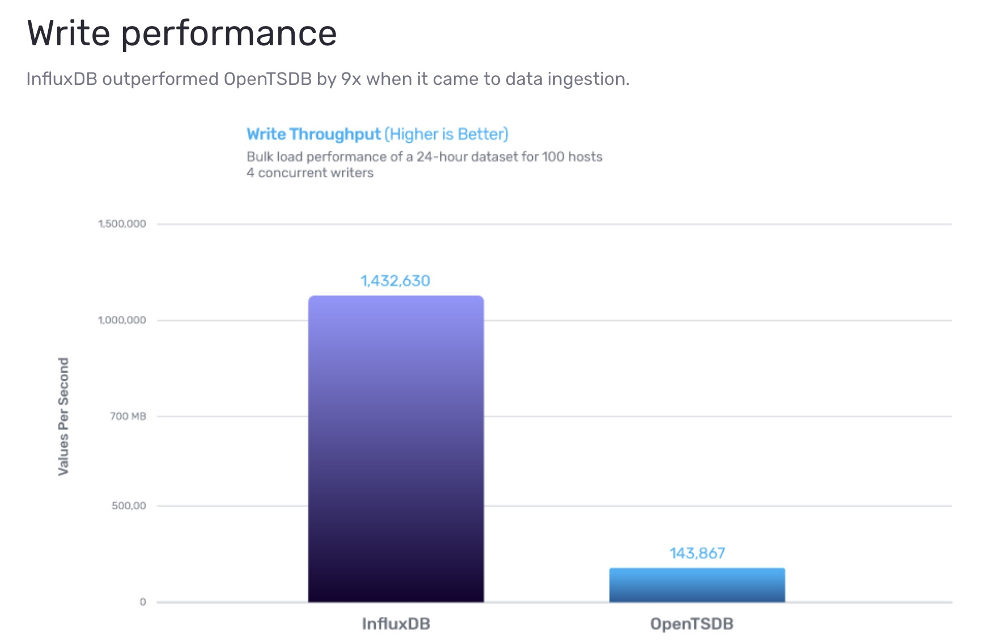
https://www.cs.ucy.ac.cy/courses/EPL421

Slide 31
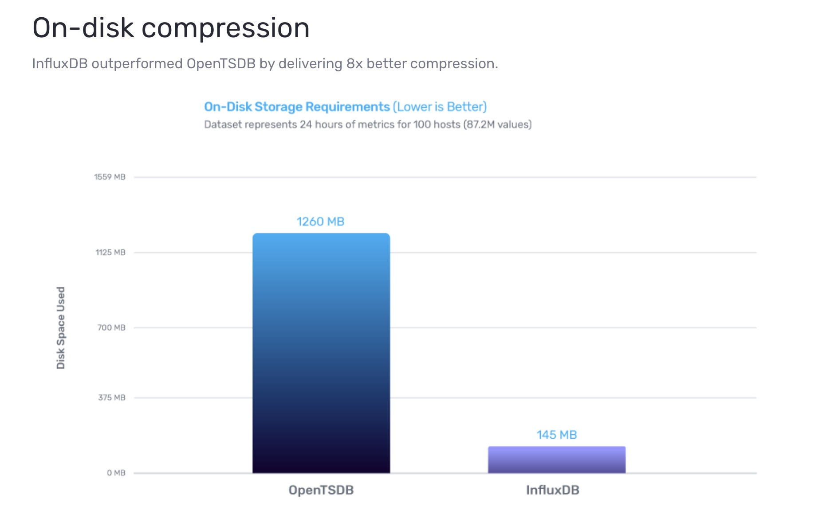
https://www.cs.ucy.ac.cy/courses/EPL421

Slide 32
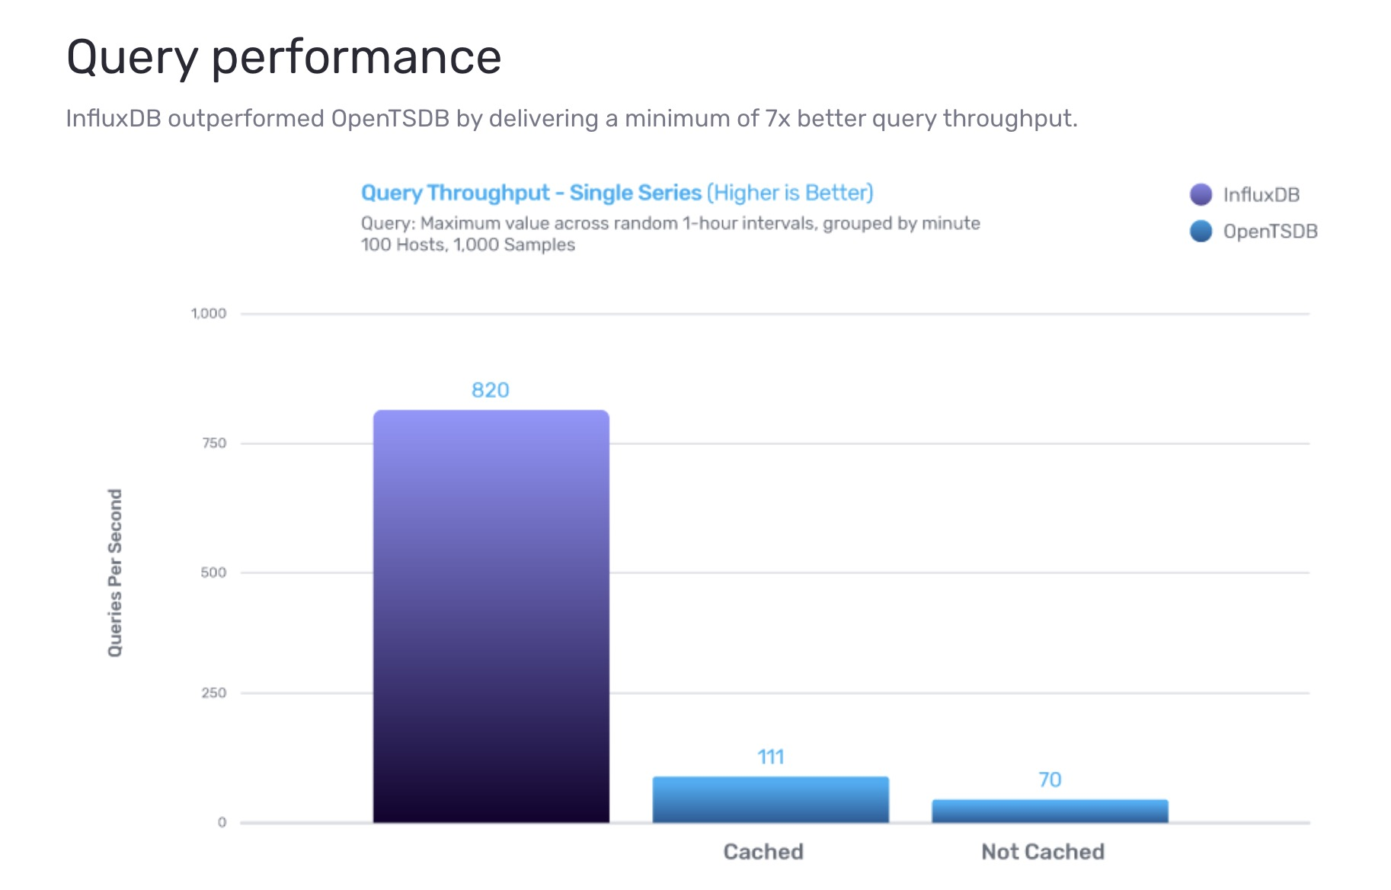
https://www.cs.ucy.ac.cy/courses/EPL421

Slide 33
VictoriaMetrics
Supports native PromQL (doesn’t support SQL)
Supports wide range of retention periods starting from 1 month
Compresses on-disk data better than competitors (according to their website), which means it can handle longer retentions without downsampling
Excels on heavy queries over thousands of metrics with millions of data points
Open Source under Apache2 license
https://www.cs.ucy.ac.cy/courses/EPL421

Slide 34
Why choose VictoriaMetrics?
Requires fewer hardware resources (RAM, CPU, storage) which allows for saving hardware costs
Outperforms InfluxDB and TimescaleDB on data ingestion
VictoriaMetrics has the best optimization for disk IO bandwidth usage, compared to InfluxDB and TimescaleDB.
VictoriaMetrics provides better vertical scalability for both data ingestion and querying, compared to InfluxDB and TimescaleDB
Stores data in LSM trees, which are better suited for storing time series data comparing to general-purpose storage provided by Postgresql
Drawbacks: It is a relatively new database, which was written from scratch and may contain unpolished code
https://www.cs.ucy.ac.cy/courses/EPL421

Slide 35
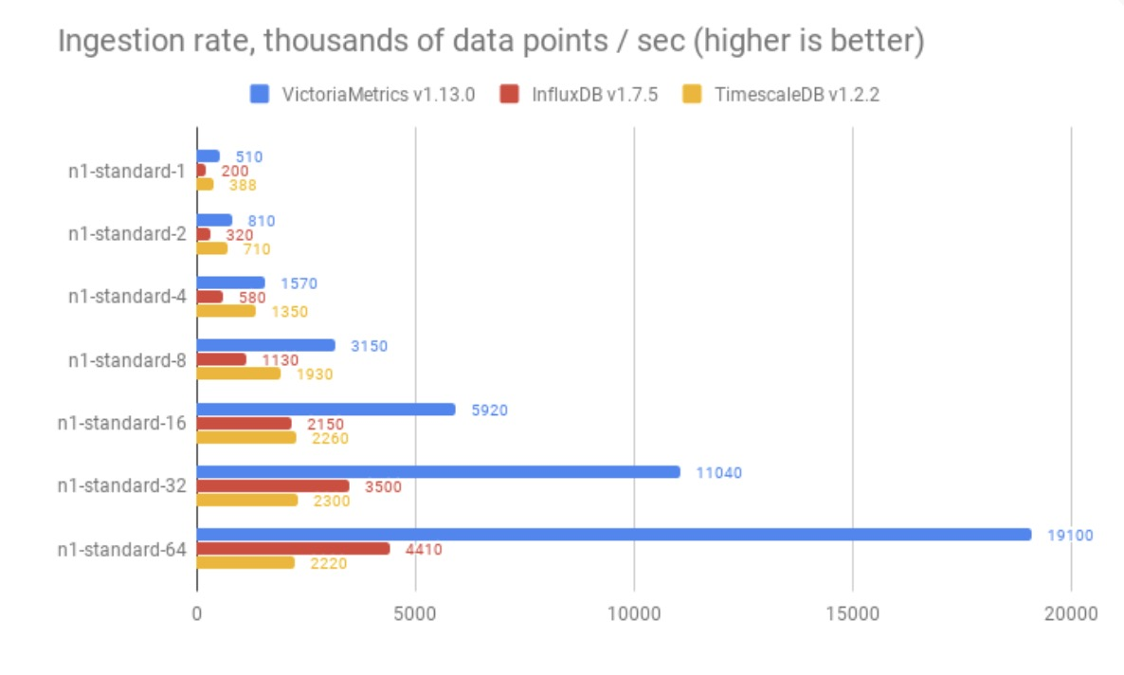
https://www.cs.ucy.ac.cy/courses/EPL421

Slide 36
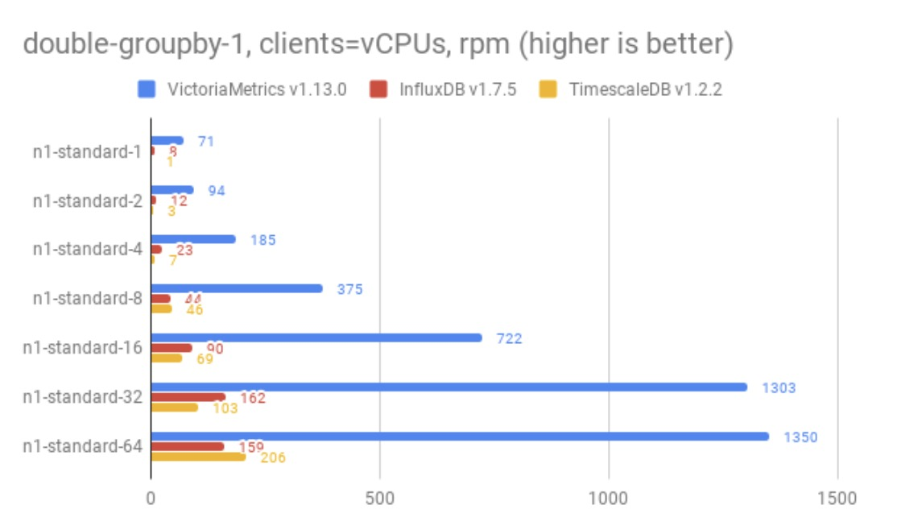
https://www.cs.ucy.ac.cy/courses/EPL421

Slide 37
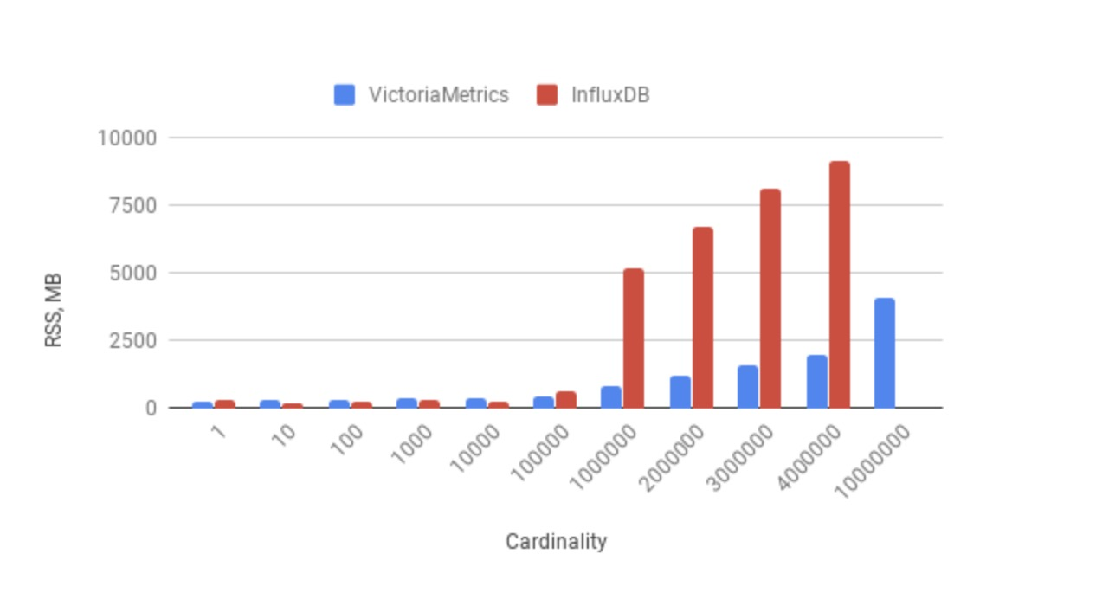
RAM usage for various cardinalities
https://www.cs.ucy.ac.cy/courses/EPL421

Slide 38
Our mission
Install and configure couchbase
Install and configure anyplace
Install and configure influxDB
Create API endpoints to connect anyplace with influxDB
https://www.cs.ucy.ac.cy/courses/EPL421

Slide 39
What is Anyplace?
A free and open Indoor Navigation Service with excellent accuracy
A first-of-a-kind indoor information service offering GPS-less localization, navigation and search inside buildings using ordinary smartphones
https://www.cs.ucy.ac.cy/courses/EPL421

Slide 40
Awards
2018 - Best Demo Award 19th IEEE International Conference on Mobile Data Management June 26 - June 28, 2018, Aalborg, Denmark.
2017 - Honorable Mention Award 18th IEEE International Conference on Mobile Data Management May 29 - June 1, 2017, KAIST, Daejeon, South Korea.
2014 - 1st place at Evaluation of RF-based Indoor Localization Solutions for the Future Internet (EVARILOS Open Challenge), European Union, Berlin, Germany
2014 - 2nd place at Microsoft Research Indoor Localization Competition at IEEE/ACM IPSN 2014, Berlin, Germany.
2012 - Best Demo Award at IEEE Mobile Data Management Conference, Bangalore, India.
https://www.cs.ucy.ac.cy/courses/EPL421

Slide 41
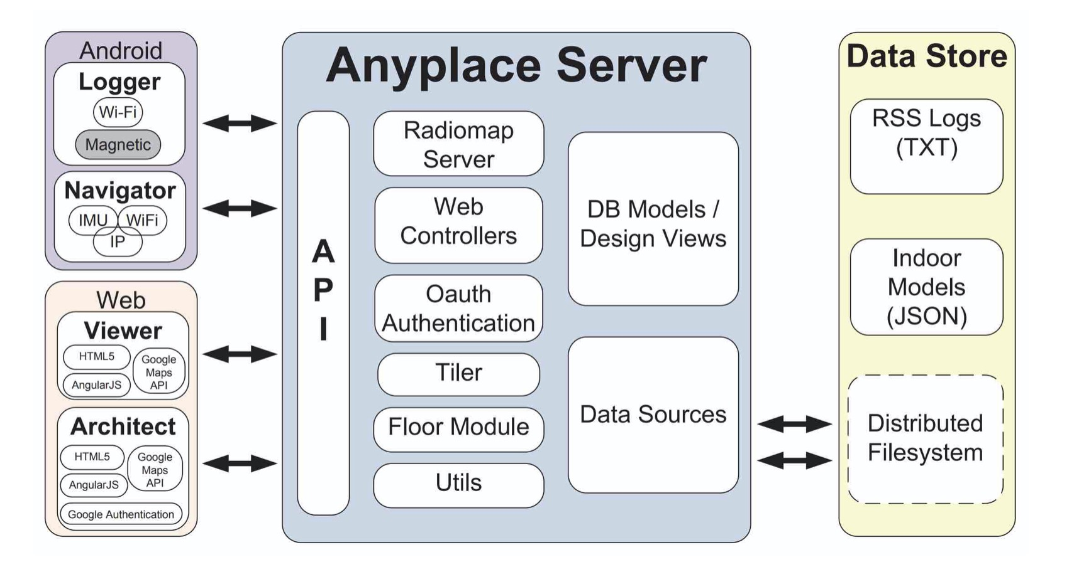
Anyplace architecture
https://www.cs.ucy.ac.cy/courses/EPL421

Slide 42
Anyplace architecture
https://www.cs.ucy.ac.cy/courses/EPL421

Slide 43
Scala
Object-oriented and functional programming high-level language
Scala's static types help avoid bugs in complex applications
Its JVM and JavaScript runtimes gives the ability to users to build high-performance systems and gives access to huge ecosystems of libraries
https://www.cs.ucy.ac.cy/courses/EPL421

Slide 44
Play framework
Lightweight, stateless, web-friendly architecture
Uses Akka and Akka Streams under the covers to provide predictable and minimal resource consumption (CPU, memory, threads)
Akka and Akka Streams abstract away from the imperative nature of how the data is inputted into the application giving us a declarative way of describing, handling it and hiding details that we don’t care about. Streaming helps you ingest, process, analyze, and store data in a quick and responsive manner.
https://www.cs.ucy.ac.cy/courses/EPL421

Slide 45
What is couchbase?
An open-source, distributed multi-model NoSQL document-oriented database software package that is optimized for interactive applications.
Designed to provide easy-to-scale key-value or JSON document access with low latency and high sustained throughput.
Designed to be clustered from a single machine to very large-scale deployments using many machines.
https://www.cs.ucy.ac.cy/courses/EPL421

Slide 46
Installation & configuration of Couchbase
Install Couchbase:
curl -O https://packages.couchbase.com/releases/couchbase-release/couchbase-release-1.0-6-amd64.deb
sudo dpkg -i ./couchbase-release-1.0-6-amd64.deb
sudo apt-get update
sudo apt-get install couchbase-server-community
Please note that you have to update your firewall configuration to allow connections to the following ports: 4369, 8091 to 8094, 9100 to 9105, 9998, 9999, 11209 to 11211, 11214, 11215, 18091 to 18093, and from 21100 to 21299.
https://www.cs.ucy.ac.cy/courses/EPL421

Slide 47
Installation & configuration of Couchbase
Start couchbase:
sudo service couchbase-server start
Stop couchbase:
sudo service couchbase-server stop
Check status:
sudo service couchbase-server status
https://www.cs.ucy.ac.cy/courses/EPL421

Slide 48
Installation & configuration of Couchbase
Configuration: Visit the below address to configure Couchbase
http://localhost:8091/
*Make sure that port 8091 is open
https://www.cs.ucy.ac.cy/courses/EPL421

Slide 49
Installation & configuration of anyplace
Install:
wget https://anyplace.cs.ucy.ac.cy/downloads/anyplace_v3.zip
unzip anyplace_v3.zip
https://www.cs.ucy.ac.cy/courses/EPL421

Slide 50
Installation & configuration of anyplace
Configuration: Edit configuration file under anyplace folder
vim conf/application.conf
Edit the following fields accordingly: (all must be in double quotes except port numbers)
application.secret=< This is a Play Framework parameter >
couchbase.hostname=< Default is "http://localhost">
couchbase.port=< Default is 8091>
couchbase.bucket=< Name of couchbase bucket, must be the same with username >
couchbase.username=< Username for couchbase database >
couchbase.password=< Password for couchbase database >
influxdb.hostname=< Default is "http://localhost">
influxdb.port=< Default is 8086 >
influxdb.database=< Name of influxDB database >
https://www.cs.ucy.ac.cy/courses/EPL421

Slide 51
Installation & configuration of anyplace
Create couchbase views:
git clone https://github.com/dmsl/anyplace.git
cd anyplace/server/anyplace_views
chmod +x create-views.sh
vim create-views.sh
Add (USERNAME, PASSWORD and BUCKET) according to your couchbase account, save and close the script
Run the script to create the views: ./create-views.sh
https://www.cs.ucy.ac.cy/courses/EPL421

Slide 52
Installation & configuration of anyplace
To launch anyplace:
cd anyplace_v3/bin
chmod +x anyplace_v3
./anyplace_v3 (alternatively use: $ nohup ./anyplace_v3 > anyplace.log 2>&1 )
To stop anyplace: Press Ctrl-C or kill the respective process
https://www.cs.ucy.ac.cy/courses/EPL421

Slide 53
Installation & configuration of anyplace
To test anyplace visit the following URLs:
http://localhost:9000/viewer
http://localhost:9000/architect
http://localhost:9000/developers
https://www.cs.ucy.ac.cy/courses/EPL421

Slide 54
Installation & configuration of anyplace
Install a free certificate from https://letsencrypt.org/ on your Anyplace Server to obtain a secure https connection.
(Optional) Install a free load balancer from HAProxy to scale your installation to multiple Anplace servers. In case of Anyplace cluster configuration, please install the certificate on the load balancer.
https://www.cs.ucy.ac.cy/courses/EPL421

Slide 55
Installation & configuration of influxDB
Download influxDB on ubuntu:
wget -qO- https://repos.influxdata.com/influxdb.key | sudo apt-key add -
source /etc/lsb-release
echo "deb https://repos.influxdata.com/${DISTRIB_ID,,} ${DISTRIB_CODENAME} stable" | sudo tee /etc/apt/sources.list.d/influxdb.list
Install influxDB:
sudo apt-get update && sudo apt-get install influxdb
https://www.cs.ucy.ac.cy/courses/EPL421

Slide 56
Installation & configuration of influxDB
Start influxDB: sudo service influxdb start
Stop influxDB: sudo service influxdb stop
Check status of influxDB: sudo service influxdb status
https://www.cs.ucy.ac.cy/courses/EPL421

Slide 57
Installation & configuration of influxDB
Configure influxDB: vim /etc/influxdb/influxdb.conf
To view the default configuration settings: influxd config
To use your own configuration file execute influxDB with: influxd -config /etc/influxdb/influxdb.conf
TCP port 8086 is available for client-server communication using the InfluxDB API TCP port 8088 is available for the RPC service to perform back up and restore operations Both ports should be open to use influxDB
https://www.cs.ucy.ac.cy/courses/EPL421

Slide 58
API route mapping
# Anyplace API - InfluxDB
POST /anyplace/influxdb/insert controllers.AnyplaceInfluxdb.insertInfluxdb()
POST /anyplace/influxdb/query_2_points controllers.AnyplaceInfluxdb.query2PointsInfluxdb()
* located in anyplace/server/conf/routes
https://www.cs.ucy.ac.cy/courses/EPL421

Slide 59
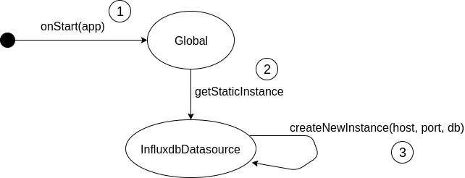
How it works?
https://www.cs.ucy.ac.cy/courses/EPL421

Slide 60
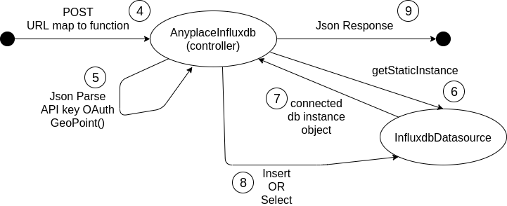
How it works?
https://www.cs.ucy.ac.cy/courses/EPL421

Slide 61
GeoHash
Spatial Hashing
Latitude | Longitude | Precision | Geohash
10 | 30 | 8 | s9v2fsmq
10 | 30 | 6 | s9v2fs
31 | 30 | 8 | stt26em
31.05 | 30.101 | 8 | stt2suqz
31.051 | 30.101 | 8 | stt2suwv
https://www.cs.ucy.ac.cy/courses/EPL421

Slide 62
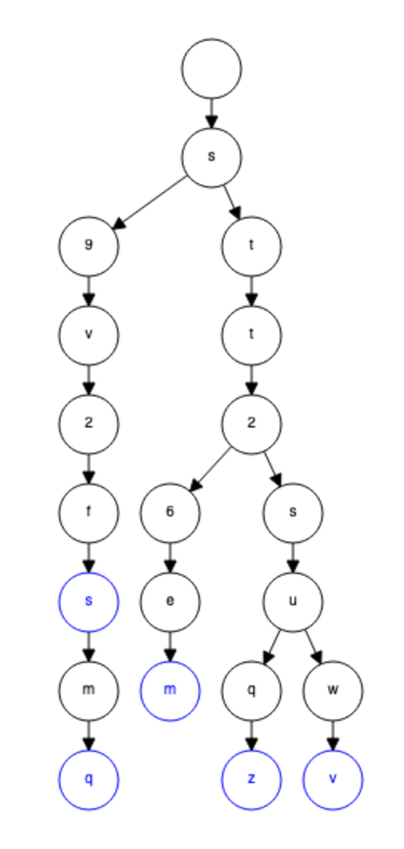
Geohash Lookups
https://www.cs.ucy.ac.cy/courses/EPL421

Slide 63
In practice
curl --header "Content-Type: application/json" \
--request POST \
--data '{"deviceID":"5","point1":{"latitude":"37.350101","longitude":"37.3501"},"point2":{"latitude":"37.35012","longitude":"37.3502"}, "beginTime":1, "endTime":10}' \
http://10.16.30.47:9000/anyplace/influxdb/query_2_points
{
"5":[
{
"deviceID":"5","point":{ "latitude":"37.350101","longitude":"37.3501"},
"timestamp":1,"ifxtime":"2019-11-23T20:43:31.81891762Z"
},
{
"deviceID":"5","point":{ "latitude":"37.350102","longitude":"37.3502"},
"timestamp":2,"ifxtime":"2019-11-23T20:43:32.056097637Z"
},
{
“deviceID":"5","point":{“latitude":"37.35011", "longitude":"37.3501"},
“timestamp":10, "ifxtime":"2019-11-23T20:43:32.287098102Z"
}
]
}
* We use strings as we have encountered issues with queries due to floating point representation issues
0.13 != “0.13”.asFloat()
https://www.cs.ucy.ac.cy/courses/EPL421

Slide 64
In practice
curl --header "Content-Type: application/json" \
--request POST \
--data '{"deviceID":"5","point":{"latitude":"37.350101","longitude":"37.3501"},"distance":"16", "beginTime":1, "endTime":20}' \
http://10.16.30.47:9000/anyplace/influxdb/query_1_point_distance
{
"5":[
{ “deviceID":"5", "point":{ "latitude":"37.350101","longitude":"37.3501"},
"timestamp":1,"ifxtime":"2019-11-23T20:43:31.81891762Z"},
{ "deviceID":"5","point":{ "latitude":"37.350102","longitude":"37.3502"},
"timestamp":2,"ifxtime":"2019-11-23T20:43:32.056097637Z"},
{ “deviceID":"5", "point":{ "latitude":"37.35011", “longitude":"37.3501" },
“timestamp":10, "ifxtime":"2019-11-23T20:43:32.287098102Z"}
]
}
* We use strings as we have encountered issues with queries due to floating point representation issues
0.13 != “0.13”.asFloat()
https://www.cs.ucy.ac.cy/courses/EPL421

Slide 65
In practice
curl --header "Content-Type: application/json" \
--request POST \
--data '{"deviceID":"myDevice", "point":{"latitude":"22","longitude":"17"}, "timestamp":900000333}' \
http://10.16.30.47:9000/anyplace/influxdb/insert
$ influx -database anyplace
Connected to http://localhost:8086 version 1.7.8
InfluxDB shell version: 1.7.8
> select * from location where deviceID =~ /myDevice/
name: location
time deviceID geohash latitude longitude timestamp
---- -------- ------- -------- --------- ---------
1575021195168509151 myDevice s7uj4ugp 22 17 900000320
* We use strings as we have encountered issues with queries due to floating point representation issues
0.13 != “0.13”.asFloat()
https://www.cs.ucy.ac.cy/courses/EPL421

Slide 66
Security issue
Use API key of user concatenated with a name for the device, which will be stored in couchbase along with the deviceID
The deviceID will be unique and will be created automatically within the anyplace system
https://www.cs.ucy.ac.cy/courses/EPL421

Slide 67
Future work
A graphical representation of the data could be created to indicate the path followed by a device, over a specific time period
A custom retention policy could be used for influxDB so that the old data will be dropped after passing a specified threshold/limit
https://www.cs.ucy.ac.cy/courses/EPL421

Slide 68
InfluxDB tutorial (1)
Open Command Line Interface (CLI): influx -precision rfc3339
Create a database: CREATE DATABASE mydb
Display all existing databases: SHOW DATABASES
Set the database for all future requests: USE mydb
Drop database: DROP DATABASE mydb
The -precision argument specifies the format/precision of any returned timestamps. In the example above, rfc3339 tells InfluxDB to return timestamps in RFC3339 format (YYYY-MM-DDTHH:MM:SS.nnnnnnnnnZ)
https://www.cs.ucy.ac.cy/courses/EPL421

Slide 69
InfluxDB tutorial (2)
Insert data into the database: INSERT <measurement>,<tag>=<value-string>[,<tag>=<value-string>…]<space><field>=<value>[,<field>=<value>…] Examples: INSERT epl421,student=Donald grade=9 INSERT epl421,student=Tom grade=8 INSERT epl421,student=Jerry grade=10
Select the data we just wrote: SELECT <tag>[,<tag>…], <field>[,<field>…] FROM <measurement> Examples: SELECT "student", "grade" FROM "epl421" SELECT * FROM “epl421" LIMIT 2
https://www.cs.ucy.ac.cy/courses/EPL421

Slide 70
InfluxDB tutorial (3)
We could use a curl command in a bash script to insert data into influxDB. The inserts could be written in a file (up to 5000 inserts), where each line should have the following structure: <measurement>,<tag>=<value-string>[,<tag>=<value-string>…]<space><field>=<value>[,<field>=<value>…]
https://www.cs.ucy.ac.cy/courses/EPL421

Slide 71
InfluxDB tutorial (4)
The below bash script was used to insert data into influxDB (0.5 billion inserts). In this case the curl command is used to insert 500 lines of data from the insertTmp.txt file into the database ‘mydb’.
#!/bin/bash
influx -execute 'CREATE DATABASE anyplace'
for j in `seq 1 1000000`
do
x=$RANDOM
y=$RANDOM
timestamp=$j
geohash="$(./geohash $x $y 8)"
for i in `seq 1 500`
do
echo "location,deviceID=$i timestamp=$timestamp,x=$x,y=$y"
done > insertTmp.txt
curl -i -XPOST 'http://localhost:8086/write?db=mydb' --data-binary @insertTmp.txt &> /dev/null
echo "Done loop $j"
done
https://www.cs.ucy.ac.cy/courses/EPL421

Slide 72
InfluxDB tutorial (5)
When a record is inserted into influxDB it takes as time the current time in nano seconds. However, this time can be specified by the user.
INSERT <measurement>,<tag>=<value>[,<tag>=<value>…] <field>=<value>[,<field>=<value>…] <time-in-nanoseconds>
https://www.cs.ucy.ac.cy/courses/EPL421

Slide 73
InfluxDB tutorial (6)
More advanced select query: SELECT * FROM "epl421" WHERE "grade" > 9 SELECT * FROM "epl421" WHERE (“grade" < 9 and "grade" > 6) Select query with curl command using GET: curl -G 'http://localhost:8086/query?pretty=true' --data-urlencode "db=mydb" --data-urlencode "q=SELECT \"user\" FROM \"epl421\" WHERE \”grade\"='10'" Appending ‘pretty=true’ to the URL enables pretty-printed JSON output. While this is useful for debugging or when querying directly with tools like curl, it is not recommended for production use as it consumes unnecessary network bandwidth.
https://www.cs.ucy.ac.cy/courses/EPL421

Slide 74
InfluxDB tutorial (7)
This script was used to find the records for a device based on deviceID and two points (x1, y1) and (x2, y2)
#!/bin/bash
if [ ! $# -eq 5 ]; then
echo "Error! The number of arguments is not correct"
echo "usage: deviceID lat1 lat2 long1 long2"
exit 1
fi
q1="select * from location where (\”deviceID\" = '$2') and ((x+180>=$5+180) and (x+180 <$6+180) and (y+90>=$3+90) and (y+90<=$4+90))"
q2="select * from location where (\"deviceID\" = '$5') and ((x+180<=$5+180) or (x+180 >$6+180) and (y+90>=$3+90) and (y+90<=$4+90))"
if [[ $1 -gt $2 ]]; then q="$q2"; else q="$q1"; fi
curl -G 'http://localhost:8086/query?pretty=true' --data-urlencode "db=anyplace" --data-urlencode "q=$q"
https://www.cs.ucy.ac.cy/courses/EPL421

Slide 75
InfluxDB tutorial (8)
Drop series: The DROP SERIES query deletes all points from a series in a database, and it drops the series from the index. DROP SERIES FROM <measurement_name[,measurement_name]> WHERE <tag_key>=‘<tag_value>’
Example: DROP SERIES FROM "epl421" WHERE "user" = 'Tom'
*A successful DROP SERIES query returns an empty result.
https://www.cs.ucy.ac.cy/courses/EPL421

Slide 76
InfluxDB tutorial (9)
Delete series: The DELETE query deletes all points from a series in a database. Unlike DROP SERIES, it does not drop the series from the index and it supports time intervals in the WHERE clause. DELETE FROM <measurement_name> WHERE [<tag_key>='<tag_value>'] | [<time interval>]
Example: DELETE FROM "epl421" WHERE "user" = 'Flash'
*A successful DELETE query returns an empty result.
https://www.cs.ucy.ac.cy/courses/EPL421

Slide 77
InfluxDB tutorial (10)
Drop measurement: The DROP MEASUREMENT query deletes all data and series from the specified measurement and deletes the measurement from the index.
DROP MEASUREMENT <measurement_name>
Example: DROP MEASUREMENT “epl421"
*A successful DROP MEASUREMENT query returns an empty result.
https://www.cs.ucy.ac.cy/courses/EPL421

Slide 78
InfluxDB tutorial (11)
Create retention policy: CREATE RETENTION POLICY <retention_policy_name> ON <database_name> DURATION <duration> REPLICATION <n> [SHARD DURATION <duration>] [DEFAULT] Example: CREATE RETENTION POLICY "one_day_only" ON "mydb" DURATION 1d REPLICATION 1 The DURATION clause determines how long InfluxDB keeps the data. The <duration> is a duration literal or INF (infinite). The minimum duration for a retention policy is one hour and the maximum duration is INF. The REPLICATION clause determines how many independent copies of each point are stored in the cluster. Modify retention policy: ALTER RETENTION POLICY <retention_policy_name> ON <database_name> DURATION <duration> REPLICATION <n> SHARD DURATION <duration> DEFAULT By default, the replication factor n usually equals the number of data nodes. However, if you have four or more data nodes, the default replication factor n is 3.
https://www.cs.ucy.ac.cy/courses/EPL421

Slide 79
References
https://medium.com/schkn/4-best-time-series-databases-to-watch-in-2019-ef1e89a72377
https://medium.com/schkn/sql-is-dead-hail-to-flux-8e8498756049
https://victoriametrics.com
https://medium.com/@valyala/insert-benchmarks-with-inch-influxdb-vs-victoriametrics-e31a41ae2893
https://blog.usejournal.com/open-sourcing-victoriametrics-f31e34485c2b
https://medium.com/@valyala/measuring-vertical-scalability-for-time-series-databases-in-google-cloud-92550d78d8ae
https://github.com/influxdata/influxdb/tree/1.8
https://www.irondb.io/2018/08/tsdbs-at-scale-part-one/
https://www.cs.ucy.ac.cy/courses/EPL421

Slide 80
References
https://www.influxdata.com/?source=post_page-----ef1e89a72377----------------------
https://blog.timescale.com/blog/sql-vs-flux-influxdb-query-language-time-series-database-290977a01a8a/
https://blog.timescale.com/blog/sql-vs-flux-influxdb-query-language-time-series-database-290977a01a8a/
https://medium.com/schkn/sql-is-dead-hail-to-flux-8e8498756049
https://www.influxdata.com/blog/influxdb-outperforms-graphite-in-time-series-data-metrics-benchmark/
https://medium.com/@valyala/high-cardinality-tsdb-benchmarks-victoriametrics-vs-timescaledb-vs-influxdb-13e6ee64dd6b
https://www.slant.co/versus/6000/33519/~influxdb_vs_victoriametrics
https://www.techrepublic.com/article/why-time-series-databases-are-exploding-in-popularity/
https://www.cs.ucy.ac.cy/courses/EPL421

Slide 81
References (implementation)
https://docs.influxdata.com/influxdb/v1.7/introduction/installation/
https://anyplace.cs.ucy.ac.cy
https://github.com/dmsl/anyplace/tree/master/server
https://github.com/Solliet/anyplace
https://www.couchbase.com/downloads
https://en.wikipedia.org/wiki/Geohash
https://github.com/Solliet/geohash_sisiphus
https://www.cs.ucy.ac.cy/courses/EPL421

Slide 82
Thank you for your attention!
Any questions?
https://www.cs.ucy.ac.cy/courses/EPL421

