Slide 1

KOTLIN
some OAUTH Implementation
Chrisdan Charalambous
Christos Fesas
Stefanos Theodosiou
CS UCY

Slide 2
KOTLIN : Basic Information
Cross-platform , statically typed, general-purpose programming language.
Interopate fully with Java & complains with JVM.
Mainly targets JVM , but compiles to Javascript .
Inspired by : ​
Java​
C#​
JavaScript​
Scala​
Groovy

Slide 3
KOTLIN : Basic Information
Developed by : JetBrains (Roman Elizarov is the current lead language designer).
Developed under Apache license 2.0 , as an open source language.
Object - oriented & Functional constructs.
Easy to learn language
.kt , .kts , .ktm (extensions)

Slide 4
KOTLIN : Usage
General-purpose programming language
Server-side & Client-side development.
Desktop programs development.
Mobile apps development . ( cross-platform development)

Slide 5
KOTLIN : Timeline
July 2011: JetBrains exposes project Kotlin with its lead developer being Dmitry Jemerov.
February 2012: Kotlin becomes an open source project.
February 2016: Kotlin official release v1.0.
2017 : Google announced first-class support for Kotlin on Android.
November 2017: Kotlin v1.2 sharing code between JVM and JavaScript.

Slide 6
KOTLIN : Timeline
October 2018: Kotlin v1.3 supporting asynchronous programming.
May 2019: Google announces Kotlin as the preferred language for Android apps.
August 2020: Kotlin v1.4 slight changes for the support of Apple platforms.
March 2021: Kotlin v1.5 latest release .

Slide 7
KOTLIN vs Java
Kotlin Application Deployment is faster, lightweight & prevents applications from increasing size.
Kotlin is less verbose and more concise.
Kotlin is more type-safe, and has the feature of smart cast.
Kotlin has a higher-order functions .

Slide 8
Programming : Design
Designed to be an industrial-strength object-oriented language.
According to Kotlin developers, you can call JavaScript code from Kotlin
Generate libraries that can be consumed as modules.
JVM version of Kotlin standard library depends on Java Class Library.

Slide 9
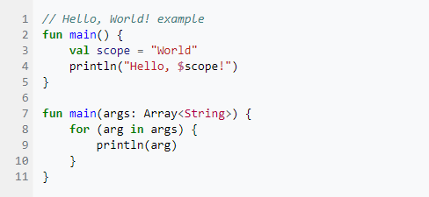
Programming : Syntax
Like in C, C++, C#, Java, and Go, the entry point to a Kotlin program is a function named "main", which may be passed an array containing any command-line arguments.

Slide 10
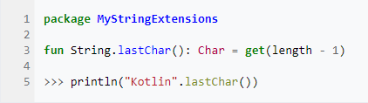
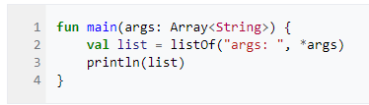
Extended Functions:
Kotlin adds the concept of an extension function which allows a function to be "glued" onto the public function list of any class without being formally placed inside of the class.
Unpacking arguments
Similar to Python, the spread operator asterisk (*) unpacks an array's contents as comma-separated arguments to a function:

Slide 11
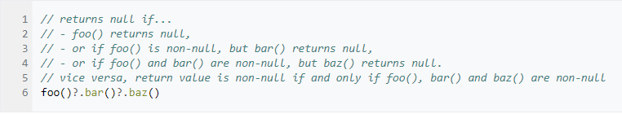
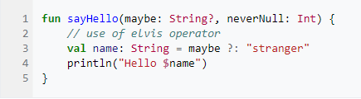
Null Safety
Kotlin makes a distinction between nullable and non-nullable data types.
All nullable objects must be declared with a "?" postfix after the type name.
Operations on nullable objects need special care from developers.
Kotlin provides null-safe operators to help developers: - “?.” (safe navigation operator) - “?:” (null coalescing operator) often referred to as the Elvis operator.

Slide 12
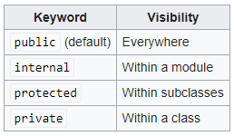
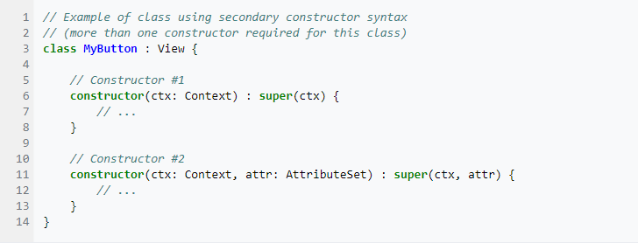
Small syntax properties of KOTLIN
Classes are final by default
Abstract classes are open by default (overridable)
Classes are public by default
Primary and secondary constructors

Slide 13
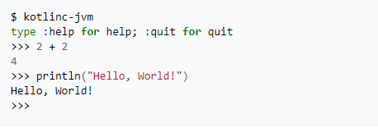

Features of KOTLIN
Kotlin interactive shell
Kotlin as a scripting language

Slide 14
Modern Applications of KOTLIN:
When Kotlin was announced as an official Android development language it became the third language fully supported for Android, in addition to Java and C++.
As of 2020, Kotlin is still most widely used on Android, with Google estimating that 70% of the top 1000 apps on the Play Store are written in Kotlin. Google itself has 60 apps written in Kotlin, including Maps and Drive.
Kotlin on Android is seen as beneficial for its null-pointer safety as well as for its features that make for shorter, more readable code.
In addition to its prominent use on Android, Kotlin is gaining traction in server-side development.
From a survey of developers who use Kotlin, that 56% were using it for mobile apps, while 47% were using it for a web back-end.
Most Kotlin users were targeting Android (or otherwise on the JVM).

Slide 15
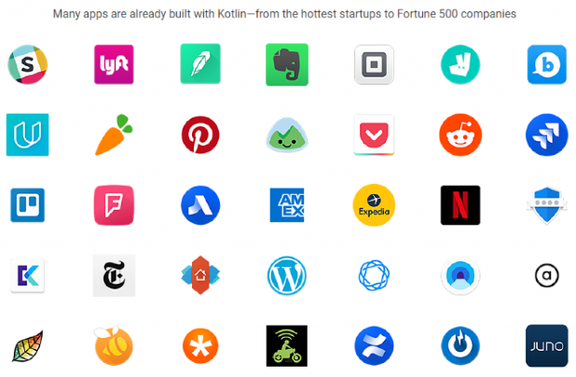
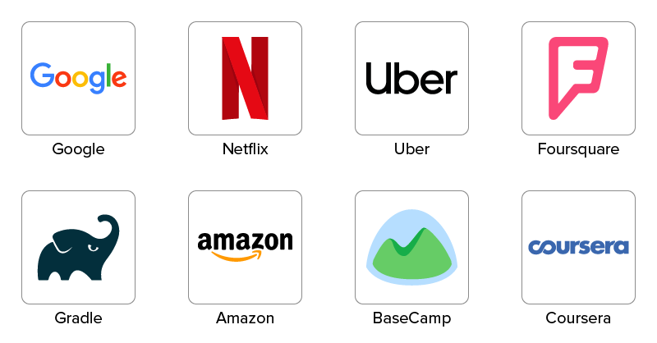
Companies that use KOTLIN

Slide 16
Introduction to OAuth 2.0
Authorization framework.
Enables applications to obtain limited access to user accounts on an HTTP service.
Works by delegating user authentication to the service that hosts the user account, and authorizing third-party applications to access the user account.
Provides authorization flows for web and desktop applications, and mobile devices.

Slide 17
Application Registration & Roles
Before using OAuth with an application, the application must be registered with the service. This is done through a registration form in the “developer” or “API” portion of the service’s website.
OAuth defines four roles: Resource Owner, Client, Resource Server, Authorization Server.

Slide 18
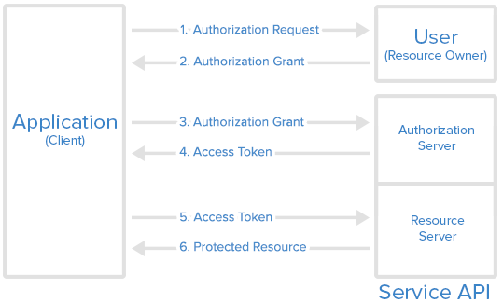
Abstract Protocol Flow

Slide 19
Authorization Grant Types
Authorization Code - Most commonly used, redirection-based flow, through user agent. - Client secret confidentiality can be maintained.
Implicit - Similar to above type but client secret confidentiality is not guaranteed.
Resource Owner Password Credentials - Used with trusted Applications, such as those owned by the service itself.
Client Credentials - Provides an application a way to access its own service account.

Slide 20
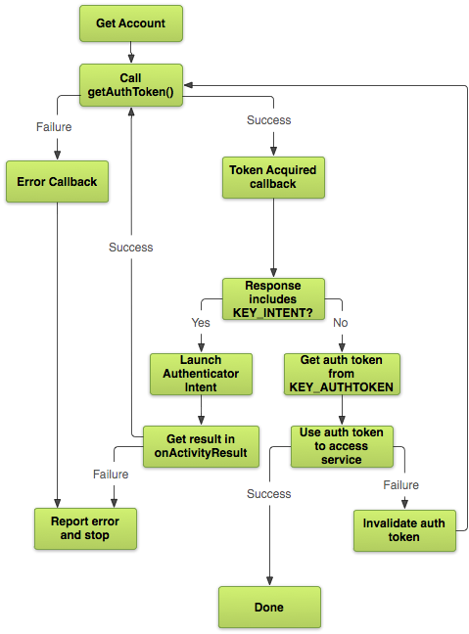
KOTLIN: OAUTH2 Implementation
To begin using OAuth2, you need to know a few things about the API you're trying to access:
The url of the service you want to access.
The auth scope, which is a string that defines the specific type of access your app is asking for. For instance, the auth scope for read-only access to Google Tasks is View your tasks, while the auth scope for read-write access to Google Tasks is Manage your tasks.
A client id and client secret, which are strings that identify your app to the service. You need to obtain these strings directly from the service owner. Google has a self-service system for obtaining client ids and secrets.
Notes:
In the case of Google API server we can obtain them from the self service website.

Slide 21
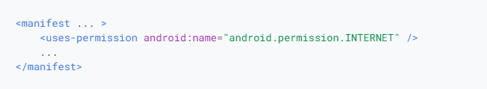
KOTLIN: OAUTH2 Implementation - Permissions
Request the internet permission
For apps targeting Android 6.0 (API level 23) and higher, the getAuthToken() method itself doesn't require any permissions. To perform operations on the token, however, you need to add the INTERNET permission to your manifest file.
Notes:
As seen in the example below.

Slide 22
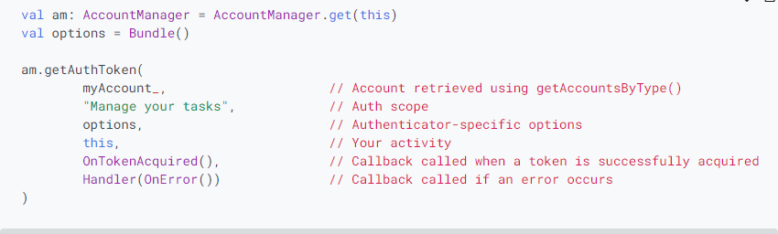
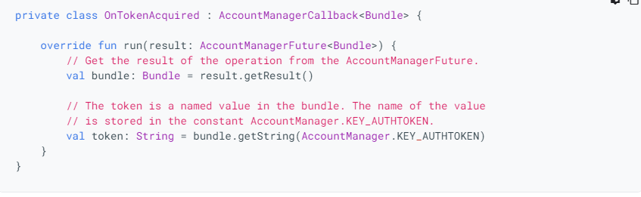
KOTLIN: OAUTH2 Implementation - Request Token
OnTokenAcquired is a class that implements AccountManagerCallback. AccountManager calls run() on OnTokenAcquired with an AccountManagerFuture that contains a Bundle. If the call succeeded, the token is inside the Bundle.
Notes:
As seen below, to make sure we have acquired the token correctly

Slide 23
KOTLIN: OAUTH2 Implementation - Request Token Again
Your first request for an auth token might fail for several reasons:
An error in the device or network caused AccountManager to fail.
The user decided not to grant your app access to the account.
The stored account credentials aren't sufficient to gain access to the account.
The cached auth token has expired.
Notes:
Applications can handle the first two cases trivially, usually by simply showing an error message to the user. If the network is down or the user decided not to grant access, there's not much that your application can do about it. The last two cases are a little more complicated, because well-behaved applications are expected to handle these failures automatically.
The third failure case, having insufficient credentials, is communicated via the Bundle you receive in your AccountManagerCallback. If the Bundle includes an Intent in the KEY_INTENT key, then the authenticator is telling you that it needs to interact directly with the user before it can give you a valid token.
There may be many reasons for the authenticator to return an Intent. It may be the first time the user has logged in to this account.
Perhaps the user's account has expired and they need to log in again, or perhaps their stored credentials are incorrect.
Maybe the account requires two-factor authentication or it needs to activate the camera to do a retina scan.
It doesn't really matter what the reason is. If you want a valid token, you're going to have to fire off the Intent to get it.

Slide 24
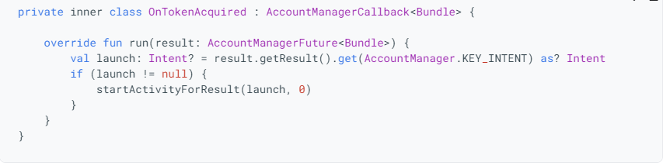
KOTLIN: OAUTH2 Implementation - Intent
If a KEY_INTENT is identified, then we must modify the Bundle to accept the correct number of credentials from the token request.
After the modification are made then we must re-run the token acquisition implementation.
Notes:
So this is a failure that can only be detected while trying to authorize a token to gain access to an online service.
The last case, where the token has expired, it is not actually an AccountManager failure. The only way to discover whether a token is expired or not is to contact the server, and it would be wasteful and expensive for AccountManager to continually go online to check the state of all of its tokens. So this is a failure that can only be detected when an application like yours tries to use the auth token to access an online service.

Slide 25
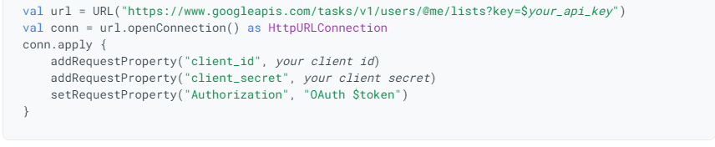
KOTLIN: OAUTH2 Implementation - Online Connection
Google Servers run with standard practise OAUTH 2 protocol.
Google API server’s require 4 keys:
Client ID
Client Secret
API Key
Auth Key
First 3 can be accessed from the Google API Self Service Website.
The last can only be accessed after authorization of the token.
Notes:
The example below shows how to connect to a Google server. Since Google uses the industry standard OAuth2 protocol to authenticate requests, the techniques discussed here are broadly applicable. Keep in mind, though, that every server is different. You may find yourself needing to make minor adjustments to these instructions to account for your specific situation.
The Google APIs require you to supply four values with each request: the API key, the client ID, the client secret, and the auth key. The first three come from the Google API Console website. The last is the string value you obtained by calling AccountManager.getAuthToken(). You pass these to the Google Server as part of an HTTP request.

Slide 26
KOTLIN: OAUTH2 Implementation - Troubleshooting
If the request returns an HTTP error code of 401 “Unauthorized”, then the token was denied.
The most common reason is the token expiring.
The best fix is to request a new token and authenticate it every time we want to gain access to the server.
Note: Most servers assume token are expired before even asking for them, so they may never ask for a token after the initial connection.
Notes:
If the request returns an HTTP error code of 401, then your token has been denied. As mentioned in the last section, the most common reason for this is that the token has expired. The fix is simple: call AccountManager.invalidateAuthToken() and repeat the token acquisition process one more time.
Because expired tokens are such a common occurrence, and fixing them is so easy, many applications just assume the token has expired before even asking for it. If renewing a token is a cheap operation for your server, you might prefer to call AccountManager.invalidateAuthToken() before the first call to AccountManager.getAuthToken(), and spare yourself the need to request an auth token twice.

Slide 27
Thank you for your time !
References :
https://en.wikipedia.org/wiki/Kotlin_(programming_language)
https://www.scottbrady91.com/Kotlin/Experimenting-with-Kotlin-and-OAuth
https://github.com/myndocs/kotlin-oauth2-server
Stefanos Theodosiou
Christos Fesas
Chrisdan Charalambous
CS UCY

