Slide 1

Hyperledger Fabric blockchain Using Docker Containers
EPL421: Systems Programming
By: Μικέλλη Παντελής (pmikel01@cs.ucy.ac.cy)
Παπαδιομήδους Μάριος (mpapad02@cs.ucy.ac.cy)
Μπόφος Μιχαήλ-Παναγιώτης(mbofos01@cs.ucy.ac.cy)
Notes:
Demo Repository : https://github.com/hyperledger/fabric-samples

Slide 2
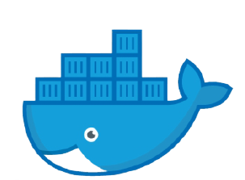
Docker
Open source project.
Simplifies the deployment of applications.
Runs on local kernel.
Uses containers.
Designed to benefit both developers and system administrators.

Slide 3
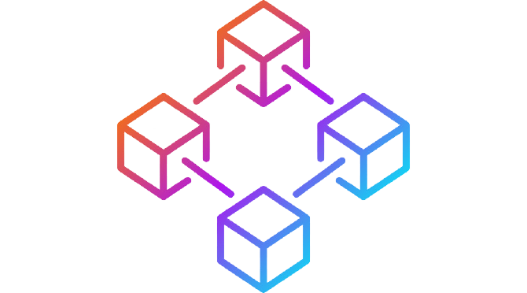
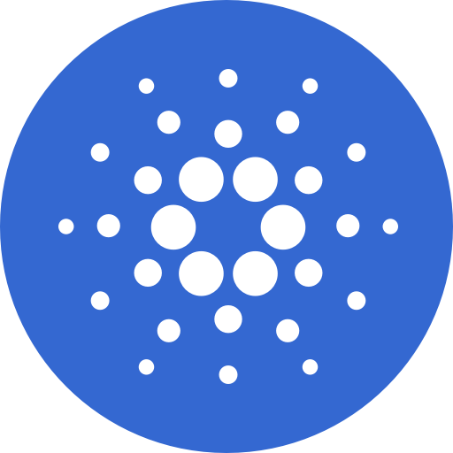
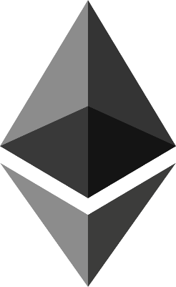
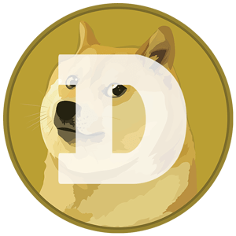

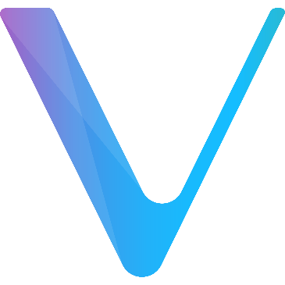
What is blockchain
Growing chain of records(blocks).
Each block contains transaction data.
Each Block contains hash value of previous block.
Used to create decentralized database.

Slide 4
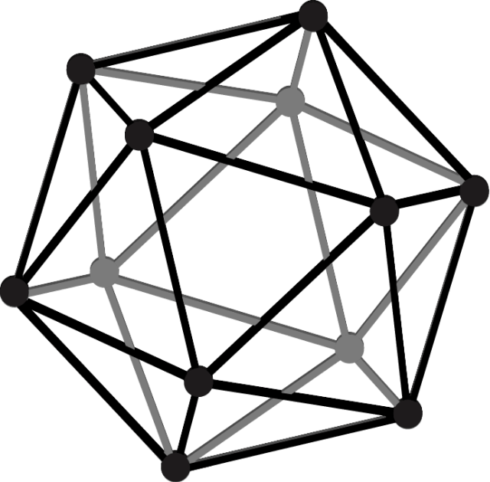
Public VS Permissioned blockchains
PUBLIC | PERMISSIONED
Anyone can participate Every participant anonymous No trust Proof of work(PoW) | Operate amongst a set of known Certain degree of trust Provides a way to secure the interactions

Slide 5
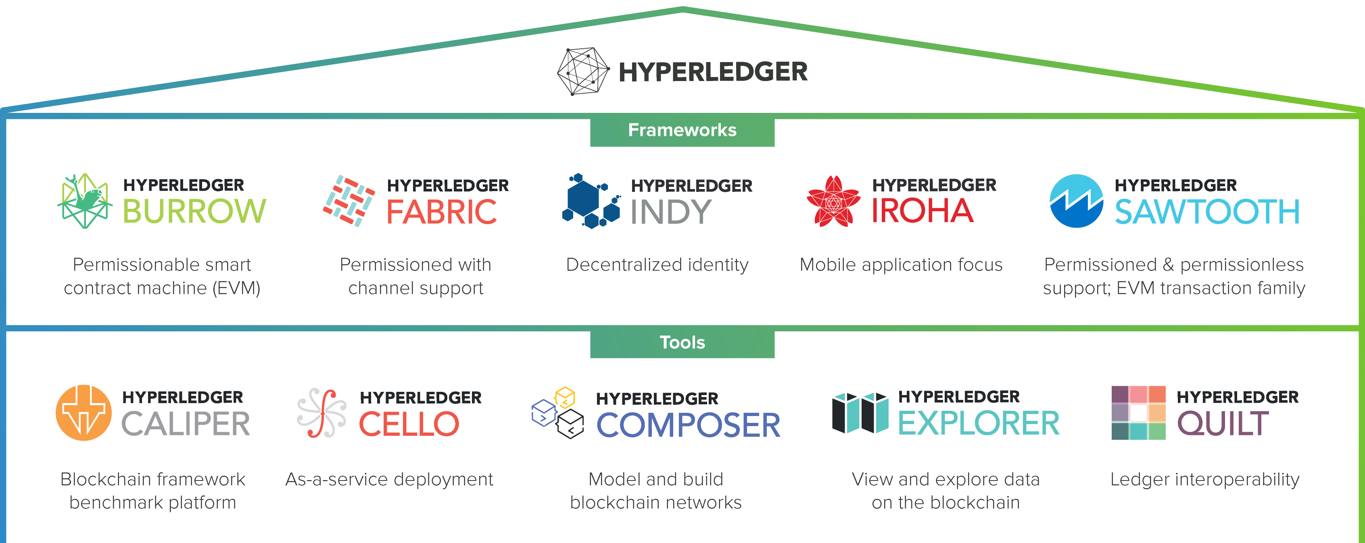

Slide 6
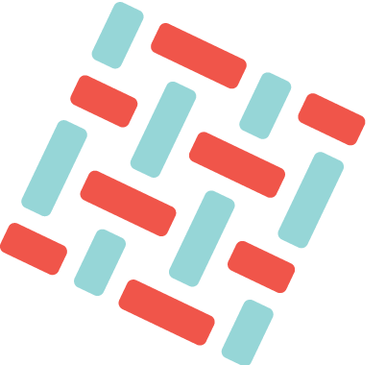
Hyperledger Fabric
Open source framework.
Established under the Linux Foundation(2015).
Used to create permissioned blockchain network.
Native support for smart contracts.
Runs over docker containers.

Slide 7
CERTIFICATE AUTHORITIES(CA)
Creates Certificates.
Certificates: public & private keys.
Public: Held by CA.
Private: Known only by user.

Slide 8
Membership Service Provider
Set of folders added to network configuration.
Used to validate users and organizations.
Validates identities(keys) created by CA.

Slide 9
Smart Contracts(Chaincode)
Set of rules and actions allowed in a channel.
More than one can be used.
Logical base of the network.
Implemented in Go, Node.js, or Java.

Slide 10

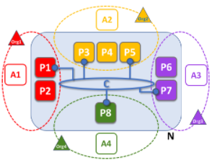
TERMINOLOGY
Peer
Organization
Channels
Assets
Consensus

Slide 11
Requirements
Go - sudo apt install golang-go
Curl - sudo apt install curl
Docker - sudo apt install docker
Docker Compose - sudo apt install docker-compose
Node.js and NPM - sudo apt install nodejs npm
Python - sudo apt install python3

Slide 12
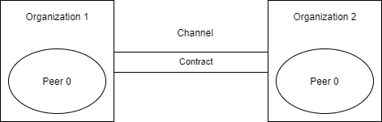
Usecase
Asset trading network.
One Channel.
Two organizations using the channel.
One peer per organization.
One chaincode controls the channel.

Slide 13
chaincode
async InitLedger(ctx);
async CreateAsset(ctx, id, color, size, owner, appraisedValue);
async ReadAsset(ctx, id);
async UpdateAsset(ctx, id, color, size, owner, appraisedValue);
async DeleteAsset(ctx, id);
async AssetExists(ctx, id);
async TransferAsset(ctx, id, newOwner);

Slide 14
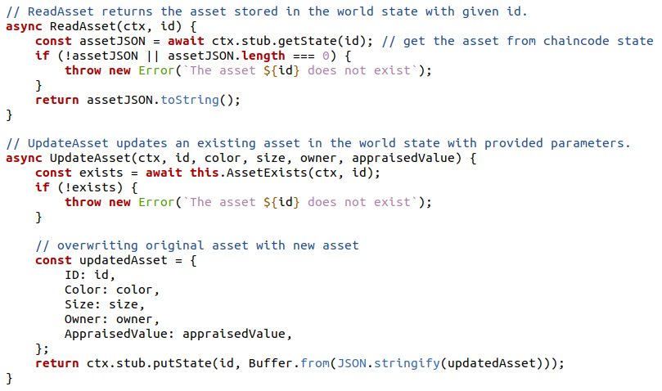
Chaincode – sample functions

Slide 15
Network setup
./network.sh up createChannel -c mychannel –ca
./network.sh deployCC -ccn basic -ccp ../asset-transfer-basic/chaincode-javascript/ -ccl javascript

Slide 16
Test application - exports
export PATH=${PWD}/../bin:$PATH
export FABRIC_CFG_PATH=$PWD/../config/
export CORE_PEER_TLS_ENABLED=true
export CORE_PEER_LOCALMSPID="Org1MSP"
export CORE_PEER_TLS_ROOTCERT_FILE=${PWD}/organizations/peerOrganizations/org1.example.com/peers/peer0.org1.example.com/tls/ca.crt
export CORE_PEER_MSPCONFIGPATH=${PWD}/organizations/peerOrganizations/org1.example.com/users/Admin@org1.example.com/msp
export CORE_PEER_ADDRESS=localhost:7051

Slide 17
Test application – commands
peer chaincode invoke -o localhost:7050 --ordererTLSHostnameOverride orderer.example.com --tls --cafile ${PWD}/organizations/ordererOrganizations/example.com/orderers/orderer.example.com/msp/tlscacerts/tlsca.example.com-cert.pem -C mychannel -n basic --peerAddresses localhost:7051 --tlsRootCertFiles ${PWD}/organizations/peerOrganizations/org1.example.com/peers/peer0.org1.example.com/tls/ca.crt --peerAddresses localhost:9051 --tlsRootCertFiles ${PWD}/organizations/peerOrganizations/org2.example.com/peers/peer0.org2.example.com/tls/ca.crt -c '{"function":"InitLedger","Args":[]}'

Slide 18
Test application – commands
peer chaincode query -C mychannel -n basic -c '{"Args":["GetAllAssets"]}’
peer chaincode invoke -o localhost:7050 --ordererTLSHostnameOverride orderer.example.com --tls --cafile ${PWD}/organizations/ordererOrganizations/example.com/orderers/orderer.example.com/msp/tlscacerts/tlsca.example.com-cert.pem -C mychannel -n basic --peerAddresses localhost:7051 --tlsRootCertFiles ${PWD}/organizations/peerOrganizations/org1.example.com/peers/peer0.org1.example.com/tls/ca.crt --peerAddresses localhost:9051 --tlsRootCertFiles ${PWD}/organizations/peerOrganizations/org2.example.com/peers/peer0.org2.example.com/tls/ca.crt -c '{"function":"TransferAsset","Args":["asset6","Christopher"]}’
peer chaincode query -C mychannel -n basic -c '{"Args":["ReadAsset","asset6"]}’5

Slide 19
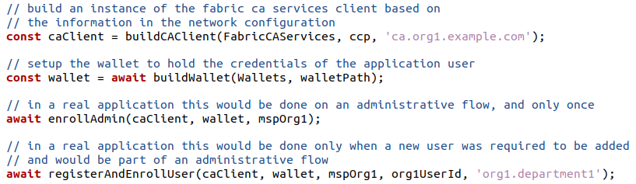
App.js
Run with: node app.js

Slide 20
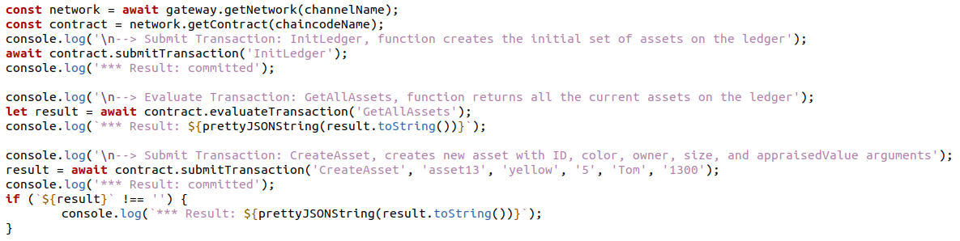
App.js

Slide 21
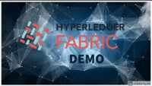
DEMO

Slide 22
Conclusion
Highly scalable
Secure (trustworthy)
Decentralized
Useful in a wide range of use cases
Challenging implementation
High rewards

Slide 23
BIBLIOGRAPHY
https://techterms.com/definition/blockchain#:~:text=A%20blockchain%20is%20a%20digital,and%20have%20many%20other%20applications.
https://hyperledger-fabric.readthedocs.io/en/release-2.2/
https://docs.microsoft.com/en-us/dotnet/architecture/microservices/container-docker-introduction/docker-defined
https://opensource.com/resources/what-docker
https://medium.com/free-code-camp/docker-simplified-96639a35ff36#06d9
https://www.quora.com/What-is-a-ledger-in-cryptocurrency?share=1

Slide 24

Thank you! Any Questions?
Μικέλλη Παντελής (pmikel01@cs.ucy.ac.cy)
Παπαδιομήδους Μάριος (mpapad02@cs.ucy.ac.cy)
Μπόφος Μιχαήλ-Παναγιώτης(mbofos01@cs.ucy.ac.cy)

