Slide 1


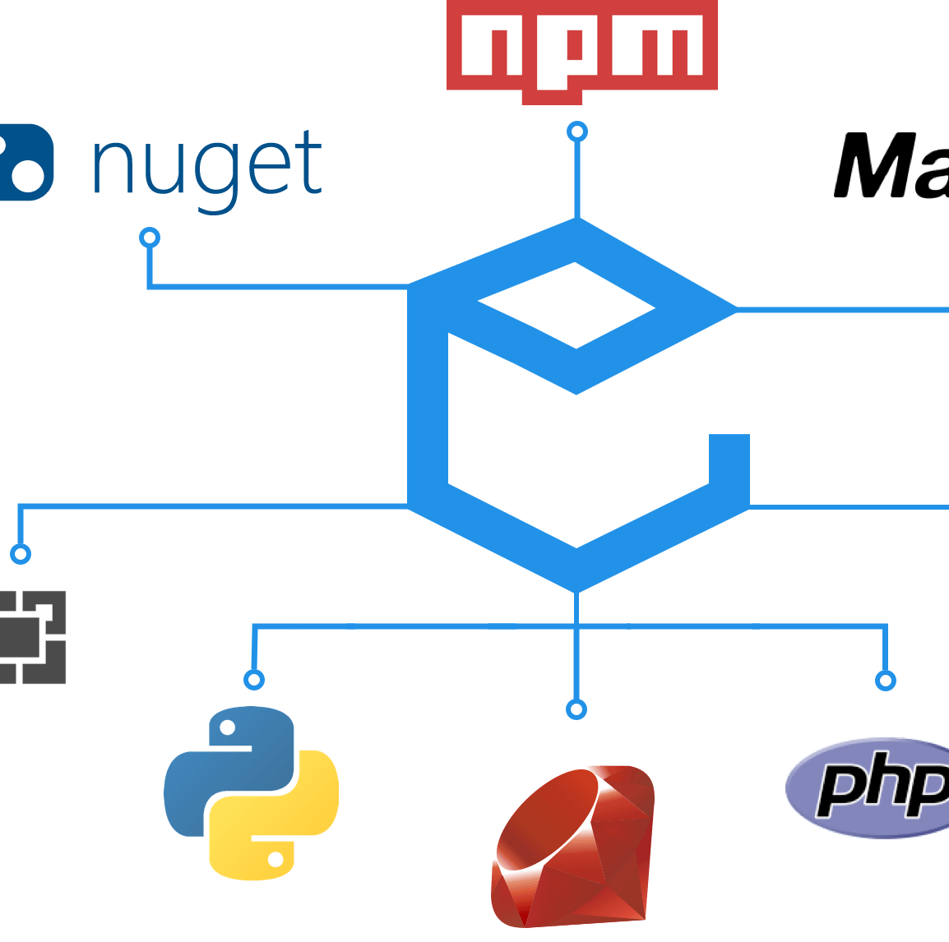

Package managers
EPL 421 – Presentation
Παναγιώτης Βασιλείου
Νικόλας Πολυκάρπου

Slide 2

What is a package
An archive type of file usually containing of metadata. It is often used for extra portability, faster transfer and data compression. It is also useful in providing the necessary dependencies for a software to run properly.
It could be:
GUI application
Command line tool
Software library

Slide 3
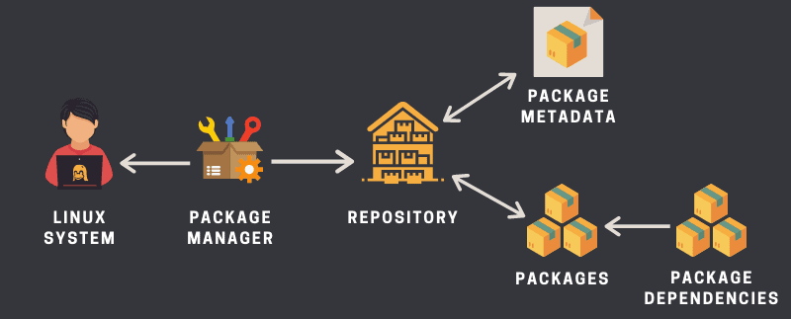
What is a package manager?
Collection of software tools that aims in automating some important tasks such as manual updating and installing. That way, software mismatches are eliminated, so are missing prerequisites.
Allow you to consistently
Install new software
Upgrade software to newer versions
Configure packages
Remove software that you previously installed
There are package managers that distribute in binary package form (rpm for linux , Google play for android, App store for iOS)
There are also package managers that distribute the source code of their apps, but those are not as easy to use as they require the user to unpack, compile and install on his own (apt-build for deb packages)

Slide 4



What are some examples
pip
Package manager for python, for dependencies and libraries
npm
Package manager for javascript, usually a cli
Maven
Builds java project with its own project object mode, mainly for dependencies

Slide 5



Quick history rundown
Package managers surfaced around 1994, with CPAN (Comprehensive Perl Archive Network) acting as a repository of more than 250000 software modules and over 39000 software distribution documentations.
In the beginning the dependency resolution was not automated but the process of adding/ removing software from a running system was drastically simplified.
Near 1995 however, package managers were starting to automatically download packages from repositories, resolve and install their dependencies as needed.
By 1998, with Debian’s apt-get you could easily fully download and install a package and all of it’s dependencies without specifying them.
Modern package managers are great tools that also help us understand the libraries our applications use

Slide 6
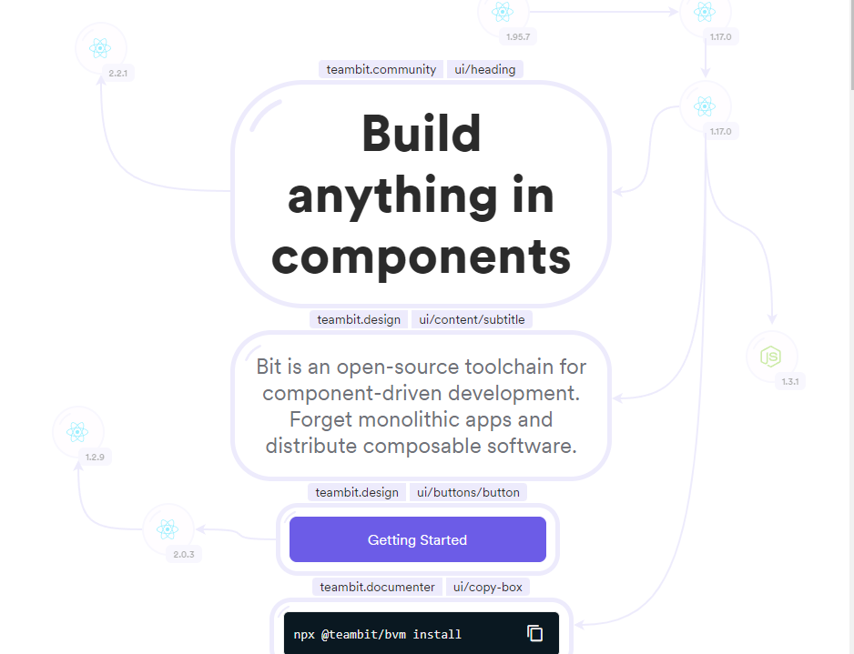
Alternative to package managers
Bit transforms every application to a multi-package repository in a way that every small part of it will be published as a package. These small parts become versioned, packaged and are ready to publish during development. It is mainly used in front-end.
The web itself can be an alternative as there are lots of archives that you can download and install to your project

Slide 7
Advantages and disadvantages
Advantages
Easy to tell which library versions are being used
Dependencies are downloaded and installed automatically through repositories
Incompatible files remain separated
Any project set up with a package manager is consistent
Disadvantages
If a dependency nightmare occurs, it will take a long time to find the errors and fix them
Generally considered an overkill for small projects/ programs
You often get error messages ths “seem completely unrelated” to what you are trying to accomplish (e.g. a deprecated dependency)

Slide 8

Personal thoughts on package managers
It is almost impossible and inhuman to work on large projects (like a web application) without having a package manager to aid you with your dependency setup.
On the other hand, dealing with errors related to your package managers can often get quite frustrating. Countless hours are wasted on figuring out what exactly went wrong and how to fix it. In automated tasks this becomes even harder.
Most of the time, users opt to install whatever the package manager wants to install, without actually knowing all the modules/ dependencies that the project scaffolding will be made of.

Slide 9
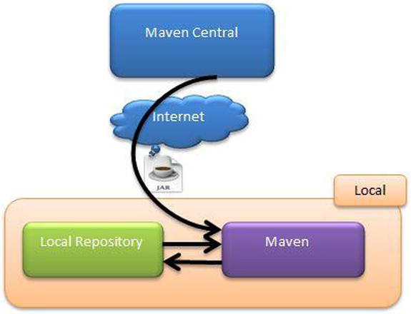
Maven dependencies
Dependencies are just archives – JAR, ZIP etc.
When we run a project, these dependencies are resolved and then loaded from the local repository
If not present in the local repository Maven will download them from remote repository

Slide 10
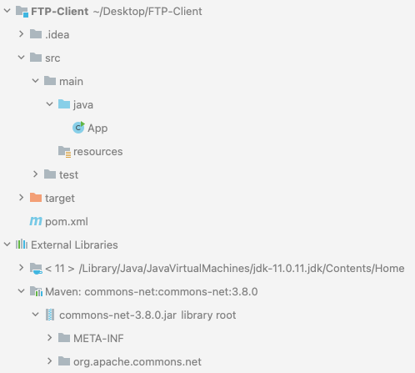
Maven setup/ install
We will be using Java maven to install apache common net, a required library for our second assignment implemented in java.
In our IDE, we simply need to install the maven plugin
We then create a maven project
In pom.xml file we set the dependencies we need
We run the following command to install all the dependencies we set
Mvn install

Slide 11
Pom.xml
<?xml version="1.0" encoding="UTF-8"?> <project xmlns="http://maven.apache.org/POM/4.0.0" xmlns:xsi="http://www.w3.org/2001/XMLSchema-instance" xsi:schemaLocation="http://maven.apache.org/POM/4.0.0 http://maven.apache.org/xsd/maven-4.0.0.xsd"> <modelVersion>4.0.0</modelVersion> <groupId>org.example</groupId> <artifactId>FTP-Client</artifactId> <version>1.0-SNAPSHOT</version> <properties> <maven.compiler.source>11</maven.compiler.source> <maven.compiler.target>11</maven.compiler.target> </properties> <dependencies> <!-- https://mvnrepository.com/artifact/commons-net/commons-net --> <dependency> <groupId>commons-net</groupId> <artifactId>commons-net</artifactId> <version>3.8.0</version> </dependency> </dependencies> </project>

Slide 12
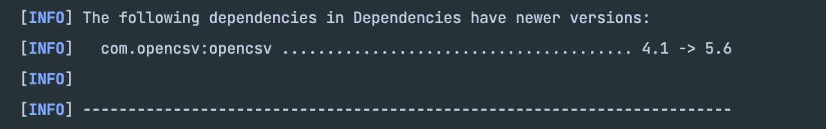
Maven update dependencies
In case there is an update in one or more dependencies that we have previously installed we can execute the following command and we can see which libraries have a newer version in the remote repository of Maven
mvn versions:display-dependency-updates
Example:
If we want to update one dependency we simply change our pom.xml file and we execute again the mvn install command
If we want to update all the libraries with the latest version we execute the following command
mvn versions:use-latest-releases

Slide 13
publish a dependency to maven remote repository steps
Create account at Sonatype
Create and Publish PGP private / public key pair
Configure your project Maven POM file (i.e. project coordinates, name, description, URL, licence, developers
Configure settings.xml
Publish JAR file using the command
Mvn clean deploy

Slide 14
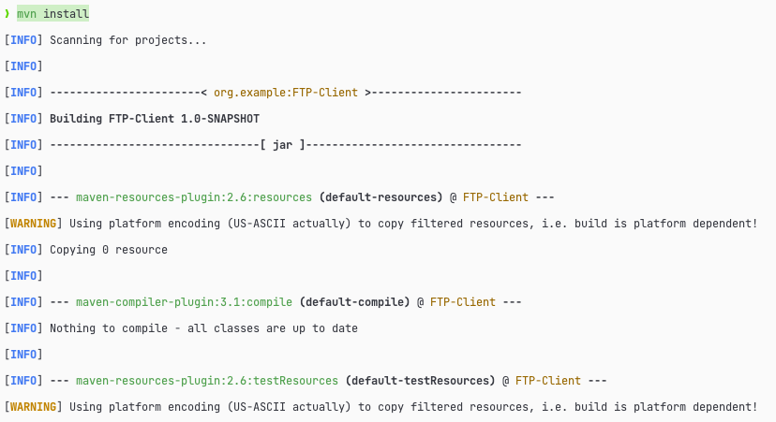

Slide 15
FTP client (java – maven)
Import libraries
import org.apache.commons.net.ftp.FTP; import org.apache.commons.net.ftp.FTPClient; import org.apache.commons.net.ftp.FTPFile;
Initialize ftp object
FTPClient ftp = new FTPClient();
ftp.connect(host, 21); ftp.login(username, passwd); ftp.enterLocalPassiveMode();

Slide 16
Ftp client cont'd(java – maven)
List Directory
ftp.changeWorkingDirectory("~"); FTPFile[] files = ftp.listFiles(); for (FTPFile file : files) { System.out.println(file.getName()); }
Upload File
File localFile = new File(localFilePath); InputStream inputStream = new FileInputStream(localFile); try { ftp.setFileType(FTP.BINARY_FILE_TYPE); ftp.storeFile(remoteFilePath, inputStream); } finally { inputStream.close(); }

Slide 17
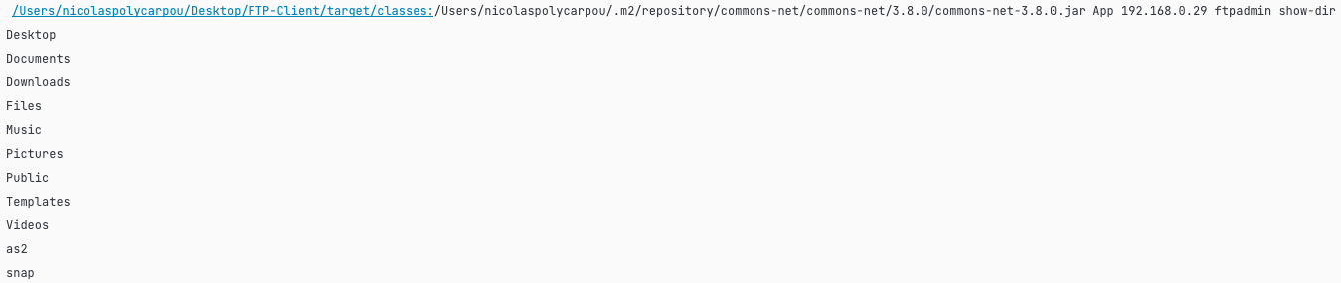
Java ftp client examples
List directory
Show file

Slide 18
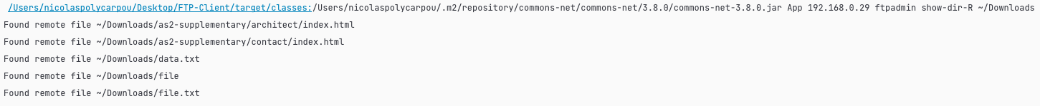
Java ftp client examples cont'd
List directory recursive
Upload directory to FTP Server

Slide 19
Java ftp stats
165 lines of code
1 – 2 hours of implementation
With the use of imported library, the implementation was very easy
The process of importing the necessary library took no effort, as everything related to that was done by the maven package manager

Slide 20
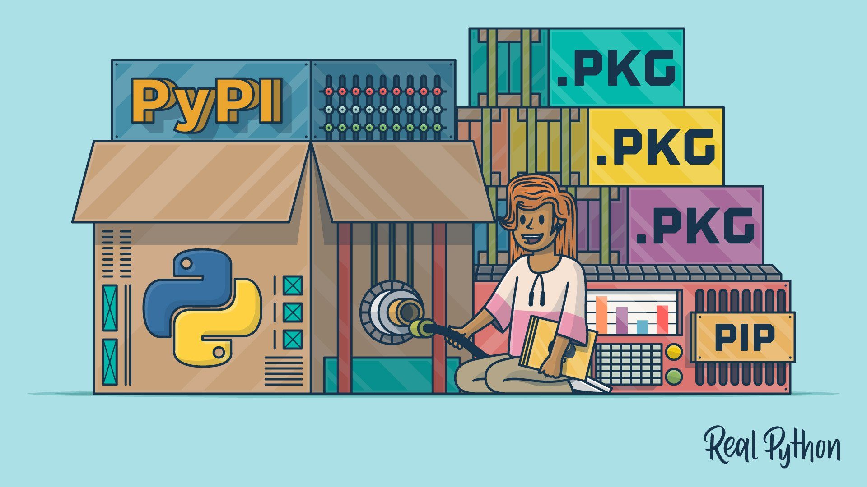
Python(pip) setup/install
In python we can install libraries using the following command
Pip install <library>
Pip stands for Package Installer for Python
In our case we used pip install ftputil to use the ftp client library to implement the FTP Client in Python

Slide 21
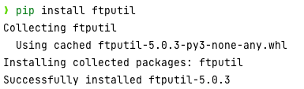

Slide 22
FTP client(python – pip)
Import libraries
import os import sys from ftputil import FTPHost from ftplib import FTP, error_perm
Initialize FTP object
ftp = FTP() ftp.connect(host, 21) ftp.login(username, passwd)
host = FTPHost(host, username, passwd, FTP)

Slide 23
FTP client(python – pip) Cont'd
List directory
print(ftp.listdir("/home/ftpadmin"))
Retrieve file (Print)
print(ftp.retrlines('RETR %s' % path))
Upload file (store "localpath" file)
ftp.storbinary('STOR ' + name, open(localpath, 'rb'))

Slide 24
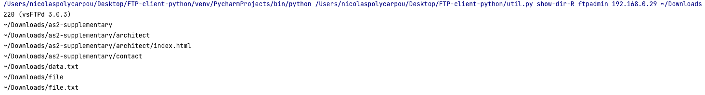
Python Ftp client examples
List directory
List directory recursively
Show file

Slide 25
Python ftp client examples cont'd
Upload directory to FTP Server

Slide 26
Python ftp stats
96 lines of code
1-2 hours of implementation

Slide 27
Using package manager to install command line tools
As we told previously, you can use package managers to install:
GUI applications
Command line tools
Software libraries
Our previous examples focused on installing software libraries using the package managers
The next example we wil show, we used a package manager to install a command line tool

Slide 28



Homebrew
MacOS does not come with an FTP command line tool.
Homebrew is a software package manager for MacOS
We used homebrew to download the ftp client using the following command
Brew install inetutils

Slide 29
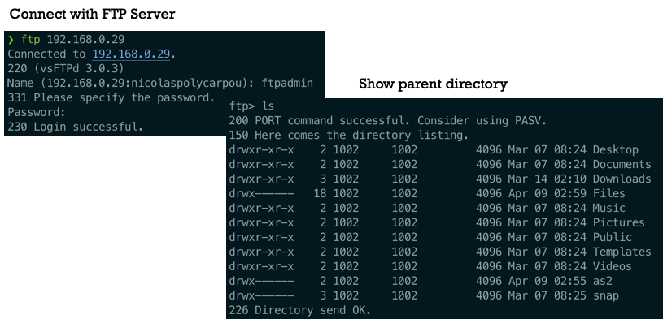
Ftp command line

Slide 30
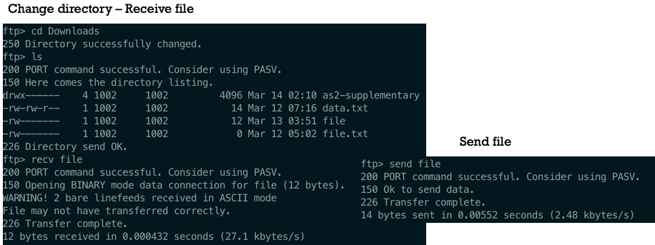
Ftp command line Cont’d

Slide 31
Conclusion
When building applications and projects that require the use of many components, external libraries and technologies, a package manager is almost necessary.
You save up a lot of time and energy by allowing a package manager to handle your library usage and your project's dependency structure.
It is much safer, as the package manager can automatically detect vulnerabilities when multiple libraries are working together.
Programmers should focus on coding their code and not their project's structure. Package managers shift the focus on that.

Slide 32
References
https://itsfoss.com/package-manager/
https://www.debian.org/doc/manuals/aptitude/pr01s02.en.html
https://devopedia.org/package-manager
https://en.wikipedia.org/wiki/List_of_software_package_management_systems
https://en.wikipedia.org/wiki/Package_manager
https://blog.tidelift.com/a-brief-history-of-package-management
https://blog.bitsrc.io/4-npm-alternatives-best-js-package-managers-and-publishing-tools-fe6779937ee9
https://howtodoinjava.com/maven/maven-dependency-management/
https://www.jetbrains.com/help/idea/delegate-build-and-run-actions-to-maven.html
https://maven.apache.org/
https://realpython.com/courses/what-is-pip/
https://en.wikipedia.org/wiki/Homebrew_(package_manager)
D. Spinellis, "Package Management Systems," in IEEE Software, vol. 29, no. 2, pp. 84-86, March-April 2012, doi: 10.1109/MS.2012.38.
https://jenkov.com/tutorials/maven/publish-to-central-maven-repository.html

Slide 33



Questions?

Slide 34

Thank you for your attention

