Slide 1

Vue Js
Γεωργία Ζαβού
Μυριάνθη Σπύρου

Slide 2
JavaScript
JavaScript works with HTML and CSS to build web apps or web pages.
Client-Side programming language
Creates Dynamic Interactive web Content
Runs in every web browser

Slide 3
Vue Js
Open-source model-view Front-End framework of JavaScript for building user Interfaces.
Released on February 2014 by Evan You a worker at Google.
Written in TypeScript
Platforms to write & run Vue Js are Sublime Text, Visual Studio and Atom

Slide 4
Basic Alternatives of Vue Js
React Js (MVC)
jQueryBootstrap. ...
Angular 2
AngularJS
Svelte
jQuery UI
Backbone.js

Slide 5
Pros of Vue
1. Tiny Size ( downloaded zip with the framework weighs 18 KB)
2. Virtual DOM rendering and performance
3. Reactive two-way data binding
4. Single-file components and readability
5. Integration capabilities and flexibility (easy switching from React or Angular )
6. Easy to learn

Slide 6
Cons of Vue
1. Lack of support for large-scale projects
2. Limited resources
3. Lack of experienced developers

Slide 7
Create Node Js Project
1. install the LTS version (node js)
2. add the Node.js development
3. install npm
4. create app
5. open the npm node
6. npm install ftp-client

Slide 8
Create Vue project
1.Create a new project : -vue create my-app
2. Build and serve the generated app on your local machine: - cd my-app
-npm run serve
3. Build the app for production: -npm run build

Slide 9
NPM RUN
Need to install serve with command -npm install -g serve
if we run the command –npm run serve
then the program will run on the browser (localhost) and the result (next slide)

Slide 10
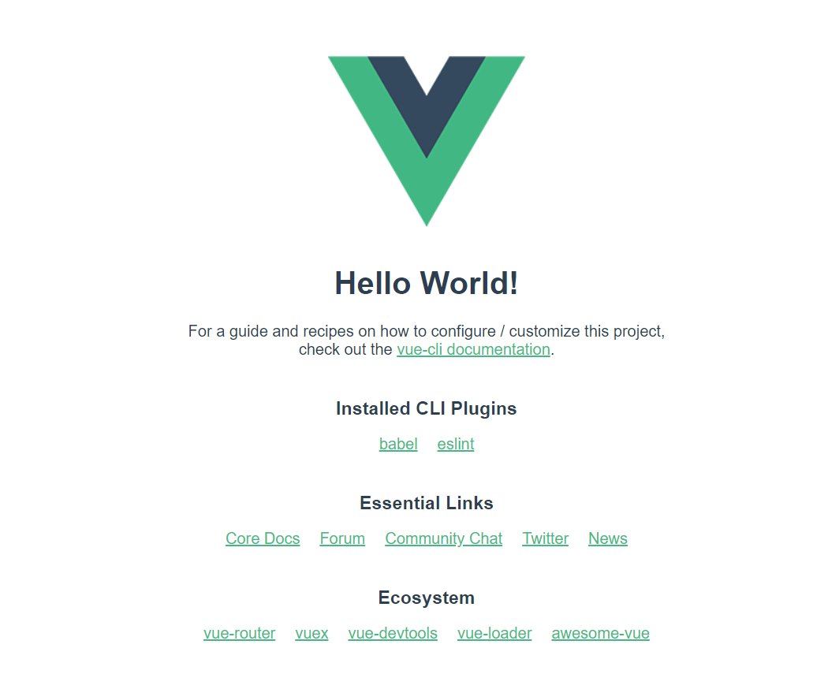

Slide 11
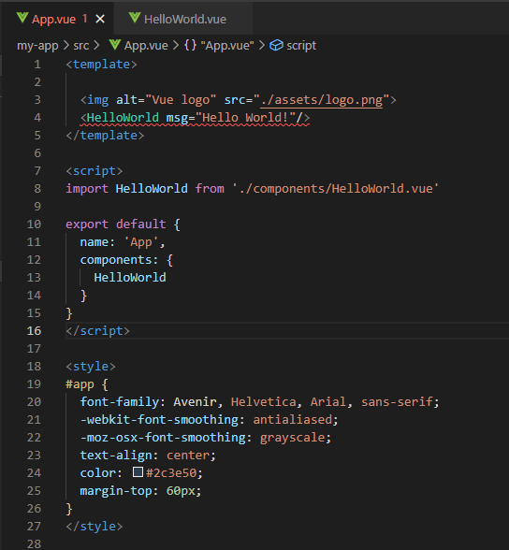

Slide 12
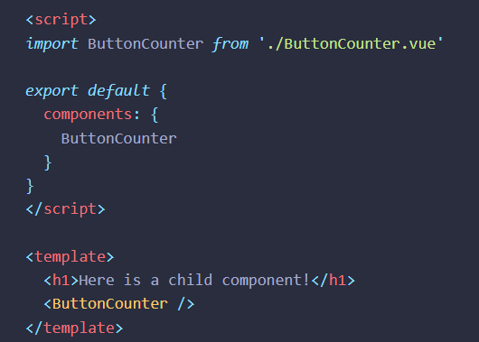
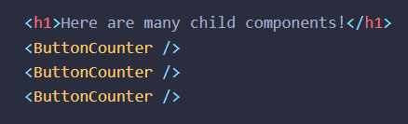
Components in Vue Js

Slide 13

Front End creation with Vue Js

Slide 14
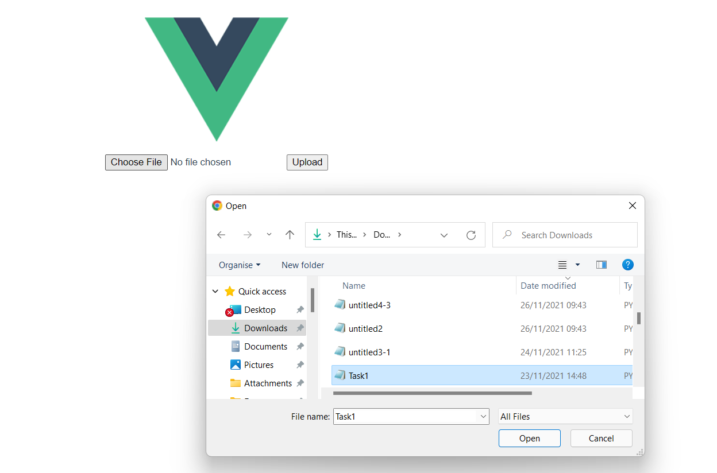


Slide 15
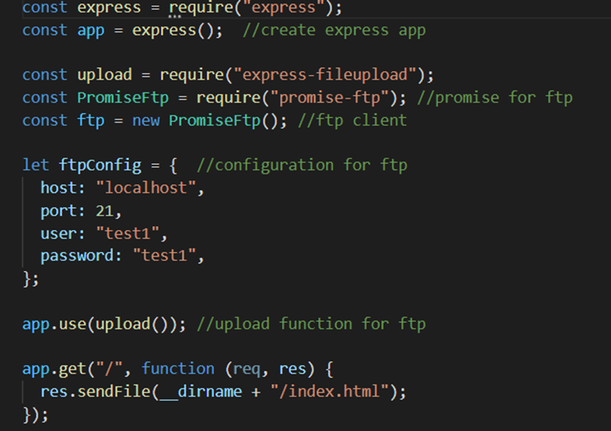
Node Js Project for the Server Connection

Slide 16
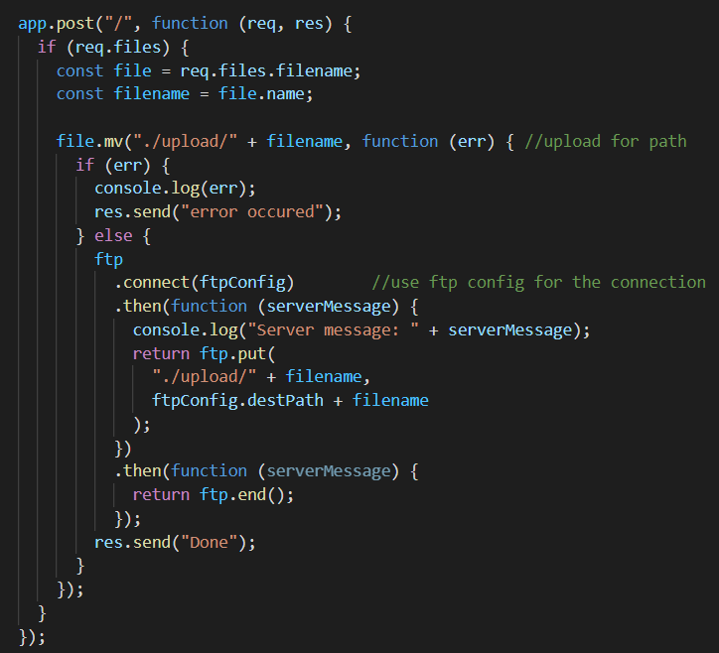
Post Method

Slide 17
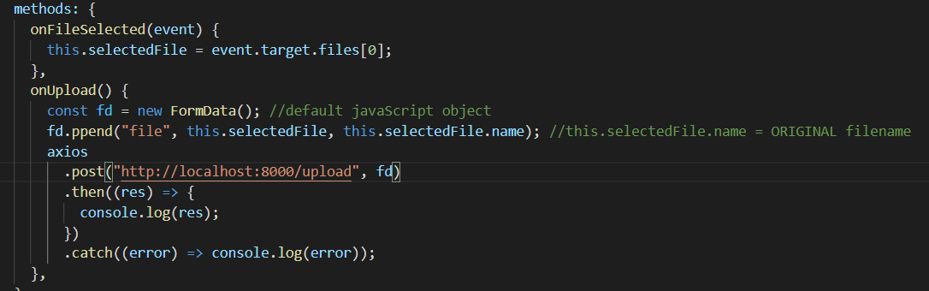
Axios
Axios allows us o work with only one promise .then and with JSON data
Can be used on both client and server site unlike the Fetch API.

Slide 18
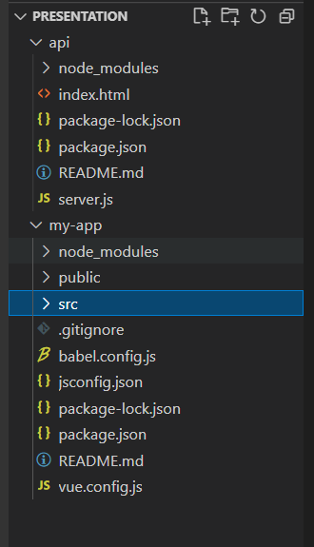
Integrate Vue Js with Node Js
Two different folders
-> api for Node Js and my-app for Vue Js
Each has its own node_modules to avoid collisions

Slide 19
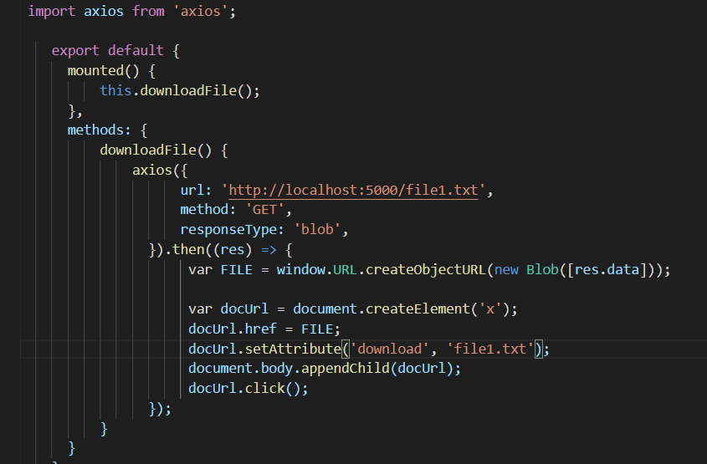
Download From Server Example(vue)
// URL.createObjectURL() create url
Notes:
Οι διευθύνσεις URL Blob δημιουργούνται από το πρόγραμμα περιήγησης και είναι εσωτερικές αναφορές. Με δεδομένο ένα blob, μπορείτε να δημιουργήσετε ένα URL σε αυτό χρησιμοποιώντας τη συνάρτηση URL.createObjectURL().
//anaparastasi se bytes→blob

Slide 20
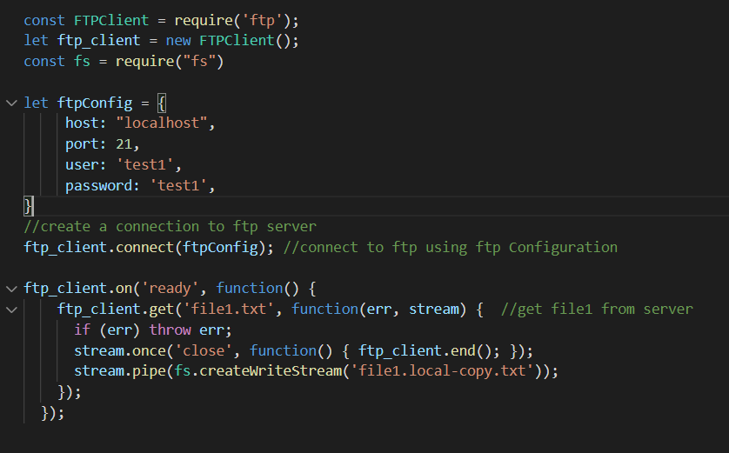
Back End

Slide 21
Facilities
1) Simplicity. You can write your Vue app within 5-6 code lines
2) Component-based architecture
with

Slide 22
Difficulties
1) Not enough examples on the web
2) Not familiar with Node Js
3) integration of Vue Js with Node Js

Slide 23
Conclusions
1) Easy to understand for beginners
2) Easy connection from Vue Js to the backend using Axios
3)Easy front end framework for developers

Slide 24
Bibliography
https://www.altexsoft.com/blog/engineering/pros-and-cons-of-vue-js/
https://www.bezkoder.com/serve-vue-app-express/
https://nodejs.org/en/docs/
https://vuejs.org/guide/introduction.html
https://levelup.gitconnected.com/set-up-and-run-a-simple-node-server-project-38b403a3dc09

