Slide 1


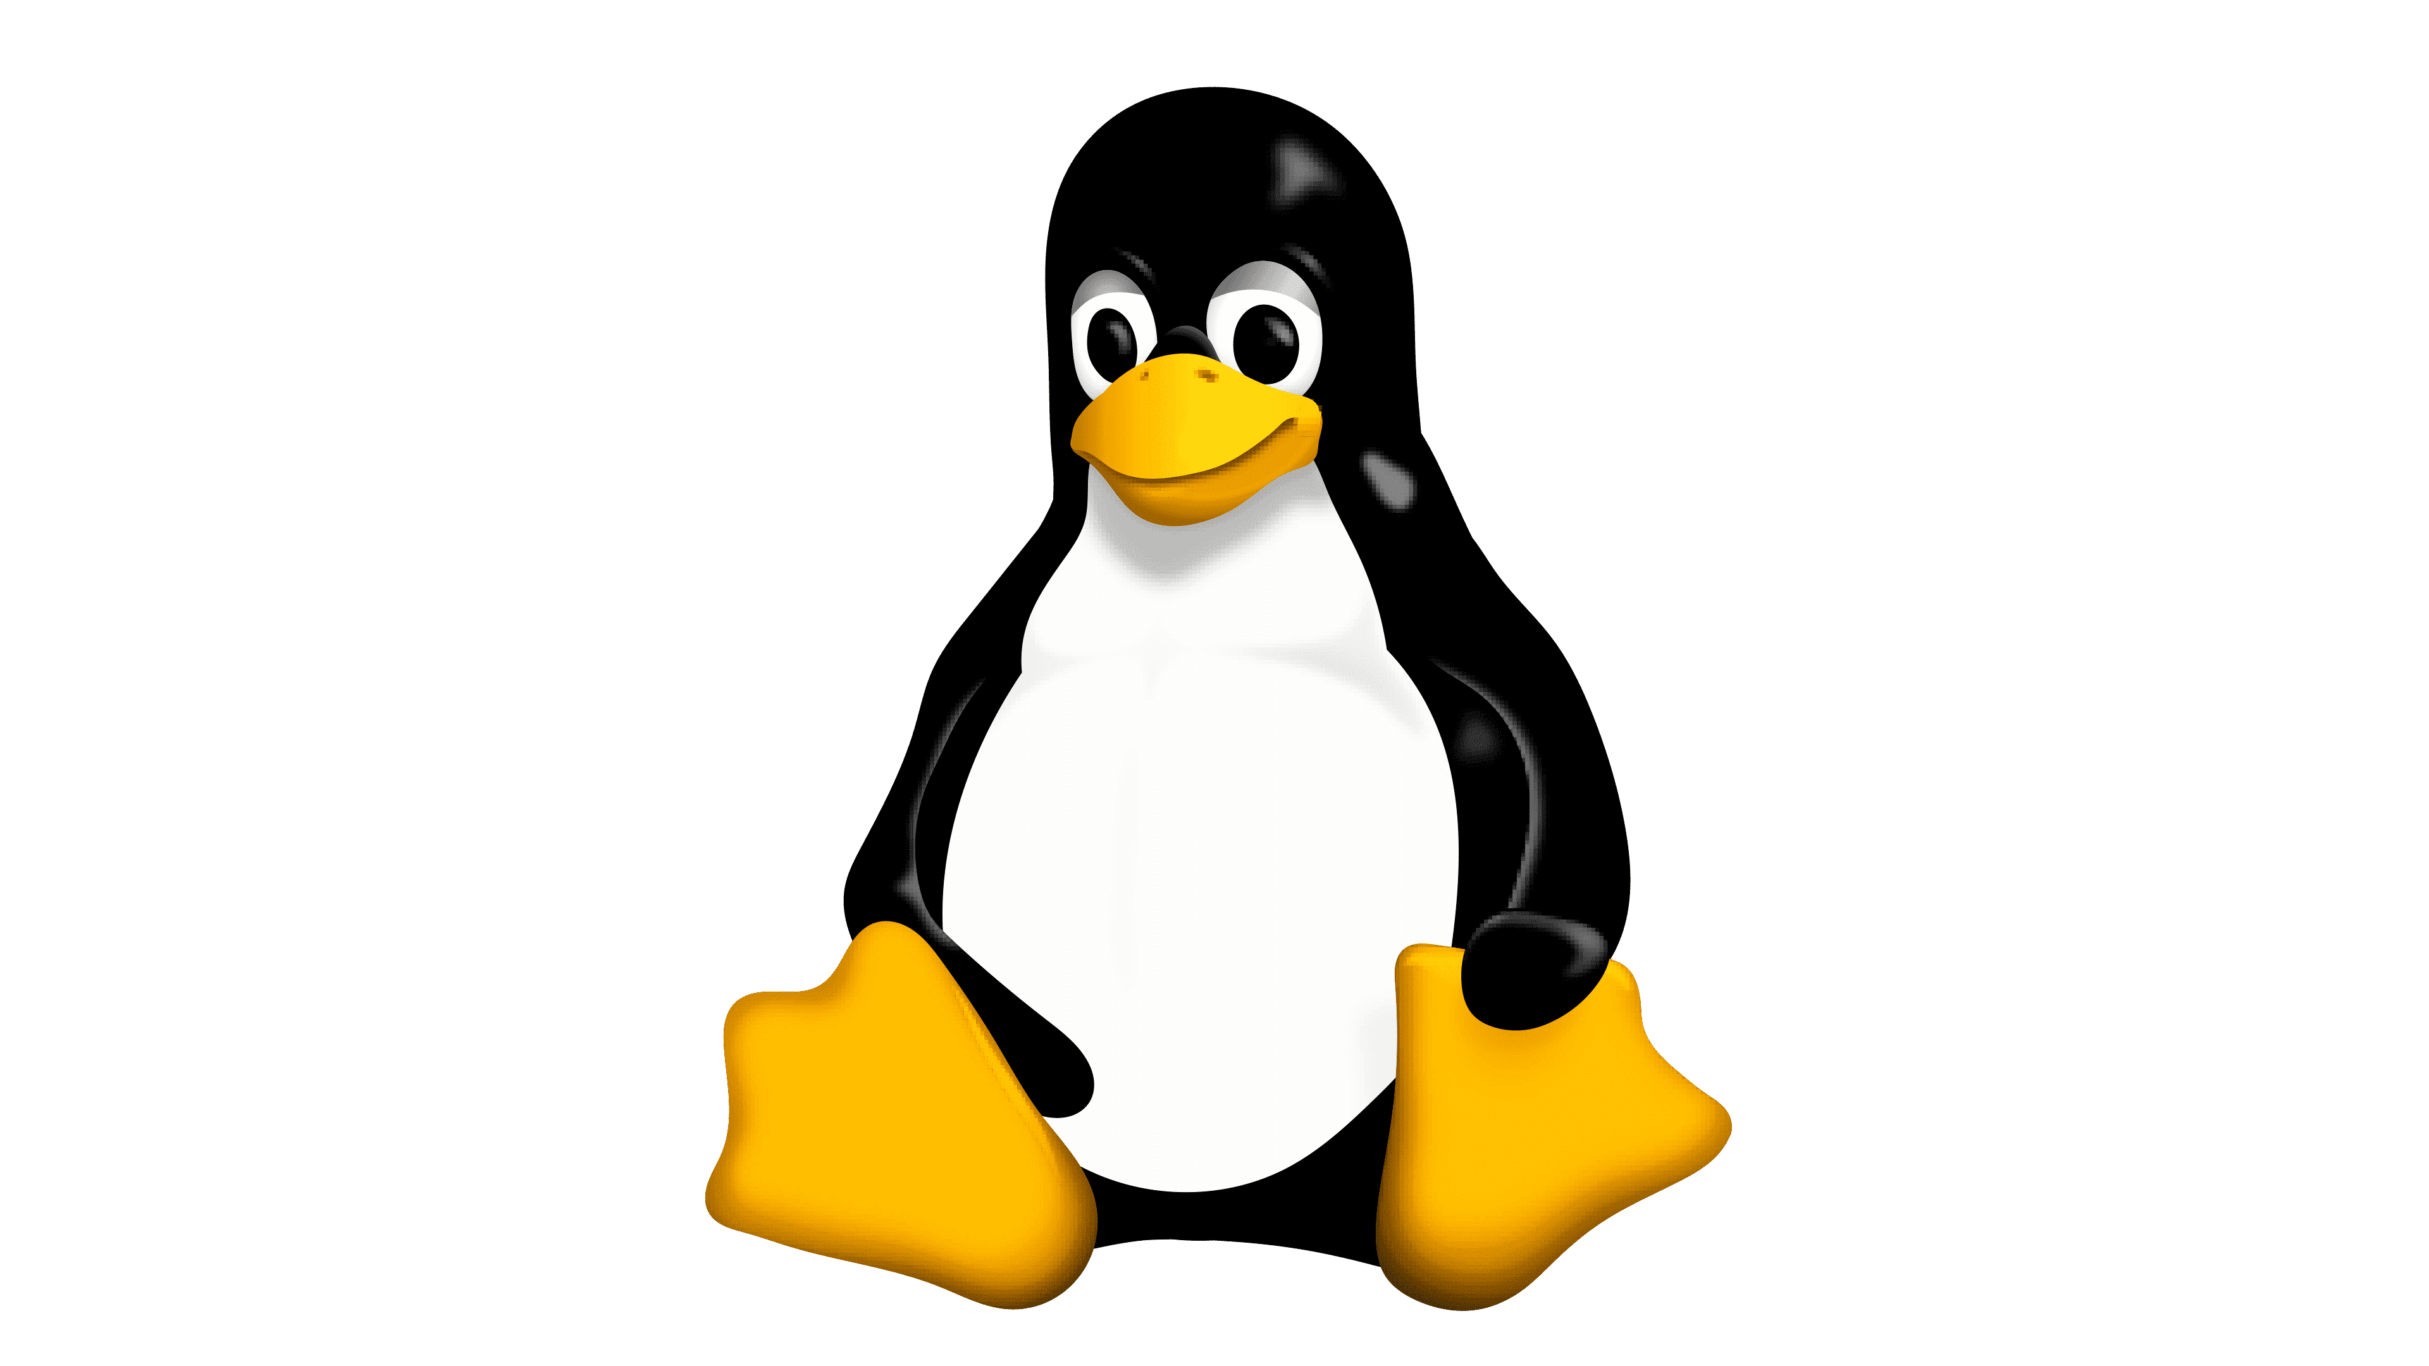



Dynamic instrumentation toolkit for developers, reverse-engineers, and security researchers.
Notes:
Instrumentation is the process of modifying or adding code to an existing software application in order to monitor, measure, or control its behavior.
It is often used in software testing, debugging, and performance analysis, as well as in security research and development.
Dynamic instrumentation tools like FRIDA allow developers and security researchers to perform dynamic analysis of applications by injecting code into them at runtime and monitoring their behavior in real time.
This can be useful for debugging, reverse engineering, penetration testing, and other tasks.
Frida.re

Slide 2
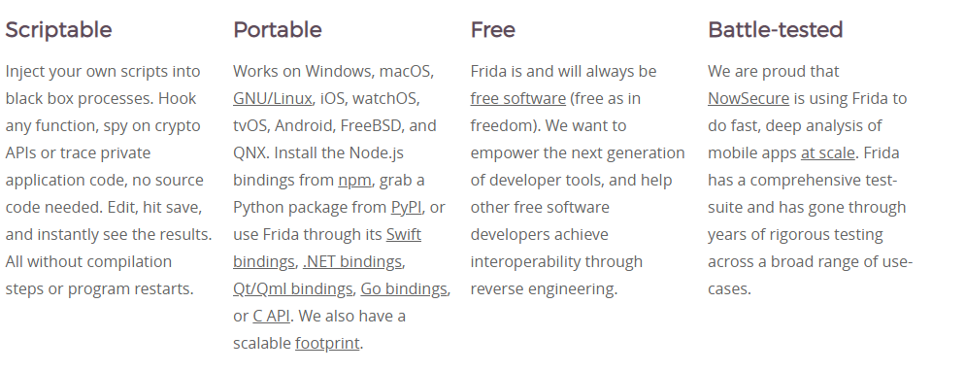

Slide 3
Frida’s core is written in C and injects QuickJS into the target processes. JS gets executed with full access to memory, hooking functions and even calling native functions inside the process.
Using Python and JS allows for quick development with a risk-free API.
You can use Frida from C directly, and on top of this C core there are multiple language bindings, e.g. Node.js, Python, Swift, .NET, Qml, Go, etc.

Slide 4
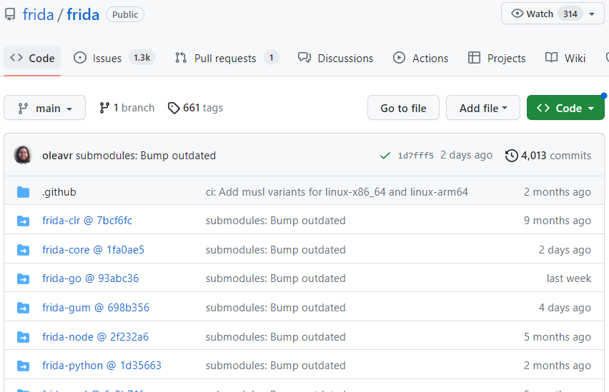
Open Source!
Released in September 2012 by its creator, Ole André Vadla Ravnås, who is also the founder of the Norwegian company NowSecure.
Website Frida.re
Active development!

Slide 5
Modes of Operation
Injected
Spawn an existing program, attach to a running program, or hijack one as it’s being spawned, and then run your instrumentation logic inside of it.
Embedded
It is sometimes not possible to use Frida in Injected mode, for example on jailed iOS and Android systems. Frida-gadget, a shared library that you’re supposed to embed inside the program that you want to instrument. By simply loading the library it will allow you to interact with it remotely, using existing Frida-based tools like frida-trace.
Preloaded
Perhaps you’re familiar with LD_PRELOAD, or DYLD_INSERT_LIBRARIES? Frida-gadget is really useful when configured to run autonomously by loading a script from the filesystem.

Slide 6
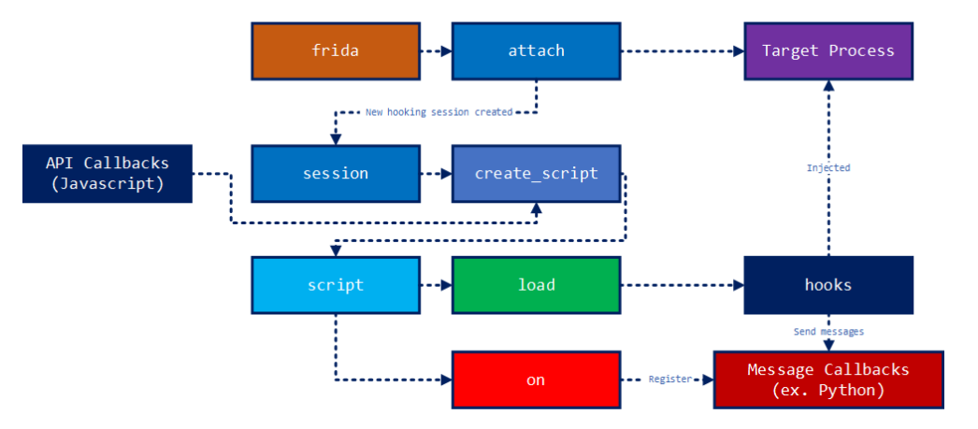
Notes:
The following diagram shows how Frida generally install hooks and gets messages from the installed hooks.
There are frida, session, script objects involved in this process to manage hook installations. The hooking callback is written in JavaScript.

Slide 7
Frida tools:
Frida CLI
Frida CLI is an interface that aims to emulate a lot of the nice features of IPython, which tries to get you closer to your code for rapid prototyping and easy debugging.
frida-ps
Lists running processes, very useful when interacting with a remote system.
frida-trace
Dynamically tracing of function calls.
frida-discover
Discovers internal functions in a program, which can then be traced by using frida-trace.
Notes:
The following diagram shows how Frida generally install hooks and gets messages from the installed hooks.
There are frida, session, script objects involved in this process to manage hook installations. The hooking callback is written in JavaScript.

Slide 8
Let's get cracking!
Notes:
Frida can be used for all kind of platforms. But I chose to showcase on android since I never had a hands on experience

Slide 9


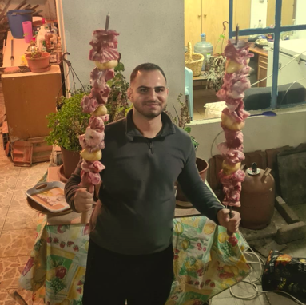
*Based on real life events

Slide 10
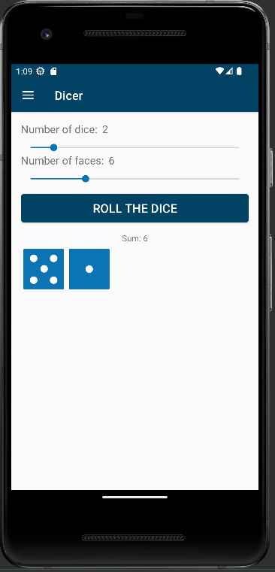

Slide 11
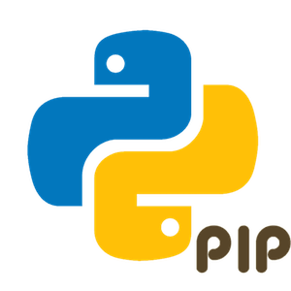
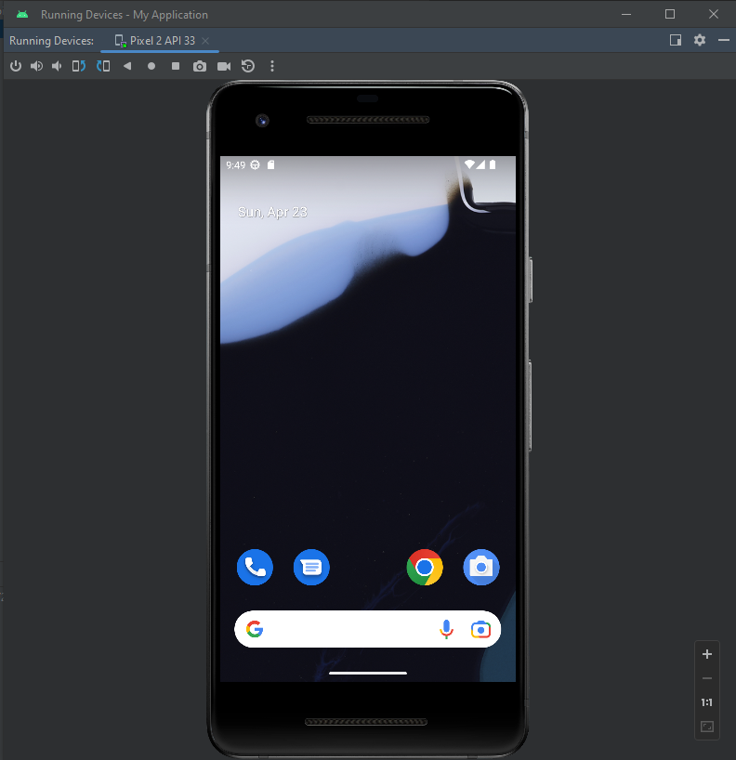
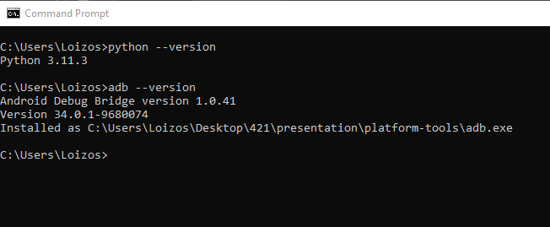

Slide 12
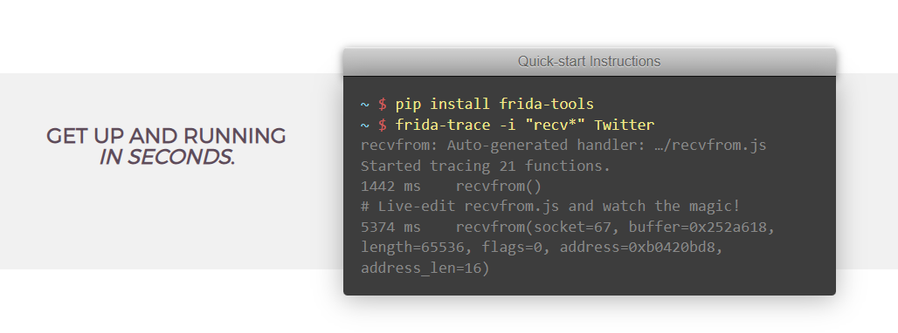

Slide 13
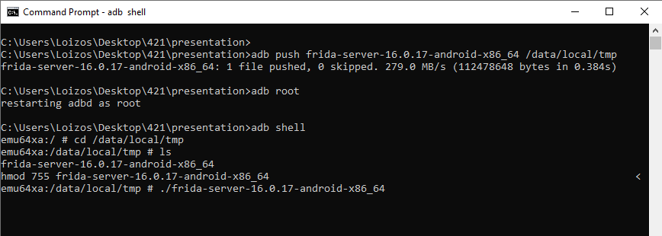
Download Frida Server https://github.com/frida/frida/releases
frida-server-16.0.17-android-x86_64.xz

Slide 14
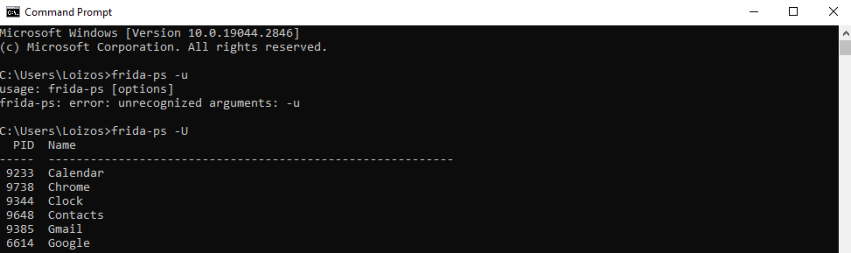

Slide 15
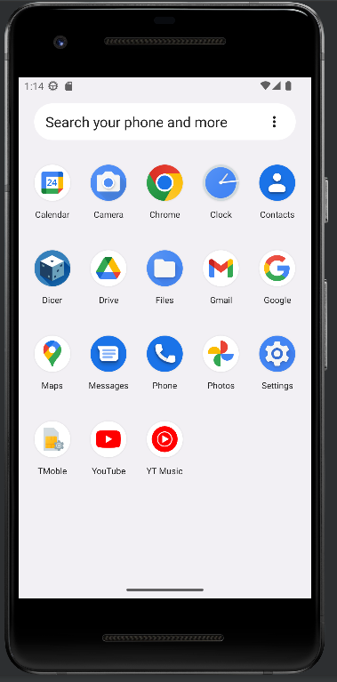
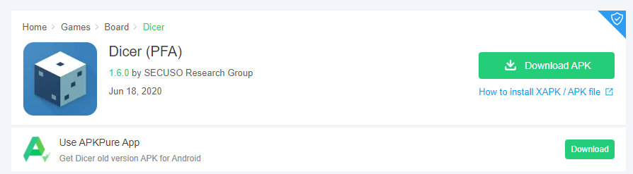

Slide 16
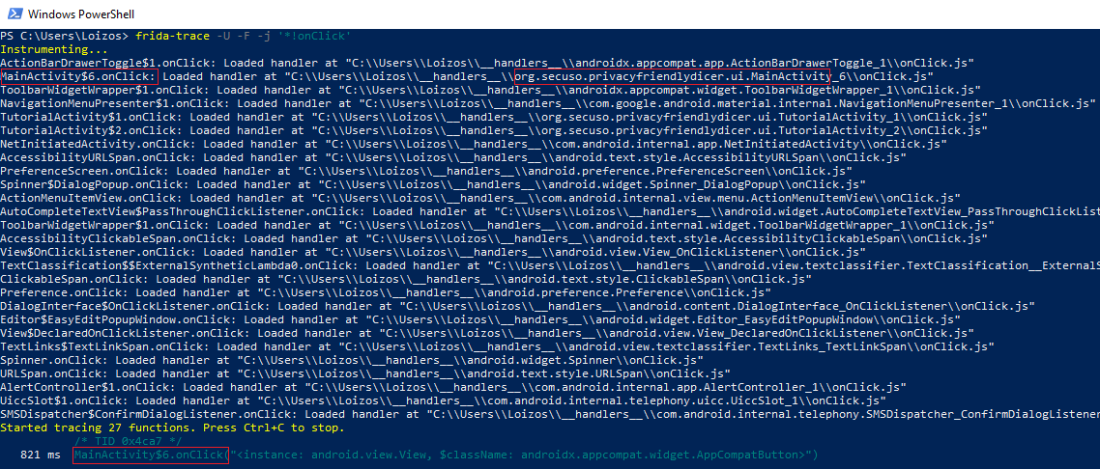
frida-trace -U -F -j '*!onClick'

Slide 17
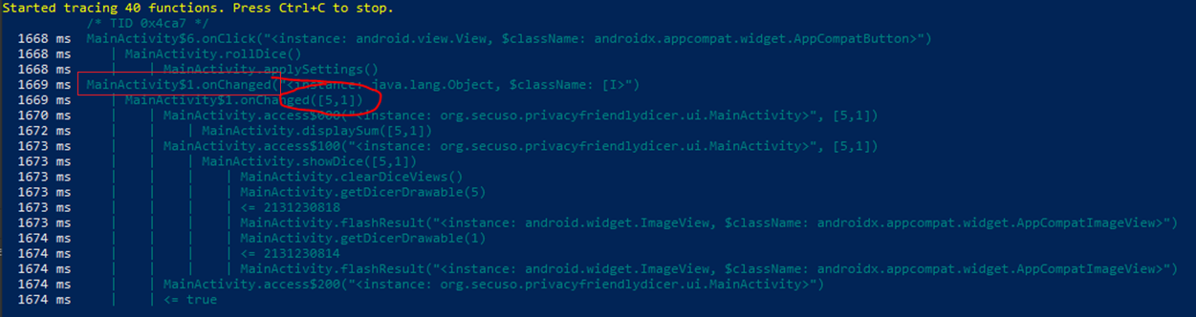
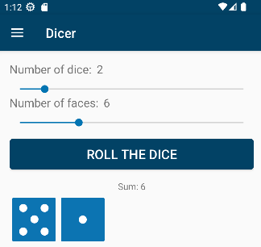
frida-trace -U -F -j 'org.secuso.privacyfriendlydicer.ui.MainActivity*!*'

Slide 18
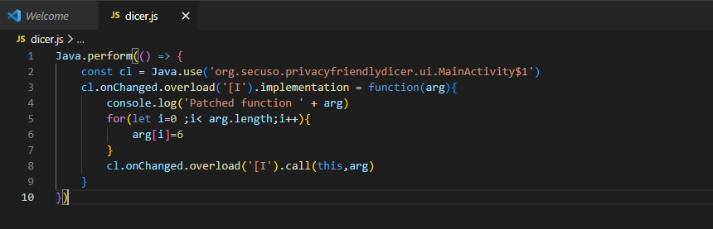

Slide 19
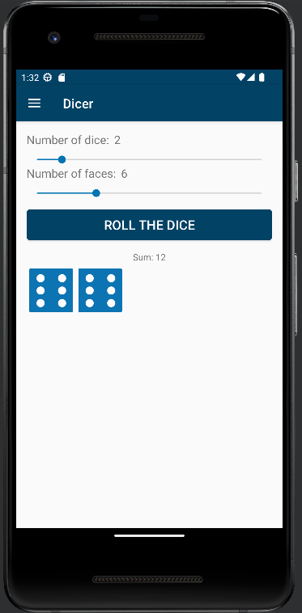
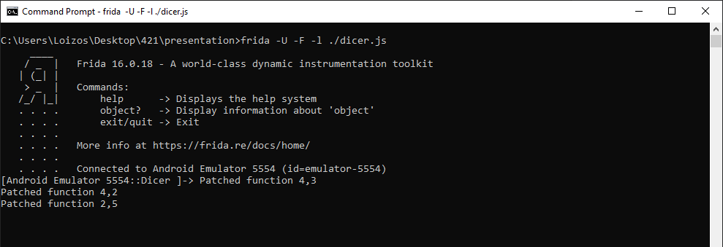

Slide 20
Thank you

