Slide 1
Database and Information - Retrieval Methods for Knowledge Discovery
Giorgos Demosthenous
Kyriakos Kyriakou

Slide 2
Abstract

Slide 3
Goals
Their ultimate aim is to support and analyze the idea of the integration of database systems (DB) and information-retrieval (IR) methods to address applications that are emerging from the ongoing explosion and diversification of digital information.
Automatic building and maintenance of a comprehensive knowledge base of facts from encyclopedic sources and the scientific literature.
Facts should be represented in terms of typed entities and relationships and allow expressive queries that return ranked results with precision in an efficient and scalable manner.

Slide 4
Database Systems and Information Retrieval Methodologies
Both Database Systems (DB) and Information Retrieval (IR) methods investigate concepts, models and computational methods for managing large amounts of complex information.
Definition of DB
DB began in the area of accounting systems (such as online reservations and banking)
DB emphasized in data consistency, precise query processing and efficiency (during the years)
Definition of IR
IR began in the area of library systems (such as bibliographic catalogs and patent collections).
IR emphasized in text understanding, statistical ranking models and user satisfaction (during the years)

Slide 5
Past, present and future of DB and IR methods

Slide 6
Past of DB and IR
Web 2.0 applications (such as social networks) require support for structured and textual data, as well as ranking and recommendation in the presence of uncertain information of highly diverse quality (Figure 1).
There were attempts at integration(late 1990s) but it is only in the past few years that mission-critical applications have emerged with a compelling need for integrated DB and IR methods and platforms.

Slide 7
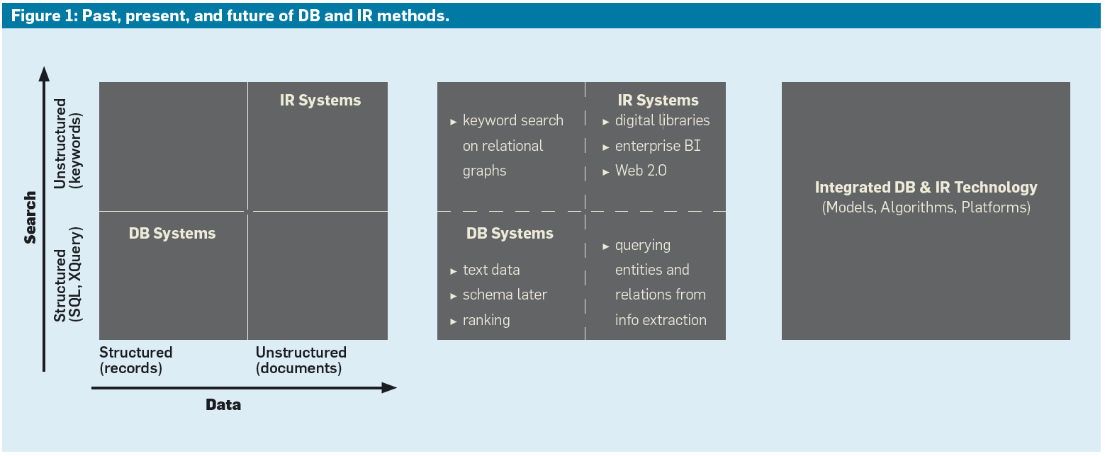
Notes:
Figure 1

Slide 8
Past of DB and IR
The Figure categorizes information systems along two dimensions:
How the data is to be managed
How the data is to be searched
The first dimension divides digital data into:
Structured data
Unstructured data
The second dimension divides search into:
Sophisticated query languages that express logical conditions
Simple keyword search as the prevalent way of posing queries to search engines.
Notes:
Structured data (such as like schema-oriented records with numerical, categorical, and short-string attributes)
Unstructured data (such as natural-language text and multimodal information, including speech and video) and loose collections of heterogeneous records.
Since the late 1960s DB and IR systems have resided in two totally separate quadrants in the Figure, while it seemed as though the other two were useless or unoccupied.

Slide 9
IR-style keyword search over structured data
IR-style keyword search over structured data (such as relational databases) makes sense when the structural data description—the schema— is so complex that information needs cannot be concisely or conveniently expressed in a structured query.

Slide 10
Example
Consider a social-network database with tables of users, friends, and posted items (such as photos, videos, and recommended books or songs), as well as ratings and comments.
Assume a user wants to find the connections shared by Alon, Raghu, and Surajit with respect to the Semantic Web.
Answers might be that the three co-authored a book on the Semantic Web, two edited a book, one commented on it, or the three are friends and one posted a video called “Semantic Web Saga.”
With structured querying, where each value (such as “Alon”) refers to a particular attribute (such as User.Name and Friend.Name), the combined options lead to very complex queries with many joins and unions.
Much simpler is to state five keywords—“Alon, Raghu, Surajit, Semantic, Web”—and let the system compute the most meaningful answers in a relational graph.
This relaxed attitude toward the schema (which value should occur in which attribute) naturally entails IR style ranking.

Slide 11
DB-style querying over originally unstructured data
Linguistic and learning-based information-extraction techniques have been applied in order to augment textual sources with structured records and enable expressive DB-style querying over originally unstructured data.

Slide 12
Example
Consider an information request about “the life of the scientist Max Planck” to be evaluated over an XML-based digital library, perhaps an extended form of Wikipedia.
A simple approach would be to formulate a keyword query like “life scientist Max Planck”.
Unfortunately, the results would be dominated by information about the Max-Planck Institutes (approximately 80 in Germany) in the area of life sciences.
Structured query languages (e.g. SQL) allow professional users to specify more precisely what they are interested in, possibly in the form of attribute name-value conditions (such as Name = “Max Planck”) and XML structure-and-content conditions.

Slide 13
Integrated DB & IR Technology
The initially pure quadrants for DB and IR systems have been substantially enhanced by new methods for:
Digital libraries
Enterprise search and analytics
Text extensions for database engines
Ranking capabilities for SQL and XQuery.
The “Future” part of Figure 1 envisions a full integration between DB and IR systems.
Notes:
The boundaries between quadrants are blurring; the DB and IR fields are increasingly fertilizing each other.

Slide 14
Health Care Scenario with DB/IR integration (1)
Relational Tables - Schemas:
Disease (DId int; Name char[50]; Category int; Pathogen char[50]; … )
Patient (PId int; … ; Age int; Treated-DId int; ResponsibleHId int; Timestamp date; Report longtext; … )
Hospital (HId int; Address char[200];… )
Foreign-key references between relations (e.g. a patient record referring to a disease identifier), is suitable for structured queries (DB).
Long text fields, often containing valuable hidden information, are amenable to only keyword and text-similarity search (IR).
Some of the attributes (e.g. Category) may refer to external taxonomies and ontologies (e.g. Unified Medical Language System).

Slide 15
Health Care Scenario with DB/IR integration (2)
Query
“Find young patients in central Europe who have been reported, in the past two weeks, to have symptoms of tropical virus diseases and an indication of anomalies”
Computing relevant answers requires evaluating structured predicates (DB):
Range conditions on Age
Joins with additional ontology tables
This computation also involves fuzzy predicates and some inherent vagueness.
Results must be ranked (IR)
Structured and unstructured search conditions are combined in a single query, and the query results must be ranked.

Slide 16
Motivations to bring IR and DB concepts together
DB and IR concepts and methods a developer would find useful

Slide 17
Motivations to bring IR and DB concepts together (1)
Approximate matching and record linkage
Adding text-matching functionality to DB systems
Spelling variants
Record linkage/matching entities
Example: The strings “William J. Clinton” and “Bill Clinton” likely denote the same person.
Approximate matching by similarity measures requires IR-style ranking.
Too-many-answers ranking
Problematic Solution: Narrowing the query conditions.
May produce too few or no results
IR-style Solution: Ranking based on data, workload statistics and user profiles.
Notes:
Record linkage (RL) is the task of finding records in a data set that refer to the same entity across different data sources (e.g., data files, books, websites, and databases). Record linkage is necessary when joining data sets based on entities that may or may not share a common identifier (e.g., database key, URI, National identification number), as may be the case due to differences in record shape, storage location, or curator style or preference. A data set that has undergone RL-oriented reconciliation may be referred to as being cross-linked. Record linkage is called data linkage in many jurisdictions, but is the same process.

Slide 18
Motivations to bring IR and DB concepts together (2)
Shema relaxation and heterogeneity
Problem: Applications access multiple databases with individual schemas. There is no unified global schema (e.g. heterogeneity of XML tags)
Solution: Queries must be schema-agnostic or at least tolerant to schema relaxation.
Information extraction and uncertain data
Extraction of entities and relationships from natural language sentences
Pattern matching, statistical learning and natural language processing
Problem: Large knowledge bases with increased uncertainty.
Solution: Ranking extracted facts.
Entity search and ranking
Recognizing entities in text sources allows entity-search queries on the web.
Extracting binary relations between entities
Example: Place and time attributes, could be used as a way towards semantic IR on digital libraries (such as PubMed), news, and blogs and also aid natural language question answering and searching the deep Web.

Slide 19
Harvesting, Searching and Ranking the Web

Slide 20
Harvesting, Searching and Ranking the Web
Problem: Valuable scientific and cultural content is all mixed up with huge amounts of noisy, low-quality, unstructured text and media.
Challenge: Extract the important facts from the Web and organize them into an explicit knowledge base that captures entities and semantic relationships among them.
Advantage: With a knowledge base that sublimates valuable content from the Web, we could address difficult questions beyond the capabilities of today’s keyword-based search engines.
Notes:
After challenge:
Imagine a formally structured Wikipedia with the same scale and richness as Wikipedia itself but that offers a precise and concise representation of knowledge that enables expressive and precise querying.

Slide 21
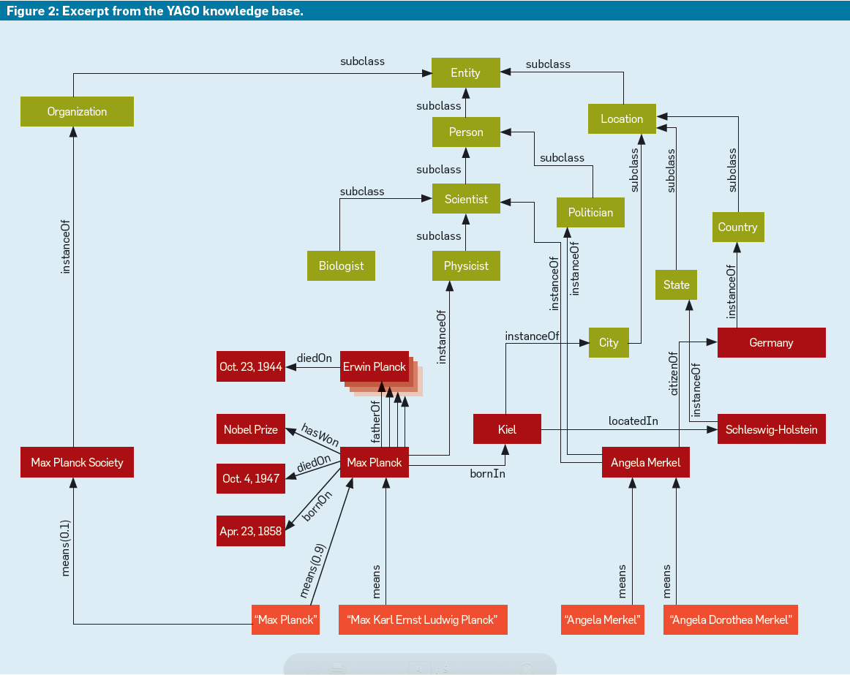

Slide 22
The process of finding relevant answers to difficult questions is complex and time-consuming.
Question 1
Which German Nobel laureate survived both world wars and outlived all four of his children?
To answer question 1 we must deconstruct it, gather its facts and connect them which could take days of manually inspecting Web Pages.
Question 2
Which politicians are also accomplished scientists?
Search engines fail on such questions because they match words and return pages rather than identify entities (such as persons) and test their relationships.
The question entails a difficult ranking problem. An insightful answer must rank important people first

Slide 23
Question 3
How are Max Planck, Angela Merkel, Jim Gray, and the Dalai Lama related?
Answer: All four have doctoral degrees from German universities.
Discovering interesting facts about multiple entities and their connections on the Web is virtually impossible due to the sheer amount of interconnected pages about these four famous people.
A rich knowledge base of entities and relationships would, like YAGO, can answer this question since it is able for much more effective natural-language question answering.
Notes:
The German chancellor Angela Merkel, who has a doctoral degree in physical chemistry, and Benjamin Franklin, who made scientific discoveries and was a founding father of the U.S.

Slide 24
Universal Methodology for Knowledge Harvesting
In modern search engines, information extraction and entity search methods are clearly at work. But these efforts focus only on specific domains.
There are three major approaches for generalizing knowledge harvesting:
[Semantic] Semantic-Web-style knowledge repositories (such as ontologies and taxonomies)
General purpose ontologies and thesauri (WordNet)
Domain-specific ontologies and taxonomies (GeneOntology)
[Statistical] Large-scale information extraction (IE) from text sources in the spirit of a Statistical Web.
Entity recognition
Learning relational Patterns
[Social] Social tagging and Web 2.0 communities that constitute the social Web.
Human contributions in the form of semantically annotated Web pages, phrases in pages, images, and videos.

Slide 25
Combination of semantic, statistical and social approaches through several projects
Research projects often combine elements of the semantic, statistical, and social approaches

Slide 26
Libra
Comprehensive technology for information extraction (e.g. pattern-matching algorithms)
Methods and tools used to build and maintain several vertical-domain portals(e.g. product search, Libra portal)
The facts are gathered and organized into searchable form
Typical IR issue: How a system should rank the results of an entity-centric query
Solution: Using an advanced statistical language model (LM)
Libra is an example of the Statistical-Web approach.
Cimple/DBLife
Aims to generate and maintain community specific portals with structured information gathered from Web sources.
Flagship application: DBLife portal
DBLife features automatically compiled “super-homepages” of researchers with bibliographic data, as well as facts about community services, colloquium lectures, and more.
For gathering these facts, Cimple has a suite of DB-style extractors based on pattern matching and dictionary lookups. The extractors are combined into execution plans and periodically applied to a carefully selected set of relevant Web sources.
Cimple emphasizes a more DB-oriented toolkit for declarative extraction programs, using Datalog as a query-language framework and DB rewriting techniques for query optimization.
Cimple leans more toward the Semantic-Web approach and less toward a Statistical-Web approach.
Contains Social-Web elements (a Wiki-based mechanism for users to provide feedback about incorrect facts they identify on community portals).
Notes:
Libra portal is for scholarly search on extracted records about authors, papers, conferences, and communities.
language model (LM) ->search has been extended from the form of document-oriented bags of words to the form of structured records.
Cimple is similar to Libra
Datalog is a declarative logic programming language that syntactically is a subset of Prolog.

Slide 27
KnowItAll/TextRunner
Libra and Cimple operate on one page at a time whereas KnowItAll and TextRunner operate on multiple pages
Aim to populate one or more entity or relationship types by inspecting multiple pages and exploiting their redundancies (dual view).
KnowItAll
Uses techniques that combine pattern matching, linguistic analysis, and statistical learning.
Seeds: the instances of the relation of interest (e.g. a set of (city, river) pairs).
Uses seeds as “training input” to automatically find sentences on the Web, extract linguistic patterns surrounding the seeds, perform statistical analyses to identify strong patterns, and finally identify the most useful patterns to obtain extraction rules.
The trained rules can be applied to newly seen Web pages, yielding facts or fact candidates.
Statistical data are needed to identify good rules and assess the confidence in the harvested facts.
TextRunner
Pays special attention to scalability and simplifies the entire fact-gathering pipeline.
Has a completely unsupervised phase for identifying simple patterns, just enough to identify, with high accuracy, noun phrases and verbal patterns.
For every new Web page, it aggressively extracts all potentially meaningful instances of all possible binary relation types from the page text (Machine Reading).
Notes:
For example(knowitall/textrunner) a user might want to find all cities on planet Earth, along with all scientists, guitar players, and other unary relations (entity types). For binary relations, a user might consider gathering all CEOs of all companies, all (city, river) pairs where a city is located on a river, or the answers to questions like: Who discovered what? and Which enzyme triggers which biochemical process?
For example(seeds) the phrase templates “located in downtown $x” and “$x is located on the banks of $y” may be determined to be good rules for extracting cities and (city, river) pairs, respectively.

Slide 28
YAGO for Large-Scale Semantic Knowledge

Slide 29
Introduction to YAGO project
The YAGO project shares the KnowItAll and TextRunner goal of large-scale knowledge harvesting but emphasizes on high accuracy and consistency rather than high coverage
Semantic-Web approach
Gathers its knowledge by (primarily) integrating information from Wikipedia and WordNet.
YAGO contains close to two million entities and about 20 million facts about them, where facts are instances of binary relations.
YAGO accuracy is at least 95%, and many of its errors are due to incorrect entries in Wikipedia itself.
YAGO is publicly available at www.mpi-inf.mpg.de/yago/.

Slide 30
How YAGO Works(1)
YAGO makes use of two Wikipedia assets (infoboxes and the category system)
Infoboxes are collections of attribute name-value pairs often based on templates and reused for important types of entities (such as countries, companies, scientists, music bands, and sports teams).
Infoboxes and categories give YAGO clues about instanceOf relations, so it can infer that one entity is an instance of multiple classes.
The YAGO extractors employ linguistic processing (noun phrase parsing) and mapping rules to achieve high accuracy in harvesting the categories information.
Relying solely on Wikipedia infoboxes and categories may result in a large but incoherent collection of facts.
Notes:
For example (Infobox), the infobox for Max Planck delivers such data as birth_date = April 23, 1858, birth_place = Kiel, death_date = October 4, 1947, nationality = Germany, and alma_mater = Ludwig-Maximilians-Universität München.
instaceOf example: The entity Max Planck is an instance of the classes GermanNobelLaureates, NobelLaureatesInPhysics, and UniversityOfMunichAlumni.
Wikipedia category example: As for the category system, the Max Planck article is manually placed in such categories as German_Nobel_laureates, Nobel_laureates_in_physics, quantum_ physics, and University_of_Munich_ alumni.
For example(incoherent collection of facts), we may know that Max Planck is an instance of GermanNobelLaureates but be unable to automatically infer that he is also an instance of Germans and of Nobel Laureates. Likewise, the fact that he was a physicist does not automatically tell us he was a scientist.

Slide 31
How YAGO Works(2)
To avoid the above problem, YAGO makes use of the WordNet thesaurus integrating the facts it harvests from Wikipedia with the taxonomic backbone provided by WordNet.
WordNet knows many abstract classes and the “is-a” and “partof” relationships among them but it has only sparse information about individual entities that would populate its classes.
The wealth of entities in Wikipedia solves WordNet’s issue. Respectively, WordNet’s taxonomy compensates for the gaps and noise in the Wikipedia category system.
Each individual entity YAGO discovers must be mapped into at least one existing YAGO class. If this fails, the entity and its related facts are not admitted into the knowledge base.
Classes derived from Wikipedia category names (such as GermanNobelLaureates) must be mapped with a subclass relationship to one or more superclasses (such as NobelLaureates and Germans).

Slide 32
Kylin/KOG
The Kylin/KOG project extracts information from Wikipedia through its tools Kylin and Kylin Ontology Generator (KOG).
Whenever an infobox type includes an attribute in some articles but the attribute has no value for a given article, Kylin analyzes the full text of the article to derive the most likely value.
Kylin pursues open information extraction by considering all potentially significant attributes, even if they occur only sparsely in the entire Wikipedia corpus.
KOG builds on Kylin’s output, unifies attribute names, derives type signatures and maps these entities onto the WordNet taxonomy through statistical relational learning.
KOG goes beyond YAGO by discovering new relationship types. It builds on the class system of both YAGO and Dbpedia.
The Kylin/KOG project combines all three knowledge-gathering paradigms:
Semantic-Web-oriented by being targeted at infoboxes
Social-Web-based by leveraging the input of the large Wikipedia community
Statistical-Web-style through learning methods.
Notes:
Open information extraction (open IE) refers to the extraction of relation tuples, typically binary relations, from plain text.

Slide 33
Searching and Ranking YAGO with NAGA

Slide 34
Searching and Ranking YAGO with NAGA
The query language designed for YAGO adopts concepts from the standardized SPARQL Protocol and RDF Query Language for RDF data but extends them through more expressive pattern matching and ranking
The prototype system that implements these features is called NAGA (for Not Another Google Answer, www.mpi-inf. mpg.de/yago/).

Slide 35
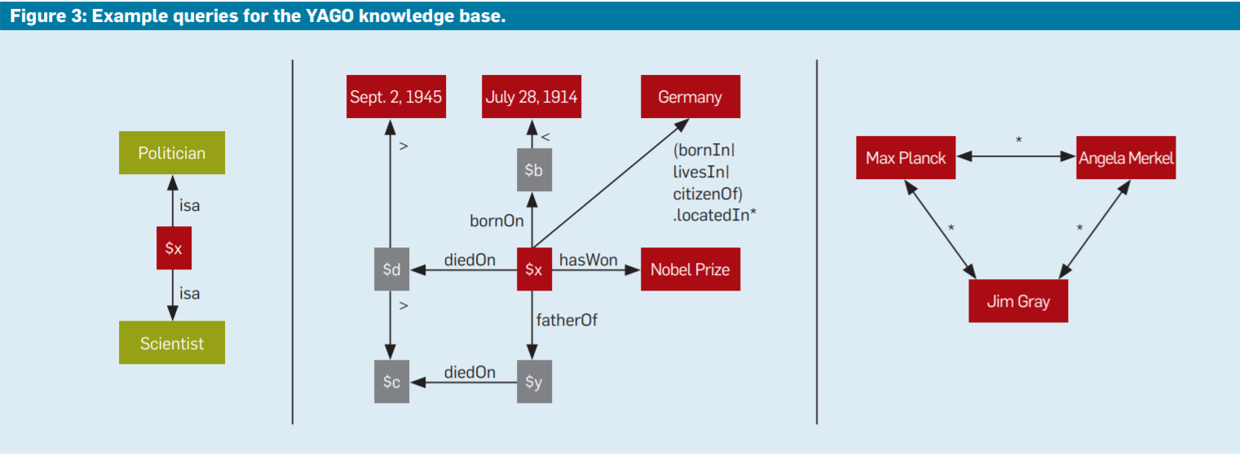
Example queries for the YAGO knowledgebase (1)

Slide 36
Question
Which politicians are also accomplished scientists?

Slide 37
Example queries for the YAGO knowledgebase (2)
This query about politicians who are also scientists shows two nodes matched by the desired results and one node (labeled $x) denoting a variable for which the query must find all bindings.
The edge labels denote relationships and need to be matched by the results. Here, “isa” is shorthand notation for a composition of two connected edges that correspond to the relationships instanceOf between an entity and a class and subclass between two classes.
This way the user also finds people who belong to the classes “mayor”(politician) and “physicist”(scientist).

Slide 38
Question
Which German Nobel laureate survived both world wars and outlived all four of his children?

Slide 39
Example queries for the YAGO knowledgebase (3)
This query generalizes the labels referring to compositions of relations.
The label (bornIn|livesIn|citizenOf).locatedIn* is a regular expression that allows users to avoid overspecifying their information demand.
The locatedIn relationship often reflects geographical hierarchies (such as with cities, counties, states, and countries).

Slide 40
Question
How are Max Planck, Angela Merkel, Jim Gray, and the Dalai Lama related?

Slide 41
Example queries for the YAGO knowledgebase (4)
This broad query looks for commonalities or other connections among several entities.
Users or programmers would use regular expressions as edge labels in the query’s graph template.
Notes:
NAGA queries often return too many results and so must rank these results. For example, a query like “What is known about Einstein?,” which may be phrased as a single-edge graph pattern isa(Einstein, $y), returns dozens if not hundreds of results, including many uninteresting ones like isa(Einstein, Entity), isa(Einstein, Organism), and isa(Einstein, Colleague). Ranking models for such results is much more difficult than for traditional search engines, as the system must consider the graph structure in both queries and results.

Slide 42
Criteria for ranking models in NAGA (1)
Informativeness
Users prefer informative answers. Interesting facts, as opposed to overly generic facts or facts that are trivially known already.
Confidence
Users may occasionally find uncertain or false statements in the YAGO knowledge base.
Each fact is annotated with a confidence value.
High confidence values are preferred
Compactness
Whenever a query returns paths or graphs rather than individual nodes, we are interested in compact graphs and short paths.
Notes:
Informativeness example: In the example query about Einstein the user would prefer the answers isa(Einstein, Physicist) or isa(Einstein, NobelLaureate) over the near-trivial results or a nontrivial but still less important fact like isa(Einstein, Vegetarian). However, when asking a different query about noteworthy vegetarians, the latter fact should be one of the highestranked results. Informativeness is a query-dependent (and potentially userand-situation-dependent) notion;
Compactness example: For example, a query about how Einstein and Bohr are related should return a short answer path that says something like “both are physicists,” rather than a convoluted answer like “Einstein was a vegetarian like Tom Cruise who was born in the same year Bohr died.”

Slide 43
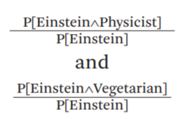
Criteria for ranking models in NAGA (2)
A good ranking function is needed to combine all three criteria. A new kind of statistical LM for graph-structured data and queries was developed for NAGA.
Consider the simple query isa(Einstein; $y).
While the YAGO knowledge base is primarily a Semantic-Web approach, the ranking for its search engine is built on Statistical-Web assets.

Slide 44
Challenges for DB and IR integration approaches
Scalable harvesting
Most new knowledge is produced in textual form. Scaling up the information extraction mechanism for higher throughput without sacrificing quality is a formidable problem.
Expressive ranking
The LM-based ranking models should be extended to better capture the context of the user and the data.
User context requires personalized and task-specific LMs that consider current location, time, short-term history, and intention in the user’s digital traces.
Data context calls for LMs for entity-relationship graphs, aiming to better model complex patterns beyond single facts (edges) and consider types
Efficient search
Evaluating complex query predicates over graphs is computationally difficult.
Ranking could be very expensive if we have a large number of results.
Solution: Compute only top-k results.
Notes:
Scalable Harvesting: For example, can IE tools process all blog postings on the planet at the same rate they are produced, without missing relevant facts or producing too many false positives

Slide 45
How the three directions could work together in the future
Semantic, Statistical and Social-Web knowledge harvesting approaches are by no means mutually exclusive.
Semantic-Web sources can be powerful tools for large-scale Statistical-Web mining.
Statistical-Web tools may produce many false positives, but they can be assessed by Social-Web platforms with large communities of users that engage in human-computing tasks.
Social-Web approaches in turn are often the basis for developing high-value knowledge repositories that eventually become Semantic-Web assets
Notes:
Social Web example : Wikipedia

Slide 46
Conclusion
Although the ultimate goal is for complete DB/IR integration, for now we observe only a partial adoption of IR concepts in DB systems and vice versa.
Modern DB/IR applications must be able to:
Manage structured and unstructured data
Manage heterogeneous information sources
Extract entities and relationships from text sources
The vision of automatically building and growing rich knowledge bases with expressive search and ranking capabilities may take a long time to materialize.

Slide 47
Thank you for your time
Feel free to ask any questions

