Slide 1
NoDB: Efficient Query Execution on Raw Data Files
loannis Alagiannis, Renata Borovica-Gajic, Miguel Branco, Stratos Idreos, and Anastasia Ailamaki
Marios Michael
Christos Hadjistyllis
Computer Science Department
University of Cyprus

Slide 2
Introduction
DBMS: Complexity (Significant initialization cost in loading data and preparing database system for queries)
Goal of NoDB:
Make a database system which is more accessible to the user by eliminating major bottleneck of data-to-query time
Main Idea:
Eliminating data loading by:
Querying over raw data in original place as the way to manage data in a database
Redesign query processing layer to incrementally and adaptively query raw data in situ state (original place) while automatically creating and refining auxiliary structures to speed-up future queries

Slide 3
Introduction - Traditional DBMS
Organizes data as a row store system, in the form of tuples, which are stored sequentially one tuple after the other in the form of slotted pages + additional metadata information to help in-page navigation
Creation of DB objects during loading process
During query processing the system brings pages into memory and process the tuples
Optimizer:
Creation of proper query plans, which exploit previously collected statistics about the data

Slide 4
Query over raw data files
Two straightforward ways:
Run the loading procedure whenever a query arrives
When a query referring to table R arrives, only then load table R, and immediately evaluate the query over the loaded data
The above approaches penalize the first query since creating the complete table before evaluating the query implies that the same data needs to be accessed twice
Once for loading
Once for query evaluation

Slide 5
Query over raw data files
Tightly integrate the raw file accesses with the query execution
It can be accomplished by enriching the leaf operators of the query plans with the ability to access raw data files
The scan operator tokenizes and parses a raw file on-the-fly, which allows it to create and pass tuples to the remaining query plan
Data parsing and processing occur in a pipeline
Limitations
Not viable for extensive and repeated query processing
E.g: If data is not kept in persistent tables, then every future query needs to perform loading from scratch
Materializing loaded data into persistent tables, forces a single query to adapt all loading costs

Slide 6
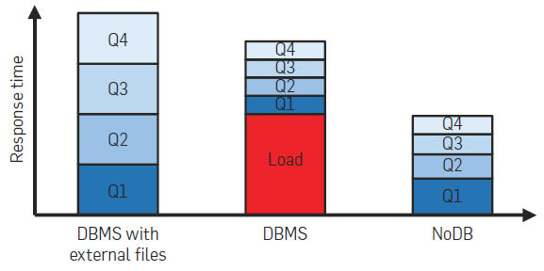
NoDB Philosophy
Minimize loading costs, while achieving or improving the query processing performance of a traditional DBMS
Individual queries may take longer to respond, than in traditional system, BUT
Data-to-query time is reduced because there is no need to load and prepare data in advance or to tune the system when different queries arrive
PERFORMANCE IMPROVES GRADUALLY AS A FUNCTION OF THE NUMBER OF QUERIES PROCESSED

Slide 7
Challenges
Main Bottleneck of in situ query processing is the access of the raw data
Degrades significantly the query performance
NoDB: Integrating raw data access in an abstract way into the query processing layer
Main challenge: Minimize the cost of accessing raw data. Two ways:
Design data structures which can help up speed-up the access
Selectively eliminating the need of raw data access by caching and scheduling raw data accesses

Slide 8
Postgresraw: Building NoDB in Postgresql
Assuming the the raw data is stored in comma separated values (CSV files)
High conversion cost to binary format (challenge for situ states)
On the fly parsing:
When a query submitted to postgresraw reference relational tables that are not yet loaded, postgresraw needs to access the respective raw files
It overrides the scan operator with the ability to access raw data files directly
Parsing and Tokenizing every time a query need to access raw data
CSV File:
File = Relational Table
Row = A Tuple of a Table
Entry = Attributed value of a Tuple

Slide 9
Postgresraw: Building NoDB in Postgresql
During parsing:
Identify each tuple or row in the raw file
Once they are identified, search for a delimiter separating values and transform those characters into proper binary values
Selective Tokenizing:
Reduce the tokenizing cost by opportunistically abort tokenizing tuples as soon as the required attributes for a query have been found
CSV is row-row so we can reduce CPU processing costs
Selective Parsing:
Reduce raw access cost
Transform to binary format only the values that are required to answer the query

Slide 10
Postgresraw: Building NoDB in Postgresql
Selective Tuple Formation:
Tuples contain only the attributes required for a given query
They are created only after select operator
RESULT:
SIGNIFICANTLY MINIMIZE ON THE FLY PROCESSING COST

Slide 11
Postgresraw: Building NoDB in Postgresql
Indexing
Adaptive Positional Map
Reduces parsing and tokenizing costs
Maintains low level metadata information on the structure of the flat file
Metadata refers to position of attributes in a raw file
Use metadata to navigate and retrieve raw data faster
Info of positional map can be used to jump to the exact position of the file or as close as possible
E.g: if a query is looking for the 9th attribute of a file, while the map contains info for the 4th and 8th attribute it will parse it until it will find it
Notes:
if a query needs an attribute X, that is not loaded, then the Postgresraw, can exploit this metadata that defer to X in raw file and jump to correct position without tokenizing

Slide 12
Postgresraw: Building NoDB in Postgresql
Map Population
Created on the fly, during query processing
Depending on where the requested attributes are located on the current map
Continuously adapting to queries
Is populated during the tokenizing phase, while tokenizing the raw file for the current query
Information also added to the map, so that Postgresraw can learn as much information as possible during each query

Slide 13
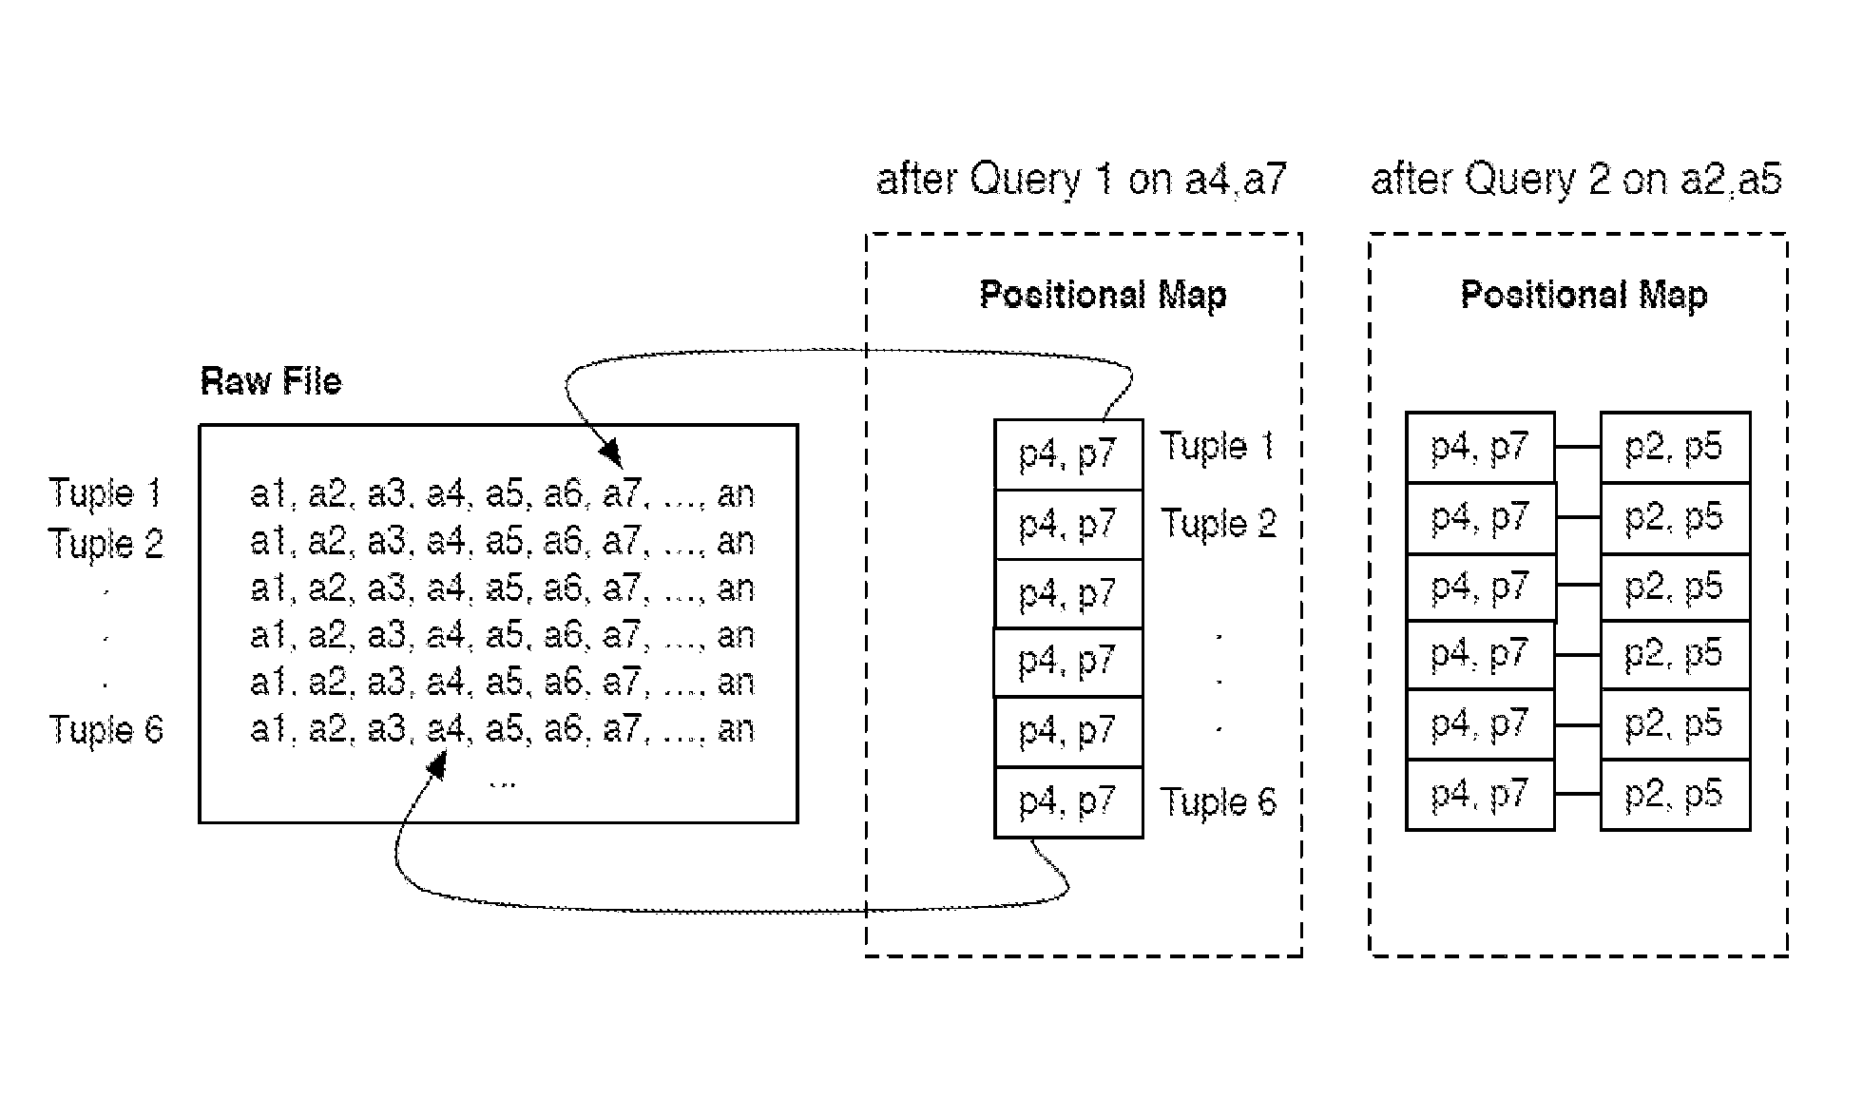
Postgresraw: Building NoDB in Postgresql
Positional Map - Storage Format
Requires a physical organization that is easy to update and incurs low cost during query execution
It is implemented as a collection of chunks that fit comfortably in the CPU cache, allowing Postgres to acquire all required data with a single access
It can also be extended by adding more chunks either vertically or horizontally
Attributes that do not necessarily appear in the map In the same order as the raw file

Slide 14
Postgresraw: Building NoDB in Postgresql
Positional Map - Maintenance
Auxiliary structure and may be dropped fully or partly without any loss of critical information
Every next query starts rebuilding the map from scratch
Postgres assign a storage threshold for the size of positional map such that the map fits comfortably in memory
Positional Map - Adaptive Behavior
Continuously indexes positions based on the most recent queries
Least recently used policy - Dropping attributes which may no longer be relevant
Combinations of attributes used in the same query, which are stored together may be dropped to give space to new combinations

Slide 15
Postgresraw: Building NoDB in Postgresql
Cache
Caching
Avoid raw file access together
If the attribute is requested by future queries, then it will be read directly from cache
Holds binary data - no need for additional parsing
Populated on-the-fly during query processing
Follows format of positional map to allowing queries to seamlessly exploit both the cache and the positional map in the same query plan

Slide 16
Postgresraw: Building NoDB in Postgresql
Optimizer
Extension of Postgres scan operator in order to create statistics on-the-fly
Invoke native statistics routines of DBMS, providing it with a sample of the data
Statistics stored and exploited in the same way as in conventional DBMS
Postgresraw creates statistics only on requested attributes in order to minimize the overhead of creating statistics query processing

Slide 17
Experimental evaluation: Environment
Sun X4140 server
2× Quad-Core AMD Opteron processor (64 bit) 2.7 GHz with 512KB L1 cache, 2MB L2 cache and 6MB L3 cache
32GB RAM
4× 250GB 10,000 RPM SATA disks (RAID-0)
Ubuntu 9.04
11GB raw file
7.5 million tuples
Each tuple contains 150 attributes with random integers [0–109)

Slide 18
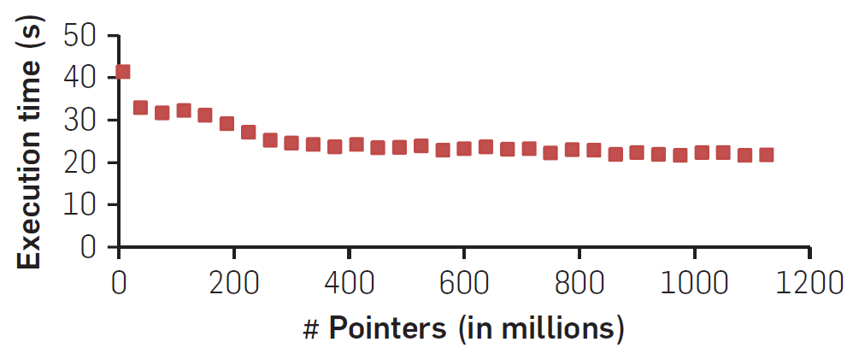
Experimental evaluation: Positional map impact
Each query asks for 10 random attributes and retrieves all the rows of the file
Measure the average time PostgresRaw needs to process all queries
varying storage capacity for positional map from 14.3MB up to 2.1GB
Notes:
improves response times by more than a factor of 2
1/4 of pointers (260 million positions) collected: execution time is 15% less
3/4 of the pointers collected: response time remains constant
PostgresRaw does not need to maintain positional information for the complete raw file
saves significant storage and access costs without compromising performance

Slide 19
Experimental evaluation: Positional map scalability
File size is increased gradually from 2GB to 92GB
Two types of tests
Adding more rows to the file (vertical)
query incrementally more attributes
Adding more attributes to the file (horizontal)
query all rows and 10 random attributes each time
Unlimited storage space for the positional map
Store only positions accessed by the most recent queries in map
Exhibits linear scalability: PostgresRaw exploits the positional map to scale as raw files grow both vertically and horizontally

Slide 20
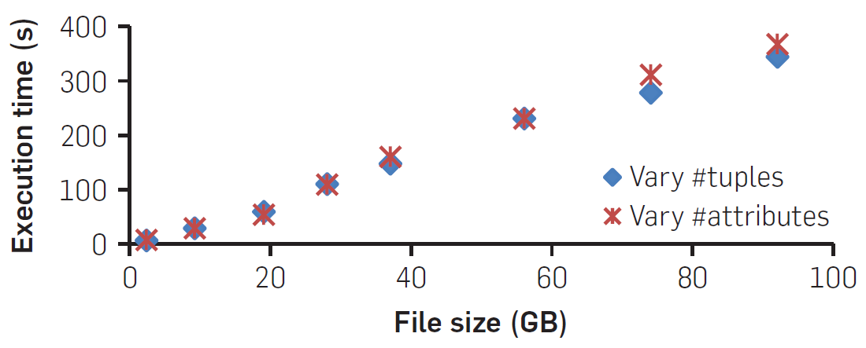
Experimental evaluation: Positional map scalability

Slide 21
Experimental evaluation: Positional map + Caching
50 queries, each query randomly accesses five columns and all rows
Four variations of test
Baseline - no positional maps or caching used
PM - only positional map is used
C - only caching used
PM+C - Both PS and caching used

Slide 22
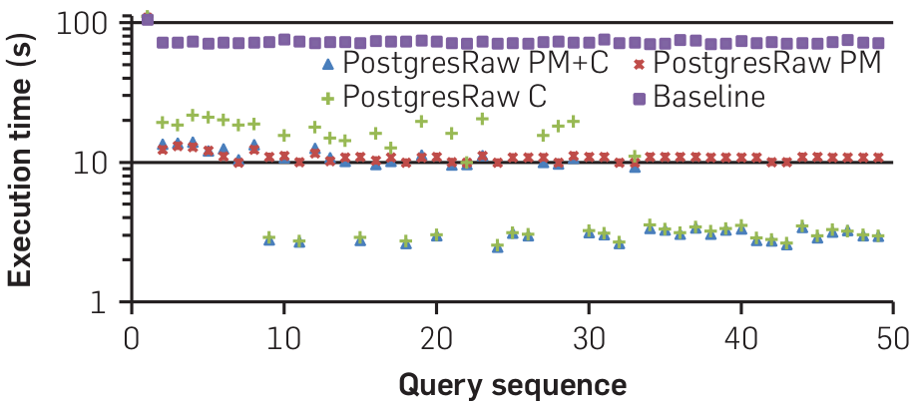
Experimental evaluation: Positional map + Caching
Notes:
Baseline variation improves slightly mainly due to file system caching then is constant
First query performance the same for all variations - no prior knowledge of raw file
Second improves
cache and the positional map are enabled the second query is 82–88% faster than the first
PM+C outperforms all other approaches across the entire query sequence

Slide 23
Experimental evaluation: Adapting to workload changes
Demonstrate that PostgresRaw progressively and transparently adapts to changes in the workload
250 queries - 50 different queries x 5 epochs (time instances)
Each epoch focuses on a given part of the raw file
5 random attributes in each query
Cache is limited to 2.8GB, positional map to 715MB

Slide 24
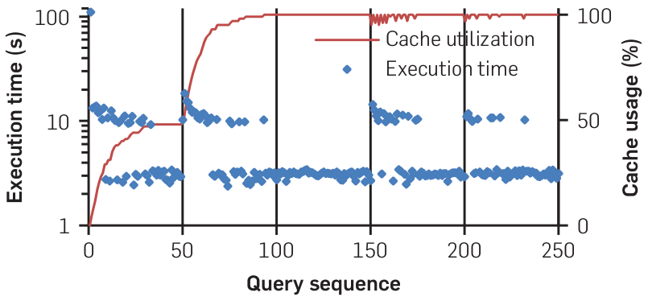
Experimental evaluation: Adapting to workload changes
Notes:
PostgresRaw gracefully adapts to the changes of the workload
quickly adapts, adjusting and populating its cache and the positional maps, automatically stabilizing to good performance levels. Additionally, the maintenance of the cache
and the positional map do not add significant overhead to query execution

Slide 25
Experimental evaluation: PostgresRaw vs DBMS
MySQL (5.5.13), DBMS X (a commercial system) and PostgreSQL
PostgresRaw with positional maps and caching enabled
MySQL and DBMS X offer “external files” functionality
Test with pre-loaded data in DBMS’s (without “external files” functionality)
Test with “external files” functionality
Q1: all attributes and all rows
Q2, Q3, Q4, Q5: access 20%, 40%, 60%, 80% less rows respectively
Q6, Q7, Q8, Q9: access 20%, 40%, 60%, 80% less columns (attributes) respectively

Slide 26
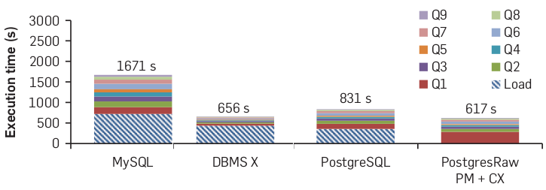
PostgresRaw vs DBMS: pre-loaded data

Slide 27
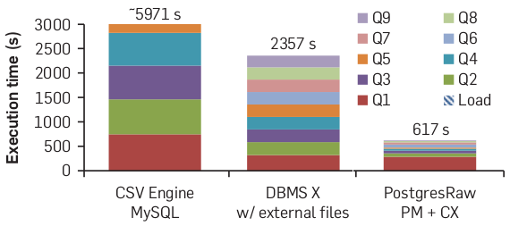
PostgresRaw vs DBMS: “external files” functionality
Notes:
results show that the in situ overhead is not a bottleneck if we apply more advanced techniques that amortize the overhead across a sequence of queries

Slide 28
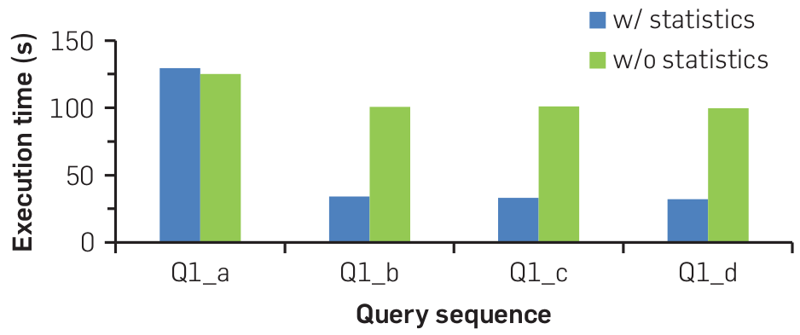
Experimental evaluation: on-the-fly statistics
Four instances of TPC-H decision support benchmark Query 1
Two tests: With on-the-fly statistics & No statistics at all
Notes:
TPC: Transaction Processing Performance Council
TPC-H is centered around the principal activities (transactions) of an order-entry environment e.g. entering and delivering orders, recording payments, checking the status of orders, and monitoring the level of stock at the warehouses
Collecting statistics adds an additional overhead of 4.5 s in the execution time of the first query
examining the query plans, we notice that the optimizer selects a different set of operators and changes the ordering of operators in PostgresRaw with statistics which explains the improvement in performance.
statistics on-the-fly adds only a small overhead,, significantly improves query plan selection.

Slide 29
TPC-H decision support benchmark Query 1
SELECT L_RETURNFLAG, L_LINESTATUS, SUM(L_QUANTITY) AS SUM_QTY,
SUM(L_EXTENDEDPRICE) AS SUM_BASE_PRICE, SUM(L_EXTENDEDPRICE*(1-L_DISCOUNT)) AS SUM_DISC_PRICE,
SUM(L_EXTENDEDPRICE*(1-L_DISCOUNT)*(1+L_TAX)) AS SUM_CHARGE, AVG(L_QUANTITY) AS AVG_QTY,
AVG(L_EXTENDEDPRICE) AS AVG_PRICE, AVG(L_DISCOUNT) AS AVG_DISC, COUNT(*) AS COUNT_ORDER
FROM LINEITEM
WHERE L_SHIPDATE <= dateadd(dd, -90, cast('1998-12-01' as date))
GROUP BY L_RETURNFLAG, L_LINESTATUS
ORDER BY L_RETURNFLAG,L_LINESTATUS

Slide 30
NoDB (In Situ Querying) trade-offs (1)
Data type conversion: overhead to convert strings to binary BUT PostgresRaw only converts attributes needed minimizing overhead
File size versus database size: data loading an overhead, BUT binary storage (usually) takes less space on disk than raw text files
Complex database schemas: DBMS can support complex relations with a lot of tables, rows and columns
Types of data analysis: NoDB querying best for exploring subsets of large datasets, DBMS best for data loaded rarely in an incremental fashion with well-known workloads

Slide 31
NoDB (In Situ Querying) trade-offs (2)
Integration with external tools: ODBC, stored procedures and user-defined functions in DBMS BUT NoDB files can be used by legacy code parallel to NoDB query engine
Database independence: using raw data files means data ownership stays with user not DBMS developer who uses proprietary data pages formats

Slide 32
NoDB Opportunities
Flexible storage: no need to worry on how data is physically organized during data loading, easier to adapt to workload later
Adaptive indexing: building and refining indexes without DBA or knowing the workload
Auto-tuning tools: exploiting idle time or workload knowledge to load and index data
Information integration: easy to develop plugins to handle different raw data file formats
File system interface: NoDB data is stored in file systems (NTFS, ext4)
can intercept file system calls and create auxiliary data structures to speed-up future queries
Notes:
Auto-tuning tools
Traditional systems assume “infinite” idle time and knowledge to perform all necessary initialization steps. In many cases, though, the reality can be somewhere in between, there might be some idle time but not enough to load all data.

Slide 33
Conclusions
For state-of-the-art database systems, the incoming data flood is a problem
Drastic changes to existing query processing technology eliminates data loading overhead/bottleneck
NoDB prototype system, PostgresRaw, demonstrates competitive performance with DBMS
Does not require any previous assumptions about data to load or how to load it before querying
Allows users to explore new data quickly
Challenges exist but more research is underway

Slide 34
Thank you
for your attention!

