Slide 1

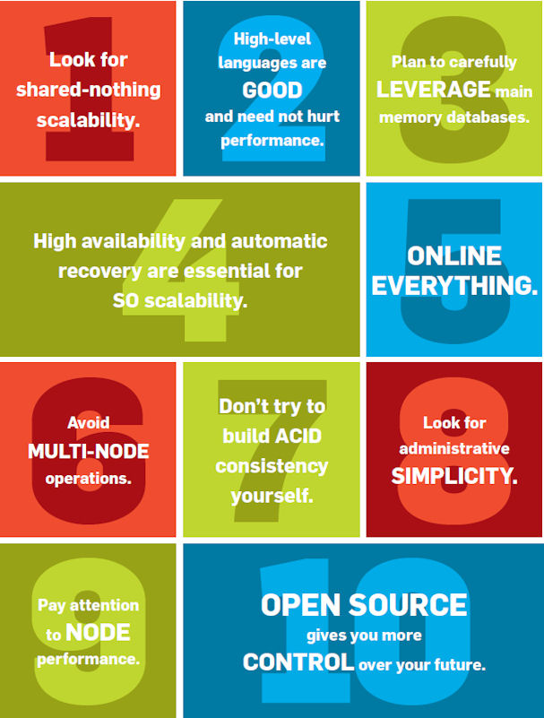
10 Rules for Scalable Performance in “Simple Operation” Datastores
By: Elena Prodromou (eprodr02@cs.ucy.ac.cy)
Giorgos Komodromos (gkomod01@cs.ucy.ac.cy)

Slide 2
Introduction
The relational Data model was proposed in 1970 by Ted Codd as the best solution for the DBMS problems of the day, the business data processing now (Online transaction processing).
Early relational systems included System R and Ingres, and almost all commercial relational DBMS (RDBMS) implementations today trace their roots to these two systems.
DBMS used in a variety of new markets e.g. data warehouses, scientific databases, social-networking sites and gaming sites.

Slide 3
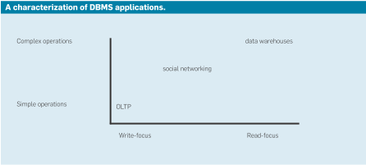
Figure 1: The modern-day DBMS market
Markets have been categorized in Simple/Complex Operations with Read/Write - focus
Focus of Paper: 10 rules the customer should consider with an SO application and in examining non-GPTRS systems.
Mix of DBMS requirements and guidelines concerning good SO application design
Rules stated in the context of customers running software in their own environment

Slide 4
Rule 1: Look for shared-nothing scalability
A DBMS can run on three hardware architectures:
Shared-memory multiprocessing (SMP)
DBMS that runs on disk clusters
Shared nothing configuration

Slide 5
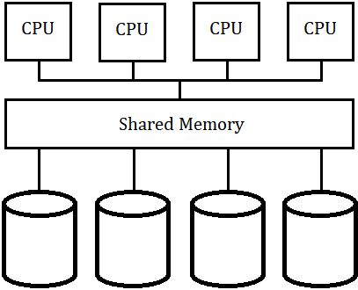
Rule 1: Look for shared-nothing scalability
Shared-memory multiprocessing (SMP)
DBMS runs on a single Node
Consists a collection of cores
Shares a common main memory
Shares a common disk system
Disadvantages:
Is limited by main memory and bandwidth to relatively small number of cores
Customers choosing an SMP system were forced to perform sharding themselves to obtain scalability across SMP nodes
Figure 2: SMP Node

Slide 6
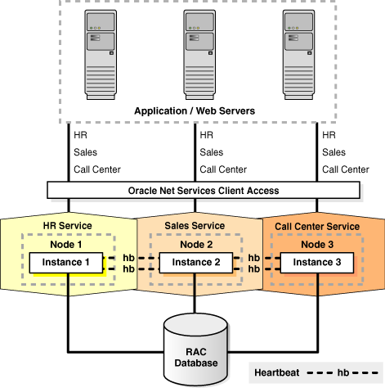
Rule 1: Look for shared-nothing scalability
DBMS that runs on disk clusters
DBMS
Consists a collection of cores with private main memory
Shares a common disk system
Disadvantages:
Includes serious scalability problems in the context of a DBMS
The same disk block can be in multiple buffer pools, due to the private buffer pool in each node’s main memory
Similarly, a private lock table is included in each node’s main memory
Careful synchronization is required!
Figure 3: Oracle RAC [3]

Slide 7
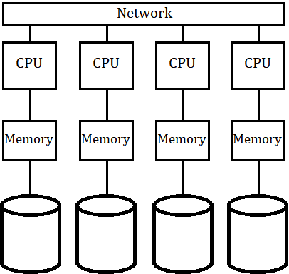
Rule 1: Look for shared-nothing scalability
Shared nothing configuration
DBMS where each node
Is self-contained (shares neither memory nor disk)
Nodes are connected through networking
Advantages:
Automatic sharding (partitioning) of data to achieve parallelism.
Systems scale only if data objects are portioned across the system’s nodes in a manner that balances the load
Unless limited by application data/operation skew, well-designed, shared nothing systems should continue to scale until networking bandwidth is exhausted or until the needs of the application are met
Warning:
Data skew or “hot spots,” degrade the performance to the speed of the overloaded node
Figure 4: Shared Nothing Configuration

Slide 8
Rule 2: High-level languages are good and need not hurt performance
Work in a SQL transaction can include the following components:
Overhead resulting from the optimizer choosing an inferior execution plan
Overhead of communicating with the DBMS
Overhead inherent in coding in a high-level language
Overhead for services (such as concurrency control, crash recovery, and data integrity)
Truly useful work to be performed, no matter what

Slide 9
Rule 2: High-level languages are good and need not hurt performance
Overhead resulting from the optimizer choosing an inferior execution plan
The claim is discarded due to:
Primitive query optimizers quickly became as good as smart human programmers
Overhead of communicating with the DBMS
For security reasons applications and DBs run in a separate address space
Communication protocols are used for the interaction (ODBC, JDBC)
These protocols require several back and forth messages over TCP/IP
Using stored Procedures will reduce the Communication Overhead
Single forth-and-back message
Using multiple transactions in one call

Slide 10
Rule 2: High-level languages are good and need not hurt performance
Overhead inherent in coding in a high-level language
This overhead is not large due to:
Most serious SQL engines compile to machine code or at least to a Java-style intermediate representation

Slide 11
Rule 3: Plan to carefully leverage main memory databases
Improvement of technology makes possible to load SO DBs entirely in the Memory:
RAM speed higher than disk. A DBMS loaded entirely in the Memory DBMS can potentially run thousands of times faster.
In cases where DBMS bigger than RAM capacity.
DBMS must be architected properly to utilize main memory efficiently.
Only modest improvements are achievable by simply running a DBMS on a machine with more memory due to the CPU overhead.
Harizopoulos et al. [2] (2008) measured performance using part of a major SO benchmark, TPC-C, on the Shore opensource DBMS.
Parameters of measurement:
DB Size that allowed all data to fit in main memory
DBMS ran in the same address space as the application driver avoiding TCP/IP cost.
Purpose of performance measurement: Categorize DBMS overhead on TPC-C

Slide 12
Rule 3: Plan to carefully leverage main memory databases
Results: CPU Performance Measurement:
Useful work (13%)
Locking (20%)
Logging (23%)
Buffer pool overhead (33%)
Multithreading overhead (11%)
A conventional disk-based DBMS clearly spends the overwhelming majority of its cycles on overhead activity. To go a lot faster, the DBMS must avoid all the overhead components
A main memory DBMS with conventional multithreading, locking, and recovery is only marginally faster than its disk based counterpart.

Slide 13
Rule 4: High availability and automatic recovery are essential for SO scalability
Today:
Few customers are willing to accept any downtime in their SO applications
Any DBMS acquired for SO applications should have built-in high availability, supporting nonstop operation
On a hardware failure, the system should switch over to the backup and continue the operation
There are three high-availability caveats:
There is a multitude of kinds of failure:
Application where the application corrupts the database
DBMS, where the bug can be recreated (Bohr bugs)
DBMS, where the bug cannot be recreated (Heisenbugs)
Hardware
Lost network packets
Denial-of-service attack
Network partitions

Slide 14
Rule 4: High availability and automatic recovery are essential for SO scalability
CAP, or consistency, availability, and partition-tolerance, theorem
Distributed system can have only two out of these three characteristics: consistency, availability, and partition-tolerance. Hence, there are theoretical limits on what is possible in the high-availability arena
Recovery from disasters is important and should be viewed as an extension of high availability, supported by replication over a wide-area network

Slide 15
Rule 5: Online everything
SO DBMS should never fail and never have to be taken offline
Operations that require the database be taken offline in many current implementations are the follow:
Schema changes: Attributes must be added to an existing database without interruption in service
Index changes: Indexes should be added or dropped without interruption
in service
Reprovisioning: It should be possible to increase the number of nodes
used to process transactions, without interruption in service
Software upgrade: It should be possible to move from version X of a DBMS to version X + 1 without interruption of service

Slide 16
Rule 6: Avoid multi-node operations
Characteristics for achieving SO scalability over a cluster of servers:
Even split: The database and application load must be split evenly over the servers
Scalability advantage: Applications rarely perform operations spanning more than one server or shard. If a large number of servers is involved in processing an operation, the scalability advantage may be lost because of redundant work, cross-server communication, or required operation synchronization
Avoid multi-shard operations to the greatest extent possible, including
queries that must go to multiple shards, as well as multi shard updates
requiring ACID properties !

Slide 17
Rule 6: Avoid multi-node operations
For example:
Customer has an employee table and partitions it based on employee age and he wants to know the salary of a specific employee.
The query is sent to all nodes, requiring a slew of messages
Only one node will find the desired data
The others will run a redundant query that finds nothing
If an application performs an update that crosses shards (e.g. raise to all employees in the shoe department) then the system must pay all of the synchronization overhead of ensuring the transaction is performed on every node.

Slide 18
Rule 7: Don’t try to build ACID consistency yourself
Building your own ACID semantics requires time and a lot of additional code
ACID semantics give the programmer the all-or-nothing guarantee needed to maintain data integrity
A commitment to a non-ACID system precludes extending such applications in the future in a way that requires coordination
If you need ACID semantics, you should use a DBMS that provides them!

Slide 19
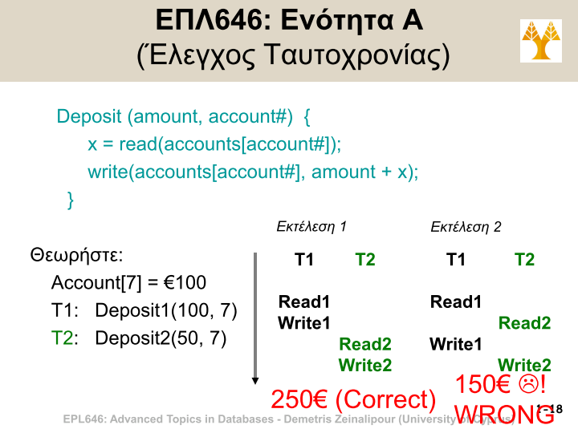
Rule 7: Don’t try to build ACID consistency yourself
Figure 5: University of Cyprus EPL646: Advanced Topics in Databases Lecture 1 [5]

Slide 20
Rule 8: Look for administrative simplicity
Most products include many tuning knobs that allow adjustment of DBMS behavior which is difficult for a common user to handle
Α DBA skilled in a particular vendor’s product, can make it go a factor of two or more faster than one unskilled in the given product
Never let the vendor do a proof-of-concept exercise for you!
Do the proof of concept yourself!

Slide 21
Rule 9: Pay attention to node performance
Though true that linear scalability is important, ignoring node performance is a big mistake
Linear scalability means overall performance is a multiple of the number of nodes times node performance
The faster the node performance, the fewer nodes one needs
Node performance makes everything else easier

Slide 22
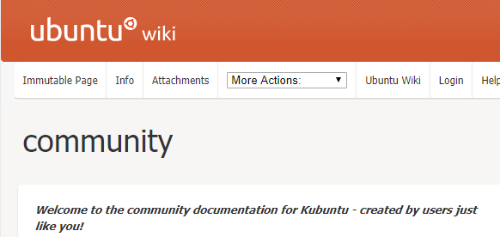
Rule 10: Open source gives you more control over your future
“Suggestion rather than a rule”
Advantages of open source:
Eliminates expensive licenses and upgrades
Offers multiple alternatives for support, new features, and bug fixes
An example for the superior alternatives supports is Ubuntu.
Think about its advantages !
Figure 5: Ubuntu Community Wiki [4]

Slide 23
References
[1] 10 rules for scalable performance in 'simple operation' datastores, Michael Stonebraker and Rick Cattell. 2011. Commun. ACM 54, 6 (June 2011), 72-80. DOI: https://doi.org/10.1145/1953122.1953144. PPTX
[2] oltP: through the looking glass and what we found there. Harizopoulos, s. et al. In Proceedings of the 2008 SIGMOD Conference on Management of Data (vancouver, b.C., June 10). aCM Press, new york, 2008, 981–992.
[3] Oracle RAC picture: https://docs.oracle.com/cd/B28359_01/rac.111/b28254/admcon.htm
[4] Ubuntu Community Wiki: https://wiki.ubuntu.com/community
[5] EPL 646 – Advanced Topics in Databases Lecture 1 by Assistant Professor Demetris Zeinalipour, University of Cyprus https://www.cs.ucy.ac.cy/~dzeina/courses/epl646/lectures/01.pdf

Slide 24
THANK YOY FOR YOUR ATTENTION ANY QUESTIONS?

