Slide 1
Data Science:
Challenges
and Directions
By Longbing Lao
ANDREAS IOANNOU & GIORGOS MOLESKIS

Slide 2
INTRODUCTION
Data Science
Observations concerning big data and the data science in:
Statistics
Computing
Informatics
Social Science
Business management
Complexities and intelligence hidden in complex data science problems
Research issues and methodologies needed to develop data science from a complex-system perspective
Notes:
Andreas

Slide 3
What is Data Science
Originated from statistics and mathematics
Expanded to data mining and machine learning
Understanding of complex data and related business problems
Translate data into insight and intelligence for decision making
Data science problems are complex systems
Notes:
Andreas

Slide 4
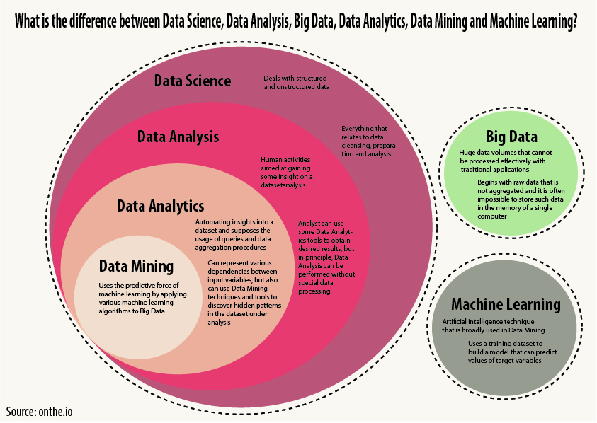
Notes:
Giorgos

Slide 5
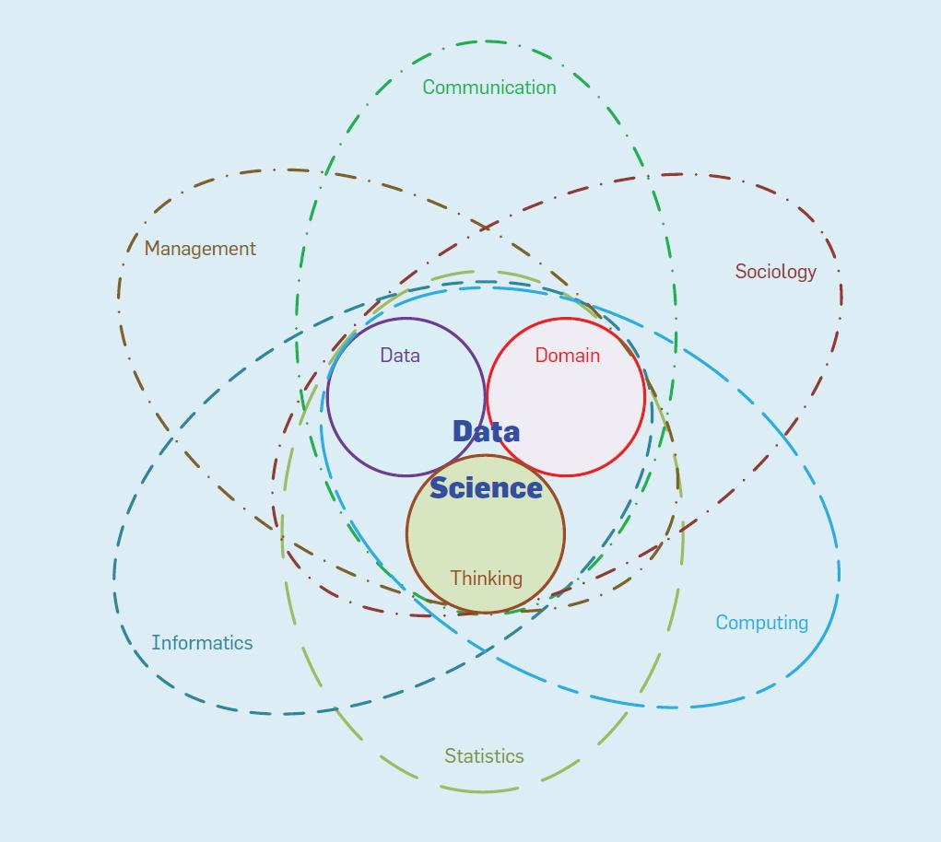
Notes:
Andreas
data science = {statistics ∩ informatics∩ computing ∩ communication ∩sociology ∩ management | data ∩domain ∩ thinking }

Slide 6
X-Complexities in Data Science
Comprehensive system complexities
Data
Large scale,high dimensionality, real time interaction and processing,noise mixed with data, unclear structures
Wrongly targeted participants, low response rate, questions unanswered
Data-driven discovery
Behavior
Business activities
Semantics and processes
Behavioral subjects and objects
Connection to physical world
Notes:
andreas

Slide 7
X-Complexities in Data Science
Comprehensive system complexities
Domain
Discovering important data characteristics value, and actionable insight.
Domain knowledge, domain factors, domain processes, human-machine synthesis, and roles and leadership in the domain
Social
In business activity and its related data
social networking, social media, group interaction and collaboration, economic and cultural factors, social norms, emotion, sentiment and opinion influence processes, and social issues
Environment
Complex contextual interactions between the business environment and data systems
Notes:
andreas

Slide 8
X-Complexities in Data Science
Comprehensive system complexities
Learning
Handle data, domain, behavioral, social, and environmental complexity.
Heterogeneous sources and inputs, parallel and distributed inputs, and their infinite dynamics in real time
Learn non-IID data-mixing coupling relationships with heterogeneity
Deliverable-product
Must satisfy and have Actionable insight for business
Must be easy to understand and interpretable by non professionals, revealing insights to business users
Designing the appropriate evaluation, presentation, visualization, refinement, and prescription of learning outcomes and deliverables to satisfy diverse business needs, stakeholders
Notes:
andreas

Slide 9
X-Intelligence in Data Science
Transform data into knowledge, intelligence, and wisdom
Transformation, comprehensive intelligence
Data
Valuable information about business problems
Understand data characteristics and complexities.
Deeply understand and represent data characteristics and complexities
Behavior
Activities, processes, dynamics,impact,behavior and business quantifiers of owners,users in the physical world
Bridge the gap between the data world and the physical world
Understanding robot's behavior
Notes:
Giorgos

Slide 10
X-Intelligence in Data Science
Domain
Domain factors, Knowledge associated with a problem and its target data
Deep understanding of domain complexities => Can help discover unknown knowledge and actionable insight
Human
Human intuition,imagination, empirical knowledge, belief
Intention, expectation, runtime supervision,evaluation
Emotional intelligence,inspiration, brainstorming
Network
Web intelligence and broad-based networking and connected activities and resources
Example: crowdsourcing-based open source system development and algorithm design
Notes:
Giorgos

Slide 11
X-Intelligence in Data Science
Organizational
Organizational goals, actors, and roles, structures, behaviors, evolution and dynamics,
For example, the cost effectiveness of enterprise analytics and functioning of data science teams rely on organizational intelligence.
Social
Social interactions, group goals and intentions
Social cognition, emotional intelligence
Group decision making
Interactions among social systems as business rules, law, trust,reputation
Environmental
Hidden in data science problems
Underlying domain and related organizational, social, human, and network intelligence
Interactions between the world of transformed data and the physical world functioning as the overall data environment.
Notes:
Giorgos

Slide 12
Known-to-Unknown Transformation
“We know there are some things we do not know”
Understand known to unknown complexities in order to transform data into knowledge, intelligence, and insight for decision taking(CKI)
Knowledge = processed information
Notes:
both

Slide 13
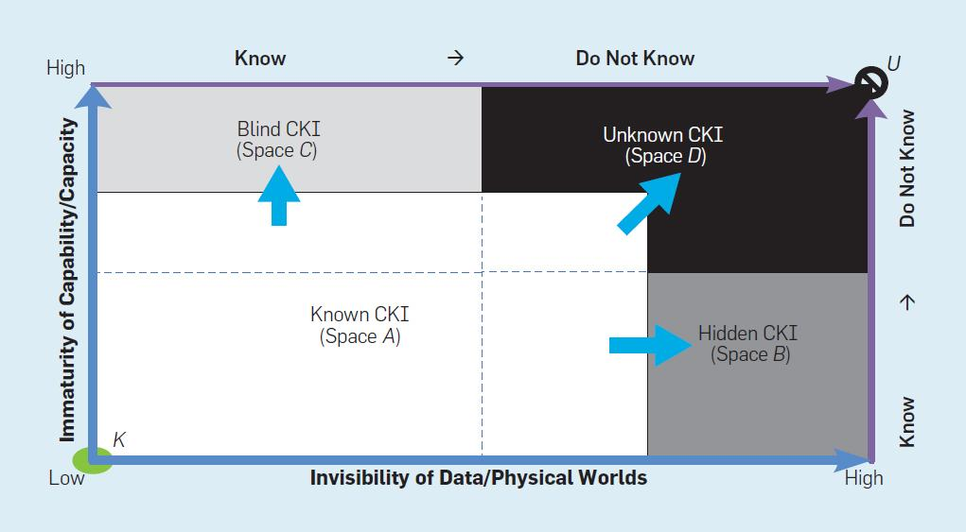
Notes:
Figure 2 outlines data science progression aiming to reduce the immaturity of capabilities and capacity (yaxis) to better understand the hidden complexities, knowledge, and intelligence (CKI) in data/physical worlds (x axis) from the 100% known state K to the 100% unknown state U. Based on data/physical world visibility and capability/capacity maturity, data science can be categorized into four data challenges:
“Space A” represents the known space; that is, “I (my mature capability/capacity) know what I know (about the visible world).” This is like the ability of sighted people to recognize an elephant by seeing the whole animal, whereas non-sighted people might be able to identify only part of the animal through touch. Knowledge concerning visible data is known to people with mature capability/capacity; that is, their capability/capacity maturity is sufficient to understand data/physical-world invisibility. This insight corresponds to well-understood areas in data science. Examples include profiling and descriptive analysis that applies existing models to data deemed by data analysts to follow certain assumptions.
“Space B” represents the hidden space; that is, “I know what I do not know (about the unseen world).” For some people or disciplines, even though certain aspects of their capability/capacity is mature, CKI is hidden to (so cannot be addressed by) current data science capability/capacity, thus requiring more-advanced capability/ capacity. Examples include existing IID models (such as k-means and the knearest neighbors algorithm) that cannot handle non-IID data.
“Space C” represents the blind space; that is, “I (my immature capability) do not know what I know (about the world).” Although CKI is visible to some people or disciplines, their capability/ capacity is also mature, but CKI and capability/capacity do not match well; immaturity thus renders them blind to the world. An example might be when even established social scientists try to address a data science problem.
“Space D” represents the unknown; that is, “I do not know what I do not know, so CKI in the hidden world is unknown due to immature capability.” This is the area today on which data science focuses its future research and discovery. Along with increased invisibility, the lack of capability maturity also increases. In the world of fast-evolving big data, CKI invisibility increases, resulting in an ever-larger unknown space.

Slide 14
Known-to-Unknown Transformation
Complexities, Knowledge, and Intelligence
Space A “We know what we know”
Easy to extract CKI
People with mature capability/capacity
Space B - “I know what i do not know”
More-advanced capability/ capacity
k-means and the knearest neighbors algorithm cannot handle IID
Problems that can’t be solved
I know that i can’t solve the problem
Space C “Do not know what I know”
Data is visible
Dificult to extract CKI because of immaturity
Space D “I do not know what I do not know”
Future research and discovery
Increased Invisibility
Even more-advanced capability/ capacity
Notes:
both

Slide 15
Data Science Directions
Data Science Landscape
Data input
X-Complecity
X-Inteligence
Data-driven discovery
Discovery Tasks
Challenges
Data output
Significant aspirational goals:
Νon-IID data learning
Ηumanlike intelligence
New research chalenges that motivate Data science
X-Complexities
X-inteligence
Gap between world invisibility
and capability/capacity immaturity
Notes:
andreas

Slide 16
Non-data-science methodologies, theories, or systems
Data/business
Identify,Specify,represent and quantify X-Complexities and X-Inteligence that cannot be managed well through existing theories and techniques
Mathematical and statistical foundation
Disclose, describe, represent, and capture X-Complexities and X-Inteligence
deep representation of data complexities, , support for non-IID data learning
Data/knowledge engineering and X-analytics
develop domain-specific analytic theories, tools, and systems το, discover and manage the data, knowledge,
automated analytical software that constructs models, that understανd intrinsic data complexities and intelligence,domain-specific context and learns algorithms that recognize data complexities
Notes:
andreas

Slide 17
Data Science Directions
Data quality and social issues
Identify, specify, and respect social issues in domain-specific data, business-understanding, and data science processes
Social Issues:Use, privacy, security, and trust
Data value, impact, utility.
Identify, specify, quantify, and evaluate the value, impact, and utility of domain-specific data.
Data-to-decision and action-taking challenges.
Develop decision-support theories and systems to enable data-driven decisions and insight-to-decision transformation,
Ways to transform analytical findings into decision-making strategies.
Notes:
andreas

Slide 18
Data Science Directions
Data-quality enhancement
Noise, uncertainty, missing values, and imbalance
Increasing scale of complexity and data-quality issues
Cross-organizational, cross media, cross-cultural, and cross-economic mechanisms
Ability to perform deep analytics
Discovering unknown knowledge and intelligence in the unknown space
Data-driven and model-based problem solving
Notes:
Giorgos

Slide 19
Data Science Directions
X-complexity and X-intelligence
Simulate the complexities, intelligence, working mechanisms, processes
Big-data analytics
High-performance processing and analytics
Large-scale, real-time, online, high-frequency
New distributed, parallel, high-performance infrastructure
Batch, array, memory, disk, and cloud-based processing and storage, data-structure and-management systems, and data to-knowledge management.
Another important issue for developers of data systems is how to support the networking, communication, and interoperation of the various data science roles within a distributed data science team.
Notes:
Giorgos

Slide 20
Violating assumptions in data
science.
Violated assumptions lead to inaccurate, distorted, or misleading results.
Many complex problems include complex coupling,relationships,distributions,formats, types and variables,and unstructured and weakly structured data.
Detection and verification of validations is limited
Tools to manage and circumvent assumption violations in big data.
Notes:
andreas

Slide 21
IID assumption Violation
Big, complex data (referring to objects, attributes, and values ) is essentially non-IID
Most existing analytical methods are IID that ignores or simplifies all these properties
Learning visible and especially invisible non-IIDness => deep understanding of data with weak and/or unclear structures, distributions, relationships, and semantics.
Individual learners cannot tell the whole story due to their inability to identify such complex non-IIDness.
Effectively learning the widespread, visible, and invisible non-IIDness of big data=> complete picture of an underlying business problem.
Notes:
andreas

Slide 22
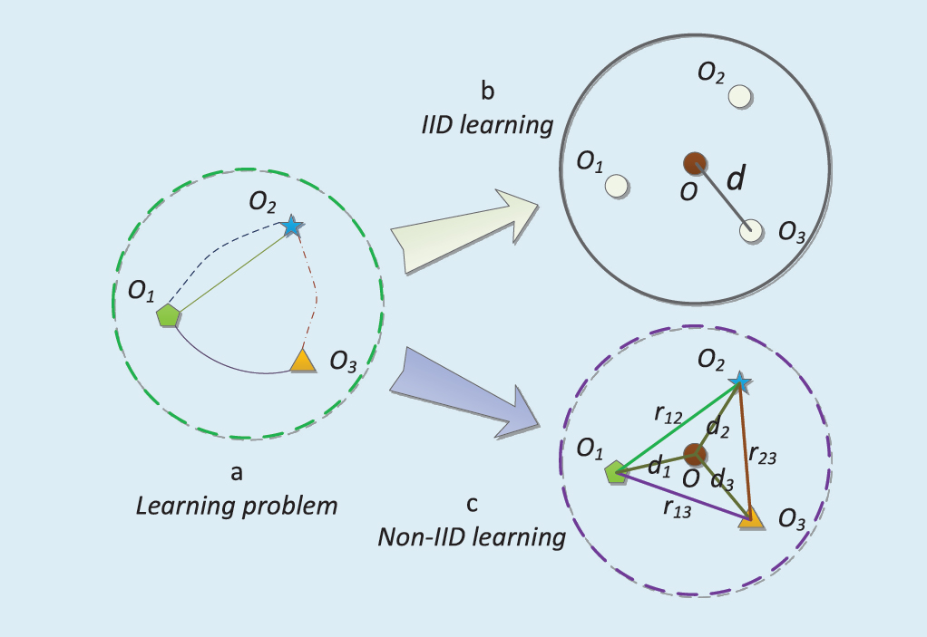
Notes:
andreas

Slide 23
Non-IIDness and nonIID data learning
Deep understanding of non-IID data characteristics.
Identify, specify, and quantify non-IID data characteristics, factors, types, and levels of non-IIDness in data and business
Identify the difference between what can be captured and what cannot be captured through existing technologies
Non-IID feature analysis and construction
invent new theories and tools for analyzing feature relationships
Non-IID learning theories, algorithms, and models
Analyzing, learning, and mining
Non-IID similarity and evaluation metrics
Similarity and dissimilarity learning methods and metrics
Notes:
Giorgos
More broadly, many existing dataoriented theories, designs, mechanisms, systems, and tools may have to be reinvented in light of non-IIDness.

Slide 24
Data characteristics and X-complexities.
Understanding data characteristics and X-complexities challenges and directions
Data characteristics and X-complexities
assume data characteristics and X-complexities determine the values, complexities, and quality of data driven discovery.
Understanding data characteristics and X-complexities
Definition of data characteristics and x complexities
Represent and model data characteristics and x complexities
Data understanding, analysis,learning and management
Evaluate the quality of data
Notes:
Giorgos

Slide 25
Data-brain and human like machine intelligence
Curiosity
Imagination, reasoning, aggregation, creativity
Experience, exploration, learning, and reflection
Create machines that generate, retain, and simulate human curiosity through learning
Imaginative thinking
Intuitive, creative, evolving, and uncertain
Transform logic and patterns into human like data systems
Machines to simulate human imagination
Cognitive science, social science, data science, and intelligence science
Discovery
Synthesizing comprehensive data, information, knowledge, and intelligence through cognitive-processing methods and processes
Notes:
Giorgos

Slide 26
Complex Systems
Large-scale data objects
Data from online, business, mobile, or social networks
Human involvement
Domain constraints,
Societal characteristics,
Uncertainty
Notes:
Giorgos
Complex systemps= have x-complexities

Slide 27
Developing Complex Systems
“single intelligence engagement”
Simple data science problem solving and systems.
“multi-aspect intelligence engagement.”
Complex data science problems.
“intelligence metasynthesis”
Complex system engineering
Synthesizes, and uses ubiquitous intelligence in the complex data environment
“reductionism” methodology
Analyzing, designing, and evaluating complex data problems
Notes:
Giorgos

Slide 28
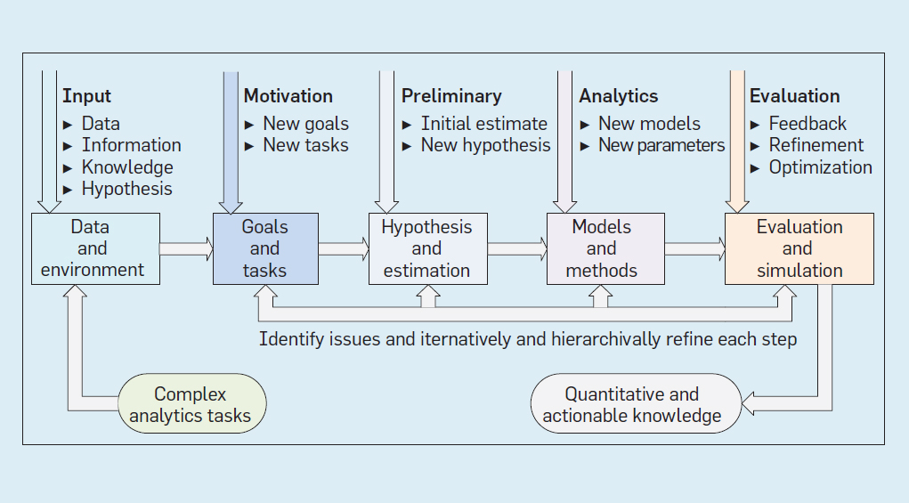
Notes:
Andreas
“metasynthetic computing and engineering”
MCE supports an iterative, hierarchical problem-solving process, incorporating internal and external inputs, including data, information, domain knowledge, initial hypotheses, and underlying environmental factors.
Data scientists would start by presetting analytics goals and tasks to be explored on the given data by incorporating domain, organizational, social and environmental complexities and intelligence. They would then use preliminary observations obtained from domain and experience to identify and verify qualitative and quantitative hypotheses and estimations that guide development of modeling and analytics methods. Findings would then be evaluated and fed back to the corresponding procedures for refining and optimizing understanding of previously unknown problem challenges, goals, and discovery methods. Following these iterative and hierarchical steps toward qualitative-to-quantitative intelligence transformation would thus disclose and quantify the initial problem “unknownness.” Finally, actionable knowledge and insight would be identified and delivered to businesspeople who would address data complexities and business goals.

Slide 29
Qualitative-to-Quantitative
Exploration of open complex systems
Iterative cognitive and problem-solving process on a human-centered
Presetting analytics goals and tasks
Preliminary observations obtained from domain and experience to identify and verify qualitative and quantitative hypotheses and estimations
Evaluated and fed back to the corresponding procedures for refining and optimizing
Disclose and quantify the initial problem “unknownness.”
Knowledge and insight would be identified and delivered to businesspeople who would address data complexities and business goals
Notes:
andreas

Slide 30
Conclusion
Understand X - Complexities, X-Inteligence = > More insight
Improve maturity of Capacity/Capability => Better CKI extraction
Νon-IID data learning and Ηumanlike intelligence => Better data analysis
Complex data problem solving require systematic, evolving, imaginative, critical and actionable data science thinking

Slide 31
Thank you for your attention ! Questions?

