Slide 1
Reference A DNA-Based Archival Storage System James Bornholt, Randolph Lopez, Douglas M. Carmean, Luis Ceze, Georg Seelig, and Karin Strauss. 2016. A DNA-Based Archival Storage System. In Proceedings of the Twenty-First International Conference on Architectural Support for Programming Languages and Operating Systems (ASPLOS '16). ACM, New York, NY, USA, 637-649. DOI: https://doi.org/10.1145/2872362.2872397
Giorgos Demosthenous georgedemo2000@gmail.com
Kyriakos Kyriakou kyriakos093@gmail.com

Slide 2
A DNA-Based Archival Storage System
Giorgos Demosthenous
Kyriakos Kyriakou

Slide 3
Abstract

Slide 4
Problem
Demand for data storage is growing exponentially, but the capacity of existing storage media is not keeping up.

Slide 5
Solution
Using DNA to archive data

Slide 6
We care about
storage density
durability

Slide 7
Storage
Traditional
DNA
Optical Disks
Tape
Durability >500 years
Density 1EB/mm³
Density 10GB/mm³
Density 100GB/mm³
^{Durability} ^{10-30 years}
^{Durability} ^{3-5 years}
Notes:
Durability: >500 years in harsh environments
Synthetic DNA sequences have long been considered a potential medium for digital data storage.

Slide 8
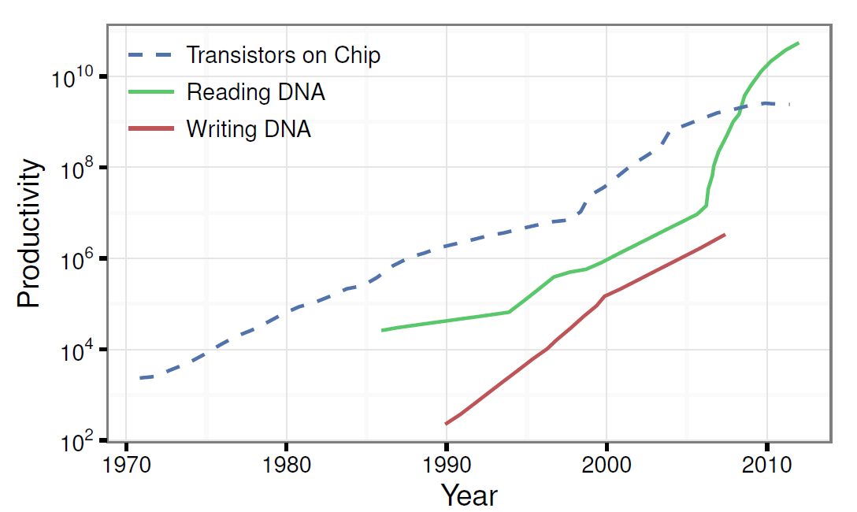
Progress in DNA Storage has been rapid
Notes:
Figure 1: Carlson curves [4]: trends in DNA synthesis and sequencing technology compared to Moore’s Law. DNA productivity is measured in nucleotides per person per day. Recent growth in sequencing technology eclipses Moore.
The volume of data that can be synthesized today is limited mostly by the cost of synthesis and sequencing, but growth in the biotechnology industry portends orders of magnitude cost reductions and efficiency improvements.
Sequencing and synthesis improvement projections. Today, neither the performance nor the cost of DNA synthesis and sequencing is viable for data storage purposes. However, they have historically seen exponential improvements. Their cost reductions and throughput improvements have been compared to Moore’s Law in Carlson’s Curves [4], as shown in Figure 1. It shows that sequencing productivity has been growing faster than Moore’s Law. Important biotechnology applications such as genomics and the development of smart drugs are expected to continue driving these improvements, eventually making data storage a viable application.

Slide 9
Challenges
Error rates on the order of 1% per nucleotide
Synthesis
Sequencing
Degrading while stored
Read latency is much longer than write latency when randomly accessing data
Large-block access
Notes:
Large-block access: to read even a single byte from storage, the entire DNA pool must be sequenced and decoded.

Slide 10
Devise appropriate encoding schemes that can tolerate errors by adding redundancy.
Error rates
Use a polymerase chain reaction (PCR) to amplify only the desired data
Read Latency
Notes:
Large-block access: to read even a single byte from storage, the entire DNA pool must be sequenced and decoded.

Slide 11
Background on DNA Manipulation

Slide 12
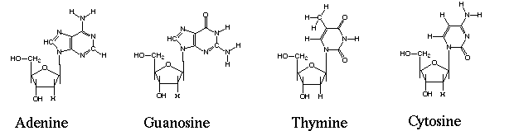
Nucleotides
The basic building blocks of DNA.
DNA BASICS
PCR PROCESS
DNA SYNTHESIS
DNA SEQUENCING
A
G
T
C

Slide 13
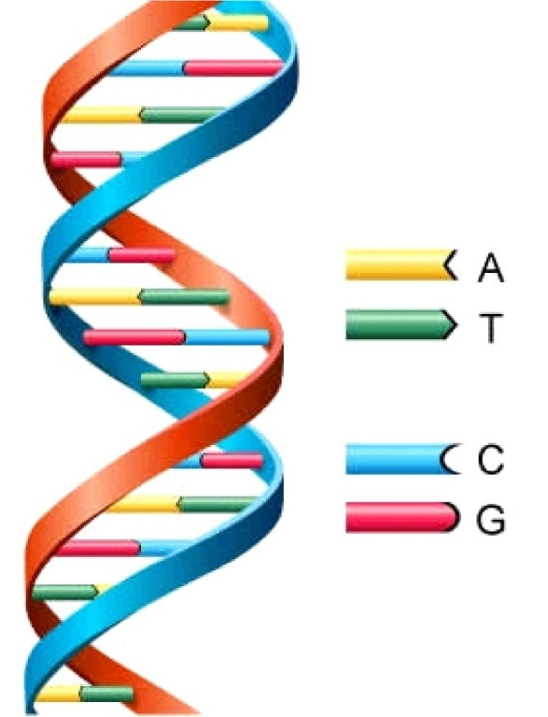
DNA Strands (oligonucleotide)
A line sequence of nucleotides.
Two single strands can bind to each other and form a double helix if they are complementary
A in one strand aligns with T in the other, and likewise for C and G.
DNA BASICS
PCR PROCESS
DNA SYNTHESIS
DNA SEQUENCING
Notes:
Starting from 5’

Slide 14
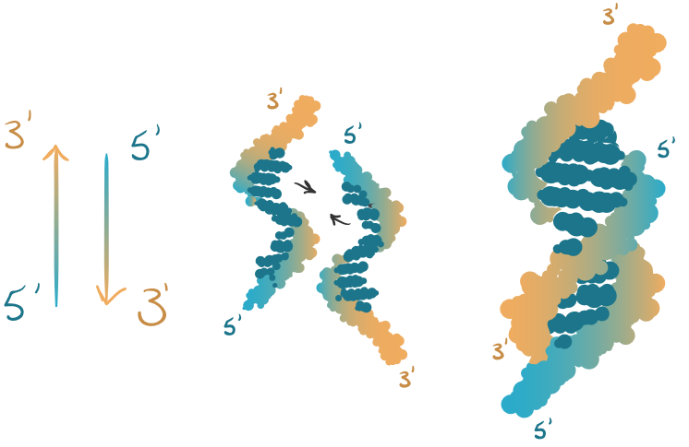
DNA Strands (oligonucleotide)
The two ends of a DNA strand, referred to as the 5′ and 3′ ends, are chemically different.
(5′ end binds to the other strand’s 3′ end)
DNA BASICS
PCR PROCESS
DNA SYNTHESIS
DNA SEQUENCING

Slide 15
Selective DNA amplification with polymerase chain reaction (PCR)
PCR is a method for exponentially amplifying the concentration of selected sequences of DNA.
This reaction requires four main components:
The template
Sequencing primers
A thermostable polymerase
Individual nucleotides
DNA BASICS
PCR PROCESS
DNA SYNTHESIS
DNA SEQUENCING
Notes:
Individual nucleotides that get incorporated into the DNA strand being amplified. The template is a single- or double-stranded molecule containing the (sub)sequence that will be amplified. The DNA sequencing primers are short synthetic strands that define the beginning and end of the region to be amplified. The polymerase is an enzyme that creates double-stranded DNA from a single-stranded template by “filling in” individual complementary nucleotides one by one, starting from a primer bound to that template.

Slide 16
Why PCR?
Using PCR we can amplify only specific subsequences of a DNA strand that contain the desired data.
This way we avoid loading and decoding unnecessary information.
DNA BASICS
PCR PROCESS
DNA SYNTHESIS
DNA SEQUENCING

Slide 17
DNA Synthesis
The process of chemically synthesizing single-strand DNA sequences, one nucleotide at a time.
This process yields a coupling efficiency of 99%, meaning that a small sequencing error is produced after each step.
As a result only 200 nucleotides can be efficiently synthesized.
DNA BASICS
PCR PROCESS
DNA SYNTHESIS
DNA SEQUENCING
Notes:
Because in each step the error increases.
In practice, synthesis of a given sequence uses a large number of parallel start sites and results in many truncated byproducts (the dominant error in DNA synthesis), in addition to many copies of the full length target sequence. Thus, despite errors in synthesizing any specific strand, a given synthesis batch will usually produce many perfect strands. Moreover, modern array synthesis techniques [15] can synthesize complex pools of nearly 105 different oligonucleotides in parallel.

Slide 18
DNA Sequencing
The process of determining the order of nucleotides within a specific DNA strand.
DNA polymerase enzymes are used for sequencing.
Fluorescent nucleotides are used to aid with reading the sequence, since each type of fluorescent nucleotide emit a different color.
DNA BASICS
PCR PROCESS
DNA SYNTHESIS
DNA SEQUENCING
Notes:
Because in each step the error increases.
In practice, synthesis of a given sequence uses a large number of parallel start sites and results in many truncated byproducts (the dominant error in DNA synthesis), in addition to many copies of the full length target sequence. Thus, despite errors in synthesizing any specific strand, a given synthesis batch will usually produce many perfect strands. Moreover, modern array synthesis techniques [15] can synthesize complex pools of nearly 105 different oligonucleotides in parallel.

Slide 19
A DNA Storage System

Slide 20
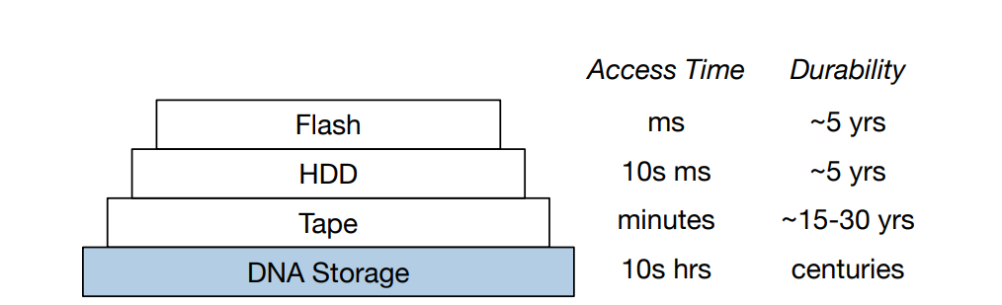
DNA storage as the bottom level of the storage hierarchy
Notes:
3. A DNA Storage System
We envision DNA storage as the very last level of a deep storage hierarchy, providing very dense and durable archival storage with access times of many hours to days (Figure 2). DNA synthesis and sequencing can be made arbitrarily parallel, making the necessary read and write bandwidths attainable. We now describe our proposal of a system for DNA-based storage with random access support.

Slide 21
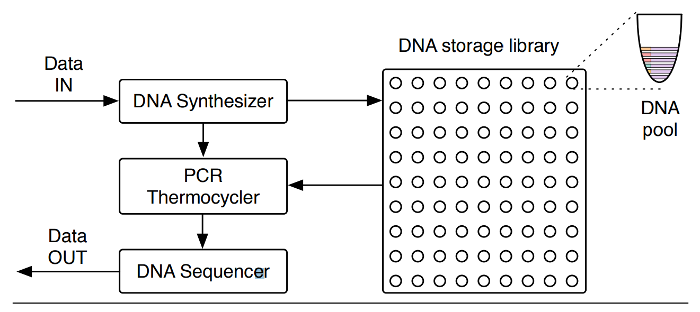
DNA Storage System
Notes:
A DNA storage system consists of a DNA synthesizer that encodes the data to be stored in DNA, a storage container with compartments that store pools of DNA that map to a volume, and a DNA sequencer that reads DNA sequences and converts them back into digital data. Figure 3 shows an overview of the integrated system.
The basic unit of DNA storage is a DNA strand that is roughly 100-200 nucleotides long, capable of storing 50-100 bits total. Therefore, a typical data object maps to a very large number of DNA strands. The DNA strands will be stored in “pools” that have stochastic spatial organization and do not permit structured addressing, unlike electronic storage media. Therefore, it is necessary to embed the address itself into the data stored in a strand. This way, after sequencing, one can reassemble the original data value. We discuss digital data representation in DNA in Section 4.

Slide 22
DNA Storage System
Key-Value Architecture
put(key, value) : associates value with key (write)
get(key) : retrieves the value assigned to key (read)

Slide 23
Implementation Requirements
a function that maps a key to the DNA pool (in the library) where the strands that contain data reside
a mechanism to selectively retrieve only desired portions of a pool (i.e, random access)
Notes:
Για το map function δεν το υλοποίησαν σε αυτό το paper αλλά το πήραν από προηγούμενη δουλειά.

Slide 24
Random Access
Use a pair of PCR primers as a key

Slide 25
At write time, those primers are added to the strands.
At read time, those same primers are used in PCR to amplify only the strands with the desired keys.
Notes:
Separating the DNA strands into a collection of pools (Figure 3) balances a trade-off between storage density, reliability, and performance. The most dense way to store data would be to have all strands in a single pool, but this arrangement sacrifices reliability for two reasons. First, a single pool requires many different primers to distinguish all keys, which increases the chance that two primers react poorly to each other. Second, a single pool reduces the likelihood that a random sample drawn during the read process will contain all the desired data. On the other hand, using a separate pool per key sacrifices density excessively. We therefore use a library of reasonably-sized pools, and use random access within each pool.

Slide 26
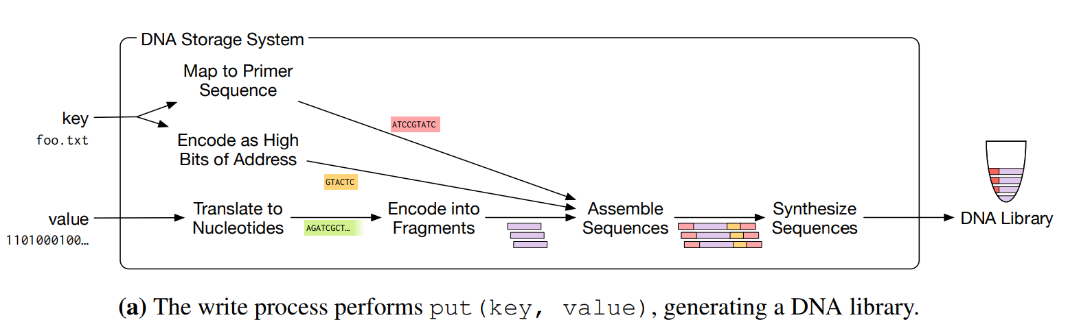
Write Process
Notes:
The write process (Fig. 4(a)) takes as input the key and value to store. It uses the key to obtain the PCR primer sequences, compute the high part of the address, and to determine the pool in the DNA library where the resulting strands will be stored. The low part of the address indexes the multiple strands generated by chunking the value (see Sec. 4.2). Next, it encodes the data addresses, payloads, and error detection codes, and attaches the primer target sequences, to produce final DNA sequences for the synthesizer to manufacture. The resulting DNA molecules are stored in the storage library for archival.

Slide 27
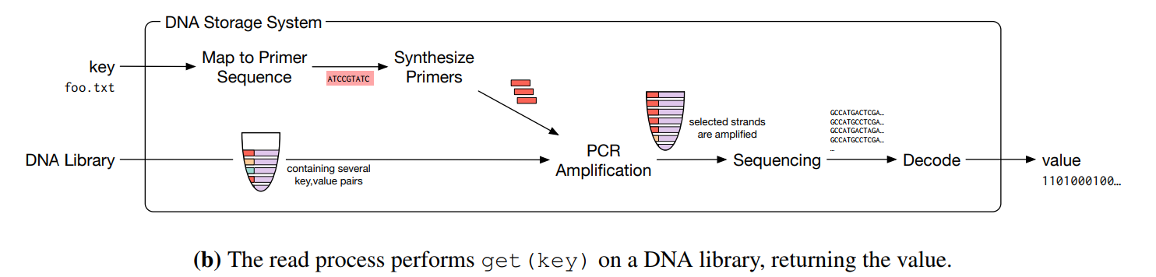
Read Process
Notes:
The read process (Fig. 4(b)) takes as input a key. It uses the key to obtain the PCR primer sequences that identify molecules in the pool associated with that key. Next, the storage system physically extracts a sample from the DNA pool that contains the stored data, but likely also includes large amounts of unrelated data. The sample and the PCR primers are sent to the PCR thermocycler, which amplifies only the desired strands. The resulting pool goes to the DNA sequencer, which ultimately produces the digital data readout. Note that this process might be iterative since it may require multiple samples and sequencing steps to extract all the data associated with the desired keys. The DNA synthesizer is used for both producing the DNA strands that hold data payload as well as synthesizing the PCR primers used to amplify data during the random access read process

Slide 28
Representing Data in DNA

Slide 29
How can we store binary data in DNA?

Slide 30
Parallelism
Lowest Level
Raw Bits (1 or 0)
Abstraction
Digital Data
Lowest Level
Nucleotides (A, G, T or C)
Abstraction
A continuous string of quaternary (base-4) numerals
encoding/decoding
TRADITIONAL STORAGE
DNA
encoding/decoding
Notes:
Goal: To store binary data in DNA
Encoding/decoding

Slide 31
First Approach
Encode the binary data in base 4
map
0 1 2 3 to A C G T
example
01110001₂ > 1301₄ > CTAC_{dna_sequence}

Slide 32
High Error Rates
Substitutions, Insertions and Deletions of Nucleotides

Slide 33
Huffman Code Approach
Encode the binary data in base 3
map
0 1 2 to A C G T
How?
Notes:
The likelihood of some forms of error can be reduced by encoding binary data in base 3 instead of base 4 [10], as Figure 5(a) illustrates.
Because base 3 is not a multiple of base 2, mapping directly between the bases would be inefficient: 6 ternary digits (3 6 = 729) can store 9 bits of data (2 9 = 512), but waste 217 possible states. Instead, we use a Huffman code [13] that maps each binary byte to either 5 or 6 ternary digits. For example, the Huffman code maps the binary string 01100001 to the base-3 string 01112. The rotating nucleotide encoding maps this string to the DNA sequence CTCTG. The code maps more common ASCII characters to 5 digit strings, offering minor compression benefits for textual data, though the effect on overall storage density is insignificant.

Slide 34
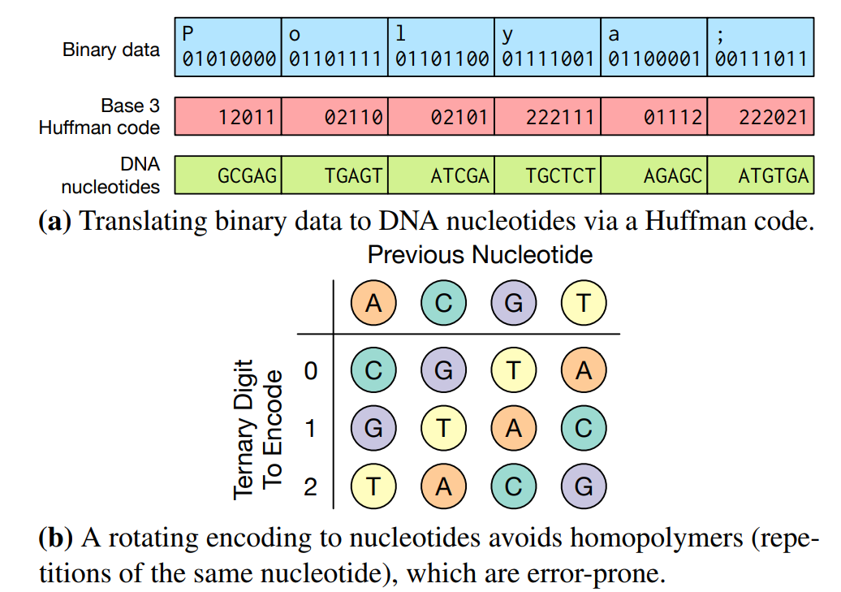

Slide 35
DNA Data Representation Challenges
Data beyond the hundreds of bits therefore cannot be synthesized as a single strand of DNA
DNA pools do not offer spatial isolation, and so a pool contains data for many different keys which are irrelevant to a single read operation. Isolating only the molecules of interest incurs significant cost and time overheads.

Slide 36
Solutions
Organize data in DNA in a similar fashion to Goldman et al
Segmenting the nucleotide representation into blocks Allows storage of large values
Tagging strands with identifying primers Allows the read process to isolate molecules of interest and so perform (random access)

Slide 37
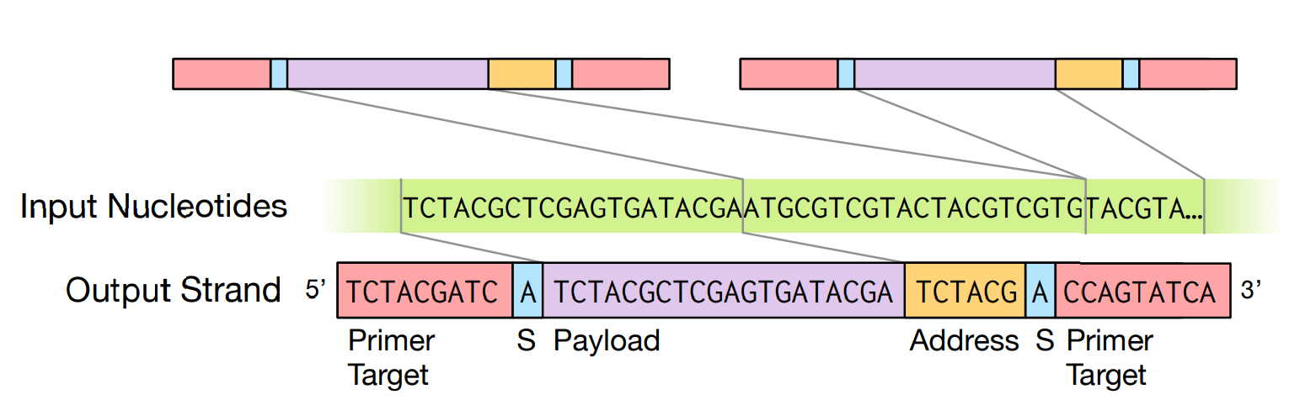
Goldman et al DNA Data Organization
Notes:
Figure 6: An overview of the DNA data encoding format. After translating to nucleotides, the stream is divided into strands. Each strand contains a payload from the stream, together with addressing information to identify the strand and primer targets necessary for PCR and sequencing.

Slide 38
Payload
The string of nucleotides representing the data to be stored is broken into data blocks
“S” indicates whether the strand has been reverse complemented
PAYLOAD
ADDRESS
PRIMERS
RANDOM ACCESS

Slide 39
High Part of Address
Identifies the key a block is associated with
PAYLOAD
ADDRESS
PRIMERS
RANDOM ACCESS

Slide 40
Low Part of Address
Indexes the block within the value associated with that key
PAYLOAD
ADDRESS
PRIMERS
RANDOM ACCESS

Slide 41
Primers
Allow the PCR to selectively amplify only those strands with a chose primer sequence.
PAYLOAD
ADDRESS
PRIMERS
RANDOM ACCESS
Notes:
Primers: To each end of the strand, we attach primer sequences. These sequences serve as a “foothold” for the PCR process, and allow the PCR to selectively amplify only those strands with a chosen primer sequence.

Slide 42
Random Access (1)
Existing work on DNA storage uses a single primer
sequence for all strands
Inefficient: The entire pool must be sequenced to recover one value
Instead, design a mapping from keys to unique primer sequences in order to provide random access.
PAYLOAD
ADDRESS
PRIMERS
RANDOM ACCESS

Slide 43
Random Access (2)
All strands for a particular object share a common primer
Different strands with the same primer are distinguished by their different addresses
PAYLOAD
ADDRESS
PRIMERS
RANDOM ACCESS

Slide 44
Random Access (3)
To read a particular key’s value, they perform a PCR process using that key’s primer, which amplifies the selected strands.
The sequencing process then reads only those strands, rather than the entire pool.
PAYLOAD
ADDRESS
PRIMERS
RANDOM ACCESS
Notes:
Note that not all adapters and primers have the same behavior or effectiveness during PCR. Also, the actual sequences affect the PCR cycle temperatures. Discussing adapter and primer design is outside the scope of this paper. The hash function that maps addresses to primers can be implemented as a table lookup of primers that are known to work well and have known thermocycling temperatures. For this paper, we used primer designs from prior work [24].

Slide 45
Encodings for Reliable Storage

Slide 46
Problem with Encoding used so far
No Redundancy
Notes:
The encoding implied by the previous section is naive: each bit of binary data is encoded in exactly one location in the output DNA strands, and so relies on the robustness of DNA for durability

Slide 47
Bancroft et al. Encoding
Translate text to DNA using a simple ternary encoding:
each of the 26 English characters and a space character maps to a sequence of three nucleotides drawn from A, C, and T
Successfully recovered a message of 106 characters
suffers substantial overheads and poor reliability for longer messages.
BANCROFT ENCODING
GOLDMAN ENCODING
XOR ENCODING
TUNABLE REDUNDANCY

Slide 48
Goldman et al. Encoding
Splits the input DNA nucleotides into overlapping segments to provide fourfold redundancy for each segment.
Successfully recovered a 739 kB message.
Offers tunable redundancy.
High Reliability but significant overhead
Each block in the input stream is repeated four times
BANCROFT ENCODING
GOLDMAN ENCODING
XOR ENCODING
TUNABLE REDUNDANCY
Notes:
In addition, it offers a tunable level of redundancy, by reducing the width of the segments and therefore repeating them more often in strands of the same length (for example, if the overlapping segments were half as long as in Figure 7, they would be repeated in eight strands instead of four).

Slide 49
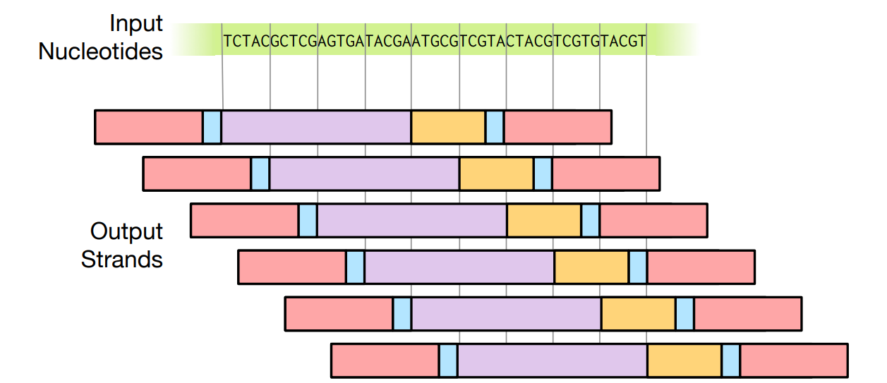
Goldman et al. Encoding
BANCROFT ENCODING
GOLDMAN ENCODING
XOR ENCODING
TUNABLE REDUNDANCY
Notes:
Figure 7: An encoding proposed by Goldman et al. [10]. The payloads of each strand are overlapping segments of the input stream, such that each block in the stream appears in four distinct strands.

Slide 50
XOR Encoding
Similar levels of redundancy with Goldman encoding, but with reduced overhead.
The exclusive-or A⊕B of the payloads A and B of two strands, produces a new payload and so a new DNA strand.
The address block of the new strand encodes the addresses of its parents.
The high bit of the address is used to indicate whether a strand is an original payload or an exclusive-or strand.
Any two of the three strands A, B, and A ⊕ B are sufficient to recover the third. (Redundancy in similar fashion to RAID5)
BANCROFT ENCODING
GOLDMAN ENCODING
XOR ENCODING
TUNABLE REDUNDANCY
Notes:
In addition, it offers a tunable level of redundancy, by reducing the width of the segments and therefore repeating them more often in strands of the same length (for example, if the overlapping segments were half as long as in Figure 7, they would be repeated in eight strands instead of four).

Slide 51
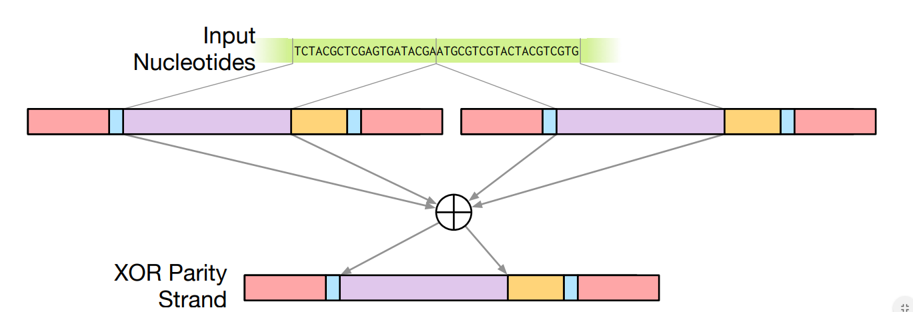
XOR Encoding
BANCROFT ENCODING
GOLDMAN ENCODING
XOR ENCODING
TUNABLE REDUNDANCY
Notes:
In addition, it offers a tunable level of redundancy, by reducing the width of the segments and therefore repeating them more often in strands of the same length (for example, if the overlapping segments were half as long as in Figure 7, they would be repeated in eight strands instead of four).

Slide 52
Tunable Redundancy with XOR
Do not need high-precision storage for all data.
High Redundancy for critical data
Pair critical blocks with multiple other blocks
Low Redundancy for less critical data
Include N blocks in an exclusive-or instead of only two
In addition to improving density, tunable redundancy has a significant effect on performance.
Tunable redundancy allows the storage system to optimize the balance between reliability and efficiency.
BANCROFT ENCODING
GOLDMAN ENCODING
XOR ENCODING
TUNABLE REDUNDANCY
Notes:
In addition, it offers a tunable level of redundancy, by reducing the width of the segments and therefore repeating them more often in strands of the same length (for example, if the overlapping segments were half as long as in Figure 7, they would be repeated in eight strands instead of four).

Slide 53
Factors in Encoding Design
Their encoding ignores special properties of DNA synthesis and sequencing that make choosing an optimal encoding more complex
Notes:
As with many encodings in the literature, ours ignores special properties of DNA synthesis and sequencing that make choosing an optimal encoding more complex. In particular, errors in synthesis and sequencing are not uniform: they vary according to location within a strand, and different sequences of nucleotides are more susceptible to undesired reactions. Synthesis error grows with the length of the strand being synthesized; nucleotides towards the end of the strand are more likely to be incorrect. Some of these errors are easily ignored, because they result in truncations, where the product strand is not of the correct length. Other errors are more insidious, with substitution errors being particularly common. An improved version of our encoding would tolerate variable substitution errors by not aligning the strands directly. For example, rather than computing A⊕B, we might instead compute A⊕B ′ , where B ′ is B in reverse. Since nucleotides at the end of a strand are more error-prone, reversing one strand ensures that the average quality is (roughly) constant along the strand, so that each nucleotide has at least some redundancy information stored in a high-reliability position.

Slide 54
Experiments

Slide 55
Materials and Method
INPUT Four image files
encodings:= {GOLDMAN, XOR}
foreach encoding foreach x.jpg in images
generate(put(x.jpg)): dna_sequences
OUTPUT Combined, the eight operations produced 45,652 sequences of length 120 nucleotides, representing 151 kB of data.

Slide 56
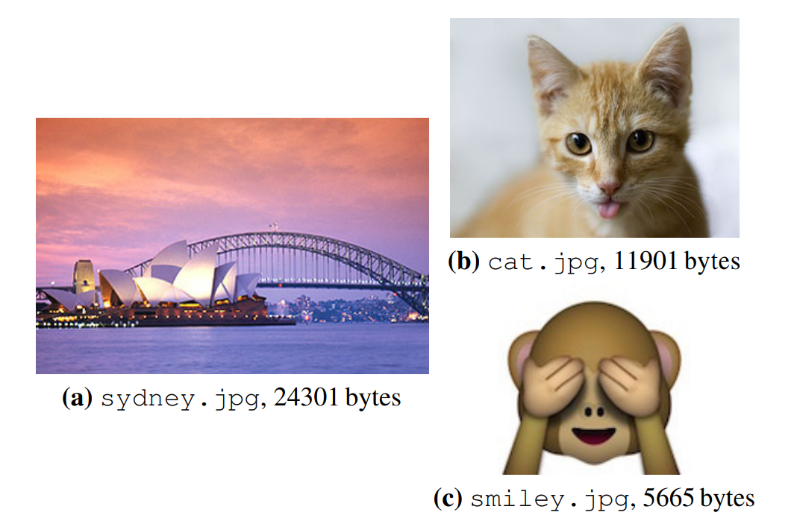
Materials and Method
Performed four get operations
3x using Goldman Encoding
1x using XOR Encoding
RESULTS
Total 16,994 sequences and 42 kB
Sequencing produced 20.8 M reads of sequences in the pool
The results where inspected and no unnecessary reads observed therefore random access was effective in amplifying target files

Slide 57
File Recovery
Successfully recovered all four files from the sequenced DNA.
One file – cat.jpg encoded with the Goldman encoder – incurred a one-byte error in the JPEG header, which we fixed by hand.
Goldman encoder provides no redundancy for the first and last bytes of a file
Proposed Solution
Extend Goldman algorithm to wrap the redundant strands past the end of the file and back to the beginning.
FILE RECOVERY
SEQUENCING DEPTH
REDUCED SEQUENCING DEPTH
NAIVE ENCODING

Slide 58
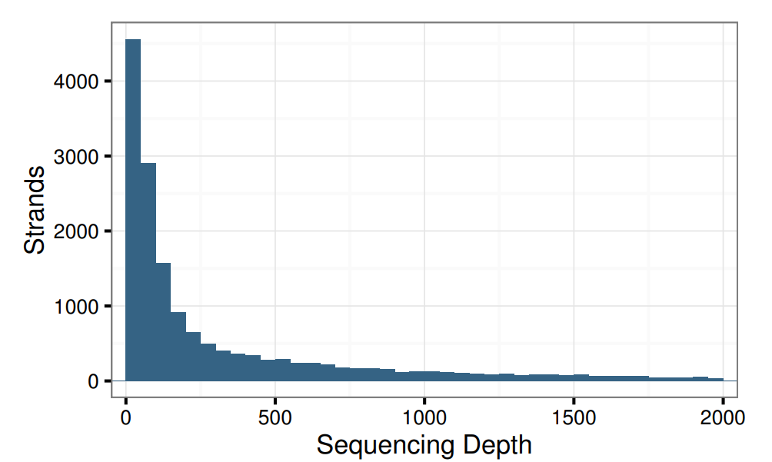
Sequencing Depth
The sequencing depth of a strand is the number of times it was perfectly sequenced.
16,994 selected sequences, 20.8 M reads 6,994 selected sequences out of which 8.6 M where error free
FILE RECOVERY
SEQUENCING DEPTH
REDUCED SEQUENCING DEPTH
NAIVE ENCODING

Slide 59
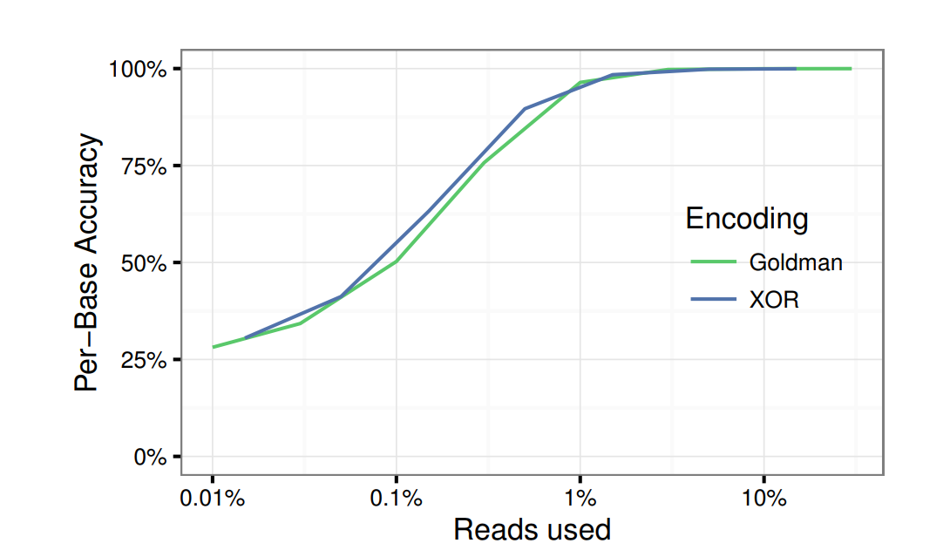
Reduced Sequencing Depth
Does reducing the sequencing depth affect the effectiveness of the encodings?
Tested both encodings using random samples from the 20.8 M reads
FILE RECOVERY
SEQUENCING DEPTH
REDUCED SEQUENCING DEPTH
NAIVE ENCODING
Notes:
The accuracy of the two encodings is similar; however, the XOR encoding is higher density than the Goldman encoding.

Slide 60
Naive Encoding
Ignoring strands which are products of XOR, we are basically left with only naively encoded strands.
Attempted to decode an image while ignoring the XOR products
Result: 11 strands where missing entirely
Conclusion: Even at very high sequencing depths, a naive encoding is not sufficient for DNA storage, therefore encodings must provide their own robustness to errors.
FILE RECOVERY
SEQUENCING DEPTH
REDUCED SEQUENCING DEPTH
NAIVE ENCODING
Notes:
The accuracy of the two encodings is similar; however, the XOR encoding is higher density than the Goldman encoding.

Slide 61
Simulation

Slide 62
How do different encodings trade storage density for reliability?

Slide 63
What is the effect of decay on the reliability of stored data?

Slide 64
Reliability and Density
TRADE-OFF Higher Density or Higher Reliability
Encoded the sydney.jpg file, using different encodings, with a variety of configurations.
CONFIGURATIONS Number of strands used for data redundancy
Notes:
These configurations vary the number of strands where a piece of data is included, by changing the overlap between strands for Goldman and increasing the number of XOR copies for XOR.

Slide 65
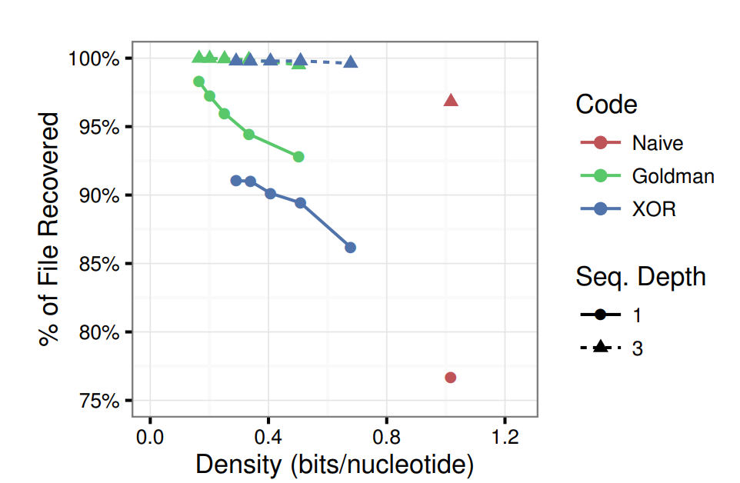
Reliability of encoded data as a function of storage density at different sequencing depths
Notes:
Figure 12: Reliability of encoded data as a function of storage density at different sequencing depths.
Figure 12 plots the density achieved by an encoding (x-axis) against decoding reliability (y-axis). The density is calculated as the file size divided by the total number of bases used to encode the file. Figure 12 includes three different encoding mechanisms: a naive encoding with no redundancy, the encoding proposed by Goldman, and our proposed XOR encoding. It presents the results for two sequencing depths, 1 and 3. Naive encoding has the lowest reliability because there is no redundancy. As the sequencing depth increases, the reliability improves, but as observed in the wet lab experiments, even at higher sequencing depths, the Naive encoding is not sufficient to provide full data recovery. For both tunable encodings, additional redundancy increases robustness, but affects density negatively. For sequencing depth of 1, where only a single copy of each strand is available, any error causes information loss if no redundancy is available (red dot). As more redundancy is added (blue and green curves), the encoding becomes more resilient to errors. At sequencing depth 1 and same density, Goldman is more resilient than XOR because it does not combine then replicate bits, it simply replicates them. As sequencing depths increase, XOR becomes as reliable as Goldman because the probability of having no copies at all of the original data lowers significantly.

Slide 66
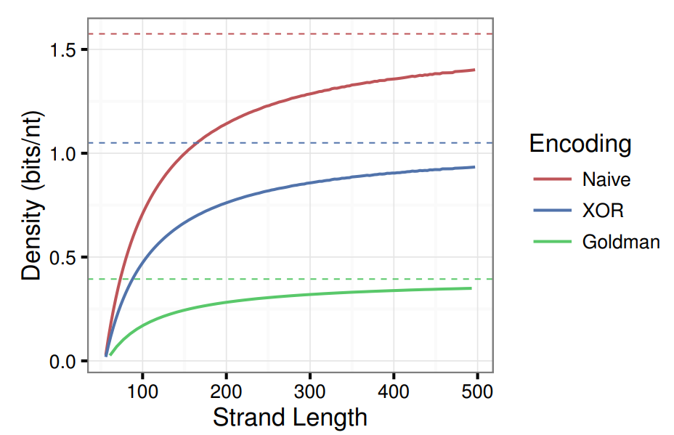
Density of different encodings as a function of the length of each synthesized DNA strand
Notes:
In the limit, the density of our XOR encoding is 2.6× that of Goldman, and yet our results show similar reliability.
The XOR encoding is also two-thirds the density of a naive encoding, which suffers much worse error rates.
Remind: strand length are limited less than 200 nucleotides.

Slide 67
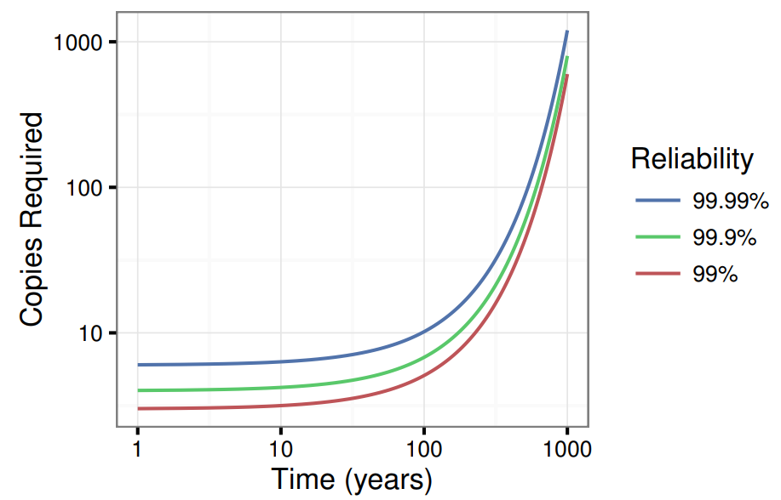
Average number of copies of sequences required to ensure a desired reliability over time
EXAMPLE In order to have a 99.99% chance of recovering an encoded value after 100 years, we need to store only 10 copies of the strands for that value.
CONCLUTION High reliability for long time intervals does not have much impact on DNA storage density.

Slide 68
Discussion and Future Work

Slide 69
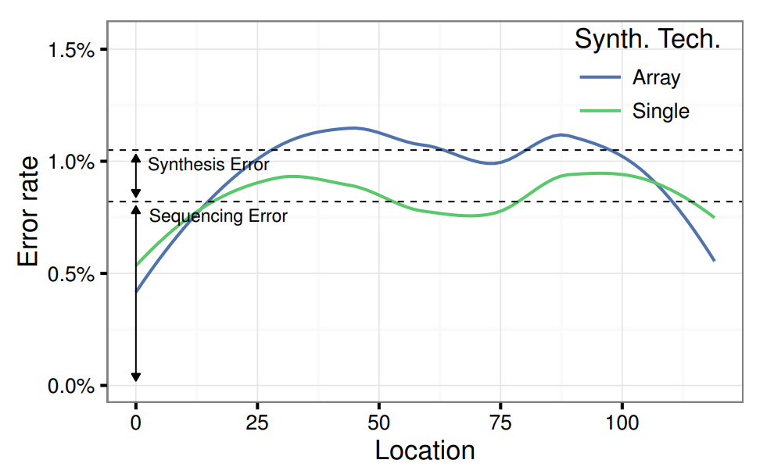
Distribution of DNA errors from two synthesis technologies
SYNTHESIS TECHNOLOGIES
Single
Array
CONCLUTION Future work should focus on improving sequencing error since it is much higher than synthesis error.
Notes:
Figure 15 compares the overall error distribution for identical strands obtained through Single and Array synthesis as a function of the relative position within the strand. The overall error rate is due to both sequencing and synthesis errors. However, if we assume that the error rate for Single synthesis is near zero, we can interpret errors measured for those strands as solely due to sequencing. The difference between the error rates for the stands derived from Single and Array can then be interpreted as synthesis errors. We clearly see that sequencing error dominates for all locations: the sequencing error rate is on average an order of magnitude higher. These results show that future technology should focus on improving the accuracy of sequencing.

Slide 70
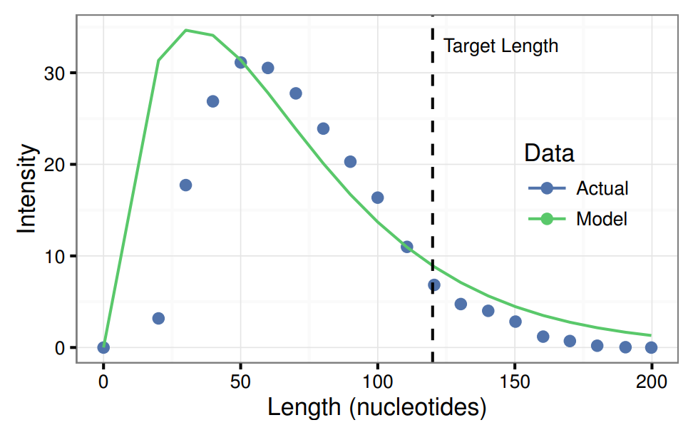
Expected and observed distributions of strand length from DNA synthesis
Notes:
Sequencing recovers only strands of the target length, but most of the synthesis product is not full length.

Slide 71
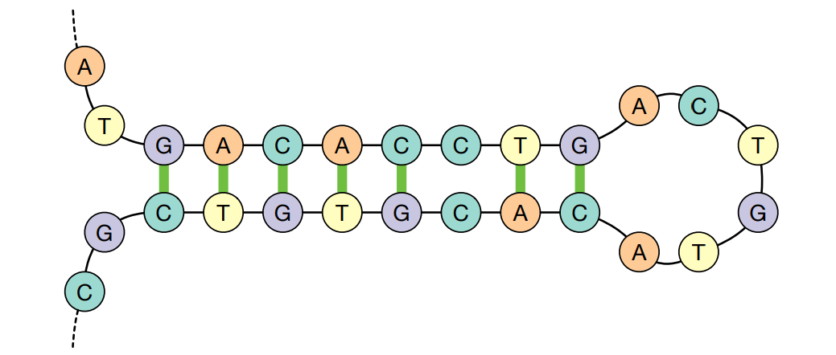
Avoiding Bad Sequences
HAIRPIN A single sequence of DNA binds to itself, folding its two ends together because they are (partially) complementary.
CONCLUTION Future work should focus on a more robust representation that avoids creating sequences that are self complementary.
Notes:
The representation we (and others) have used does not avoid more complex sources of error in DNA data representation.
The binding of the two ends to each other prevents this strand from being easily amplified and sequenced. A more robust representation would avoid creating sequences that are self-complementary to reduce the chance of this self-hybridization. Of course, restricting self-complementarity also reduces the potential density of the representation, so it presents a trade-off between density and reliability.

Slide 72
Conclusion

Slide 73
DNA-based storage has the potential to be the ultimate archival storage solution:
Extremely dense
durable

Slide 74
But not practical for now, due to limitations on synthesis and sequencing technologies

Slide 75
Is it ethical?

Slide 76
Thank you for your time
Feel free to ask any questions

