Slide 1

Data Lifecycle Challenges in Production Machine Learning: A Survey
EPL646: Advanced Topics in Databases
Data Lifecycle Challenges in Production Machine Learning: A Survey, Neoklis Polyzotis, Sudip Roy, Steven Euijong Whang, and Martin Zinkevich. 2018, SIGMOD Rec. 47, 2 (December 2018), 17-28. DOI: https://doi.org/10.1145/3299887.3299891.
By: Batiridis Maxim (mbatir01@ucy.ac.cy)

Slide 2

What is Machine Learning and why do we need it ?

Slide 3


Machine Learning: Purpose
Machine Learning is an essential tool for gleaning knowledge from data and tackling
Better accuracy for predictions based on existing knowledge
Machine Learning is very important in various different sectors e.g. healthcare, economics, biology, management, sales etc
Notes:
Notes to presenter:
Description of what you learned in your own words on one side.
Include information about the topic
Details about the topic will also be helpful here.
Tell the story of your learning experience. Just like a story there should always be a beginning, middle and an end.
On the other side, you can add a graphic that provides evidence of what you learned.
Feel free to use more than one slide to reflect upon your process. It also helps to add some video of your process.

Slide 4
Machine Learning: Challenges
Building high quality ML models is very difficult because high quality data is needed
The data fed to the model must be similar in proportions and distribution with the data at serving time
Good training algorithm
Bug – Free code that will guarantee the accuracy of results that will be fed to model
Reduce architecture without reducing the accuracy (for large scale ML platforms)
Notes:
Notes to presenter:
Description of what you learned in your own words on one side.
Include information about the topic
Details about the topic will also be helpful here.
Tell the story of your learning experience. Just like a story there should always be a beginning, middle and an end.
On the other side, you can add a graphic that provides evidence of what you learned.
Feel free to use more than one slide to reflect upon your process. It also helps to add some video of your process.

Slide 5
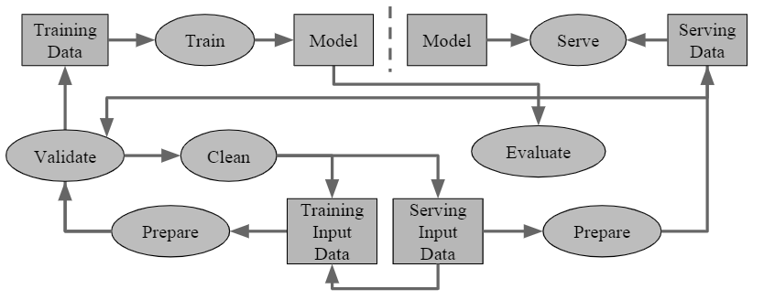

Overview of an End-to-End ML pipeline
Notes:
Notes to presenter:
What did you think at first?
What obstacles did you encounter along the way?
How did you overcome those obstacles?
What images can you add to support your process?
This SmartArt allows you add images and text to help outline your process. If a picture is worth a thousand words, then pictures and words should help you communicate this reflection on learning perfectly! You can always click on Insert>SmartArt to change this graphic or select the graphic and click on the Design contextual menu to change the colors.
Feel free to use more than one slide to reflect upon your process. It also helps to add some video of your process.

Slide 6
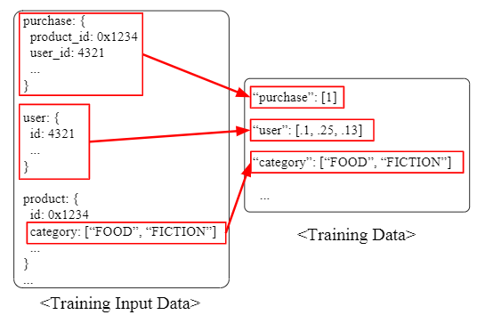
Machine Learning: Purpose
Machine Learning is an essential tool for gleaning knowledge from data and tackling
Better accuracy for predictions based on existing knowledge
Machine Learning is very important in various different sectors e.g. healthcare, economics, biology, management, sales etc
Notes:
Notes to presenter:
Description of what you learned in your own words on one side.
Include information about the topic
Details about the topic will also be helpful here.
Tell the story of your learning experience. Just like a story there should always be a beginning, middle and an end.
On the other side, you can add a graphic that provides evidence of what you learned.
Feel free to use more than one slide to reflect upon your process. It also helps to add some video of your process.

Slide 7
People around the ML Infrastructure pipeline
ML Expert: Has a board knowledge of ML, know how to create models, how to use statistics for data improvement and can advice multiple pipelines
Software Engineer: Understands the problem domain and has the most engineering expertise for a specific product
Site Reliability Engineer: Maintains the health of many ML pipelines simultaneously, but lacks of expertise in both other fields.
Notes:
Notes to presenter:
Description of what you learned in your own words on one side.
Include information about the topic
Details about the topic will also be helpful here.
Tell the story of your learning experience. Just like a story there should always be a beginning, middle and an end.
On the other side, you can add a graphic that provides evidence of what you learned.
Feel free to use more than one slide to reflect upon your process. It also helps to add some video of your process.

Slide 8

Data lifecycle through an ML pipeline
Get Data
Prepare
Train and Evaluate
Validate
Clean
Serve
6
5
4
3
2
1
Notes:
Notes to presenter:
What steps will you be taking as a result of this learning experience?
Did you learn from any failed experiences? How will you do things differently?
What advice will you give to others so they can learn from your experiences?
How can you share what you learned with a real-world audience?
Some examples of next steps might be:
After delivering my first persuasive presentation, I am thinking about joining the debate team.
After making my first film, I’m considering entering it in our school film festival or local film festival.
After connecting with this career expert, I’d like to do some research on that career field because it sounds interesting to me.
This SmartArt allows you add images and text to help outline your process. If a picture is worth a thousand words, then pictures and words should help you communicate this reflection on learning perfectly! You can always click on Insert>SmartArt to change this graphic or select the graphic and click on the Design contextual menu to change the colors.
Feel free to use more than one slide to share your next steps. It also helps to add some video content to explain your message.

Slide 9
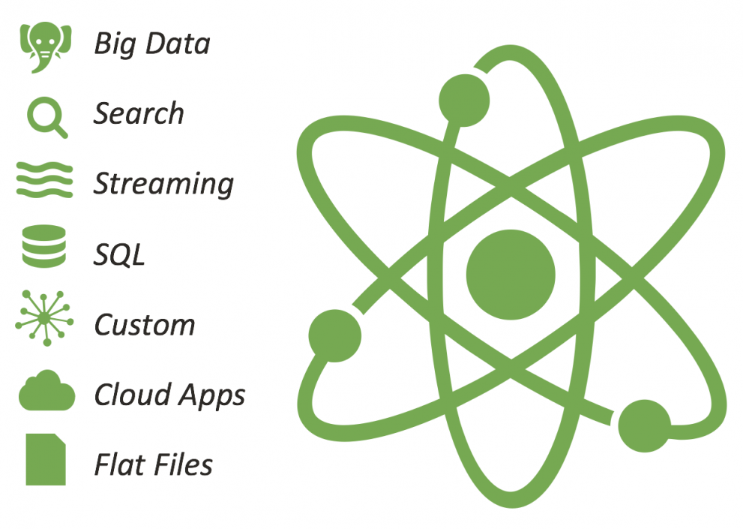
Get Data
Can be gathered from variety of sources in structured, semi-structured or un-structured formats
RDBMS
KeyValue stores
Logs
Notes:
Notes to presenter:
Description of what you learned in your own words on one side.
Include information about the topic
Details about the topic will also be helpful here.
Tell the story of your learning experience. Just like a story there should always be a beginning, middle and an end.
On the other side, you can add a graphic that provides evidence of what you learned.
Feel free to use more than one slide to reflect upon your process. It also helps to add some video of your process.

Slide 10
Prepare
The Training Input Data is transformed into Training Data
3 key questions
What features can be generated from data
What are the properties for the feature value
What are the best practices to transcode the value
Notes:
Notes to presenter:
Description of what you learned in your own words on one side.
Include information about the topic
Details about the topic will also be helpful here.
Tell the story of your learning experience. Just like a story there should always be a beginning, middle and an end.
On the other side, you can add a graphic that provides evidence of what you learned.
Feel free to use more than one slide to reflect upon your process. It also helps to add some video of your process.

Slide 11


Train and Evaluate
Train Data is fed into Train module
TensorFlow
Keras
Microsoft Cognitive Toolkit
ML.NET
Evaluate module checks if the model has acceptable accuracy.
More data
Different encoding
Notes:
Notes to presenter:
Description of what you learned in your own words on one side.
Include information about the topic
Details about the topic will also be helpful here.
Tell the story of your learning experience. Just like a story there should always be a beginning, middle and an end.
On the other side, you can add a graphic that provides evidence of what you learned.
Feel free to use more than one slide to reflect upon your process. It also helps to add some video of your process.

Slide 12
Validate
Make sure that training data does not contain errors
Bad Training data can create bad accuracy and will give bad results on production
Validation between Training Data and Serving Data
Any abnormal observation must trigger an alert to user in order to take some actions
Notes:
if training data and serving data have deviations then the model will not perform consistently

Slide 13
Clean
Based on alerts
3 key questions
Cleaning the data will improve the model
Which part of the data is to be fixed
How should the fix be reflected to all input data until now (if new properties are added)
Notes:
Notes to presenter:
Description of what you learned in your own words on one side.
Include information about the topic
Details about the topic will also be helpful here.
Tell the story of your learning experience. Just like a story there should always be a beginning, middle and an end.
On the other side, you can add a graphic that provides evidence of what you learned.
Feel free to use more than one slide to reflect upon your process. It also helps to add some video of your process.

Slide 14
Serve
Responsible for
Receiving the Servicing Input Data (raw input data)
Prepare it as Service Data (prepared data for model)
*Common practice is to use this data also as training data for the model. This is done as batch process
Notes:
Servicing input data should be the same as Training Input data because this is on what the model was trained
Prepare module of serve should be the same as previous Prepare in order to get consistency

Slide 15

Understanding
Validation and Cleaning
Preparation
Sanity Checks
Analysis for Launch and Iterate
Open Challenges
Alert Tradeoffs
Alert Categories
Open Challenges
Feature Engineering and Selection
Data Enrichment
Open Challenges
Notes:
Notes to presenter:
What was important about this learning experience?
How is it relevant to your course, yourself, or your society or community?
Why is this significant?
This SmartArt allows you add images and text to help outline your process. If a picture is worth a thousand words, then pictures and words should help you communicate this reflection on learning perfectly! You can always click on Insert>SmartArt to change this graphic or select the graphic and click on the Design contextual menu to change the colors.

Slide 16
Understanding - Sanity Check types
Minimum, Maximum, Average, Range check
Distribution of categorical values
Data presence
Data Validity
Data verification from external sources
Visualization Tools (graphs, histograms, deviation based metrics)
Notes:
Minimum Maximum etc: are need to check there is any abnormal value that was incorrectly inerted e.x -50000, this will decease significantly the model accuracy
Data presence – e.x. 70% of county values must be available in data
Data validity – e.x. only one age for person

Slide 17
Understanding - Analysis for Launch and Iterate
Data need to be proportional to real data volume
OLAP can be used for better analysis (ML Cube)
Coase-grained data lifecycle tracking
Fine-grained data lifecycle tracking
Notes:
Coase grained data: general and not tied to particular system
Fine grained data: can analyze individual features but it is tightly couples with the system

Slide 18
Understanding – Open Challenges
If model is prejudiced against certain classes of data
New kind of spams
Notes:
Ean to Montello posvalletai / meiwnetai I poiotita se sxesi me kapoioy eidous dedomenwn

Slide 19
Validation and Cleaning – Alert Tradeoffs
Recall – what fraction of alerts we catch
Precision – what alerts lead to good catches
Not all anomalies are equally important, the ones that worse model accuracy in production must be alerted first

Slide 20
Validation and Cleaning – Alert Categories
Alerts is difficult to design and they depend on training data - complex data
Alerts can be generated from the result of comparison between existing and previous data
Statics (ANOVA, t-statics, chi-squared)
Notes:
Some times this task can become very challenging due to multiple comples variables that may exists. E.g. real estate prices is depended on multiple variables and its is very hard predict the expected data shape for all these data/applications

Slide 21
Validation and Cleaning – Open Challenges
The real challenge is to find good technique to generate proper and targeted alerts.
Generate guide books for maintenance
Notes:
Some times this task can become very challenging due to multiple comples variables that may exists. E.g. real estate prices is depended on multiple variables and its is very hard predict the expected data shape for all these data/applications

Slide 22
Preparation – Feature Engineering
Instead of calculating multiple, different and complicated data
Rules
Techniques
Representational learning: feed straight raw data into model and let it figure out by its own the features
Manual feature engineering is still used in most cases
Notes:
Example is : calculating price for real estate may depend on multiple variables, so it is easier to classify some of that data, in order to reduce the amount of calculations
Crime rate: high, medium, low
Unenployment rate: high, medium, low
Theory of chaos, let the model find by its own how to calculate the important properties
When the users selects the features that he believes that are important and feeds them into model

Slide 23
Preparation – Data Enrichment
Technique of adding extra data from external source in order to improve the accuracy of the model
Data contextualization
Extract knowledge from new data
Improving the quality of existing data may lead to better results instead of adding more data
Notes:
Data contextualization : putting data in the same context as the training data is, because coming from different system it may be referred to different context
Extract knowledge: is when heterogenous system refer to same labels

Slide 24
Preparation – Open Challenges
Automatically generating feature transforms that result in the highest model accuracy
Notes:
Αυτόματη δημιουργία μετασχηματισμών χαρακτηριστικών που οδηγούν στην υψηλότερη ακρίβεια μοντέλου

Slide 25
Lessons Learned
Data Management > Optimizing Data Flow
Realistic Assumptions
Different users different needs
Integration is a key
Notes:
Most of companies focus on Data flow instead of data management and data itself, this is very important issue
Realistic assumptions for data that will be processed, ether its an data source (RDBMS, BigTable, Hadoop, Json files logs etc)
Working together with different users on same ML Infrastructure will show the different need of each user, which needs to be taken into account (software engineer vs site reliability engineer)
Integration into existing environment is a key, because users will not use the tools unless they are necessary

Slide 26
Conclusion
Data Management will get more important as the amount of data grows
Challenges
Understanding
Validation and Cleaning
Preparation
Many Open Challenges for both Data Management and Machine Learning Communities

Slide 27

Thank you!

