Slide 1

Stream Processing Languages in the Big Data Era
EPL646: Advanced Topics in Databases
Martin Hirzel, Guillaume Baudart, Angela Bonifati, Emanuele Della Valle, Sherif Sakr, and Akrivi Akrivi Vlachou. 2018, SIGMOD Rec. 47, 2 (December 2018), 29-40. DOI: https://doi.org/10.1145/3299887.3299892
By: Georgia Hadjiyiorki (ghadji17@cs.ucy.ac.cy)

Slide 2
Contents
Stream Processing Languages-Background
Stream Processing Languages-Purpose
Stream Processing Language-Styles
Big Data Streaming
XML Streaming
Stream Reasoning
Language Design Principles
Challenges
Veracity
Data Variety
Adoption

Slide 3
Stream Processing Languages: Background
Data streams, or continuous data flows, have been around for decades
The advent of the big-data era, the size of data streams has increased dramatically
In nowadays with the evolution of the internet of things and related technologies, many end-user applications require stream processing and analytics
We are in the big data era, for the handle and development the big data applications necessary is the use of Streaming Processing Languages.

Slide 4
Stream Processing Languages: Purpose
Stream Processing Languages are programming languages for writing applications that analyze data streams.
Most streaming languages are more or less declarative
Facilitate the development of stream processing applications
The goal of them languages are to strike a balance between the three requirements:
Performance
Generality
Productivity

Slide 5
Stream Processing Languages: Styles
Examined eight stream processing languages:
Relational Streaming
Synchronous Dataflow
Big-Data Streaming
Complex Event Processing
XML Streaming
RDF Streaming
Stream Reasoning
Streaming for End-Users
The above stream processing languages, stemming from different primary objectives,
data models, and ways of thinking.

Slide 6
Stream Processing Languages: Big Data Streaming
First Category
Second Category
Τhe basic idea of the first category of languages for big-data streaming is that of a directed graph of streams and operators.
Graph is an evolution of the query plan of earlier stream-relational systems
Also focus on relational operators
Example: stand-alone Stream Processing Language (SPL)
Languages embedded in a general-purpose host language.
Java
Determining more or less explicit stream graphs

Slide 7
Stream Processing Languages: XML Streaming
NiagaraCQ
YFilter
Before YFilter came NiagaraCQ
A Scalable Continuous Query System for Internet Databases
Process update streams to existing XML documents
Borrowing syntax from XML-QL
Support incremental evaluation
consider only the changed portion of each updated XML file
Support change-based queries and timer-based queries
Applied a multi-query optimization that used a single finite state machine.
to represent and evaluate several XPath expressions
XMLParse is an operator for XML stream transformation in a big-data streaming language

Slide 8
Stream Processing Languages: Stream Reasoning(1)
An ontology offers a conceptual view over pre-existing autonomous data sources.
The reasoner can find answers that are not syntactically present in the data sources
This approach is called ontology-based data access
RDF is the dominant data model in reasoning for data integration
Τhis kind of reasoning is hard to do efficiently.

Slide 9
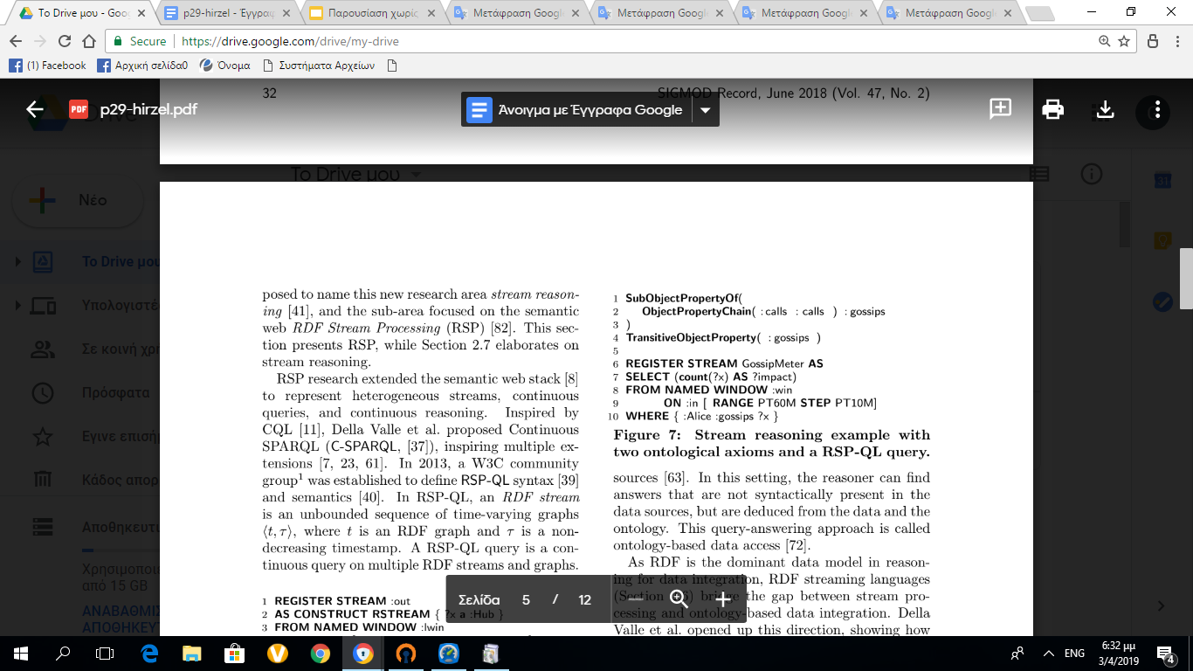
Stream Processing Languages: Stream Reasoning(2)
This picture shows an example for stream reasoning with two ontological axioms and a RSP-QL query.
RSP-QL query uses reasoning to continuously count how many people : Alice gossips with.

Slide 10
Stream Processing Languages: Language Design Principles
Categorized based on three requirements:
Performance
Generality,
Productivity

Slide 11
Performance Generality Productivity
Windowing principle:
Windows turn streaming data into static data suitable for optimized static computation
Partitioning principle:
Simplify data parallelism
Stream graph principle:
is central to the big-data languages
Restriction principle:
The schedules and communication rates in a streaming application are restricted for both performance and safety.
Orthogonality principle:
Basic language features are irredundant and work the same independently.
related to the ease of use of the language
No-built-ins principle:
Enable extensions in the library
Auto-update principle
General-feature principle:
Special case features are replaced by a single more general feature
Familiarity principle.
related to the ease of use of the language
Conciseness principle:
Increases productivity since there is less code to write and read
Regularity principle
Backward reference principle:
Code direction is consistent with both scope and control dominance, for readability.
Orthogonality and Familiarity principle are uniformly covered!!

Slide 12
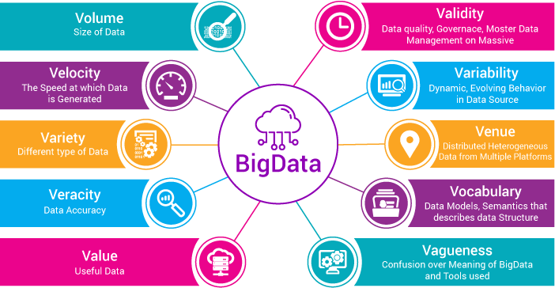
Stream Processing Languages: Challenges
In the Big Data era, the need to process and analyze a high volume of data is a fundamental problem
Βesides that there are open challenges:
Veracity
Data Variety
Adoption

Slide 13
Veracity
Streaming languages should ensure veracity of the output stream in terms of accuracy, correctness, and completeness of the results.
Veracity depends on the semantics of the language:
since the stream is infinite and new results may be added or computed aggregates may change
Errors may occur:
in the data itself
by delays
data loss during the transfer to the stream processing system
Stream processing makes veracity even more challenging than in the static case
Stream producing sensors have limitations which can easily compromise veracity

Slide 14
Data Variety
The term emerged with the advent of Big Data
the problem of taming variety is well known for machine understanding of unstructured data.
Multiple known solutions to data variety for a moderate number of high-volume data sources.
data variety is still unsolved when there are hundreds of data sources to integrate and when the data to integrate is streaming

Slide 15
Adoption
No one streaming language has been broadly adopted
The adoption of language is not only due to the technical advantages of the language itself, but also to external factors
External factors: open source applications with open government
Adoption is difficult for any programming language, but especially for a streaming language.

Slide 16
Veracity-Measure the Challenge
Ideally, the output stream should be accurate, complete, and timely even if errors occur in the input stream (this is not always feasible).
We define as ground truth the output stream
Error be a function that compares the produced result of an approach with and without veracity problems.
Challenge can be broken down into the following measures:
Fault-tolerance: A program in the language is robust even if some of its components fail
Out-of-order handling: The streaming language should have clear semantics about the expected result and should be robust to out-of-order data.
Inaccurate value handling: A program in the language is robust even if some of its input data is wrong.

Slide 17
Data Variety-Measure the Challenge
Challenge can be broken down into the following measures:
Expressive data model: Data model used to logically represent information is expressive and allows encoding multiple data types, data structures and data semantics.
Multiple representations: The language can ingest data in multiple representations
New sources with new formats: The language allows adding new sources where data are represented in a format unforeseen when the language was

Slide 18
Adoption-Measure the Challenge
If most systems adopted more or less the same language, they would become easier to benchmark against each other
Challenge can be broken down into the following measures:
Widely-used implementation of one language
Standard proposal or standard.
Multiple implementations of same language
If the problem of streaming language adoption were solved, we would expect streaming systems to become more robust and faster

Slide 19
Conclusion
Streaming processing languages are necessary in the big data area
offer many advantages and advance (development).
Based on the challenges of these languages that have been mentioned, the languages of this field can be better developed.
For the big data streaming language, the challenge Adoption remains an open challenge
The goal are streaming languages that are all descriptions of the challenges mentioned above and closes the gap on all the challenges (adoption, data variety, veracity)
Many Open Challenges for stream processing languages in big data era.

Slide 20

Thank you!!

Slide 21
Presentation Outline (Indicative)
Background
Integration
Problem overview
Self-driving architecture
Workload Classification
Workload Forecasting
Action Planning & Execution
Preliminary Results
Conclusions

Slide 22
Background
In the last decades, advisory tools to assist DBAs in system tunning and physical design have been built but this work is incomplete because humans are still needed to make the final decisions about changes to the database
For a self-driving DBMS we need a new architecture designed for autonomous operation
This way, all aspects of the system are controlled by an integrated planning component which optimizes the system for the current workload and predicts future workload trends
With this, DBMS doesn't require a human to determine the right way and proper time to deploy all of the previous tunning techniques
We're presenting the architecture of Peloton, the first self-driving DBMS

Slide 23
Introduction
Using a DBMS to remove the burden of data management allows that a developer only writes a query that specifies what data they want to access and the DBMS finds the most efficient way to store and retrieve data, and to safely interleave operations
Using existing automated tunning tools is an onerous is a harsh task, as they require laborious preparation of workload samples, spare hardware to test proposed updates and above all else intuition into the DBMS's internals
If DBMS's could do these things automatically, it would be less complicated and cheaper to deploy a database
Most of the previous work on self-tunning systems is focused on standalone tools that target only a single aspect of the database
Most of the tools of operate in the same way: the DBA provides it with a sample database and workload trace that guides a search process to find an optimal or near-optimal configuration

Slide 24
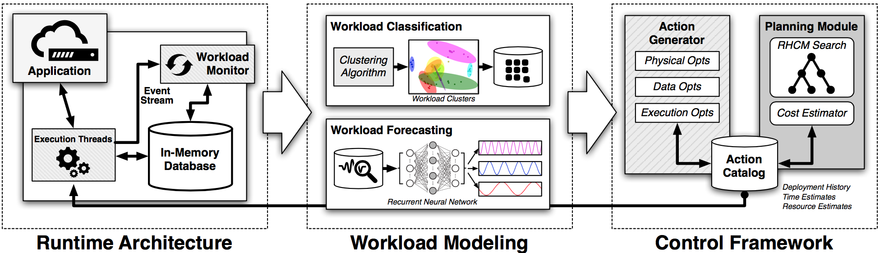
Introduction
Introduction
All of these are insufficient for a completely autonomous database because they are external to the DBMS, reactionary or unable to take a holistic view that considers more than one problem at a time
Even if these tools were automated such that they could deploy the optimizations on their own, existing DBMS architecture are not designed to support major changes without stressing the system further nor are able to adapt in anticipation of future obstacles
The architecture of Peloton is the first DBMS designed for autonomous operation
Peloton Self-Driving Architecture

Slide 25
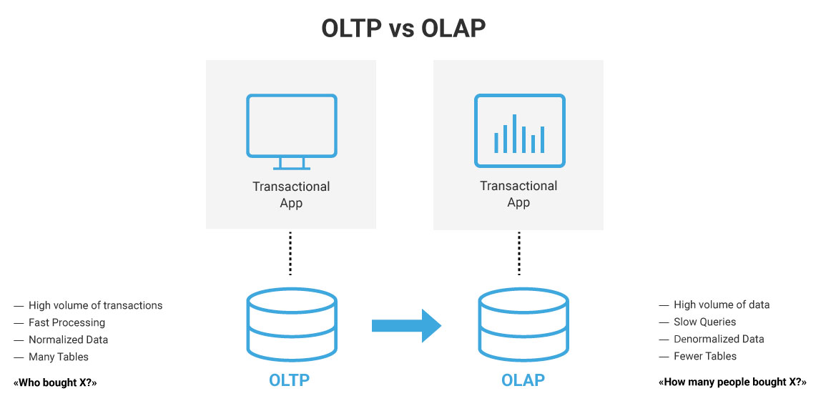
Problem Overview
Problem Overview
The first challenge in a self-driving DBMS is to understand an application's workload
The most basic level is to characterize queries as being for either an OLTP or OLAP application
One way to handle this is to deploy separate DBMSs that are specialized for OLTP and OLAP workloads and then periodically stream updates between them
But there is an emerging class of applications, known as hybrid transaction-analytical processing (HTAP), that cannot split the database across two systems because they execute OLAP queries on data as soon as it is written by OLTP transaction

Slide 26
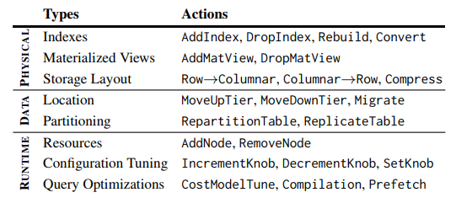
Problem Overview
Problem Overview
A better approach is to deploy a single DBMS that supports mixed HTAP workloads such a system automatically chooses the proper OLTP or OLAP optimizations for different database segments
There are some workload anomalies that a DBMSs can never antecipate but these models provide an early warning that enables the DBMS to enact mitigation action more quickly than what an external monitoring system could support
If the DBMS isn't able to apply these optimizations efficiently without incurring large performance degradations, the system won't be able to adapt to changes quickly
Self-Driving Actions

Slide 27
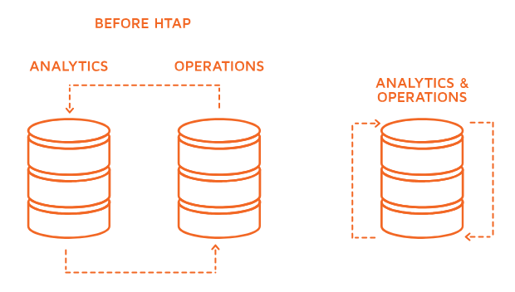
Problem Overview
Problem Overview
A self-driving DBMS cannot support DBA tasks that require information that is external to the system, such as permissions, data cleaning and version control
There are three optimization categories that a self-driving DBMS can support: for the database's physical design, changes to data organization and the last three affect the DBMS's runtime behavior
An autonomous DBMS has two constraints it has to satisfy to be relevant for today's applications: it cannot require developers to rewrite their application to use a proprietary API or provide suplemental information about its behavior and it can't rely on program analysis tools that only support certain programming environements

Slide 28
Problem Overview
Self-driving architecture
Existing DBMSs are too unwidely for autonomous operation because they often require restarting when changes are made
Peloton uses a variant of multi-version concurrency control that interleaves OLTP transactions and actions without blocking OLAP queries
It uses as in-memory storage manager with lock-free data structures and flexible layouts that allows for fast execution of HTAP workloads
Main goal is for Peloton to efficiently operate without any human-provided guide information
The system automatically learns how to improve the latency of the application's queries and transactions latency is the most important metric in a DBMS as it captures all aspects of performance
Peloton contains an embedded monitor that follows the system's internal event stream of the executed queries
The DBMS then constructs forecast models for the application's expected workload from this monitoring data

Slide 29
Problem Overview
Workload Classification
Clustering the workload reduces the number of forecast models that the DBMS maintains
Pelotons' initial implementation uses the DBSCAN algorithm which has been used to cluster static OLTP workloads
One of the questions with this clustering is what query features to use
Two types of query features: query's runtime metrics and query's logical systems
Second problem is how to determine when the clusters are no longer correct. When this occurs, the DBMS has to re-build its clusters, which could shuffle the groups and require it to re-train all of its forecast models
Peloton uses standard cross validation techniques to determine when the clusters' error rate goes above a thresold

Slide 30
Problem Overview
Workload Forecasting
We need to train forecast models that predict the arrival rate of queries for each workload cluster
With the exception of anomalous hotspots, this forecasting enables the system to identify periodicity and data growth tends to prepare for load fluctuations
The DBMS executes a query, then tags each one with its cluster identifier and then populates a histogram that tracks the number of queries that arrive per cluster within a time period
Peloton uses this data to train the forecast models that estimate the number of queries per cluster that the app will execute in the future
Previous attempts at autonomous systems have used the auto-regressing-moving average model (ARMA) to predict the workload of web services for autoscaling in the cloud
Recurrent neutral networks (RNNs) are an effective method to predict time-series patterns for non-line systems
A variant of RNNs called long short-term memory (LSTM) allow the networks to learn the periodicity and repeating trends in a time-series data beyond what's possible with regular RNNs

Slide 31
Problem Overview
Workload Forecasting
Peloton maintains multiple RNNs per group that's forecast the workload at different time horizons and internal granularities
Combining multiple RNNs allows the DBMS to handle immediate problems where accuracy is more important as well as to accommodate longer term planning where the estimates can be broad

Slide 32
Action Planning & Execution
This part is where the control framework is done:
Monitors the system
Selects the optimized actions
Improve the application’s performance.
Action Generation:
The system searches for actions that improves performance
Stores those actions in catalog.
Logs the systems updates.
Guided by forecasting models.
Regulates the use of CPUs.
Certain actions have reversal actions.

Slide 33
Action Planning & Execution
Action Planning:
Decides the action based in:
Forecasts;
Current database configuration;
Latency.
Uses RHCM (Receding Horizon Control Model)

Slide 34
RHCM (Receding Horizon Control Model)
What is it?
Used to manage complex systems.
Estimates the workload using the forecasts and search for the best actions that minimizes the latency of the function.
It only deploys the first action and then wait till its finished.
How it works?
Tree Model where each level contains the actions that can be invoked.
Estimates the cost-benefit of the actions and chooses the one with best outcome.
The actions are selected randomly.
Avoids the actions that were recently called and reversed by the system.

Slide 35
RHCM (Receding Horizon Control Model)
Is it reliable?
There are things that are not completely studied and are under investigation yet.
With short horizons the DBMS cant prepare itself to the upcoming load spikes
With long horizons it can not solve sudden problems because the models are to big.
So…

Slide 36
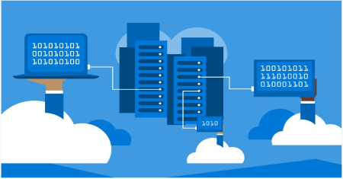
Action Planning & Execution
Deployment:
Actions are deployed in a non blocking way.
Some actions need a special consideration.
Deals with resource scheduling and contention issues from its integrated machine learning components.
Uses GPU to handle heavy computation to avoid slowing down the DBMS.

Slide 37

Preliminary Results
Specifications:
Google TensorFlow integrated in Peloton;
One month of data in two RNN queries using two different models.
Peloton was run in a Nvidia GeForce GTX 980.
Training of the queries took 11 and 18 minutes.
Data is separated by “hot” tuples and “cold” tuples.

Slide 38

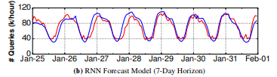
Preliminary Results
Results:
Model 1: predicts the number of queries that will arrive in a 24h horizon.
Are able to predict the workload with an error rate of 11.3%
Model 2: predicts the number of queries that will arrive in a 7day horizon.
Are able to predict the workload with an error rate of 13.2%

Slide 39
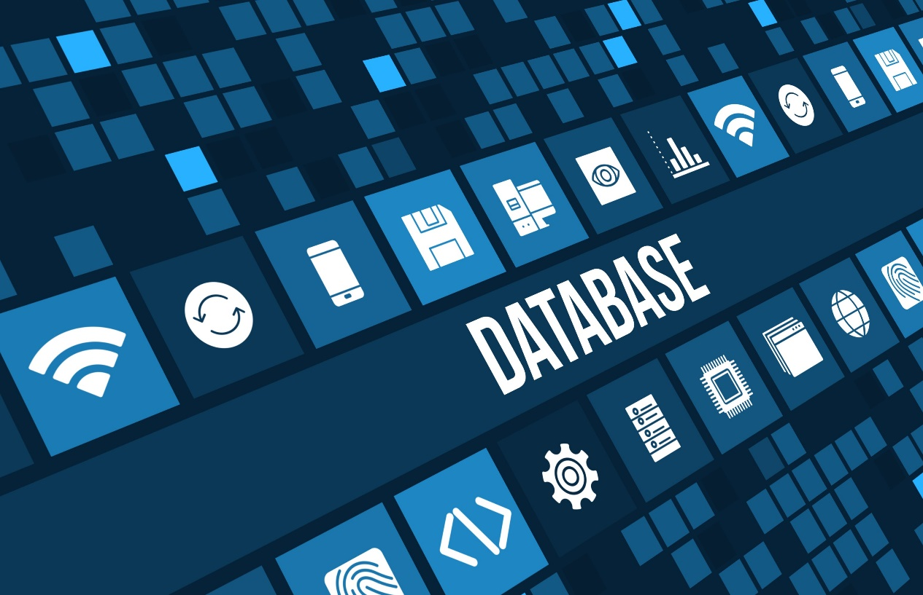
Conclusion

Slide 40
References
[1] Peloton Database Management System. http://pelotondb.org. [2] M. Abadi and et al. TensorFlow: Large-Scale Machine Learning on Heterogeneous Distributed Systems. CoRR, abs/1603.04467, 2016. [3] S. Abdelwahed and et al. A control-based framework for self-managing distributed computing systems. WOSS’04, pages 3–7. [4] D. Agrawal and et al. Database scalability, elasticity, and autonomy in the cloud. DASFAA, pages 2–15, 2011. [5] S. Agrawal, S. Chaudhuri, and V. R. Narasayya. Automated selection of materialized views and indexes in SQL databases. VLDB, 2000.

