Slide 1

Self-Driving Database Management Systems
EPL646: Advanced Topics in Databases
Andrew Pavlo, Gustavo Angulo, Joy Arulraj, Haibin Lin, Jiexi Lin, Lin Ma, Prashanth Menon Todd C. Mowry, Matthew Perron, Ian Quah, Siddharth Santurkar, Anthony Tomasic Skye Toor, Dana Van Aken, Ziqi Wang, Yingjun WuF, Ran Xian, Tieying Zhang Carnegie Mellon University, *National University of Singapore
By: Daniela Torres(dtorre01@cs.ucy.ac.cy),
Rafael Gonçalves(rgonca01@cs.ucy.ac.cy)

Slide 2
Presentation Outline (Indicative)
Background
Integration
Problem overview
Self-driving architecture
Workload Classification
Workload Forecasting
Action Planning & Execution
Preliminary Results
Conclusions

Slide 3
Background
In the last decades, advisory tools to assist DBAs in system tunning and physical design have been built but this work is incomplete because humans are still needed to make the final decisions about changes to the database
For a self-driving DBMS we need a new architecture designed for autonomous operation
This way, all aspects of the system are controlled by an integrated planning component which optimizes the system for the current workload and predicts future workload trends
With this, DBMS doesn't require a human to determine the right way and proper time to deploy all of the previous tunning techniques
We're presenting the architecture of Peloton, the first self-driving DBMS

Slide 4
Introduction
Using a DBMS to remove the burden of data management allows that a developer only writes a query that specifies what data they want to access and the DBMS finds the most efficient way to store and retrieve data, and to safely interleave operations
Using existing automated tunning tools is an onerous is a harsh task, as they require laborious preparation of workload samples, spare hardware to test proposed updates and above all else intuition into the DBMS's internals
If DBMS's could do these things automatically, it would be less complicated and cheaper to deploy a database
Most of the previous work on self-tunning systems is focused on standalone tools that target only a single aspect of the database
Most of the tools of operate in the same way: the DBA provides it with a sample database and workload trace that guides a search process to find an optimal or near-optimal configuration

Slide 5
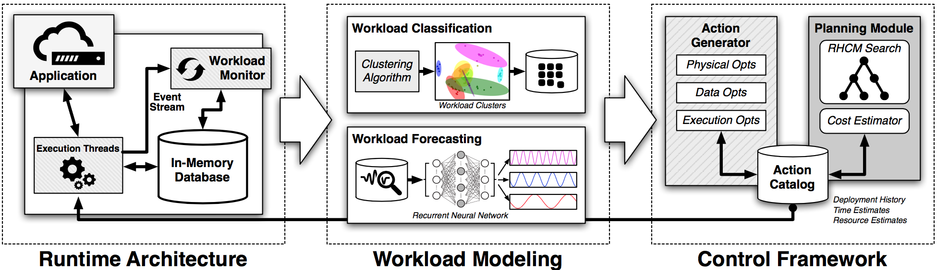
Introduction
Introduction
All of these are insufficient for a completely autonomous database because they are external to the DBMS, reactionary or unable to take a holistic view that considers more than one problem at a time
Even if these tools were automated such that they could deploy the optimizations on their own, existing DBMS architecture are not designed to support major changes without stressing the system further nor are able to adapt in anticipation of future obstacles
The architecture of Peloton is the first DBMS designed for autonomous operation
Peloton Self-Driving Architecture

Slide 6
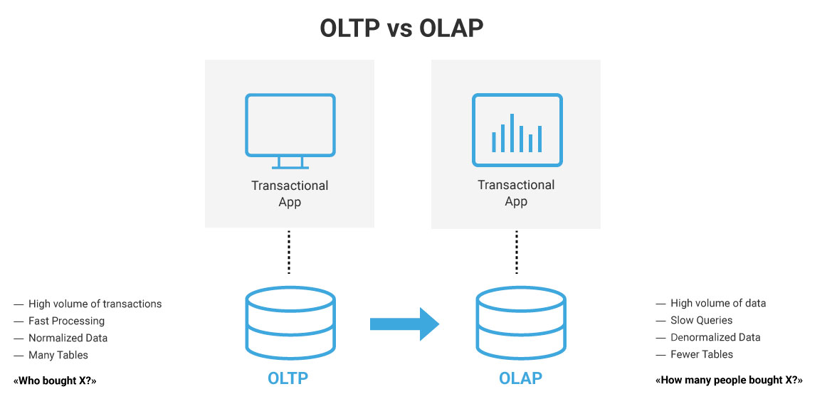
Problem Overview
Problem Overview
The first challenge in a self-driving DBMS is to understand an application's workload
The most basic level is to characterize queries as being for either an OLTP or OLAP application
One way to handle this is to deploy separate DBMSs that are specialized for OLTP and OLAP workloads and then periodically stream updates between them
But there is an emerging class of applications, known as hybrid transaction-analytical processing (HTAP), that cannot split the database across two systems because they execute OLAP queries on data as soon as it is written by OLTP transaction

Slide 7
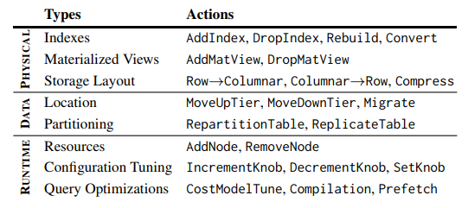
Problem Overview
Problem Overview
A better approach is to deploy a single DBMS that supports mixed HTAP workloads such a system automatically chooses the proper OLTP or OLAP optimizations for different database segments
There are some workload anomalies that a DBMSs can never antecipate but these models provide an early warning that enables the DBMS to enact mitigation action more quickly than what an external monitoring system could support
If the DBMS isn't able to apply these optimizations efficiently without incurring large performance degradations, the system won't be able to adapt to changes quickly
Self-Driving Actions

Slide 8
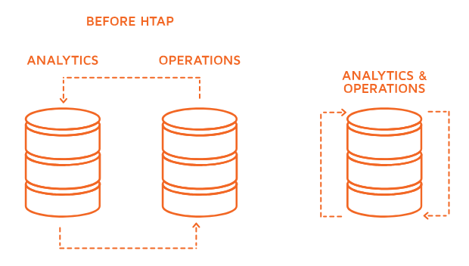
Problem Overview
Problem Overview
A self-driving DBMS cannot support DBA tasks that require information that is external to the system, such as permissions, data cleaning and version control
There are three optimization categories that a self-driving DBMS can support: for the database's physical design, changes to data organization and the last three affect the DBMS's runtime behavior
An autonomous DBMS has two constraints it has to satisfy to be relevant for today's applications: it cannot require developers to rewrite their application to use a proprietary API or provide suplemental information about its behavior and it can't rely on program analysis tools that only support certain programming environements

Slide 9
Problem Overview
Self-driving architecture
Existing DBMSs are too unwidely for autonomous operation because they often require restarting when changes are made
Peloton uses a variant of multi-version concurrency control that interleaves OLTP transactions and actions without blocking OLAP queries
It uses as in-memory storage manager with lock-free data structures and flexible layouts that allows for fast execution of HTAP workloads
Main goal is for Peloton to efficiently operate without any human-provided guide information
The system automatically learns how to improve the latency of the application's queries and transactions latency is the most important metric in a DBMS as it captures all aspects of performance
Peloton contains an embedded monitor that follows the system's internal event stream of the executed queries
The DBMS then constructs forecast models for the application's expected workload from this monitoring data

Slide 10
Problem Overview
Workload Classification
Clustering the workload reduces the number of forecast models that the DBMS maintains
Pelotons' initial implementation uses the DBSCAN algorithm which has been used to cluster static OLTP workloads
One of the questions with this clustering is what query features to use
Two types of query features: query's runtime metrics and query's logical systems
Second problem is how to determine when the clusters are no longer correct. When this occurs, the DBMS has to re-build its clusters, which could shuffle the groups and require it to re-train all of its forecast models
Peloton uses standard cross validation techniques to determine when the clusters' error rate goes above a thresold

Slide 11
Problem Overview
Workload Forecasting
We need to train forecast models that predict the arrival rate of queries for each workload cluster
With the exception of anomalous hotspots, this forecasting enables the system to identify periodicity and data growth tends to prepare for load fluctuations
The DBMS executes a query, then tags each one with its cluster identifier and then populates a histogram that tracks the number of queries that arrive per cluster within a time period
Peloton uses this data to train the forecast models that estimate the number of queries per cluster that the app will execute in the future
Previous attempts at autonomous systems have used the auto-regressing-moving average model (ARMA) to predict the workload of web services for autoscaling in the cloud
Recurrent neutral networks (RNNs) are an effective method to predict time-series patterns for non-line systems
A variant of RNNs called long short-term memory (LSTM) allow the networks to learn the periodicity and repeating trends in a time-series data beyond what's possible with regular RNNs

Slide 12
Problem Overview
Workload Forecasting
Peloton maintains multiple RNNs per group that's forecast the workload at different time horizons and internal granularities
Combining multiple RNNs allows the DBMS to handle immediate problems where accuracy is more important as well as to accommodate longer term planning where the estimates can be broad

Slide 13
Action Planning & Execution
This part is where the control framework is done:
Monitors the system
Selects the optimized actions
Improve the application’s performance.
Action Generation:
The system searches for actions that improves performance
Stores those actions in catalog.
Logs the systems updates.
Guided by forecasting models.
Regulates the use of CPUs.
Certain actions have reversal actions.

Slide 14
Action Planning & Execution
Action Planning:
Decides the action based in:
Forecasts;
Current database configuration;
Latency.
Uses RHCM (Receding Horizon Control Model)

Slide 15
RHCM (Receding Horizon Control Model)
What is it?
Used to manage complex systems.
Estimates the workload using the forecasts and search for the best actions that minimizes the latency of the function.
It only deploys the first action and then wait till its finished.
How it works?
Tree Model where each level contains the actions that can be invoked.
Estimates the cost-benefit of the actions and chooses the one with best outcome.
The actions are selected randomly.
Avoids the actions that were recently called and reversed by the system.

Slide 16
RHCM (Receding Horizon Control Model)
Is it reliable?
There are things that are not completely studied and are under investigation yet.
With short horizons the DBMS cant prepare itself to the upcoming load spikes
With long horizons it can not solve sudden problems because the models are to big.
So…

Slide 17
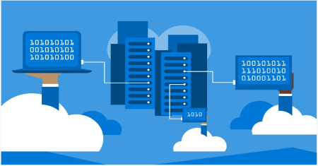
Action Planning & Execution
Deployment:
Actions are deployed in a non blocking way.
Some actions need a special consideration.
Deals with resource scheduling and contention issues from its integrated machine learning components.
Uses GPU to handle heavy computation to avoid slowing down the DBMS.

Slide 18

Preliminary Results
Specifications:
Google TensorFlow integrated in Peloton;
One month of data in two RNN queries using two different models.
Peloton was run in a Nvidia GeForce GTX 980.
Training of the queries took 11 and 18 minutes.
Data is separated by “hot” tuples and “cold” tuples.

Slide 19

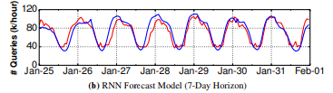
Preliminary Results
Results:
Model 1: predicts the number of queries that will arrive in a 24h horizon.
Are able to predict the workload with an error rate of 11.3%
Model 2: predicts the number of queries that will arrive in a 7day horizon.
Are able to predict the workload with an error rate of 13.2%

Slide 20

Conclusion

Slide 21
References
[1] Peloton Database Management System. http://pelotondb.org. [2] M. Abadi and et al. TensorFlow: Large-Scale Machine Learning on Heterogeneous Distributed Systems. CoRR, abs/1603.04467, 2016. [3] S. Abdelwahed and et al. A control-based framework for self-managing distributed computing systems. WOSS’04, pages 3–7. [4] D. Agrawal and et al. Database scalability, elasticity, and autonomy in the cloud. DASFAA, pages 2–15, 2011. [5] S. Agrawal, S. Chaudhuri, and V. R. Narasayya. Automated selection of materialized views and indexes in SQL databases. VLDB, 2000.

Slide 22
References
[6] S. Agrawal and et al. Integrating vertical and horizontal partitioning
into automated physical database design. SIGMOD, 2004.
[7] I. Alagiannis, S. Idreos, and A. Ailamaki. H2o: A hands-free adaptive
store. SIGMOD, pages 1103–1114, 2014.
[8] O. D. Anderson. Time Series Analysis and Forecasting: The
Box-Jenkins Approach. Butterworth & Co Publishers, 1976.
[9] J. Arulraj and et al. Bridging the archipelago between row-stores and
column-stores for hybrid workloads. SIGMOD, pages 583–598, 2016.
[10] D. Basu and et al. Cost-Model Oblivious Database Tuning with
Reinforcement Learning, pages 253–268. 2015.

Slide 23
References
[11] P. Belknap, B. Dageville, K. Dias, and K. Yagoub. Self-tuning for SQL
performance in Oracle Database 11g. ICDE, pages 1694–1700, 2009.
[12] P. Bernstein, M. Brodie, S. Ceri, and et al. The asilomar report on
database research. SIGMOD record, 27(4):74–80, 1998.
[13] E. Cecchet, R. Singh, and et al. Dolly: Virtualization-driven database
provisioning for the cloud. VEE ’11, pages 51–62, 2011.
[14] S. Ceri, S. Navathe, and G. Wiederhold. Distribution design of logical
database schemas. IEEE Trans. Softw. Eng., 9(4):487–504, 1983.
[15] S. Chaudhuri and V. Narasayya. Autoadmin “what-if” index analysis
utility. SIGMOD Rec., 27(2):367–378, 1998.

Slide 24
References
[16] S. Chaudhuri and V. Narasayya. Self-tuning database systems: a
decade of progress. VLDB, pages 3–14, 2007.
[17] S. Chaudhuri and V. R. Narasayya. An efficient cost-driven index
selection tool for microsoft SQL server. VLDB, pages 146–155, 1997.
[18] S. Chaudhuri and G. Weikum. Rethinking db system architecture:
Towards a self-tuning RISC-style database system. VLDB’00.
[19] C. Curino, E. P. Jones, and et al. Workload-aware database monitoring
and consolidation. SIGMOD, pages 313–324, 2011.
[20] S. Das, F. Li, and et al. Automated demand-driven resource scaling in
relational database-as-a-service. SIGMOD, pages 1923–1934, 2016.

Slide 25
References
[21] S. Das and et al. Elastras: An elastic, scalable, and self-managing
transactional database for the cloud. ACM TDS, 38(1):5:1–5:45, 2013.
[22] B. Debnath, D. Lilja, and M. Mokbel. SARD: A statistical approach
for ranking database tuning parameters. ICDEW, pages 11–18, 2008.
[23] K. Dias, M. Ramacher, U. Shaft, V. Venkataramani, and G. Wood.
Automatic performance diagnosis and tuning in oracle. CIDR, 2005.
[24] N. Du, X. Ye, and J. Wang. Towards workflow-driven database system
workload modeling. DBTest, pages 1–6, 2009.
[25] S. Duan, V. Thummala, and S. Babu. Tuning database configuration
parameters with iTuned. VLDB, 2:1246–1257, August 2009.

Slide 26
References
[26] S. Elnaffar, P. Martin, and R. Horman. Automatically classifying
database workloads. CIKM, pages 622–624, 2002.
[27] M. R. Frank, E. Omiecinski, and S. B. Navathe. Adaptive and
automated index selection in RDBMS. EDBT, pages 277–292, 1992.
[28] G. Graefe and et al. Transactional support for adaptive indexing.
VLDB, 23(2):303–328, 2014.
[29] C. Gupta and et al. PQR: Predicting Query Execution Times for
Autonomous Workload Management. ICAC, pages 13–22, 2008.
[30] H. Gupta, V. Harinarayan, A. Rajaraman, and J. D. Ullman. Index
selection for olap. ICDE, pages 208–219, 1997.

Slide 27
References
[31] J. M. Hellerstein and M. Stonebraker. What goes around comes around.
chapter Transaction Management, pages 2–41. 4th edition, 2005.
[32] S. Hochreiter and J. Schmidhuber. Long short-term memory. Neural
Comput., 9(8):1735–1780, Nov. 1997.
[33] M. Holze and N. Ritter. Towards workload shift detection and
prediction for autonomic databases. In PIKM, pages 109–116, 2007.
[34] M. Holze and N. Ritter. Autonomic Databases: Detection of Workload
Shifts with n-Gram-Models. In ADBIS, pages 127–142, 2008.
[35] S. Idreos. Data systems that are easy to design (SIGMOD Blog).
http://wp.sigmod.org/?p=1617, June 2015.
[36] S. Idreos, M. L. Kersten, and S. Manegold. Database cracking. CIDR,
pages 68–78, 2007.

Slide 28
References
[37] J. O. Kephart. Research challenges of autonomic computing. ICSE,
pages 15–22, 2005.
[38] S. Kumar. Oracle Database 10g: The self-managing database, Nov.
2003. White Paper.
[39] E. Kwan, S. Lightstone, and et al. Automatic configuration for IBM
DB2 universal database. Technical report, IBM, jan 2002.
[40] G. Lanfranchi and et al. Toward a new landscape of sys. mgmt. in an
autonomic computing env. IBM Syst. J., 42(1):119–128, 2003.
[41] B. Mozafari and et al. Performance and resource modeling in
highly-concurrent oltp workloads. SIGMOD, pages 301–312, 2013.
[42] D. Narayanan, E. Thereska, and A. Ailamaki. Continuous resource
monitoring for self-predicting DBMS. MASCOTS’05, pages 239–248.

Slide 29
References
[43] A. Pavlo and et al. On Predictive Modeling for Optimizing Transaction
Execution in Parallel OLTP Systems. VLDB, 5:85–96, 2011.
[44] J. Rao, C. Zhang, N. Megiddo, and G. Lohman. Automating physical
database design in a parallel database. SIGMOD’02, pages 558–569.
[45] J. Richalet and et al. Model predictive heuristic control: Applications
to industrial processes. Automatica, 14(5):413–428, 1978.
[46] F. Rosenthal and W. Lehner. Efficient in-database maintenance of
arima models. SSDBM, pages 537–545. 2011.
[47] N. Roy and et al. Finding approximate POMDP solutions through
belief compression. J. Artif. Intell. Res. (JAIR), 23:1–40, 2005.
[48] N. Roy and et al. Efficient autoscaling in the cloud using predictive
models for workload forecasting. CLOUD, pages 500–507, 2011.

Slide 30
References
[49] E. Samaras, M. Shinzuka, and A. Tsurui. ARMA representation of
random processes. J. of Eng. Mechanics, 111(3):449–461, 1985.
[50] C. Sapia. PROMISE: Predicting Query Behavior to Enable Predictive
Caching Strategies for OLAP Systems. DaWaK, pages 224–233, 2000.
[51] D. Silver, A. Huang, and et al. Mastering the game of go with deep
neural networks and tree search. Nature, 529:484–503, 2016.
[52] A. A. Soror and et al. Automatic virtual machine configuration for
database workloads. SIGMOD, pages 953–966, 2008.
[53] N. Srivastava and et al. Dropout: A simple way to prevent neural
networks from overfitting. J. ML. Res., 15(1):1929–1958, 2014.
[54] M. Stonebraker and U. Cetintemel. "one size fits all": An idea whose
time has come and gone. ICDE, pages 2–11, 2005.

Slide 31
References
[55] A. J. Storm, C. Garcia-Arellano, and et al. Adaptive self-tuning
memory in DB2. VLDB, pages 1081–1092, 2006.
[56] D. G. Sullivan and et al. Using probabilistic reasoning to automate
software tuning. SIGMETRICS, pages 404–405, 2004.
[57] W. Tian, P. Martin, and W. Powley. Techniques for automatically
sizing multiple buffer pools in DB2. CASCON, pages 294–302, 2003.
[58] G. Valentin, M. Zuliani, and et al. DB2 advisor: an optimizer smart
enough to recommend its own indexes. ICDE, pages 101–110, 2000.
[59] G. Weikum and et al. Self-tuning db technology and info services:
From wishful thinking to viable engineering. VLDB’02, pages 20–31.
[60] D. Wiese and et al. Autonomic tuning exp.: A frmwk. for best-practice
oriented autonomic db tuning. CASCON, pages 3:27–3:41, 2008.

Slide 32
References
[61] K. Yagoub, P. Belknap, B. Dageville, K. Dias, S. Joshi, and H. Yu.
Oracle’s sql performance analyzer. IEEE Data Eng. Bul., 31(1), 2008.
[62] Q. Yao, A. An, and X. Huang. Finding and analyzing database user
sessions. DASFAA, pages 851–862, 2005.
[63] D. Y. Yoon, N. Niu, and B. Mozafari. Dbsherlock: A performance
diagnostic tool for transactional databases. SIGMOD, 2016.
[64] D. C. Zilio, J. Rao, and et al. DB2 design advisor: integrated
automatic physical database design. VLDB, pages 1087–1097, 2004.

