Slide 1

vChain: Enabling Verifiable Boolean Range Queries over Blockchain Databases
EPL646: Advanced Topics in Databases
C. Xu, C. Zhang, and J. Xu. "vChain: Enabling Verifiable Boolean Range Queries over Blockchain Databases." Proc. the ACM SIGMOD International Conference on Management of Data (SIGMOD '19), Amsterdam, Netherlands, 2019.
By: Nectarios Efstathiou (nefsta01@ucy.ac.cy)

Slide 2
Presentation Outline (Indicative)
Motivation
Background
Contribution
Framework Design
Basic Solution
Conclusions / Future Work

Slide 3
Background - Blockchain Network
A blockchain is, in the simplest of terms, a time-stamped series of immutable record of data that is managed by cluster (peer) of computers not owned by any single entity.
Each of these blocks of data (i.e. block) are secured and bound to each other using cryptographic principles (i.e. chain).

Slide 4
Background - Blockchain Network
A blockchain is an append-only data structure that are stored among peers in the network
The problem is that peers in the network may not trust each other
Blockchain = Integrity

Slide 5
Background - Blockchain Network
So, how the blockchain ensures data integrity
Two aspects are followed:
Hash chain technique
Data stored on a blockchain are immutable (unchangeable)
Consensus protocol
A blockchain guarantees that all peers maintain identical replicas of the data.

Slide 6
Background – SQL-like queries
There many tries on blockchain database solutions to support SQL-like queries (from DB giants and startups)
All of them assuming the existing of a trusted node for executing user queries

Slide 7
Background – SQL-like queries
What is the problem with these solutions:
Not full decentralization (required trust node)
Single point of failure (trust node compromised)
Query processing with integrity assurance remains an unexplored issue in blockchain research.

Slide 8
Background – How Blockchain Work
In a Blockchain there are chain of blocks and each block contain data (information)
Each block contains
Timestamp (time of the block creation)
Hash of data as Merkle Hash Tree (MHT)
Previous block MHT Hash
ConsProof, extracting from Proof of Work (PoW)

Slide 9
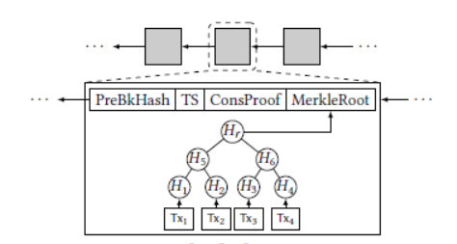
Background – Blockchain Nodes
ConsProof = hash(PreBkHash | TS | MerkleRoot | nonce) ≤ Z (Z mining difficulty)

Slide 10
Background – Blockchain Nodes
In a typical blockchain network there are three types of nodes:
A full-node stores all the data (Block headers and Data records)
A miner is a full node with great computing power (responsible for constructing consensus proofs)
A light-node stores only block headers (consensus proofs and the cryptographic hashes of a block)

Slide 11
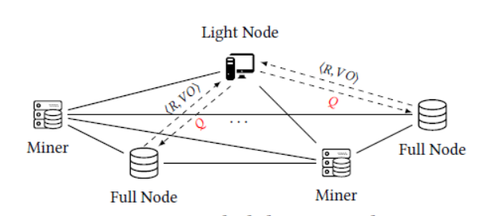
Background – Blockchain Nodes

Slide 12
Motivation
There is an increasing demand for querying the data stored in a blockchain database
The valuable that blockchain give us is the integrity of the data
Commonly to ensure query integrity, the user can maintain the entire blockchain database and query the data locally.
However, this approach is not economic
Blockchain’s huge data size
Maintenance costs

Slide 13
Background – Similar Work
vChain framework is inspired by query authentication techniques studied for outsourced databases
Based on Authenticated Data Structure (ADS)
ADS stored on block (actually is a hash)
Commonly used to dynamically generate Verification Object (VO) on each query

Slide 14
Contribution
vChain framework is inspired by these query authentication techniques
But, there are several key differences
Target to ensure the integrity without considering trust node
The query client will act as light-node (stored block headers)

Slide 15
Contribution – Issues ADS (1)
The conventional techniques rely on a data owner to sign the ADS using a private key
But, in the blockchain network there is no data owner
Blocks append to the chain only from miners by constructing consensus proofs according to the consensus protocol.
They cannot act as data owner due that cannot hold private key

Slide 16
Contribution – Issues ADS (2)
A conventional ADS is built on a fixed dataset,
Such ADS cannot be efficiently adapted to a blockchain database in which the data are unbounded

Slide 17
Contribution – Issues ADS (3)
In traditional outsourced databases, new ADSs can always be generated and appended as needed, to support more queries involving different sets of attributes.
But, that would be difficult due to the immutability of the blockchain
A one-size-fits-all ADS is more desirable to support dynamic query attributes

Slide 18
Contribution (1)
A novel framework called vChain proposed that
Alleviates the storage
Computing costs of the user
Employs verifiable queries to guarantee the results’ integrity.
For supporting verifiable Boolean range queries, an accumulator-based authenticated data structure that enables dynamic aggregation over arbitrary query attributes proposed.
numerical attributes
set-valued attributes

Slide 19
Contribution (2)
Two new indexes are further developed to aggregate data records for efficient query verification:
intra-block
inter-block
An inverted prefix tree structure to accelerate the processing of a large number of subscription queries simultaneously proposed (simultaneously)

Slide 20
Contribution - Overview
To the best of our knowledge, this is the first work on verifiable query processing that leverages built-in ADSs to achieve query integrity for blockchain databases.
We propose a novel vChain framework, together with a new ADS scheme and two indexing structures that can aggregate intra-block and inter-block data records for efficient query processing and verification.

Slide 21
Contribution - Overview
We develop a new query index that can handle a large number of subscription queries simultaneously
We conduct a security analysis as well as an empirical study to validate the proposed techniques. We also address the practical implementation issues.

Slide 22
Framework Design - Definition
vChain, involves three type of nodes:
Miner
Responsible for constructing the consensus proofs and appending new blocks to the blockchain.
Service Provider (SP)
Provides query services to the lightweight user.
query user (light-node)
Light node that keeps track of the block headers only.

Slide 23
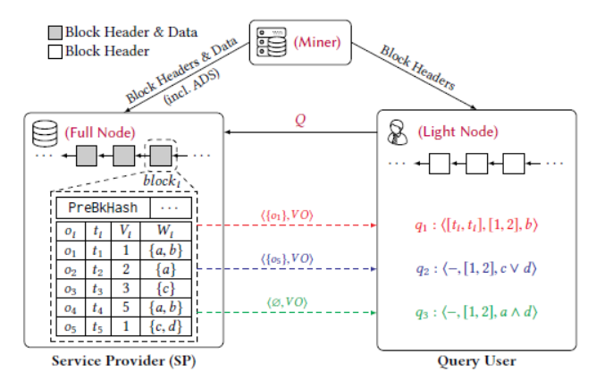
Framework Design - Definition

Slide 24
Framework Design - Definition
Data in blockchain are:
blocks of temporal objects {o1, o2, · · · , on }
Each temporal object represented by
Timestamp (ti)
Multi-dimensional vector of numerical attributes (Vi)
Set-valued attribute (Wi)
ADS constructed and embedded into each block by the miners

Slide 25
Boolean range queries - Time-window
Query is in the form of q = ⟨[ts , te ], [α, β], ϒ⟩
[ts , te ] is a temporal range selection predicate for the time period
[α, β] is a multi-dimensional range selection predicate for the numerical attributes
ϒ is a monotone Boolean function on the set-valued attribute

Slide 26
Boolean range queries - Time-window
Example:
q=⟨[2018-05, 2018-06], [10, +∞], send:1FFYc∧receive:2DAAf⟩
To find all of the transactions happening from May to June of 2018 with a transfer amount larger than 10 and being associated with the addresses “send:1FFYc” and “receive:2DAAf”

Slide 27
Boolean range queries - Subscription
Query is in the form of: q = ⟨−,[α, β], ϒ⟩
[α, β] and ϒ are identical to the query conditions in time-window queries
the SP continuously returns all objects such that much the query until the query is deregistered.

Slide 28
Boolean range queries - Subscription
Example:
q = ⟨−, [200, 250], “Sedan”∧(“Benz”∨“BMW”)⟩
receiveing all rental messages that have a price within the range [200, 250] and contain the keywords “Sedan” and “Benz” or “BMW”.

Slide 29
Boolean range queries

Slide 30
Basic Solution
A naive scheme is to construct a traditional MHT as the ADS for each block and apply the conventional MHT-based authentication methods.
For simplicity, considers the Boolean query condition on the set-valued attribute Wi only. We assume that each block stores a single object oi = ⟨ti ,Wi ⟩ and use ObjectHash to denote MerkleRoot in the original block structure

Slide 31
Basic Solution – ADS Generation
ADS is generated for each block during the mining process
Used by the SP to construct a verification object (VO) for each query
Original block structure extended by adding an extra field, named AttDigest

Slide 32
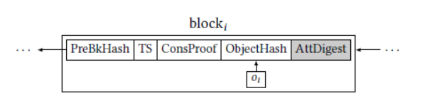
Basic Solution – ADS Generation

Slide 33
Basic Solution – ADS Generation
AttDigest should have three desired properties
AttDigest should be able to summarize an object’s attributeWi in a way that it can be used to prove whether or not the object matches a query condition.
In case of a mismatch, we can just return this digest instead of the whole object.

Slide 34
Basic Solution – ADS Generation
AttDigest should be in a constant size regardless of the number of elements in Wi
AttDigest should be aggregatable to support batch verification of multiple objects within a block or even across blocks

Slide 35
Verifiable Query Processing
Given a Boolean query condition and a data object, there are only two possible outcomes:
Match (Easy)
Mismatch (Hard)
Match is easily verified by returning the object as a result (can verify by ObjectHash from block header)

Slide 36
Verifiable Query Processing
For the mismatch used the AttDigest
As CNF is a Boolean function expressed in a list of AND of OR operators, we can view the Boolean function in CNF as a list of sets.
For example, a query condition “Sedan”∧(“Benz”∨“BMW”) == of two sets: {“Sedan”} and {“Benz”, “BMW”}

Slide 37
Verifiable Query Processing
Apply ProveDisjoint({“Van”, “Benz”}, {“Sedan”}, pk) to generate a disjoint proof π as the VO for the mismatching object.
User can retrieve
AttDigesti = acc({“Van”, “Benz”}) from the block header and use
VerifyDisjoint(AttDigesti , acc({“Sedan”}), π,pk) to verify the mismatch.

Slide 38
Verifiable Query Processing
Query ondition “Sedan”∧(“Benz”∨“BMW”)
Object | Timestamp | MD-Vector | Set-valued attribute
O1 | Ti | Vi | {“Sedan”, “Benz”}
O2 | Ti | Vi | {“Sedan”, “Audi”}
O3 | Ti | Vi | {“Van”, “Benz”}
O4 | Ti | Vi | {“Van”, “BMW”}
Match
Mismatch
Mismatch
Mismatch

Slide 39
Extension to Range Queries
In many scenarios, the user may also apply range conditions on the numerical attributesVi
We transform a numerical value into a set of binary prefix elements (denoted as function trans(·))
trans(6) = {1∗, 10∗, 110}

Slide 40
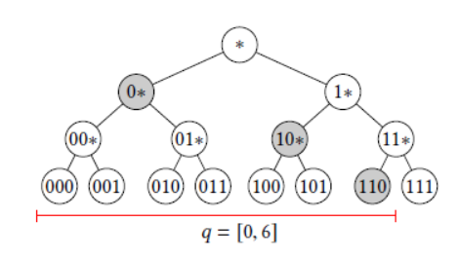
Extension to Range Queries
4 ∈ [0, 6] since {1∗, 10∗, 100}∩{0∗, 10∗, 110} = {10∗} != ∅;

Slide 41


Batch Verification - Intra-block Index
Intra-Block Index Non-Leaf Node
Intra-Block Index Leaf Node

Slide 42
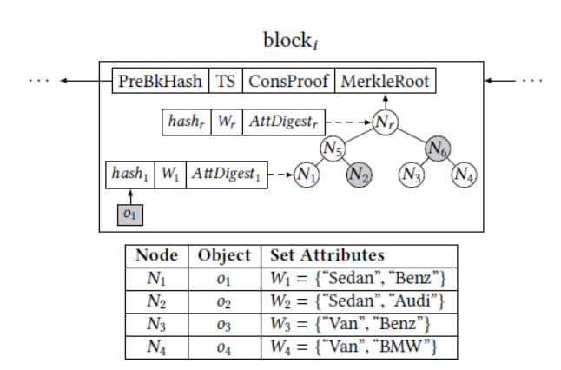
Batch Verification - Intra-block Index
SP can process a query as a tree search. Starting from the root node, if the attribute multiset of the current node fulfills the query condition, its subtree will be further explored.

Slide 43
Batch Verification - Inter-block Index
Inter-block index consists of multiple skips, each of which skips an exponentially number of previous blocks.
For example, the list may skip previous blocks
2, 4, 8, · · ·

Slide 44
Batch Verification - Inter-block Index
For each skip, it maintains three components:
Hash of all skipped blocks (denoted by PreSkippedHashLk )
Sum of the attribute multisets for the skipped blocks (denoted byWLk )
Corresponding accumulative value w.r.t.WLk (denoted by AttDigestLk )

Slide 45
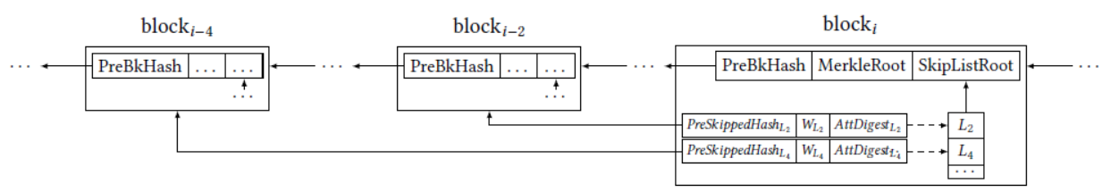
Batch Verification - Inter-block Index

Slide 46
Verifiable Subscription Queries
A subscription query is registered by the query user and continuously processed until it is deregistered
Upon seeing a newly confirmed block, the SP will need to publish the results to registered users, together with VOs

Slide 47
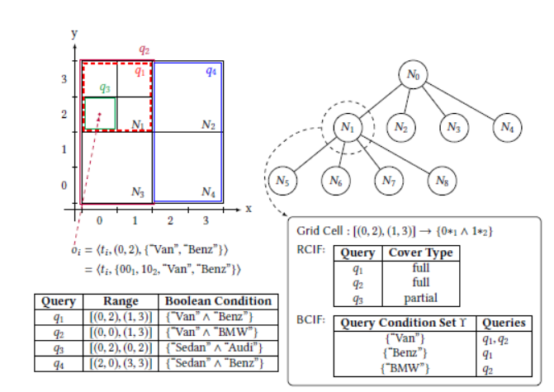
Verifiable Subscription Queries

Slide 48
Conclusion
This paper opens up a new direction for blockchain research.
There are a number of interesting research problems that deserve further investigation:
How to support more complex analytics queries
How to leverage modern hardware such as multi- and many-cores to scale performance
How to address privacy concerns in query processing

Slide 49
References
All figures were taken by the paper presented [1]
[1] S. Nakamoto. 2008. Bitcoin: A peer-to-peer electronic cash system.
[2] G. Wood. 2014. Ethereum: A secure decentralised generalised transaction ledger. Ethereum project yellow paper, 151, 1–32.
[3] C. Mohan. 2017. Tutorial on blockchains and databases. Proc. VLDB Endow., 10, 12, 2000–2001.
[4] T. T. A. Dinh, J.Wang, G. Chen, R. Liu, B. C. Ooi, and K.-L. Tan. 2017. Blockbench: A framework for analyzing private blockchains. In ACM SIGMOD.
[5] T. T. A. Dinh, R. Liu, M. Zhang, G. Chen, B. C. Ooi, and J. Wang. 2018. Untangling blockchain: a data processing view of blockchain systems. IEEE Trans. Knowl. Data Eng., 30, 7, 1366–1385.

Slide 50
References
[6] H. T. Vo, A. Kundu, and M. Mohania. 2018. Research directions in blockchain data management and analytics. In EDBT.
[7] S. Wang, T. T. A. Dinh, Q. Lin, Z. Xie, M. Zhang, Q. Cai, G. Chen, W. Fu, B. C. Ooi, and P. Ruan. 2018. ForkBase: An efficient storage engine for blockchain and forkable applications. Proc. VLDB Endow., 11, 10, 1137–1150.
[8] Blockchair. 2018. A blockchain search and analytics engine for Bitcoin, Bitcoin Cash and Ethereum. (2018). https://blockchair.com/about.
[9] Vaultitude. 2018. Intellectual property blockchain platform. (2018). https://vaultitude.com/assets/downloads/AVaultitude_WhitePaper.pdf
[10] B. M. Platz, A. Filipowski, and K. Doubleday. 2017. Flureedb: a practical decentralized database. (2017). https://flur. ee/assets/pdf /flureedb%5C_whitepaper%5C_v1.pdf.

Slide 51
References
[11] BigchainDB GmbH. 2018. Bigchaindb 2.0: the blockchain database. (2018). https://www. bigchaindb.com/whitepaper/bigchaindb-whitepaper.pdf.
[12] Wolk Inc. 2017. Wolk swarmdb: decentralized database services for web 3. (2017). https://wolk.com/whitepaper/WolkTokenGenerationEvent-20170717.pdf.
[13] Bitcoin. 2018. Running a full node. (2018). https://bitcoin.org/en/fullnode.
[14] H. Pang and K.-L. Tan. 2004. Authenticating query results in edge computing. In IEEE ICDE.
[15] F. Li, M. Hadjieleftheriou, G. Kollios, and L. Reyzin. 2006. Dynamic authenticated index structures for outsourced databases. In ACM SIGMOD.
[16] Y. Yang, S. Papadopoulos, D. Papadias, and G. Kollios. 2008. Authenticated indexing for outsourced spatial databases. The VLDB Journal, 18, 3, 631–648.

Slide 52
References
[17] Q. Chen, H. Hu, and J. Xu. 2015. Authenticated online data integration services. In ACM SIGMOD.
[18] C. Xu, J. Xu, H. Hu, and M. H. Au. 2018. When query authentication meets fine-grained access control: A zero-knowledge approach. In ACM SIGMOD.
[19] R. C. Merkle. 1989. A certified digital signature. In Advances in Cryptology — CRYPTO, 218–238.
[20] G. Ateniese, A. Faonio, B. Magri, and B. de Medeiros. 2014. Certified bitcoins. In Applied Cryptography and Network Security, 80–96.
[21] J. Garay, A. Kiayias, and N. Leonardos. 2015. The bitcoin backbone protocol: Analysis and applications. In Advances in Cryptology - EUROCRYPT, 281–310.
[22] I. Eyal, A. E. Gencer, E. G. Sirer, and R. Van Renesse. 2016. Bitcoin-NG: A scalable blockchain protocol. In USENIX NSDI, 45–59.

Slide 53
References
[23] G. Pirlea and I. Sergey. 2018. Mechanising blockchain consensus. In ACM SIGPLAN Int’l Conf. Certified Programs and Proofs, 78–90.
[24] C. Dong, Y. Wang, A. Aldweesh, P. McCorry, and A. van Moorsel. 2017. Betrayal, distrust, and rationality: Smart counter-collusion contracts for verifiable cloud computing. In ACM CCS, 211–227.
[25] J. Camenisch, M. Drijvers, and M. Dubovitskaya. 2017. Practical ucsecure delegatable credentials with attributes and their application to blockchain. In ACM CCS, 683–699.
[26] IBM Blockchain. 2018. Enterprise blockchain solutions and services.
(2018). https://www.ibm.com/blockchain.
[27] Oracle. 2018. Transforming the enterprise with oracle blockchain platform. (2018). https://www.oracle.com/cloud/blockchain/.

Slide 54
References
[28] SAP. 2018. Blockchain applications and services. (2018). https://www.sap.com/products/leonardo/blockchain.html.
[29] Y. Zhang, D. Genkin, J. Katz, D. Papadopoulos, and C. Papamanthou. 2017. vSQL: verifying arbitrary SQL queries over dynamic outsourced databases. In 2017 IEEE S&P, 863–880.
[30] B. Parno, J. Howell, C. Gentry, and M. Raykova. 2013. Pinocchio: nearly practical verifiable computation. In 2013 IEEE S&P, 238–252.
[31] E. Ben-Sasson, A. Chiesa, E. Tromer, and M. Virza. 2014. Succinct non-interactive zero knowledge for a von neumann architecture. In Proceedings of the 23rd USENIX Conference on Security Symposium, 781–796.
[32] C. Papamanthou, R. Tamassia, and N. Triandopoulos. 2011. Optimal verification of operations on dynamic sets. In Advances in Cryptology – CRYPTO, 91–110.

Slide 55
References
[33] R. Canetti, O. Paneth, D. Papadopoulos, and N. Triandopoulos. 2014. Verifiable set operations over outsourced databases. In Public-Key Cryptography – PKC, 113–130.
[34] D. Papadopoulos, S. Papadopoulos, and N. Triandopoulos. 2014. Taking authenticated range queries to arbitrary dimensions. In ACM CCS.
[35] Y. Zhang, J. Katz, and C. Papamanthou. 2017. An expressive (zeroknowledge) set accumulator. In IEEE EuroS&P.
[36] C. Xu, Q. Chen, H. Hu, J. Xu, and X. Hei. 2018. Authenticating aggregate queries over set-valued data with confidentiality. IEEE Trans. Knowl. Data Eng., 30, 4, 630–644.
[37] D. Schroeder and H. Schroeder. 2012. Verifiable data streaming. In
ACM CCS.

Slide 56
References
[38] C. Papamanthou, E. Shi, R. Tamassia, and K. Yi. 2013. Streaming authenticated data structures. In Advances in Cryptology – EUROCRYPT, 353–370.
[39] D. Schöder and M. Simkin. 2015. VeriStream – A framework for verifiable data streaming. In Financial Cryptography and Data Security, 548–566.
[40] S. Papadopoulos, Y. Yang, and D. Papadias. 2009. Continuous authentication on relational streams. The VLDB Journal, 19, 2, 161– 180.
[41] L. Chen, G. Cong, and X. Cao. 2013. An efficient query indexing mechanism for filtering geo-textual data. In ACM SIGMOD.
[42] C. Thoma, A. J. Lee, and A. Labrinidis. 2016. PolyStream. Cryptographically enforced access controls for outsourced data stream processing. In ACM Symposium on Access Control Models and Technologies - SACMAT.
[43] K. Yang, K. Zhang, X. Jia, M. A. Hasan, and X. Shen. 2017. Privacypreserving attribute-keyword based data publish-subscribe service on cloud platforms. Information Sciences, 387, 116–131.

Slide 57
Thank you!
Q & A

