Slide 1

LightDB: A DBMS for Virtual Reality Video
EPL646: Advanced Topics in Databases
Brandon Haynes, Amrita Mazumdar, Armin Alaghi,
Magdalena Balazinska, Luis Ceze, Alvin Cheung
Paul G. Allen School of Computer Science & Engineering
University of Washington, Seattle, Washington, USA
By: Daniela Torres (dtorre01@cs.ucy.ac.cy),
Rafael Gonçalves (rgonca01@cs.ucy.ac.cy)

Slide 2
Presentation Outline (Indicative)
Background
Introduction
LightDB Model
Data Model
Algebra
Data Manipulation
Input & Output
Data Definition
Algebra Expressions
Query Language
VAMR Applications
LightDB Architecture

Slide 3
Introduction
LightDB is a database management system designed to manage virtual, augmented and mixed reality (VAMR) video content
LightDB treats VAMR video data as a logically-continuous six-dimensional light field
LightDB automatically transforms declarative queries into executable physical plans

Slide 4
Introduction
While all video applications tend to be data-intensive and time-sensitive, VAMR video applications are often particularly so
Recent VR light field cameras sample every visible light ray occuring within some volume of space and are able to produce up to a half terabyte per second of video data
For spherical panoramic VR videos (a.k.a. 360º videos), encoding one stereoscopic frame of video can involve processing up to 18× more bytes than an ordinary 2D video
AR and MR video applications, on the other hand, often mix smaller amounts of synthetic video with the world around a user
Similar to VR, however, these applications have extremely demanding latency and throughput requirements since they must react to the real world in real time

Slide 5
Introduction
To address these challenges, various specialized VAMR systems have been introduced for preparing and serving VAMR video data:
VRView
Facebook Surround 360
YouTube VR
Google Poly
Lytro VR
Magic Leap Creator
Goal:
Enabling developers to easily implement their applications
Problem:
Such systems manage VAMR video as if it were ordinary 2D video, which results in conceptual and technical difficulties that we call the VAMR impedance mismatch (…)

Slide 6
Introduction
Further compounding this impedance mismatch, current VAMR systems are fixed to a particular 2D video layout
Transforming data from one 2D format to another is expensive and this limits interoperation between systems that otherwise would be compatible
To address the VAMR impedance mismatch, a system is developed to treat all types of VAMR video in a logically unified manner
We are introducing a unified data model containing a logical construct that we call a temporal light field (TLF) (…)

Slide 7
Introduction
LightDB is a new database management system designed to handle the storage, retrieval and processing of both archived and live VAMR video
It combines the state of the art in array-oriented systems
In addition to an implementation of the TLF data model, LightDB exposes a declarative query language – VRQL –, for developers to use

Slide 8
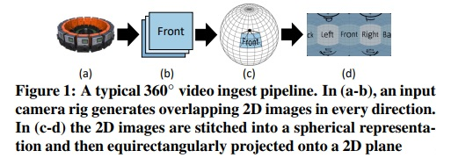
Background
LightDB ingests and processes two types of VAMR videos: spherical panoramic (360º) videos and light fields.
Spherical Panoramas:
These videos allow a viewer, while wearing a head-mounted display or using a mobile device, to observe a scene from a fixed location at any angle (…)

Slide 9
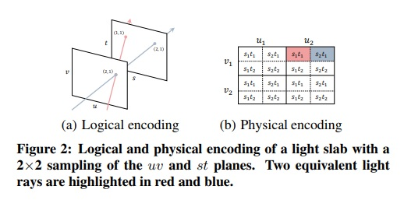
Background
Light Fields:
A 360º video enables a user to look in any direction but the user must remain static. A light fields enables a user to both look in any direction and move in space. (…)

Slide 10
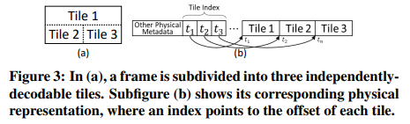
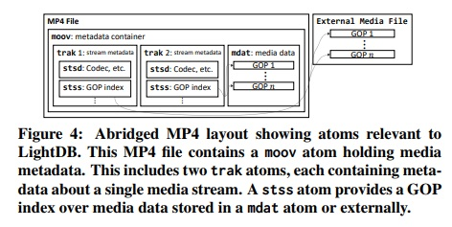
Background
Video encoding & Streaming:
Both types of VAMR video described before are ultimately encoded using two-dimensional codecs to reduce the amount of storage required
Rather than streaming raw encoded videos streams to clients, videos are typically “muxed” into files such as MP4 or WebM/Matroska media container formats (…)

Slide 11
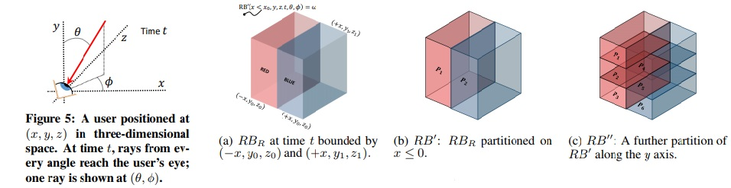
LightDB Model
Existing database management systems specialized in the processing of image and video data, including:
RasDaMan
SciDB
Oracle Multimedia
Model image and video data as multidimensional arrays
Three dimensions of the arrays: x, y and t
For a VAMR application, the fundamental concepts are the current location of the viewer and the direction in which the viewer is looking
If a user observes the same object from a different viewing angle, the value of the pixels representing the object must change, which cannot be captured with spatiotemporal dimensions but can be captured with light fields

Slide 12
Data Model
LightDB adopts light fields as the fundamental construct in its data model
Because our light fields can change over time, we use TLFs to represent all data, whether originally ingested as a light field or as a 360º video
Data as multidimensional objects with both rectangular and angular coordinates and six overall dimensions:
Three spatial (x, y, z)
One temporal (t)
Two angular (θ, φ) – capture the user’s viewing direction
capture the user’s position over time

Slide 13
Data Model
The TLF function we’ve been talking about is a function from position and orientation to a point in a user-specified color space C
RB_{R} = ^{RED if x≤0}
_{Blue otherwise}
Color space containing the colors red and blue
Volume R = (-x, y0, z0), (x, y1, z1)

Slide 14
Data Model
Data objects in LightDB take the form of nullable, temporal light fields.
Every TLF, L, in LightDB is associated with metadata that includes a unique identifier – id(L) – and a bounding volume – V(L).
TLFs may further be partitioned into pieces for parallel processing. (figura 6b) (…)

Slide 15
Algebra
LightDB query algebra is designed to enable a variety of operations on different types of VAMR data to capture the logical specifications of those operations while hiding their physical complexity
It exposes nineteen logical operators for expressing queries over TLFs, divided in three broad categories:
Data manipulation operators used to manipulate TLFs stored in LightDB
Encode and Decode operators, which are used to transform and internal TLF representation to and from an encoded representation
Data definition operators used to create, modify and remove TLFs from the LightDB catalog

Slide 16
Data Manipulation
The data manipulation operators exposed by LightDB include:
Selection – derives a “smaller” TLF from its input
Partitioning – “cuts” a TLF into equal-sized, non-overlapping blocks along a given dimension
Merging – merges two or more TLFs into a single TLF
Transformation – transforms a TLF into a new field defined within the same bounding volume as its input
Translation & Rotation – The Translate operator adjusts every light ray in a TLF by some spatiotemporal distance. The Rotate operator rotates the rays at each point by angles ∆θ and ∆φ

Slide 17
Input & Output
Data flowing into LightDB must always go through a Decode operator that transforms 360º videos and light field encoded as MP4 files into one of the physical TLF representations (…)
LightDB also exposes Scan and Store operators, which are used to read and overwrite TLFs that are defined in LightDB’s internal catalog
In LightDB, TLFs are immutable and writes are performed by copying video data at the track granurality (…)
Writes to TLFs are versioned and version numbers are stored as part of the TLF’s metadata
LightDB uses the immutability and versioning of TLFs to provide snapshot isolation during query evaluation

Slide 18
Data Definition
Create – Creates a new TLF that is a copy of Ω, a distinguished, immutable TLF where each point is associated with the null token ꙍ.
Drop – Removes a TLF from the LightDB catalog and deletes its content from disk.
CreateIndex (L, d₁, ..., d_{n}) – Creates na index over TLF L in dimensions d₁, ..., d_{n.}
DropIndex – Removes a previously created index.

Slide 19
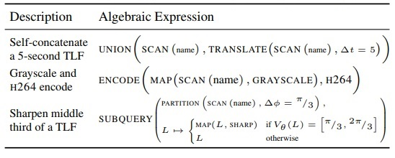
Algebra Expressions
LightDB operators can be composed into expressions in the same way as relational algebra operators
LightDB supports both one-shot and streaming queries, with each executed similarly
Either query type may operate over TLFs that are being continuously ingested, those already stored in LightDB, or from other data sources such as a socket, local disk or distributed file system
All of the operators in LightDB are non-blocking, though user-defined functions used as arguments may lead to blocking

Slide 20
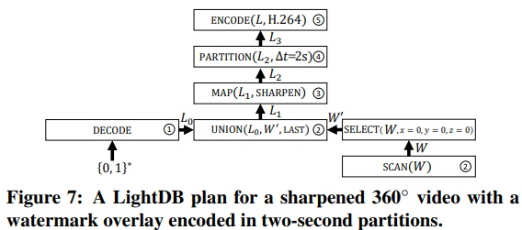
Query Language
LightDB includes a declarative query language called VRQL
VRQL allows developers to describe queries without the need to be concerned with the underlying complexities of the video data, how the query is executed, or which hardware to use for individual operations
Union(Decode(filename), Scan("W") >> Select(0, 0, 0))
>> Map(sharpen) >> Partition(Time, 2)
>> Encode(H264);

Slide 21
Query Language
To improve readability, a VRQL query may assign an intermediate result to a variable.
Developers may use VRQL to create indices over existing TLFs.
auto tlf = Scan(name);
auto cat = Union(tlf, (tlf >> Translate(Time,5));
cat >> Select(Time, 0, 3) >> Store(“out”);
CreateIndex(“out”, Y, Time);
Scan(“out”) >> Select(Y, 0, 0, Time, 0, 1) >> Map(grayscale)
Notes:
The second query modifies cat from the previous example by selecting only the first three seconds of video data (line 1). Line 2 then creates an index over two spatiotemporal dimensions of out. LightDB may then utilize this index on line 3.

Slide 22
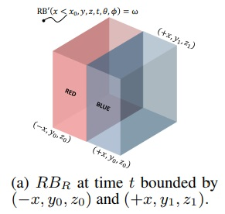
Query Language
LightDB supports user-defined functions (UDFs) that may be used with the Map and Union operators for functionality not available in its built-in library
auto x = 1;
auto tlf = Create(“RB”)
>> Select(Volume{{-x, x}, …})
>> Map([](auto &point) { return point.x < 0 ? Red : Blue; });
Notes:
To create the TLF shown in the figure, a developer would define an anonymous function used in MAP in the following query:

Slide 23
VAMR Applications
Predictive 360º Video Tiling:
Many streaming video services serve an entire panoramic viewing sphere to client devices
Recent work has demonstrated substantial savings (up to 75%) in data transfer by degrading the quality of the unimportant areas of the 360º sphere
Decode(“rtp://…”)
>> Partition(Time, 1, Theta, π / 2, Phi, π / 4)
>> Subquery([](auto& partition) {
return Encode(partition, is_important(partition)
? Quality::High : Quality::Low) })
>> Store(“output”);
Notes:
This approach is suboptimal, because at any instant only a small portion of the sphere is displayed in a VR viewer, which generally have a narrow field of view (PRIMEIRO PONTO)
Developing this query in existing frameworks is tedious and error-prone. Using LightDB, a developer can simply express this as the following
This query subdivides the input TLF into one-second segments and partitions of size ( π/2, π/4 ). Next, the SUBQUERY operator changes the quality of each partition to that given by a function that predicts a user’s future orientation. For example, we might use dead reckoning to predict a user’s next orientation and encode that partition in high quality (and low quality elsewhere)

Slide 24
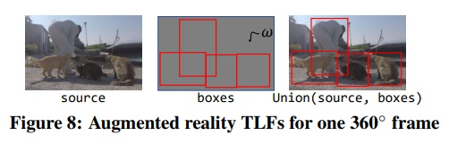
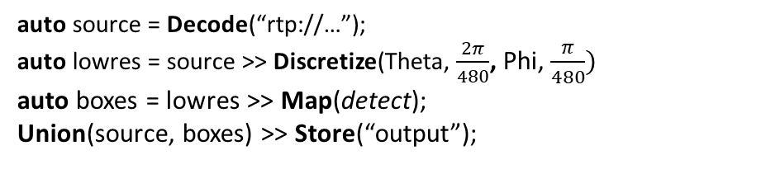
VAMR Applications
Augmented Reality:
One augmented reality application that has seen heightened interest in the computer vision and mobile sensing communities involves ingesting a live video stream from a worn camera or mobile device, automatically detecting objects within the field of view, and highlighting them in real-time with a bounding rectangle
auto source = Decode(“rtp://…”);
auto lowres = source >> Discretize(Theta, $\frac{2π}{480}$, Phi, $\frac{π}{480})$
auto boxes = lowres >> Map(detect);
Union(source, boxes) >> Store(“output”);
Notes:
In many cases, the object detection function associated with this application is a neural network trained on a particular input video resolution (e.g., 480×480). This workload may be easily expressed in VRQL:
- This query lowers the resolution of its input to 480×480, and applies a MAP UDF called detect. The UDF applies an object detection algorithm such as YOLO9000 (a state-of-the-art, real-time object detection system that can detect over 9000 object categories) and generates a result that is red at detection boundaries and null otherwise. Finally, the result is combined with the original input.

Slide 25

VAMR Applications
Depth Map Generation
For a light field stored in LightDB, the extremely high data sizes (gigabytes or terabytes of raw data per second) make cloud-based streaming to remote clients infeasible
One strategy to reduce the amount of data transfer involves sampling a light field at two points near where a user’s eyes are located and computing a depth map for the 360◦ videos incident to those points
auto stereo = Union(Scan(L) >> Select(p + $\frac{i}{2}),$
Scan(L) >> Select(p - $\frac{i}{2}))$
>> Interpolate(DepthMapInterpolation)
>> Store(“sample”)
Notes:
- (SEGUNDO PONTO): One strategy to reduce the amount of data transfer involves sampling a light field at two points near where a user’s eyes are located (i.e., her current position p offset by an interpupillary distance i) and computing a depth map for the 360◦ videos incident to those points
- The VRQL query for this process is as follows

Slide 26
LightDB Architecture
LightDB is currently a single-node, single-threaded system
The objective is to extend it to support distributed execution in shared-nothing clusters
Users submit individual queries as a statement or script that may include variable assignments
LightDB executes each such query as a single transaction with snapshot isolation
Notes:
O quadro e o prototype
- We currently disallow queries that overwrite the same TLF more than once

Slide 27
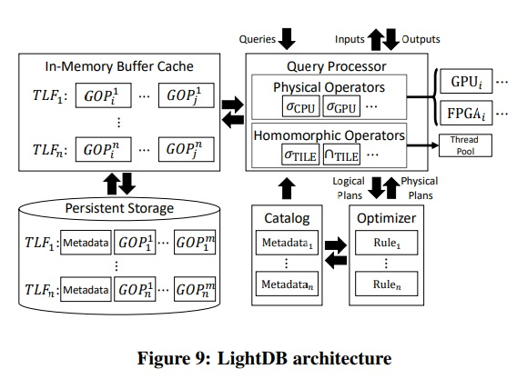
LightDB Architecture
The Query Processor (QP) receives declarative queries as input and converts them into physical query plans that it executes, returning results to applications in the form of encoded videos
The translation of the input declarative queries into logical query plans is a straightforward one-to-one mapping
The logical-to-physical query plan translation, however, is amenable to various optimizations
LightDB’s physical algebra includes operators that directly process encoded video frames, called homomorphic operators, and operators that process decoded data

Slide 28
Physical Organization and Data Storage
Phisically, each TLF can be represented using one of two formats explained before:
360◦ TLF: contains one or more 360◦ videos, with a separate video stream.
SlabTLF: contain one or more slabs at various positions and orientations, with a separate stream encoded for each.
Combinations of 360TLF and SlabTLFs may be merged through application of the Union operator, generating a CompositeTLF.

Slide 29
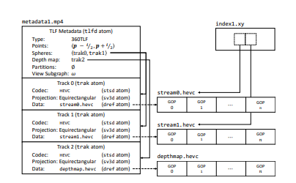
Physical Organization and Data Storage
For each formats, LightDB organizes a TLF within a single directory on the system.
Each direction contains one metadata file(MP4) with atoms containing the properties od the TLF and pointers to associated vídeo streams.

Slide 30
Physical Organization and Data Storage
LightDB extends the MP4 format by introducing an additional atom (tlfd) to serialize the remaining data about a TLF’s physical type.
For a 360TLF, the tlfd atom contains a pointer to one or more video spheres and optional pointers to depth map tracks.
For SlabTLFs, the tlfd contains one pointer per slab.

Slide 31
Indexing
LightDB uses two indices for index:
Tile índex: for point or range queries over one or more angular dimensions. Used to identify applicable subregions of frames.
GOP index: for point or range queries over time. Used if temporal constraints are present.
LightDB also supports spatial indices, which are external indices over any combination of spatial dimensions.
If there are any spatial indices, those are choosed over the other two.

Slide 32
Buffer Pool
During query execution, the query processor (QP) interacts with an in-memory TLF cache (TC) to load data from persistent storage.
The TC also contains a buffer pool to GPOs that improves the temporal locality and reduces the misses of predictive frames, since the policy used is the LRU (least-recently used).

Slide 33
Physical Algebra
LightDB has two homomorphic operators (HOps) that perform operations directly on 360TLF or SlabTLF video data without requiring that it be decoded:
Those that operate over encoded groups of pictures: uses the GOP index to identify the byte region in an encoded video file that contains the frame data for the relevant GOPs.
Those that operate over the tiles in each frame : using tile index to efficiently identify the relevant bytes.

Slide 34
Rule-Based Optimization
In order to improve the performance, the optimization is devaded intwo phases.
Phase one:
selects the physical implementation of logical operation, including the device that should execute the operation.
The selection is heuristic and proceeds in a bottom-up fashion.
The query optimizer (QO) generates the physical plan by transforming the logical plan in a bottom-up fashion.

Slide 35
Rule-Based Optimization
Phase one:
For each TLF stored within LightDB, the QO consults the TLF catalog (TC) and selects a GPU-based 360◦ or light field physical operator if one exists for the video codec.
Having selected physical operators for the leaves in the query plan, the QO then selects physical operator.
If no physical operator implementation is available for that device, the QO selects a GPU-based implementation.

Slide 36
Rule-Based Optimization
Phase two:
QO “pushes up” instances of the INTERPOLATE operator in order to so the TLF remains discrete for as many operations as possible.
The QO attempts to substitute highly-efficient homomorphic operators (HOps) that may be executed directly on encoded TLF video.

Slide 37
Evaluation
In order to evaluate the LightDB, a experiment was made, comparing LightDB against OpenCV, Ffmpeg, Scanner and ScyDB.
Datasets: 360TLF experiments: “Timelapse”, “Venice”, and “Coaster; SlabTLFs experiments: “Cats” light slabs;
Characteristics of hardware:
Prototype using C++;
GPU-based operators were implemented using NVENCODE/NVDECODE and CUDA;
Intel i7- 6800K processor;
32 GB DDR4 RAM at 2133 MHz
256 GB SSD drive and a Nvidia P5000 GPU.

Slide 38
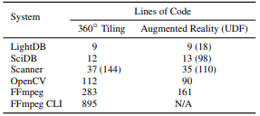
Evaluation - Programmability
Both LightDB and SciDB are able to express the complex workload in a small number of lines, while OpenCV and FFmpeg require many more lines of code to express the same query.
Lines of code required to reproduce the predictive
360◦and augmented reality queries
Advantages of LightDB:
LightDB produces correct results using significantly fewer lines of code;
Do it in a declarative manner that avoids requiring developers to be involved with the low-level details associated with workload execution.

Slide 39
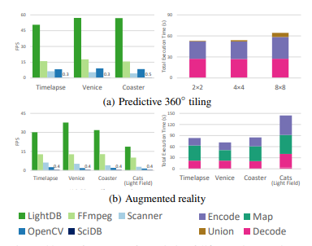
Evaluation - Programmability
Prefictive 360 tiling: LightDB is able to achieve the highest performance. Why? Because uses efficient physical tile union operators that avoids an expensive additional decode/encode step that is required by the other systems.
Augmented reality: This performance is possible because LightDB is able to perform most of the processing (decode, discretize, and union) using its GPU-optimized physical operators and parallelize the GPU-to-CPU transfer.
Performance of predictive 360◦ and AR applications.

Slide 40
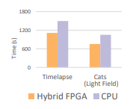
Evalutation -Hardware Acceleration
The game changer here was introducing a FPGAbased UDF variant that allows the LightDB query optimizer to reduce query execution by more than 25%. This is a useful performance advantage, since high-quality depth map generation is computationally-expensive and is often performed offline.
Performance of depth map application

Slide 41
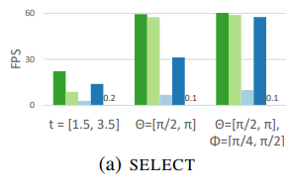
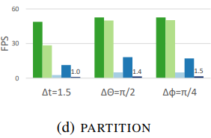
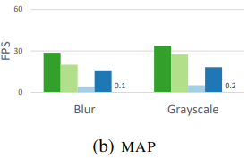
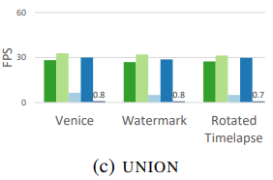
Evalutation -Operator Performance
For most operations, LightDB performs better since it utilizes its GPU-based physical operators across the entire query.
In this case LightDB uses its GOP index to decode only the relevant portions of the 360TLF.
LightDB performs slightly worse for unions due to its merge UDF overhead

Slide 42
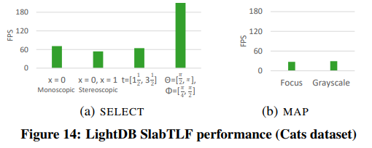
Evalutation- SlabTLF Operator Performance
Because the baseline systems do not support light fields, this was only tested in LightDB
Select: Here LightDB is able to generate results at approximately 60 frames per second, which is a common throughput for 4K VR video;
Map: Similarly, blur and grayscale operations perform at a rate comparable to their 360TLF counterparts (previous slide);

Slide 43
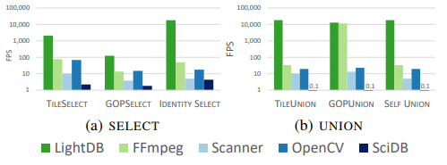
Evalutation- Effectiveness of Optimizations.
LightDB outperform the baseline systems—in some cases by more than 500×.
The one exception is FFmpeg’s GOP unioning performance, which matches LightDB because it utilizes a similar GOP stitching mechanism that it calls a “concat protocol”.

Slide 44
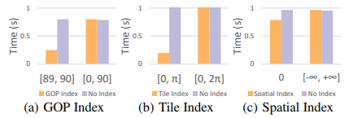
Evalutation- Index Performance
Gop Index: Here the presence of the index substantially improves performance for queries over a small interval, but does not impact performance for queries over a large extent
Tile Index: LightDB’s use of the tile index is able to improve performance by allowing LightDB to decode only the relevant tile rather than the entire encoded video.
Spacial Index:, and illustrate that the R-tree yields a modest benefit relative exhaustive search for relevant videos.
Index Performance

Slide 45
References
[1] S. Adali, K. S. Candan, K. Erol, and V. Subrahmanian. Avis: An advanced video information system. Technical Report 97-44, 1997. [2] E. H. Adelson and J. R. Bergen. The plenoptic function and the elements of early vision. In Computational Models of Visual Processing, pages 3–20. MIT Press, 1991. [3] G. Ananthanarayanan, P. Bahl, P. Bod´ık, K. Chintalapudi, M. Philipose, L. Ravindranath, and S. Sinha. Real-time video analytics: The killer app for edge computing. IEEE Computer, 50(10):58–67, 2017. [4] R. Anderson, D. Gallup, J. T. Barron, J. Kontkanen, N. Snavely, C. Hernandez, S. Agarwal, and S. M. Seitz. ´ Jump: virtual reality video. TOG, 35(6):198:1–198:13, 2016. [5] W. G. Aref, A. C. Catlin, J. Fan, A. K. Elmagarmid, M. A. Hammad, I. F. Ilyas, M. S. Marzouk, and X. Zhu. A video database management system for advancing video database research. In MIS, pages 8–17, 2002.

Slide 46
References
[6] I. Bauermann, Y. Peng, and E. G. Steinbach. RDTC optimized streaming for remote browsing in image-based scene representations. In 3DPVT, pages 758–765, 2006. [7] P. Baumann, A. Dehmel, P. Furtado, R. Ritsch, and N. Widmann. The multidimensional database system rasdaman. In SIGMOD, pages 575–577, 1998. [8] F. Bellard. FFmpeg. https://ffmpeg.org. [9] N. Birkbeck, C. Brown, and R. Suderman. Quantitative evaluation of omnidirectional video quality. In QoMEX, pages 1–3, 2017. [10] C. Birklbauer, S. Opelt, and O. Bimber. Rendering gigaray light fields. Computer Graphics Forum, 32(2):469–478, 2013. [11] C. Brown. Bringing pixels front and center in VR video. https://www.blog.google/products/google-vr/ bringing-pixels-front-and-center-vr-video, 2017.

Slide 47
References
[12] P. G. Brown. Overview of SciDB: large scale array storage, processing and analysis. In SIGMOD, pages 963–968, 2010. [13] S. Chang, W. Chen, H. J. Meng, H. Sundaram, and D. Zhong. Videoq: An automated content based video search system using visual cues. In MMSys, pages 313–324, 1997. [14] T. Y. Chen, L. Ravindranath, S. Deng, P. Bahl, and H. Balakrishnan. Glimpse: Continuous, real-time object recognition on mobile devices. In SenSys, pages 155–168, 2015. [15] S. Christodoulakis, F. Ho, and M. Theodoridou. The multimedia object presentation manager of MINOS: A symmetric approach. In SIGMOD, pages 295–310, 1986. [16] Contributors to the FFmpeg Community Documentation Wiki. FFmpeg: Concatenating media files. https://trac.ffmpeg.org/wiki/Concatenate. [17] X. Corbillon, F. D. Simone, and G. Simon. 360-degree video head movement dataset. In MMSys, pages 199–204, 2017. [18] I. F. Cruz and W. T. Lucas. Delaunaymm: A visual framework for multimedia presentation. In VL, pages 216–223, 1997.

Slide 48
References
[19] M. E. Donderler, E. Saykol, U. Arslan, ¨ O. Ulusoy, and ¨ U. Gud¨ ukbay. Bilvideo: Design and implementation of a ¨ video database management system. MTAP, 27(1):79–104, 2005. [20] Facebook Surround 360. https://facebook360.fb.com/facebook-surround-360. [21] J. L. Feuvre and C. Concolato. Tiled-based adaptive streaming using MPEG-DASH. In MMSys, pages 41:1–41:3, 2016. [22] J. L. Feuvre, C. Concolato, and J. Moissinac. GPAC: open source multimedia framework. In ICME, pages 1009–1012, 2007. [23] G. Gao and Y. Wen. Morph: A fast and scalable cloud transcoding system. In MM, pages 1160–1163, 2016. [24] Google. Google Jump. https://www.google.com/get/cardboard/jump. [25] Google Poly. https://poly.google.com. [26] M. Graf, C. Timmerer, and C. Muller. Towards bandwidth ¨ efficient adaptive streaming of omnidirectional video over HTTP: design, implementation, and evaluation. In MMSys, pages 261–271, 2017.

Slide 49
References
[27] GStreamer Team. Gstreamer: open source multimedia framework. https://gstreamer.freedesktop.org. [28] A. Guttman. R-trees: A dynamic index structure for spatial searching. In SIGMOD, pages 47–57, 1984. [29] J. S. Hare, S. Samangooei, and D. Dupplaw. Openimaj and imageterrier: Java libraries and tools for scalable multimedia analysis and indexing of images. In ICME, pages 691–694, 2011. [30] B. Haynes, A. Minyaylov, M. Balazinska, L. Ceze, and A. Cheung. Visualcloud demonstration: A DBMS for virtual reality. In S. Salihoglu, W. Zhou, R. Chirkova, J. Yang, and D. Suciu, editors, Proceedings of the 2017 ACM International Conference on Management of Data, SIGMOD Conference 2017, Chicago, IL, USA, May 14-19, 2017, pages 1615–1618. ACM, 2017. [31] S. Heinzle, P. Greisen, D. Gallup, C. Chen, D. Saner, A. Smolic, A. Burg, W. Matusik, and M. H. Gross. Computational stereo camera system with programmable control loop. TOG, 30(4):94:1–94:10, 2011. [32] International Organization for Standardization. Coding of audio-visual objects – part 14: MP4 file format. Standard ISO/IEC 14496-14:2003, 2003.

Slide 50
References
[33] D. Kang, P. Bailis, and M. Zaharia. Blazeit: An optimizing query engine for video at scale (extended abstract). In SysML, 2018. [34] C. Kim, A. Hornung, S. Heinzle, W. Matusik, and M. H. Gross. Multi-perspective stereoscopy from light fields. ACM Trans. Graph., 30(6):190:1–190:10, 2011. [35] B. Krolla, M. Diebold, B. Goldlucke, and D. Stricker. ¨ Spherical light fields. In BMVC, 2014. [36] M. Levoy and P. Hanrahan. Light field rendering. In SIGGRAPH, pages 31–42, 1996. [37] S. Liu, J. Pu, Q. Luo, H. Qu, L. M. Ni, and R. Krishnan. VAIT: A visual analytics system for metropolitan transportation. ITS, 14(4):1586–1596, 2013. [38] W. Liu, D. Anguelov, D. Erhan, C. Szegedy, S. E. Reed, C. Fu, and A. C. Berg. SSD: single shot multibox detector. In ECCV, pages 21–37, 2016.

Slide 51
References
[39] X. Liu, Q. Xiao, V. Gopalakrishnan, B. Han, F. Qian, and M. Varvello. 360° innovations for panoramic video streaming. In HotNets, pages 50–56, 2017. [40] Y. Lu, A. Chowdhery, and S. Kandula. Optasia: A relational platform for efficient large-scale video analytics. In SoCC, pages 57–70, 2016. [41] Lytro. https://vr.lytro.com. [42] Lytro Immerge. https://www.lytro.com/press/releases/

