Slide 1

SQL Statement Logging for Making SQLite Truly Lite
Jong-Hyeok Park, Gihwan Oh, Sang-Won Lee
Notes:
Background for SQL Lite and what are todays use cases.

Slide 2

How to make SQLite faster?
Why logical logging implementation is a perfect fit for mobile applications running on SQLite database using WAL and providing TCC?
Notes:
Logical log contains data about the changes (updates, deletes, insertions)
From version 1 to 2.
SSL = statement scheme logging
SSL = will write all update SQL statements of the committing transaction persistently and atomically in log device
TCC = transaction consistent checkpoint

Slide 3

What is the problem with SQLite ?
Forcing commit for every transaction
2/3 of all writes in smartphones are from SQLite
Shorten lifespan of flash storage in mobile devices
Increased locality
Same pages are repeatedly updated by consecutive transactions
Notes:
What are the problems with SQLite and why do we even need to discuss something about changing something that is working ?
There is a big problem with commits in SQLite, where every dirty page is forced to be written onto disk (this is IO cost) this is completely redundant
2/3 of all writes is a very big number and this has to be reduced
Lifespan of flash storage is shortened because of this usage

Slide 4
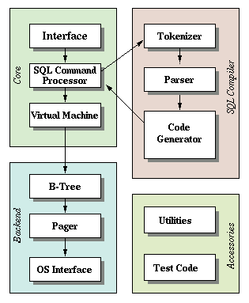
SQLite Architecture
SQLite is server-less transactional database engine
Different applications can be used as Management Systems to SQLite DB file
Tables and Indexes are in the single DB file (on top of ext4)
Journaling Mechanism: Rollback and WAL
Notes:
SQLite management studios : SQLiteStudio, SQLiteBrowser, SQLite Studo Management, plugins for Firefox and Chrome etc
ext4 provide atomic operations even on windows and mac (through open source drivers) ext2fsd, extfs etc
Uses fsync - synchronize a file's in-core state with storage device (flush)
Journaling mechanism is a mechanism that keeps trach of changes not yet committed
-Rollback will update the transaction to original content before updating -WAL = Write Ahead Log appends the new transactions in a log file while their old/original pages remain intact. The change is then later propagated to the db by checkpoint

Slide 5
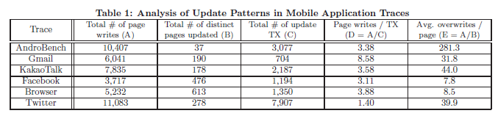
Mobile Application workload characteristics

Slide 6
Logical Logging
SystemR and VoltDB use it
SQLite/SSL a variant of Logical Logging is perfect fit for SQLite based apps
SQLite/SSL provides TCC by using WAL
Local Logging can realize full potential with NVM

Slide 7
NVM-based Logging
Pages are updated by a transaction and the changes are captured in either physio-logical log or physical-differential log, and, later when the transaction commits, the logs are flushed to NVM
More data captured means longer latency
Notes:
NVM –based logging : flushes changes to storages but fast. Considering the time taken to write in NVM is proportional to the amount of data to transfer, more log means longer commit latency

Slide 8
Flash-Optimized Single-Write Journaling
Atomically propagate multiple pages updated by a transaction to the storage
The atomicity comes at the cost of redundant writes
To achieve the write atomicity of multiple pages at no cost of redundant writes, two novel schemes, X-FTL and SHARE, have been recently proposed for flash storage from the database community
Notes:
NVM –based logging : flushes changes to storages but fast. Considering the time taken to write in NVM is proportional to the amount of data to transfer, more log means longer commit latency
X-FTL and Share are different journaling mechanisms for SQLite which improve the existing mechanism, but they still rely on extensive writing to disk

Slide 9
Design of SQLite/SSL
It is a mobile database manager, which logs only SQL statements upon commit
Achieving its transactional atomicity and durability in a truly lightweight manner
Have modified its existing modules minimally
Notes:
SSL – Statement Logging Strategy

Slide 10
Design of SQLite/SSL (2)
Only minimal changes to keep the codebase as reliable as vanilla SQLite, WAL mode was modified to embody a TCC
Recovery logic remained as simple as before, added additional data structure for logging SQL statements
Use of mmap and msync to achieve byte-addressability and device independence
Notes:
SSL – Statement Logging Strategy

Slide 11
New data structure
Statement Log Buffer (SLB): For active transaction, all the updating SQL statements, in addition to transaction begin, commit, and abort, are captured and buffered in SLB
Statement Log Area (SLA): all the updating statement logs of the transaction which are buffered in SLB will be flushed to SLA
Avoid crashes: atomic operation mmap, in byte-addressable NVM with DIMM interface to avoid IO
Notes:
SLA - Statement log area
SLB – Statement log buffer

Slide 12
SQLite / SSL Architecture

Slide 13
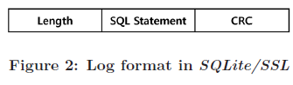
New Functionality
Log Capturer: Log capturer buffer the statement into SLB in sequence
Recovery will always be deterministic because it was parsed into SLB
Storing SQL statements sequentially is the key to knowing the beginning and end of a transaction
Notes:
SLA - Statement log area
SLB – Statement log buffer
Log Capturer makes the SQLite SSL deterministic, will not catch SELECT statements which will keep SLA smaller

Slide 14
New Functionality
Log writer: When a transaction commits, the log writer is responsible for writing all the update SQL statement logs of the transaction persistently to SLA
Msync: is used to flush all data from DRAM which is used as SLB to PCM which is used as SLA. This is achievable because reference are byte addressable.
Notes:
SLA - Statement log area
SLB – Statement log buffer

Slide 15
Transaction Consistent Checkpoint
No force commit policy – faster commit
Recovery will have to replay all logged SQL statements in SLA against old database each time – very time consuming
2 Checkpoints
SSL-checkpoint: is triggered when the transaction commits or the buffer of SLA has reached the 70% or 1024 dirty pages.
WAL-checkpoint: is triggered when 1000 pages reached. Because of update locality only the most recent versions of each page will be copied from WAL to database
Notes:
All the update pages should be regularly checkpointed to reduce the recovery time
While SSL Checkpoint is triggered no new transactions will be proceeded. The cost is acceptable
WAL : write ahead log can outperform rollback

Slide 16
Transaction Consistent Checkpoint (2)
WAL-checkpoint will also be triggered after SSL-checkpoint
Reduce complexity of WAL lazy checkpoint if remain full after ssl
To benefit from write buffering effect by WAL journal

Slide 17
Recovery
Vanilla SQLite: recovers all pages in WAL journal and commits them to database
SQLite/SSL: can cope with all the type of crashes.
If SLA exists then check it status (reset or in use) and flush all dirty pages from buffer to wal and resseting sla
Copy pages from wal to original database and reset wal
Notes:
SLA: If the file is not found, it means that the system
has terminated normally and thus the normal operation can
start without further recovery action
SLA = reset & No-WAL-file This combination normal shutdown (or after checkpoint). Therefore, the system can resume simply after creating WAL journal file.
SLA = reset & WAL = reset This combination shows that no new transaction has not committed.
SLA = reset & WAL = in-use This indicates that In this case, SQLite/SSL will copy the most recent version of each page in the WAL journal to original database, and then resetting the WAL file.
SLA = in-use Regardless of the WAL journal, all pages in SLA were not propagated to the original database yet. re-executes all the valid SQL statements from SLA in sequence against the original database, and then call its checkpoint

Slide 18
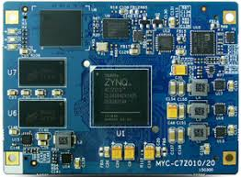
Performance Evaluation
UMS board Xilinx Zynq-7030
Dual ARM Cortex-A9 1GHz
1GB DDR3 533MHz DRAM
512MB LPDDR2-N PCM
Linux 3.9.0 Xilinx kernel
etx4

Slide 19
Performance Evaluation (2)
Intel i7 3370 3.40GHz
12GB DRAM
Ext4

Slide 20
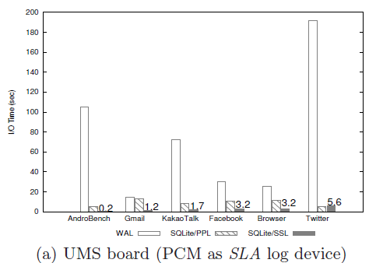
Performance Evaluation (3)

Slide 21
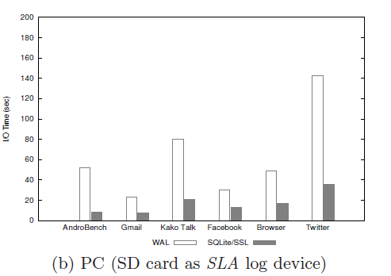
Performance Evaluation (4)

Slide 22
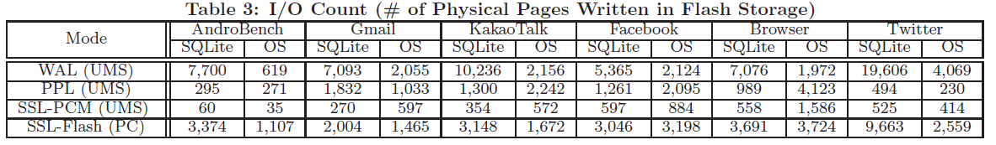
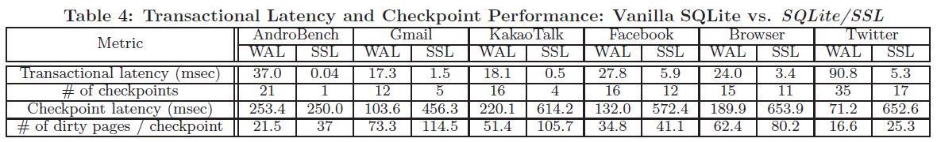
Performance Evaluation (5)

Slide 23
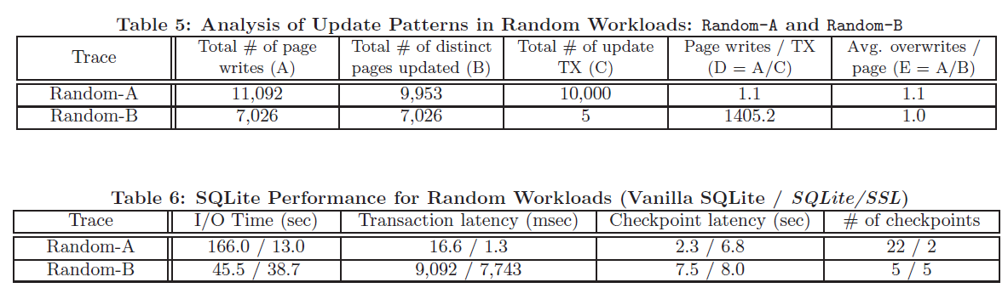
Performance Evaluation (6)

Slide 24
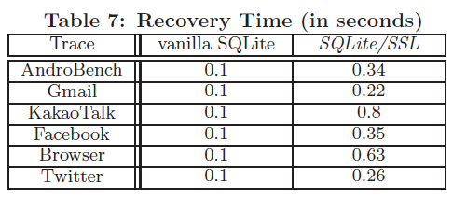
Performance Evaluation (7)

Slide 25
Conclusion
Remove of force commit policy and important observation about transactional workload in SQLite-based apps
Logical Logging is not new feature but it is used as TCC
Logical logging can realize its full potential by using a real PCM with DIMM interface as its log device

