Slide 1

CloudKit: Structured Storage for Mobile Applications
EPL646: Advanced Topics in Databases
Alexander Shraer∗, Alexandre Aybes, Bryan Davis, Christos Chrysafis, Dave Browning, Eric Krugler, Eric Stone, Harrison Chandler, Jacob Farkas John Quinn, Jonathan Ruben, Michael Ford, Mike McMahon, Nathan Williams, Nicolas Favre-Felix, Nihar Sharma, Ori Herrnstadt Paul Seligman, Raghav Pisolkar, Scott Dugas, Scott Gray, Shirley Lu, Sytze Harkema, Valentin Kravtsov, Vanessa Hong, Wan Ling Yih, Yizuo Tian
Apple, Inc.
Yiannis Demetriades

Slide 2
CloudKit
Apple’s cloud backend service and application development framework
storage for structured data
synchronization
scale, consistency, durability and security
Notes:
Apple’s cloud backend service and application development framework
Provides strongly-consistent storage for structured data and easy synchronization of data across user devices or among multiple users
Using CloudKit, application developers focus on delivering the application while relying on CloudKit for scale, consistency, durability and security

Slide 3
Introduction
Leverages multi-tenancy along two dimensions
Container
Define and manage app’s schema
Databases
One public – Manage user scoped data
Many private – For common application data
Inherit schema from container
Manages it’s own data and indices
Notes:
In order to handle the combined scale of its client apps, CloudKit employs a unique approach that leverages multi-tenancy along two dimensions.
First, each app operates in an isolated logical space called a CloudKit container. Within a container an application developer manages the app’s schema, which can support a large number of record types and complex relationships.
Second, within each container CloudKit uniquely divides the dataspace into
many private databases that manage user-scoped data and
one public database for common application data.
A database instance is a self-contained unit that inherits the schema definition from the logical container and manages it’s own data and indices. Each private database belongs to exactly one container and one user, and provides strong synchronization and serialization capabilities within the database.

Slide 4
CloudKit Data Model
Designed with mobile use-case
Faces a dual multi-tenancy challenge
Serve large number of apps
Hundreds of millions of users
Notes:
CloudKit’s data model was designed with the mobile use-case in mind.
CloudKit faces a dual multi-tenancy challenge:
it serves a very large number of apps, and
hundreds of millions of users.

Slide 5
CloudKit Data Model
Apps with data accessible to multiple users
Eg. News, Maps, Music
Apps with private data
Eg. User’s Settings, Preferences, Photos, Messages, etc.)
Stored in public and private databases
Notes:
Many apps have data which is accessible across users (e.g. news articles, maps, music), while other data is private (e.g., a user’s settings, preferences, photos, docs, messages).
CloudKit stores this data in designated public and private databases, respectively.

Slide 6
CloudKit Data Model
Different storage requirements between public and private databases
Private databases support
stronger security, consistency semantics
change-tracking, sharing data with specific users
Public databases designed
Scalable
Serve many users concurrently
Databases inherit containers schema
Notes:
The storage requirements for these two types of data are very different and hence the private and public databases have different capabilities.
Private databases support stronger security and consistency semantics, change-tracking, sharing data with specific users
While
Public databases are designed to be more scalable and serve many users concurrently.
All databases within one container share a single schema

Slide 7
Containers
Data of one app is encapsulated in a single container
Can be shared across applications using shared containers
Notes:
Usually, the data of one app is encapsulated in a single container
Data can be shared across applications (not a common use-case) by using shared containers.

Slide 8
Databases
Each container has 3 types of databases
a single public database
n private databases
n shared databases
where n is the number of app users
Notes:
Each container is logically divided into three types of databases:
a single public database,
n private and
n shared databases where n is the number of app users with an iCloud account.

Slide 9
Databases
Databases are created automatically
Data in public database is visible to all users of the app
Each user has a dedicated private database
Shared database is used to access another user’s private database
Notes:
These databases are created by CloudKit automatically.
Data stored in the public database is, by default, visible to all users of the app
Each user has a dedicated private database, and no other user can store or access data in that database unless explicit sharing relationships are created.
A shared database is a user’s “window” into the private databases of other users.

Slide 10
Records
Basic storage unit
Consist of fields
Dictionary of key-value pairs
Fields can contain
Simple value types (eg. strings, numbers, dates)
Complex types (eg. locations, record references, assets)
List of values of a type
Notes:
Records are the basic unit of storage.
Each record is a dictionary of key-value pairs, called record fields.
Fields can contain
simple value types (e.g., strings, numbers, dates) or more
complex types (e.g., locations, references to other records, and assets). A field can also contain
a list of values of a certain type.
Reference fields represent relationships between records while assets reference data stored externally (e.g., when a photo is uploaded by a user, only its metadata and URL are stored in CloudKit). A separate sub-system manages the creation and garbage collection of assets and generates asset references. CloudKit supports encrypted field values, available in the private database.

Slide 11
Record Zones
Organize records into logical groups
Enable application to selectively sync subsets of data
Each record belongs to one zone
Public database has a single default zone
Private databases have
a default zone
multiple custom zones
Notes:
Zones are a useful way to organize records into logical groups and enable an application to selectively sync subsets of data across devices.
Each record belongs to one zone; zone name is a logical component of a record’s full identifier.
The public database has a single default zone.
A private database contains a default zone but may in addition contain custom zones.

Slide 12
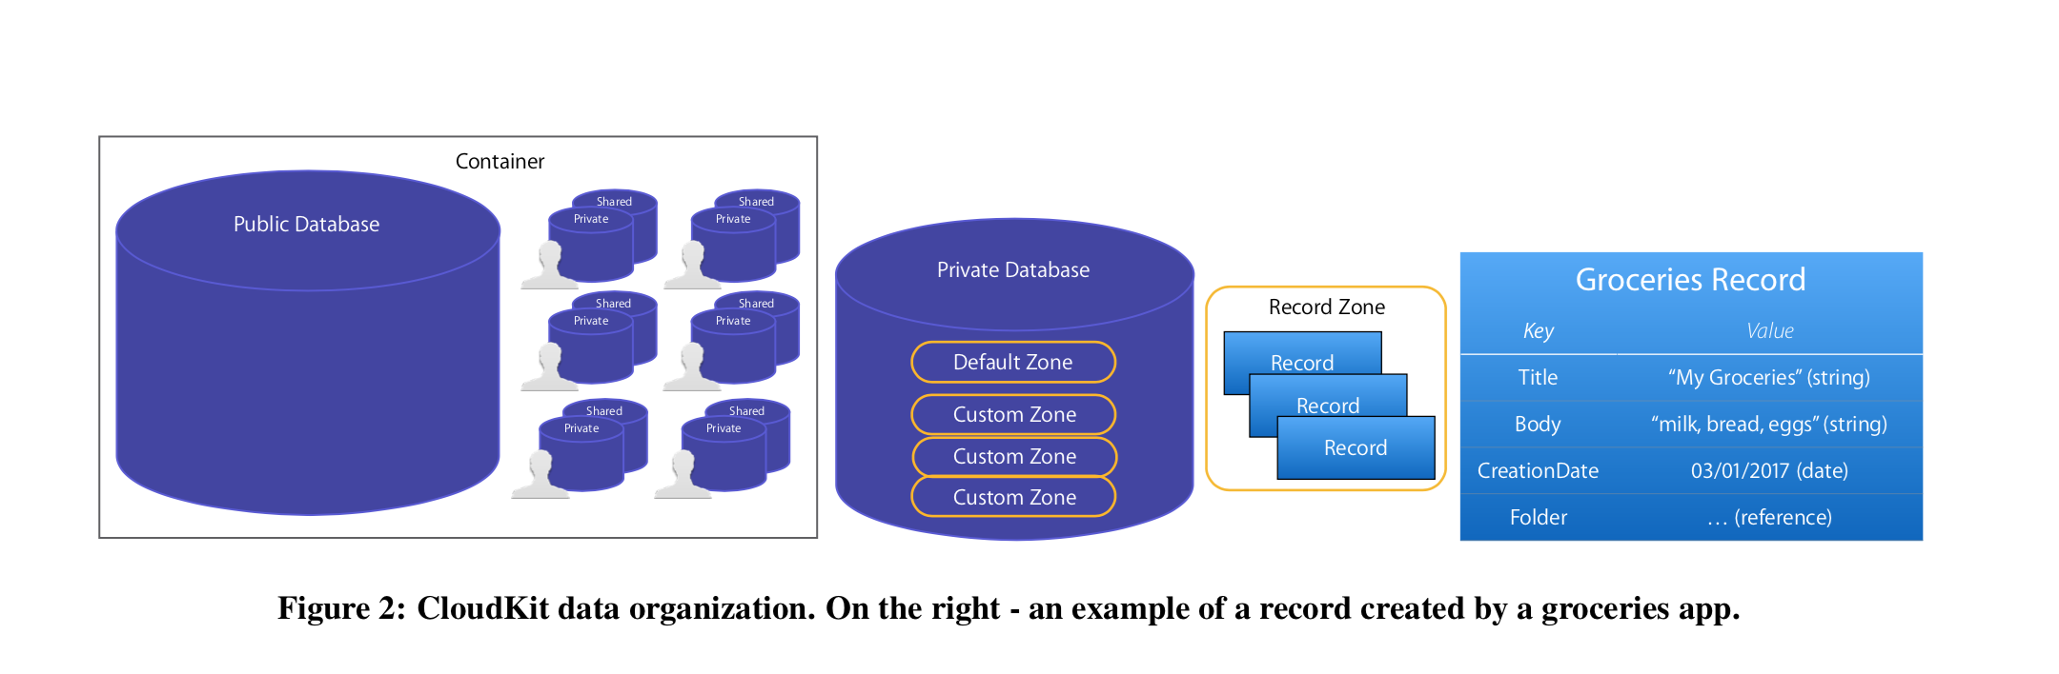
CloudKit’s Data Model

Slide 13
CloudKit API
Rich set of CRUD API’s
Create, Update Delete, Fetch (Records, Zones),
Upload, Queries, Subscriptions etc.
Libraries available for Swift, Objective-C and Javascript
Notes:
CloudKit provides a rich set of CRUD APIs allowing clients to create, update, delete and fetch records and zones, list zones, upload and reference assets, get a list of changed zones in a database or changed records in a zone, listing users, sharing records, queries, subscriptions, notifications, and more.
CloudKit exposes client-side libraries in Swift, Objective-C and JavaScript to support mobile and web developers.

Slide 14
Dashboard
Web dashboard for Application Developers
View and Manage app data
Define secondary indices
Notes:
CloudKit provides a dashboard where developers can view and manage app data, define secondary indices

Slide 15
Architecture Overview
Support of 3 different interfaces
REST-like web interface
For web-applications
gRPC
Other backend services using CloudKit
Custom Interface over TCP
Used by mobile client apps through a client-side library and a daemon installed on devices
Notes:
CloudKit supports three different interfaces, wrapping the same set of APIs
a REST-like web interface (for web applications),
gRPC [21] (mainly for other backend services using CloudKit) and
a custom interface over TCP, used by mobile client apps through a client-side library and a daemon installed on devices.

Slide 16
Server extensions
Many apps, using CloudKit, don’t have custom server-side logic
CloudKit uses:
Apache Cassandra as the underlying storage system
Solr for indexing and querying
Apple’s Push Notification System for notifications
Asynchronous tasks are queued using a queue management system and processed by maintenance jobs
Notes:
Most apps using CloudKit, including many first-party apps, don’t have custom server-side logic.
CloudKit uses
Apache Cassandra as the underlying storage, and
Solr for indexing record fields queriable by users.
Apple’s Push-Notification Service is used to notify users (queries, subscriptions and notifications are discussed Section 7).
Asynchronous tasks are queued using a queue management system and processed by maintenance jobs.

Slide 17
Data placement
Data is sharded into multiple CloudKit partitions
Each user is assigned to a single partition
Cassandra provides Compare-And-Set (CAS)
CloudKit uses CAS for
Conditional updates
Lock-Free synchronization
Concurrent updates
Notes:
Data is sharded into multiple CloudKit partitions. Each user is assigned to a single partition
Each CloudKit partition has a dedicated Cassandra cluster, storing multiple Cassandra partitions.
Within a Cassandra partition, Cassandra provides light-weight transactions, implemented using Paxos and exposed as a compare-and-set (CAS) functionality.
CloudKit uses CAS to implement conditional updates, which provide a way to achieve lock-free synchronization of con- current updates.

Slide 18
Data placement – Custom Zones
Each custom zone is assigned to one Cassandra partition
Leverage conditional and multi-key atomic updates
Notes:
Each custom zone is assigned to one Cassandra partition.
This is done in order to leverage conditional and multi-key atomic updates provided by Cassandra within a partition.
Specifically, each custom zone has an update counter in Cassandra, and each update (to one or more records in the zone) additionally attempts to up- date this counter using CAS, which succeeds only if it was not concurrently updated by a different operation.

Slide 19
Data placement – Default Zones
Default zones vs Custom Zones
Default zones trade-off stronger semantics for scalability
Sharded across multiple Cassandra partitions
Grow significantly larger
Only provide single-record operations
Cassandra does not support cross-partition transactions
Notes:
Default zones trade-off stronger semantics for scalability.
They are sharded across multiple Cassandra partitions, which allows them to grow significantly larger than custom zones, but only provide single-record linearizable operations since Cassandra does not support cross-partition transactions.

Slide 20
Data placement – Some numbers
Private database default zone is sharded into 10 Cassandra partitions
Public default zone is sharded into 10,000 Cassandra partitions
Notes:
By default, the private database default zone is sharded into 10 Cassandra partitions while the pub- lic default zone is sharded into 10 thousand partition

Slide 21
Read and update semantics
Atomic single records reads and updates
Custom zones further support multi-record atomic batches
Record updates have one of three possible modes:
save-if-unchanged
save-changed-keys
save- all-keys
Notes:
All reads and updates of single records are atomic (linearizable) and custom zones further support multi-record atomic batches
Record updates have one of three possible modes:
save-if-unchanged, save-changed-keys and save- all-keys.

Slide 22
Read and update semantics
save-if-unchanged
Is performed only iff
The record hasn’t changed since fetch
Using CAS
Incremented version in record with every update
Sent in operations and responses
Notes:
With save-if-unchanged, an update is performed only if the record hasn’t changed at the server since the last time it was fetched by this client (if the record wasn’t previously fetched, the save succeeds only if the record does not exist).
The check is performed using CAS on a version stored in the record, incremented by the server with every update to the record, and sent in operations and responses.

Slide 23
Read and update semantics
save-changed-keys
Client sends only the modified fields
Possibility of invalid update due to concurrent update by another client
save-all-keys
Client sends all fields
Notes:
With save-changed-keys, the client sends only fields modified since the record was fetched,
while save-all-keys sends all fields.
Note that since save-changed-keys updates only a subset of the fields, it is possible that the result is not what the client expected: other fields may have been updated concurrently by other clients.

Slide 24
Reference semantics
Reference fields create stronger relationships
Two types
Owning
Validating
Notes:
Reference fields create a stronger relationship between records than just saving the identifier of a record as a string.
Two examples are the owning and the validating references.

Slide 25
Reference semantics - Owning
Target (referenced) record becomes source record’s owner
Deleting the target record, deletes all its source records
Cascading down
If a record contains two or more owning references
The record is deleted when any of its owners is deleted
Notes:
With an owning reference, the target (referenced) record becomes the owner of the source record. Deleting the target record deletes all its source records, cascading further if these records themselves “own” other records. If a record contains two or more owning references, the record is deleted when any of its owners is deleted.

Slide 26
Reference semantics - Validating
Validating reference ensures that
Its target exists as long as the source exists
Deleting the target is not permitted
Notes:
A validating reference ensures that its target exists as long as the source record exists; creating the reference is only allowed if the target record exists, and deleting the target is not permitted as long as it’s referenced.

Slide 27
Conflict Resolution
Offline-Online Synchronization
Device comes online and syncs
Device has local pending changes
Some may conflict
The app should detect and fix conflicting records
CloudKit does not offer conflict resolution functionality
Notes:
CloudKit does not offer a general conflict resolution functionality. The app is expected to handle the error, resolve any conflicts, and attempt to save the record again, if needed.
CloudKit provides the app with three copies of the conflicting record to assist with comparing and merging the changes (commonly referred to as a three-way merge): (1) client record – a copy of the record the client attempted to save, (2) server record – a copy of the record as it currently exists on the server, and (3) ancestor record – a copy of the record fetched by the client, before any of the pending changes were applied.

Slide 28
CloudKit Use Patterns
Five main use patterns
Publish-Subscribe
Cross-Device Sync
Sharing and Collaboration
Bounded Queue
Cloud Storage

Slide 29
Publish-Subscribe
Backend or several users Produce data
Others Consume and Query them
Eg. Apple News
Articles are written to Public Database
Clients register query subscriptions based on their preferred topics
News uses the private database to save each user’s preferences and sync them across its devices
Notes:
One example is Apple News – articles are written to CloudKit’s public database and clients register query subscriptions based on their preferred topics and news outlets (in this case, the database is backed by a glob- ally distributed Cassandra cluster). News uses the private database to save each user’s preferences and sync them across its devices. Multiple apps use the public database to allow querying public in- formation such as transportation time-tables and routes.

Slide 30
Cross-Device Sync
Leveraging the change-tracking capabilities of custom zones
Eg. Document Sharing Apps
The content is kept in-sync on all user devices
Jointly edit, subscribe to change notifications and receive state updates

Slide 31
CloudKit Use Patterns
Sharing and Collaboration
Sharing documents, photos, presentations and other content (eg. Notes)
Bounded Queue
Store a sliding-window of the most recent events
Eg. The recent call history
Eg. The most recently visited websites in Safari in-sync across devices
Cloud Storage
A transactional key-value store without syncing across devices
Eg. Apple’s mobile backup app
Notes:
Cloud Storage. Some apps use CloudKit as a transactional key- value store, but don’t (normally) sync stored data across devices. An example is Apple’s mobile backup app. This is a write-heavy app, making use of two zones in each user’s private database: the default zone, where file records are stored and a custom zone, where snapshot information is stored.

Slide 32
Sync
Most-frequently used to sync app data on multiple user devices
When a device generates new data it is stored
On the device
In CloudKit
Propagated to all devices through CloudKit
Notes:
CloudKit is most-frequently used to synchronize app data on multiple user devices (e.g., laptops, tablets or mobile phones). When one device generates new data, it is stored both on the device and in CloudKit, and propagated to all devices through CloudKit.

Slide 33
Forward Sync
Each custom zone maintains a log of record changes
When a record is modified
Index is updated
Adding an entry for the new assigned version
Deleting the previous index
Notes:
To support sync, each custom zone maintains a log of record changes.
When a record is modified, the index is updated transactionally, adding an entry for the newly assigned version and deleting the previous index entry for the record.

Slide 34
Forward Sync
The sync request, made by client, specifies
a zone identifier
a maximum number of records to return
and a continuation
Continuation is a cursor to the sync index
Allows resuming from an incomplete sync
Notes:
As part of a sync request, the client specifies a zone identifier, a maximum number of records to return, and a continuation. The latter is a cursor into the sync index, and allows resuming an incomplete sync.

Slide 35
Forward Sync - Continuation
Initially continuation is not specified
Scan Index from the start of the log
With the response, continuation cursor is returned to client from where the scan left
To continue the Scan
Client must do another sync request
Set continuation to where the last request left
Notes:
Initially, no continuation is specified which causes an index scan starting from the start of the log.
An updated continuation is sent back to the client in the sync response, and returned by the client in a subsequent sync request.

Slide 36
Reverse Sync
Some apps need to get the newest data first
Eg. Messaging app
Show the last hour of messages when user opens the app on a new device
Complete history of messages will come up later
Reverse sync scans the sync index backwards from the latest change committed in the zone
then automatically continues in the forward direction
Notes:
Some apps need to get the newest data first. For example, when implementing a messaging app it may be important to show the last hour of messages when the user first opens the app on a new device; the complete message history doesn’t need to appear immediately.
Reverse sync starts by scanning the sync index backwards from the latest change committed in the zone, and then automat- ically continues in the forward direction

Slide 37
Snapshot Sync
Sync index contains the latest version of each record
Scanning the index, may skip any change superseded by a later one
Scanning prefix of the index does not guarantee a consistent snapshot
Not acceptable for some apps
Notes:
Since the sync index only contains the latest version of each record, scanning the index may skip any change that was superseded by a later change.
Hence, scanning a prefix of the index is not guaranteed to provide a consistent snapshot.
For some apps, this isn’t acceptable.

Slide 38
Snapshot Sync - Example
Directory D, Files F1 and F2
Sync index include the pairs
[(1, D), (2, F1), (3, F2)]
D is renamed at version 20
Index now is changed to
[(2, F1), (3, F2), ..., (20, D)]
Syncing only the first two entries result in a missing parent
Problem occurs when one device is writing faster that the other syncs
Notes:
For example, a client of a hierarchical document store app may have a directory D with files F1 and F2. At this point, the sync index may include the pairs [(1, D), (2, F1), (3, F2)].
Now, suppose that D is renamed at version 20, and the index becomes [(2, F1), (3, F2), ..., (20, D)].
Syncing down only the first two entries does not provide a state of the system that ever existed. In this case, since F1 and F2 are missing a parent, the state cannot be shown to the user. This problem is exacerbated if one device is writing faster than another device is syncing – it is possible that sync state is always inconsistent at the slower device, rendering the app unusable on that device.
To address this, an app can use the snapshot sync mode. In this mode, entries are not deleted from the sync index when records are updated (they are garbage collected when no longer needed by any client). Snapshot points are chosen by the server (e.g., every 500 zone changes). When a client syncs, we choose a target snapshot point (latest available at the time), and return it as part of the con- tinuation to the client.

Slide 39
Snapshot Sync - Resolution
Usage of Snapshot Sync
Entries are not deleted from the sync index upon update
Collected when no longer needed
Snapshot points are chosen by server
Eg. Every 500 zone changes
When a client sync, return a snapshot point
Notes:
To address this, an app can use the snapshot sync mode. In this mode, entries are not deleted from the sync index when records are updated (they are garbage collected when no longer needed by any client). Snapshot points are chosen by the server (e.g., every 500 zone changes). When a client syncs, we choose a target snapshot point (latest available at the time), and return it as part of the continuation to the client.

Slide 40
Sharing
CloudKit support selective sharing among users
When sharing a record r for first time
r’s owner creates a share record sr
sr contains a list of participants with
Permissions (read-only, read-write)
Other Information
100 participants limit
Notes:
When sharing a record r for the first time, r’s owner creates a share record sr , a special record that facilitates sharing. The identifier of this record is called the share identifier. This record contains a list of participants – users with whom r is being shared, along with their permissions (read-write or read-only) and other information

Slide 41
Sharing
Upon sr creation, participants must be notified
Each sr has a unique URL which can be sent or shared with the participants
Using the URL, the participant can accept and start sharing
A participant can also leave a share
Notes:
When sharing a record r for the first time, r’s owner creates a share record sr , a special record that facilitates sharing. The identifier of this record is called the share identifier. This record contains a list of participants – users with whom r is being shared, along with their permissions (read-write or read-only) and other information

Slide 42
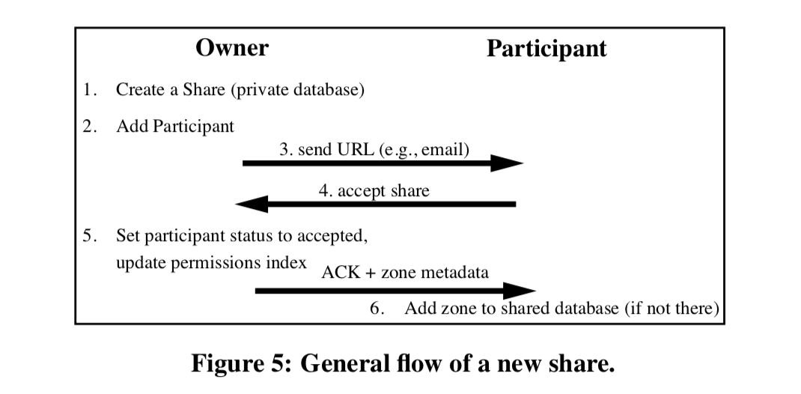
Sharing
Notes:
When sharing a record r for the first time, r’s owner creates a share record sr , a special record that facilitates sharing. The identifier of this record is called the share identifier. This record contains a list of participants – users with whom r is being shared, along with their permissions (read-write or read-only) and other information

