Slide 1

Cloudy with High Chance of DBMS: A 10-year Prediction for Enterprise-Grade ML
Ashvin Agrawal, Rony Chatterjee, Carlo Curino, Avrilia Floratou, Neha Gowdal, Matteo Interlandi, Alekh Jindal,
Konstantinos Karanasos, Subru Krishnan, Brian Kroth, Jyoti Leeka, Kwanghyun Park, Hiren Patel, Olga Poppe,
Fotis Psallidas, Raghu Ramakrishnan, Abhishek Roy, Karla Saur, Rathijit Sen, Markus Weimer, Travis Wright, Yiwen Zhu
name.surname@microsoft.com
Microsoft
Andreas Yelasis
Chrysovalantis Christodoulou
Notes:
Brief description of the paper
The paper refers to how the DBMS community will help ML systems

Slide 2
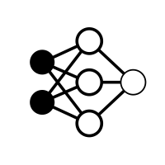







What is Machine Learning?
Input Data
Model Training
Model Decision
Data Preprocessing
Final Stored Model
Training Data
Model Evaluation/Retraining
Test Data

Slide 3

What is Machine Learning?
Input Data
Model Training
Model Decision
Data Preprocessing
Final Stored Model
Training Data
Model Evaluation/Retraining
Test Data

Slide 4

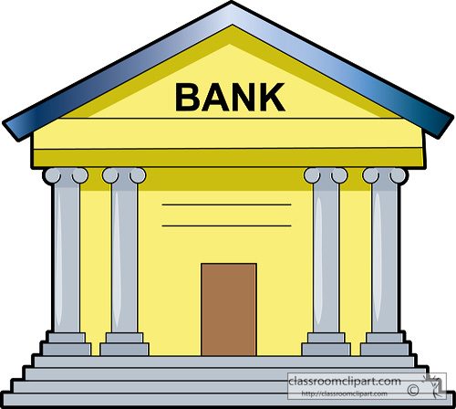

What is EGML?
Enterprise Grade Machine Learning
Notes:
In this paper, we present our vision of how ML and database systems are likely to come together, and early steps we take towards making this vision a reality
We refer to this new class of applications as Enterprise Grade Machine Learning (EGML). In this paper, we speculate on how ML and database systems will evolve to support EGML over the next several years.
We believe that this is too simplistic, and understanding the path forward requires a more careful look at the various aspects of EGML, which we divide into three main categories: model development/training, model scoring and model management/governance.
Recall that in EGML settings individual decisions could be very consequential (e.g., loan acceptance, or choice of medical treatment), so “average model accuracy” is not a sufﬁcient validation metric
When it comes to leveraging ML in enterprise applications, especially in regulated environments, the level of scrutiny for data handling, model fairness, user privacy, and debuggability will be substantially higher than in the first wave of ML applications.
το επίπεδο ελέγχου για τον χειρισμό των δεδομένων, τη δίκαιη συμπεριφορά, την ιδιωτικότητα των χρηστών και την αποσφαλμάτωση θα είναι σημαντικά υψηλότερο από ό, τι στο πρώτο κύμα εφαρμογών ML.

Slide 5
The Vantage Point (EGML Requirements)
First Hand experience
Microsoft has many years of experience on ML applications
“An ML model is software derived from data”
-> ML has typical software needs ( e.g. CI/CD pipelines, track lineage)
Conversations with enterprises
ML applications consists of smaller less experience teams
There are strict demands
-> Great need for supporting these teams with model management, deployment and tracking.
GitHub Analysis
> 70% of Python scripts refers on ML
Only few of them use solution of CI/CD and model tracking (e.g. MLFlow)
There are a lot of Python packages but some dominates the market (e.g. Pandas, Sklearn, Numpy)
-> Need a broad coverage, but we can focus on the ones who dominates
Notes:
The Vantage point Ειναι οι λόγοι όπου η αυτή η λύση της Microsoft έχει πλεωνεκτημα Throughout the paper, this emerging class of applications are referred to as EGML apps: Enterprise Grade Machine Learning. And there’s going to be a lot of them!
Σε ολόκληρο το έγγραφο, αυτή η αναδυόμενη κατηγορία εφαρμογών αναφέρεται ως εφαρμογές EGML: Enterprise Grade Machine Learning. Και θα υπάρξουν πολλά από αυτά!
1.
The key insight this led to is that ML models are software, derived from data. ML learning systems combine the characteristics of software, e.g. the need for CI/CD pipelines, and of data, e.g. the need to track lineage. Model development itself typically represents less than 20% of most projects.
Η βασική γνώση που οδήγησε αυτό είναι ότι τα μοντέλα ML είναι λογισμικό που προέρχεται από δεδομένα. Τα συστήματα μάθησης ML συνδυάζουν τα χαρακτηριστικά του λογισμικού, π.χ. την ανάγκη για CI / CD και δεδομένων, π.χ. την ανάγκη παρακολούθησης της γραμμής. Η ανάπτυξη μοντέλου αντιπροσωπεύει συνήθως λιγότερο από το 20% των περισσότερων έργων.
2.
We predict that in the next 10 years, hundreds of thousands of small teams will build millions of ML-infused applications – most just moderately remunerative, but with huge collective value.
Προβλέπουμε ότι τα επόμενα 10 χρόνια, εκατοντάδες χιλιάδες μικρές ομάδες θα κατασκευάσουν εκατομμύρια ML applications - οι οποίες είναι πιο μετριες αλγοριθμικά αλλά με τεράστια συλλογική αξία.
3.
An analysis of projects on GitHub suggests that there is a broad base of ML packages out there, but also some leaders emerging. Systems aiming to support EGML, therefore, need to provide broad coverage but can optimise a core set of ML packages.
Μια ανάλυση των έργων στο GitHub δείχνει ότι υπάρχει μια ευρεία βάση πακέτων ML , και ορισμένες de facto λύσεις που αναδύονται συνήθος σε python. Επομένως, τα συστήματα που στοχεύουν στην υποστήριξη της EGML πρέπει να παρέχουν ευρεία κάλυψη, και να μπορούν να βελτιστοποιήσουν ένα βασικό σύνολο πακέτων ML.

Slide 6
The Vantage Point (EGML Requirements)
Competitive landscape
Comparison of most mature ML systems in the public cloud and major companies (e.g. Azure, AWS, Google Cloud, Uber, LinkedIn, Bing)
Capabilities: a) Training & Authoring, b) Serving & Deployment, c) Data Management
-> Mature proprietary solution have stronger support for data management
-> Providing complete and usable third-party solution in this space is non-trivial
Research in ML community
Trend ML research: 1) Systems for training, 2) Systems for scoring, 3) AutoML solutions, 4) Responsible AI
-> Data platforms significantly helps fast and reliable training and scoring
-> Meta-data management and provenance tracking are foundational for responsible AI and AutoML solutions
Notes:
4.
Υπαρχει ανταγωνισμος απο διαφορους cloud services providers.
Από αυτό, ο συγγραφεας καταλήγει σε δύο συμπεράσματα:
- Οι ώριμες ιδιόκτητες λύσεις έχουν ισχυρότερη υποστήριξη για τη διαχείριση δεδομένων, και
- Η παροχή πλήρων και χρησιμοποιήσιμων λύσεων τρίτων είναι μη τετριμμένη (διαφορετικά οι προμηθευτές σύννεφων θα το είχαν ήδη κάνει).
5.
Υπαρχουν νεες περιοχες ερευνας στο ML όπως...
Οι πλατφορμες δεδομένων όπως διαφορες βάσεις δεδομενων βοηθουν σηματνικα στην γτρήγορη και αξίοπιστη εκπαίδευση και βαθμολόγηση των μοντελων

Slide 7
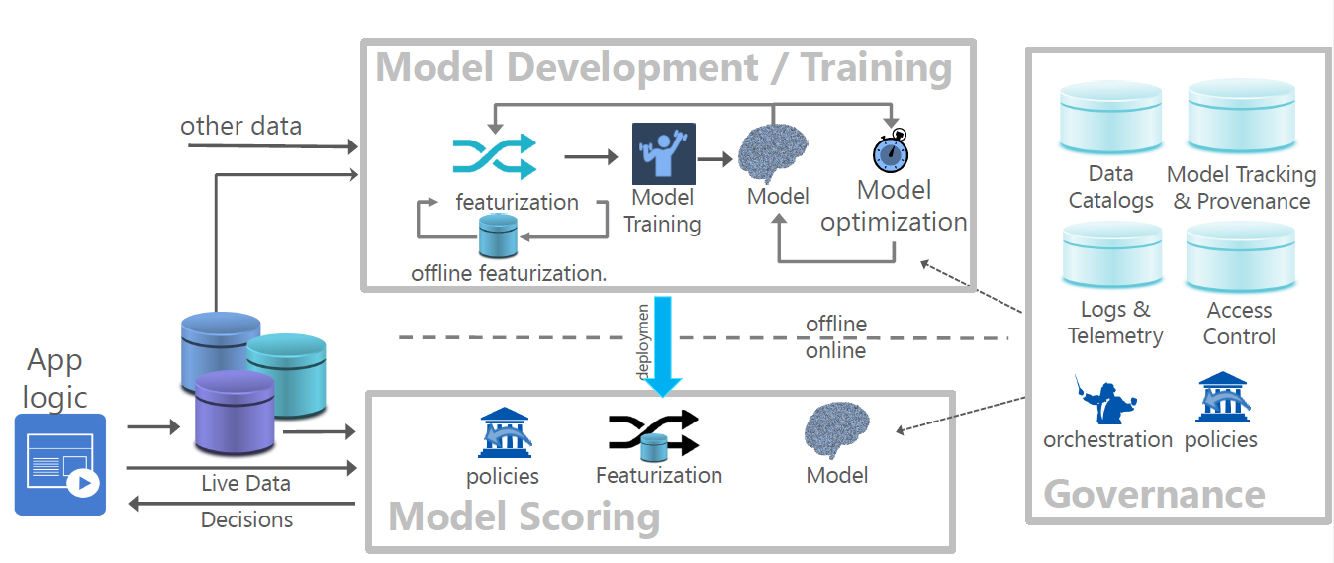
The FLOCK Vision
Notes:
Flock is Microsoft reference architecture built to explore these ideas.
Flock treats ML models as software artefacts derived from data.
Το Flock είναι αρχιτεκτονική αναφοράς της Microsoft που έχει σχεδιαστεί για να διερευνήσει αυτές τις ιδέες
Το Flock αντιμετωπίζει τα μοντέλα ML ως αντικείμενα λογισμικού που προέρχονται από δεδομένα.
Looking at ML as software, we expect the ML and Software Engineering communities to provide us with automation, tooling, and engineering best practices – ML will become an integral part of the DevOps lifecycle. Looking at ML models as derived data, the DB community must address data discovery, access control and data sharing, curation, validation, versioning, and provenance.
Κοιτάζοντας το ML ως λογισμικό, αναμένουμε από τις κοινότητες ML και Software Engineering να μας προσφέρουν
-- αυτοματοποίηση,
--εργαλειομηχανές και μηχανικές βέλτιστες πρακτικές - το ML θα γίνει αναπόσπαστο μέρος του κύκλου ζωής DevOps. Εξετάζοντας τα μοντέλα ML ως παράγωγα δεδομένα, η κοινότητα του DB πρέπει να αντιμετωπίσει την ανακάλυψη δεδομένων, τον έλεγχο πρόσβασης και την ανταλλαγή δεδομένων, την επεξεργασία, την επικύρωση, την έκδοση και την προέλευση.
Models themselves must be subject to scrutiny with their storage and querying/scoring secured and auditable. For consistency reasons, in more complex applications transactional updates to models (and across multiple models) may be required.
This is another argument in favour of in-DB scoring. A nice side-effect is that scoring in the DB can also be fast: early experiments suggest that in-DB model scoring can be up to 5x-24x faster than standalone state-of-the-art approaches.
Τα ίδια τα μοντέλα πρέπει να υπόκεινται σε έλεγχο με την αποθήκευση και την ερώτηση / βαθμολόγηση τους, εξασφαλισμένα και ελεγχόμενα. Για λόγους συνέπειας, σε πιο σύνθετες εφαρμογές ενδέχεται να απαιτούνται ενημερώσεις συναλλαγών σε μοντέλα (και σε πολλά μοντέλα).
Αυτό είναι ένα άλλο επιχείρημα υπέρ της βαθμολόγησης in-DB. Ένα ωραίο αποτέλεσμα είναι ότι η βαθμολόγηση στο DB μπορεί επίσης να είναι γρήγορη: τα πρώτα πειράματα υποδηλώνουν ότι η βαθμολόγηση μοντέλου in-DB μπορεί να φτάσει έως και 5x-24 φορές ταχύτερα από τις αυτόνομες προσεγγίσεις τελευταίας τεχνολογίας.

Slide 8
The FLOCK Vision

Slide 9
The FLOCK Vision

Slide 10
The FLOCK Vision

Slide 11
The FLOCK Vision
Author’s proposal:
The ML development/training will happen in the Cloud
Models must be stored and scored in managed environments such as a DBMS
Provenance needs to be collected across all phases
Notes:
We will train in the cloud, where its possible to take advantage of managed infrastructure well suited to large amounts of data, spiky resource usage, and access to the latest hardware.
Inference (scoring) engines will be deployed everywhere, and ML scoring will be deeply integrated into the DBMS "as a foundational extension of relational algebra, and an integral part of SQL query optimizers and runtimes."
Governance will be everywhere, with "a massive need for the DB community to step up in the areas of secure data access, version management, and provenance tracking and governance."
Θα εκπαιδεύσουμε στο σύννεφο, όπου είναι δυνατόν να εκμεταλλευτούμε μια διαχειριζόμενη υποδομή κατάλληλη για μεγάλα ποσά δεδομένων, απειλητική χρήση πόρων και πρόσβαση στο πιο πρόσφατο υλικό.
Οι μηχανισμοί συμπερασμάτων θα αναπτυχθούν παντού και η βαθμολογία ML θα ενσωματωθεί βαθιά στο ΣΔΒΔ ως βασική επέκταση της σχεσιακής άλγεβρας και αναπόσπαστο τμήμα των βελτιστοποιητών ερωτημάτων SQL και των χρόνων εκτέλεσης.
Η διακυβέρνηση θα είναι παντού, με "μια τεράστια ανάγκη να ενισχυθεί η κοινότητα του DB στους τομείς της ασφαλούς πρόσβασης σε δεδομένα, της διαχείρισης της έκδοσης και της παρακολούθησης της προέλευσης και της διακυβέρνησης".

Slide 12
From Model to Decision: Inference
Challenges | Possible Solution
Many applications use more than one model where each one depends on other. Therefore, preprocessing steps should be updated atomically. | DBMS provides transaction-based updates, which ensures atomicity
Low latency sensitive decisions High performance on large batch predictions | In-DBMS inference (ONNX)
Mixing application-level policies and inference logic | A clean framework to fill the gap of ML models and business logic

Slide 13
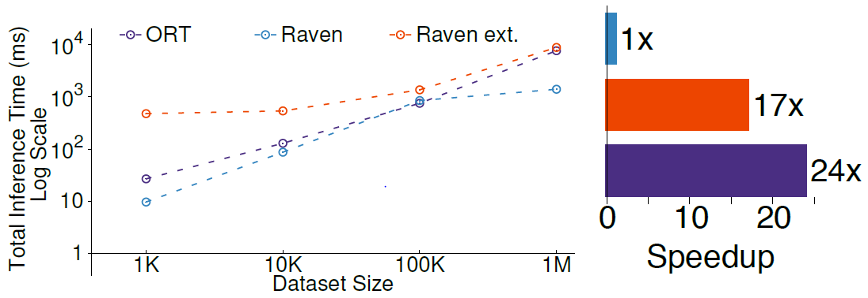
In-DBMS inference (ONNX)
ONNX is an in-database cross optimizer between SQL AND ML models
Notes:
ORT – ONNX RunTime
predicate-based model pruning, which uses selections from the SQL subsection of the query to simplify the ML subsection;
model inlining, which transforms ML operators to relational ones (similar in spirit to [49]);
Policy modules apply business constraints on top of model outputs, continuously monitoring the output of the ML models and applying the specified policies before taking any action in the application domain.
The output of a model is just the input to the next stage in a business process.
ORT is standalone. No SQL
Raven is the ONNX runtime in SQL process with 5.5x better inference time over standalone ORT (due to automatic parallelization of the inefence task in SQL Server)
Raven external. Is in SQL but in different process out of process
In Figure 4 we present two key results:
Left (1) performance of integrating ONNX Runtime (ORT) within SQL Server, both through in-process execution (Raven) and out-of-process (Raven ext.); and
The results show that SQL Server integration provides up to 5.5× over standalone ORT (due to automatic parallelization of the inference task in SQL Server) and
Right (2) benefit of cross-optimizations, including model in-lining and predicate-based model pruning. up to 24× from our combined optimizations. Early results indicate that in-DBMS inference is very promising.

Slide 14
What is ONNX
Performance-focus Inference
Models in different popular libraries (like Tensorflow, Keras, PyTorch) can be converted to the standard ONNX format, allows it for interoperability and helping to maximize the reach of hardware optimization
By this approach, it provides a solution for systems to integrate a single inference engine to support models trained from a variety of frameworks.
ONNX Runtime was designed with a focus on performance and scalability in order to support heavy workloads in high-scale production scenarios

Slide 15
Optimizations
predicate-based model pruning, which uses selections from the SQL subsection of the query to simplify the ML subsection;
model-projection pushdown, which automatically prunes(projects out) unused input feature-columns exploiting model-sparsity;
model clustering that compiles simplified models for different parts of the input based on data statistics;
model in lining, which transforms ML operators to relational ones (similar in spirit to);
physical operator selection based on statistics, available runtime (SQL/ONNX/Python UDFs) and hardware(CPU, GPU).

Slide 16
Bridging the model-application divide (Dhalion)
Steps:
Takes as input user-defined policies (Business constraints)
The module continuously monitors the output of the ML models
Applies the specified policies where is needed
Features:
Maintains the system state and actions
Ensures that actions happen in a transactional way
Provides recovery in case of failure
Notes:
ML applications need to transform the model predictions into actionable deci-sions in the application domain.
In real deployment scenarios,
business rules and constraints are important factors that need to be taken into account before any action is taken.
Business rules expressed as policies the no verride the model.

Slide 17
Data Management for ML
Data Discovery, Access and Versioning
Model Management
Model Tracking and Provenance

Slide 18
Data Discovery, Access and Versioning
Data types: Text, Images, Videos, Tabular, Sensor
Only few of > 4 million notebooks they analyzed makes use of a database access library
“There is an open need for quarriable data abstractions, lineage-tracking and storage technology that can cover heterogenous, versioned, and durable data”

Slide 19


Model Management
ML models are software artifacts created from data
Needs:
Security
Tracking
Managed on par with other high-value data
DBMS

Slide 20
Model Tracking and Provenance
Need for a full provenance across ML pipeline, for debugging & auditing
Challenges:
C1. Provenance data model: Hard to design, capture, maintain, and query polymorphic data models
C2. Provenance capture: Difficult to capture provenance across several system architectures
C3. Provenance across disparate systems: Difficult to consolidate and communicate the provenance information to the whole system

Slide 21
Model Tracking and Provenance
Initial Solutions:
Provenance in SQL:
Eager: Given a query, extracts coarse-grained provenance information. (i.e., input tables and columns that affected the output)
Lazy: Gets the whole query log to build the provenance data model
Scale across databases using Apache Calcite and keep track of every change
Provenance in Python:
Analyze and Identify variables (models, features, etc.) in Python Scripts
Connects these variables to the corresponding column of the dataset
The Catalog:
Acts as a bridge between the above two modules.
Stores all the provenance information and allow access from different systems
✔ C1
✔ C2
✔ C3

Slide 22
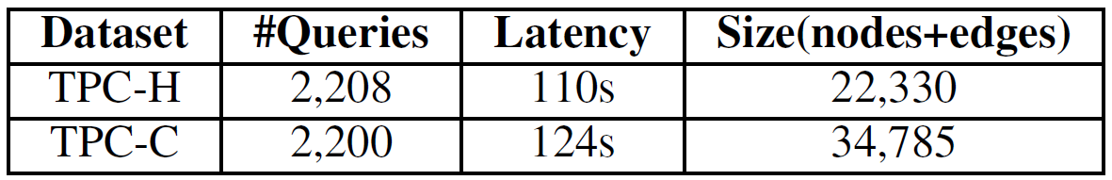
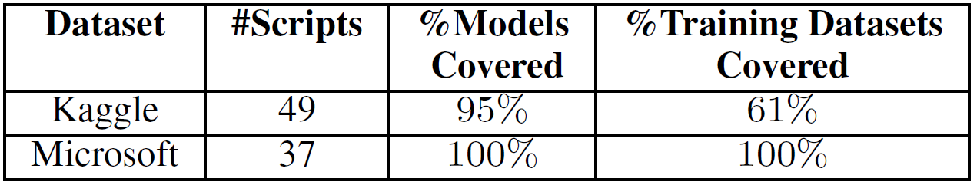
Model Tracking and Provenance
Provenance in SQL Overhead:
Evaluation of Provenance in Python:
Increased Latency

Slide 23
Conclusion
DB community will play a key role in the future of EGML applications
Improve ML training/development by providing Data Management (Data Discovery, Access, and Versioning)
Improve ML scoring system (In-database inference, Combination of business logic and ML outputs)
Provides the ability for general system governance (Provenance across the whole system)

Slide 24

Thank you!

