Slide 1

Compiling PL/SQL Away
EPL646: Advanced Topics in Databases
Christian Duta, Denis Hirn, Torsten Grust
2019
Stavroulla Koumou, Stavros Georgiou
https://www.cs.ucy.ac.cy/courses/EPL646

Slide 2
Contents
ABSTRACT
NOW IS NOT A GOOD TIME TO INTERRUPT ME
COMPILING PL/SQL AWAY
ONCE PL/SQL IS GONE
(TOO EARLY FOR) CONCLUSIONS
(PAPER) REFERENCES

Slide 3
ABSTRACT
"PL/SQL functions are slow"
GOAL: literally compiling PL/SQL away;
compile(SQL with embedded PL/SQL) : SQL
→ PL/SQL iteration replaced by SQL recursion
→ no context switches
→ higher performance
Notes:
Is common developer wisdom that derives from the tension between set-oriented SQL evaluation and statement-by-statement PL/SQL interpretation. We pursue the radical approach of compiling PL/SQL away, turning interpreted functions into regular subqueries that can then be efficiently evaluated together with their embracing SQL query, avoiding any PL/SQL to SQL context switches. Input PL/SQL functions may exhibit arbitrary control flow. Iteration, in particular, is compiled into SQL-level recursion. RDBMSs across the board reward this compilation effort with significant run time savings that render established developer lore questionable
PL/SQL is a completely portable, high-performance transaction-processing language.
PL/SQL provides a built-in, interpreted and OS independent programming environment.
PL/SQL can also directly be called from the command-line SQL*Plus interface.
Direct call can also be made from external programming language calls to database.
PL/SQL's general syntax is based on that of ADA and Pascal programming language.

Slide 4
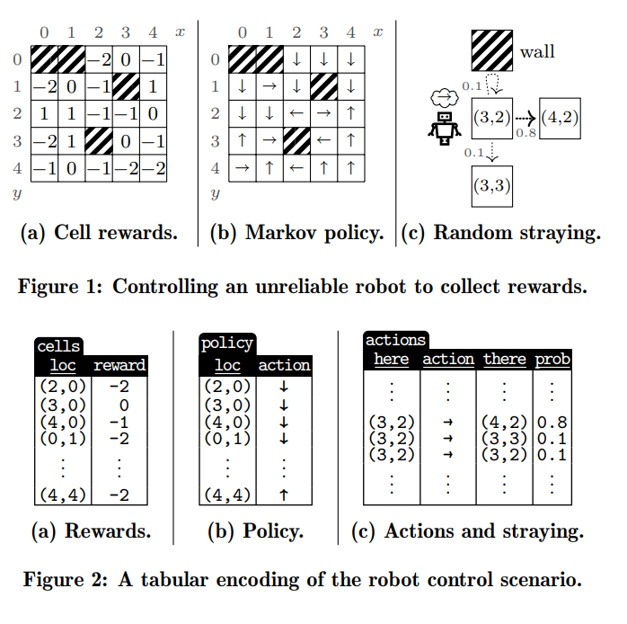
ROBOT EXAMPLE [i]
Controlling an unreliable robot to collect rewards.
The function simulates the walk of a robot on a grid whose cells hold rewards.
The robot follows a prescribed policy.
Notes:
Let us make the conundrum concrete with PL/pgSQL function walk() of Figure 3. The function simulates the walk of a robot on a grid whose cells hold rewards (see Figures 1a and 2a). On cell (x, y) the robot follows a prescribed policy (e.g., move down ↓ if on cell (3, 0), see Figures 1b and 2b). This policy has been precomputed by a Markov decision process which takes into account that the robot may stray from its prescribed path: a planned move right from (3, 2) will reach (4, 2) with probability 80% but may actually end up in (3, 3) or (3, 2), each with probability 10% (see Figures 1c and 2c). A call walk(o,w,l,s) starts the robot in origin cell o and performs a maximum of s steps; walk returns early if the accumulated reward exceeds w or falls below l

Slide 5
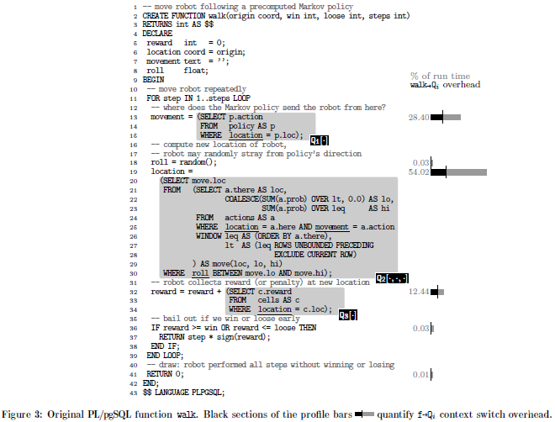
ROBOT EXAMPLE [ii]
PROBLEM: context switching overhead
[SQL set-oriented evaluation] ←→ [PL/SQL
statement-by-statement interpretation]
CONTEXT SWITCHES:
SQL query call to PL/SQL (embedded) function
SQL statement evaluation within PL/SQL function
Notes:
Each execution of PL/SQL function walk leads to the iterated evaluation of the embedded SQL queries Q1...3. The run time profile on the rightmost edge of Figure 3 identifies these embedded queries to use the lion share of execution time (e.g., Q2 accounts for 54.02% of walk’s overall run time). While we expect such embedded queries to dominate over the evaluation of simpler expressions and statements, the profile also shows that a significant portion of the evaluation time for the Qi stems from walk→Qi context switch overhead (see the black section of the profile bars).
For PostgreSQL, this cost is to be attributed to the engine’s ExecutorStart and ExecutorEnd functions.
These prepare the Qi’s plans (i.e., copy the cached plan into a runtime data structure and instantiate the query’s placeholders) and free temporary memory contexts, respectively.
The FOR loop iteration in walk multiplies this effort.
The bottom line shows that PostgreSQL invests more than 35% of its time in walk→Qi overhead during each invocation of walk.
Section 3 shows similar or worse bad news for more PL/pgSQL functions.

Slide 6
NOW IS NOT A GOOD TIME TO INTERRUPT ME [i]
Two words on interpreters
SQL evaluation:
Predetermined paths of control != PL/SQL interpretation:
→ Control path depends on updatable variables
Alternative to context switching:
Intermediate format compilation, common interpreter usage
Notes:
Need to change it.

Slide 7
NOW IS NOT A GOOD TIME TO INTERRUPT ME [ii]
Froid (Microsoft SQL Server team)
if PL/SQL function f is simple enough (loop-less control flow), compile statements into SQL, inline using OUTER APPLY*.
Compile PL/SQL away paper
Froid approach for every control flow
runtime impact/benefit study
solution for in-database PL/SQL programming for DBs that lack such support (e.g. SQLite3)
Notes:
*OUTER APPLY: JOIN operations cannot be used to join a table with the output of a table valued function (i.e. a function that receives a table column value as input). APPLY operators are used for this purpose.
Change titles for Complie PL/SQL Away
The present research thus sets out
1. to completely compile PL/SQL functions f away, transforming them into regular SQL queries Qf. The PL/SQL functions may feature iteration—in fact any control flow is acceptable. If f indeed contained iteration, Qf will employ a recursive common table expression (CTE, WITH RECURSIVE) to express this in pure SQL. No changes to the underlying DBMS are required (although modest local changes can provide another boost, see Section 3).
2. We study and quantify the run time impact of this compilation approach and the benefit of getting rid of Q→f and f→Qi context switches, in particular.
3. As a by-product, the approach enables in-database programming support for DBMSs like SQLite3 that previously lacked any PL/SQL support at all

Slide 8
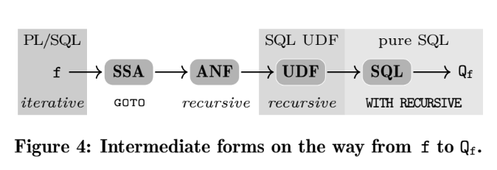
COMPILING PL/SQL AWAY
Notes:
Having stated the reasons that lead to this study, or experiment if you prefer, we move on to section 2 where I am going to describe the steps taken for the conversion of an imperative (in this case PL/SQL) to Pure SQL.
The overall conversion involves 4 steps, as shown in the diagram.
The 1st one makes use of GOTO expressions and labels to simulate the iterations that exist in the code,
the 2nd and 3rd ones use recursive techniques,
and the final one replaces recursion with Common Table Expressions (CTEs).

Slide 9
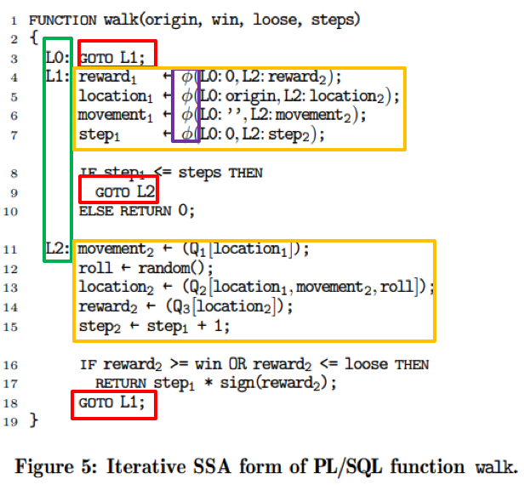
Transformation [i]
STEP 1
↑ Static Single Assignment form (SSA)
single variable assignment
[φ: assignment via >1 control flows]
GOTO <label> in place of LOOP, EXIT,
CONTINUE, FOREACH, FOR, WHILE
STEP 0
Notes:
This is step 1 applied on the walk example function.
Step 1 is actually a conversion to the Static Single Assignment form.
We can see that for each variable there is only a single assignment statement (as the name of the form implies),
And auxiliary variables are being used to achieve that;
e.g. reward1 and reward2, are completely different variables and have only one assignment statement each.
Additionally, notice that the symbol φ is used to mark the variables whose value changes by more than one control flows, and that some variables get their values from embedded queries.
For example, about the φ notation, take reward1:
if control flow reaches L1 from L0, reward1 becomes 0, else if control flow is from L2 reward1 takes the value of reward2.
Now, about the subqueries mentioned before, the notation Qi[var1, var2, …, varN] is used to refer to a subquery with a single-value result.
(There is no chance of the query returning more than one value. It is guaranteed by the conversion from the initial code, in where all the variables are also scalar.)
Leaving the single assignment to the side and focusing on the iterations, we can see that the aforementioned replacement of iteration control structures (such as LOOP, FOREACH, WHILE, etc) with GOTO expressions and labels as well.

Slide 10
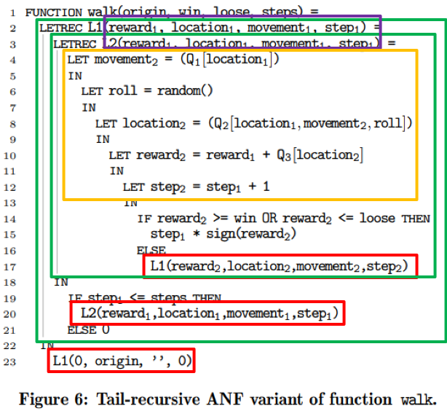
Transformation [ii]
STEP 1
← Administrative Normal Form (ANF)
<label> translated into LETREC functions; <label>-governed statements enclosed in corresponding LETREC function body; lambda lifting*; tail recursion*
GOTO <label> statements replaced by calls to corresponding LETREC functions; calls provide next value for φ-bound variables
STEP 2
Notes:
Although verbose, the GOTOs of step 1 are necessary for the step 2, which involves converting the SSA form to Administrative Normal Form, or ANF.
During this conversion the labels are replaced by LETREC functions, whose body encloses the statements that were previously governed by the corresponding labels.
(In other words, the LETREC functions consist of the statements that were previously placed under the corresponding label.)
As you see, the transformation to ANF also involves lambda lifting and tail recursion.
By lambda lifting we mean that some local variables in the callee functions are replaced by arguments supplied by their caller functions.
In particular, we can see that lambda lifting was only applied to variables with multi-control-flow value assignment;
This makes sense, because, now that labels became functions, one way to simulate the control flow depended value assignment is by using function calls and passing arguments from the right caller to the right callee.
(Notice that L0 (which is renamed as the walk) passes the value 0 for reward1 to L1, and that L2 passes the value of reward2 for reward1 to L1; same semantics as the φ notation implies at step 1)
Furthermore, we can see that the function calls are in fact recursive, since all the functions are nested (i.e. recursive call to part of self), and the recursive calls are such that we have tail recursion.
This means that no more statements follow after the call, and, hence, the execution won’t return to the caller function for further calculations after exiting the callee.
(We will refer to the advantages of tail recursion later on.)

Slide 11
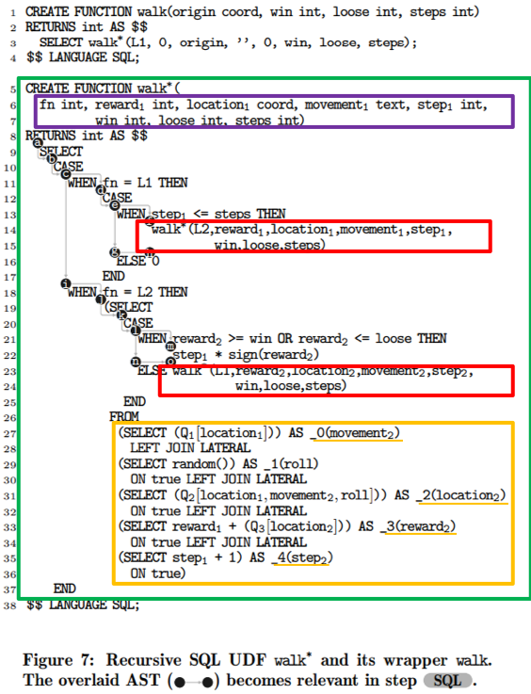
Transformation [iii]
STEP 2
← SQL User Defined Function (SQL UDF)
LETREC functions translated into single recursive UDF with CASE-WHEN statements
Iterative control flow simulated with the use of flag variable(s) and recursive calls
Value assignment replaced by chained SELECT statements.
[UDF recursion not universally supported]
STEP 3
Notes:
Moving on, step 3 is again a recursive transformation, since it results in a recursive User Defined Function.
In fact, the conversion of PL/SQL to Pure SQL could have stopped here, but some database systems do not support recursive UDF functions (e.g. MySQL) and, therefore, the transformation had to have the 4rth step that will be described later on.
This step involves replacing the LETREC functions with CASE-WHEN statements, each CASE consisting of one of the necessary functions, and using an auxiliary argument to select which CASEs are triggered.
We can see that here the fn argument is used to select whether to execute the statements of L1 or L2.
Additionally, since variable value assignment is still an operation of imperative languages, it is replaced with SQL SELECT statements.
Going in more detail, we can see that the assignment was replaced by several SELECT statements joined together using LEFT JOIN LATERAL with an always true condition in order to form a table from which the statements in the CASE-WHEN parts can SELECT the values they need to use for their recursive UDF function calls.

Slide 12
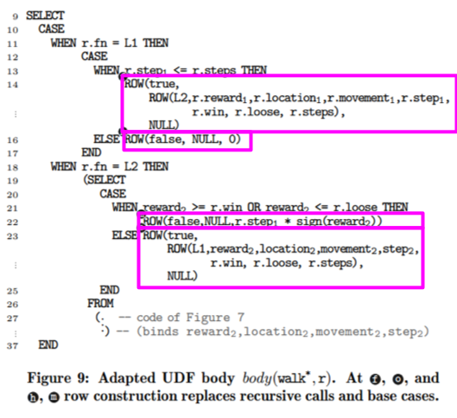
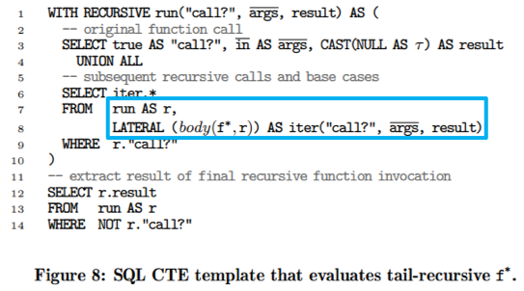
Transformation [iv]
STEP 4i
(Pure) SQL Common Table Expression
CTE recursion used to replace UDF recursion
UDF modified so that recursive call’s arguments are returned in a ROW instead
Recursion carried out by CTE (by calling the adapted UDF and managing the returned ROW-results) instead of UDF
[CTEs universally supported]
STEP 4ii
Notes:
Finally, we have step 4, which consists of the conversion of recursion to Common Table Expressions, or CTEs.
It must be noted that CTEs also use a type of recursion, but this causes no issues, since they are Pure SQL statements and, hence, all database systems support them.
CTEs, in essence, reference themselves from within the SELECT-FROM-WHERE blocks that make them up.
In order to understand the example CTE we must first understand the body(f*, r) function/subquery.
The body function is the walk function of step 3, with a slight modification:
Instead of recursively calling itself, it returns a tuple/ROW consisting of 3 elements; a boolean value (that is true when further iterations are necessary), a tuple/ROW (containing the necessary variables for subsequent iterations), and a result variable (where the final iteration’s result value is placed).
We can clearly see that when extracting the final value, we will only get a single result.
Going back to the CTE:
* The CTE is called in an ordinary SELECT-FROM-WHERE block (lines 12-14); where the result is requested from the CTE, by using NOT “call?” as a condition. (We know, from body(f*, r) function, that only the ROW with the result will satisfy this condition.)
* Now, inside the CTE:
- At first, the base SELECT statement is executed. Base SELECT sets “call?”=true to trigger further recursive calls, and initializes the values for the arguments that body(f*, r) function needs.
- From then on, in every recursive call, the 2nd SELECT-FROM-WHERE block that makes up the CTE is executed.
More specifically, in each recursive call X, the body(f*, r) function is executed for each of the records in the result set r, using LATERAL.
Notice that r is in fact a recursive reference to the CTE.
This call results into the record of the base SELECT statement to become the 1st input of the body(f*, r) function, then the record produced by the 2nd recursive call to become the 2nd input of the body(f*, r) function, etc.
- This continues until the “call?” attribute of the record returned by the body(f*, r) function takes the value of False.
The final result is then returned to the initial SELECT that invoked the CTE, and that’s it basically.
The Pure SQL program which executed SELECT with the CTE invocation did not need to perform any context switches, only Pure SQL.

Slide 13
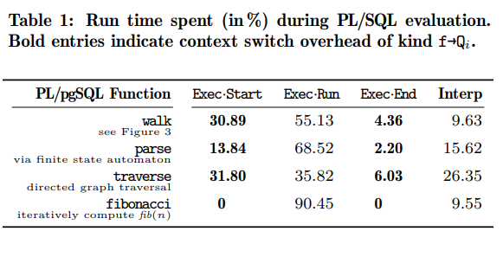
ONCE PL/SQL IS GONE [i]
Context switching overhead
Overhead = Exec Start + Exec End
Functions with only simple expressions/no queries (Fibonacci) not expected to benefit from the compilation; overhead already zero
Notes:
Iterative PL/SQL vs. Recursive SQL. For PL/pgSQL function walk(), Table 1 indicates potential run time savings of about 35% ≈ 30.89%+4.36% should we manage to get rid of context switching overhead.
The translation from iterative PL/SQL to pure SQL built on a recursive CTE can indeed realize this advantage. Figure 10 shows the wall clock time of one invocation of walk() for a growing number of FOR loop iterations (which is controlled by parameter steps, see Figure 3).
Throughout the experiment, the recursive SQL variant consistently shows an even greater run time savings of approximately 43%.
Beyond saved context switches, this suggests that the evaluation of pure SQL expressions generally undercuts the interpretation of PL/SQL statements. We have found the underlying RDBMSs to cope well with the resulting SQL queries and their associated plans.
The SQL equivalent of function walk() accounts for a translation and optimization time of about 25 ms on PostgreSQL.
As expected, the plans feature their share of LATERAL joins. Since these come with a prescribed order of evaluation (from left to right) and process single-row tables, the joins do not present a challenge to plan enumeration, however. We further observed that the sub-plans associated with the Qi before and after compilation did not diverge, essentially.

Slide 14
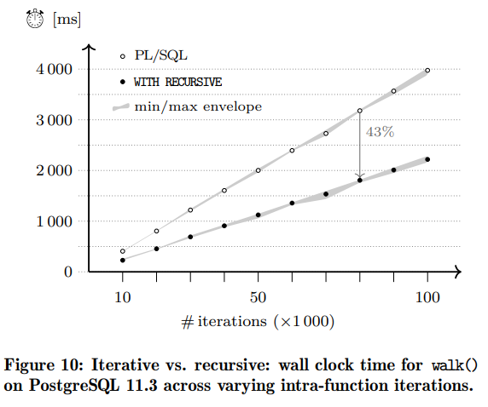
ONCE PL/SQL IS GONE [ii]
Iterative PL/SQL vs. Recursive SQL
Expected speed-up <= Real speed-up
Evaluation of pure SQL undercuts interpretation of PL/SQL statements

Slide 15
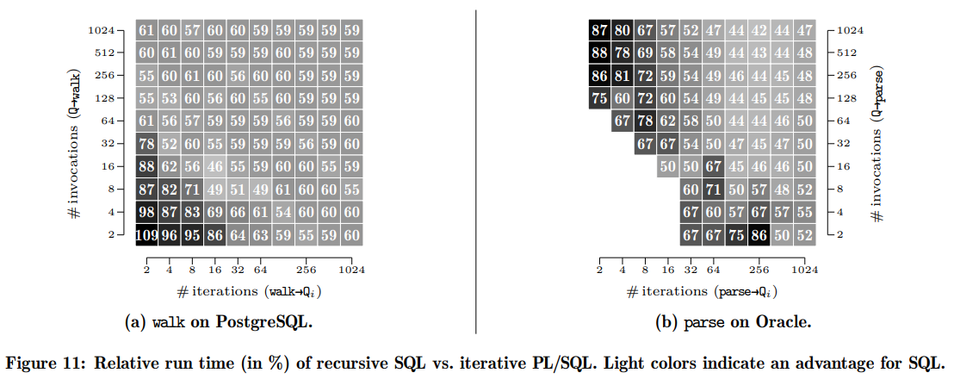
ONCE PL/SQL IS GONE [iii]
Scaling the number of context switches + Beyond PostgreSQL
Increase # of iterations and function calls:
→Increase # of context switches
For small # of context switches
PL/SQL interpreted faster than compiled (compilation overhead)
Applies to other imperative languages as well
Notes:
measurements in the lower left appeared to be close to 100; we have omitted them here due to the DBMS’s coarse timer resolution

Slide 16
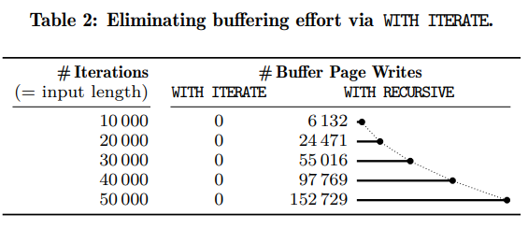
ONCE PL/SQL IS GONE [iv]
When WITH RECURSIVE does too much. Exploiting tail Recursion
Tail recursion needs no stack frames (last statement in function), but CTE needs stack (uses current recursion level’s arguments after the recursive call returns)
→ WITH TAIL RECURSIVE (proposed) → WITH ITERATE* (PostgreSQL)
WITH RECURSIVE:
Dramatic increase of buffer page writes (i.e. too much stack memory used), because of increased amount of arguments kept in memory as recursive calls # increases
WITH ITERATE:
Memory usage does not change (much)
Notes:
*WITH ITERATE: keeps in stored only the most recent returned row of the CTE, instead of all of them.

Slide 17
(TOO EARLY FOR) CONCLUSIONS [i]
Current coverage of PL/SQL
No restrictions on control flow of PL/SQL functions
Exceptions difficult to detect (cannot branch predict), but exception handling is manageable (with GOTOs)
Non-atomic data types supported as long as the DB supports their storing the, in table cells
Positional array updates translated into whole array replacement
Dynamic SQL cannot be compiled to SQL
Return types can be record-sets (instead of scalar variables)
Notes:
Moving on to section 4 the authors list the things the things that *have* been tested/covered, but also the things that are yet to be studied, or need further study.
<read from slide>

Slide 18
(TOO EARLY FOR) CONCLUSIONS [ii]
Directions waiting to be explored
Merge of CTEs with the queries they call
Use of partitioning and parallelism for further optimization
Multi-ROW input to CTE (instead of just one) for generating all necessary results in single CTE call
Experimental analysis of accuracy of query evaluation costs by DBMSs
Experimental analysis of impact of proposed compilation technique with other imperative languages
Notes:
<read from slide>

Slide 19
(PAPER) REFERENCES [i]
[1] B. Alpern, M. Wegman, and F. Zadeck. Detecting Equality of Values in Programs. In Proc. POPL, San Diego, CA, USA, 1988.
[2] A. Appel. SSA is Functional Programming. ACM SIGPLAN Notices, 33(4), 1998.
[3] M. Chakravarty, G. Keller, and P. Zadarnowski. A Functional Perspective on SSA Optimisation Algorithms. Electronic Notes in Theoretical Computer Science, 82(2), 2004.
[4] W. Cook and B. Wiedermann. Remote Batch Invocation for SQL Databases. In Proc. DBPL,
Seattle, WA, USA, 2011.
[5] R. Cytron, J. Ferrante, B. Rosen, M. Wegman, and F. Zadeck. Efficiently Computing Static Single Assignment Form and the Control Dependence Graph. ACM TOPLAS, 13(4), 1991.
[6] C. Galindo-Legaria and M. Joshi. Orthogonal Optimization of Subqueries and Aggregation. In Proc. SIGMOD, Santa Barbara, CA, USA, 2001.
[7] T. Grust, N. Schweinsberg, and A. Ulrich. Functions are Data Too (Defunctionalization for PL/SQL). In Proc. VLDB, Riva del Garda, Italy, 2013.

Slide 20
(PAPER) REFERENCES [ii]
[8] R. Guravannavar and S. Sudarshan. Rewriting Procedures for Batched Bindings. Proc. VLDB, 1(1), 2008.
[9] B. Ozar. Froid: How SQL Server 2019 Might Fix the Scalar Functions Problem. www.brentozar.com, 2018.
[10] L. Passing, M. Then, N. Hubig, H. Lang, M. Schreier, S. Günnemann, A. Kemper, and T. Neumann. SQL-and Operator-Centric Data Analytics in Relational Main-Memory Databases. In Proc. EDBT, Venice, Italy, 2017.
[11] K. Ramachandra, K. Park, K. Emani, A. Halverson, C. Galindo-Legaria, and C. Cunningham. Froid: Optimization of Imperative Programs in a Relational Database. Proc. VLDB, 11(4), 2018.
[12] J. Reynolds. Definitional Interpreters for Higher-Order Programming Languages. Higher-Order and Symbolic Computation, 11, 1998.
[13] SQL:1999. Database Languages–SQL–Part 2: Foundation. ISO/IEC 9075-2:1999.

