Slide 1

VisualWorldDB :
A DBMS for the Visual World
Brandon Haynes1, Maureen Daum1, Amrita Mazumdar1, Magdalena Balazinska1, Alvin Cheung2, and Luis Ceze1
1Paul G. Allen School for Computer Science & Engineering,
University of Washington {bhaynes, mdaum, amrita, magda, luisceze}@cs.washington.edu
2Department of Electrical Engineering and Computer Sciences, University of California, Berkeley
Overview Paper Presentation
Christakis Achilleos
https://www.cs.ucy.ac.cy/~dzeina/courses/epl646/

Slide 2
Intro
Why the need for a new database?
Rise of Visual World Applications.
VWAs create video data from the real world or a virtual world.
The video data can have many different camera angles.
Why not use existing VDBMSs?
Not fast enough
Store the data independently
Hard to optimize queries
https://www.cs.ucy.ac.cy/~dzeina/courses/epl646/

Slide 3

VisualWorldDB
Multi-video Applications
Multi-perspective video
Combine videos
Optimize
Store
Single Multidimensional Object
https://www.cs.ucy.ac.cy/~dzeina/courses/epl646/

Slide 4
Visual World Applications
Drone Analytics
Civil Engineering
Surveillance
Autonomous Driving
Intelligent Infrastructure
Retail analytics
Unstructured Stitching
https://www.cs.ucy.ac.cy/~dzeina/courses/epl646/

Slide 5
VisualWorldDB creates a queryable multidimentional object
Users need to model worlds with multiple video streams originating from different points in space.
It allows for the generation of high-level objects and can assign properties to these objects such as trajectory and orientation.
https://www.cs.ucy.ac.cy/~dzeina/courses/epl646/

Slide 6
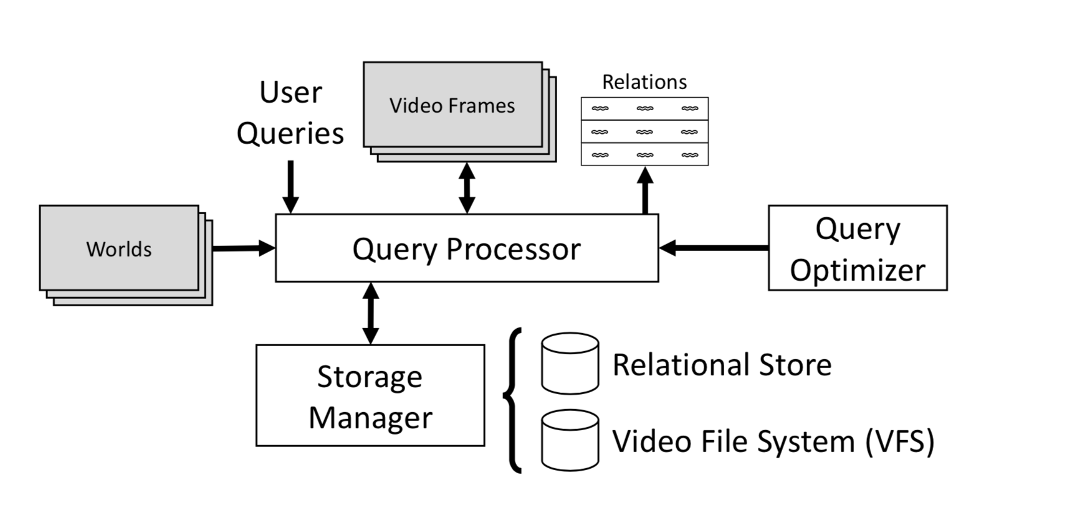
Proposed Architecture
https://www.cs.ucy.ac.cy/~dzeina/courses/epl646/

Slide 7
Important Components
Data Model
Storage System
Query Optimizer
Pixel
Point
Camera
Object
Property
Video File System
Storage Manager
Decrease video size necessary for query execution.
Reduce accuracy loss.
https://www.cs.ucy.ac.cy/~dzeina/courses/epl646/

Slide 8
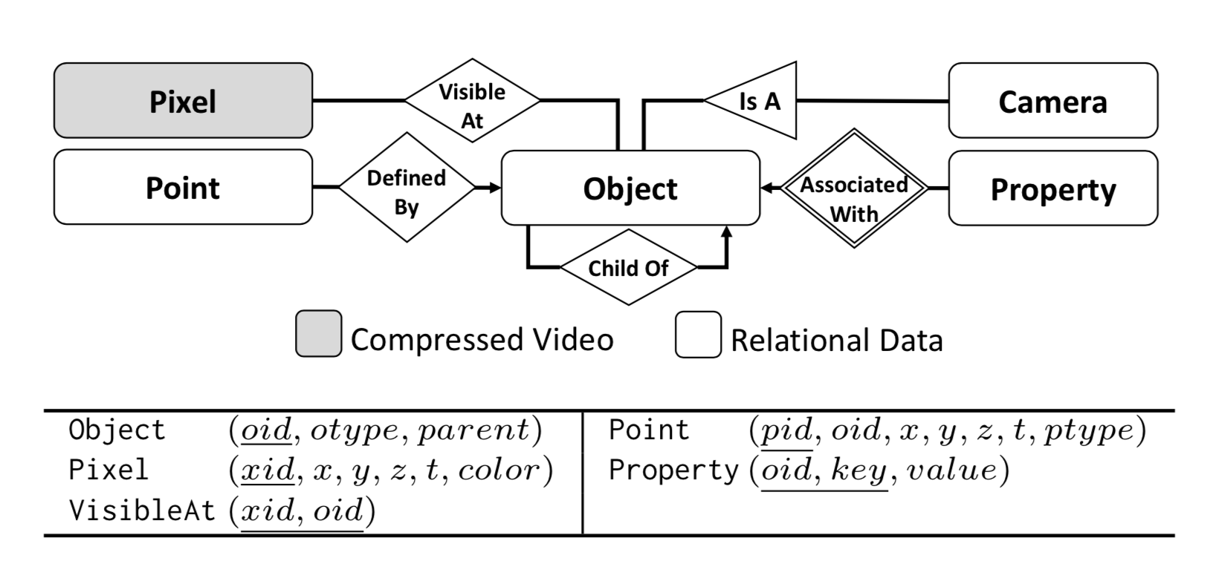
Data Model Overview
https://www.cs.ucy.ac.cy/~dzeina/courses/epl646/

Slide 9
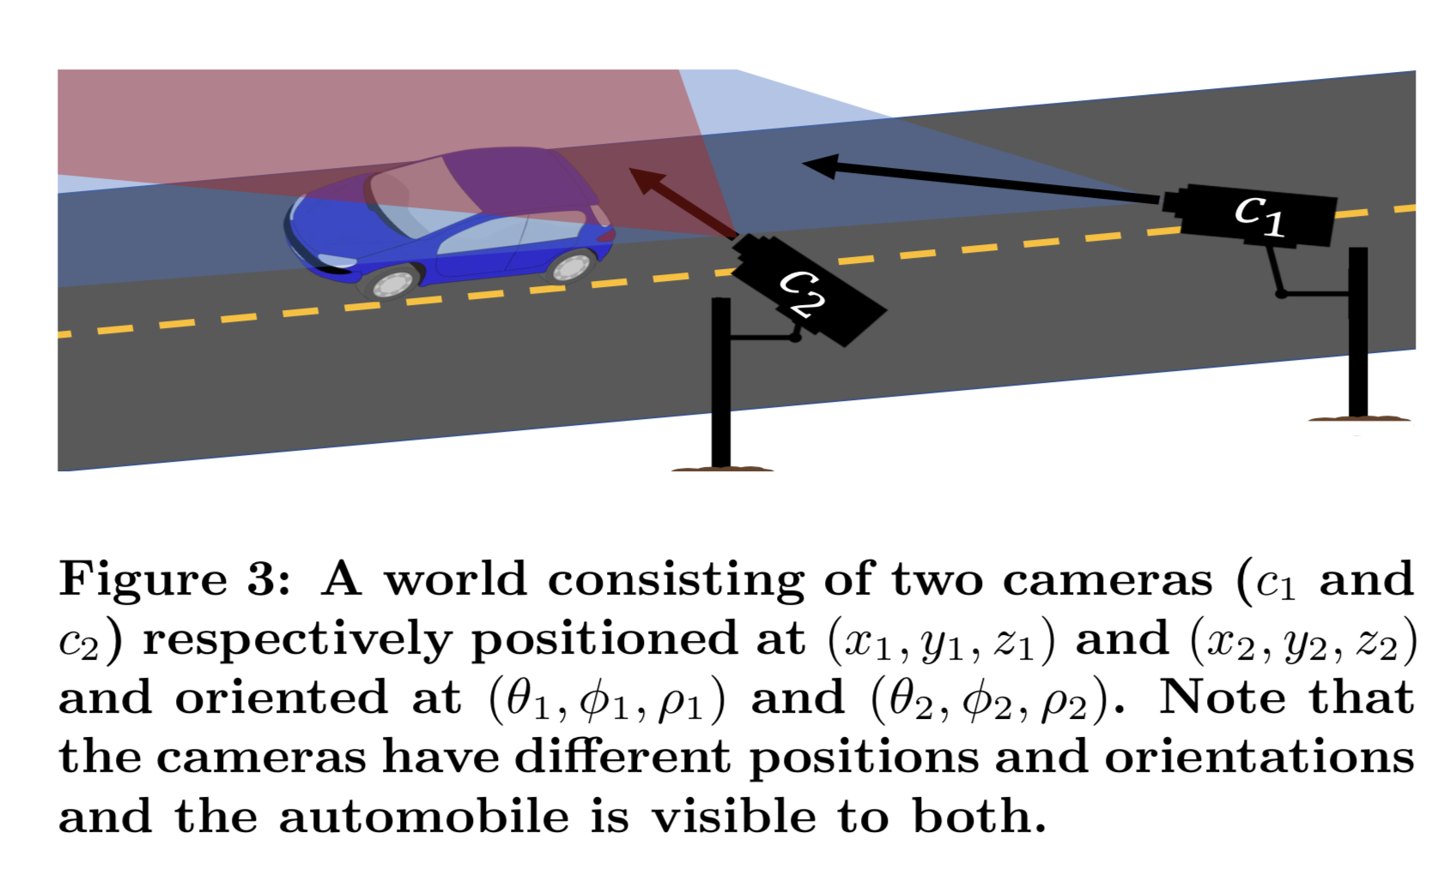
Example World
https://www.cs.ucy.ac.cy/~dzeina/courses/epl646/

Slide 10
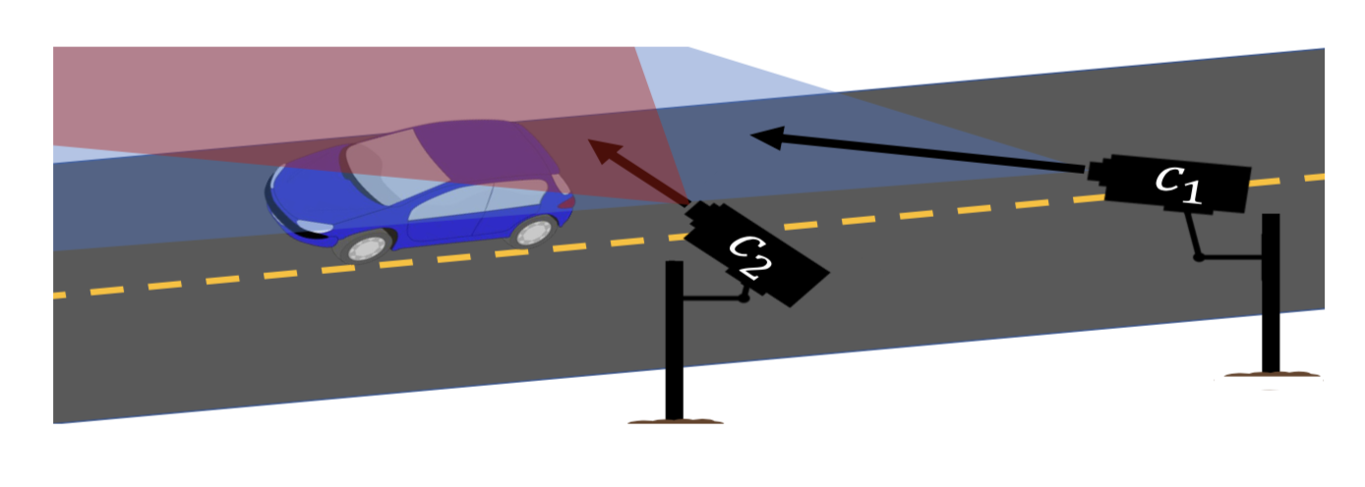
The user uses a object recognition function to populate the database with objects
Each inserted object has a polyhedral shape defined by one or more points
The object is also associated to the pixels that produced it
Objects can also have a trajectory that is defined by the movement of the points during the transitions in time
All objects are associated with an arbitrary number of key/value properties
The database will automatically identify the most efficient way to deliver any requested video related to the cameras
Objects can also have a trajectory that is defined by the movement of the points during the transitions in time
https://www.cs.ucy.ac.cy/~dzeina/courses/epl646/

Slide 11
Storage System
Current VDBMSs treat video compression as a black box, so they either store it as raw pixels or a single compressed file.
The vision of our database is to extract and separate indipendant data to improve performance.
For that reason the system has been split to two parts:
Storage Manager (SM)
Video File System (VFS)
https://www.cs.ucy.ac.cy/~dzeina/courses/epl646/

Slide 12
Video File System
It exposes a POSIX-compliant file system interface through which applications read and write video data.
It has the ability to optimize the storage, can choose compression strategies, fragment videos and reorganize pixels within frames.
https://www.cs.ucy.ac.cy/~dzeina/courses/epl646/

Slide 13
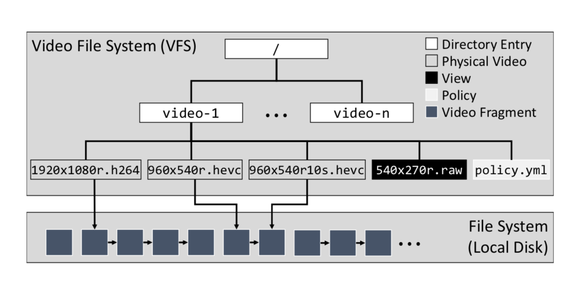
Directory Structure
The VFS arranges each video under its own subdirectory.
Each subdirectory has a policy that determines the optimizations that are applied.
The directory has the materializations and the views.
The sequence of blocks are the compressed video blocks as dictated by the policy
New requests generate new materializations that might be needed for future queries.
https://www.cs.ucy.ac.cy/~dzeina/courses/epl646/

Slide 14
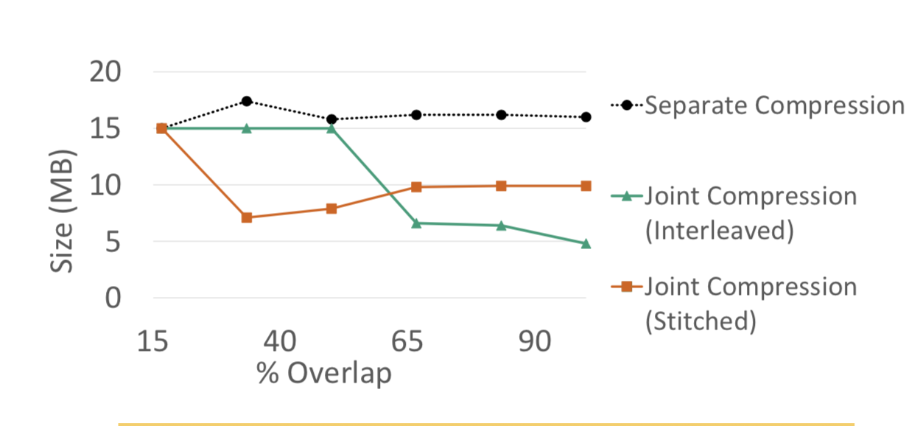
Storage Manager
What the SM does:
Whether to jointly compress video from overlapping cameras.
What strategy to use for retrieving this kind of compressed video.
Which video to operate on when executing queries.
These results suggest that jointly compressing video data reduces compressed video for sizes by up to 60%.
https://www.cs.ucy.ac.cy/~dzeina/courses/epl646/

Slide 15
Two types of joint compression:
The interleave method aligns and alternates rows of pixels in corresponding pairs of video frames and then depends on video compression to minimize the resulting redundancy.
The stitching method merges pairs of frames into a panorama.
https://www.cs.ucy.ac.cy/~dzeina/courses/epl646/

Slide 16
Query optimization
The basic strategy for executing queries in the DB is to translate the query into operations on each video, decompress and process each video, then combine results.
Specifically it tries to reuse the results between overlapping videos.
It targets the video part that contains only the desired object and this can reduce accuracy.
It tries to decompress the smallest amount of video data possible.
https://www.cs.ucy.ac.cy/~dzeina/courses/epl646/

Slide 17
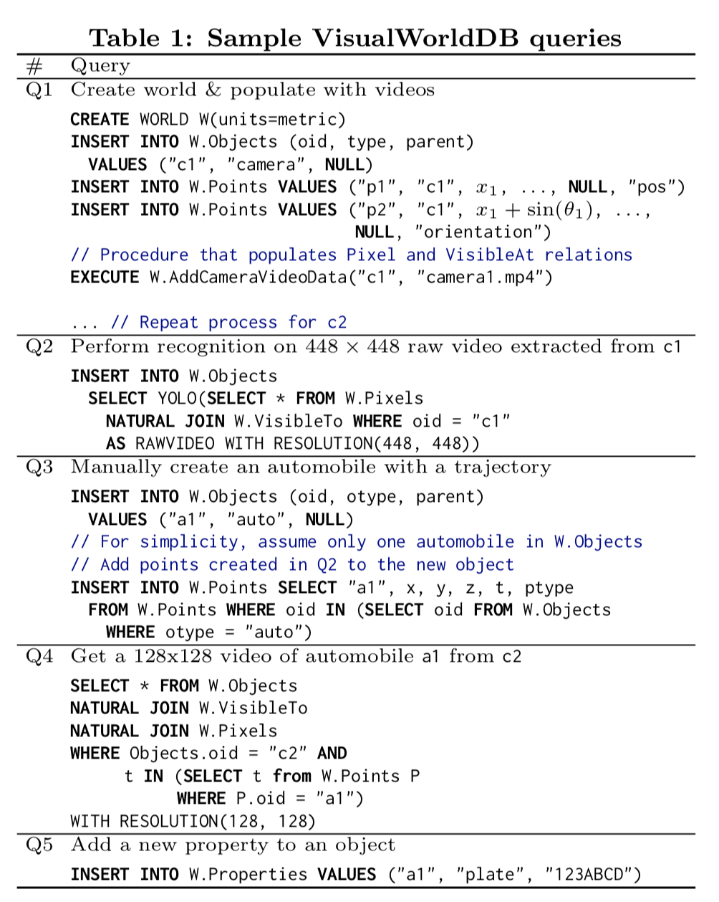
Query examples
https://www.cs.ucy.ac.cy/~dzeina/courses/epl646/

Slide 18
Future Work
VIDEO FILE SYSTEM
Space optimizations:
1. Pixel reordering.
2. Frequency – domain conversions.
3. Incremental refinement technique
- similar to database cracking.
https://www.cs.ucy.ac.cy/~dzeina/courses/epl646/

Slide 19
Future Work
QUERY PERFORMANCE OPTIMIZATION
Physical transformations
Reorganization approaches
Indexing techniques
https://www.cs.ucy.ac.cy/~dzeina/courses/epl646/

Slide 20
Thank you!
Questions;
cachil01@ucy.ac.cy
https://www.cs.ucy.ac.cy/~dzeina/courses/epl646/

