Slide 1

Your notebook is not crumby enough, REPLace it
EPL646: Advanced Topics in Databases
Your notebook is not crumby enough, REPLace it, Michael Brachmann, William Spoth, Oliver Kennedy, Boris Glavic, Heiko Mueller, Sonia Castelo, Carlos Bautista, Juliana Freire.
http://cidrdb.org/cidr2020/papers/p13-brachmann-cidr20.pdf
By:Loizos Loizou(lloizo04@cs.ucy.ac.cy) &
Andreas Hadjigeorgiou(ahadji40@cs.ucy.ac.cy)

Slide 2
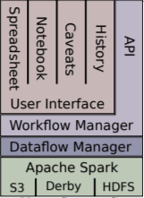
Vizier Overview
Vizier is an open-source tool that helps analyst to build and refine data pipelines.
It combines the flexibility of notebooks with the easy-to-use data manipulation interface of spreadsheets.
Advanced provenance tracking for both data and computational steps.
Exposes potential issues with data refer to as data caveats.
Notes:
Notes to presenter:
Description of what you learned in your own words on one side.
Include information about the topic
Details about the topic will also be helpful here.
Tell the story of your learning experience. Just like a story there should always be a beginning, middle and an end.
On the other side, you can add a graphic that provides evidence of what you learned.
Feel free to use more than one slide to reflect upon your process. It also helps to add some video of your process.

Slide 3
Limitation of Existing Tools
Most existing tools are REPLs-based notebooks but this models leads to limitations with:
Reproducibility
Direct Manipulation
Versioning and Sharing
Uncertainty and Error Tracking
Notes:
Notes to presenter:
Description of what you learned in your own words on one side.
Include information about the topic
Details about the topic will also be helpful here.
Tell the story of your learning experience. Just like a story there should always be a beginning, middle and an end.
On the other side, you can add a graphic that provides evidence of what you learned.
Feel free to use more than one slide to reflect upon your process. It also helps to add some video of your process.

Slide 4
Problem of REPLs-based Notebooks
The REPL-based notebooks are stateful
Every state managed by the REPL

Slide 5
Trail of Breadcrumbs
Common use of notebooks
Pros
Produce new data
Intermediate states
Other usage of notebook
Cons
Manual work from user
Notes:
Notes to presenter:
Description of what you learned in your own words on one side.
Include information about the topic
Details about the topic will also be helpful here.
Tell the story of your learning experience. Just like a story there should always be a beginning, middle and an end.
On the other side, you can add a graphic that provides evidence of what you learned.
Feel free to use more than one slide to reflect upon your process. It also helps to add some video of your process.

Slide 6
Vizier Design
Designed to encourage reproducibility
Don’t use REPL’s model

Slide 7

Requirements Designing Vizier
Enforcing in-order execution.
Workflow-style execution.
Fine-grained provenance.
Big data support.
Notes:
1. Enforcing in-order execution: We needed a state representation that could be correctly, efficiently checkpointed to allow replay from any point in the notebook. A typical REPL’s state is a complex graph of mutable objects that can be checkpointed completely or efficiently, but not both simultaneously. 2. Workflow-style execution: We needed a state representation that permits at least coarse-grained dependency analysis between cells. Operations in a REPL can have arbitrary side effects, making dependency analysis challenging. 3. Fine-grained provenance: To support provenancebased features of Vizier like caveats, we wanted a state representation that supported declarative state transformations. A typical REPL for an imperative language like Python makes such analysis challenging. 4. Big data support: We needed a state representation that could manage large, structured datasets. This criterion is met by Python REPLs, which offer limited support for large, in-memory datasets through libraries like NumPy and Pandas.

Slide 8
Vizier Notebook
Similar to other notebooks, Jupyter and Apache Zeppelin.
An analytics workflow is broken down into individual steps called Cells.
In order workflow cells
Vizier’s two core components : Workflow & Dataflow manager
Notes:
Notes to presenter:
Description of what you learned in your own words on one side.
Include information about the topic
Details about the topic will also be helpful here.
Tell the story of your learning experience. Just like a story there should always be a beginning, middle and an end.
On the other side, you can add a graphic that provides evidence of what you learned.
Feel free to use more than one slide to reflect upon your process. It also helps to add some video of your process.

Slide 9
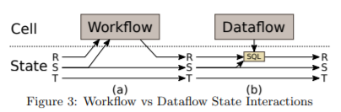
Workflow & Dataflow
Workflow Cells
1. Read dataset
2. Checkpoint dataset
3. Create dataset
Dataflow Cells
1. Compiled to SQL queries
2. Views

Slide 10
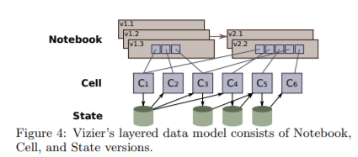
Vizier’s Version Models
Vizier is versioning:
The notebook
The states
The cells
Note: Figure 4 illustrates the branching version history

Slide 11
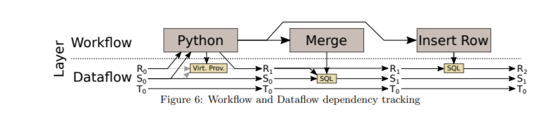
Vizier’s Dependency Model
Vizier manages two graphs of dependencies:
Workflow dependencies
Dataflow dependencies
Notes:
Workflow Dependencies: Form a coarse-grained view of which cells depend on other cells and are used to manage cell execution order.
Dataflow Dependencies: Provide a fine-grained view of how a dataset version was derived and are used primarly for propagating caveats

Slide 12
Vizier’s Execution Model
As we mentioned before Vizier has two core components :
Workflow manager
Dataflow manager

Slide 13
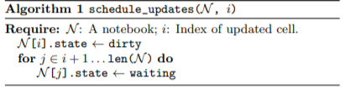
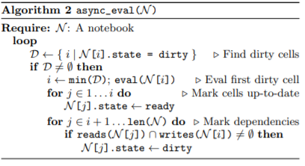
Workflow Manager
Workflow manager is responsible for:
Managing Cells
Inter-Cell Dependencies
Scheduling Workflow Cell Execution
The version history

Slide 14
Dataflow Manager
Dataflow Manager is responsible for:
Storing and mediating access to dataset versions
Propagating caveats
Fine-grained provenance analysis
Notes:
Api and cell Execution Engine:
new dataset versions to be uploaded or linked from URLs,
new dataset versions to be defined declaratively as views,
existing dataset versions to be queried, and
the caveats of existing dataset versions to be analyzed.

Slide 15
Vizier’s User Interface
Vizier User’s Interface consist of four main views:
1. The Notebook view
2. The Spreadsheet view
3. The Caveat view
4. The History view

Slide 16
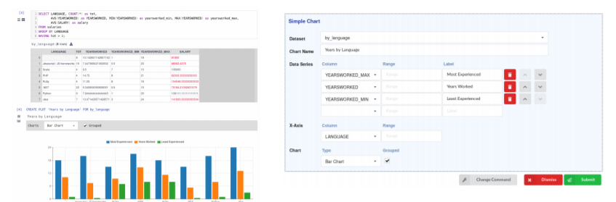
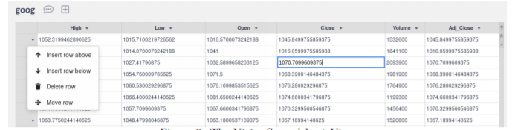
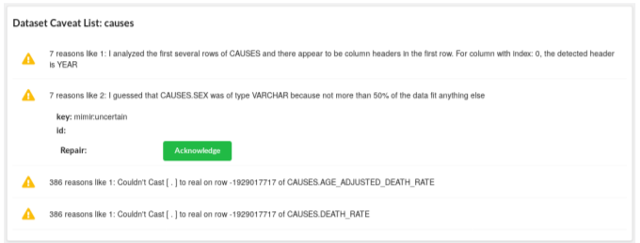
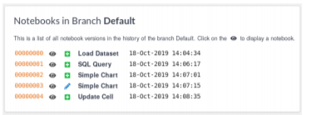
Vizier’s User Interface

Slide 17
Spreadsheet Operations
Spreadsheet edits must be reflected in the notebook
Vizier Supports a range of cell types based on a language for spreadsheet-style operations called Vizual
Vizual is responsible to model user actions on a spreadsheet
Challenges Viziers had to overcome was:
1. Data types in Spreadsheets
2. Declarative Updates
3. Row Identity

Slide 18
Spreadsheet Data Types
Vizier’s datasets are using a stronger relational data model than the lightweight interface used by typical spreadsheets.
Vizier assumes that user’s actions are intentional for that reason it allows column types to be escalated so that the newly entered value to represented as-is.
Vizier relies on the column type to resolve the ambiguity that is occurring in the spreadsheets.

Slide 19
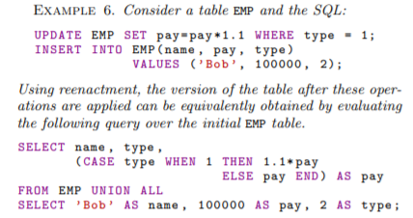
Declarative Updates
Vizier has build a technique called reenactment which translates sequences of DML operations into equivalent queries. This technique was built to preserve the versioning in Vizier.
The user’s actions in the spreadsheet are added as vizual cells to the notebook. And these vizual operations are translated automatically into SQL DDL/DML expressions.

Slide 20
Row Identity
Vizier in order to deal with such updates and to be able to represent unordered relational data as a spreadsheet, it needed to maintain a mapping between rows and their positions in the spreadsheet. Since Vizier recorded both the position of a row and a unique stable identifier for it, Vizier can ensure that a Vizual operation always applies to the same cell.
For derived data, Vizier uses a row identity model based on GProM’s encoding of provenance.
Derived rows, such as those produced by declaratively specified table updates, are identified as follows:
Rows in the output of a projection or selection use the identifier of the source row that produced them
Rows in the output of a UNION ALL are identified by the identifier of the source row and an identifier marking which side of the union the row came from
Rows in the output of a cross product or join are identified by combining identifiers from the source rows that produced them into a single identifier
Rows in the output of an aggregate are identified by each row’s group-by attribute values.
Base case: datasets loaded into Vizier or created through the workflow API. We considered three approaches for identifying rows in raw data: order-, hash-, and key-based. None of. Our prototype implementation combines the first two ordering and hashing to preserve associativity and commutativity during optimization, union-handedness is recorded during parsing proaches: deriving identifiers from both sequence and hash code.
Notes:
Challenge when a new cell is added or a new dataset is loaded into Vizier.

Slide 21
Caveat
An annotation that applied on a cell or a row of the dataset
Indicates that a cell value or a row is potentially suspect or uncertain
Consist of a human readable description
Originally introduced as uncertain values

Slide 22
Managing Caveats
Management of caveats is one of the core functionalities of Vizier.
Vizier steps for managing caveats
Applying Caveats
Propagating Caveats

Slide 23
Applying Data Caveats
Vizier expose a function from the dataflow layer
Caveats applied when a dataset is uploaded.
Use of caveats to annotate data
String Parsing
CSV Parsing
caveat(id, value, message)

Slide 24
Propagating Caveats
General annotation management systems let the user decide how an annotation propagate.
Vizier propagate caveats only if the value affect the output

Slide 25
Propagating Caveats
Vizier splits propagation of caveats into two parts for limiting overhead
Instrumenting Queries
Computing Caveat Details

Slide 26

Thank you !!

