Slide 1
MapReuse: Recycling Routing API Queries
R. Stanojevic, S. Abbar and M. Mokbel, 2019 20th IEEE International Conference on Mobile Data Management (MDM),
Hong Kong, Hong Kong, 2019, pp. 279-287.
doi: 10.1109/MDM.2019.00-47
http://ieeexplore.ieee.org/stamp/stamp.jsp?tp=&arnumber=8788811&isnumber=8788716
University of Cyprus Department of Computer Science
EPL646 - Advanced Topics in Databases
By: Andreas Savva & Soteris Constantinou
Instructor: Dr. Demetris Zeinalipour

Slide 2
Introduction
Traffic information is critical in location based services
Dependency for the success of commercial map engines
These allow to be queried for routing information and output the total travel time on a path
Free and Open Map services offer highly accurate geometric representation of the road network
They lack traffic awareness
Aim: Exploit the results of a limited number of queries to commercial map routing API to construct per-road-segment traffic image
By incorporating it into open maps, it will allow for queries that require traffic awareness

Slide 3
Motivation
There are countless of location based services depending on traffic information
Optimized route scheduling and route planning
Location-aware recommendations
Transportation modelling and planning
Scenario: Fleet of courier vans scheduling the routes for delivery to minimize fuel consumption and travel time
Traffic conditions vary depending on time
Commercial map services rely on connected devices acquire traffic information

Slide 4
Target users of MapReuse
High-volume routing API applications
Consistently requesting routes/travel times (thousands – millions of calls /day)
Commercial map services will cost will be substantial
Non-standard spatial queries
Commercial maps allow only a list of standard queries
Complex spatial queries require extensive engineering and cost
Example: Many-to-Many distance matrix
Can be obtained with a large cost (10 thousand >)

Slide 5
Contributions of Paper
System: MapReuse
Consumes travel information returned by commercial map engines API
Returns travel times for individual edges of the road network graph
Evaluation: Empirically
Using four cities
Mean and median percentage error: 4% and 8%

Slide 6
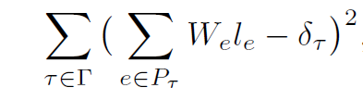
Problem Formulation
Road network as a graph
Nodes: (longitude, latitude)
Edges: Road connects directly the 2 nodes
A journey is represented by the available information:
I_{t} =[path_{t} ,δ_{t}]
Path: (long,lat) pairs
δ: time to travel over the path
Γ: the set of training journeys (I_{t},P_{t})
The duration of a journey following a path is approximated by the sum of the weights of edges in the path
Estimate of travel time
Observed travel time

Slide 7
Weighing the edges
Weight might depend :
Time of day
Day of week
Minimizing the equation blindly might lead to inefficient edge weights
Road networks might be huge
Group the edges in a structured way
Leads to reduction of dimensionality
Allows for solver scaling over large networks
MapReuse steps:
Heavy Edge Detection
Heave Road Detection
Constraint-aware linear regression

Slide 8
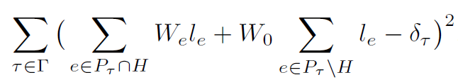
Heavy Edge Detection
Journeys may share a part of their trajectory with other journeys
Allowing each edge of the graph independently in (1) leads to over-fitting
Heavy edges: Support a large number of trajectories
For training set: Take h1 most ‘popular’ edges
h1=10000 for the paper
Shortest paths usually rely on heavy edges => Light edges have minimal effect on duration
Minimizing this sum reduces the complexity of the model
Weigh of non-heavy edges

Slide 9
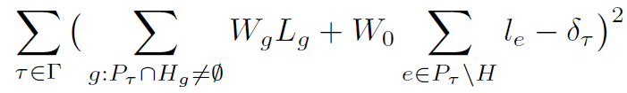
Heavy road detection
Further reduction of dimensionality
Group heavy edges together if they belong in the same trajectories
Rewriting the equation now gives us:
This gives us r+1 unknowns
r:weight of heavy roads, 1 weight for all light edges
Number of heavy roads is 3-4 times less that of heavy edges
Lg = Length of heavy road Hg

Slide 10
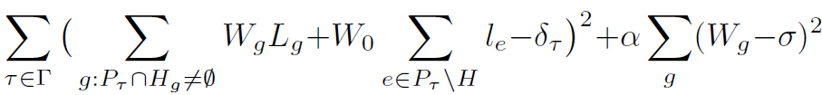
Enforcing physical constraints
W_{g} is inverse of the speed on the road segment (sec/m)
Speed is depended on the information of the map
In OSM it is measured in km/h
Therefore we get W_{g} > 3.6/maxspeed_{g} (4)
Using ridge regression ensures that this constraint holds
Penalize weights that deviate from the average speed
Results to W_{g} being close to σ
For cases that violate the speed limit, weight is set to: W_{g}=max(3.6/maxspeed_{g},W_{g})
σ: inverse of average speed
α:regularization strength

Slide 11
Last Steps
Choosing regularization strength α
Start with a=1 and obtain the weights
Measure the cost on the validation set by substituting them in (3) -> C(α)
Keep doubling α until C(a)>C(2α)
Number of weights per segment
Traffic conditions vary depending on time scales
For more accurate estimates we may train multiple models
Example: derive one weight per edge for every hour of day
Time varying weights reduce errors in estimated travel time

Slide 12
Evaluation - Data
Four prominent cities have been studied :
Randomly selected 5000 origin-destination pairs
Each pair query Google Maps directions API four times, requesting the routes which connect the origin to the destination at four different times
Quoted Google Maps Direction API guideline: indicates that the returned duration−in−traffic should be the best estimate of travel time
Live traffic becomes more important the closer the departure−time is to now.
Bogota
Doha
New York
Rome

Slide 13
Origin-Destination(OD) pairs selection
OD location pairs are drawn randomly from the set of OpenStreetMaps (OSM) nodes
Iterates through a list of randomly selected pairs (O, D) of OSM 2-way road nodes and accept them with a probability
min(1,(5km/d(O, D))²
Selecting nodes which lie on 2-way roads → eliminated the effects of inappropriate geocoding which matches a location to a road on the opposite side of the street
Routes which connect far-apart locations almost exclusively utilize motorways and primary roads

Slide 14
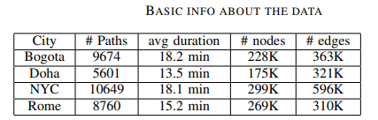
For each (orig, dest, timestamp) triplet, the API call returns a list of up to three routes together with the estimated travel time over that route at the given departure time
Open Source Routing Machine(OSRM) is used to map matching service to match each route to the OSM
Reports the total number of map-matched routes in the 4 cities using 5000 API calls, at midnight timeslot.
For each city and each of the four time slots
used the routes obtained from 80% of the API calls for training the model
the remaining 20% of the routes for testing

Slide 15
MapReuse vs. traffic-oblivious routing engines
How does MapReuse compare with traffic oblivious OSM-based routing engine in terms of ETA errors?
Uses the default engine that OSM landing page offers
Open Source Routing Machine (OSRM) .
OSRM utilizes the underlying OSM data to build the road network graph equipped with weights which are used for computing the optimal routes.
The weights OSRM uses are derived from the OSM metadata in a way to prioritize routing over motorways and other primary roads.
For each (origin,destination) pair OSRM returns a route together with ETA (estimated time of arrival, or route duration) which is derived by solving an appropriate quickest-path query.
OSRM has a web-based API, and offers code to set-up a local-server on own premises, in order to be able to maintain high-throughput.

Slide 16
OSRM and MapReuse
Evaluated based on four different metrics: median and mean absolute error (in seconds), and median and mean percentage error (in %)
Conclusions:
Querying traffic-oblivious routing engines may offer reasonable routes but the actual ETA is highly inaccurate
With OSRM, in the cities of New York and Bogota the mean absolute error is over 40% of mean percentage error.
MapReuse offers an order of magnitude reduction in errors compared to barebones OSRM
MapReuse can capture the relevant traffic information on a per-road-segment level and use it to accurately capture the travel time on arbitrary path

Slide 17
How many API calls?
There is a trade-off between the number of API calls used in the training phase of MapReuse and the actual errors in travel times.
More API calls result in more accurate representation of the travel times throughout the city
More API calls result in a higher cost for data acquisition

Slide 18
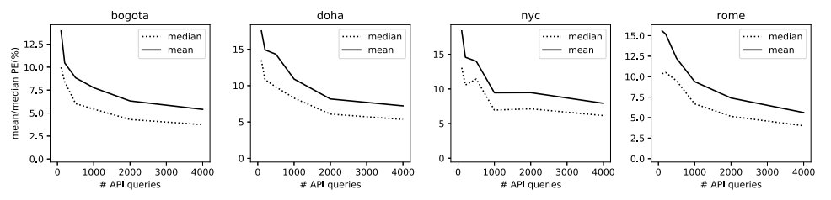
A limitation has been applied in the number of API calls used in the training phase of MapReuse to n−samples and evaluated the ETA errors on a set of 1000 paths not used in the training phase
The larger the training data the smaller the errors.
Law of diminishing returns, with minor improvements with larger data
→ After 1000 API calls, the accuracy of the MapReuse model improves only marginally with more data.
→ Training the MapReuse model even on a small dataset with several hundred of journeys would outperform traffic oblivious OSRM.

Slide 19
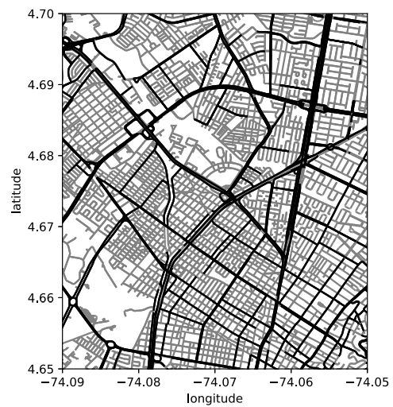
Heavy roads
MapReuse effectively infers speed on each heavy road individually and simultaneously assigns a single weight (speed) to all the light roads.
By focusing on heavy roads, it effectively captures most of the major road arteries, and eliminates low volume roads which may create overfitting issues in the training model phase of MapReuse.
Not focusing on light roads means that certain traffic events (such as congestion or extraordinary fast light road) may not be captured by MapReuse.
This is one of the factors which limits the accuracy of MapReuse weights, and can explain the effect observed in errors where additional training data does not lead to noticeable improvements in the accuracy of MapReuse

Slide 20
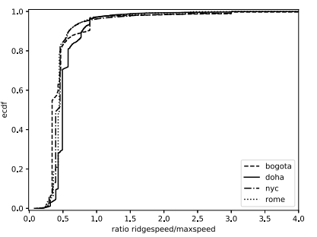
MapReuse Relative speeds
Depiction of the empiric CDF of the ratio between the inferred speed 3.6/Wg, and the maxspeed tag for all road segments in the four cities.
The figure shows that the weights derived by minimizing, satisfy the speed limits in a large majority of cases.
The fraction of edges for which Wg violates the OSM-reported speed limit is less than 4% in all four cities.

Slide 21
RELATED WORK
A shortest path algorithm with an acceptable processing time and accurate edge weights would be favored over another algorithm that has faster processing time but uses inaccurate edge weights.
The wide spread of GPS-enabled devices and subsequently the availability of trajectory data they generate has made it possible for the community to approach the problem of edge weight estimation → also known as link travel time (LTT) problem
Other researchers :
Aimed at predicting travel time for any pair of origin destination on a map
→However they focus on inferring overall travel time of a route, as opposed to accurately inferring individual edge weight.
Proposed a time-dependent trajectory regression on road networks
Use trajectory data to find fastest routes in a road network which often requires the computation of edge travel times as an intermediate step
Proposed to use the “incomplete” trip information for complete weight annotation of road networks

Slide 22
CONCLUSION
The coarse path-level information available in most commercial maps engines can be dissected into fine-grained information which captures traffic-aware travel times on every road segment of the city
A system called MapReuse was built → it can infer travel times on each road segment in a large city using several thousand calls to commercial maps directions API.
The empiric analysis in four large metropolitan areas shows that reusing travel time info derived by MapReuse has very high accuracy
MapReuse is able to reproduce path-travel times reported by the commercial map within a very small margin of error

