Slide 1

Data Platform for Machine Learning
Pulkit Agrawal, Rajat Arya, Aanchal Bindal, Sandeep Bhatia, Anupriya Gagneja, Joseph Godlewski, Yucheng Low, Timothy Muss, Mudit Manu Paliwal, Sethu Raman, Vishrut Shah, Bochao Shen, Laura Sugden, Kaiyu Zhao, Ming-Chuan Wu∗
Apple Inc.
Cupertino, CA
Andreas Yelasis
Chrysovalantis Christodoulou
Notes:
Brief description of the paper
The paper refers to how the DBMS community will help ML systems

Slide 2
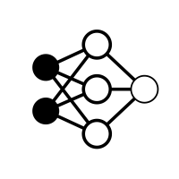








What is Machine Learning?
Input Data
Model Training
Model Decision
Data Preprocessing
Final Stored Model
Training Data
Model Evaluation/Retraining
Test Data

Slide 3
Motivation
Little emphasis on integrated ML data systems
Usually we are using simple passive data silos (file system, Blob)
ML Engineers used to spend a lot of time dealing with data rather than focusing on ML algorithms
Luck of data provenance, data versioning, compliance, auditing, usage analytics
Waste of resources by doing the same job many times
Notes:
C.

Slide 4



ML Teams
ML Engineer
Software Engineer
ML engineers focus on finding the best ML model
Building support toolset for end-to-end ML training
Data Science
Legal Team
Feature Engineering,
Data labeling (annotation)
Data quality control
Terms of use on data
Protect Privacy (GDPR)
Auditing

Slide 5
ML Requirements
A data model to cover slowly changing and real time data assets and features
Mechanism for continues data injection
A domain specific language for feature engineering
A big data storage with capabilities of versioning, efficient support of incremental updates, and ML training access patterns
A data access interface
Explicit version management to ensure reproducibility of ML experiments
Tracking of data lineage and provenance
A toolset and a programming interface for data exploration and discovery
Notes:
C.
3) Parallilismos kai sharding
7) Na idopias kapion an tixon ekpedefse mondela me lathos dedomena na ta 3anaekpedefsi

Slide 6
Contribution
Recognize the needs and to call out the requirements of an ML data platform
Share experiences in building MLdp by adopting existing database technologies to the new problem as well as by devising new solutions
Call for actions from our communities on future challenges

Slide 7
Related Work
Other works | MLdp
ModelHub, ProvDB and Model Governance: Described systems that track the lineage of machine learning models | √
DataLab and SciDB: Track provenance, and versioning | √
Petastorm: API integration with frameworks (Tensorflow) | √
Kayak: Provides a catalog for loosely structure data | √ Using a minimalist data model which allows flexible schema for semi-structure data.
DataHub and Goods: Data sharing and discovery | √ Additional compliance and privacy features
Boehm et al, and Kraska et al: Proposed declarative domain specific languages for machine learning systems | √ MLdp DSL focuses on data and feature engineering tasks

Slide 8
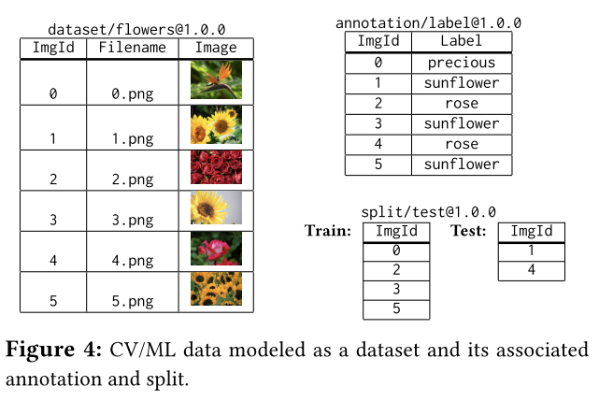
Data Model
1
Dataset: Collection of entities that are the main input of ML training
Annotation: Is a collection of labels and features describing the entities of the related dataset
Splits: Train/Test split (horizontal partitions)
Packages: Virtual objects that provides a conceptual view over dataset, annotation, and/or split (like database views)
2
3
Notes:
C

Slide 9
Versioning and data life cycle management
<schema>.<revision>.<patch>
Schema: Major changes on the schema, which need code revise to read the data
Revision & Patch: Add, Update, Delete of entities without changing the schema
The application always points to a reproducible version
Explicit versioning system
Provides dependencies' tracking between data and models
MLdp objects states: draft, published, archived, and purges
Draft: Validate object before published
Published: A stable and immutable object
Archived: Expired data we don’t want to delete yet
Purges: Expired data we want to permanently remove
Notes:
C

Slide 10
Physical Data Model
Primary Key is the only schema requirement (flexible schema)
Column type Scalar: number, string, date-time, rich multimedia types, and byte stream
Column type Collection: vector, set, and dictionary(document)
MLdp tables are stored in column-wise fashion
MLdp tables are scalable distributed data structures
MLdp tables are interoperable with Apache Resilient Distributed Datasets (RDD), Apache DataFrames, Pandas, and R Data Frames
MLdp allows user-defined access paths, such as primary indexes, secondary indexes, and partial indexes

Slide 11
Data Interface
Server Site | Client Site
High level domain specific language (DSL) | Low-level API
Declarative language | Imperative language
Helps on server-site batch data and feature engineering tasks | Providing Streaming I/O for client-site data processing
Distribution and parallel execution environment | -
Notes:
C.

Slide 12
Data Interface - DSL
Allows users to describe the intent, programs will be compiled and optimized into execution graphs
Executed locally or on elastic cluster computer for execution
Provides local execution mode with debugging and testing before the cluster execution
Query Optimization techniques are applicable to MLdp
DSL is integrated with Python
Notes:
Query optimization:
interesting properties,
view matching,
index selection,

Slide 13
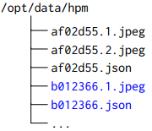
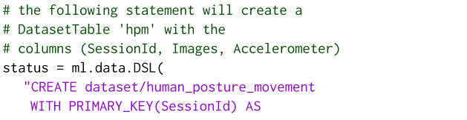
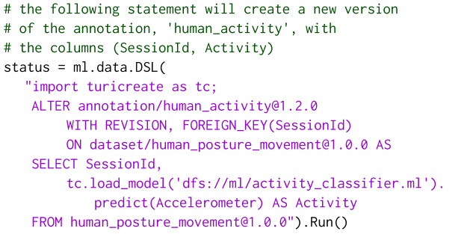
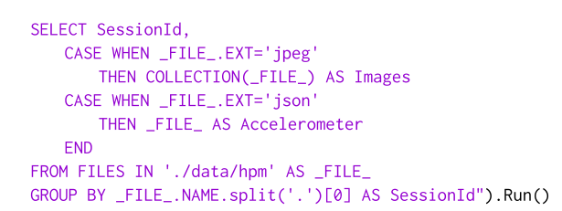
Data Interface – DSL (examples)
Notes:
Listing 1
Afto to script kanei ena dataset apo files sigkekrimena to human_posture_movement.
Oi stiles mas einai to SessionID, Images, Acceleromenter
Otan I kataliksi tou arxeiou einai jpeg to vazei san Image
Otan I kataliksi tou arxeiou einai json to vazei san Accelerometer
To primary key enai to SessionId
Listing 2 Use a pre-trained model to create new labels.
Shows how to create a new version of an existing annotation on the human_posture_movement dataset.
, @, is used to specify a particular version of an object. ALTER...WITH REVISION6 will create a revision based on the specified version.
New version will be human_activity@1.3.0.
The ON mas leei se pio version tou dataset which this annotation references to. The SELECT...FROM clause defines the input data source.
SessionId is the foreign key to the previous table.
To tc.load_model kalei ena montello pou einai idi ekpedevmeno kai kanei predict me ta dedomena tou accleometer kai ta vgazei se mia alli stili pou legete Activity

Slide 14
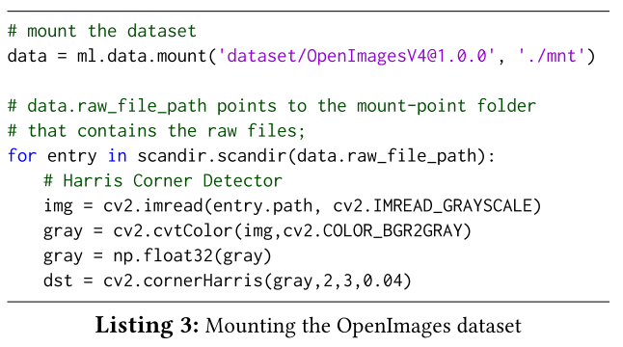
Data Interface – Low-level data primitives
Streaming I/O File
Supports ML applications running on the client site
Allows ML application to mount MLdp objects. Mounts the OpenImages dataset
Performs corner detection on each image
Mount command implements data streaming on-demand
Harris Corner Detector is a corner detection operator that is commonly used in computer vision
Notes:
Στο ML einai sixno diafora datasets na me raw multimedia files na xrisimopiounta gia train pollon ML montella. To MLdp client SDK epintrepei meso
Pianei ta dedomena sto computer tou xristi ta dedomena einai ta OpenImages gia na ektelesei corner distance

Slide 15
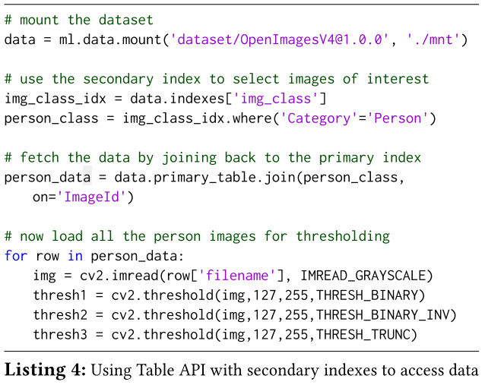
Data Interface – Low-level data primitives
2) Table API
Uses secondary index to “search” for the data of interest
Then performs a join in order to retrieve the images
And apply an image thresholding processing
Notes:
C

Slide 16
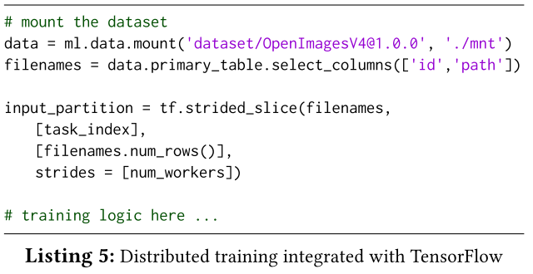
Data Interface – Low-level data primitives
3) Distributed Training
Multiple worker nodes train the same model on different partitions of the data
Each worker node in TensorFlow takes a slice of input using the “task_index”
Due to streaming of the data each worker will only incur the I/O of the specific partition
Notes:
C

Slide 17
Storage and Data Layout Design - Hybrid Data Store
A hybrid data store that supports both high velocity updates at the data curation stage and high throughput reads at the training stage
In-flight data store uses a distributed key-value store that supports efficient updates concurrently
In-flight store only keeps the current version of its data in contrast with curated data store (slowly changed).
Snapshots can be taken on curated data store (each time that updated), which is a versioned data store based on a distributed cloud storage system.
Curated data store is read-optimized, supports efficient append-only updates based on copy-on-write.
Data-pipe is the subsystem that manages the data movement between the in-flight and curated data stores
Data-pipe uses this information to track deltas between different versions of the same dataset

Slide 18
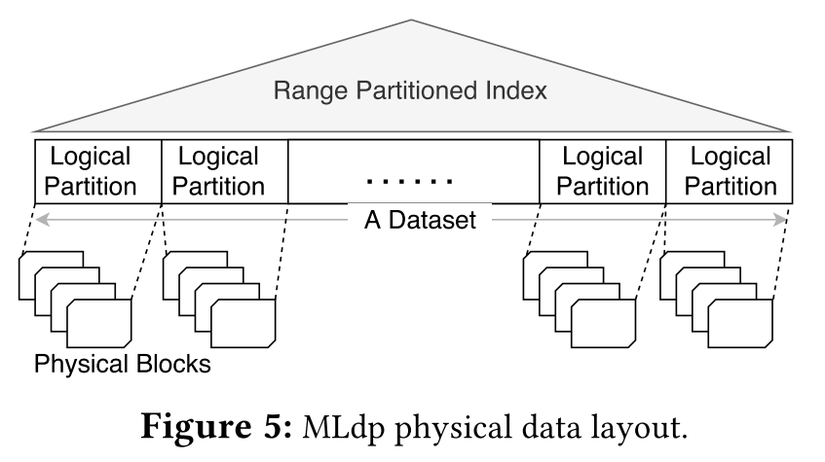
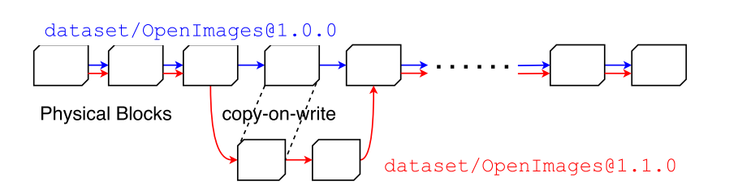
Storage and Data Layout Design - Scalable Data Layout
A scalable physical data layout that can support ever- growing data volume, and efficiently record and track deltas between different versions of the same object
Goal: Achieve minimum data movement
(Based on given sort key & the timestamp)
Notes:
C.
The choices of the sort keys depend on the sequential access patterns to the data

Slide 19
Storage and Data Layout Design – Performance Optimization
Distributed training: data is divided into subsets (Partitions) for individual workers
Streaming On-Demand: Improves the resource utilization ( reducing idle time e.g. GPU). Without Streaming I/O each training task had a long waiting time for the entire data to be downloaded
Range Scan and Point Query: Data blocks are linearly linked to support scans. Index provide key ranges allows efficient point queries
Secondary Index: Allows users to materialize search results. Leaf-nodes of the secondary indexes store a collection of partition keys. MLdp execute range queries can easily sort and map the keys into partitions.

Slide 20
Distributed Cache
Transparent distributed cashing: Application do not know the existence of this service, but they benefit from it
Design to decrease the data distance
Build-in fail-safe in case cache is unavailable (call the relevant API)
Can be deployed in any virtual cluster
The system throughput increases by scaling out existing cache services, or by setting up new cache deployments
MLdp cache stores only published versions of data (immutable), to achieve strong consistency of the data
Notes:
C.

Slide 21
Future Work
Data silos becomes the bottleneck of ML Projects increasing the complexity and limitations
Strategic features with the goal of maximizing the productivity of ML teams
Data Discovery and Exploration
Time-consuming human-in-the-loop finding the right data for training tasks
MLdp data discoverability allows catalog search capabilities
System Improvements
Reduce data latency to increase data throughput (Object-based read-Cache Service)
Improved prefetching prediction and local buffering
Full integration of DSL with parallel data processing systems (eg Spark)
Eco-system Integration
MLdp compatible with major ML Frameworks => minimum code changes to user application
1st Keep MLdp data stored in MLdp’s own format => needs a format converter
2nd Store MLdp data in the native target format (eg TFRecord) => needs lightweight connector

Slide 22
Conclusions
Data plays a crucial role in the rate of model convergence
Existing ML solutions do not provide well-integrated data systems
MLdp is a proposed data platform designed specifically to support ML data life cycle management and ML workflow integration
Data Model enables collaboration through data sharing and versioning
Data Interface enables ubiquitous data access
There are still many challenges to be addressed including declarative ML language, system internal optimization, ML frameworks integration.
Notes:
C.

Slide 23

Thank you!

