Slide 1

EPL646: Advanced Topics in Databases
Socrates: The New SQL Server in the Cloud
Panagiotis Antonopoulos, Alex Budovski, Cristian Diaconu, Alejandro Hernandez Saenz, Jack Hu, Hanuma Kodavalla, Donald Kossmann†, Sandeep Lingam, Umar Farooq Minhas†, Naveen Prakash, Vijendra Purohit,
Hugh Qu, Chaitanya Sreenivas Ravella, Krystyna Reisteter, Sheetal Shrotri, Dixin Tang‡, Vikram Wakade
SIGMOD ’19, June 30–July 5, 2019, Amsterdam, Netherlands
Stavroulla Koumou, Stavros Georgiou
https://www.cs.ucy.ac.cy/courses/EPL646

Slide 2
Contents
Abstract
Introduction
State of the Art
Important SQL Server Features
Socrates Architecture
Socrates at Work
Discussion & Socrates Deployments
Performance Experiments and Results + Appendix A
Conclusion
References

Slide 3
Abstract
Databases-as-a-service (DBaaS) in the cloud are becoming popular.
DBaaS preferable to traditional on-premise approaches because they offer higher security, availability and performance, and lower and more flexible cost.
Traditional, monolithic database architecture fails to meet these expectations due to scaling limitations.
Solution: Socrates:
a new and flexible DBaaS architecture
implemented in Microsoft SQL Server
available in Azure as SQL DB Hyperscale
This Paper:
presents key ideas and features of Socrates
compares the performance of Socrates with the previous SQL DB offering in Azure (HADR architecture).

Slide 4
1. Introduction
Why move to the cloud?
→ security + time-to-market + pay-as-you-go
Expectation:
higher performance than on-premise
support of large DBs
high availability
high performance
elastic service and cost (i.e. DB resource pool and cost grow/shrink among with the workload)
Reality: Monolithic architecture imposes limits to availability and elasticity:
To achieve a small mean-recovery-time (availability) on-premise we use highly expensive H/W (e.g. SANs...) and carefully plan updates and down-times. On the cloud there is no expensive H/W, nor the option of planning.
The traditional approach to scaling is to transfer the database’s data from node N with resources X to node M with resources Y, where Y>X. This is an O(database_size) operation, therefore, it is quite expensive, and limits the max database_size to the maximum memory that a single machine can handle.

Slide 5
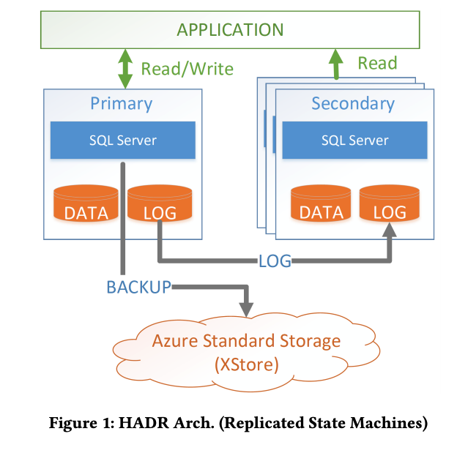
2. State of the Art
Azure SQL DB
Log-replicated HADR Arch.
Google Spanner
Log-replicated HADR Arch.
Amazon AWS Aurora
Shared disk Architecture
Oracle DBaaS
Exadata & Oracle RAC Arch.
Notes:
HADR - High Availability Disaster Recovery

Slide 6
3. Important SQL Server Features [i]
1 - Page Version Store – Consistent Concurrency
SQL Server → maintains versions of records using local temporary storage to allow concurrent read and write operations.
[use-case: Snapshot Isolation; each transaction will see the last committed version of the records at the
time it was initiated.]
Socrates → shared-disk architecture: shared persistent storage tier for record versions.
2 - Accelerated Database Recovery (ADR) – Crash Recovery
SQL Server → ARIES-style recovery: Analysis (checkpoint discovery) + REDO (committed) + UNDO (uncommitted) = slow.
Socrates → ADR: record versions (committed and uncommitted) available on shared persistent storage, uncommitted versions are ignored, Analysis + REDO phases only.
[result: recovery is a constant-time operation relative to checkpoint internal.]
3 - Resilient Buffer Pool Extension (RBPEX) – Cache-aided Recovery
SQL Server → Buffer Pool Extension (BPE): uses SSD to increase available buffer pool space.
Socrates → *RBPEX: recoverable buffer pool space, used as persistent caching mechanism.
[use-case: MRU approach for database recovery; use the most-recently-used pages to speed-up ADR]
Notes:
Look up:
- How is persistent caching implemented? i.e. which technology is being used?

Slide 7
ASIDE: *RBPEX Implementation
Hekaton:
In-memory storage engine for optimizations
Fully integrated into SQL Server; not a separate system
Hekaton tables can be used among with ordinary tables; they just have better performance
RBPEX:
Implemented as a Hekaton table; recovered on crash, like all other tables.
Read I/O time ~= direct I/O to local SSD.
Write I/O time == tricky
Metadata I/O must not stall data I/O
RBPEX failures must not corrupt RBPEX state
=> intercept buffer pool
page lifetime tracking mechanism
(e.g. to obscure delays)

Slide 8
3. Important SQL Server Features [ii]
4 - RBIO protocol – Network Layer
SQL Server → Unified Communication Stack (UCS)
Socrates → UCS + Remote Block I/O (RBIO) protocol
[protocol features: stateless, strongly typed, automatic versioning support, transient failure resilience,
QoS support for best replica selection]
5 - Snapshot Backup/Restore
SQL Server → almost instantaneous backups using blob snapshots (a read-only “photo” of binary data/blob at a specific point in time)
[note #1: SQL Server uses the Azure Storage (XStore) service which supports snapshots, XStore is
organized as a log-structured storage system]
Socrates → backup + restore using blob snapshots
[note #2: blob snapshots on log-structured storage systems can be used like a log file, Socrates
backups are also “log files”, 2 in 1, less I/Os.]
6 - I/O Stack Virtualization
SQL Server → File Control Block (FCB): provision of I/O capabilities while abstracting underlying devices, lowest level of I/O stack.
Socrates → implementation of new FCB instances that obscure distributed+heterogenous components of new architecture from higher levels. [result: backwards compatibility]
Notes:
Look up:
RBIO: Automatic versioning??
Remember:
- QoS = Quality-of-Service (manages data traffic to reduce packet loss, latency and network jitter)

Slide 9
4. Socrates Architecture [i]
4.1. Design Goals and Principles
layered and scale-out storage architecture to provide SAN-like services
[optimal management of directly-attached+high-performance storage (SSD)
and durable+scalable+cheap storage (HD)]
elimination of size-of-data-operations
[approaches: reduce time (e.g. snapshot-based backup+restore) and/or do it
asynchronously (e.g. replica seeding)]
shared-disk (shared+remote storage tier) instead of shared-nothing (HADR: independency+replication+size limit); easy scale-out
low logging latency
[separate+durable+fault-tolerant+pluggable logging service that uses MRU caching approach for serving record requests]
storage functions close to data / storage tier
full backwards compatibility
[T-SQL, APIs, DB management, etc]
Notes:
SAN = Storage Area Network
pluggable => no need to implement new protocols, but instead using existing technologies and “enjoying” their advances over time.

Slide 10
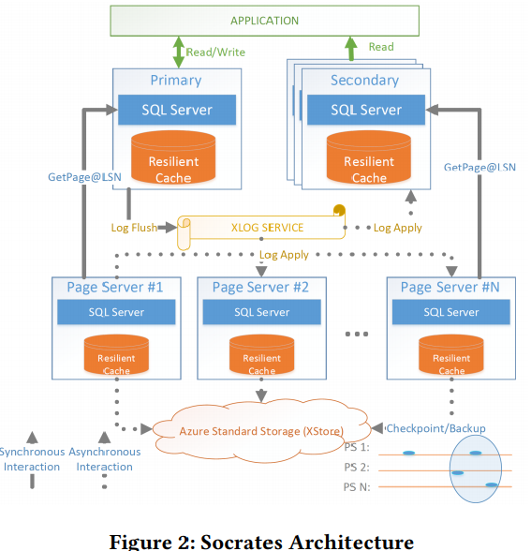
4. Socrates Architecture [ii]
red: “stateless”, only main-memory
blue: the “true” DB, persistent storage
4.2. Socrates Architecture Overview
Tier 1: Compute Nodes
1 Primary*: read/write ops
>=1 Secondaries*: read ops, fail-overs
→ RBPEX support
Tier 2: XLOG / Logging Service
Primary*: flushes to XLOG
Secondaries*: asynch log pulls
Tier 3: Page Servers / Storage Tier
Page Servers: keep DB partition in main-memory, serve page requests from Tier 1, execute storage ops (e.g. checkpoints+backups)
Tier 4: Azure Storage Service (XStore)
independent storage service
Page Servers: use it as persistent storage of checkpoints+backups (asynch)

Slide 11
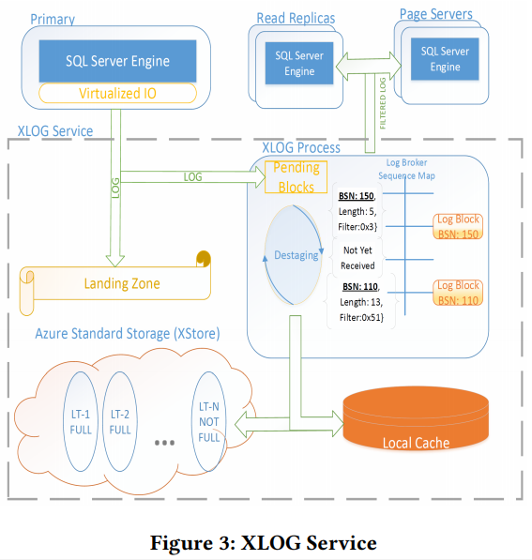
4. Socrates Architecture [iii]
4.3. XLOG Service
1a: Primary → *LZ:
synchronous + reliable: durability
1b: Primary → XLOG Process:
asynchronous: availability
2 → 3: Pending Area → LogBroker:
hardened blocks ready for dissemination
+archiving
3 → 4 + 3 → 5: destaging:
3→4 for fast access, 3→5 for retention
[*1→2→3→4+5 pipeline, no block removed from
LZ unless destaged, limits throughput of update
transactions]
3 → 6a+6b: LogBroker → Consumers:
pull on-demand from *memory hierarchy
6a+6b (Consumers)
XLOG Process
1b
2
1a
3
(LZ / Azure Premium Storage XIO)
5
4
(local SSD)
(LT / Azure XStore)
Notes:
“hardered blocks”: bc 1a+1b happen in parallel, 1b might cause a secondary compute node to get a page before the page is made durable in the LZ, which may result into inconsistencies if the page won’t make it to the LZ at the end. only hardened blocks (i.e. the ones that have made it to the LZ) can proceed further into the XLOG process. the primary is the one that updates the states of the blocks in the pending queue.
*1→2→3→4+5 pipeline limits throughput of update transactions ⇒ if destaging is slow, and LZ is full, no transactions can be processed.
grafei sto LZ g n eksasfalisei oti to log tha einai kapou asfales/DURABLE k n proxwrisei thn ergasia t k stelnei k sto XLOG asynchrona g n kserei oti einai AVAILABLE k g ta ypolipa components t Socrates ta opia eksipiretounte apo to XLOG on-demand (they PULL what they need). akoma, xrisimopiontas pali MRU approach k performance-based storage-hierarchy, g thn eksipiretisi twn requests t XLOG tier ginete elegxos sta diafora ierarxias mnimis p to apartizoun, me thn seira p fenete sto slide...

Slide 12
4.3 [more about] XLOG Service
*Landing Zone (LZ):
very fast and reliable storage service with SAN-like capabilities
currently implemented with Azure Premium Storage (XIO) in SQL DB Hyperscale
pluggable service [ → Appendix A]
limited capacity (expensive), at some point dumped to LT
*memory hierarchy:
1 - Sequence Map (main memory hashmap of log blogs, owned by LogBroker)
2 - Local SSD Cache
3 - LZ
4 - Long-Term Storage (LT)

Slide 13
4. Socrates Architecture [iv]
4.4. Primary Compute Nodes
Unaware of other replicas, remote storage, separation of log
Differences from on-premise SQL Server:
Storage level ops delegated (e.g. backups) to lower tiers
Log “flushed” to LZ using virtualized filesystem mechanism (Virtual I/O Stack…)
RBPEX cache
Only hot portion of DB in cache: GetPage@LSN mechanism:
→ getPage(pageId, LSN): returns a version of the page with updates at least up to LSN
- pageId: desired page
- LSN: Log Sequence Number (log entry no.)
→ Why?
- (primary) applies WAL protocol; hardens log on XLOG tier.
- evicts page from buffers to make space.
- wants to read from evicted page → issues request with latest LSN that concerns the
page.
* Page Servers (Storage tier) applies log up to LSN to requested page, returns page.
Notes:
Differences of THIS primary from the traditional one in SQL Server
WAL: write-ahead logging protocol: first record/harden log on stable storage and THEN apply updates to the DB itself
Primary node maintains a hash map with highest LSN that concern the pages it evicts. This works for the primary because primary is the only one that updates pages, therefore all page requests will retrieve the latest page version in the DB

Slide 14
4. Socrates Architecture [v]
4.5. Secondary Compute Node
Similarities (with HADR):
log-replicated state machines
read-only transactions with Snapshot Isolation
query processor, security manager, transaction manager
Differences:
Do not persist log blocks
Apply relevant log-records (pulled from XLOG) to keep cached pages up to date
Ignore all other log-records received
Unaware of log producer (i.e. Primary’s identity)
Have only hot data pages
Race Conditions (GetPage@LSN)
RACE #1: Concurrent cache page-look-up and getPage request.
SOLUTION: Requests registered before issued, look-ups put in queue
RACE #2: B-tree index: parent node in cache, but not child node, and getPage request of child
returns with childLSN > parentLSN. What if child was split at x, x ε (parentLSN, childLSN)?
SOLUTION: Inconsistency detection, pause to allow log-apply thread to refresh stales, restart traversal

Slide 15
4. Socrates Architecture [vi]
4.6. Page Servers
Pull (from the XLOG) and apply log records that affect their partition
maintain all data in their main memory (RBPEX cache)
→ permits XStore failures: even if Page Sever fails while unavailable, cache is recoverable, no data loss
→ permits XStore batch writes (max throughput): XStore fails, resumes from last checkpoint*, no data loss
"stride-preserving cache layout“: dense cache organization for read amplification avoidance
→ 1 I/O request from Compute Nodes translated into 1 I/O for serving the request at Page Servers
(only on-way applicable)
(layered) shared-disk architecture → asynchronous seeding of new Page Servers
Responsible for XStore interaction: checkpointing* + backups
Notes:
XLOG can decide which log blocks to send to which page server by reading the metadata of each log-block (by pulling we mean that the consumers ask for more log recs when they can handle them, but the XLOG service decides what to send). The Primary Compute Node includes information about which partitions are affected by the log block at reference.
One-way applicable: Compute Nodes DO suffer from read amplification, when receiveing the multi-page response to their page-server request

Slide 16
4. Socrates Architecture [vii]
4.7. XStore for Durability and Backup/Restore
XStore = Azure's Storage Service
Specs:
Cheap
Slow
Durable: replication to 6 nodes, across 3 Availability Zones*
Efficient Backup & Restore: Log-Structured Design keeps all versions of pages (only append),
restoring enabled by adding timestamps to page-versions
→ Point-In-Time-Restoration (PITR) based on snapshots and page metadata/timestamps
"In other words, XStore plays in Socrates the same role as hard disks and tape in a traditional database system. The main-memory and SSD caches (RBPEX) of Compute nodes and Page Servers play in Socrates the same role as main memory in a traditional system."
=>Hard Disks
Notes:
- Azure’s Availability Zones are physically separated locations to which the data are stored/maintained: durability in the sense of eliminating the single-point-of-failure that results from using machines in the same data center.

Slide 17
5. Socrates at Work
Socrates mini-services are Primary, Secondaries, XLOG and Page Server.
Socrates mini-services are autonomous, decouple and communication is asynchronous whenever possible.
They do not need to know about other mini-services.
Synchronization is done by time travel or by waiting if a mini-service is behind.

Slide 18
6. Discussion & Socrates Deployments
Separate Compute and Storage
Build scalable database systems
Establish a more fine-grained pay-as-you-go model
Can become more expensive as it needs to access remote servers
Socrates minimum deployment consist a single Compute Node and a Page Server with downside the availability.
To achieve higher availability, need to add number of Secondaries and number of Page Servers

Slide 19
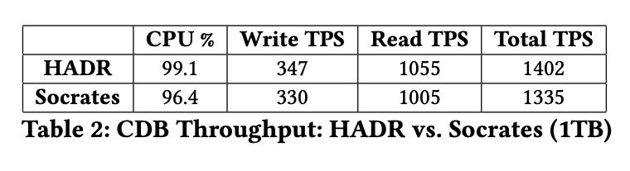
7. Performance Experiments and Results [i]
HADR architecture as a baseline
Two different deployments:
Production
Test (LZ: XIO vs DirectDrive)
CDB Default Mix, Throughput,
Production Cluster
Lose 5% of CPU Utilization
Need to wait longer for remote I/Os

Slide 20
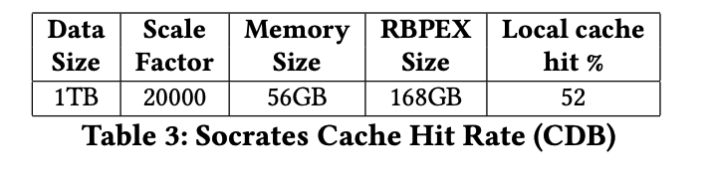
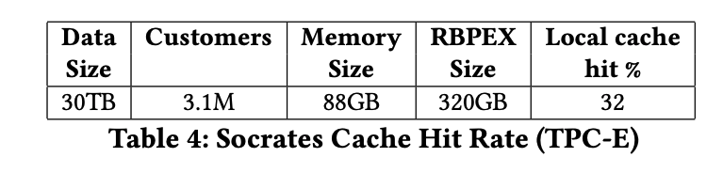
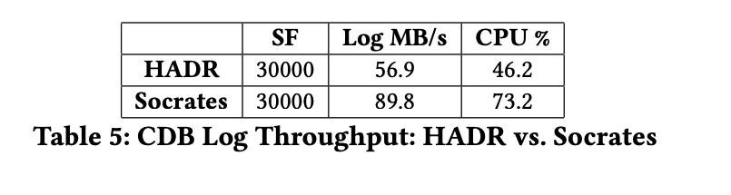
7. Performance Experiments and Results [ii]
2) Caching Behavior
HADR hit rate is 100%
Randomly touches pages across the entiry database.
3) Update-heavy CDB, Log Throughput
The log is the bottleneck for both

Slide 21
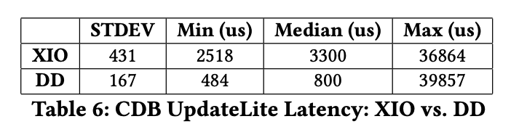
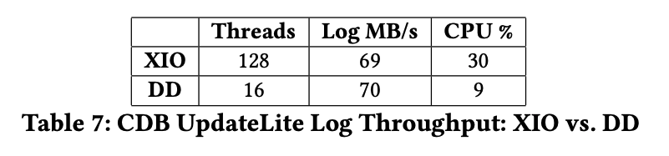
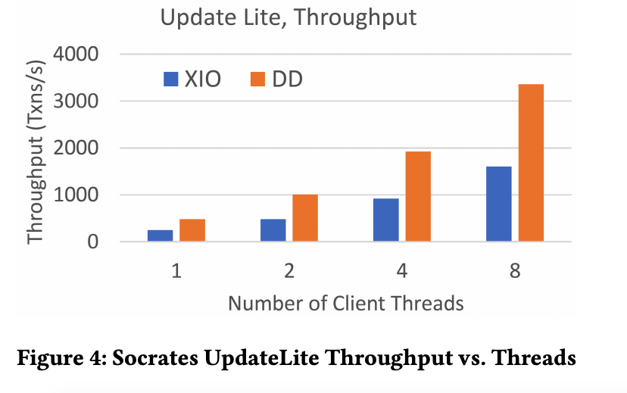
+ Appendix A
Test cluster, XIO vs DirectDrive (DD)
Implement the LZ
DD has better min and median latency
Socrates benefits nicely from such innovations as DD
XIO needs 8x the load to achieve the same log throughput as DD and three times the CPU

Slide 22
8. Conclusion
Socrates is a novel architecture
It relies on separating Compute and Storage
Socrates allows to flexibly meet customer requirements
Future work include exploring multi-master variation for Socrates, better Hybrid transaction/analytical processing (HTAP) support and making use of the log for other services.

Slide 23
References [i]
[1] 2018. CDB/DTU benchmark. https://docs.microsoft.com/en-us/azure/sql-database/sql-database-service-tiers-dtu.
[2] 2018. Microsoft SQL Hyperscale. https://docs.microsoft.com/en-us/azure/sql-database/sql-database-service-tier-hyperscale.
[3] 2018. Oracle Cloud Database. https://cloud.oracle.com/database/.
[4] Hal Berenson, Phil Bernstein, Jim Gray, Jim Melton, Elizabeth O’Neil, and Patrick O’Neil. 1995. A Critique of ANSI SQL Isolation Levels. In SIGMOD 1995.
[5] Philip A. Bernstein, Colin W. Reid, and Sudipto Das. 2011. Hyder - A Transactional Record Manager for Shared Flash. In CIDR 2011.
[6] Dhruba Borthakur. 2017. The Birth of RocksDB-Cloud. http://rocksdb.blogspot.com/2017/05/the-birth-of-rocksdb-cloud.html.
[7] Peter Braam, Sean Roberts, Matthew O’Keefe, and David Bonnie. 2016. The Limits of Open Source in Extreme-scale Storage Systems Design. https://docplayer.net/62056362-The-limits-of-open-source-in-extreme\-scale-storage-systems-design.html.
[8] Matthias Brantner, Daniela Florescu, David Graf, Donald Kossmann, and Tim Kraska. 2008. Building a Database on S3. In SIGMOD 2008.
[9] Alain Bui and Hacène Fouchal (Eds.). 2002. OPODIS 2002. Studia Informatica Universalis, Vol. 3.

Slide 24
References [ii]
[10] Brad Calder, Ju Wang, Aaron Ogus, Niranjan Nilakantan, Arild Skjolsvold, Sam McKelvie, Yikang Xu, Shashwat Srivastav, Jiesheng Wu, Huseyin Simitci, Jaidev Haridas, Chakravarthy Uddaraju, Hemal Khatri, Andrew Edwards, Vaman Bedekar, Shane Mainali, Rafay Abbasi, Arpit Agarwal, Mian Fahim ul Haq, Muhammad Ikram ul Haq, Deepali Bhardwaj, Sowmya Dayanand, Anitha Adusumilli, Marvin McNett, Sriram Sankaran, Kavitha Manivannan, and Leonidas Rigas. 2011. Windows Azure Storage: a highly available cloud storage service with strong consistency. In SOSP 2011.
[11] James C. Corbett, Jeffrey Dean, Michael Epstein, AndrewFikes, Christopher Frost, JJ Furman, Sanjay Ghemawat, Andrey Gubarev, Christopher Heiser, Peter Hochschild, Wilson Hsieh, Sebastian Kanthak, Eugene Kogan, Hongyi Li, Alexander Lloyd, Sergey Melnik, David Mwaura, David Nagle, Sean Quinlan, Rajesh Rao, Lindsay Rolig, DaleWoodford, Yasushi Saito, Christopher Taylor, Michal Szymaniak, and Ruth Wang. 2012. Spanner: Google’s Globally-Distributed Database. In OSDI 2012.
[12] Michael J. Franklin, Björn Þór Jónsson, and Donald Kossmann. 1996. Performance Tradeoffs for Client-Server Query Processing. In SIGMOD 1996.
[13] Jim Gray, Pat Helland, Patrick E. O’Neil, and Dennis E. Shasha. 1996. The Dangers of Replication and a Solution. In SIGMOD 1996.
[14] Jim Gray and Andreas Reuter. 1990. Transaction Processing: Concepts and Techniques.

Slide 25
References [iii]
[15] Per-Åke Larson, Spyros Blanas, Cristian Diaconu, Craig Freedman, Jignesh M. Patel, and Mike Zwilling. 2011. High-Performance Concurrency Control Mechanisms for Main-Memory Databases. PVLDB 5, 4 (2011).
[16] Simon Loesing, Markus Pilman, Thomas Etter, and Donald Kossmann. 2015. On the Design and Scalability of Distributed Shared-Data Databases. In SIGMOD 2015.
[17] David B. Lomet, Alan Fekete, GerhardWeikum, and Michael J. Zwilling. 2009. Unbundling Transaction Services in the Cloud. In CIDR 2009.
[18] C. Mohan, Don Haderle, Bruce Lindsay, Hamid Pirahesh, and Peter Schwarz. 1992. ARIES: A Transaction Recovery Method Supporting Fine-granularity Locking and Partial Rollbacks Using Write-ahead Logging. TODS 17, 1 (1992).
[19] Mendel Rosenblum and John K. Ousterhout. 1992. The Design and Implementation of a Log-Structured File System. TOCS 10, 1 (1992).
[20] Alexandre Verbitski, Anurag Gupta, Debanjan Saha, Murali Brahmadesam, Kamal Gupta, Raman Mittal, Sailesh Krishnamurthy, Sandor Maurice, Tengiz Kharatishvili, and Xiaofeng Bao. 2017. Amazon Aurora: Design Considerations for High Throughput Cloud-Native Relational Databases. In SIGMOD 2017.

