Slide 1

DASH :
Database Shadowing for Mobile DMBS
Youjip Won, Sundoo Kim, Juseong Yun, Dam Quang Tuan, Jinwon Seo
KAIST, Daejeon, Korea Hanyang University, Korea
ywon@kaist.ac.kr {sksioi12|yjs05|damquangtuan|seojiwon}@hanyang.ac.kr
Technical Paper Presentation
Christakis Achilleos
https://www.cs.ucy.ac.cy/~dzeina/courses/epl646/

Slide 2
Database Shadowing (DASH):
DASH is a new crash recovery technique for SQLite DBMS. DASH is a hybrid mixture of classical shadow paging and logging.
DASH addresses four major issues in the current SQLite journal modes:
Performance and write amplification issues of the rollback mode.
Storage space requirements.
Tail latency issues of the WAL mode.
https://www.cs.ucy.ac.cy/~dzeina/courses/epl646/

Slide 3
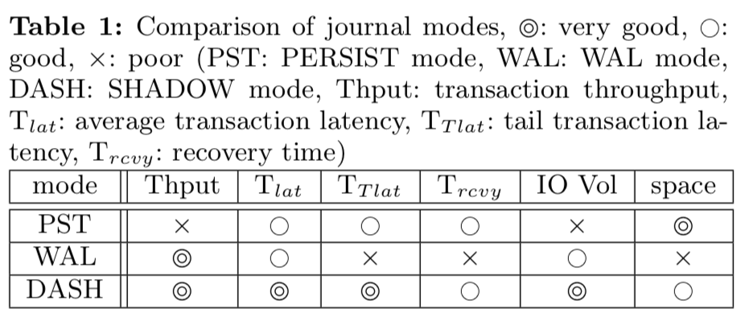
Contribution
Aggregate Update, Atomic Exchange and Version Reset collectively reinvent shadow paging and full file shadowing into a new crash recovery scheme, called Database Shadowing.
Database Shadowing effectively relieves the order preserving overhead of rollback journaling of SQLite.Database Shadowing enforces the storage order of the metadata update operations without calling fdatasync().
https://www.cs.ucy.ac.cy/~dzeina/courses/epl646/

Slide 4
SQLite Concurrency control
SQLite is a library-based DBMS and accounts for more than 70% of all IOs on the android platform.
SQLite achieves concurrency control in a serial fashion using an exclusive lock.
Autocommit mode:
SQLite writes the updated database pages back to the database file when the transaction finishes (force)
SQLite writes the updated database pages to the database file only after the transaction finishes (no-steal)
https://www.cs.ucy.ac.cy/~dzeina/courses/epl646/

Slide 5
SQLite Crash recovery
SQLite provides two types of Crash recovery modes:
Rollback journaling
Write-Ahead-Logging (WAL)
https://www.cs.ucy.ac.cy/~dzeina/courses/epl646/

Slide 6
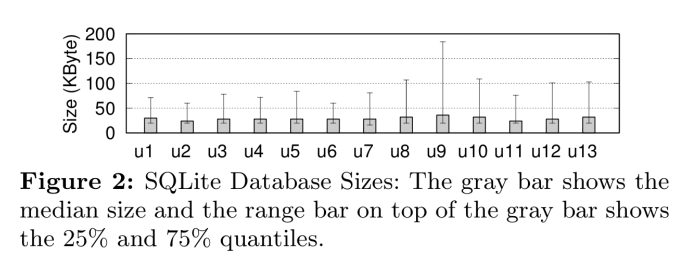
Database Size of SQLite
The database files are very small. 80% of the database files shown are less than 100KB.
https://www.cs.ucy.ac.cy/~dzeina/courses/epl646/

Slide 7
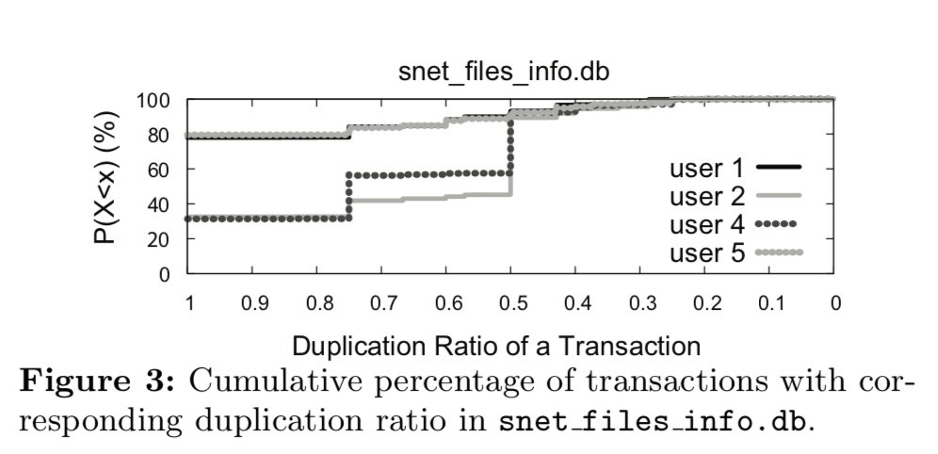
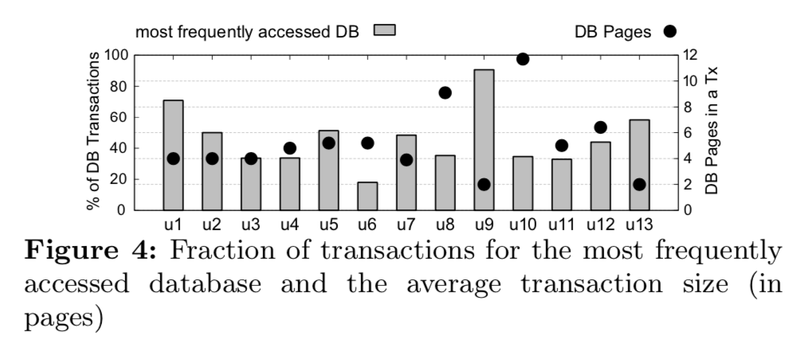
Database Access
80% of the transactions update the same database pages as the preceding transaction. For user 4 and user 5, 90% of the transactions share more than half of the database pages with the preceding transaction. In the snet_files_info.db database, the average duplication ratio of a transaction is 90%.
The most frequently accessed databases include snet_files_info.db, es0.db, accounts.db and savepoint.db. These databases are updated by automatic system activities and not by the user. They amount to 40% of the activity
https://www.cs.ucy.ac.cy/~dzeina/courses/epl646/

Slide 8
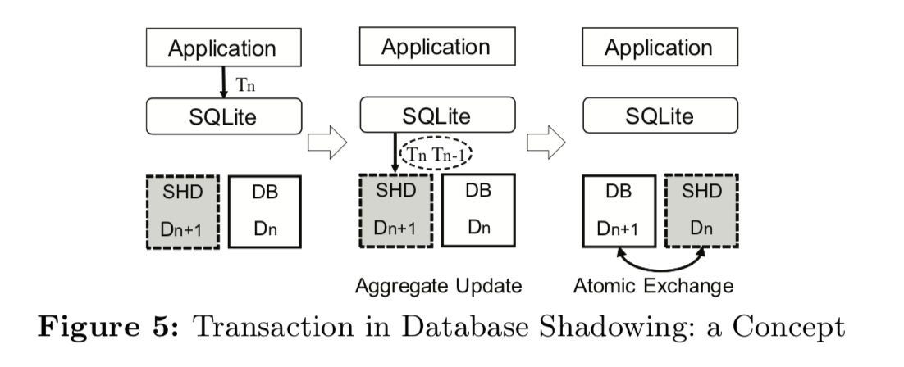
Database Shadowing
DASH defines a shadow file for each database file; the roles of the shadow and database files switch on each transaction commit. The database file contains the most recent state written by the latest committed transaction Tn (and all previous transactions); the shadow file contains the state written by the previous transaction or Tn−1 (and the previous ones). When one executes a new transaction Tn+1, the updates are written to the shadow file with the updates from Tn. It is called Aggregate Update. After Tn+1 commits, the DBMS switches the database and shadow files so that the newly designated database file represents the most recent state of the database. It is called Atomic Exchange.
https://www.cs.ucy.ac.cy/~dzeina/courses/epl646/

Slide 9
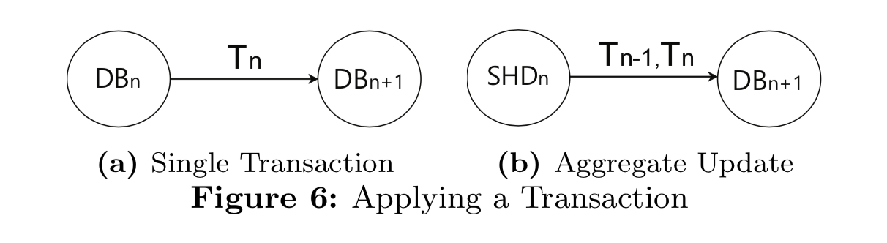
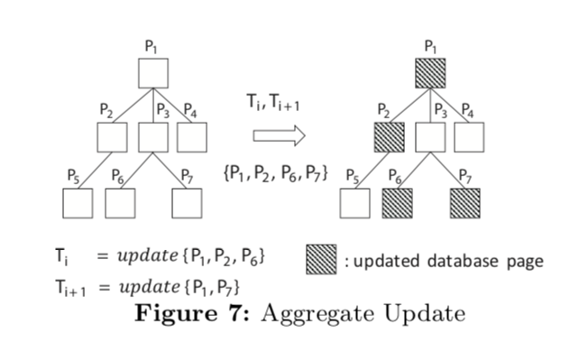
Aggregate Update
In Aggregate Update, the DBMS reads the database pages that need to be updated by the incoming transaction, modifies them, aggregates them with the updated pages associated with the most recently committed transaction and writes them together to the shadow file.
https://www.cs.ucy.ac.cy/~dzeina/courses/epl646/

Slide 10
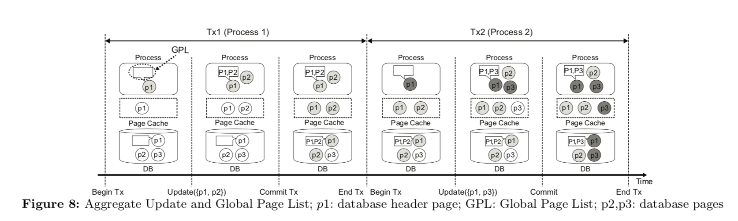
Global Page List
We introduce Global Page List to address the situation where two consecutive transactions are associated with different processes.
If the following transaction is associated with a different process from the preceding one, the process that issues the following transaction cannot determine the updated pages associated with the preceding transaction since they reside in different address space.
https://www.cs.ucy.ac.cy/~dzeina/courses/epl646/

Slide 11
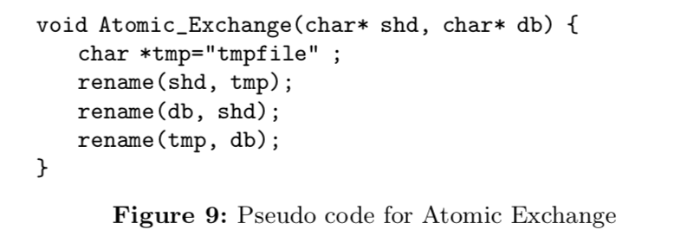
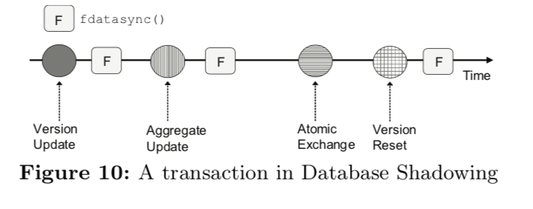
Atomic Exchange
Atomic Exchange exchanges the hard links of the associated directory entries.
We implement Atomic Exchange with three rename() calls. rename(char* old, char* new) atomically changes the name of the hard link from old to new.
https://www.cs.ucy.ac.cy/~dzeina/courses/epl646/

Slide 12
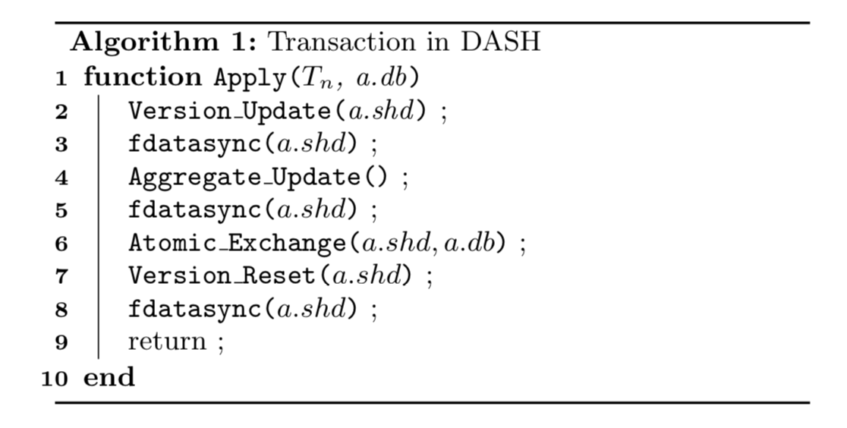
A transaction in DASH
A transaction in Database Shadowing consists of three phases; (i) Version Update, (ii) Aggregate Update and Atomic Exchange, and (iii) Version Reset.
Version Update and Version Reset are used to denote when a transaction has begun and when it has finished.
https://www.cs.ucy.ac.cy/~dzeina/courses/epl646/

Slide 13
Version Update
Task completed by this phase:
Check whether the preceding transaction has successfully committed.
Check whether the local copies of the database pages are up-to-date.
Update the version number of the shadow file
The Version number is used in the first two tasks.
https://www.cs.ucy.ac.cy/~dzeina/courses/epl646/

Slide 14
Version Reset
Version Reset sets the version number of the shadow file to zero.
It updates the header block of the Shadow File.
In the recovery routine the DBMS checks if the version number is zero, if it is then that means the preceding transaction finished successfully.
The DBMS can use fdatasync() for only this one block and makes the result of Version Reset durable.
https://www.cs.ucy.ac.cy/~dzeina/courses/epl646/

Slide 15
Implementation Complexity
DASH uses the same libraries as SQLite.
DASH needs 424 LOC to implement the entire functionality. For comparison, PERSIST mode requires 618 LOCs and WAL requires 581 LOCs to implement
The complexity of DASH was measured using Cyclomatic Complexity. The score is 115 for DASH which is 33% less than PERSIST(177) and WAL(172).
https://www.cs.ucy.ac.cy/~dzeina/courses/epl646/

Slide 16
Exclusive Connection
In the case where the database file is exclusively used by a dedicated application the database pages in the local buffer are guaranteed to be up-to-date. This allows for the DBMS to not need to check at the start of each transaction for the local buffer.
In DASH when SQLite closes the database connection, i.e. end of transaction, SQLite zero-fills the entire header of the shadow file(100 byte), called a Header Reset. This also sets the version number to zero. Therefore when the next transaction starts, the DBMS just needs to check if the version number is zero, otherwise it takes the previous state of the database file that exists and starts the recovery procedure.
https://www.cs.ucy.ac.cy/~dzeina/courses/epl646/

Slide 17
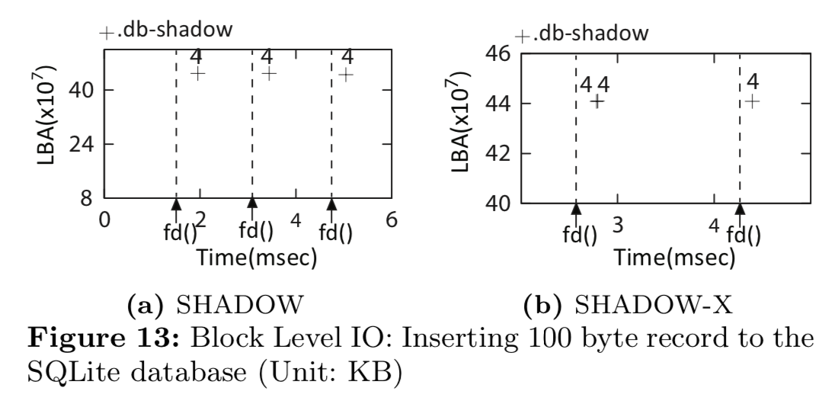
Experiment
In an experiment to test DASH we used Database Shadowing and Database Shadowing with an exclusive connection and named them SHADOW and SHADOW-X respectively.
In Mobibench, we perform the database transaction 10,000 times in each experiment. We vary the number of operations in a transaction from 1 to 20.
We compare the performance of four journal modes: PERSIST, WAL, SHADOW and SHADOW-X.
https://www.cs.ucy.ac.cy/~dzeina/courses/epl646/

Slide 18
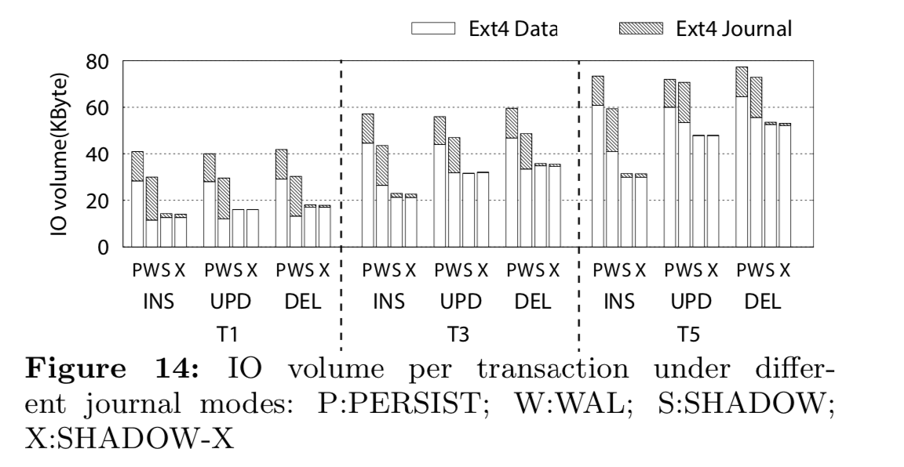
IO Volume
Here we can see the comparisons with 1, 3 and 5 operations per transaction (denoted T1, T3 and T5) with a total of 10000 transactions each.
SHADOW mode reduces the IO volume per transaction by as much as 1/3 compared to PERSIST mode (T1 case)
https://www.cs.ucy.ac.cy/~dzeina/courses/epl646/

Slide 19
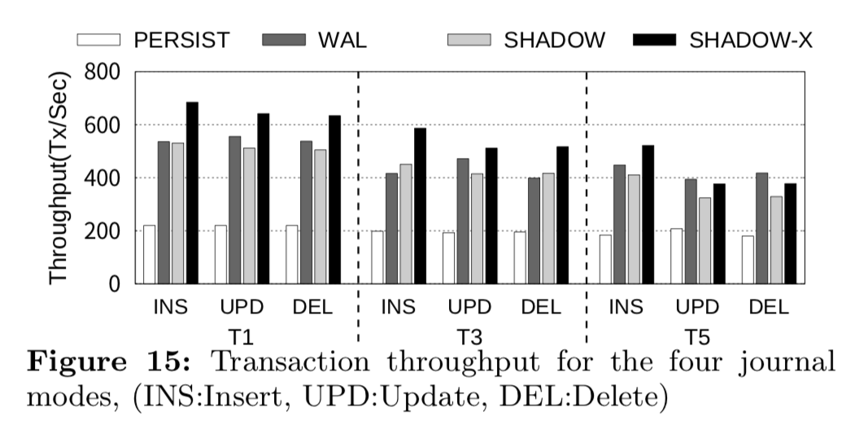
Transaction Throughput
For insert transactions, SHADOW mode has at least twice the throughput of PERSIST mode in T1, T3, and T5. Compared to WAL mode, the SHADOW mode shows a similar throughput. and SHADOW-X performs 25% better. This performance improvement is attributed to the reduced flush operations (fdatasync()) in a transaction from three in SHADOW mode to two in SHADOW-X.
https://www.cs.ucy.ac.cy/~dzeina/courses/epl646/

Slide 20
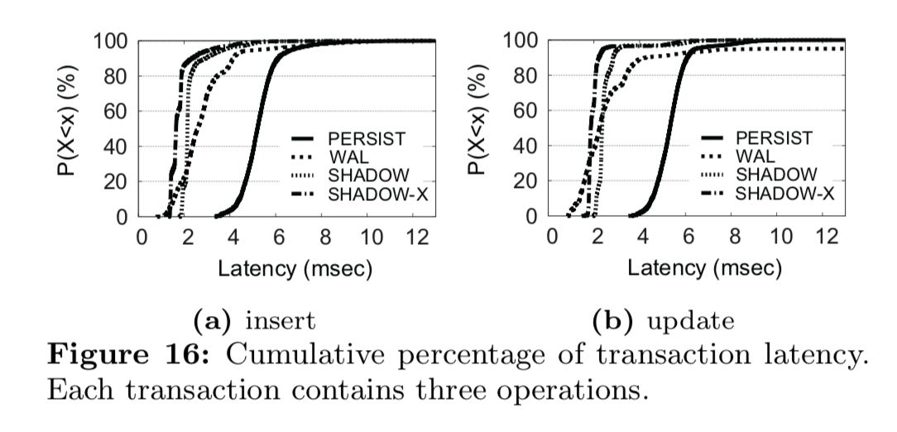
Transaction Latency
For the average latency, both SHADOW mode and WAL mode exhibit the best behavior. The average latency in SHADOW-X mode is approximately 20% smaller than that of SHADOW mode. PERSIST mode exhibits the worst behavior in average latency. For insert operations, the average transaction latency in SHADOW mode is 40% that of PERSIST mode.
https://www.cs.ucy.ac.cy/~dzeina/courses/epl646/

Slide 21
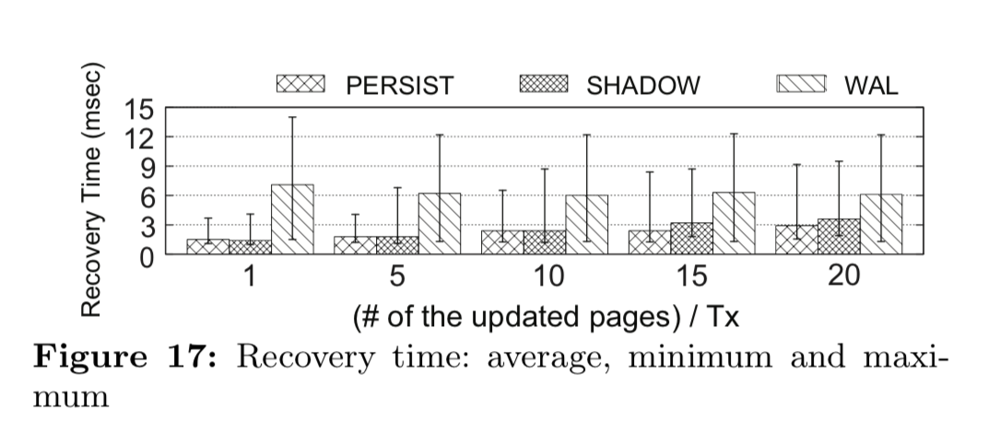
Recovery Overhead
PERSIST mode yields the best recovery time in all cases. SHADOW mode performs nearly as good as PERSIST mode. For larger transaction sizes, PERSIST mode exhibits slightly shorter recovery latency than DASH. WAL mode exhibits the worst recovery overhead among the three journal modes. For a transaction with five records, the recovery time in SHADOW mode is 1/3 of that in WAL mode.
https://www.cs.ucy.ac.cy/~dzeina/courses/epl646/

Slide 22
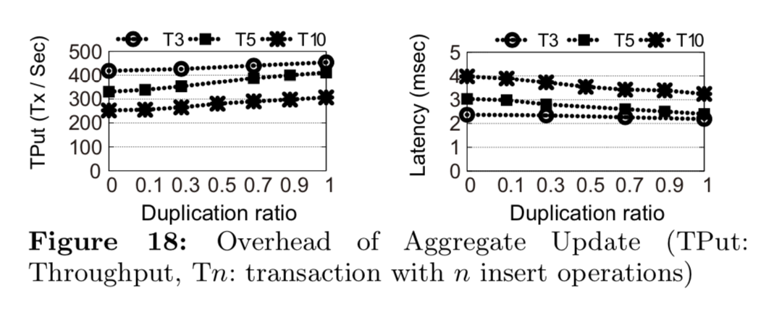
Aggregate Update Overhead
This experiment shows that the redundancy caused by the Aggregate Update does not have significant performance overhead. Even when the consecutive transactions do not share any pages, the performance overhead of Aggregate Update is less than 8% against when the individual transactions are executed separately.
https://www.cs.ucy.ac.cy/~dzeina/courses/epl646/

Slide 23
Conclusions
A new crash recovery scheme
Aggregate Update, Atomic Exchange and Version Reset collectively make Database Shadowing an effective crash recovery technique for SQLite.
When the database file is small and database transactions are serialized, Database Shadowing well addresses the issues in SQLite such as transaction throughput, average and tail latencies of the transaction, recovery time, IO volume and storage space requirements for journaling.
https://www.cs.ucy.ac.cy/~dzeina/courses/epl646/

Slide 24
Thank you!
Questions;
cachil01@ucy.ac.cy
https://www.cs.ucy.ac.cy/~dzeina/courses/epl646/

