Slide 1

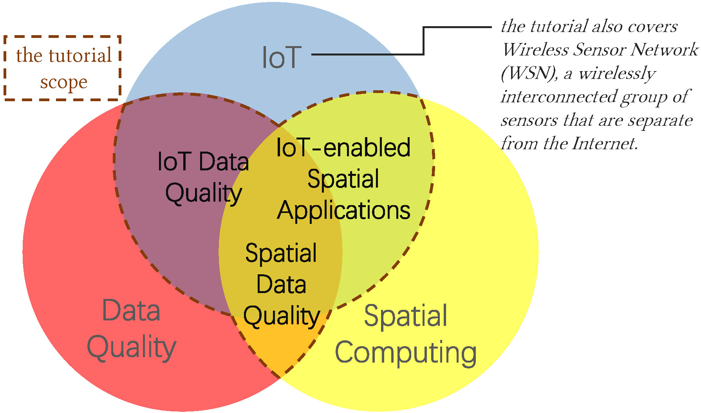
Spatial Data Quality in the IoT Era: Management and Exploitation
Huan Li, Bo Tang, Hua Lu, Muhammad Aamir Cheema, and Christian S. Jensen
In Proceedings of the 2022 International Conference on Management of Data (SIGMOD ‘22)
Association for Computing Machinery, New York, NY, USA, 2474–2482
CS 646: Advanced Topics in Databases
Dimitris Papazachariou (dpapaz02@ucy.ac.cy)

Slide 2
Outline
Internet of Things (IoT)
Spatial IoT data (SID)
SID quality framework
SID quality management
Exploitation of low-quality SID
Trends and future directions

Slide 3
Outline
Internet of Things (IoT)
Spatial IoT data (SID)
SID quality framework
SID quality management
Exploitation of low-quality SID
Trends and future directions

Slide 4
Internet of Things (IoT)
The Internet of things (IoT) describes physical objects (or groups of such objects) with sensors, processing ability, software and other technologies that connect and exchange data with other devices and systems over the Internet or other communications networks.
[https://en.wikipedia.org/wiki/Internet_of_things]

Slide 5
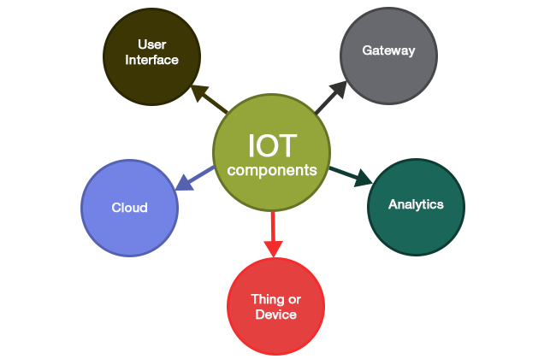
IoT components
sensors/devices collect data from their environment
sensors/devices connect to the cloud through a variety of methods
data is sent to the cloud
software performs data processing
information made available to the end-user
https://www.aapnainfotech.com/iot-beginners-perspective/

Slide 6
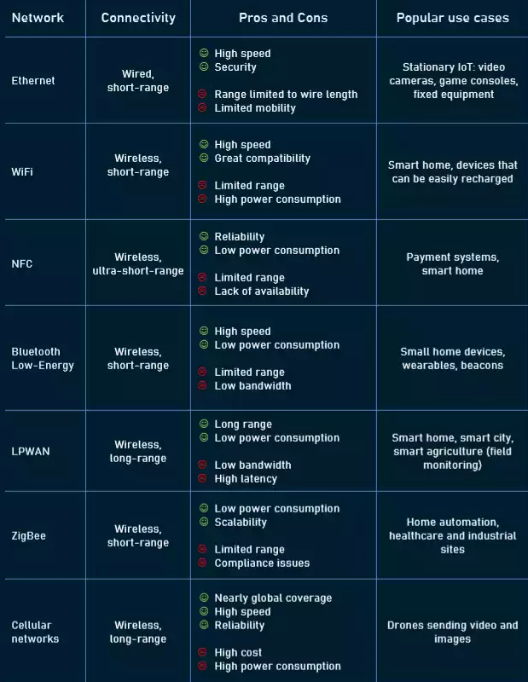
Networking technologies
Near Field Communication (NFC)
Low Power Wide Area Network (LPWAN)
https://www.altexsoft.com/blog/iot-architecture-layers-components/

Slide 7
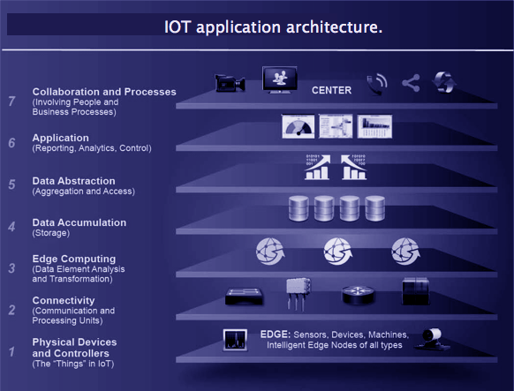
IoT architecture
https://data-flair.training/blogs/iot-architecture/

Slide 8
IoT applications
Healthcare
Transportation
Smart homes
Smart cities
Agriculture
Energy
Asset tracking
Waste management
…

Slide 9
IoT statistics
2025
41.6 billions IoT devices
79.4 zettabytes (ZB) of data
1 ZB = 10²¹ Bytes
[https://futureiot.tech/idc-forecasts-connected-iot-devices-to-generate-79-4zb-of-data-in-2025/]

Slide 10
IoT vulnerabilities
IoT devices are particularly vulnerable to network attacks:
data thefts
phishing attacks
spoofing
denial of service attacks (DDoS attacks)
These can lead to other cyber security threats:
ransomware attacks
data breaches
[https://www.cm-alliance.com/cybersecurity-blog/iot-security-5-cyber-attacks-caused-by-iot-security-vulnerabilities]

Slide 11
Outline
Internet of Things (IoT)
Spatial IoT data (SID)
SID quality framework
SID quality management
Exploitation of low-quality SID
Trends and future directions

Slide 12
Spatial IoT data (SID)
Spatially referenced data from IoT devices
Trajectories (time series of location values)
Spatiotemporal IoT data (STID) (general sensory values with temporal and spatial references)

Slide 13
SID quality issues
IoT devices are often limited by production specifications and resources (erroneous, incomplete, duplicated spatial information)
IoT is decentralized and includes a wide range of dynamic devices (excessive, disordered, inconsistent data)
IoT devices use diverse positioning technologies, causing the spatial information generated to be heterogeneous (incompatible formats, resolutions, and semantics)

Slide 14
Outline
Internet of Things (IoT)
Spatial IoT data (SID)
SID quality framework
SID quality management
Exploitation of low-quality SID
Trends and future directions

Slide 15
SID quality framework
SID should be:
accurate and reliable
comprehensive and informative
easy to use

Slide 16
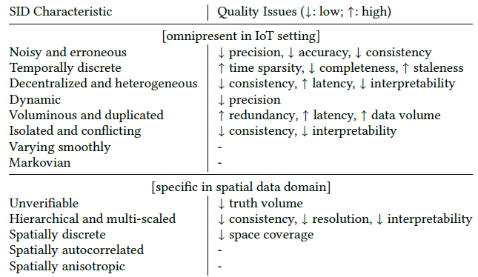
SID characteristics and quality issues

Slide 17
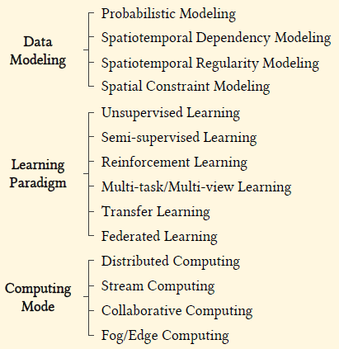
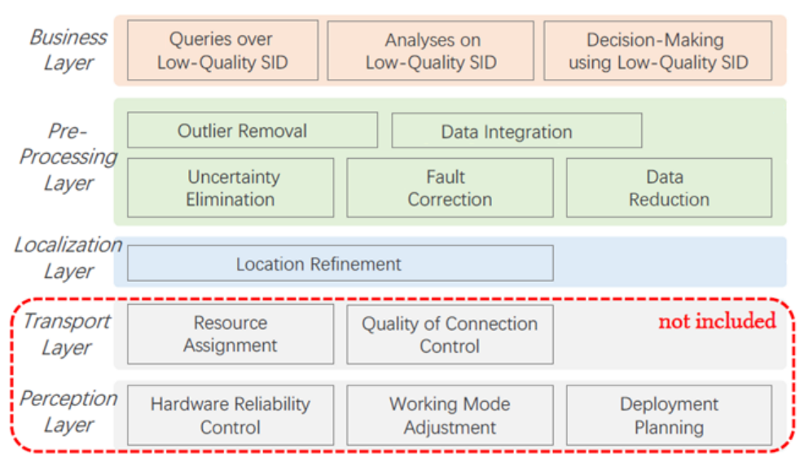
Means to resolve data quality issues
Task Perspective
Technique Perspective

Slide 18
Means to resolve data quality issues:
Task Perspective

Slide 19
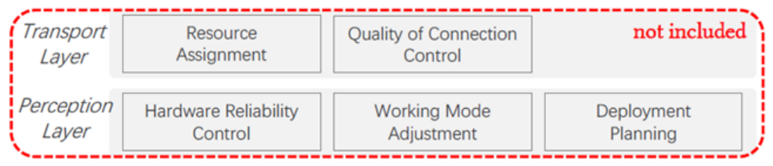
Perception and Transport Layers
The Data Quality (DQ) tasks in the perception and transport layers optimize mainly the infrastructure

Slide 20
Localization Layer
Localization layer: estimates object locations (produces spatial data)
Key task: Location Refinement (accompanies or follows the positioning process and adjusts initial location estimates to reduce system and random errors)
Main goals: ↑ precision ↑ accuracy ↑ resolution

Slide 21
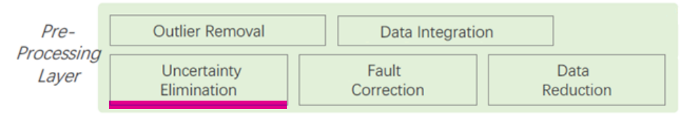
Pre-processing Layer [1/5]
Pre-processing layer: manages SID, encompassing DQ tasks that explicitly target improvements of input data quality
Key task: Uncertainty Elimination (reduces uncertain or imprecise measurements and imputes unknown measurements at unsampled points)
Main goals: ↑ precision ↑ completeness ↑ resolution ↓ time sparsity

Slide 22
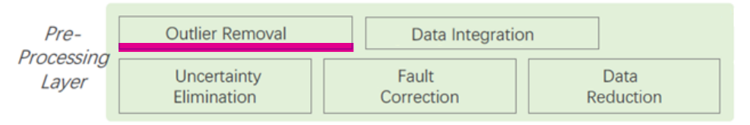
Pre-processing Layer [2/5]
Key task: Outlier Removal (detects and removes items in a collection that do not conform to their context)
Main goals: ↑ precision ↑ accuracy ↑ consistency

Slide 23
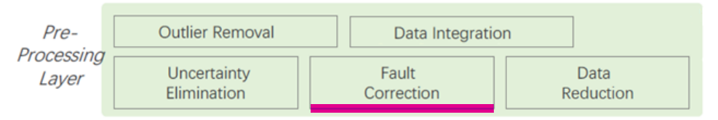
Pre-processing Layer [3/5]
Key task: Fault Correction (finds and repairs wrong, conflicting, or missing data values)
Main goals: ↑ accuracy ↑ consistency ↑ completeness

Slide 24
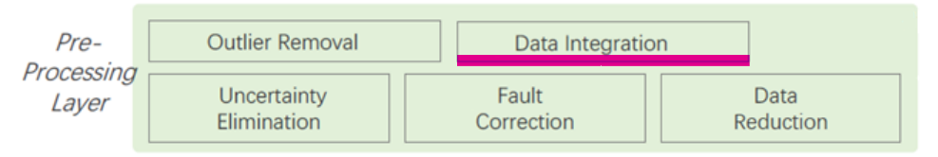
Pre-processing Layer [4/5]
Key task: Data Integration (obtains a unified data representation by comparing, combining, and fusing data sets from multiple sources)
Main goals: ↑ accuracy ↑ completeness ↑ consistency ↑ data volume
↑ resolution ↑ interpretability

Slide 25
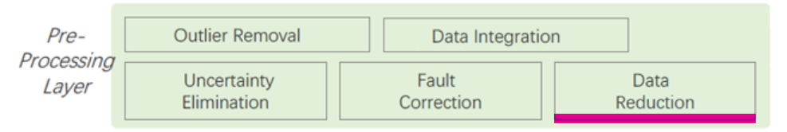
Pre-processing Layer [5/5]
Key task: Data Reduction (converts a data set into a corrected and simplified form)
Main goals: ↓ data volume ↓ latency ↓ redundancy

Slide 26
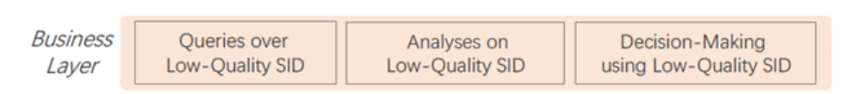
Business Layer
The DQ tasks in the business layer aim to ensure that the data can support specific needs of diverse spatial applications
Key task: Queries, Analyses, and Decision-Making using Low-Quality SID
Different subcategories of these tasks consider different DQ issues

Slide 27
Means to resolve data quality issues:
Technique Perspective
They apply to:
Business Layer
Pre-processing Layer
Localization Layer
They may be combined

Slide 28
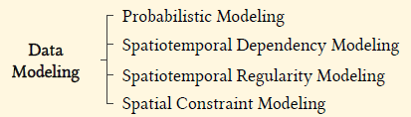
Data Modeling
Probabilistic Modeling (combats uncertainty and noise by generating probabilistic representations of observations or results)
Spatiotemporal Dependency Modeling (derives spatiotemporal correlations from the inherent characteristics of SID)
Spatiotemporal Regularity Modeling (discovery and extraction of spatial and temporal regularities from SID collections)
Spatial Constraint Modeling (utilizes additional spatial and motion constraints to contend with noisy, incomplete, and faulty SID)

Slide 29
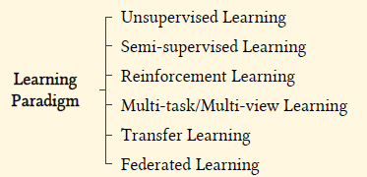
Learning Paradigm
Unsupervised Learning (scarcity of labels [ground-truth data])
Semi-supervised Learning (partial availability of labels)
Reinforcement Learning (incompleteness and dynamics in sequential decision-making)
Multitask Learning and Multi-view Learning (scarcity of labels and bias/heterogeneity of data in training)
Transfer Learning (limited data availability and biased data, borrowing labeled data or knowledge from related domains)
Federated Learning (scarcity of data across multiple domains and facilitate decentralized model training)

Slide 30
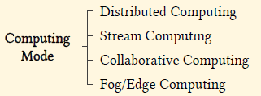
Computing Mode
Distributed Computing (for improving system throughput and reducing single points of failure)
Stream Computing (for timely data exploitation)
Collaborative Computing (for improving consistency, completeness, and availability of SID with multiple computing nodes and their data involved)
Fog/Edge Computing (for reducing data volumes, redundancy, latency, and staleness of SID by pushing computing tasks closer to data sources)

Slide 31
Outline
Internet of Things (IoT)
Spatial IoT data (SID)
SID quality framework
SID quality management
Exploitation of low-quality SID
Trends and future directions

Slide 32
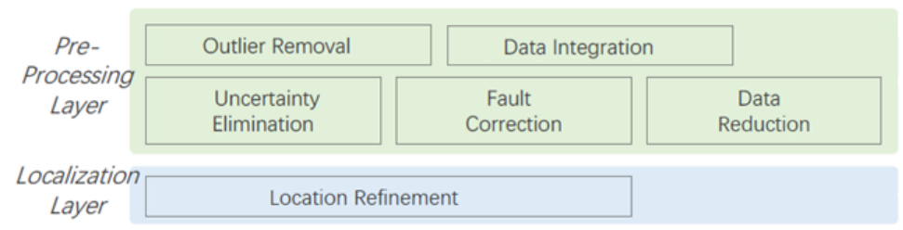
SID Quality Management
Location Refinement
Uncertainty Elimination
Outlier Removal
Fault Correction
Data Integration
Data Reduction

Slide 33
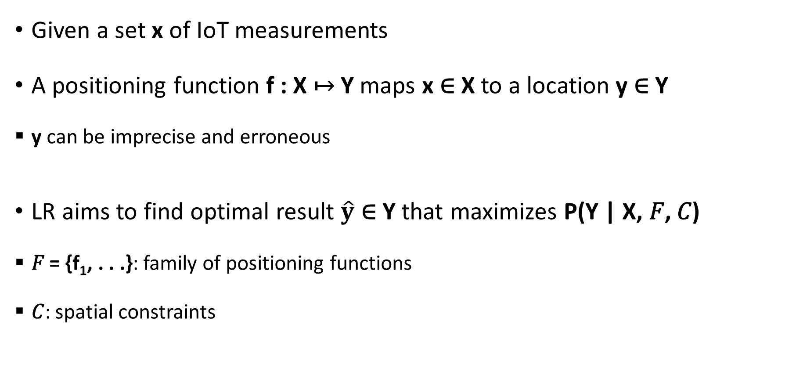
Location Refinement (LR)
Given a set x of IoT measurements
A positioning function f : X ↦ Y maps x ∈ X to a location y ∈ Y
y can be imprecise and erroneous
LR aims to find optimal result $\hat{y}$ ∈ Y that maximizes P(Y | X, 𝐹, 𝐶)
𝐹 = {f₁, . . .}: family of positioning functions
𝐶: spatial constraints

Slide 34
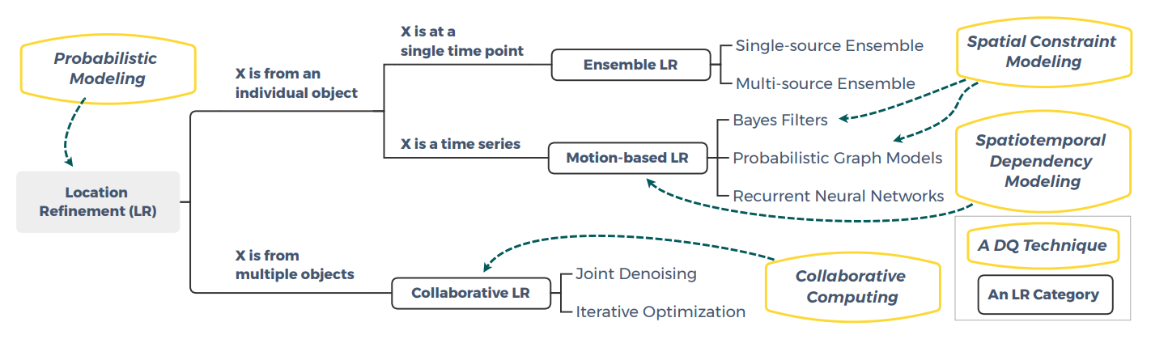
Categories of LR technologies

Slide 35
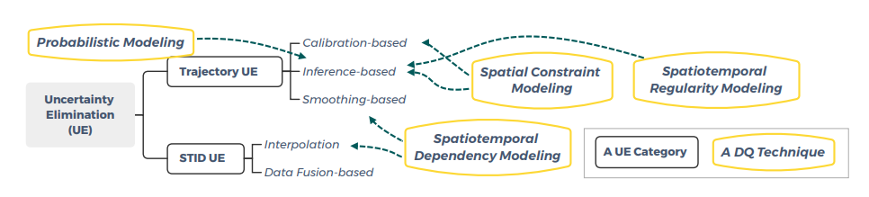
Categories of UE technologies

Slide 36
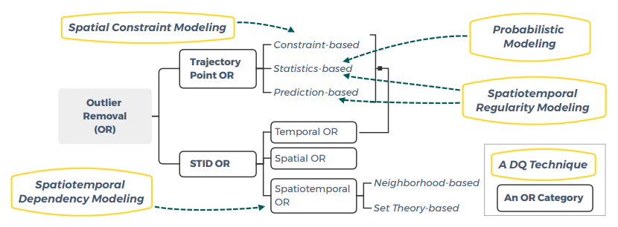
Categories of OR technologies
Spatiotemporal outliers
Items whose thematic attribute values deviate clearly from those of other items in their spatial and temporal neighborhoods

Slide 37
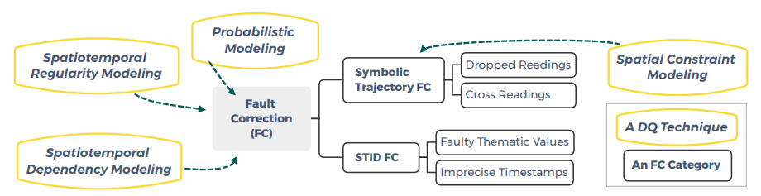
Categories of FC technologies
False Negatives (Dropped Readings): a sensor fails to detect an object
False Positives (Cross Readings): a sensor fails to detect movement of object (an object is detected by multiple sensors simultaneously)

Slide 38
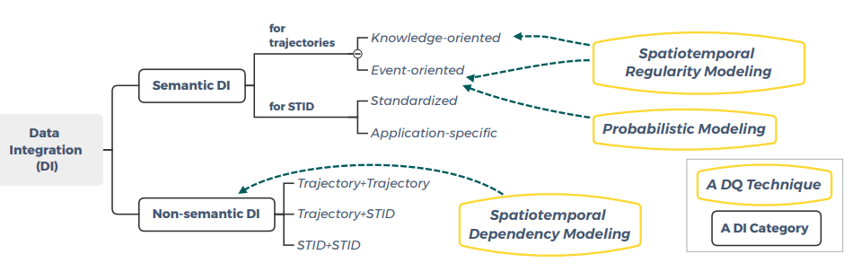
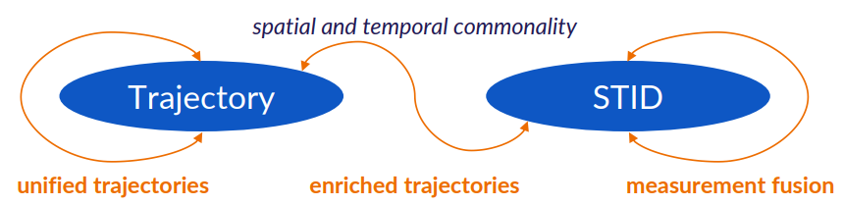
Categories of DI technologies

Slide 39
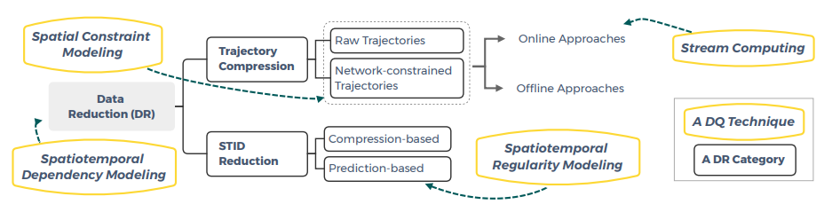
Categories of DR technologies
Online Approaches (only buffered points are accessible)
Offline Approaches (all points are accessible)

Slide 40
Outline
Internet of Things (IoT)
Spatial IoT data (SID)
SID quality framework
SID quality management
Exploitation of low-quality SID
Trends and future directions

Slide 41
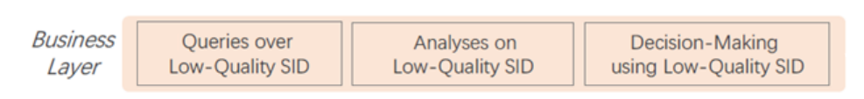
Exploitation of low-quality SID

Slide 42
Queries over Low-Quality SID
Data Uncertainty
Data Dynamics obstacles to effective and efficient SID query processing
Data Decentralization

Slide 43
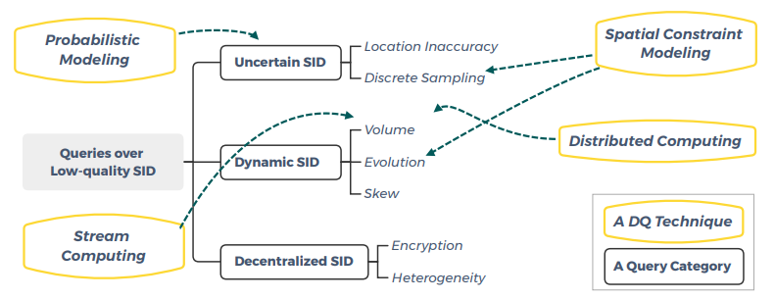
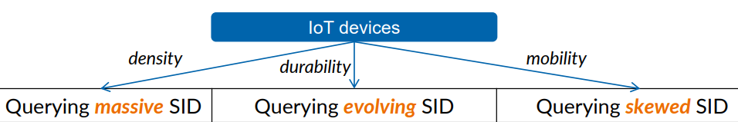
Categories of queries over low-quality SID

Slide 44
Analyses on Low-Quality SID
Uncertainty in SID
Dynamics (Volume and Evolution) in SID

Slide 45
Analyses of Uncertain SID
Uncertainty in SID
Data inaccuracy and incompleteness
Tasks: clustering, anomaly detection, frequent-pattern mining, popular-route discovery
Existing techniques: batch-oriented and centralized
Opportunities: techniques for real-time and decentralized settings

Slide 46
Analyses over Dynamic SID
Dynamics (Volume and Evolution) in SID
Tasks: clustering, anomaly detection, frequent-pattern mining, event discovery
Opportunities: services to IoT edge, reduce cost/latency

Slide 47
Decision-Making using Low-Quality SID
Predictions (e.g., next location, traffic volume, spatiotemporal variables)
Recommendations (e.g., recommendation of POIs)
Planning (e.g., task assignments)
Scarcity of labels
Limited availability and bias of data
Uncertainty of data
Dynamics of data
Heterogeneity and decentralization of data

Slide 48
Outline
Internet of Things (IoT)
Spatial IoT data (SID)
SID quality framework
SID quality management
Exploitation of low-quality SID
Trends and future directions

Slide 49
Emerging Trends
Privacy-preserving computing
Edge/Fog computing
Reinforcement and incremental learning
Comprehensive data fusion for improved DQ

Slide 50
Privacy-preserving computing
Effective generation and exploitation of encrypted or obscured SID
IoT data may include sensitive data
SID is often encrypted, obscured, anonymized, or hidden, to address privacy requirements
Studies on effective queries, analyses, and decision-making on encrypted or obscured SID
How to construct privacy-preserving data representations or effective cryptographic solutions?

Slide 51
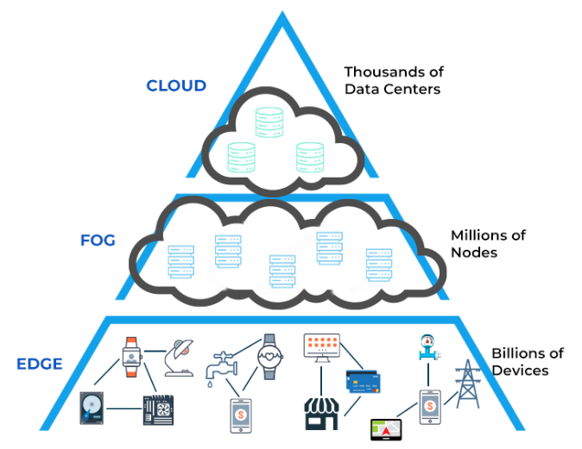
Edge/Fog computing
https://www.spiceworks.com/tech/cloud/articles/edge-vs-fog-computing/
Improving processing efficiency and reducing central, single-point workloads
Decentralized IoT architecture (data is created at the edge)
IDC (International Data Corporation): at least 40% of IoT data will be stored and processed at the edge or close to the edge
Combined with stream computing, blockchain technology, transport SDN, lightweight AI and system-on-a-chip to increase system scalability, autonomy, and economy

Slide 52
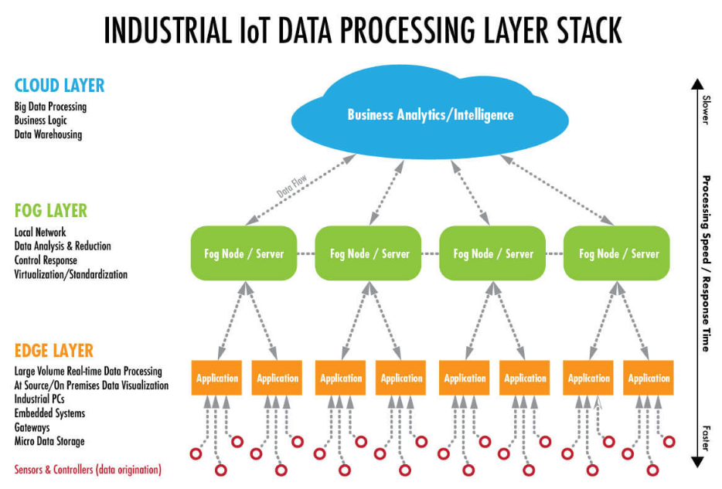
Edge/Fog computing
https://www.winsystems.com/cloud-fog-and-edge-computing-whats-the-difference/

Slide 53
Reinforcement and incremental learning
Models with corresponding capabilities of dynamic and incremental processing
SID often tracks evolving processes and is updated dynamically
Control and decision-making processes can be abstracted into reinforcement learning models whose parameters can be adjusted incrementally
Use in quality management, data analysis, and decision-making tasks on streaming and dynamically changing SID

Slide 54
Comprehensive data fusion for improved DQ
Integrating diverse and rich, but also biased, spatiotemporal data sources
Multi-source, multi-modal, and heterogeneous data is becoming increasingly available
Multi-task and multi-view learning, transfer learning, federated learning, and pre-trained models, representation learning techniques, techniques based on data integration

Slide 55
Open Issues and Future Directions
Dynamic DQ modeling
Secure SID sharing
DQ-aware task planning
Cross-layer quality management
Quality management middleware for SID

Slide 56
Dynamic DQ modeling
Millions of heterogeneous and dynamic data nodes
Effective quality modeling techniques: to guide each individual node’s data handling and interaction with other nodes

Slide 57
Secure SID sharing
Power of integrating multiple data sources
Discovery of valuable insights across IoT data repositories (IoT data repositories in silos, need to construct SID data pools)
Blockchain, federated learning techniques

Slide 58
DQ-aware task planning
A variety of quality management services (outlier removal, fault correction, compression, interpolation)
Efficient coordination of multiple DQ-related services

Slide 59
Cross-layer quality management
IoT’s layered approach that separates DQ tasks with different goals and data scopes logically
Make DQ-related services sufficiently general to support diverse applications
Modularize and containerize services
Organize the resulting modules in a cross-layer fashion e.g., through directed acyclic graph models

Slide 60
Quality management middleware for SID
To enable ubiquitous quality management of SID and to enable applications to better utilize SID
Integrate the technical directions mentioned above

Slide 61


