Slide 1

Database and Distributed Computing Foundations of Blockchains
Sujaya Maiyya Victor Zakhary Mohammad Javad Amiri
Divyakant Agrawal Amr El Abbadi Department of Computer Science, University of California, Santa Barbara Santa Barbara, California
Eleanna Nikolaou
EPL646
2023

Slide 2

CONTENTS
Introduction
Permissionless Blockchain
Bitcoins Challenges
Off Chain Transactions
Bitcoin And Nakomoto’s Consensus
PoW Puzzle
Enhancing Permissionless Blockchain Performance
Permissioned Blockchains
Permissioned Examples:
Tendermint
Hypeledger Fabric
Cross Chain Transactions

Slide 3
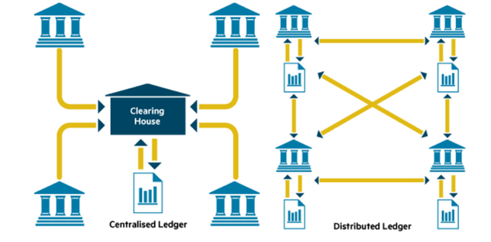
Introduction
Bitcoin was the first cryptocurrency that allowed participants to submit a transaction by replacing the trusted third person with a distributed ledger.
What is a Blockchain?
It is a decentralized linked list of blocks, each identified by its own hash ID (digest), and all together connected with a hash pointer.
2 Types:
Permissioned
Permissionless
https://www.realdolmen.com/nl/node/350
https://steemit.com/blockchain/@vedvati/fk9ewwc4x

Slide 4
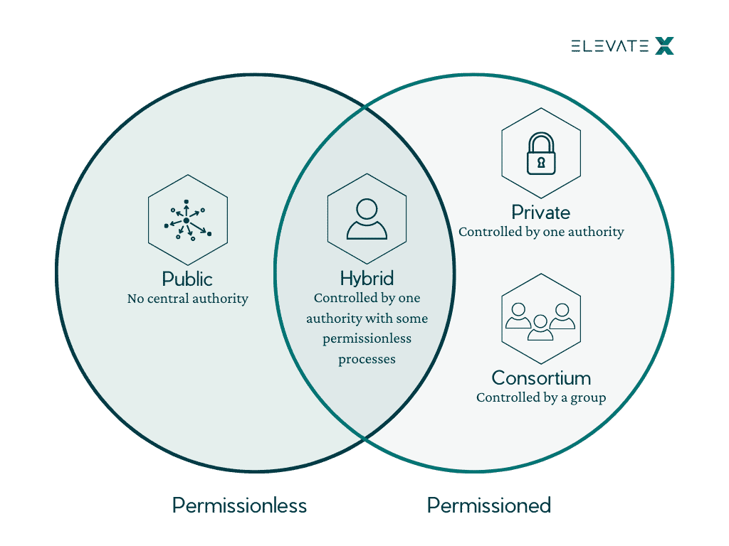
Permissionless Blockchain
Anyone can participate and contribute to the network without any restrictions or requirements for approval.
There is no central authority that controls the network, and transactions are validated and added to the blockchain by a decentralized network of nodes.
https://elevatex.de/blog/web3/4-blockchains-types-explained/

Slide 5
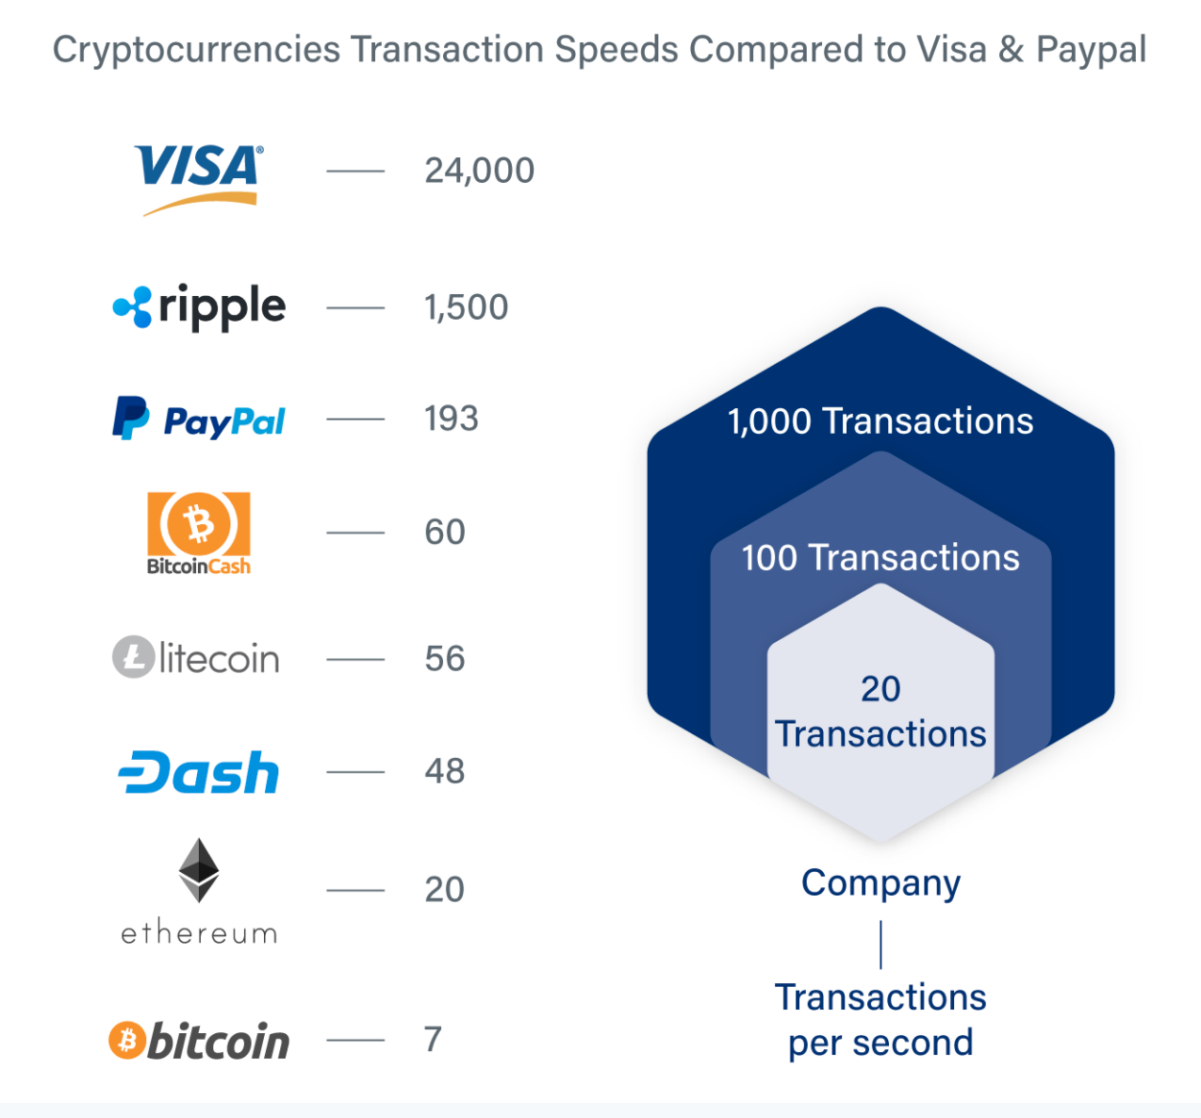
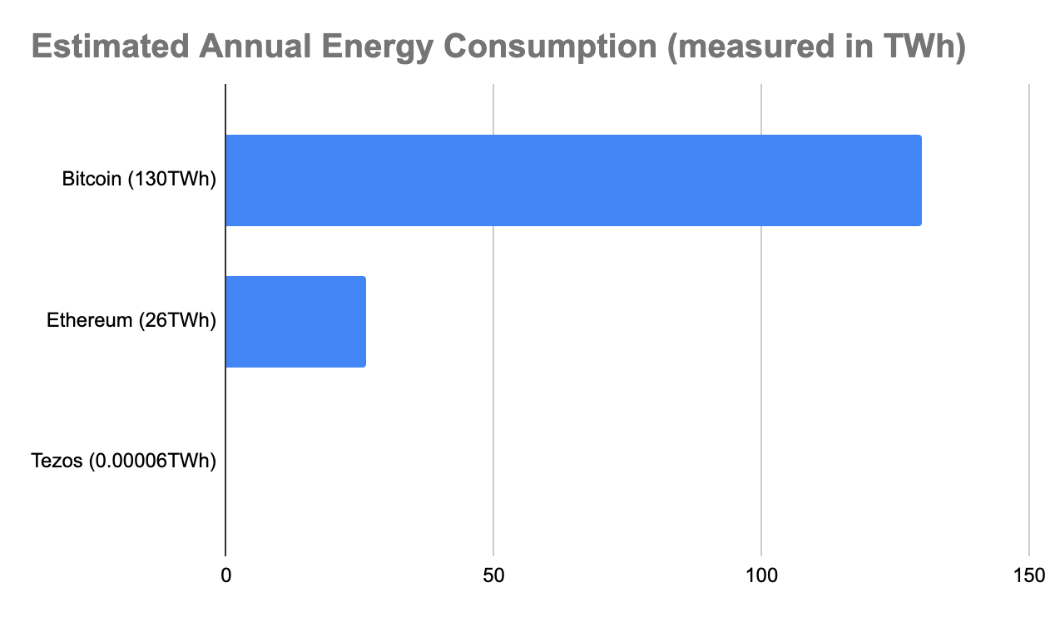
Bitcoin’s Challenges
However, Bitcoin is not known for its scalability performance.
The Reason?
The Proof of Work consensus model before every transaction .
A difficult computable puzzle, it results in a massive amount of waste.
Double spending
https://wiki.tezosagora.org/learn/baking/tezos-energy-consumption

Slide 6
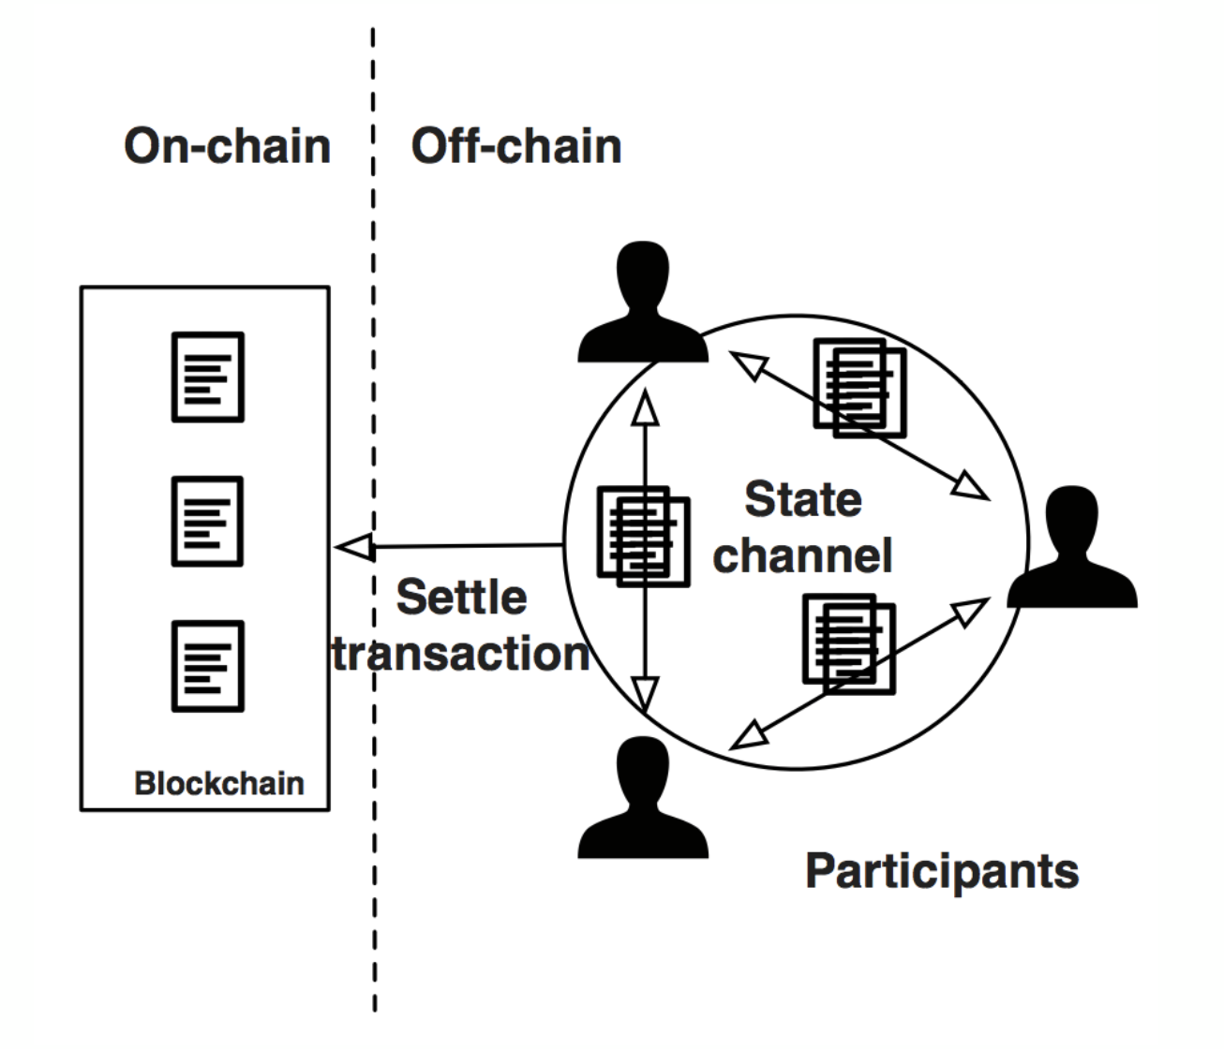
OFF CHAIN transactionS
Provides a more efficient and cost-effective way of conducting transactions
Direct micro payment transactions between untrusted participants OUTSIDE the blockchain.
Can occur through payment channels or trusted intermediaries.
Payment channel : a temporary private ledger between themselves, allowing them to execute multiple transactions without the need to record each transaction on the blockchain.
Reduce transaction fees and processing times.
How to avoid attackers ?
Hashlocks and Timelocks

Slide 7

Bitcoin and Nakomoto’s Consensus
Double Spending: A participant tries to spend the same coin twice by 2 parallel transactions
Solution ? Serial Transactions !?
Proof of work:
Computationally hard puzzle
Verifies every transaction before adding it to the blochain network.Ensures that the transaction is neither conflicting with each other nor conflicting with other transactions in any preceding block
Very few miners can successfully solve the puzzle, very high probability to be unique.
However, with low probability, more than one miner can concurrently reach a solution to the puzzle causing a fork in the blockchain
Serializability is ensured by adding verified blocks one at a time. After a block is added, the miner who "mined" this block broadcasts it to all other miners. Miners are incentivized to accept the first received block, add it to their copy of the blockchain, and immediately start mining for the next block.

Slide 8
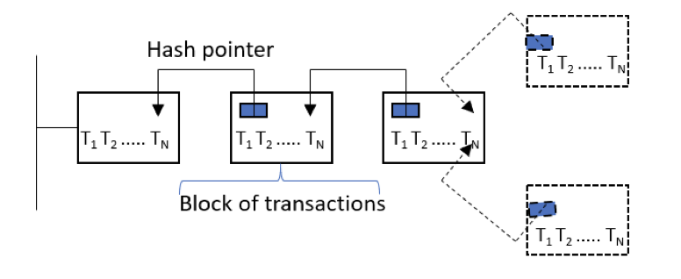
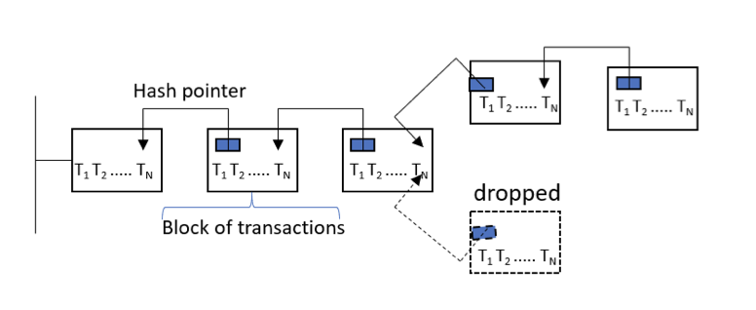
Threat to serializability and cause double spending as transactions in the two added blocks can have conflicts.
Solution ?
Divide the miners network into two groups
Εach group independently mines for the next block.
Once a block is added to either of the fork branches, miners in both groups join the longest chain and drop the other branch of the fork
Transactions in the dropped block are considered aborted and need to be resubmitted to the network again.
Τransactions should not be considered committed unless they have 6 blocks after them.
51% attack:miners can redo transaction regardless of their depth

Slide 9
PoW puzzle
The hash function takes an input string of any length and produces a fixed-length output, called a hash value or digest.
miners use specialized hardware and software to perform a brute-force search of the solution space.
Assume a puzzle that use SHA-256 algorithm. Miners needs to find the nonce value(int) .They have to solve the equitation
SHA-256 (string,nonce)=Hash digest (the more zeros it has, the harder it is)
SHA-256 (“blockchain” + nonce) =hash value starting with x000000
SHA256("blockchain0") = 0xbd4824d8ee63fc82392a6441444166d22ed84eaa6dab11d4923075975acab938 (not solved) SHA256("blockchain1") = 0xdb0b9c1cb5e9c680dfff7482f1a8efad0e786f41b6b89a758fb26d9e223e0a10 (not solved) ...
SHA256("blockchain10730895") = 0x000000ca1415e0bec568f6f605fcc83d18cac7a4e6c219a957c10c6879d67587 (solved)
To solve this puzzle, it took 10,730,896 guesses
By increasing the target by one additional leading zero (“0000000”), the same hardware took 934,224,175 guesses to solve the puzzle (completed in 1 hour, 18 minutes, 12 seconds):
SHA256("blockchain934224174") = 0x0000000e2ae7e4240df80692b7e586ea7a977eacbd031819d0e603257edb3a81

Slide 10
Enhancing Permissionless Blockchain Performance
BitcoinNG separates blocks into key-blocks and micro-blocks, increasing throughput by allowing the key-block miner to publish many micro-blocks until the next key-block is mined
ByzCoin forms a dynamically changing group of trustees who collectively decide on micro-blocks, changing by one member each time a key-block is mined, using PBFT and CoSi to obtain consensus and collectively sign the chosen block
Elastico splits servers into smaller groups called committees, with each committee responsible for processing a subset or shard of transactions, using PBFT to agree on a set of transactions, and a final committee to aggregate and run another round of PBFT to make a global, final decision on the next block
These protocols strive to improve upon the original bitcoin protocol by addressing some of its limitations and achieving better scalability, security, and efficiency.

Slide 11
Permissioned Blockchains
Permissioned:
Blockchains that are closed ,not publicly accessible.
A defined group of participants who are recognized.
Mainly use order-execute architecture and Practical Byzantine fault-tolerant protocol to achieve agreement between transactions.

Slide 12
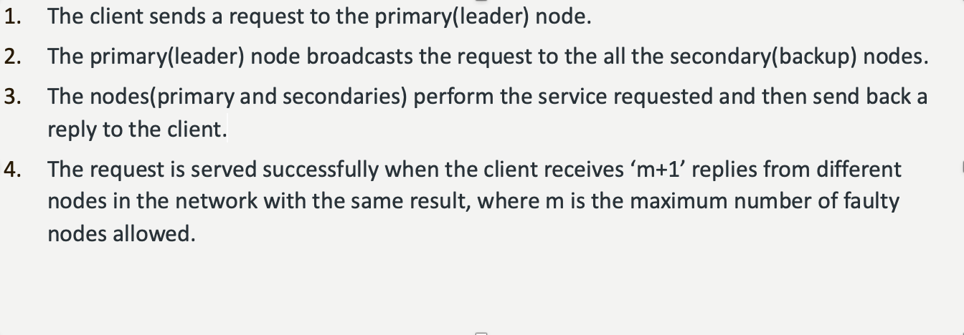
Practical byzantine fault tolerance
m<= 1/3 of all nodes

Slide 13

Tendermint
Order-execute architecture
Validators: subnet of nodes participate in the consensus
Differences from PBFT:
Must Lock their coins and have vote strength equal to the number of their locked coins -> In contrast with PBFT where each validator has equal voting power
Round Robin: In each block the leader(primary node) is different
->Spinning Protocol ,BFT

Slide 14

HypeRledger Fabric
Provides a framework for building blockchain-based solutions, including the implementation of smart contracts.
Execute-order architecture : Peers execute transactions concurrently, and then a separate set of peers, called orderers, orders the transactions using a consensus protocol.
Supports modular consensus protocols.
Smart contracts known as "chaincode" :written in programming languages such as Go or Java and can be deployed and executed on a Fabric network.
Defines the rules and conditions of a particular transaction, and once deployed on the network,
it is immutable and cannot be altered.
Hyperledger supports private channels: allow participants to transact privately without revealing their data to the entire network. Smart contracts can be deployed on private channels, enabling secure and private transactions between parties.

Slide 15
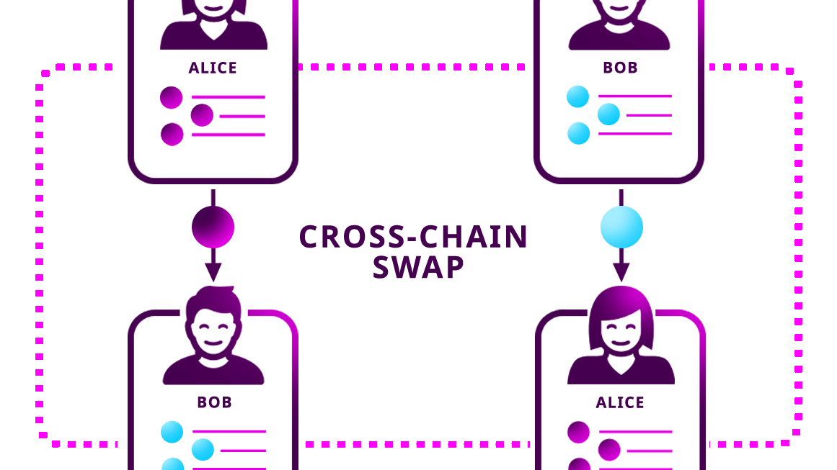
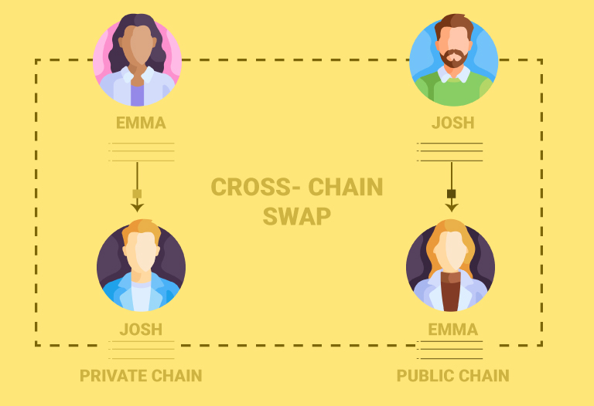
Cross Chain
cross CHAIN transaction
The transfer of assets between two different blockchain networks.
It's a transaction that takes place across multiple blockchain networks, rather than just within a single network.

Slide 16
THANK YOU ! ANY QUESTIONS ?

Slide 17
References
Practical Byzantine Fault Tolerance(pBFT) ,Geeks for Geeks https://www.geeksforgeeks.org/practical-byzantine-fault-tolerancepbft/
On-Chain vs Off-chain: Is One Better Than The Other? https://zebpay.com/blog/on-chain-vs-off-chain
Smart Contracts and Chaincode, Hyberledger Fabric Doc https://hyperledger-fabric.readthedocs.io/en/release-2.5/smartcontract/smartcontract.html
The 4 Blockchain Types Explained,Elevate X https://elevatex.de/blog/web3/4-blockchains-types-explained/
Tezos Energy Consumption , Tezos Agora wiki https://wiki.tezosagora.org/learn/baking/tezos-energy-consumption

