Slide 1

Introducing Photon: A Vectorized Query Engine for Lakehouse Environments
EPL646: Advanced Topics in Databases
By Achilleas Eftychiou: aeftyc03@ucy.ac.cy
27/4/2023

Slide 2
Agenda
Introduction
Motivation
Photon Design and Architecture
Experimental Results
Conclusion

Slide 3

Introduction
Introduce Photon as a vectorized query engine for Lakehouse environments
Developed for the Databricks Runtime
Overcomes scalability and performance limitations of JVM-based execution engine

Slide 4
DataBricks Runtime Understanding Databricks Runtime
Databricks Runtime is a highly optimized and efficient execution environment for running big data workloads
Based on Apache Spark, it provides unified analytics by combining batch processing, stream processing, machine learning, and graph processing
Offers seamless integration with popular big data storage systems like HDFS, S3, and Delta Lake
Enhanced features like autoscaling and caching to optimize performance, cost, and resource utilization
Photon query engine is specifically designed to be integrated into the Databricks Runtime, ensuring smooth transitions between operators and enhanced query processing
Provides advanced monitoring, debugging, and security features to support enterprise-grade data workloads

Slide 5
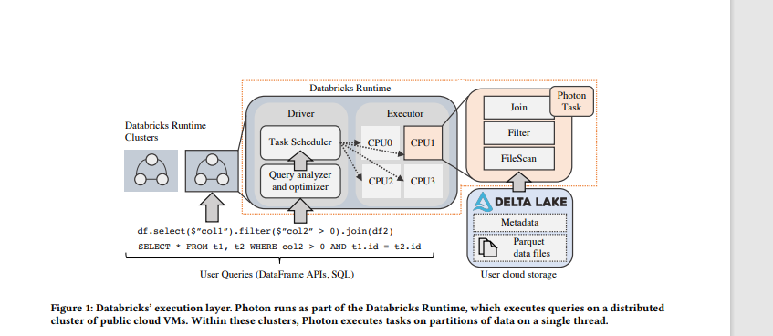

Slide 6
Motivation for Developing Photon
Importance of efficient query processing in data lakes
Challenges with existing JVM-based engines
Need for a vectorized execution model

Slide 7
Introduction to Photon
Photon's goals: Overcoming scalability and performance limitations of JVM-based execution engine
Vectorized execution model: Increased memory locality, efficient use of SIMD operations
Integration with Spark and other big data frameworks

Slide 8
Columnar Data Representation
Benefits of columnar representation: Improved memory locality, cache efficiency
Efficient use of SIMD operations: Exploiting modern CPU architectures
Comparison with row-based representation

Slide 9
Vectorized Execution Model
Advantages over code-generation models: Efficient and easy to develop, hardware utilization
Importance of runtime adaptivity: Adapting to changing data and hardware characteristics
Specialization of execution kernels: "Offline" code generation, potential for hybrid approaches

Slide 10
Runtime Adaptivity
Adapting to sparse column batches: Compaction for increased memory parallelism
Adaptive string encoding: UUID string compression, reduced data volume and execution time
Benefits of adaptivity: Improved performance and memory efficiency

Slide 11
Spilling and Memory Management
Importance of spilling in memory-constrained environments
Columnar memory management: Efficient handling of memory pressure
Integration with Spark's memory management system

Slide 12
Spilling and Memory Management
Importance of spilling in memory-constrained environments
Columnar memory management: Efficient handling of memory pressure
Integration with Spark's memory management system

Slide 13
Integration with Spark
Seamless transition between Photon and Spark operators
JNI overhead and transition nodes: Low overhead observed
Incremental rollout: Enabling Photon for millions of queries, even in unsupported scenarios

Slide 14
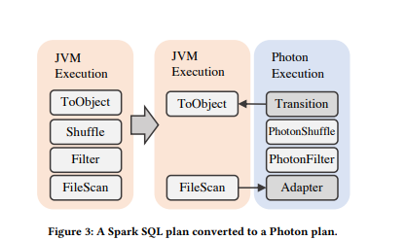

Slide 15
Experimental Results - Setup and Performance Comparison
TPC-H benchmark, AWS cluster setup, and scale factor
Overall performance improvement of Photon vs. DBR
Maximum and average speedup across all queries

Slide 16
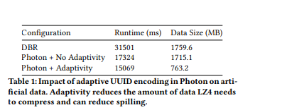

Slide 17
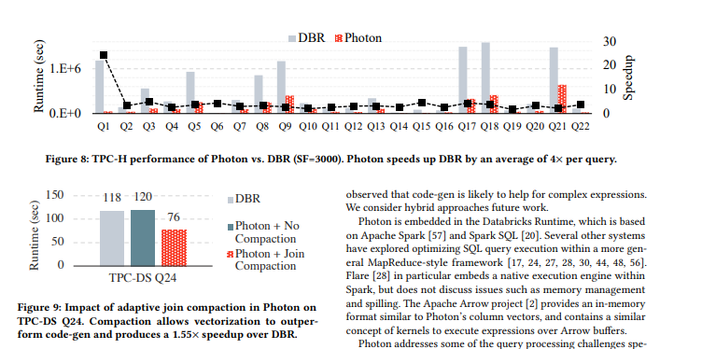

Slide 18
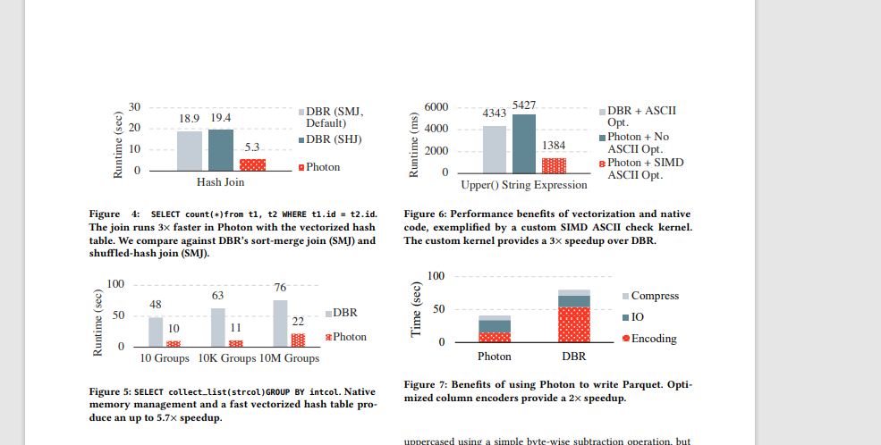

Slide 19
Query-specific Performance Improvements
Q1: Decimal arithmetic vectorization
Q6: Vectorized aggregations
Q9: Efficient large join execution

Slide 20
TPC-DS Performance and Overhead of JVM Transitions
Independent TPC-DS benchmark on DBR with Photon
TPC world record in overall benchmark
Low overhead of JVM transitions and JNI

Slide 21
Conclusion, Related Work, and Future Work
Photon: A solution for query processing challenges in Lakehouse environments
State-of-the-art performance on SQL workloads
Related Work: Brief mention of related work in vectorized execution models and database engines
Future Work: Potential hybrid approaches with code-generation models, continued optimization, and development

Slide 22

Thank you!

