Slide 1

Alibaba database
Erotokritos Erotokritou

Slide 2
Introduction
The world’s largest e-commerce platform
Millions users
Each seller is assigned to a unique MySQL instance
distributed multi-tenant databases
multiple tenants share a same set of resources (computation and storage)
transaction log database
Log data: transaction ID, seller ID, created time and transaction status, sellers’ and buyers’ nickname

Slide 3
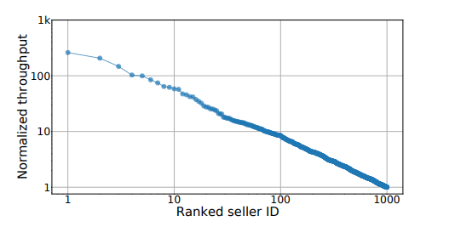
The top 10 sellers utilize the 14.14% of the total throughput

Slide 4

Skewed workloads
Imbalanced distributions of tasks or data across a infrastructure, resulting in an uneven workload distribution among resources
Some resources are overloaded
Others remain under-utilized

Slide 5
Database schema - problem
Sellers can add customized attributes such us the size, materials and weight of the products
Mysql can to add columns for all customized attributes
"attributes" column: concat customized attributes as a single string
No indexing is supported
Mysql provides operations LIKE and REGEXP but the performance is not acceptable.

Slide 6
ESDB - Elasticsearch database
Cloud document oriented database
Full-text search
Distributed indexing and querying
Encoded in JSON file format
No predefined data format
Supports flexible schema.
Handling complex queries for nested documents
We can Implement all SQL operations on ES-DSL queries

Slide 7
LOAD BALANCING requirements
Query efficiency. Data of multiple tenants should be placed on as few shards as possible in order to avoid query executions across too many shards
Load balancing. Distribution of workloads across multiple shards should be as uniform as possible in order to avoid overload on a single shard
trade-off between these two contradictory requirements by limiting data of small tenants on single shard and distributing data of large tenants across multiple shards

Slide 8
Load balancing
Sharding is a partitioning method which distributes large tables across multiple machines by a shard key (e.g., time, region, seller ID)
1-level hash of the partition key (e.g., tenant ID)
2-level hashing:
Double hashing: routes workloads to shards based two keys (i.e., tenant ID and record ID)
Dynamic secondary hashing: same as double hashing but the shards are changed dynamically based on current storage and the real-time write throughput
𝑝 = (ℎ1 (𝑘1) + ℎ2 (𝑘2) mod s) mod n

Slide 9
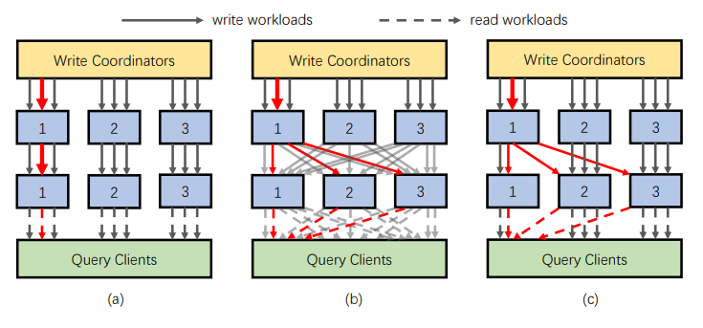

Slide 10
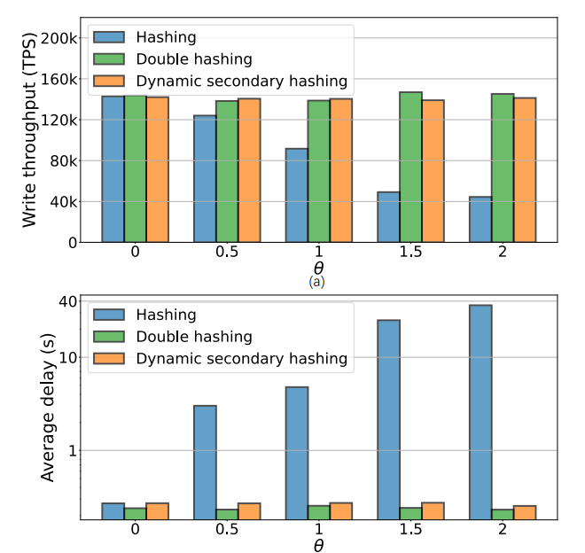

Slide 11
Frequency-based indexing
To much storage to build indexes for all sub attributes
Build indexes only for the most frequent

Slide 12
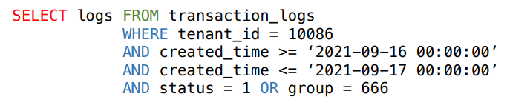
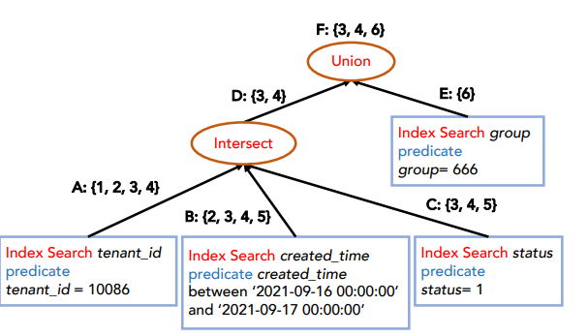

Slide 13
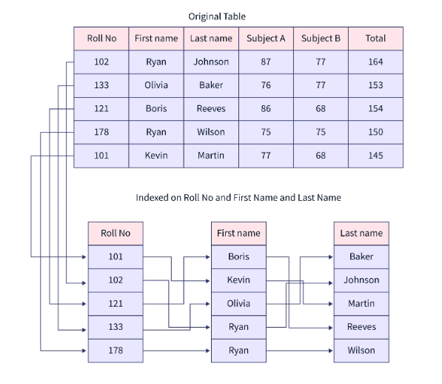
Composite index
Overhead on multicolumn queries
Index on multiple columns
With an index of two columns column1 and column2, we can use the index for queries including column1 or both column1 and column2
But we cannot use the index for queries including only the column2

Slide 14
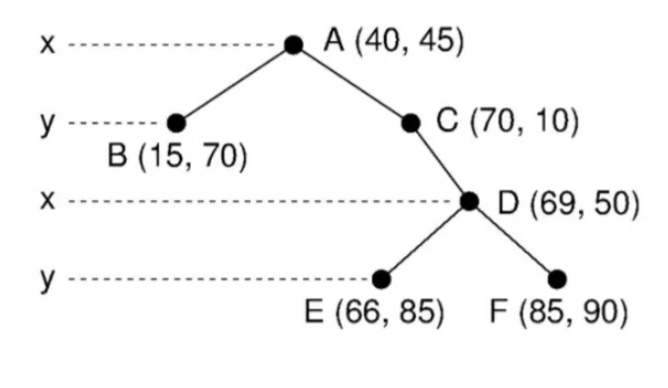
Kd trees for geo-information

Slide 15
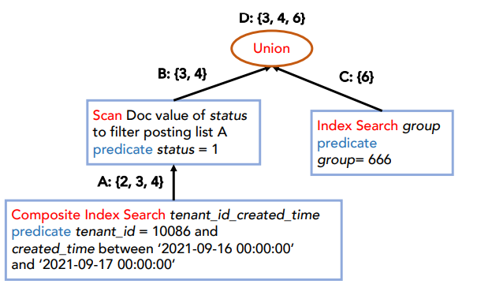
Sequential scan

Slide 16
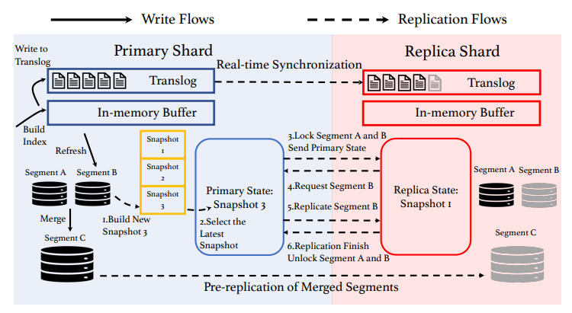
Replication

Slide 17
end

