Slide 1
Triton Join: Efficiently Scaling to a Large Join State on GPUs with Fast Interconnects
Clemens Lutz, Sebastian Breß, Steffen Zeuch, Tilmann Rabl, Volker Markl

Slide 2
Table of Contents
Introduction
Overview of GPU Architecture and Fast Interconnects
Strategies to improve parallel-radix partitioned hash join algorithm
Efficiently partitioning data over a Fast Interconnect
The Triton Join Algorithm
Experiments-Evaluation
Conclusions

Slide 3
Introduction
GPU adoption is used to speed up query processing.
The DMBSs with GPU support are particularly advantageous for join and group-by aggregation queries that are in a GPU state.
Due to a data transfer bottleneck brought on by the GPU-CPU interconnect's high latency, GPUs cannot easily scale to massive, out-of-core states.
Scalability, Robustness, and Efficiency are the three primary obstacles that must be solved in order to broaden GPU application.

Slide 4
Overview of GPU Architecture and Fast Interconnects
GPU Architecture
Threads are executed in parallel on up to 84 streaming multiprocessors(SM) by Nvidia "Volta" and AMD "Vega."
Each SM provides 65 thousands registers and consists of 32-128 cores.
Fast Interconnects
With NVLink 2.0, the GPU and CPU are connected at a combined speed of 150 GB/s (75 GB/s in each direction).
A high-speed hub and an NVLink processing unit on the CPU act as the connection's intermediaries.
They are sent packets with a payload of 1–256 bytes and a 16-byte header.

Slide 5
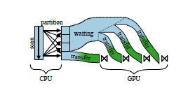
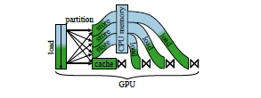
Strategies to improve parallel-radix partitioned hash join algorithm
The CPU-Partitioned Join Strategy
The aim is to retrieve the status of the join in GPU memory quickly and to reduce data transfers over the interconnect.
The GPU-Partitioned Join Strategy
The join should be computed on the GPU from beginning to end. This technique has the advantages of (1) offloading computation to the GPU and (2) smoothly scaling to out-of-core states.
Before beginning to process data on the GPU, the CPU-PJS divides state into manageable portions.
The GPU-PJS separates state and executes the join and partition phases on the GPU, spilling state if required to the CPU memory.
Notes:
The core idea of partitioned join algorithms is to increase data locality, such that we are able to store the hash table in the processor cache. Radix-partitioned hash joins have two constraints. First, the hash tables must fit into the cache. Second, a high fanout(number of partitions) incurs frequent Translation lookaside buffer entries misses if the fanout is higher than the number of available TLB entries.

Slide 6

Efficiently partitioning data over a Fast Interconnect
The GPU must first divide the data outside the core in order to connect huge data effectively.
Design Goals
A space-efficient algorithm is required due to the scratchpad's capacity.
Accesses to random memory through the connection should follow flawless coalescing.
For large datasets, a high fanout is necessary to shrink the size of each partition.

Slide 7
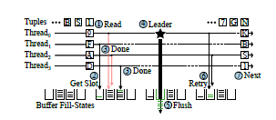
Efficiently partitioning data over a Fast Interconnect(cont.)
Shared: High-Throughput Partitioning
A share software write-combining(Shared) algorithm
The fill phase is comprised of Steps 1-3, and the flush phase is made up of Steps 4-6. A new fill phase is started in step 7. The input is separated into equal-sized chunks and assigned to thread blocks prior to execution.
Scratchpad buffer sharing and coalesced flushing occur within a thread block.

Slide 8
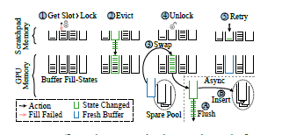
Efficiently partitioning data over a Fast Interconnect(cont.)
Hierarchical: High-Fanout Partitioning
Goal: Lower the cost of GPU TLB misses.
Using a two-level hierarchy, High-Fanout Partitioning is derived from Shared Algorithm by extending the flush phase. The new flush phase has seven phases and the fill phase doesn't change.
Buffer tuples for high fanouts in a two-level SWWC hierarchy. There is room for extra buffers on the second level.

Slide 9
The Triton Join Algorithm
All join techniques have a memory and interface bandwidth constraint imposed by the GPU.
The difficulty is to reduce interconnect transfers while achieving acceptable data locality.
These two restrictions are balanced by the Triton join method.

Slide 10
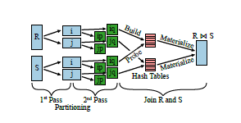
The Triton Join Algorithm(cont.)
Using an equality predicate, the Triton join method joins an inner relation R and an outer relation S.
There are three steps in the algorithm:
1st pass: initial pass Radix-partitioning R and S by the lower B1 bits of the hashed join key in the first pass
2nd pass: In the second pass, each Ri and Si partition is divided into its
Join 𝑅 and 𝑆: The join phase processes each 𝑅𝑖𝑝 and 𝑆𝑖𝑝 pair together.
The parallel radix-partitioned hash join with three stages is the foundation of the Triton join.

Slide 11
Evaluation of Triton Join Algorithm
Measurements were conducted on an IBM AC922 Power System.
Two IBM POWER9 ("Monza") CPUs and two Nvidia Tesla V100-SXM2 ("Volta") GPUs make up the system.
Methodology: Measure the join throughput in G tuples/s, or billions of tuples per second.
Twelve experiments were conducted:
Scaling the Triton Join vs. Baselines
Why the Triton Join Outperforms No-partitioning Joins
Time Accounting
CPU-Partitioned vs. GPU-Partitioned Join
Partitioning Algorithms
Why Hierarchical Outperforms the State-of-the-Art
Caching the Working Set in GPU Memory
CPU vs. GPU Prefix Sum
Build-to-probe Ratios
Tuple Width
Power Efficiency
Compute Power Scaling

Slide 12
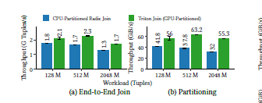
Evaluation of Triton Join Algorithm(cont.)
Experiment 4 - CPU-Partitioned vs. GPU-Partitioned Join(M tuples = tuples)
Analyse the effect of the partitioning processor on the end-to-end join.
Investigate the partitioning phase
End-to-End Join
The CPU-partitioned join can process between 1.3 and 1.8 G tuples per second.
A speedup of 1.2–1.3x is achieved by the Triton join.
Partitioning
Faster joining with Triton.
The GPU divides data 1.5–1.7x times faster than the CPU, to start.
Second, a decreased transfer volume is achieved via the Triton join, which caches intermediate results in GPU memory.

Slide 13
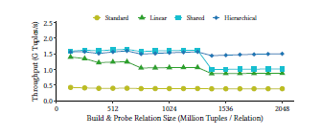
Evaluation of Triton Join Algorithm(cont.)
Experiment 5 - Partitioning Algorithms
Analyze how the join is affected by the partitioning algorithm.
Compare the radix partitioning methods Shared-Hierarchical with Linear-Standard.
Up to a size of 1280 M tuples, the shared approach achieves a throughput of 1.5-1.6 G tuples/s. Shared size decreases to 0.9–1 G tuples/s for larger relations.
Over the entire range, the hierarchical variant performs between 1.4 and 1.5 G tuples/s and degrades gracefully. As a result, Hierarchical outperforms Linear and Standard algorithms in terms of speed by 1.1-1.9 and 3.6-4, respectively.
Scaling a GPU join depends on the partitioning strategy chosen.(The scalability to big data sizes is improved by the hierarchical technique.)

Slide 14
Conclusions
Large-scale hash joins cannot be solved by fast interconnects alone.
According to NVLink 2.0, interconnect overhead and TLB misses hurt performance, and the Triton Join Algorithm was created to address these issues.
Triton join takes advantage of the fast interconnect to scale to enormous data volumes at up to 400 times faster speed.

Slide 15
Thank You !

