Slide 1

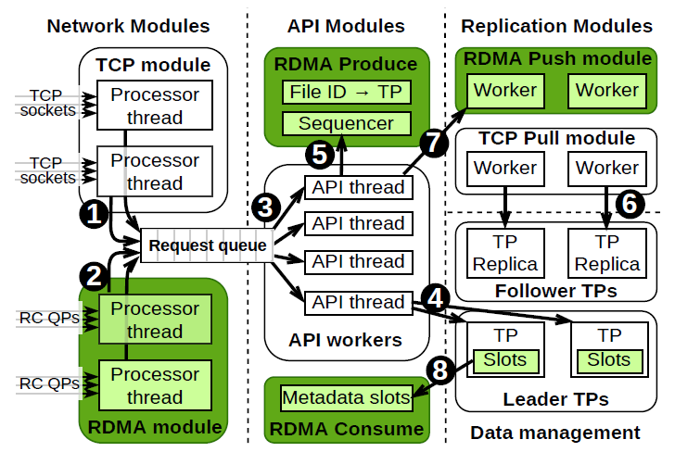
CS 646: Advanced Topics in Databases
KafkaDirect: Zero-copy Data Access for Apache Kafka over RDMA Networks
Konstantin Taranov, Steve Byan, Virendra Marathe, Torsten Hoefler
In Proceedings of the 2022 International Conference on Management of Data (SIGMOD ‘22)
Association for Computing Machinery, New York, NY, USA, 2191–2204
Dimitris Papazachariou (dpapaz02@ucy.ac.cy)

Slide 2
Outline
Remote Direct Memory Access (RDMA)
Publish-Subscribe messaging systems
Apache Kafka
KafkaDirect
Evaluation
Discussion

Slide 3
Outline
Remote Direct Memory Access (RDMA)
Publish-Subscribe messaging systems
Apache Kafka
KafkaDirect
Evaluation
Discussion

Slide 4
Remote Direct Memory Access (RDMA)
Remote Direct Memory Access is a technology that enables two networked computers to exchange data in main memory without relying on the processor, cache or operating system of either computer.
RDMA improves throughput and performance because it frees up resources, resulting in faster data transfer rates and lower latency between RDMA-enabled systems.
[https://www.techtarget.com/searchstorage/definition/Remote-Direct-Memory-Access]

Slide 5
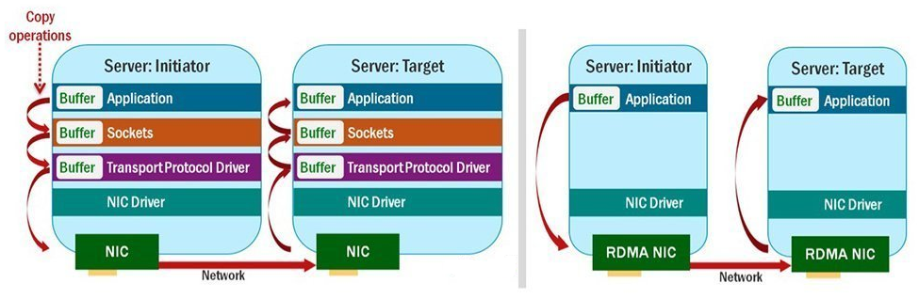
RDMA
https://www.techtarget.com/searchstorage/definition/Remote-Direct-Memory-Access

Slide 6
RDMA
Improve performance of:
query processing
distributed index structures and transactions
data replication
Naive use of RDMA → not achieve maximum performance

Slide 7
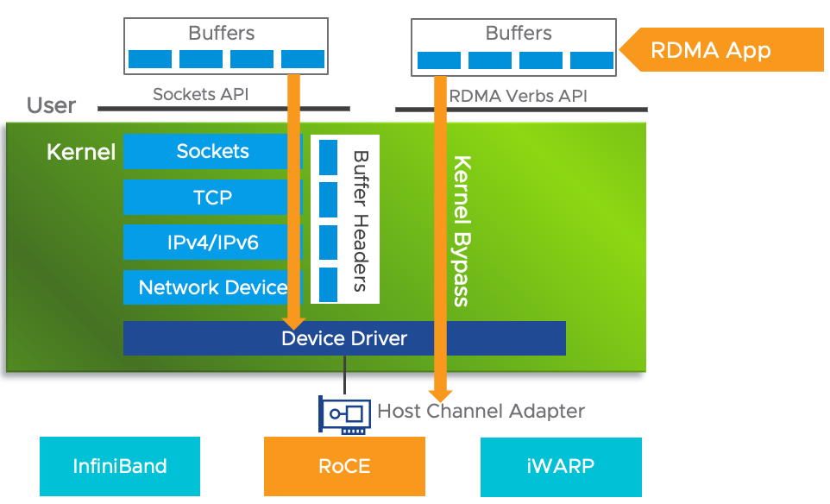
RDMA
https://core.vmware.com/resource/basics-remote-direct-memory-access-rdma-vsphere

Slide 8
Network protocols supporting RDMA
Infiniband
RoCE (RDMA over Converged Ethernet)
iWARP

Slide 9
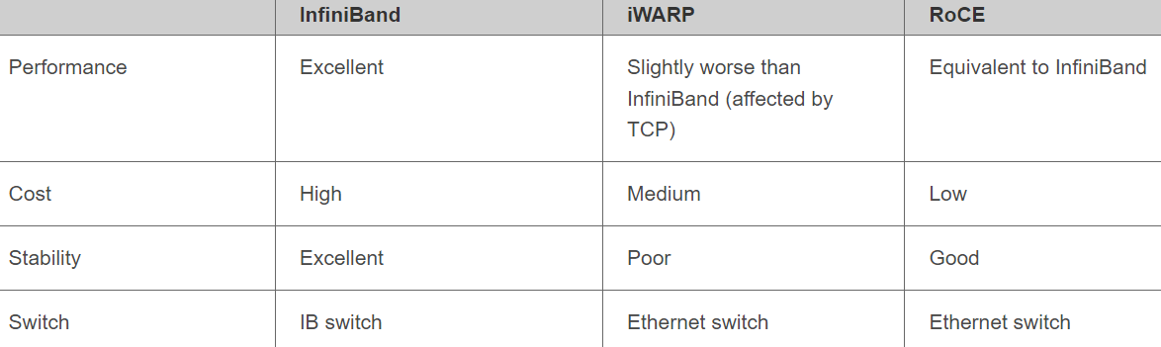
Network protocols supporting RDMA
https://support.huawei.com/enterprise/en/doc/EDOC1100203339

Slide 10
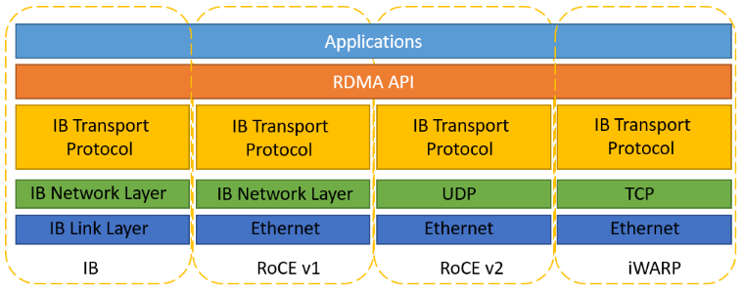
Network protocols supporting RDMA
https://support.huawei.com/enterprise/en/doc/EDOC1100203339

Slide 11
Products and vendors supporting RDMA
Apache Hadoop and Apache Spark
FreeBSD operating system
Microsoft Windows Server (2012 and higher)
Nvidia DGX deep learning systems
Oracle Solaris and NFS over RDMA
Red Hat Enterprise Linux
TensorFlow open-source software library for machine intelligence
VMware ESXi
https://www.techtarget.com/searchstorage/definition/Remote-Direct-Memory-Access

Slide 12
Outline
Remote Direct Memory Access (RDMA)
Publish-Subscribe messaging systems
Apache Kafka
KafkaDirect
Evaluation
Discussion

Slide 13
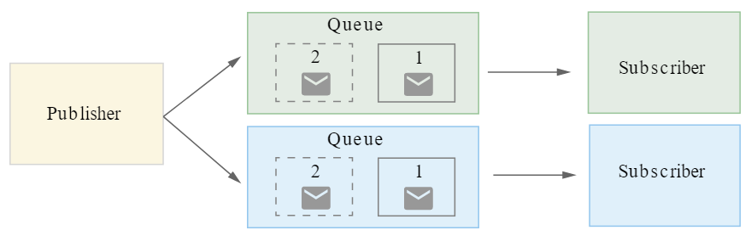
Publish-Subscribe messaging systems
Asynchronous data transfer between applications
https://cloud.google.com/solutions/event-driven-architecture-pubsub

Slide 14
Publish-Subscribe messaging systems
Building block for data center applications
Applications as open-source systems (Apache Kafka) and as a service
Sequence of ordered records in append-only data logs

Slide 15
Outline
Remote Direct Memory Access (RDMA)
Publish-Subscribe messaging systems
Apache Kafka
KafkaDirect
Evaluation
Discussion

Slide 16
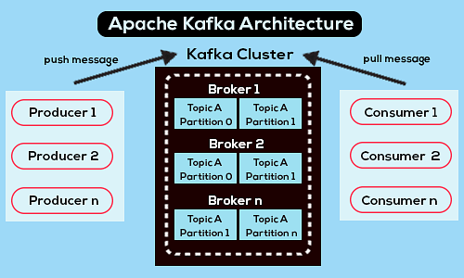
Apache Kafka
Fault-tolerant distributed publish-subscribe messaging system
https://www.projectpro.io/article/apache-kafka-architecture-/442

Slide 17
Kafka Topics
Records → categorized into topics partitioned into partitions (topic partitions)
TP → ordered, immutable sequence of records
Sequential ID numbers (Kafka offset)

Slide 18
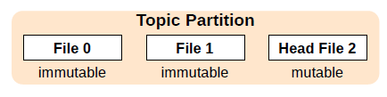
Kafka Topics
Distinct files on disk
New record → appended to the head segment
Record size: 1 MB
Segment size: 1 GB
Replicated TP (replication leader, replication followers)

Slide 19
Kafka Broker
Broker: storage server of Kafka cluster
Receives records from producers
Assigns offsets
Commits records to local disks
Responds to fetch requests
Processes multiple TPs

Slide 20
Outline
Remote Direct Memory Access (RDMA)
Publish-Subscribe messaging systems
Apache Kafka
KafkaDirect
Evaluation
Discussion

Slide 21
KafkaDirect
Extension to Apache Kafka
RDMA to accelerate record production, consumption and replication
Focus on InfiniBand standard and reliably connected queue pair (RC QP)
Consumers directly read records from subscribed topics (bypass CPU of brokers)

Slide 22
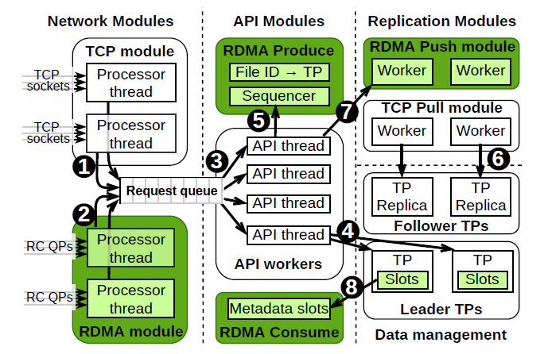
KafkaDirect’s broker architecture

Slide 23
KafkaDirect
RDMA network module → RC QP connections from clients and brokers
RDMA Produce module → producers write data directly to TP files
RDMA Push module → replicate data directly from leaders to followers
RDMA Consume module → metadata slots (information about TP files)

Slide 24
RDMA produce datapath
RDMA Produce module → generates a unique ID, sends it to producer
API worker thread → maps the file ID to the requested TP
Broker → commits records

Slide 25
RDMA push replication
Leader → writes new records to TPs of its followers
Disadvantage → replication gets triggered for each new record
KafkaDirect → batches contiguous RDMA Writes into a single Write
Maximum batch size: 1 KB

Slide 26
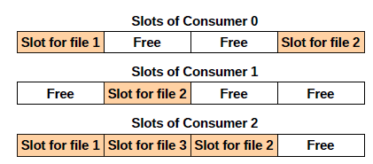

RDMA consume datapath
Main goal: offload the processing of fetch requests to RNICs
RDMA consumer → periodically reads metadata slots of subscribed TPs (to get informed whether new records have been appended to them)
For each RDMA consumer → brokers allocate a region (stores metadata slots)
Fetch size: 2 KB

Slide 27
Outline
Remote Direct Memory Access (RDMA)
Publish-Subscribe messaging systems
Apache Kafka
KafkaDirect
Evaluation
Discussion

Slide 28
Evaluation
Comparison of the performance of KafkaDirect with:
the original Apache Kafka 2.2.1 (Kafka)
an RDMA-enabled Kafka proposed by the Ohio State University (OSU Kafka)
KafkaDirect outperforms the existing Kafka systems
(in terms of bandwidth and latency for all datapaths)

Slide 29
Evaluation
KafkaDirect uses RDMA to accelerate the three most network intensive datapaths.
The RDMA producer offers a 9x improvement over today’s Kafka producer bandwidth.
The RDMA replication module provides a 13x improvement in replication performance.
The RDMA consumer offers a 50x reduction in latency and a 10x increase in throughput.

Slide 30
Outline
Remote Direct Memory Access (RDMA)
Publish-Subscribe messaging systems
Apache Kafka
KafkaDirect
Evaluation
Discussion

Slide 31
Discussion
Memory usage → KafkaDirect has higher memory usage compared to Kafka
Batching requests targeting different TPs → KafkaDirect’s RDMA datapaths cannot batch RDMA requests that target different TP files
Reliability of RDMA → KafkaDirect uses reliable RDMA connections
Security of RDMA → InfiniBand architecture (not secure transport, not possible application-level encryption)
Proposal for secure RDMA transport → sRDMA

Slide 32


