Slide 1
Performance study of big data on small nodes.
Ομάδα:
Παναγιώτης Μιχαηλίδης
Αντρέας Σόλου
Instructor: Demetris Zeinalipour

Slide 2
What is Big data?
Big data is a collection of data sets so large and complex that it becomes difficult to process using on-hand database management tools or traditional data processing applications.

Slide 3
Big data processing
Traditional Processing Nodes
Large computing nodes (Intel Xeon)
High energy consumption (~thousands of watts)
Data Trends
Continuous increase in volume of Big Data for process
Increasing variety of data
Problems occurred
Energy utilization problem
Increase of cost to build and maintain a datacentre
Need for more man power

Slide 4
Case of study
Use of mobile nodes
Significantly improved in the last years
Energy efficient
Cheap
Small in size

Slide 5
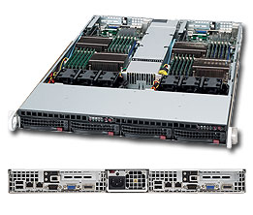
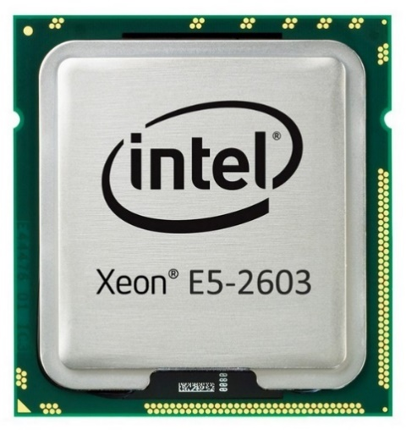
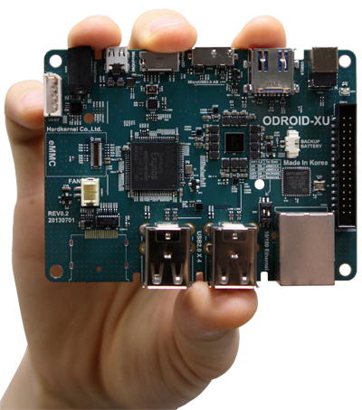
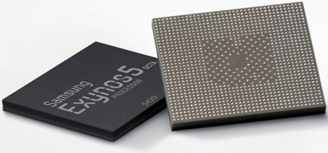
Traditional node Vs Mobile Node
Supermicro 813M 1U server system with:
Two Intel Xeon E5-2603 4 core CPUs
8GB DDR3 memory
1TB Hard Disk
1Gbit Ethernet Network Card
Odroid XU development board with:
Samsung Exynos 5410 SoC using ARM big.LITTLE architecture
8 cores
2GB low power DDR3 memory
64GB eMMC flash storage
100Mbit Ethernet Network Card

Slide 6
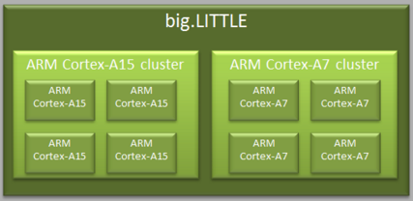
ARM big.LITTLE on Odroid XU system
Mobile CPU is consisted of:
4 ARM Cortex-A7 LITTLE cores (250-600MHz)
4 ARM Cortex-A15 big cores (600-1600MHz)
Only one cluster is used each time
To improve network speed we use a USB 3.0 Gigabit Ethernet adapter

Slide 7
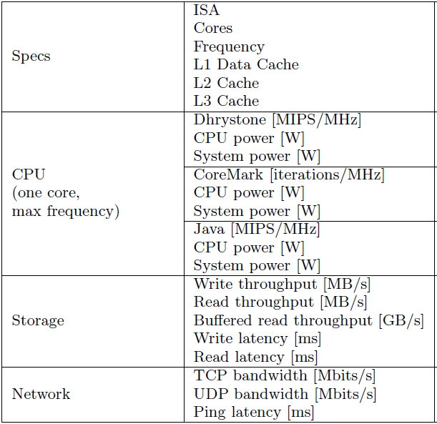
Benchmarks
Performance of CPU MIPS
Dhrystone benchmark
Core-Mark CPU benchmark
Custom Java execution benchmark
Memory bandwidth
Parallel Memory Bandwidth Benchmark
I/O throughput and latencies
dd 8.20
ioping 0.7
Networking bandwidth on TCP and UDP

Slide 8
Dhrystone Benchmark
ARM big.LITTLE
LITTLE cores have 21% better performance than big ones as per MHz
ARM claims that LITTLE cores should have less Dhrystone MIPS per MHz that big ones
Reason:
Different compilers (gcc vs armcc) generating the machine code differently
Xeon node
Almost twice the performance of ARM

Slide 9
CoreMark Benchmark
To confirm Dhrystone’s results
LITTLE cores have better performance than big ones as per MHz
Big cores score 3.52 instead of the expected 4.68
Different compiler
Xeon node
Almost twice the performance of big ARM

Slide 10
Java Execution Benchmark
ARM big.LITTLE
LITTLE cores have less than half the MIPS of big cores
big cores achieve just 7% of the performance of Xeon cores
Using only a quarter of the energy

Slide 11
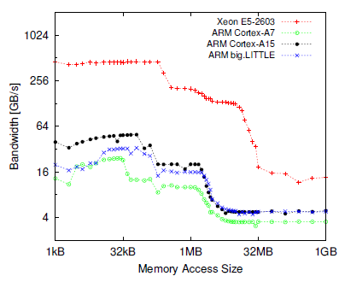
Parallel Memory Bandwidth Benchmark
When data fits in cache
Xeon has 450GB/s bandwidth using 8 cores and 225GB/s using 4 cores
ARM big have 10 times less bandwidth
ARM LITTLE have 20 times less bandwidth
When main memory access is needed
ARM big have 2 times less bandwidth
ARM LITTLE have 4 times less bandwidth

Slide 12
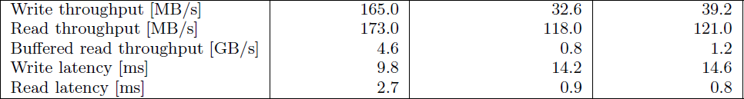
I/O Throughput and Latencies
On write instructions
ARM big cores have 4 times worse throughput than Xeon’s
ARM LITTLE cores have even less throughput
Disk driver and file system have important CPU usage
On buffered read
Results are correlated with memory bandwidth values mentioned before
Write latency on eMMC memory is grater than traditional hard disks
Modern hard disks have caches and intelligent controllers
eMMC uses NAND flash which has big write latency

Slide 13
Networking Bandwidth on TCP and UDP
TCP
ARM big cores have 3 times less bandwidth than Xeon’s
ARM LITTLE cores have 4 times less bandwidth than Xeon’s
UDP
ARM big cores have 2 times less bandwidth than Xeon’s
ARM LITTLE cores have 3 times less bandwidth than Xeon’s
Justification
Ethernet adapter connected through USB 3.0 on Ondroid XU server system
Longer communication path shown by the grater ping latency

Slide 14
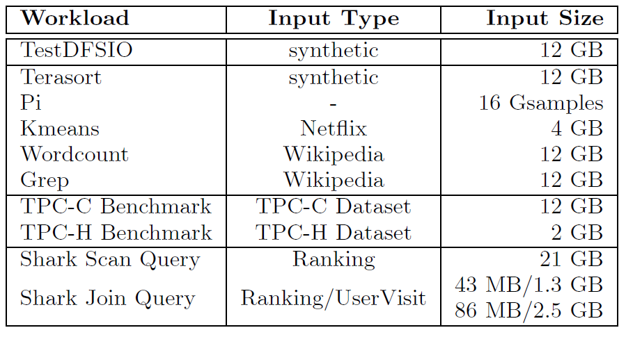
Complex Data Intensive Workloads
Big Data execution on small nodes in comparison with traditional server-class nodes
Evaluating the performance of HDFS, Hadoop MapReduce and query processing frameworks

Slide 15
Hadoop TestDFSIO Benchmark (1)
Throughput and Energy consumption of I/O instructions
12GB input data on 1 and 6 nodes
Writing on 6 nodes
Throughput drastically reduced especially on Xeon node
HDFS replication mechanism x3
Network and Storage operations lower the overall throughput also due to the replication
Leads to higher energy consumption
Reading degradation when using 6 nodes not as visible
Reading not affected by replication mechanism

Slide 16
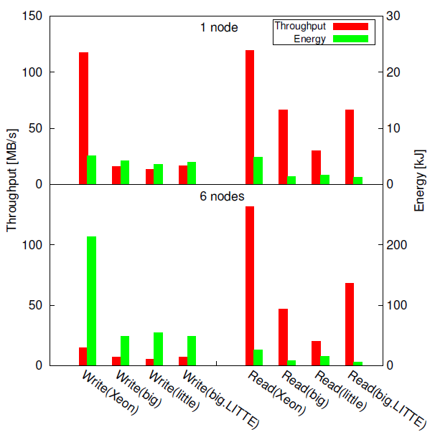
Hadoop TestDFSIO Benchmark (2)
Writing on 6 nodes
Xeon’s throughput is 2 times grater than ARM
With 4 times more energy consumption
Reading using 6 nodes
Xeon’s throughput is 3 times better than ARM big.LITTLE
With 5 timer more energy consumption
ARM big.LITTLE consums less energy than Xeon but with 2-3 times lower throughput

Slide 17
Hadoop (1)
Evaluating time performance and energy efficiency through the 5 workloads
We set number of slots to 4 matching the number of cores of each node
Error on Kmeans and Terrasort due to insufficient memory
Kmeans: limit the io.sort.mb to 50MB
Terrasort: limit the number of slots to 2

Slide 18
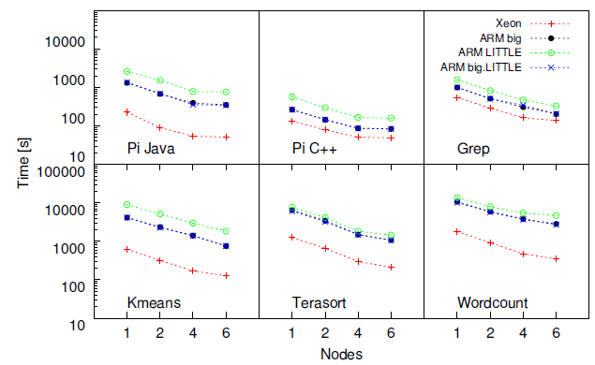
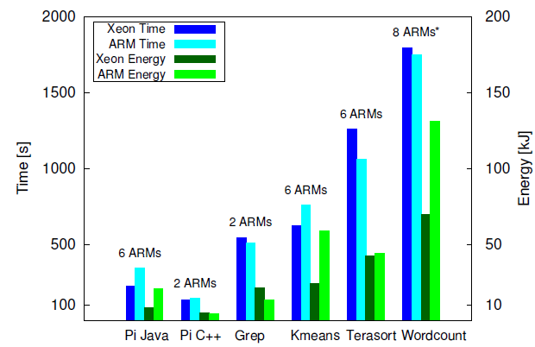
Time Performance and Energy Consumption (2)
Pi workload implemented on C++ benefits both nodes, especially ARM node
All workloads show a sublinear scaling as number of nodes increases
To achieve the execution time of one Xeon node, we need multiple ARM nodes

Slide 19
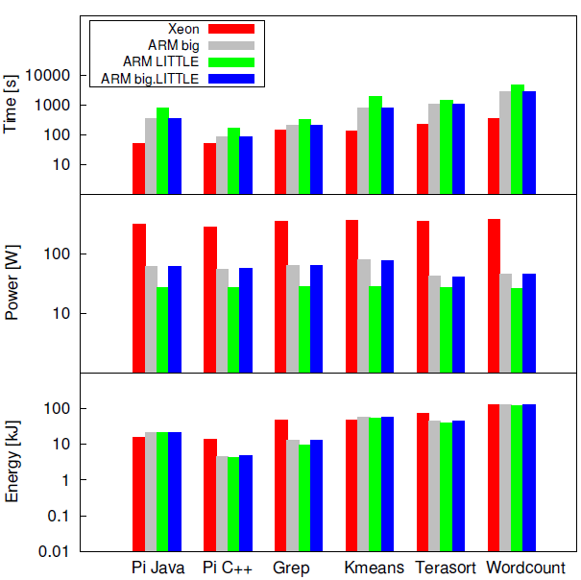
Workload Categorization (3)
We categorize the workloads based on time, power and energy
Pi Java and Kmeans
Larger execution times on ARM compared to Xeon
Leading to higher energy usage due to high CPU usage
Pi C++ and Grep
Smaller execution time gap
Both are CPU-intensive and have high power usage
ARM energy usage is significantly lower
Workcount and Terrasort
I/O intensive workloads
Better execution times on Xeon
Higher memory and storage bandwidth

Slide 20
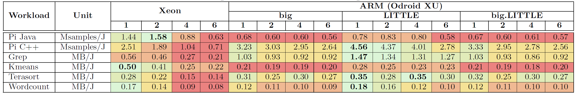
Hadoop Workloads Conclusion (4)
Performance per power (PPR) ratio shows the amount of useful work performed per unit of energy
Higher PPR indicates more energy efficient execution (green colour)

Slide 21
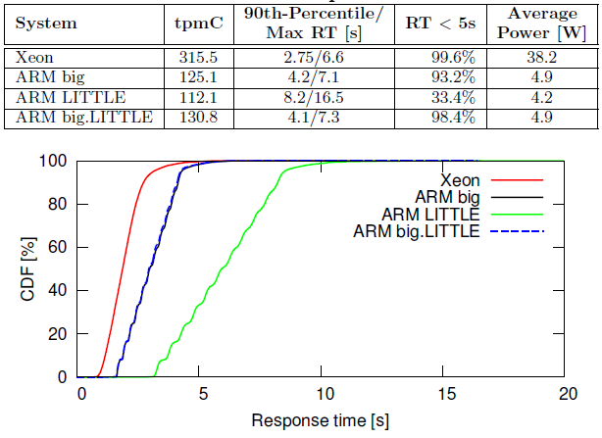
Query Processing (1)
Evaluating the performance of OLTP and OLAP workloads using TPC-C and TPC-H benchmarks accordingly on MySQL
TPC-C: data intensive, random data access with read to write ratio 1.9:1
Xeon has 2 times higher throughput than Odroid XU
Similar Response Time (RT) between Xeon and ARM big/big.LITTLE
RT on ARM LITTLE is 2 times worse
Xeon has 10 times higher average power consumption with only 2 times better throughput

Slide 22
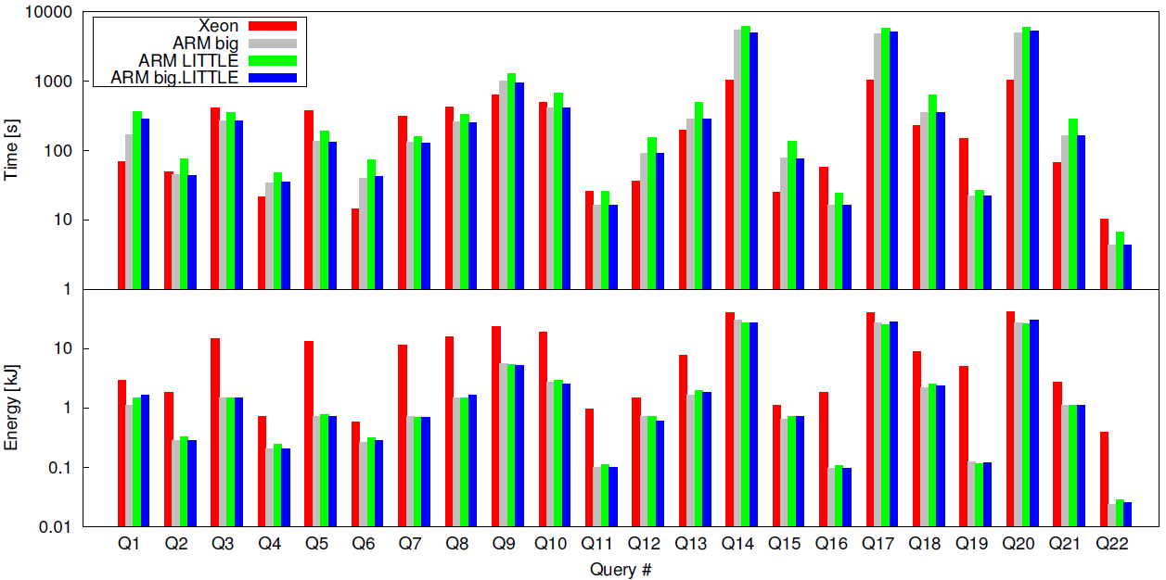
Query Processing (2)
TPC-H: read-only queries and I/O bounded
We run 22 queries of different types
On scan queries and long-running queries Xeon performs 2-5 timer better than all ARM configurations
Because of the higher read throughput and larger memory used as file cache
On random access queries with small working set ARM performs 1.2-6.9 times better
Because of lower read latency of Odroid XU eMMC flash based storage
Summary
Xeon is using 1.4-44 more energy
ARM is more energy efficient on executing queries

Slide 23
Query Processing – Shark (1)
Evaluating the performance of in-memory Big Data analytics
Scan and Join queries
On scan queries ARM big/big.LITTLE is 1.1-1.7 timer slower than Xeon and 3 times better in energy usage
ARM LITTLE are 2 times slower and 4 times better in energy usage
Join queries have 3 different senarios
Both servers have enough cache memory
Xeon has enough cache memory
None has enough cache memory

Slide 24
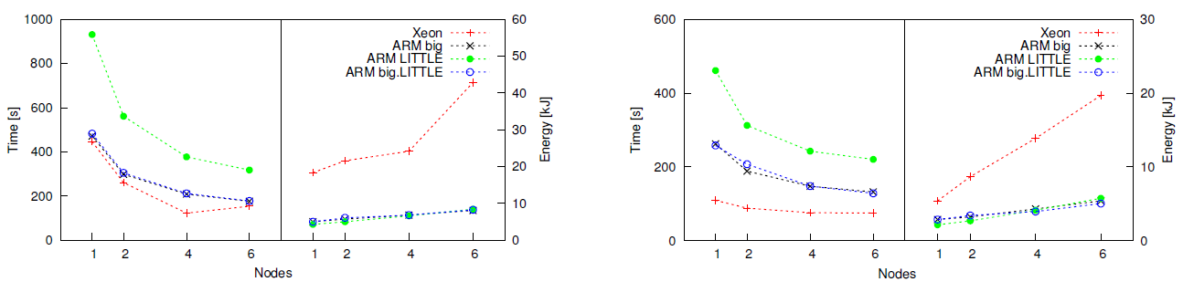
Query Processing – Shark (2)
On first scenario
ARM big/big.LITTLE are 2-4 times slower than Xeon and 1-3.6 times more energy efficient
ARM LITTLE is 3-7 times slower and only 1.5-2.9 times better in energy usage
On third scenario
ARM big/big.LITTLE are 2.4 times slower and LITTLE are 4.2 times slower
ARM has up to 4 times better energy usage
Xeon has to read from storage thus doesn’t benefit from it’s high memory bandwidth
On Second scenario
Runtime gap increases leading to high energy usage on ARM
Summary
ARM has better energy efficiency on I/O bounded scan queries
For join queries because of larger memory and I/O bandwidth traditional servers are better

Slide 25
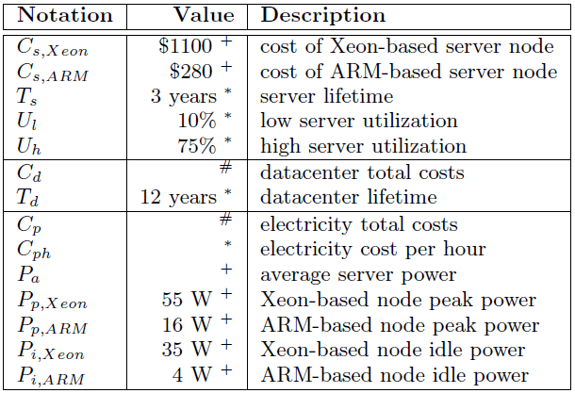
TCO Analysis (1)
Two cost models
Marginal Cost
Google’s TCO model
Lifespan of a server, 3 years
Cost is expressed in US Dollars
Lifespan of a datacentre, 12 years
Typical usage of a server has
Lower bound: 10% utilization
Upper bound: 75% utilization
Electricity price range: 0.024$/kWh - 0.398$/kWh

Slide 26
Marginal Cost (2)
Simple cost model: Equipment cost + Electricity cost
On Pi and Terrasort
ARM uses 20% and 50% utilization to achieve Xeons lower bound performance with 4 times less cost
We need more than one ARM nodes to achieve Xeons upper bound performance
6 for Terrasort Workload with 86% utilization each
2 for Pi Workload with 82% utilization each
On I/O intensive jobs with high utilization
ARM costs 50% more since 6 ARM servers are needed to achieve the utilization of Xeon
On idle we can assume having zero energy consumption
Xeon uses 22% less energy
ARM uses just 6-10% less energy since it’s already energy efficient

Slide 27
Google’s TCO Model (3)
Also includes capital cost and operational expenses
Capital cost is 15$/Watt as per datacentre’s power capacity
Operational cost is 0.04$/kW per month
Equipment cost includes maintenance cost of 5% for both type of servers
This model also includes the interest rate for a loan which is 8% per year
Electricity costs are calculated based on the average power consumption of the datacentre
Additional costs are expressed as PUE (Power Usage Effectiveness) per month
PUE for Xeon server: 1.1
PUE for ARM server: 1.5
All in all the 6 ARM servers implementation costs more than traditional Xeon server

Slide 28
Conclusion
Lower power advantage of ARM nodes is cancelled from small memory size, low memory and I/O bandwidth, and software immaturity
On CPU-intensive workloads ARM is 10 times slower when using Pi MapReduce on Java
On C++ this time is improved by a factor of 5
Data analysis is 4 times cheaper
For I/O-intensive workloads, 6 ARMs are needed to achieve the performance of a Xeon
50% bigger TCO
For query processing ARMs are much more energy efficient with slightly lower throughput
For small random database accesses, ARM are faster due to lower I/O latency
For sequential database scan, Xeon servers benefit more from bigger memory size

Slide 29
Conclusion
In the near future, if the memory of ARM is increased with maintaining their fast I/O and with maturity of software, they will become a serious contender for traditional Intel/AMD server system

