Slide 1





Blended near-optimal tools for flexible water resources decision making
Dr. David E. Rosenberg
April 13, 2015
European Geophysical Union General Assembly
Grant #1149297

Slide 2
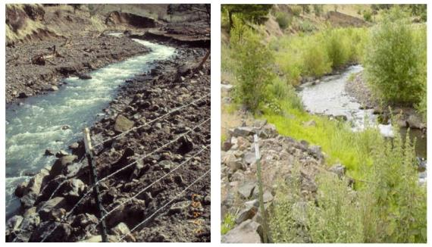
Why Near-Optimal?
Now
Complex problems
Solutions optimal only for modeled issues
Un-modeled issues persist
Managers need more than single-best
Best or better?

Slide 3
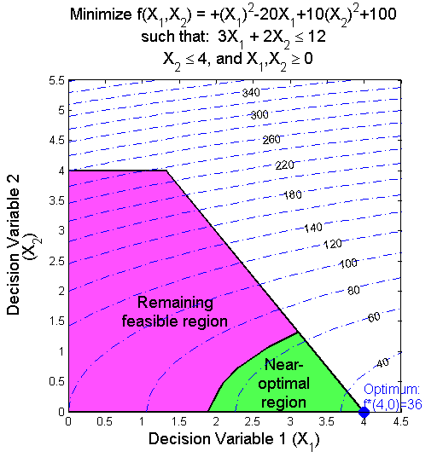
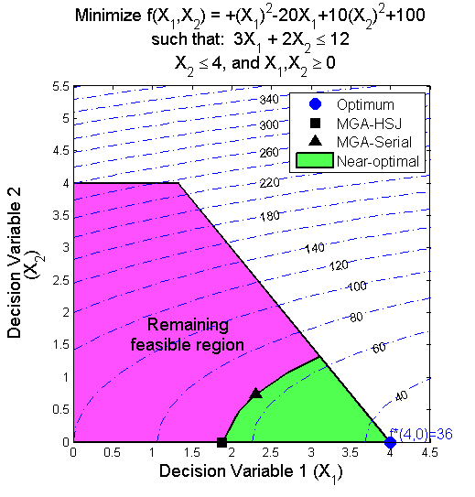
Near-Optimal Defined
Find optimal
Alternatives a specified tolerance (γ) from optimal
Prior MGA methods
Find maximally-different alternatives
Slow
Partial picture

Slide 4
New Blended Near-Optimal Tools
Alternative generation
Stratify Monte Carlo Markov Chain sample
Visualize
Parallel coordinate plot
Interact
Plot controls to render, filter, generate new alts.
Update model formulation
Help managers find near-optimal alternatives they prefer to the optimal solution

Slide 5
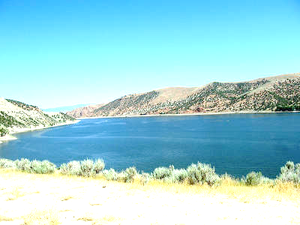
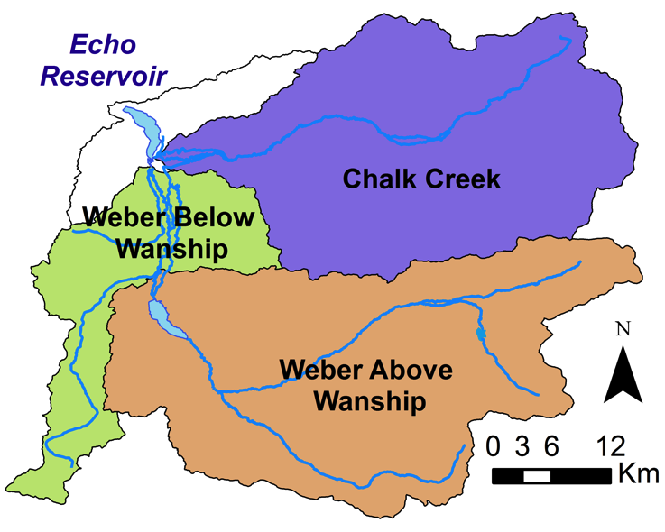
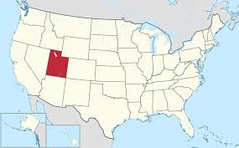
Phosphorus removal, Echo Reservoir, Utah

Slide 6
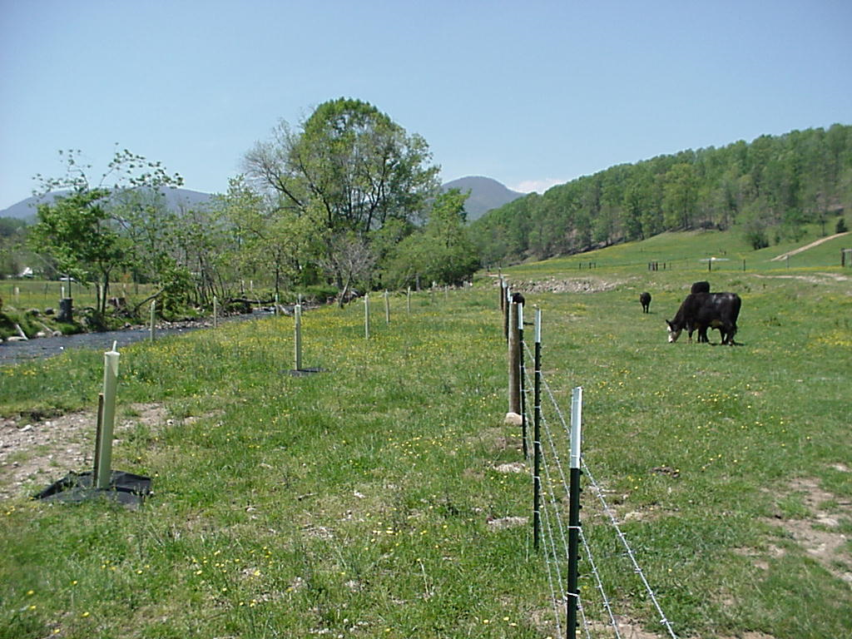
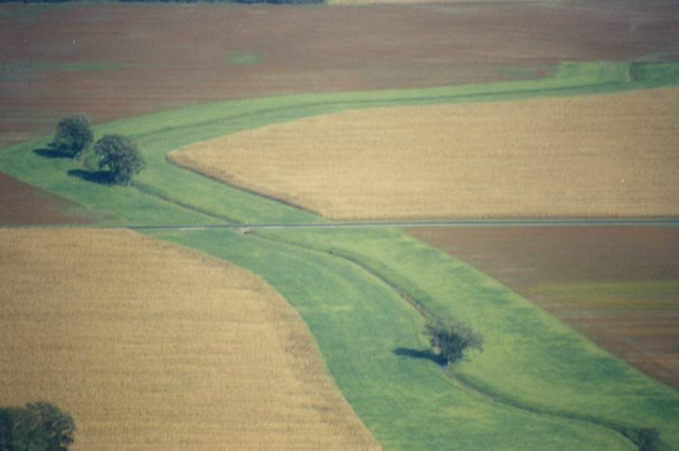
Best Management Practices
1. Fence streams
2. Grass filter strips
3. Protect grazing land
4. Stabilize stream banks
5. Retire land
6. Cover crop
7. Manage agricultural nutrients
…and others

Slide 7
Problem Specifics and Formulation
Decide BMP implementation levels (b_{iws}) to
Minimize costs
Pending TMDL in 2006
Reduce non-point source load by 8,067 kg/year
10 practices (i)
3 sources (s)
3 sub-watersheds (w)
39 decisions!!
Such that
Define phosphorus removed,
Phosphorus reduction targets achieved,
Available resources to implement BMPs,
Remove no more than the existing load, and
Non-negative variable values
(Alminagorta et. al, 2013)

Slide 8
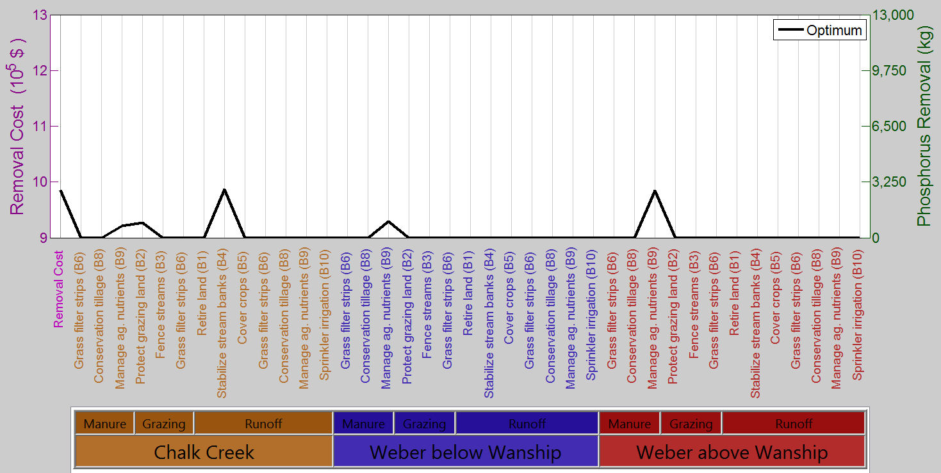
Compare optimal solution and near-optimal alternative generation methods

Slide 9
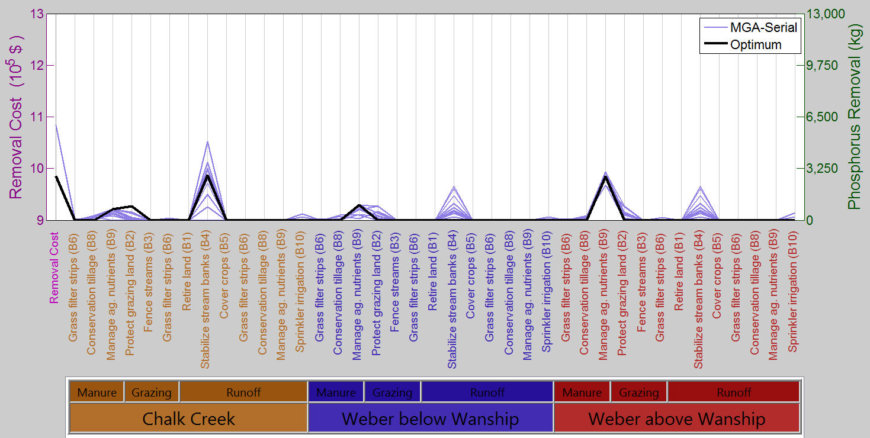
Compare optimal solution and near-optimal alternative generation methods
110% Tolerance

Slide 10
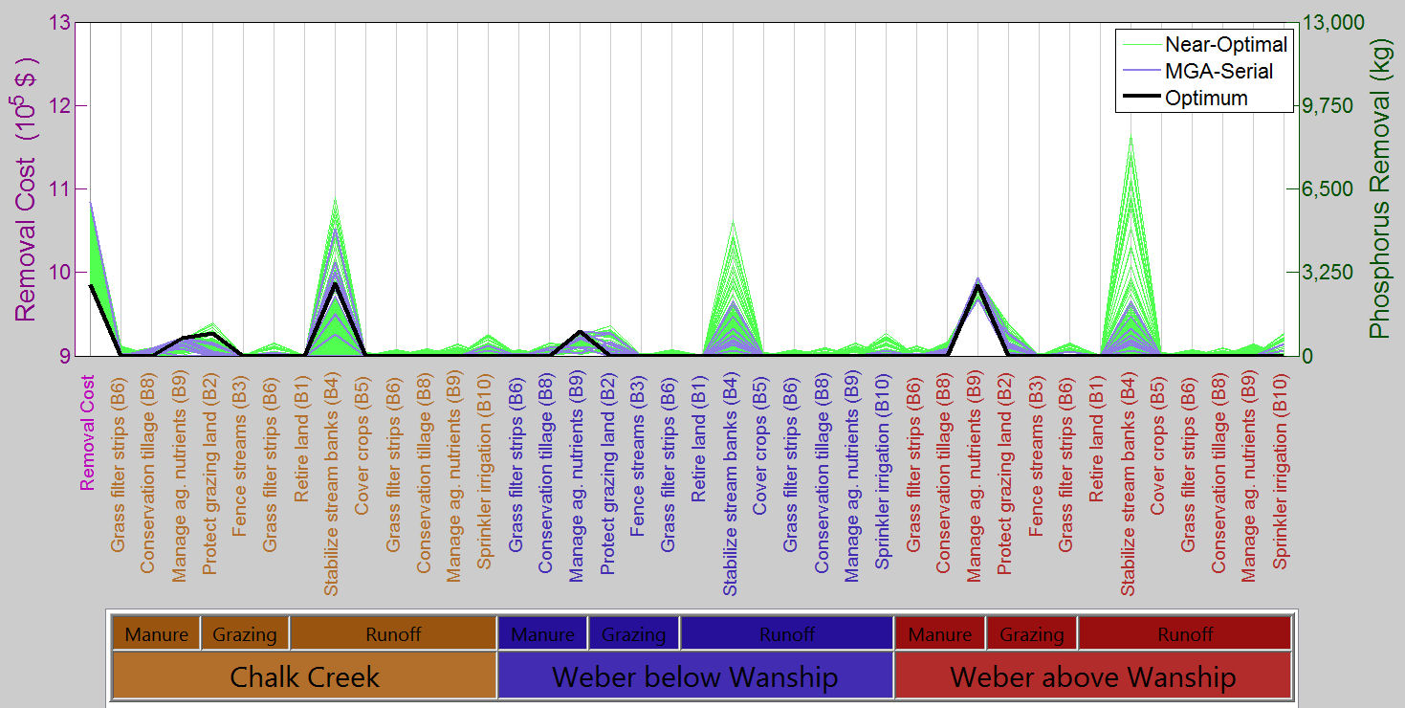
Compare optimal solution and near-optimal alternative generation methods
110% Tolerance

Slide 11
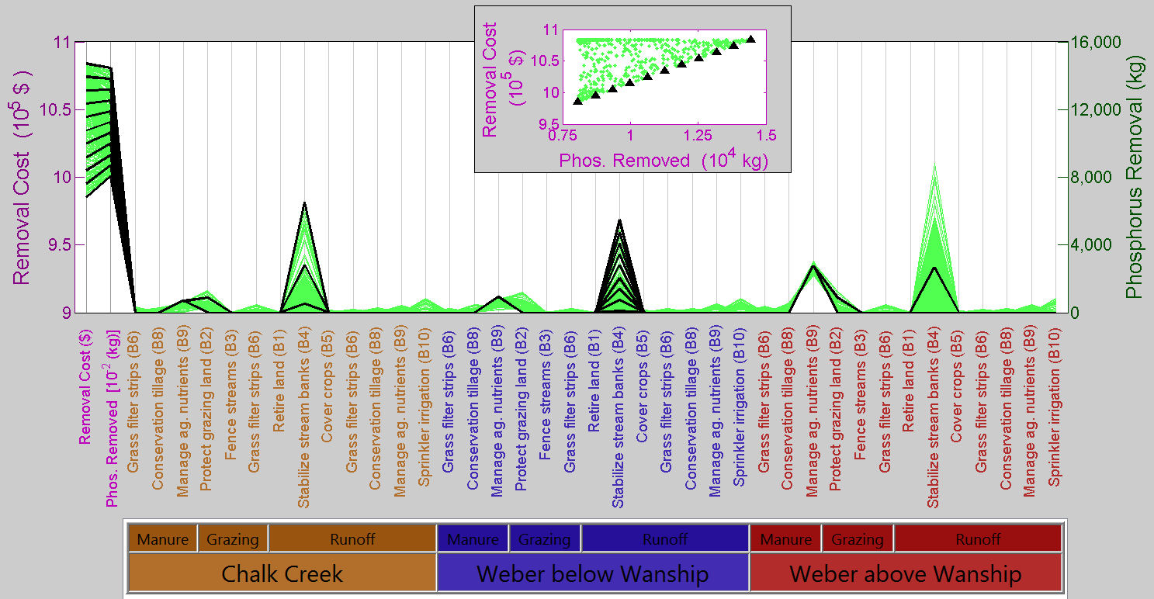
Update model formulation to include phosphorus removal objective

Slide 12
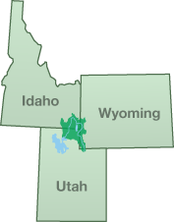
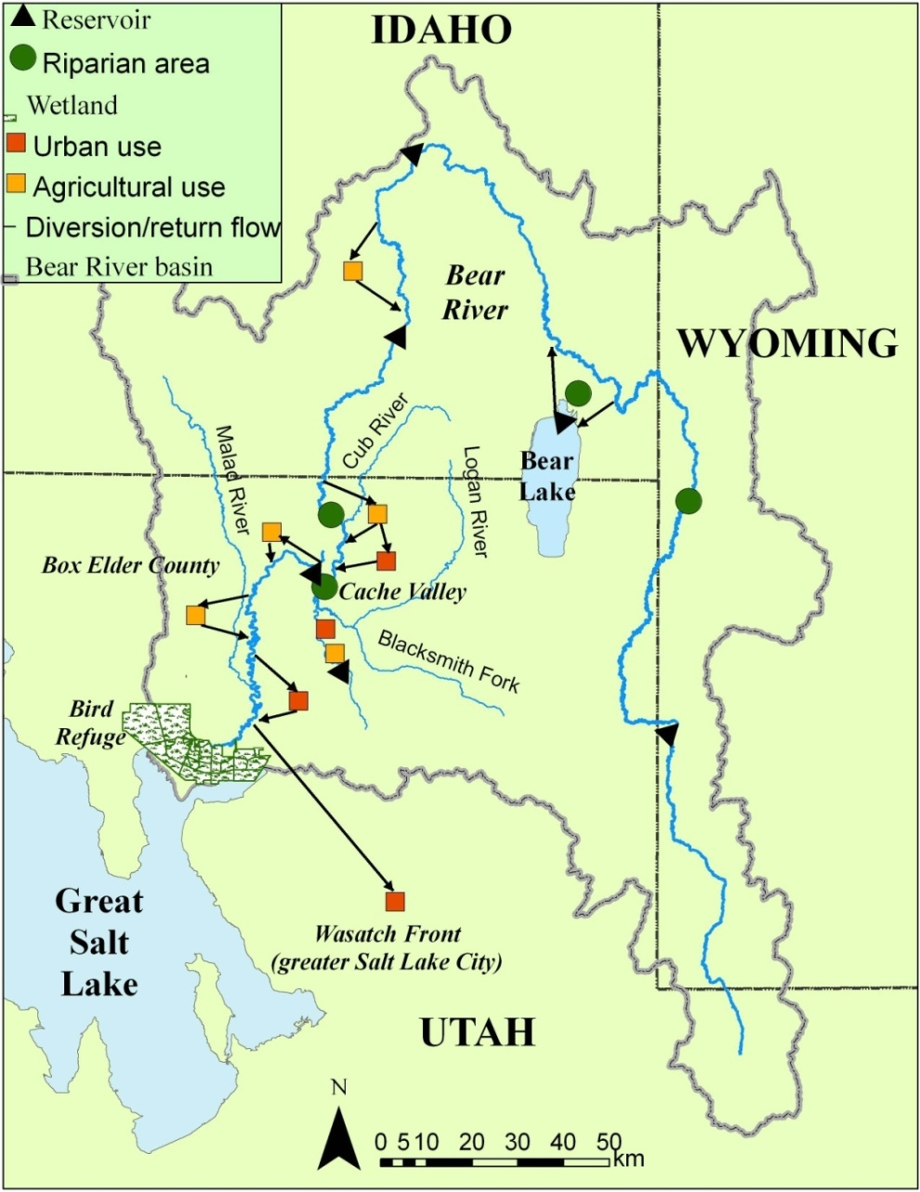
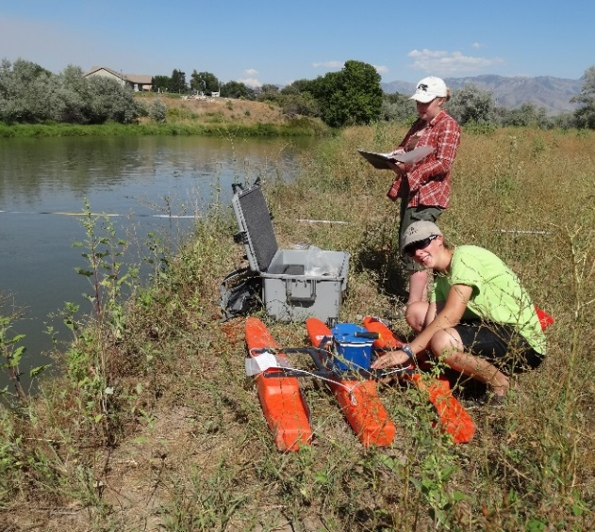
Next Steps
Basin-scale
Non-linear problems
Test tool use

Slide 13
Conclusions
Faster tools to generate, visualize, and explore near-optimal alts.
More-completely show the region
Elicit un-modeled issues
=> improve model
Numerous, flexible ways to manage

Slide 14


Further Information
david.rosenberg@usu.edu
http://rosenberg.usu.edu
@WaterModeler
Code Repository & Documentation
https://github.com/dzeke/Blended-Near-Optimal-Tools
Rosenberg (in press). “Blended near-optimal alternative generation, visualization, and interaction tools for water resources decision making.”Water Resources Research. 10.1002/2013WR014667.

Slide 15
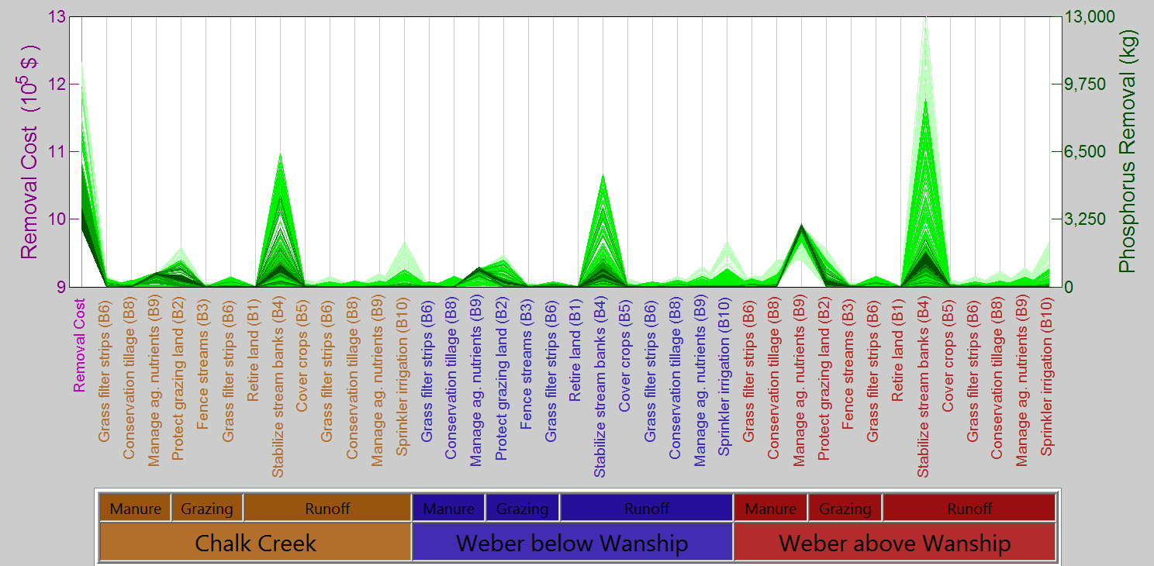
Expand the near-optimal region
125% Tolerance

