Slide 1
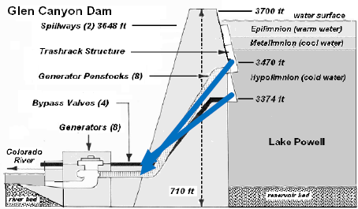
Glen Canyon Dam Outlets
Penstock (max ~ 31,500 cfs)
River (max ~ 15,000 cfs)

