Slide 1
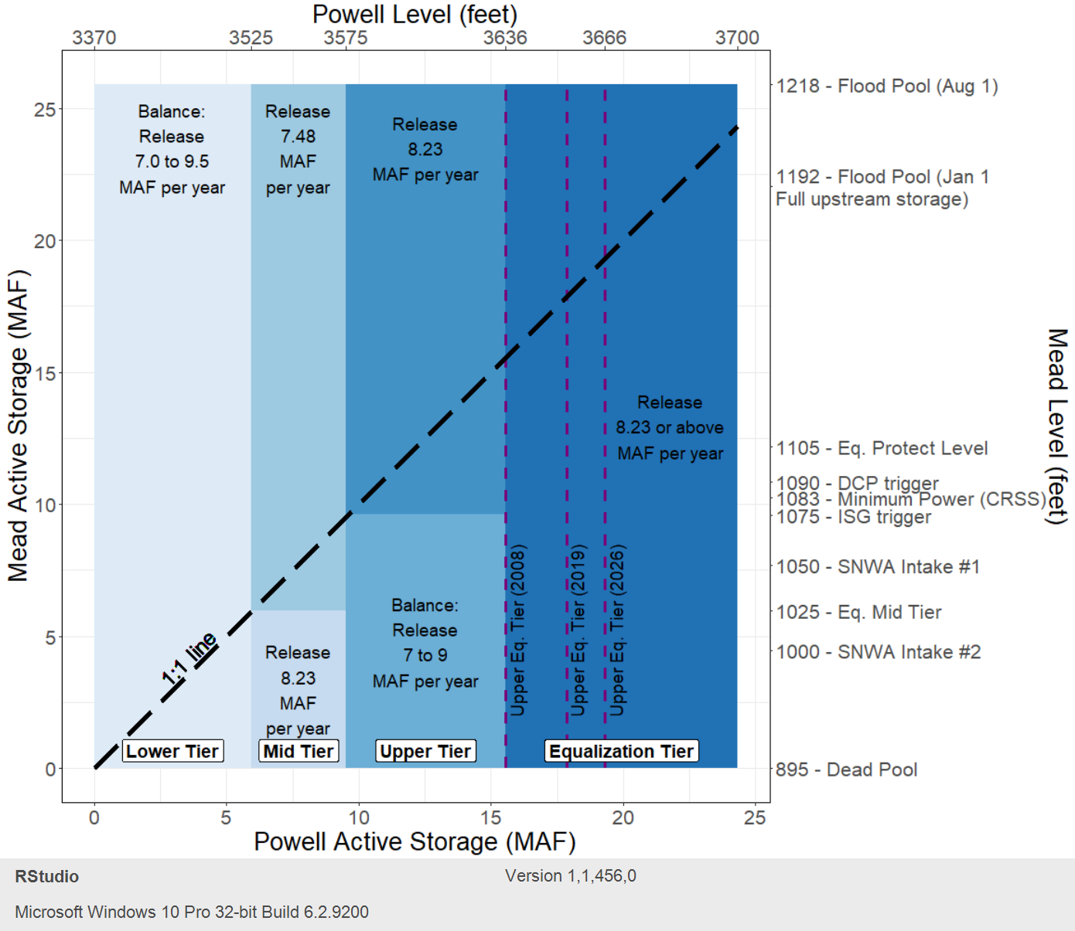
Visualization of Lake Powell-Lake Mead Equalization Rule
(Tiers in Blue, Changing upper equalization tier level in dashed-purple, Required annual Powell release in black text)

Slide 2
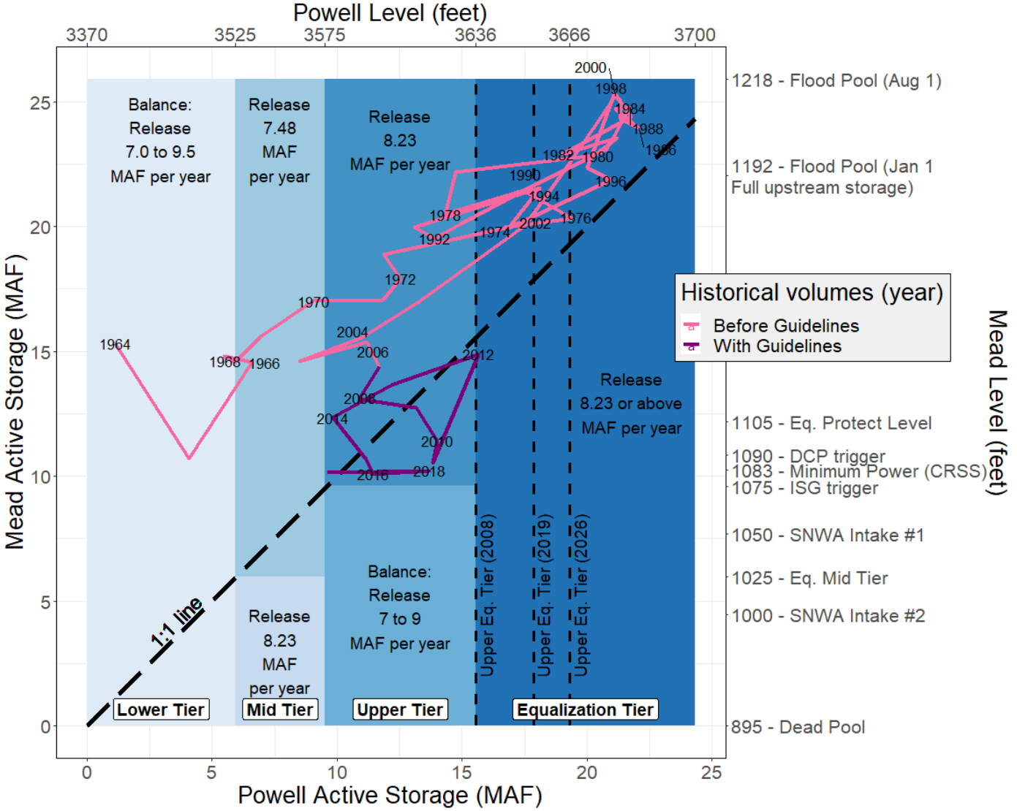
Observed January 1 Lake Mead-Lake Powell Storages before (red) and with (purple) Equalization Guidelines

Slide 3
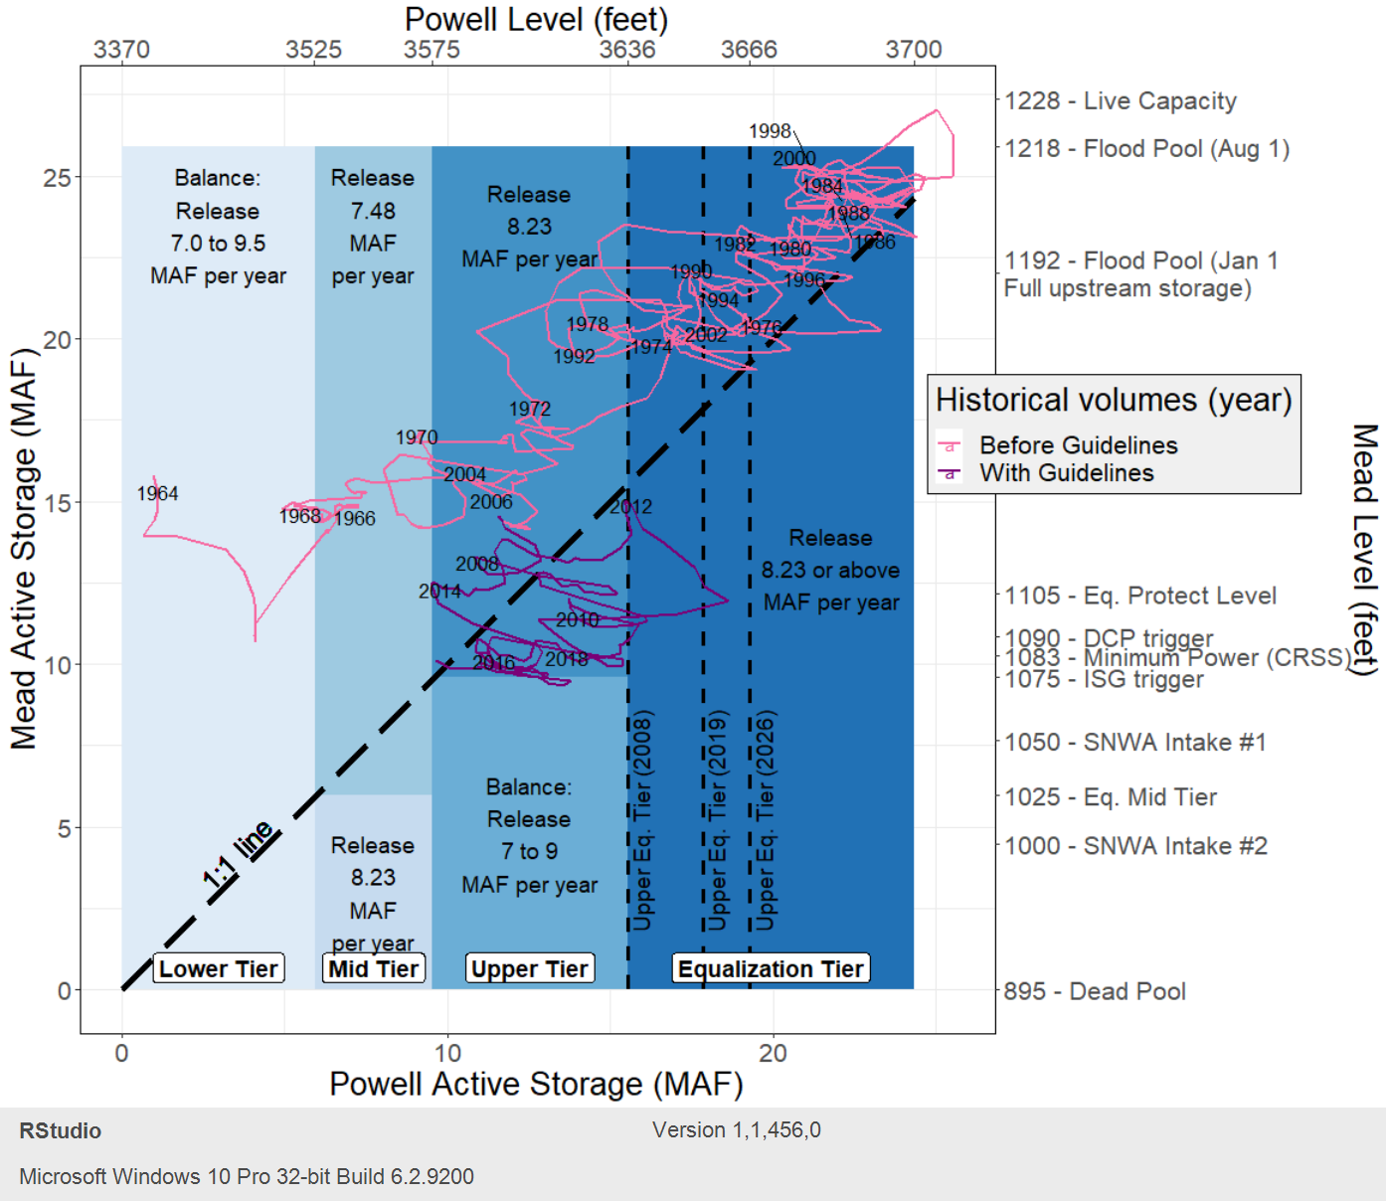
Observed Monthly Lake Mead-Lake Powell Storages before (red) and with (purple) Equalization Rules
(Year label identifies January 1 of the year)

Slide 4
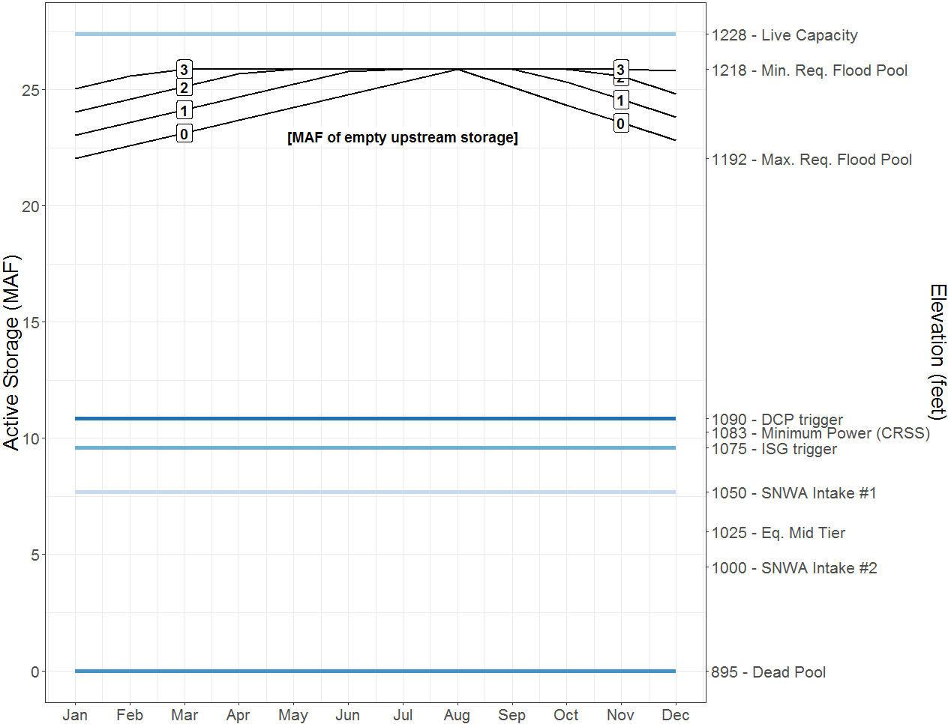
Lake Mead Pool Definitions by Month

Slide 5
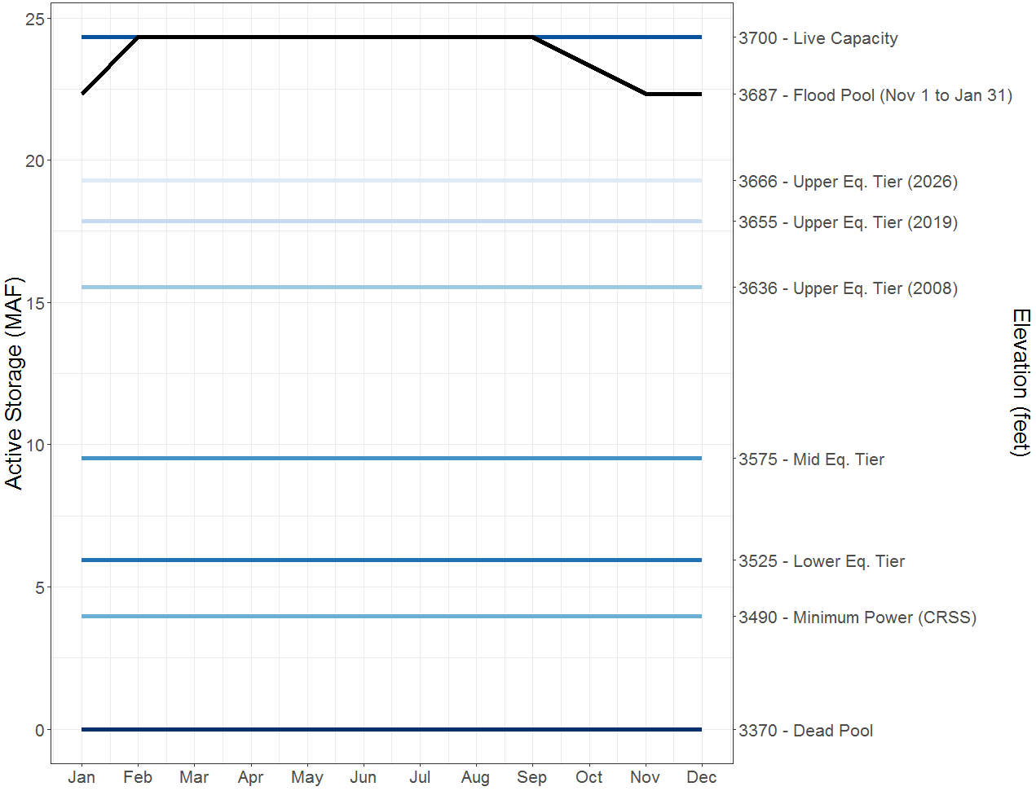
Lake Powell Pool Definitions by Month

Slide 6
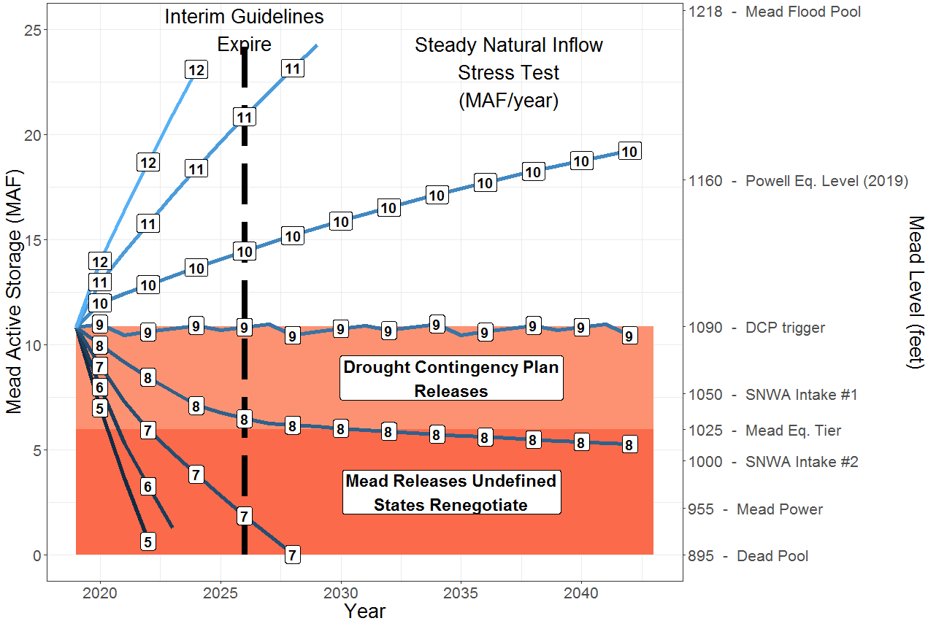
Annual Simulation of Lake Mead Active Storage with steady, constant future inflow (stress test)
Next Storage = Current Storage + Inflow – Release – Evaporation
Release = 9.0 MAF - Drought Contingency Plan cutback
Evaporation = (6.2 ft/year)*Area

