Slide 1
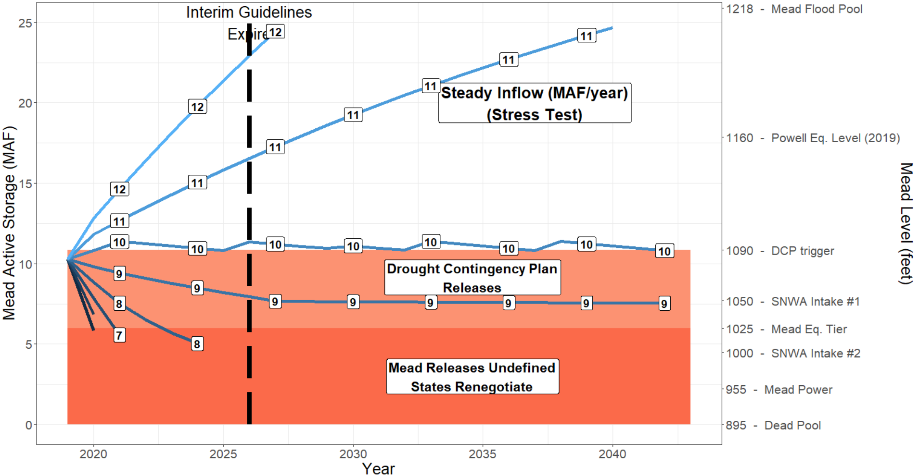
Annual, deterministic Lake Mead simulation
Storage_{t+1} = Storage_{t} + Inflow – Release(Storage_{t}) – EvapRate*Area(Storage_{t})
Release = 9.6 MAF - Drought Contingency Plan cutback
EvapRate = 6.2 ft/year

Slide 2
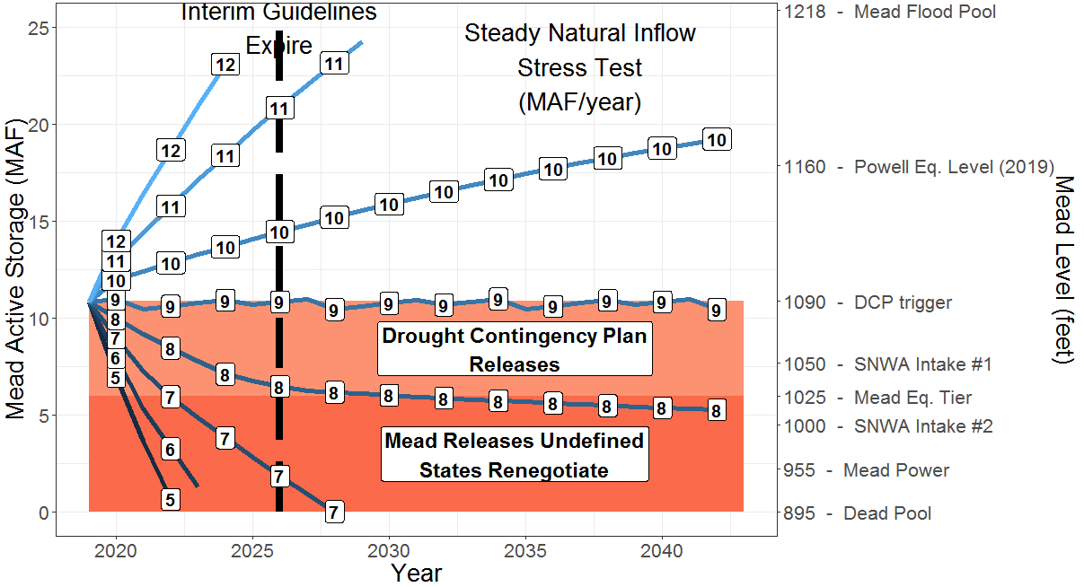
Annual, deterministic Lake Mead simulation
Storage_{t+1} = Storage_{t} + Inflow – Release(Storage_{t}) – EvapRate*Area(Storage_{t})
Release = 9.0 MAF - Drought Contingency Plan cutback
EvapRate = 6.2 ft/year

Slide 3
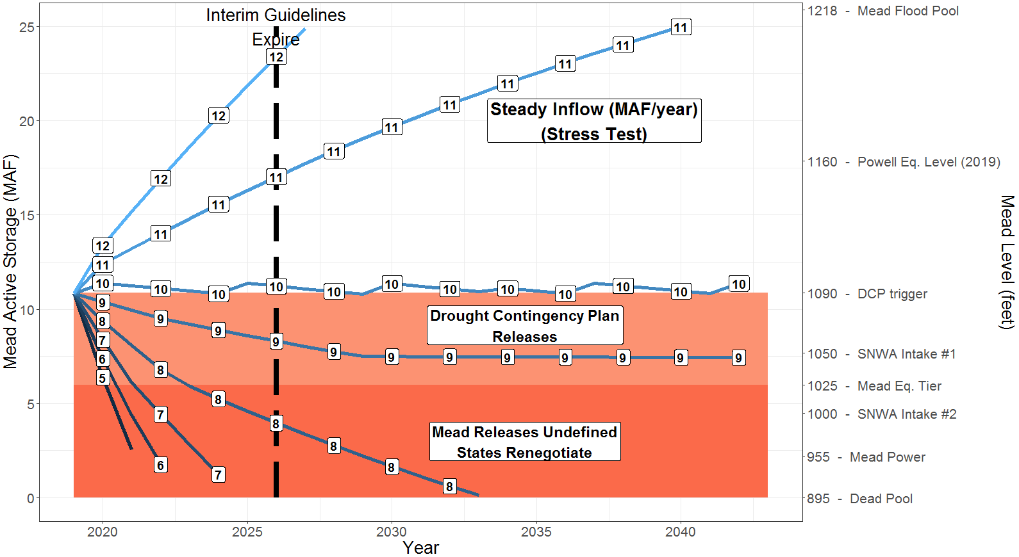
Annual, deterministic Lake Mead simulation
Storage_{t+1} = Storage_{t} + Inflow – Release(Storage_{t}) – EvapRate*Area(Storage_{t})
Release = 9.6 MAF - Drought Contingency Plan cutback
EvapRate = 6.2 ft/year

Slide 4
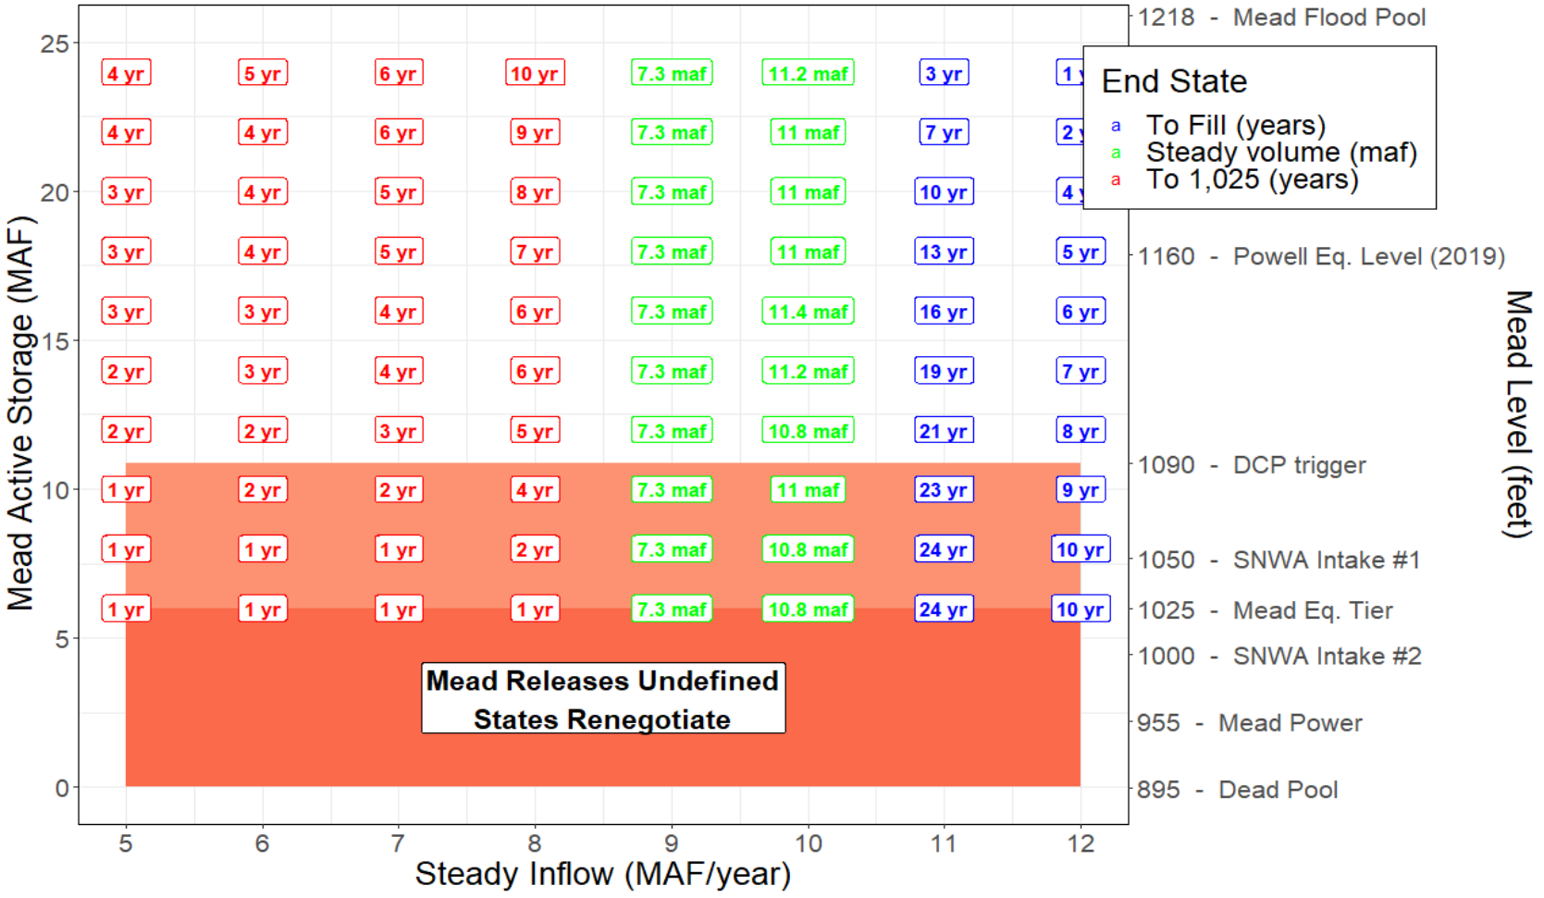
Years to hit Lake Mead 1,025 feet

