Slide 1
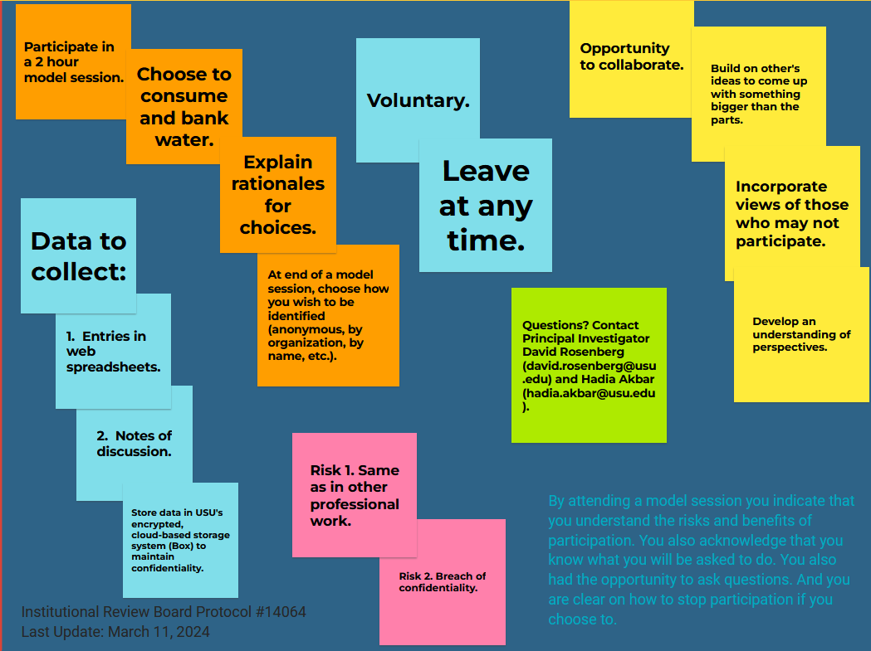

Immersive Modeling of Colorado River Management
Possible benefits:
Research Goals:
2. Articulate vulnerabilities and strategies to manage vulnerabilities.
1. Formulate extreme assumptions for reservoir storage, hydrology, and ecosystem responses.
Questions? Contact Principal Investigator David Rosenberg (david.rosenberg@usu.edu)
3. Adapt strategies to manage vulnerabilities.
4. Share new insights to manage conflicting vulnerabilities.
Last update: Nov. 18, 2024

