Slide 1


Immersive Model for Lake Mead based on the Principle of Division of Reservoir Inflow Let’s Start!
David E. Rosenberg
david.rosenberg@usu.edu
http://rosenberg.usu.edu
Erik Porse
https://ucanr.edu
January 2025

Slide 2
Purpose
Immerse in and personify water user roles for a Lake Mead model based on the principle of divide reservoir inflow
Learn why:
Basin partners choose assumptions.
Articulate strategies to mange risk.
Modify strategies in response to their:
Available water.
Other’s choices.
Real-time discussion of choices.
Provoke thought and discussion to:
Stabilize and recover reservoir storage with low storage and low inflow.
Increase user autonomy to manage their conflicting vulnerabilities to water shortages.

Slide 3
1. Lake Mead water level is the sum of the protection elevation and each user’s available water
Evaporation
Inflow
California
Arizona
Nevada
Mexico
Lake Mead active storage
(not to scale)
Lake Mead Withdraw
First Nations
Reclamation Protect Zone

Slide 4
2. Each user manages all their available water not just prior conserved water.
Share of Lake Mead inflow
Prior Available Water
Share of Evaporation
Available Water
=
+
─
+
Purchases
─
Sales
Optional

Slide 5
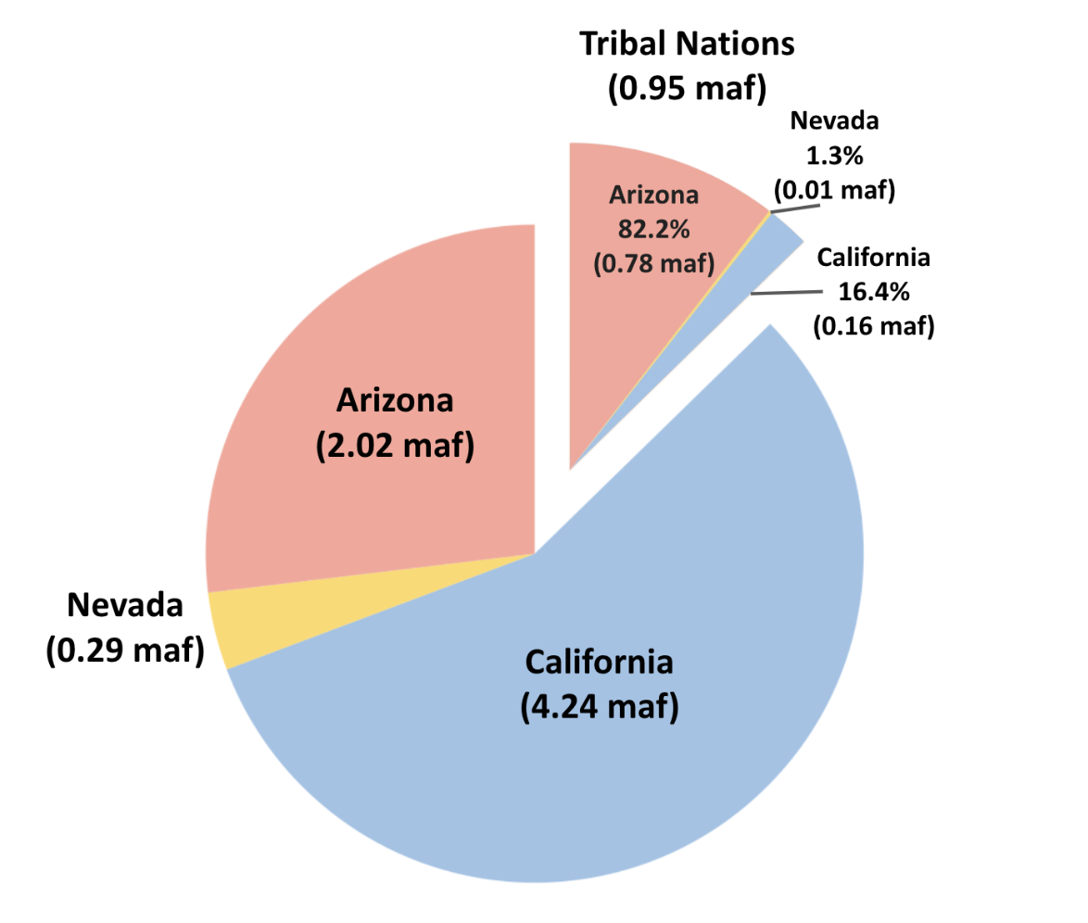
3. Tribal Nations of the Lower Basin manage their own settled water rights

Slide 6





Ready to Immerse?
1. Identify session guide
2. Download (link or QR code)
3. Move into Google Drive
https://tinyurl.com/ImmerseLakeMead
4. Invite participants
David E. Rosenberg
Utah State University
http://rosenberg.usu.edu
@WaterModeler
5. Open ReadMe-Directions sheet

