Slide 1
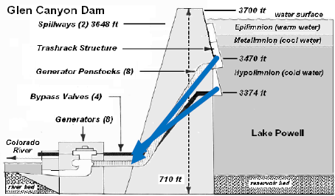
Glen Canyon Dam Outlets
Penstock (max ~ 31,500 cfs)
River (max ~ 15,000 cfs)

Slide 2
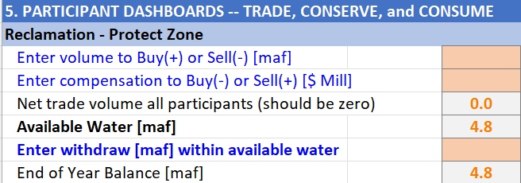
a. Enter volume in maf.
b. Enter compensation as formula = [Price][Volume] = [$/acre-foot][maf].
Track value. Is zero when each seller has a buyer.
Account balance. Water available to sell, withdraw, or consume.
c. Enter withdraw of consume volume.
End Balance = Available water - Withdraw.

