Slide 1
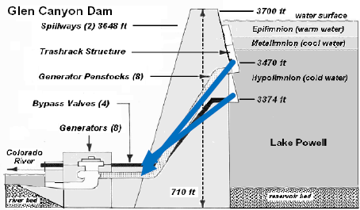
Glen Canyon Dam Outlets
Penstock (max ~ 31,500 cfs)
River (max ~ 15,000 cfs)

Slide 2
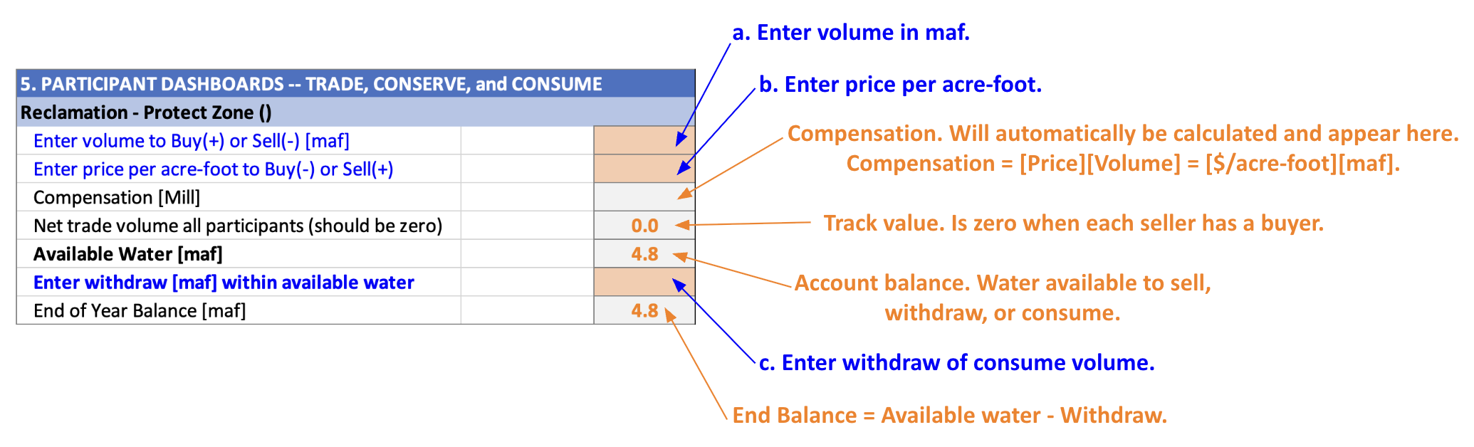

Slide 3
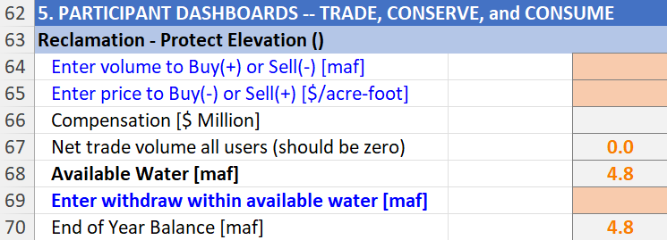
a. Enter volume in [maf].
b. Enter price in [$/acre-foot].
c. Compensation will automatically populate.
Compensation = [Price][Volume]
= [$ Million].
d. Track value. Is zero when each buyer has a seller.
e. Account balance. Water available to sell, consume, or conserve.
f. Enter volume to withdraw and consume.
g. End balance = Available water - Withdraw.

