Slide 1
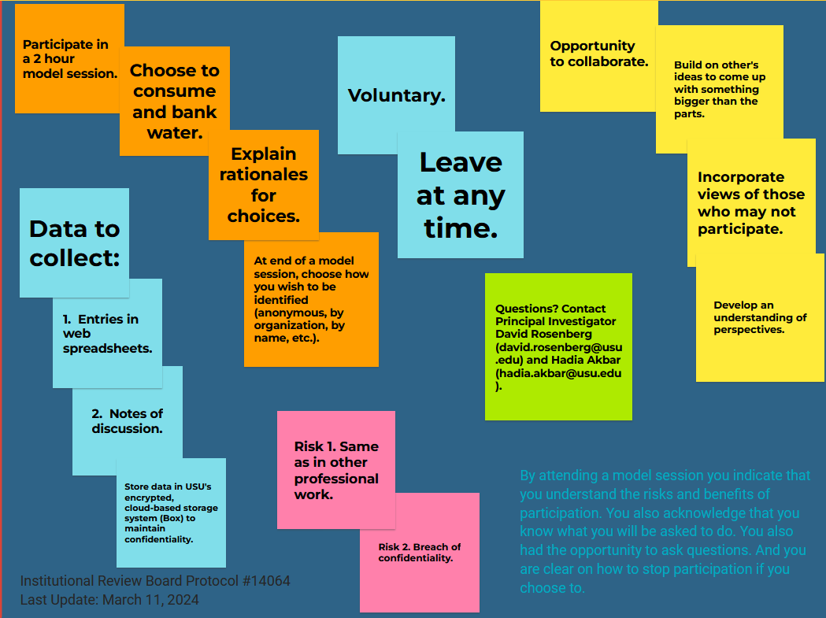

Immersive Modeling of Colorado River Management
Research Goals:
2. Articulate vulnerabilities and strategies to manage vulnerabilities.
1. Formulate extreme assumptions for reservoir storage, hydrology, and ecosystem responses.
3. Adapt strategies to manage vulnerabilities.
4. Share new insights to manage conflicting vulnerabilities.
Last update: Nov. 15, 2024

