Slide 1

Request for contributions:
Pilot test flex accounting to encourage more water conservation in a combined Lake Powell-Lake Mead system?
David E. Rosenberg
@WaterModeler
david.rosenberg@usu.edu
http://Rosenberg.usu.edu

Slide 2
1. Give managers more flexibility to consume and conserve water independent of other parties
Adhere to prior agreements as much as possible

Slide 3
2. Stretch the Lee Ferry Compact Point
Upper Basin
Grand Canyon tributary flows
Upper Basin
Grand Canyon tributary flows
Natural inflow to Powell
Powell
Lower Basin
Mead
Mead Release
Lower Basin
Lower Basin
Upper Basin
Shared, Reserve
Lee Ferry
Compact point
Mexico
Other?
Region of combined management
Mexico
Mexico
A. 1922 to present
B. Combined system

Slide 4
3. Manage all available water not just prior conserved water
Available Water
Account Balance
Share of Inflow
Share of Evaporation
=
+
─
+
Purchases
─
Sales
Optional

Slide 5
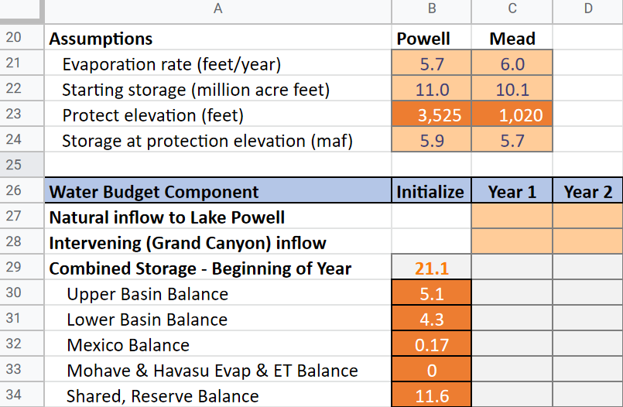

4. Will you try a pilot numerical implementation?
Download link

Slide 6
Shared governance
Major uncertainties
Natural flows – More droughts? More wet years? A mix?
Withdrawals – How much water will managers consume or conserve (store)?

Slide 7
Invite Participant(s)
Role Play
Seek Feedback

