Slide 2
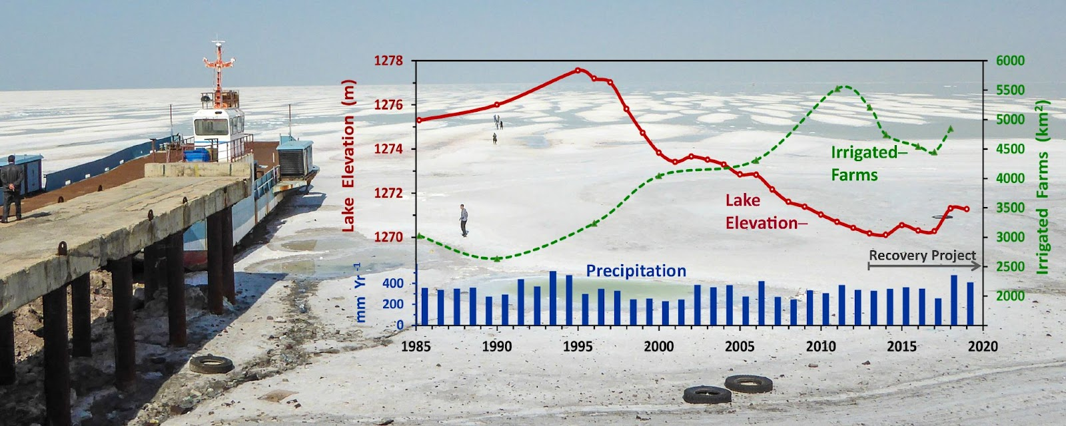

Slide 3
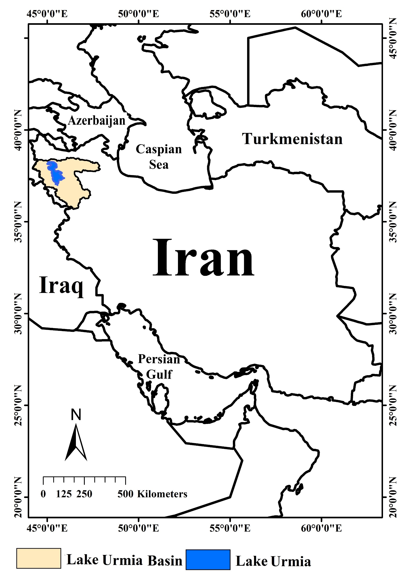

Slide 4
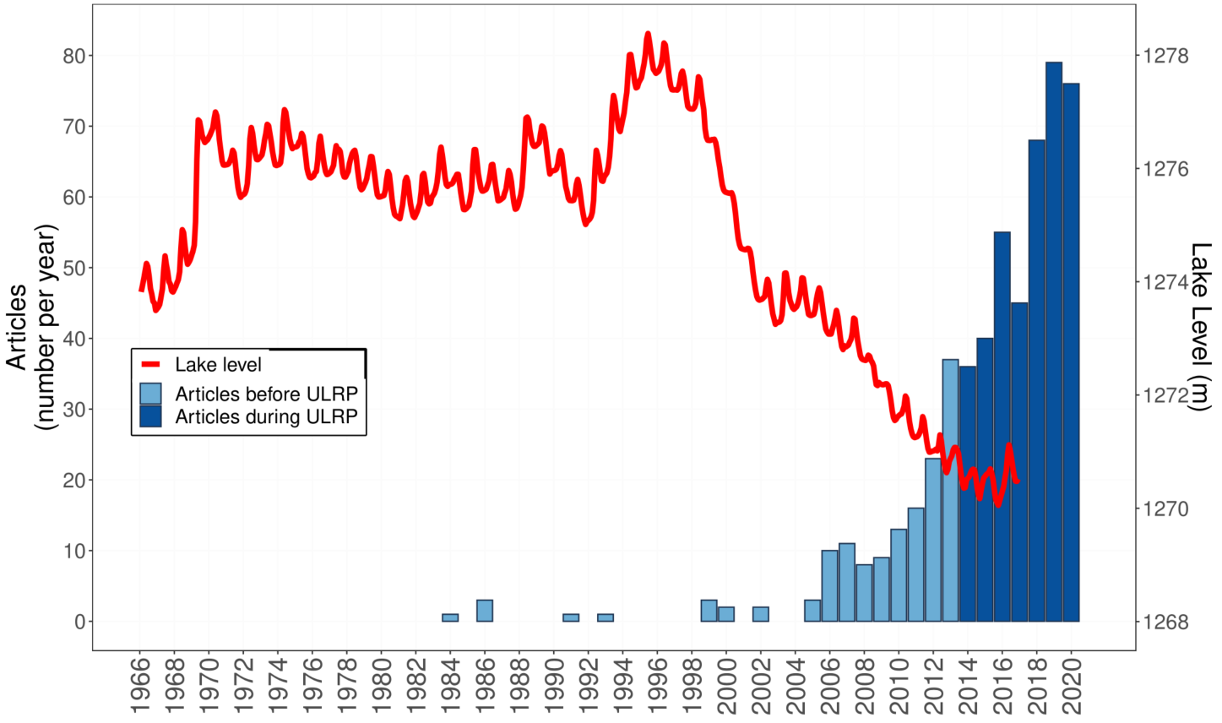
The data and code to generate this figure are at https://github.com/dzeke/UrmiaCoding/tree/main/LiteratureSynthesis/FigsApril2021 in the file BibliometrixUrmia2020.Rmd

Slide 5
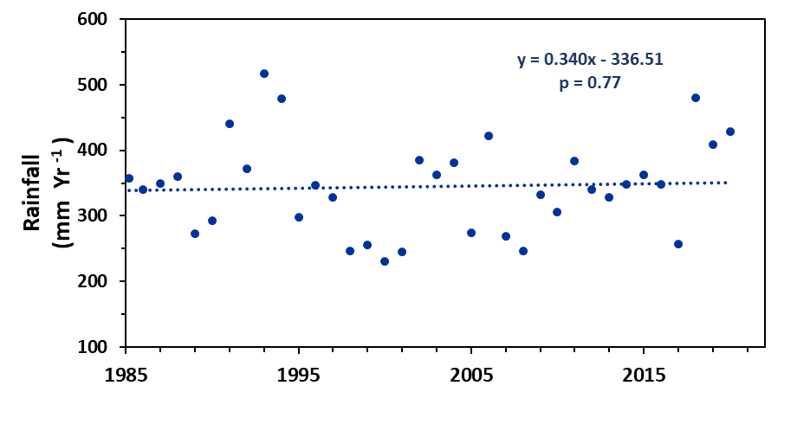

Slide 6
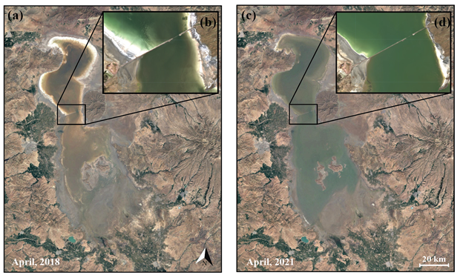

Slide 7
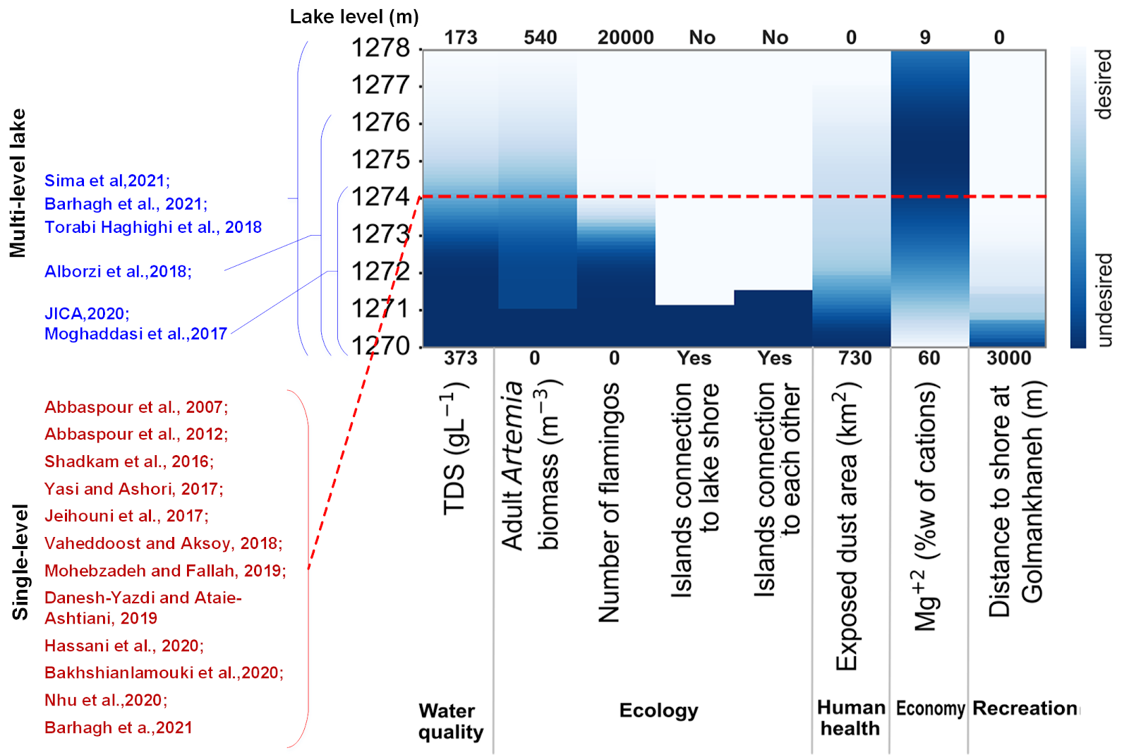

Slide 8
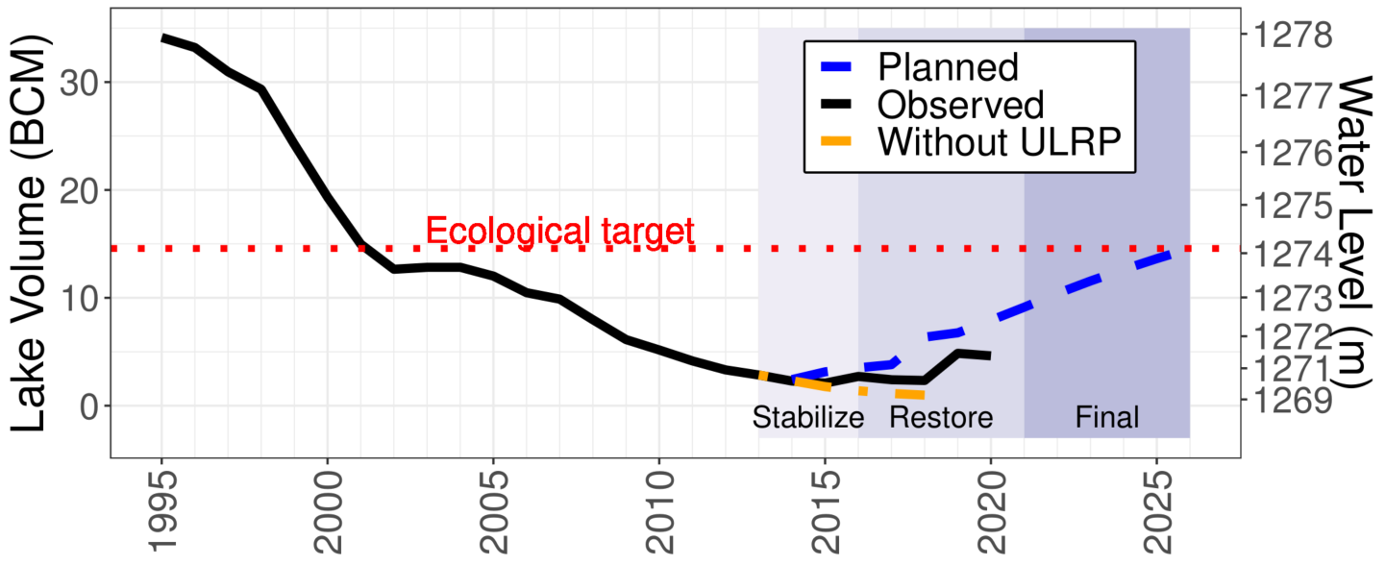

Slide 9

Studied
Limited or conflicting results
No studies
Flamingos & Other Birds
Mammals
Rivers
Dust
Channelization
Islands
Playa
Salinity
Artemia
Invertebrates
Wetlands
Breach
Plants, Algae
Ionic composition
Nutrients
Brine flies
Lake
Elevation, Area,
Volume
Salt Precipitation
Archaea &
Causeway
Salinity
Algae
Lake Elevation,

Slide 11
Irrigation Efficiency
Crop area, Crop ET
Risk aversion,
Shortage
Estimate lake level
Water allocation
Irrigation/land use
Lake properties
Farmers & governance
Ecology, salinity,
& lake level
Portfolio/multi-criteria analysis
Sustainable Governance
Farmers
Land Use Change
Urban Heat Degree Days
Treated Wastewater
Mental Health
Water User Allocation
Land Subsidence
Water Yield
Humidity
Agriculture water release
Evaporation
Precipitation
Illegal Wells
Water temperature
Headwaters flow
Lake Elevation
Lake Urmia Volume
Downscale
Reservoir releases
Stream gage
Reservoir
Fault Tree Analysis
Climate
Temperature Precipitation
Groundwater Quality
Salinity
Managerial
Soil, brine shrimp fecal pellets, pollen
Water Quantity
Social
Water
Groundwater infiltration, ET, runoff, soil type
Artemia
Economic
Water Quality
Water distribution system scaling
Ecological
Energy
Birds

Slide 12
Measurement Quality
Evapo-transpiration
Illegal Wells
None or Unknown
Poor
High
Farm deliveries
Legal Wells
Return flows to rivers
Basin Precipitation
Agricultural diversions from Rivers
Agriculture water release
Evaporation
Lake Precipitation
Reservoir inflows
Lake Elevation
Lake Urmia Volume
River flows to Lake
Snowpack
Reservoir + Releases
Salinity
Treated Wastewater
Photosynthetic production
Artemia
Municipal & Industrial Use
Birds

Slide 13
