Slide 1
Santander Customer
Transaction Prediction
By Dzekem Christa Maria Fonyuy

Slide 2
The Problem
Customer preservation is essential in a variety of businesses as acquiring new customers is often costlier than keeping the current ones. Many companies are therefore always trying to answer the question “How can we predict the value of a customer over the course of his or her interactions with the business”. Santander therefore wants to know future customer transaction predictions.

Slide 3
Santander is presently working on how to accelerate its digital transformation and platform strategy to boost growth and increase profitability.
This question can best be answered by using predictive analysis of the customer past interactive data with the company to predict the possibility of these customers being retained or lost.
This data gotten from Kaggle an online community of Data Scientists and machine learners owned by Google LLC contains:
Unique ID_code
200 numerical features labeled from var_0 to var_199
Target either a 0 for no future transaction and a 1 for future transaction
Total of 20000 unique records

Slide 4
Process Outline
01
Exploratory Data Analysis
Visualizing the relationship between the 200 features and applying Inferential statistics on them
02
Story Telling
Stories are brought out from the observations obtain when doing Inferential Statistics to see which features are statistically important.
03
Machine Learning Algorithms
Two machine learning models will be tested on the dataset to see which best trains and predicts with highest model accuracy score.
04
Applicable Extensions
Since there is data unbalancing, further extensions will be to balance the target classes before implementing the classification models.

Slide 5
Exploratory Data Analysis
Visualizing the relationship between each feature and the target using density plots of all the 200 features shows sum of all probabilities with the peak of the density plot showing the highest probability of the data points. Most of these features have very low peak values(Probability values) which shows they have little or no influence on a customer making a transaction in the future.

Slide 6
Applying Inferential Statistics
Inferential statistics on the Santander data was concentrated on some of the features which had high probability values when density plots were plotted against the 200 features. Three of these features(var_91, var_108 and var_148) were considered and on each a Pearson Correlation was computed to see their relationship with the target.
A null hypothesis was set for as “There is a correlation between each feature and the target”.

Slide 7
Observations from Pearson
Correlation
An r value of 0.04 for var_91. This implies there is a positive but weak correlation between them. An increase in var_91 which is undefined increase the probability of a customer making a future transaction.
For all the features, their p values are all greater than 0.05 which implies a weak evidence against the null hypothesis. We therefore fail to reject the Null Hypothesis but can’t say if the correlation is statistically significant or not.
For var_108 and var_148 their r values are negative which implies there is a weak but negative correlation between these two features and the target. A decrease in any of these anonymous features instead causes an increase in the target which in turn increases the probability of a customer making a feature transaction.

Slide 8
Story Telling
From this analysis, the Pearson correlation therefore shows that var_91 could be used to increase future customer transactions which is the aim of this project. If for instance this feature was a coupon or some bonuses, increasing these offers will increase the probability of having a customer make a future transaction.
Var_108 and var_148 from Pearson correlation shows that decreasing these values will increase the probability of having a customer make a future transaction. If for example these features are related to fraudulent level, a decrease in this will make the clients trust increase and they will surely want to future transaction in the future.

Slide 9
Applying Machine Learning
Machine learning is an application that provides systems with the ability to automatically learn and improve from experience without being explicitly programmed.
Two machine learning algorithms will be compared.
Logistic Regression
Logistic Regression without Regularization
Logistic Regression with Regularization
Gaussian Naïve Bayes

Slide 10
Logistic Regression Model
The model after being trained and tested produced high accuracy scores for both the training and test set as 0.9148 and 0.9112 respectively. Since the difference between these two accuracies is small and also above 0.9, the model can therefore be used for predictions. More details about the classification model was gotten from the Classification report.

Slide 11
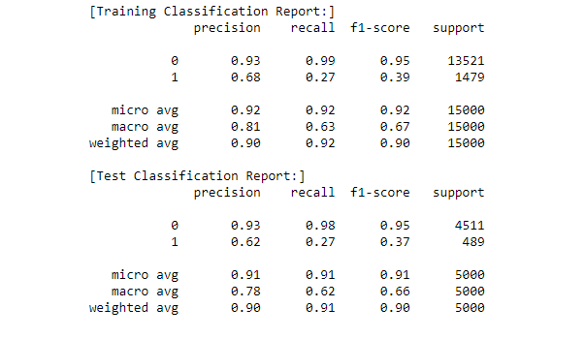
Classification Report Logistic Regression

Slide 12
From this report, the precision values for 0 an 1 have a great difference with values 0.93 and 0.62 respectively for the test data. This great difference also spans through the parameter recall which is 0.98 and 0.27 for 0 and 1 respectively.
This difference comes forth because of the nature of the target data which is imbalance. The data points for a 0 are 13000 greater than the data points for a 1 and both sum up to 15000.

Slide 13
Logistic Regression with Regularization
Why use Regularization?
Since the goal of every data scientist is to have accurate model performance as much as possible, regularization is therefore implemented to better model performance.
Accuracy score when training the model with regularization is 0.9124 which is slightly greater than that without regularization by 0.0009. This difference may seem minimal but it will greatly increase the probability of a customer making a future transaction.

Slide 14
Gaussian Naïve Bayes
Training this model produced an accuracy value of 0.9262 and when testing the model, it produced an accuracy value of 0.8606. This great difference between the train accuracy and the test accuracy therefore shows there is model overfitting.
Model overfitting is a situation where the model is too complex to explain features in the data. Also, overfitting causes a modelling error which occurs when a function is too closely fit to a limited set of data points

Slide 15
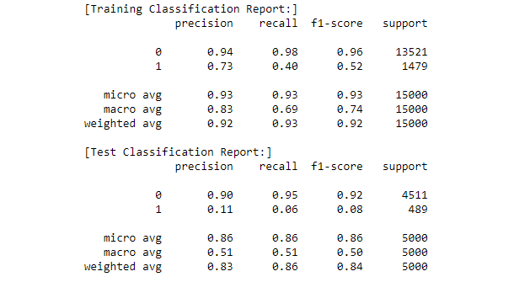
Classification report GaussianNB

Slide 16
From the classification testing report of the Naïve Bayes Model, A 0.90 probability to predict a 0 and a 0.11 probability to predict a 1 which is a customer will make a future transaction. This difference also spans through the recall parameter too with values of 0.95 and 0.06 for a 0 and 1 respectively.
Since this model is too complex for these data points and also as there is data imbalance, the model’s accuracies turn to be very poor for the target 1 which is the minority class as the target class 0 is 13000 data points greater than the other class

Slide 17
Comparing the models
Logistic Regression on the data set produced good accuracy scores for both training and test data.
Gaussian Naïve Bayes model is overfitting because the training and test accuracies have a large difference which implies the model is too complex for the dataset.
Therefore, the best algorithm for this case is Logistic Regression which is implemented after the data has been made balanced. This therefore solves the problem of Imbalance data which was faced because of the great difference in the two classes.

Slide 18
Further Research
Further research has to be done on how to best solve the issue of imbalance data as the two target classes have a great difference. This can therefore be solved by:
Resampling the Dataset: This is done by randomly adding copies of instances from the under-represented class called over-sampling.
Generating Synthetic Samples: SMOTE (Synthetic Minority Oversampling TEchnique) system works by creating synthetic samples from the minor class instead of creating copies.
After implementing the techniques above on the imbalanced data, Logistic Regression with Regularization can therefore be used to better do training and testing of the model which will result in better predictions and accuracies as the two target classes are already made balanced.

Slide 19
Client Recommendations
Considering the three features with highest probability values of having a customer make a future transaction in the future. These features though anonymous could therefore be used to further increase this probability by ensuring values equivalent to their mean or higher for those with positive correlation and lower than the mean for the others with negative correlation.
Also, the features with lowest probability values like var_5, var_84 and var_86 are one of the features causing the customers not to make a future transaction in the future. These features which are unidentified could further be used by ensuring they instead contribute to a higher probability of having a 1 as the target.
The average number of customers transaction per day, week or month could be calculated and from this the Santander will be able to know if they are meeting up with the target ahead of them or not. And if the target is not being met, they can therefore bring forth improvements to this by offering bonuses and more promotions which will increase customer awareness about their products and services.

Slide 20
Thank you!!!
Dzekem Christa Maria Fonyuy

